Slide 1
Assimilation of SMAP Global Freeze Thaw (FT) Products to Improve the CASA Ecosystem Model and Our Understanding of Northern Latitude Carbon Fluxes and Wildfire Impacts
Christopher Potter (PI), NASA AMES
Stephanie Pass, BAERI
K. Arthur Endsley, Univ. Montana
John S. Kimball, Univ. Montana

Slide 2
Assimilation of SMAP Global Freeze Thaw (FT) Products to Improve the CASA Ecosystem Model
Main Objective: Assimilate SMAP observations of daily soil freeze-thaw (FT) state into the CASA (Carnegie-Ames-Stanford) ecosystem model to reduce the uncertainty of global and regional carbon flux estimates and wildfire emissions.
Hypotheses for northern latitude biomes:
(1) changing snow cover areas in winter under climate warming conditions are leading to increases in the frequency and spatial extent of soil freeze–thaw events; and
(2) increases in soil microbial respiration outside the growing season are outpacing increases in carbon uptake (NPP) during the growing season.

Slide 3
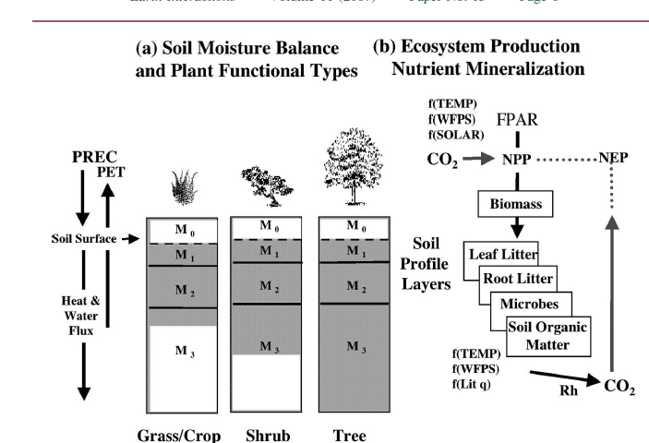
CASA (Potter et al. 1993) Ecosystem Model Structure

Slide 4
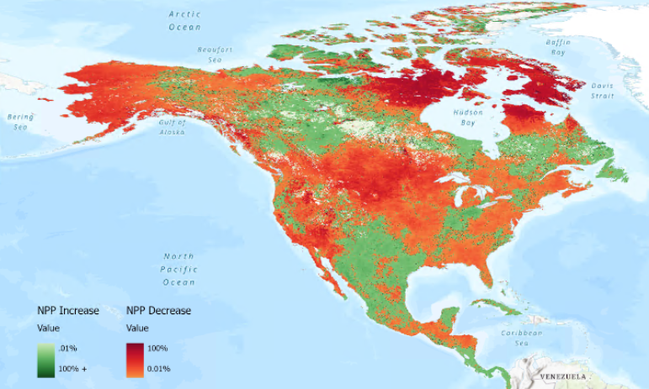
CASA in 2025 – Open-Source Python Code, New Publications
Map of North America depicting the relative percent change of plant production from 2019 to 2021 related to drought: -22% change

Slide 5
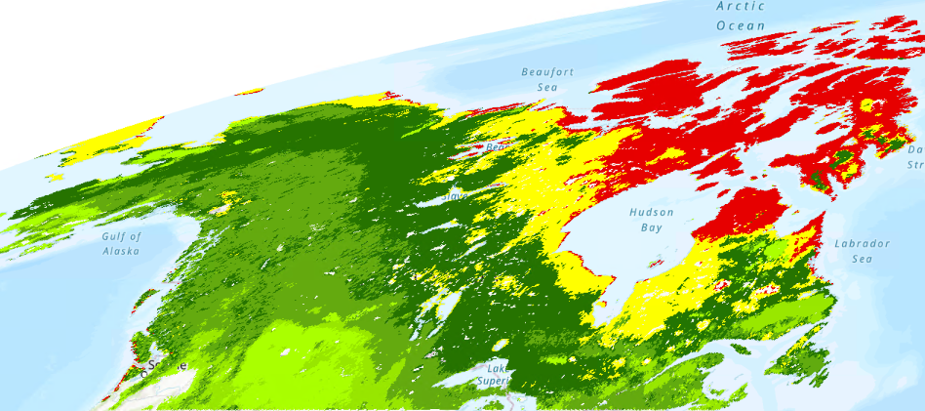
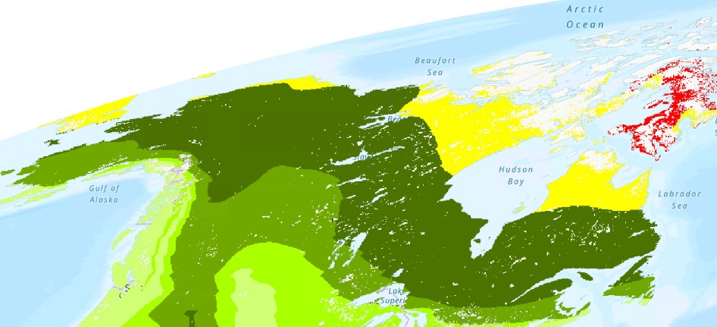
Goal: Improved Timing and Spatial Detail for Soil F/T
Predicted Month of Thaw – 2016
SMAP CASA
James Bay
Yukon
Coastal BC

Slide 6
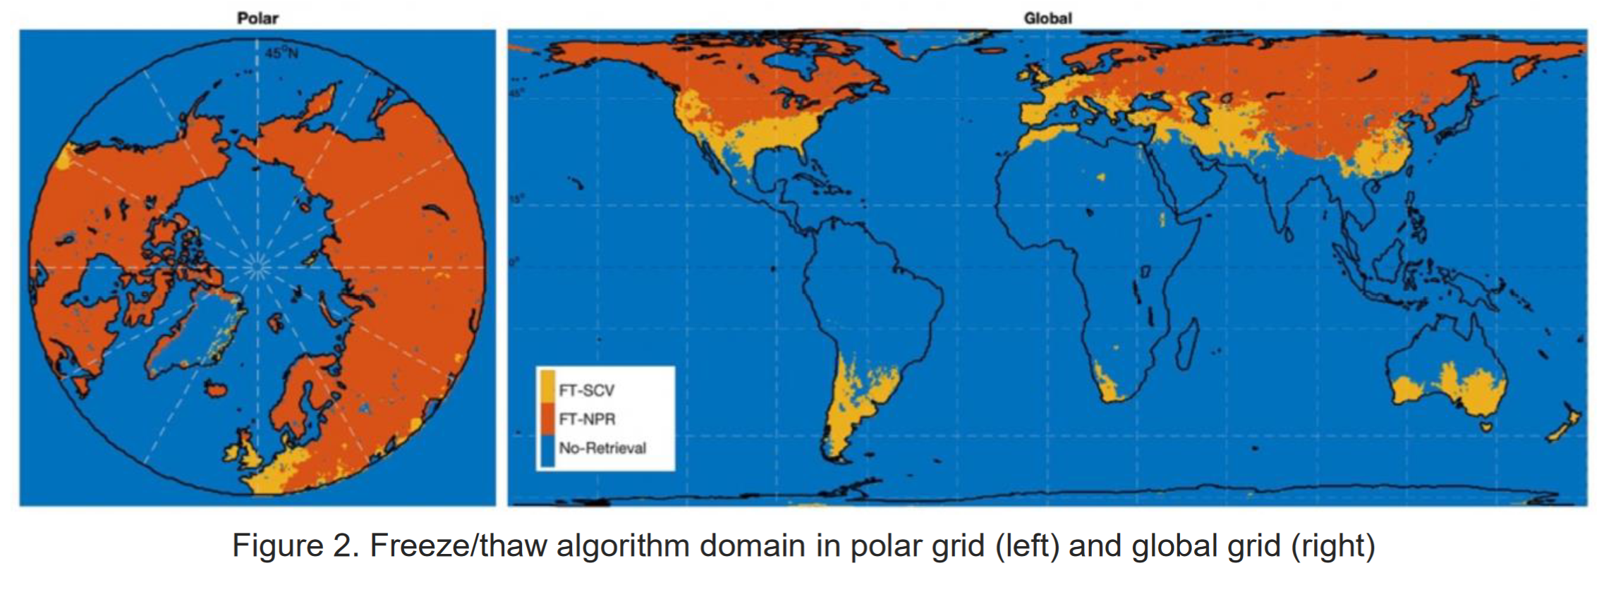
A. Endsley – Overview of SMAP Freeze/Thaw (F/T)
SMAP Level 3 F/T, Enhanced (SPL3FT_E) 9-km Product
Twice daily (“AM” and “PM” overpasses)
Using all records from 2015-2024
Combining AM and PM data: If either is Frozen, it is “Frozen” for the day
Two methods:
Single-channel (SCV)
Normalized Polarimetric Ratio (NPR)

Slide 7
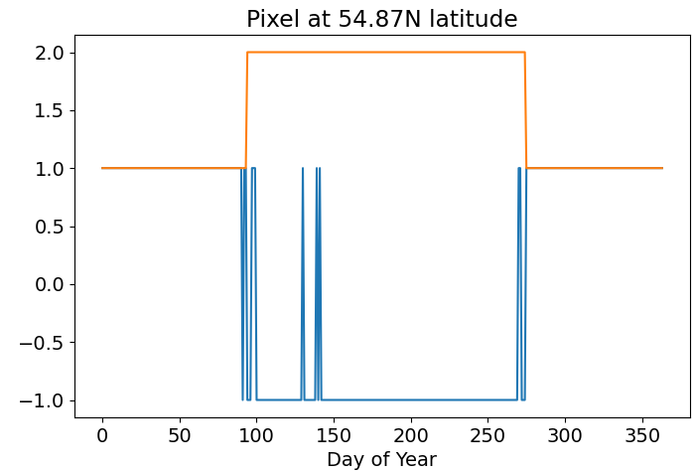
A. Endsley – SMAP F/T Processing Methods
Traditional approach to picking day-of-year (DOY) for Thaw, Freeze-Up based on moving window filters
Can be very slow, difficult to parameterize
Multiple (sometimes spurious), transient flags can confound discrete Thaw, Freeze-Up dates
Frozen Flag = +1
Thawed Flag = -1

Slide 8
A. Endsley – SMAP F/T Processing Methods
Traditional approach to picking day-of-year (DOY) for Thaw, Freeze-Up based on moving window filters
Can be very slow, difficult to parameterize
Multiple (sometimes spurious), transient flags can confound discrete Thaw, Freeze-Up dates
Frozen
Thawed
Frozen
Frozen Flag = +1
Here, we used mixed integer linear programming (MILP) to solve an optimization problem:
a) Minimize sum of Frozen flags
b) Minimize sum of transitions
Thawed Flag = -1

Slide 9
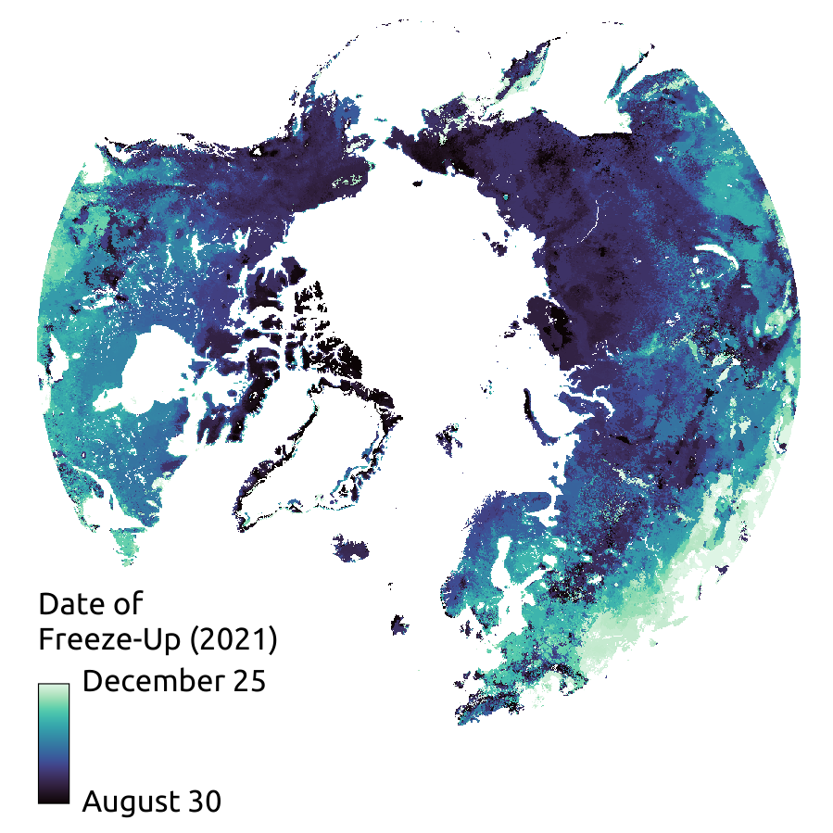
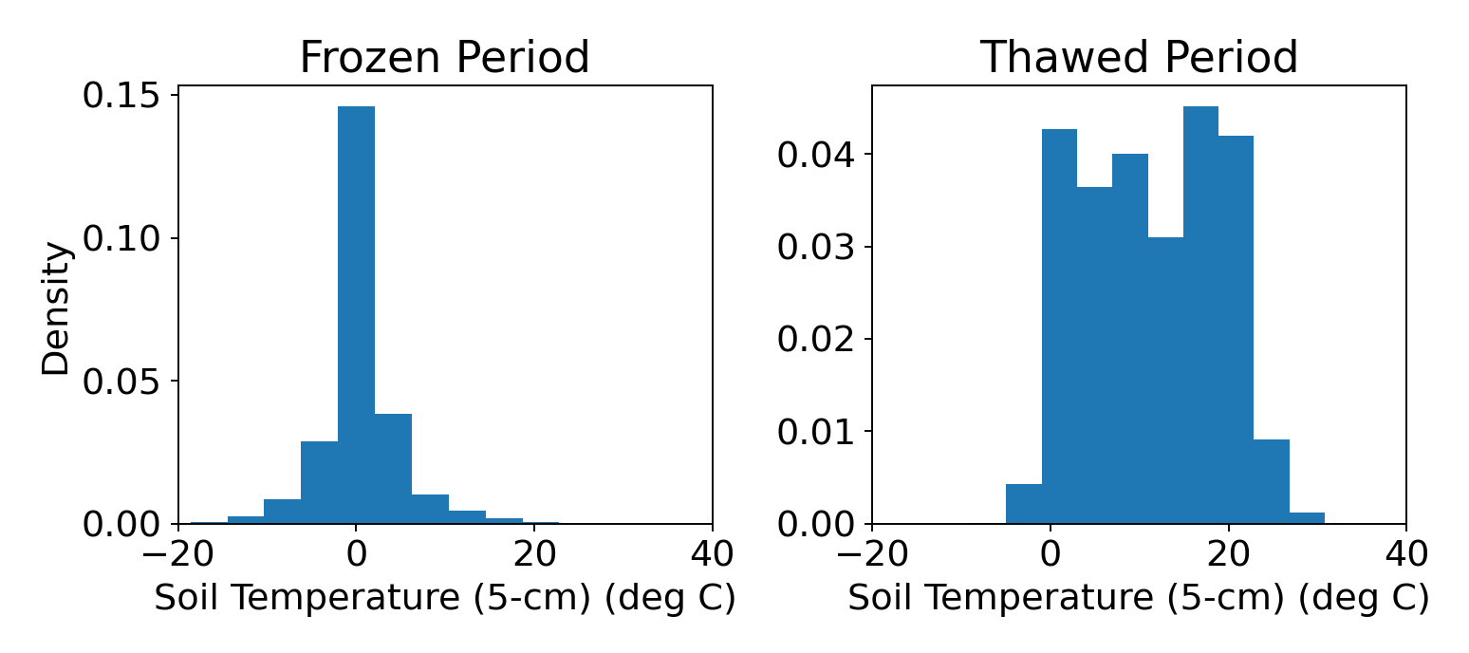
A. Endsley – SMAP F/T Comparisons with Ground Temperatures
Soil Temp. (deg C)
AmeriFlux (above), USCRN (below) soil temperatures

Slide 10
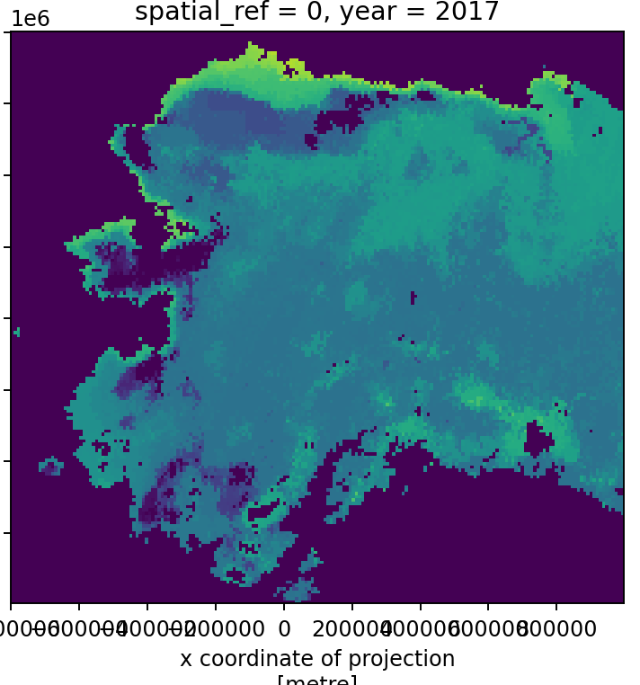
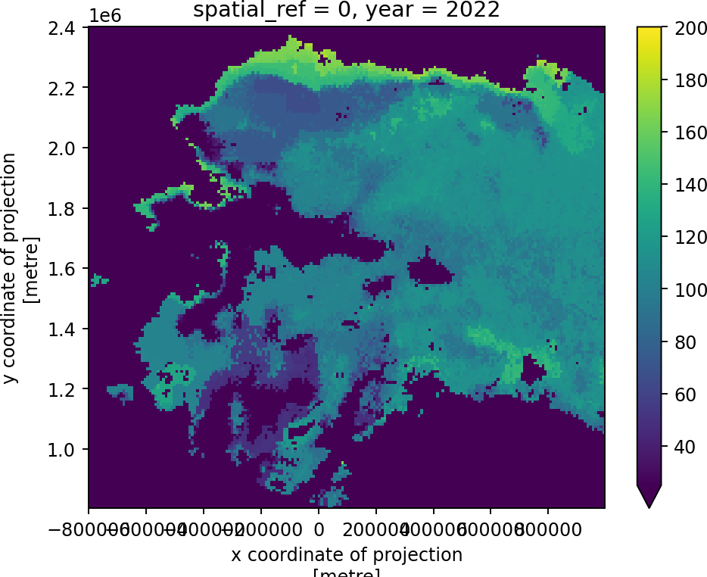
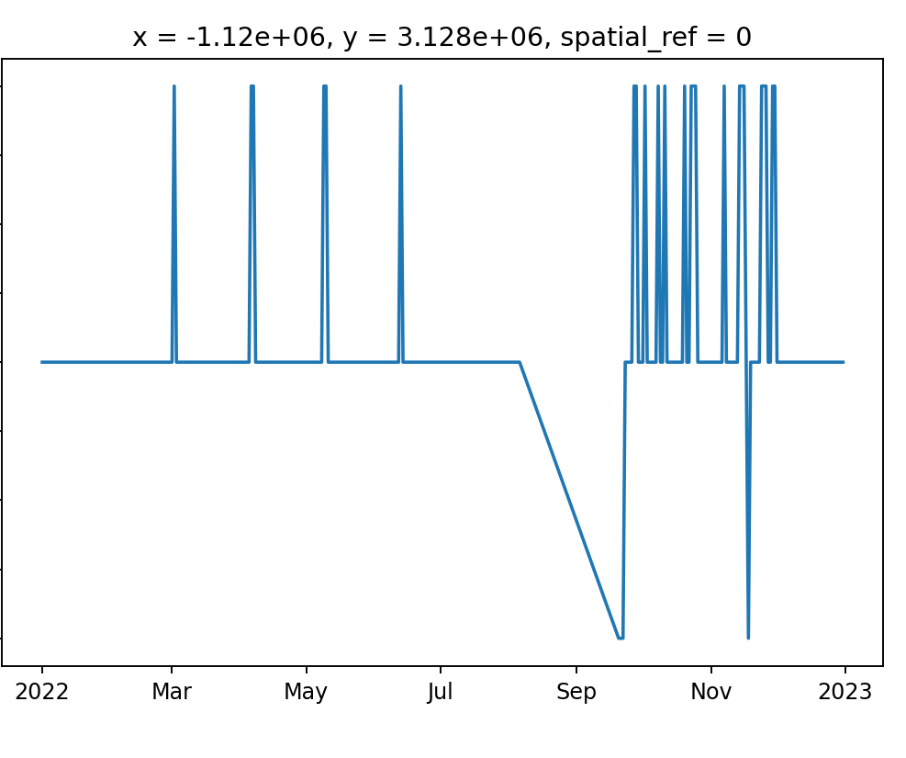
A. Endsley – Issues with SPL3FT_E F/T Estimates
Day of Spring Thaw
Large coastal, warm inland tundra areas with no apparent Frozen period; Togiak in 2022, below
Frozen
=1
Thawed
=0
Affected areas vary widely but may be characterized by boreal forest cover, complex terrain, or generally warmer conditions
No Data = -1

Slide 11
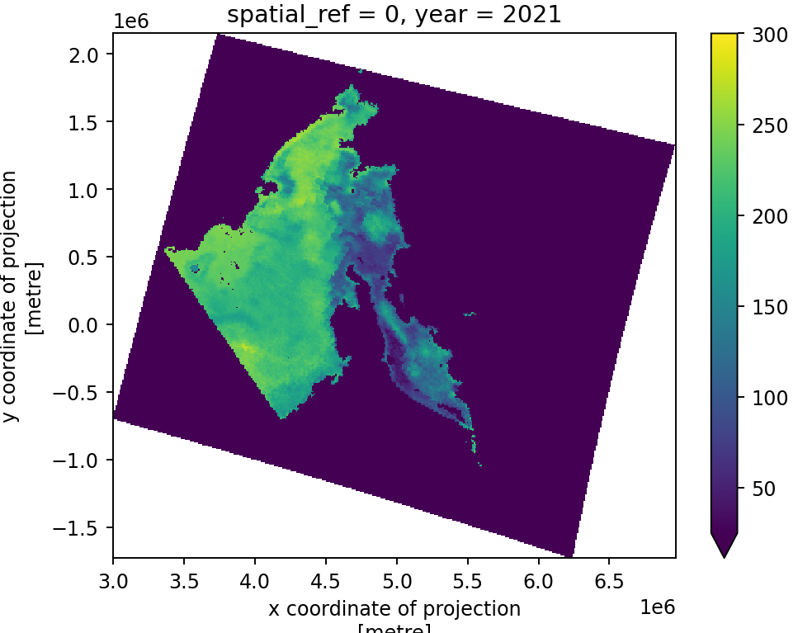
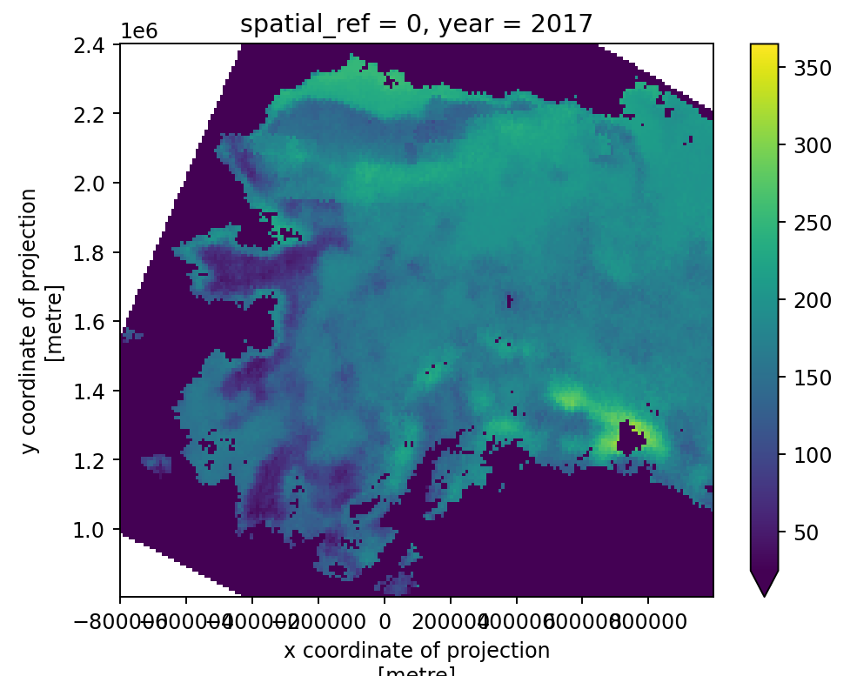
A. Endsley – Water Contamination of Tb Retrievals?
Annual cumulative sum of Frozen=1 flags;
“bathtub rings” suggest water-corrected
Tb data are not being used(?)

Slide 12
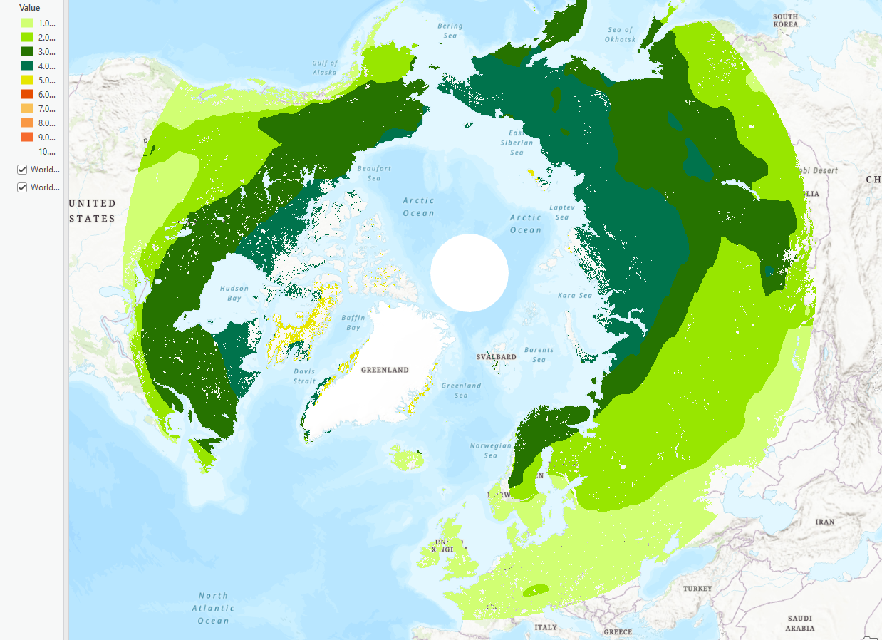
S. Pass – Conversion of CASA to EASE Polar Grid 2.0
Predicted Month of Thaw – 2016

Slide 13
Pending Questions and Ecosystem Science Milestones
Are persistent thawed areas the result of snow insulation (or incorrect Frozen reference)? Dynamic snow-cover data could inform post-processing…
Compare CASA, CASA-SMAP FT model predictions in Pan-Boreal and Arctic regions (2016-2025), validate against tower and other in situ site measurements: Monthly snow melt, Surface water fluxes, Evapotranspiration rates, NPP, and soil microbial CO2
Across Boreal and Arctic ecosystems, pre- and post-wildfire, is there a relationship between changing snow cover, expanding soil freeze–thaw (F/T) zones, and soil moisture changes?
Are wildfire-mediated changes in soil F/T timing leading to altered soil thermal profiles? How does this contribute to permafrost change, H2O and CO2 fluxes?

