Slide 1
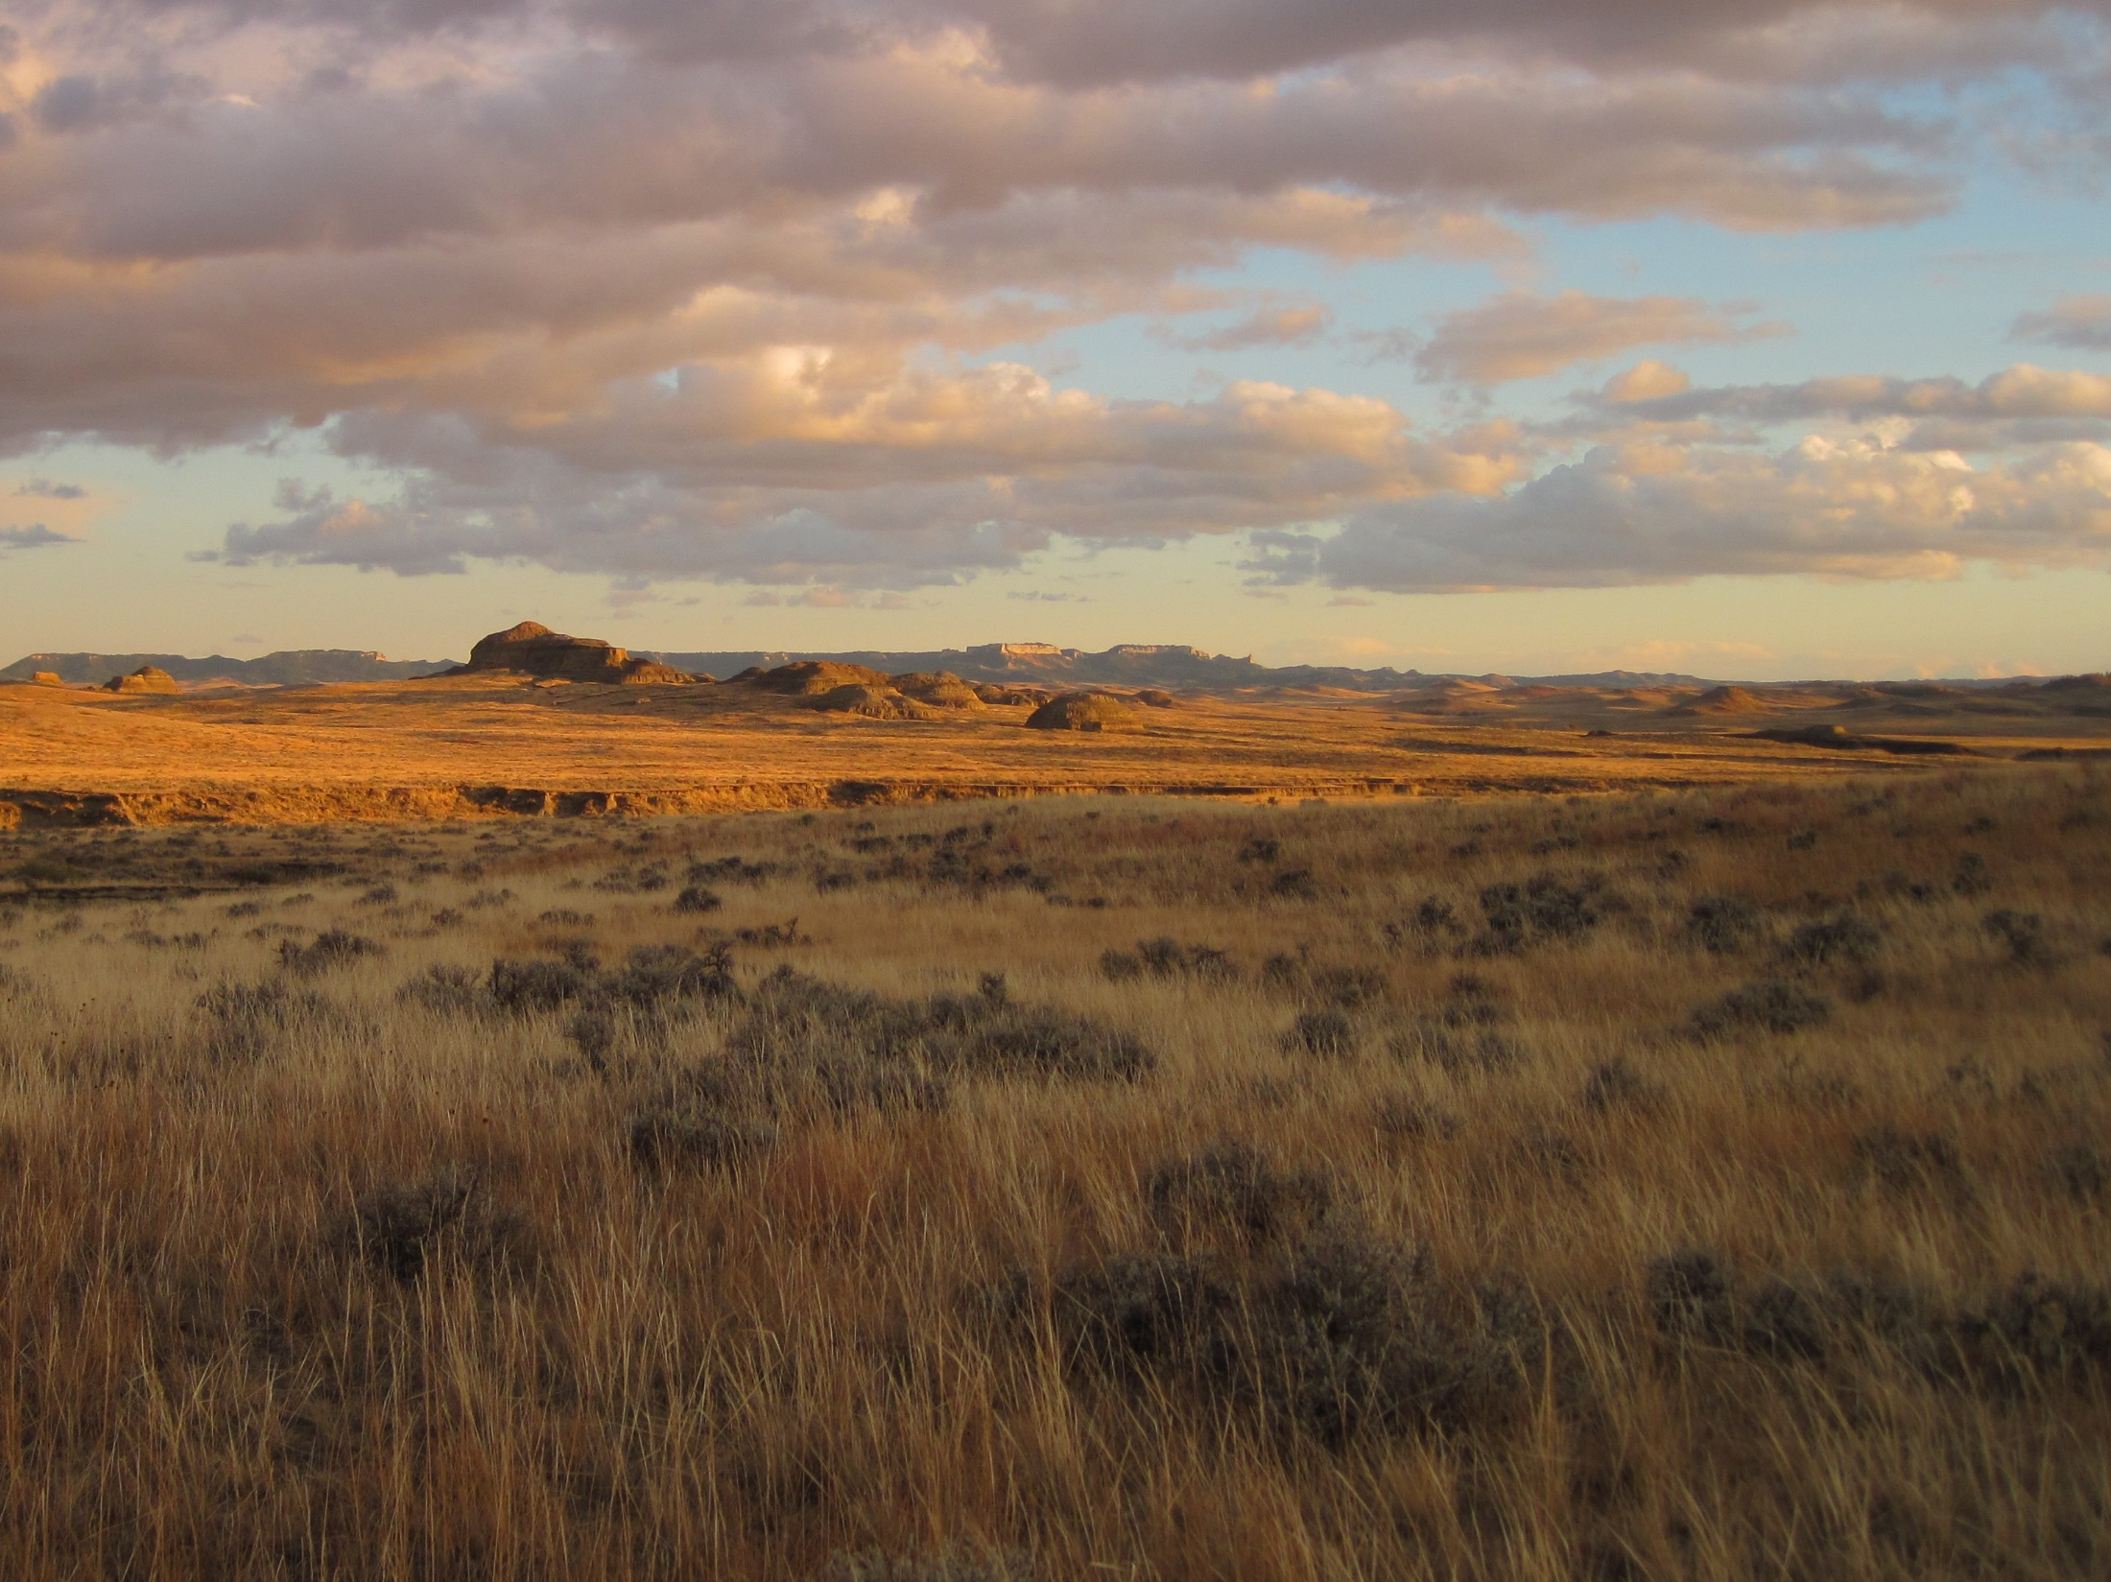




Monitoring Land-Atmosphere
CO₂ Exchange:
The SMAP Level 4 Carbon (L4C) Product
John S. Kimball
University of Montana, Missoula, MT, USA
email: johnk@ntsg.umt.edu website: www.ntsg.umt.edu
In Collaboration with:
Rolf Reichle (NASA GSFC/GMAO) and SMAP L4C Cal/Val Partners

Slide 2
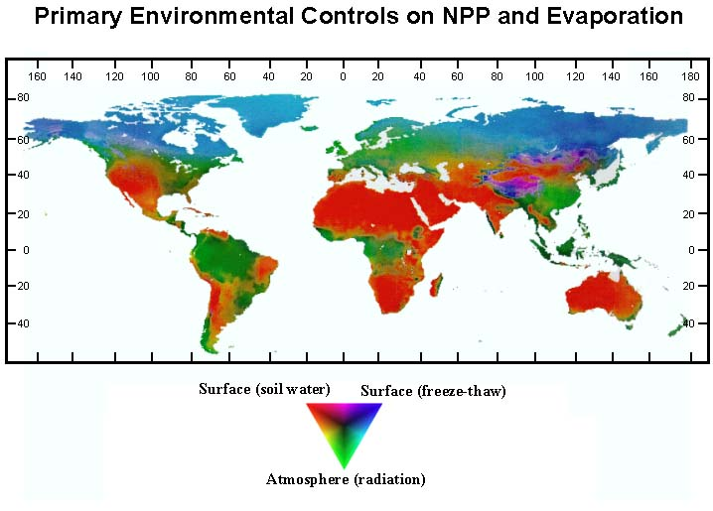
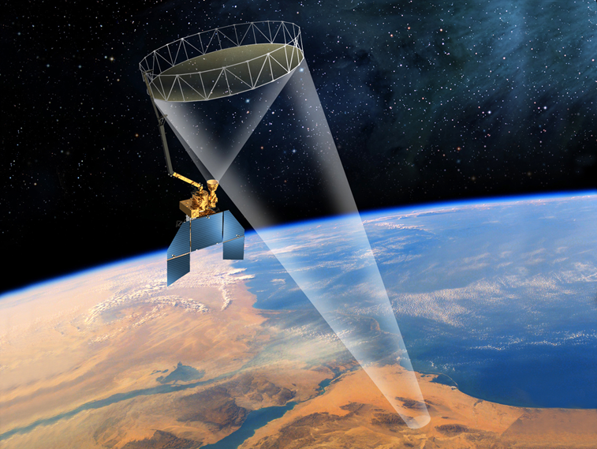
NASA Soil Moisture Active Passive (¹SMAP) Mission
Mission objective involves global mapping of soil moisture (SM) and freeze/thaw (FT) state to:
  Link land water-carbon-energy cycles
  Estimate global water and energy fluxes at the land surface
  Quantify net ecosystem carbon flux
  Extend weather and climate forecast skill
  Improve drought assessment
Soil moisture and freeze/thaw state are primary environmental controls on Productivity
SMAP sensor and product design:
  Sun-synchronous 6 am/pm polar orbit; L-band (1.4 GHz) radiometer; 40-km footprint; constant (40º) view-angle; mean global 3-day revisit
  Enhanced (L-band) microwave sensitivity to surface FT and SM variability
  Operational data include geophysical retrievals (L1-3) and model enhanced (L4) products for surface to root zone SM (L4SM) and C-exchange (L4C)
¹Entekhabi et al., 2014. SMAP Handbook.
Notes:
SMAP was a first-tier NASA Decadal Survey mission

Slide 3
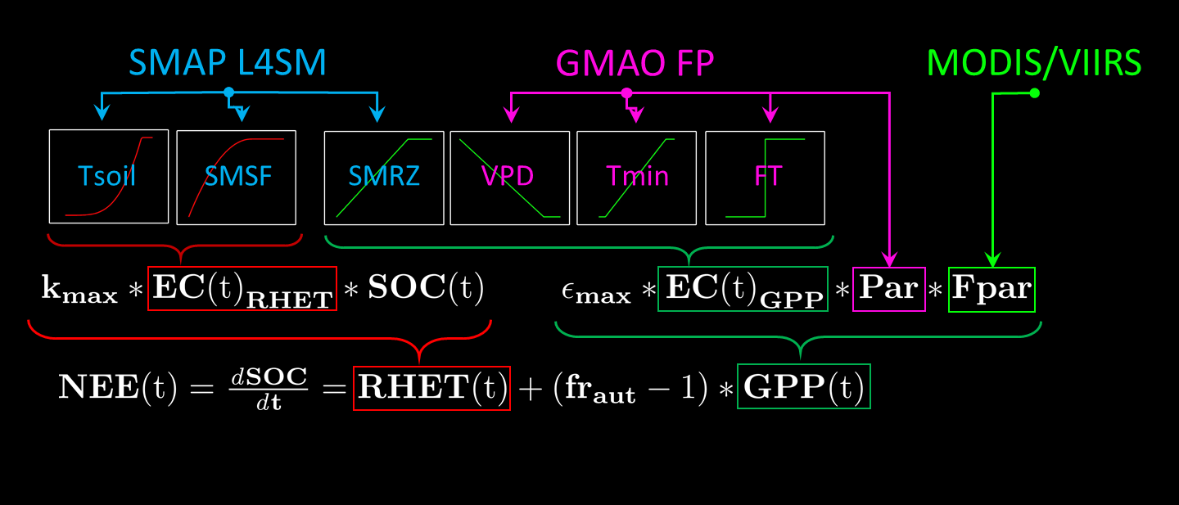
SMAP L4C Algorithm Summary
Satellite-driven C-flux model: NEE derived as daily difference between GPP and RECO (RHET+RAUT);
GPP derived using LUE model driven by SMAP L4SM, MODIS (LC, FPAR) and GMAO FP daily meteorology (VPD, Tmn, PAR) inputs
Coupled LUE and 3-pool soil decomposition model to derive SOC and RHET
Model calibrated using global tower CO2 flux records (FLUXNET)
Links C-fluxes with underlying Veg., Atm. and SM constraints to GPP and RECO.
¹Jones, Kimball, Reichle, et al. 2017. IEEE TGARS, 55, 11

Slide 4
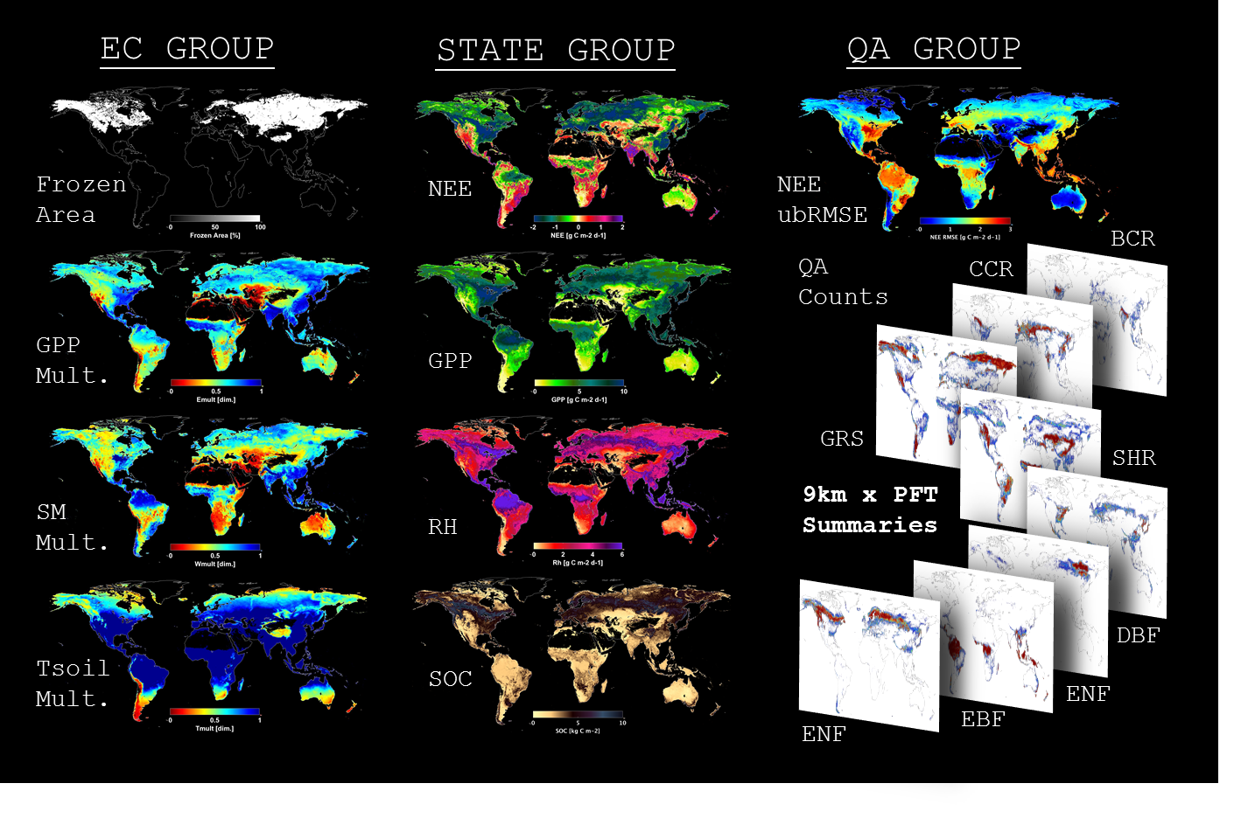
SMAP L4C Daily Product Set
Includes Carbon state, environmental control (EC) and quality (QA) variables
Internally consistent C-budget
Global daily 1-km processing posted to 9-km grid while preserving sub-grid PFT means
SMAP L4C operational product extends from April 2015 to present; product access through NSIDC DAAC
Notes:
PFT: Plant functional Type classification for up to 9 global vegetation classes (from MODIS Type II landcover classification): Grassland (GRS), Shrubland (SHR), Evergreen needleleaf forest (ENF), Deciduous Broadleaf forest (DBF), Evergreen broadleaf forest (EBF), Cereal crop (CCR), Broadleaf crop (BCR), Deciduous Needleleaf forest (DNF)

Slide 5
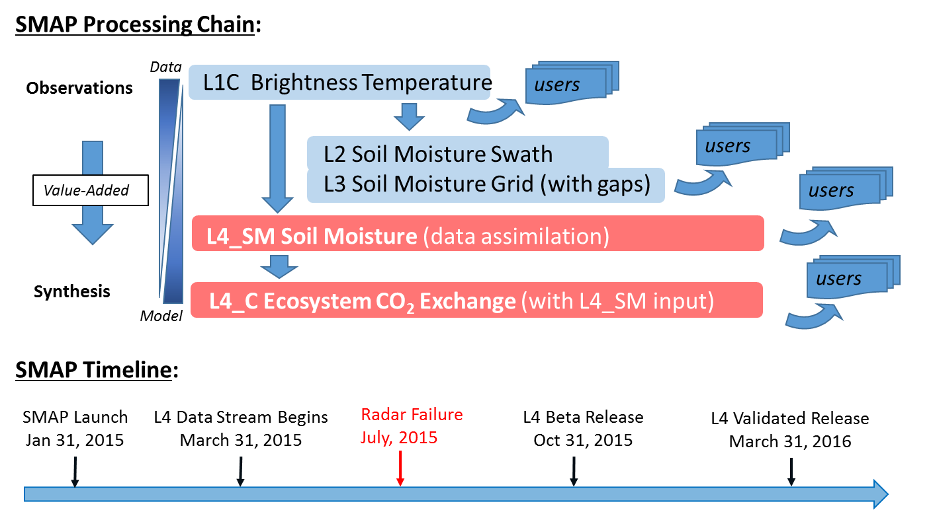
SMAP Data Product Processing Chain
Notes:
Input data is a substantial source (>30 %) of error in ecosystem models.

Slide 6
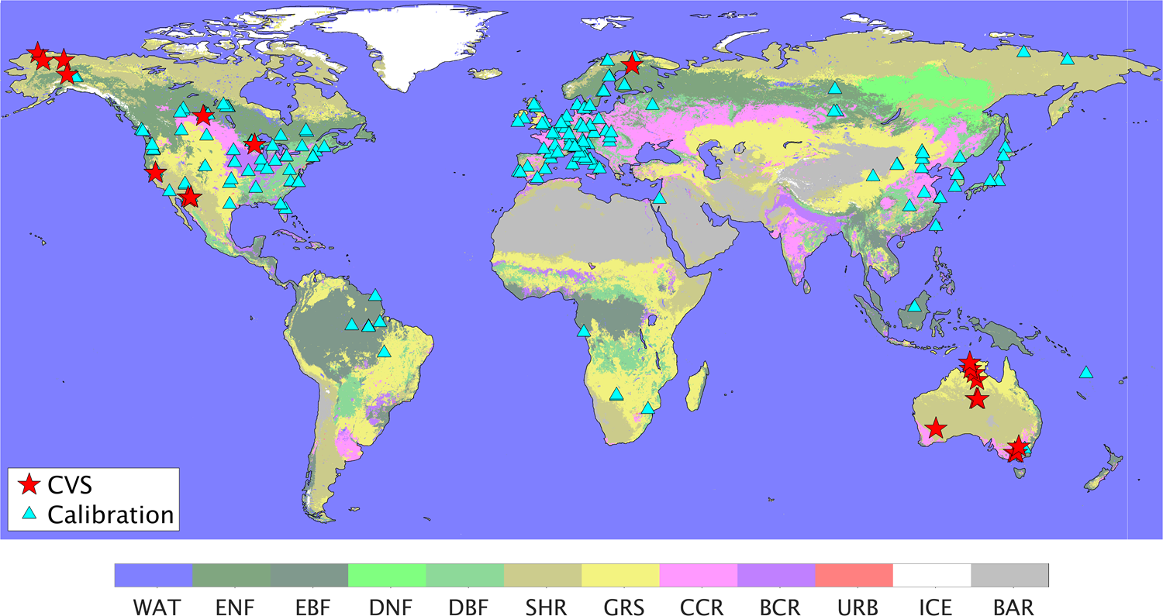
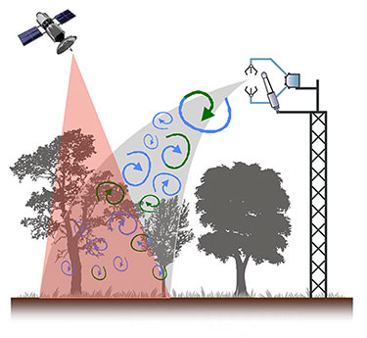
L4C Flux Tower Calibration & Validation Network
Core Validation Sites (CVS): 26 locations, 21 unique grid cells, provide recent flux tower data for SMAP mission period (March 31, 2015-present).
Calibration Sites: >228 tower locations, FLUXNET La Thuile/2015 Datasets, historic fluxes for SMAP Nature Run period (2001-2014).
Notes:
The model is fit by binning calibration sites based on dominant plant functional type. Brings up an important consideration of representativeness of sites and extrapolation error – not easily addressed. Must make adjustments for steady-state assumptions when fitting to flux data. Flux towers measure net ecosystem exchange, and GPP & ecosystem respiration must be separated using a model (based on night-time fluxes). So there’s also a problem with model/model comparison.

Slide 7
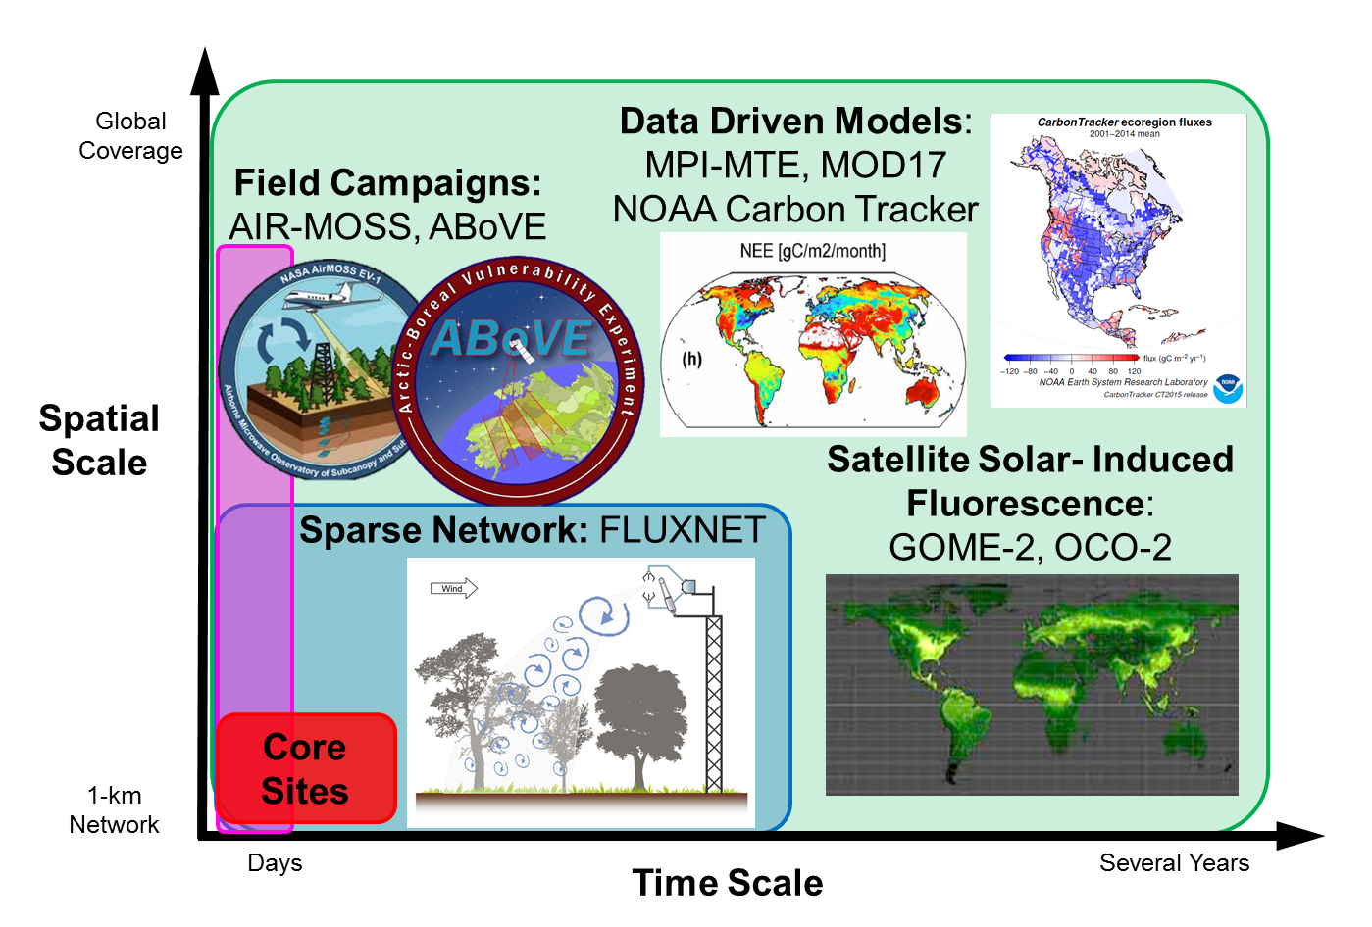
Multi-tier L4C Validation

Slide 8
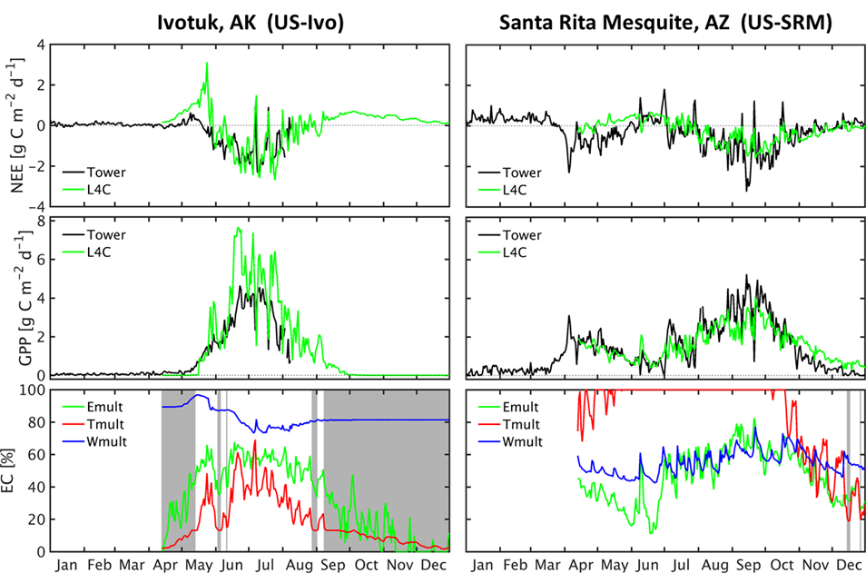
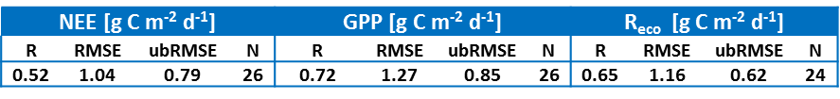
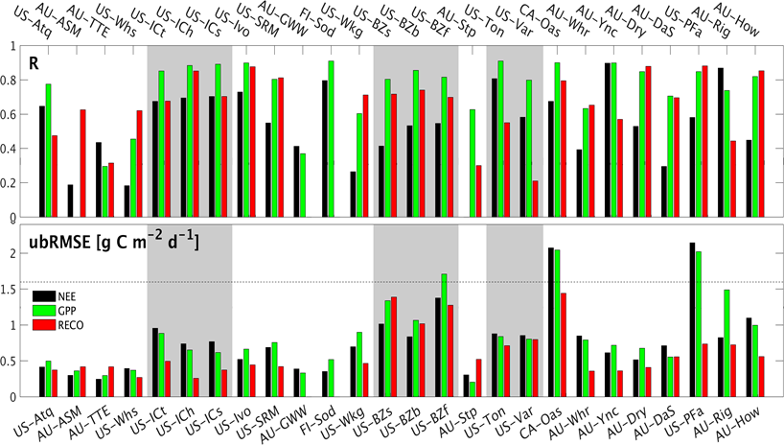
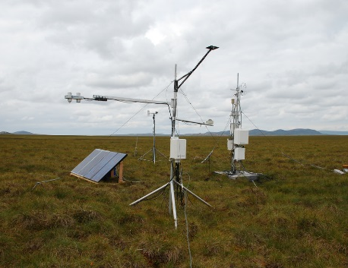
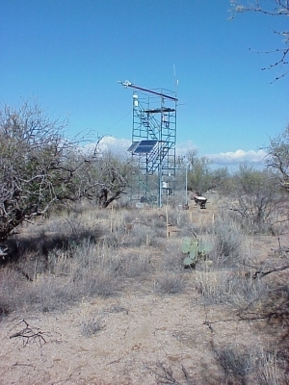

L4C Flux Tower Validation Summary
(March – Dec, 2015-2017)
Overall Stats:
Individual Site Stats:
same grid cell
same grid cell
frozen
Shrub Steppe
Desert,
Tundra
Increasing Flux
Forest,
Savanna
$$\left|GPP+RECO\right|$$
Tundra
Notes:
Example sites have widely varying moisture conditions/constraints. Sites sorted by increasing annual flux. Error roughly scales with increasing flux. Average errors well within mission target accuracy of 1.6 g C m-2 d-1. However, time record omits the Australia growing season, so the errors are lower than might be expected. Difficult to get up-to-date flux tower data.

Slide 9
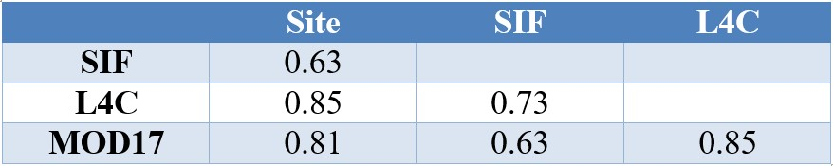
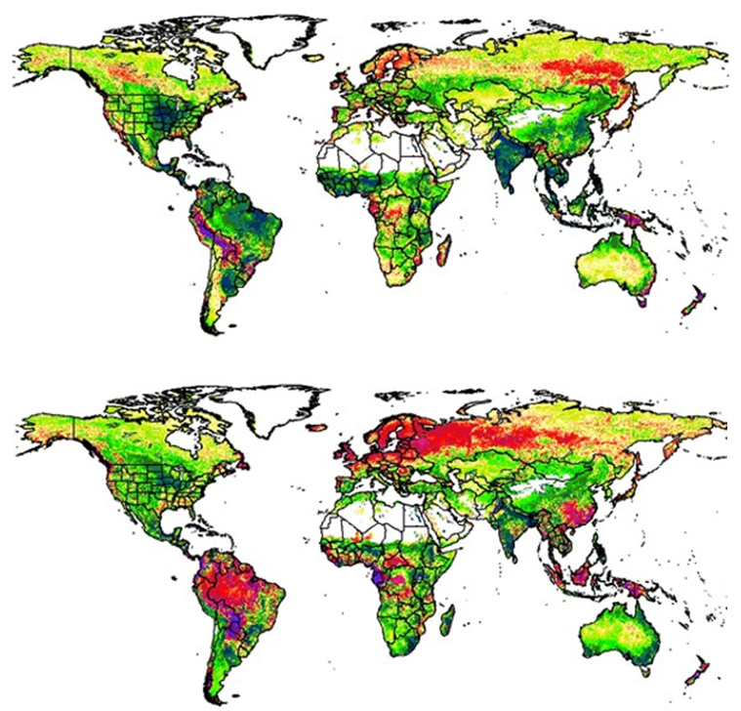
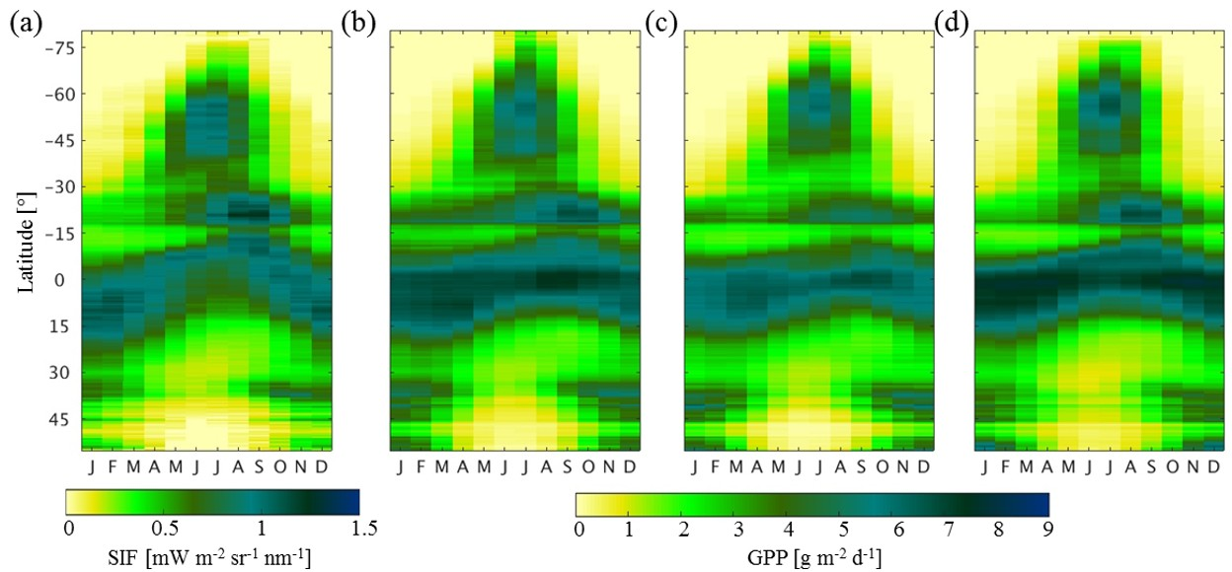

L4C GPP Comparison with MOD17 and GOME-2 SIF
L4C Increases Seasonal Cycle Amplitude
Monthly Correlation Summary for CVS Flux Towers.
L4C minus MOD17
Mean Seasonal Cycle by Latitude
SIF
L4C
MOD17
MPI-MTE
L4C minus MPI-MTE

Slide 10
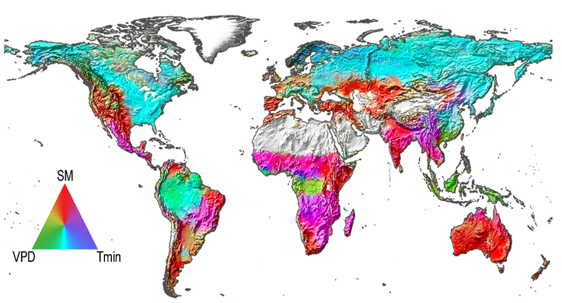
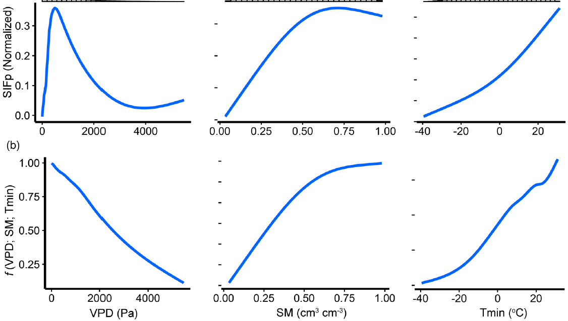
Verifying L4C Climate Controls on Global Productivity
(L4C GPP vs GOME-2 SIF)
¹Relative Climate Impacts on SIF Observations
Solar-induced chlorophyll fluorescence (SIF) from GOME-2 (2007-2014) used as GPP proxy
Correlations between monthly SIF & selected climate parameters (MERRA-2),
Machine-learning (GAM) prediction SIF global response functions
SM (and VPD) significant control over ~35% (59%) of global domain
Similar SIF and L4C response characteristics
SIF
L4C
¹Madani, Kimball, Jones, et al. 2017. Remote Sensing, 9, 530.
Notes:
ESA Global Ozone Monitoring Experiment (GOME-2)
Generalized additive model used to defined the smoothed curvilinear relationships between SIFp and each climate variable, which was compared with prescribed L4C model parameterizations derived from tower calibrations.
GPP is affected by joint climatic constraints so that VPD, Tmin, and SM are significant controls over 60, 59, and 35 percent of the global domain.

Slide 11
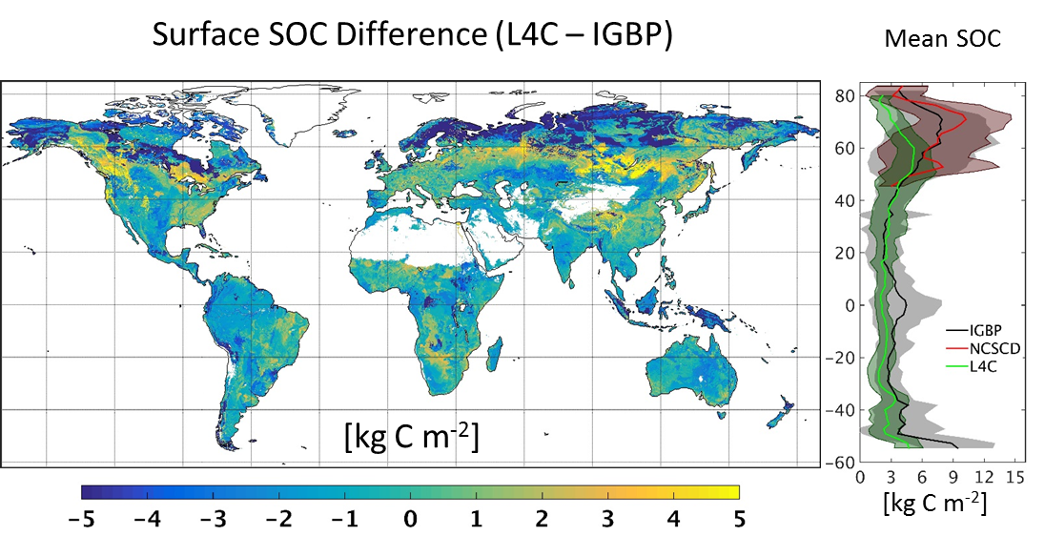
L4C Comparison with Soil Organic Carbon Maps
L4C and IGBP agree in temperate latitudes, whereas L4_C shows relatively less in the tropics and especially the Arctic, and relatively more SOC in boreal regions.
Mismatch factors include development history (up to 4,000 yrs for SOC development), disturbance, and IGBP sampling/extrapolation.

Slide 12
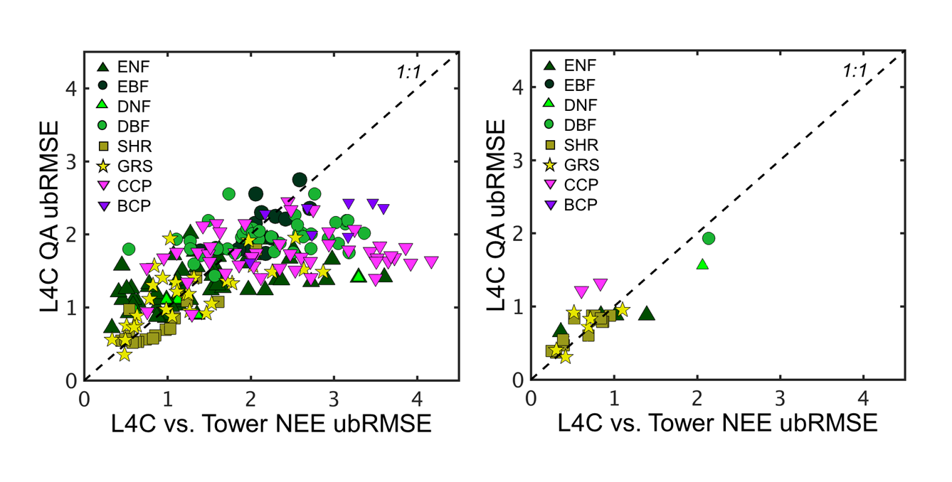
L4C Uncertainty & Quality Assurance
Estimated Daily Average NEE RMSE [g C m⁻² d⁻¹]
Error propagated using input error and L4C model derivatives.
Proportional to overall flux & biomass.
Fit plateaus for RMSE>2 g C m⁻² d⁻¹ (Cropland & Forest).
Notes:
Random error (as opposed to bias) is proportional to overall flux. Simply propagating input error has significant explanatory power up to ~2 g C m-2 d-1. Above that threshold other sources of error dominate, these might include heterogeneity and disturbance.

Slide 13
L4C Constraint Exclusion Experiment
Vapor Pressure Deficit GPP
Root Zone Soil Moisture GPP
Surface Soil Moisture Soil Resp.
Soil moisture affects GPP in arid shrub/grass regions.
VPD influence extends to forests.
Soil moisture has a widespread impact on soil respiration.
Notes:
Soil moisture impacts GPP in the most arid regions. VPD has a more widespread impact, especially for many forested regions, especially boreal and tropical forests. Soil moisture impact on soil respiration is also widespread. Since soil respiration responds to the surface, whereas GPP responds to deeper, root zone soil moisture, soil respiration tends to be more sensitive to soil moisture in areas where GPP is less sensitive (deciduous forests for example).
Soil moisture quality makes a difference in model skill relative to flux data.

Slide 14
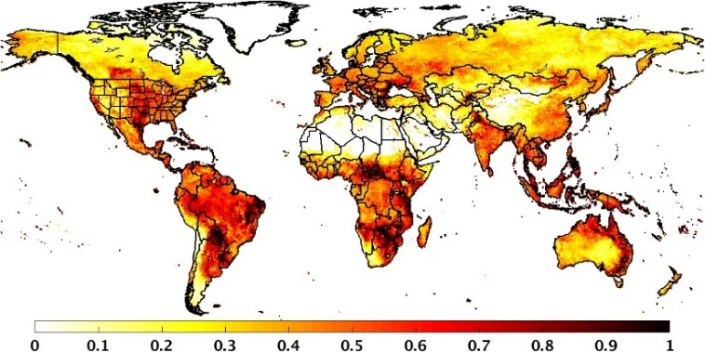
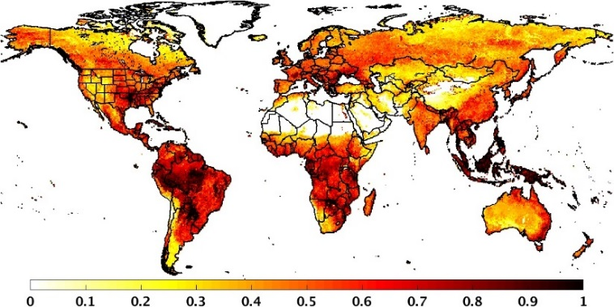

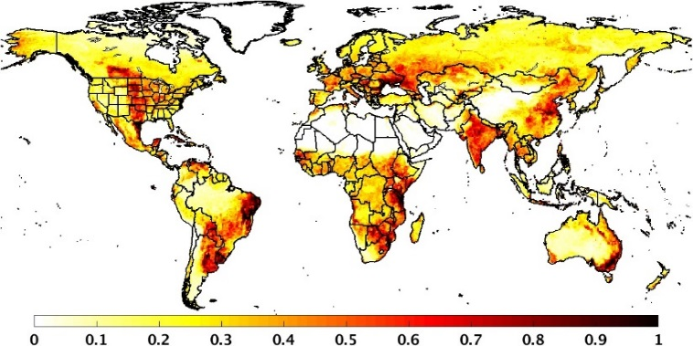

SMAP Influences L4C in Semi-Arid Regions
Daily GPP Anomaly Stdev.
Impact of SMAP Obs on L4C GPP
(L4C using L4SM vs. NatureRun RMS Difference)
L4C
[g C m⁻² d⁻¹]
MOD17
L4C regions of largest inter-annual anomaly variance generally align with SMAP impact.
Suggests potential for SMAP to inform interannual variability.
More SMAP influence in China following upcoming L4SM version release.
MPI-MTE
[g C m⁻² d⁻¹]

Slide 15
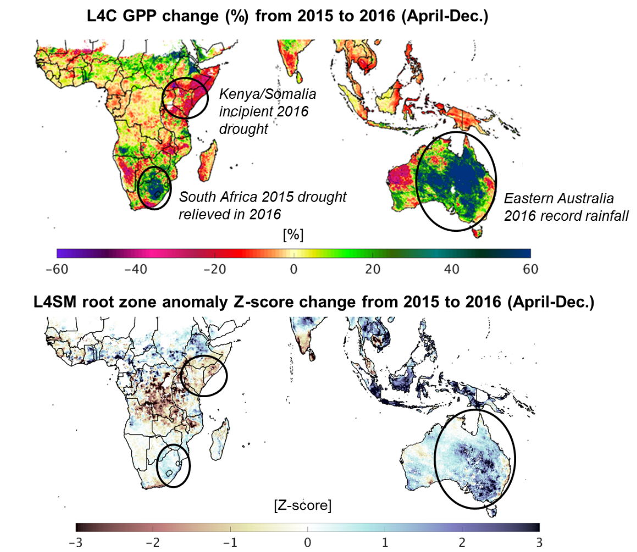
Southern Hemisphere Response to 2015-16 Climate Anomalies (SMAP L4 vs OCO-2 SIF)
Strong productivity increase in central and eastern Australia from record 2016 rainfall.
Large productivity decline in East Africa due to extended drought in 2016.
Notes:
National average precipitation in June, July and Aug 2016 in Australia was respectively 116%,61% and 45% above the average.

Slide 16
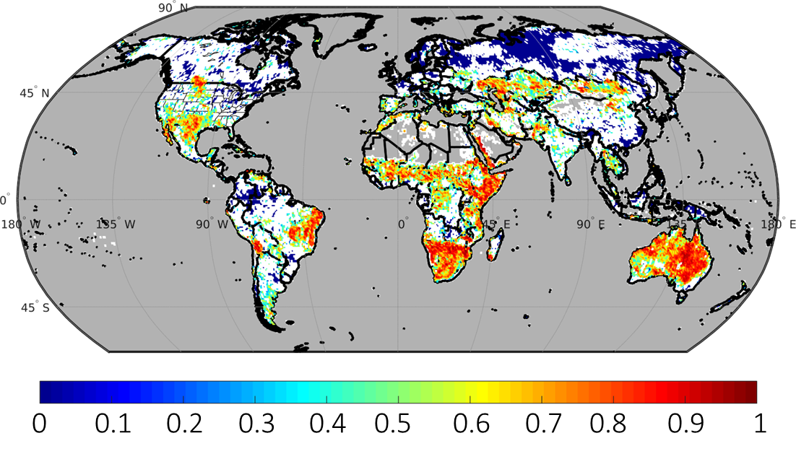
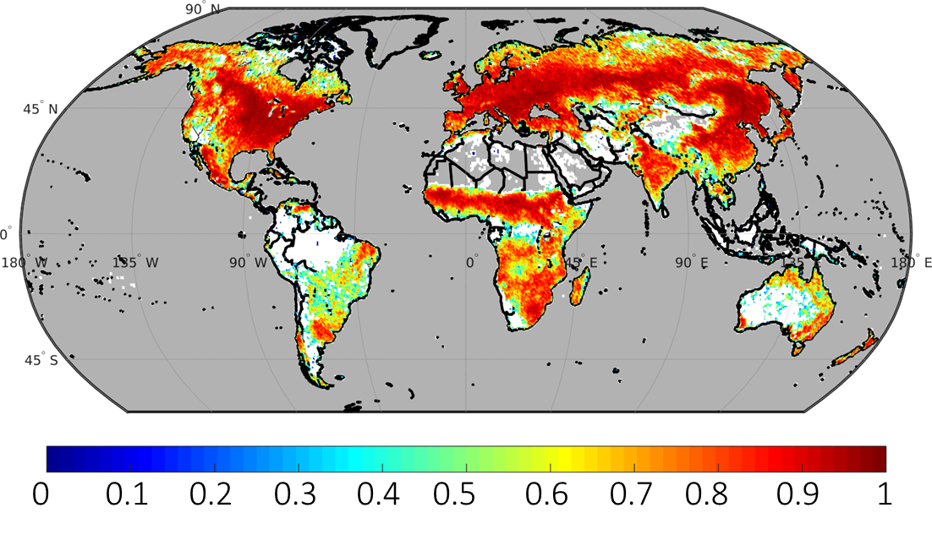
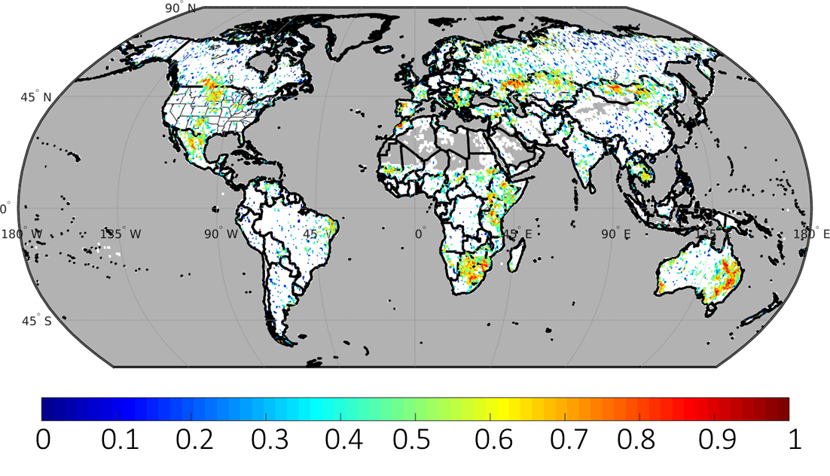
Atmospheric and Solar Induced Florescence Perspectives
L4C GPP vs L4SM Correlation
Year-to-Year Difference
L4C GPP and GOME-2 SIF show coherent response to global drought/pluvial events.
Corresponding with regions where soil moisture explains GPP variability.
L4C GPP vs GOME-2 SIF Correlation
(2015-2017)
L4C GPP vs GOME-2 SIF Correlation
Year-to-Year Difference

Slide 17
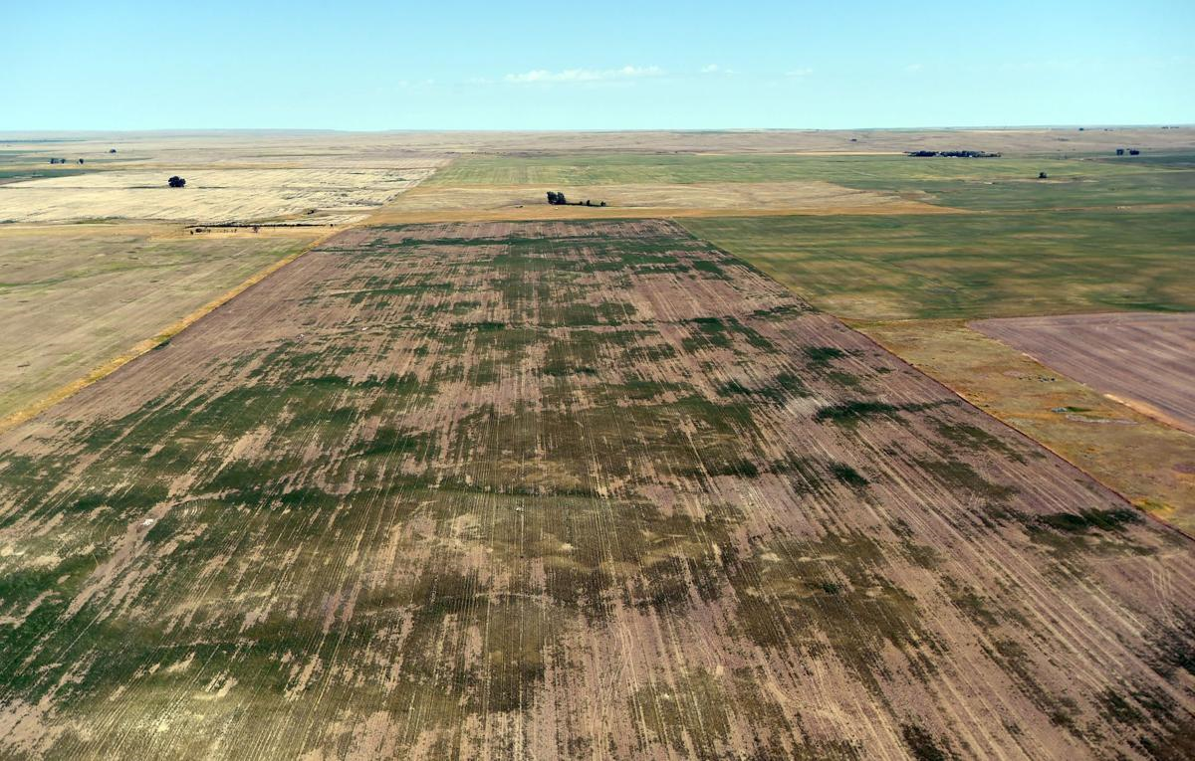
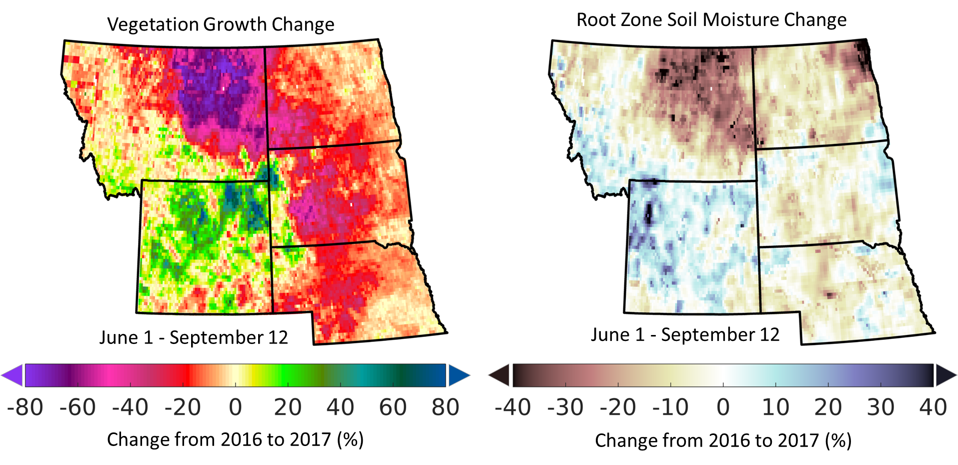
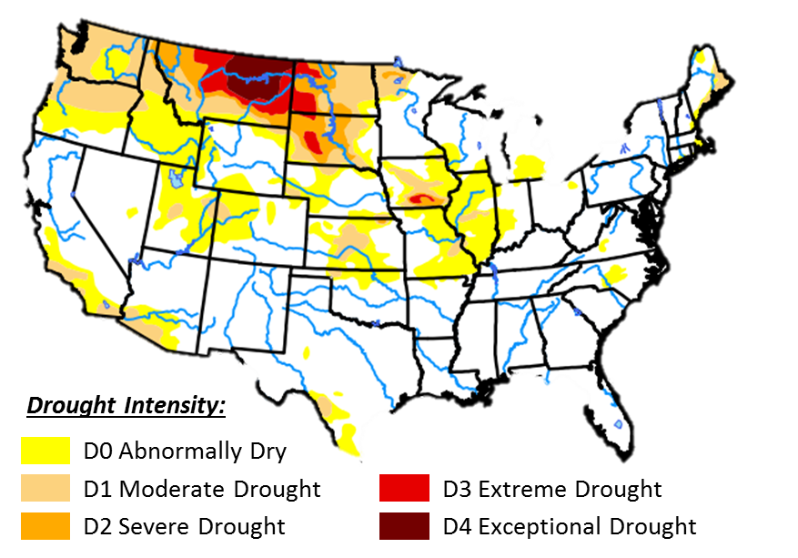
L4C Assessment of 2017 Northern Plains Summer Drought
Widespread GPP collapse during exceptional (D4) summer “flash” drought
MT epicenter; persistent hot, dry conditions drove GPP decline.
Drought impacts Incl.:
  >70 % of pasture and rangeland rated poor or very poor
  Crop production well below normal
  >400,000 acres burned by wildfires
Billings Gazette (Aug 19, 2017)
U.S. Drought Monitor
(Sep 12, 2017)
Notes:
MT cropland statistics obtained from the USDA NASS Crop Progress report: https://www.nass.usda.gov/Charts_and_Maps/Crop_Progress_&_Condition/2017/MT_2017.pdf

Slide 18
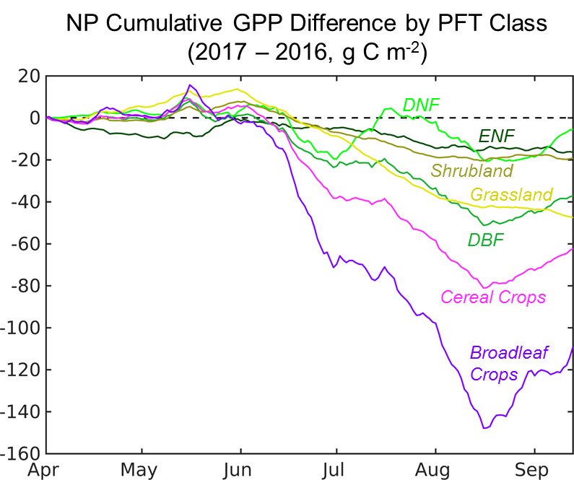

2017 Northern Plains Summer Drought Impact on L4C GPP
Large GPP interannual variability (2015-17).
Early growing season onset and spring GPP increase in 2017, followed by widespread productivity decline due to hot, dry summer
Regional productivity decline largely from croplands
NP GPP Cumulative Anomaly
2016
2017
2015
Pg C
Notes:
Apr 1 arbitrarily selected as 0 for GPP accumulation.

Slide 19
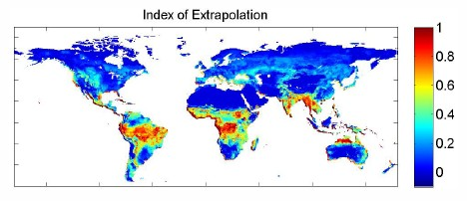
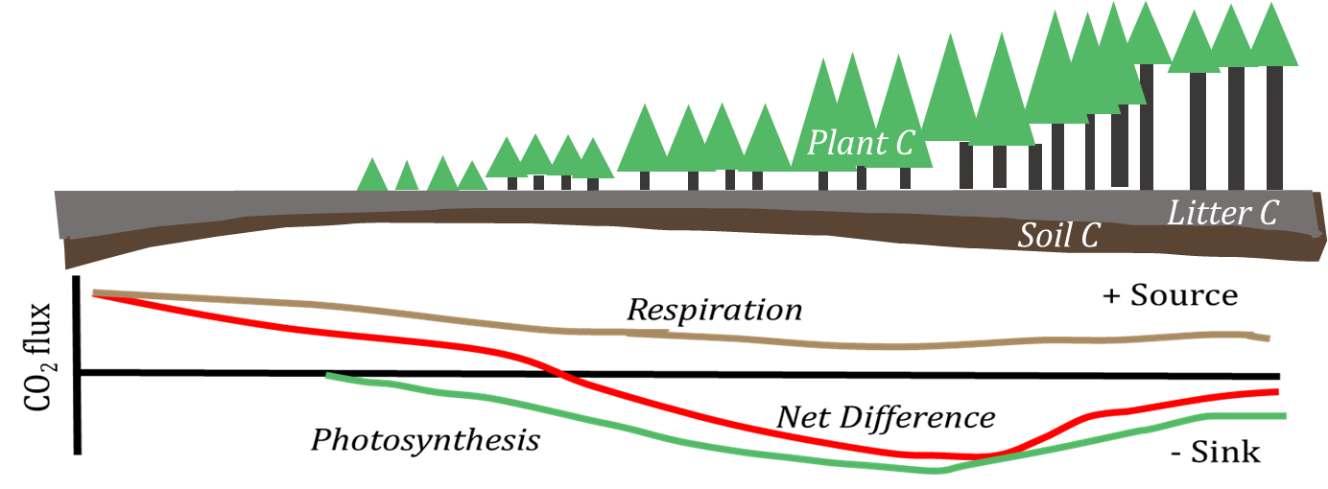
L4C Caveats & Drawbacks
NEE source/sink activity depends on SOC initialization and disturbance.
Representation error
Extrapolation error
Soil moisture and other input data biases
Model structure and optimization
From M. Jung et al. 2009. Biogeosci. 6, 2001-13.

Slide 20
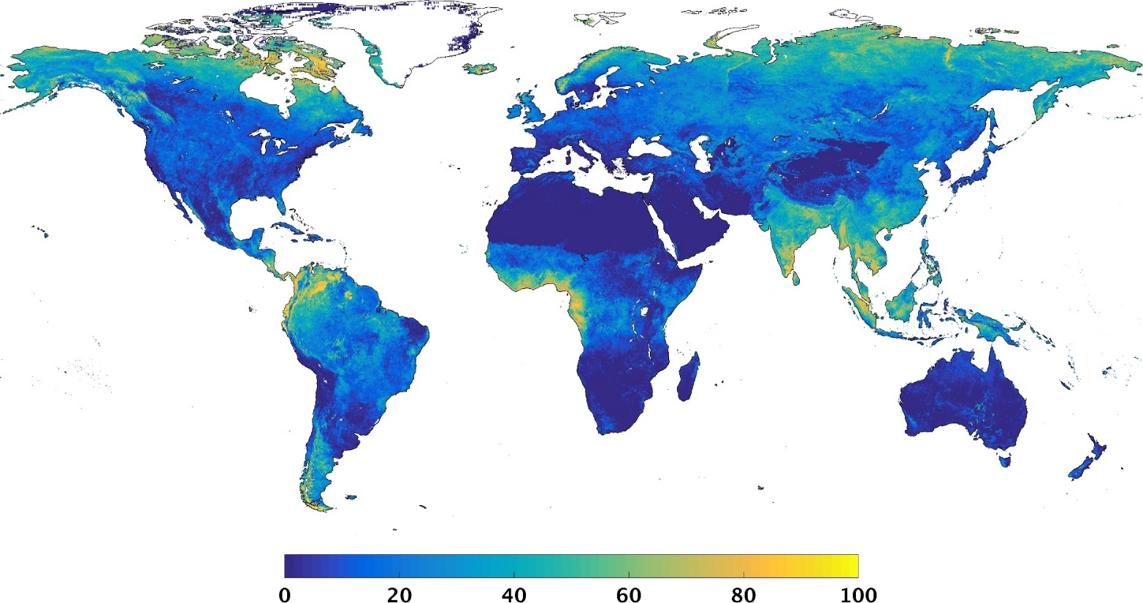
FPAR Climatology Replacement
Cloud cover contamination effects on L4C FPAR inputs mitigated using best quality MODIS FPAR climatology derived from long-term (2000-2014) MODIS record.
Percentage of Grid Cells with > 50 % FPAR Clim Fill
(L4C April 13-Dec 31, 2015)

Slide 21

Reading SMAP L4C HDF-5 Files
Filename Example:
MATLAB:
% Open file and read into array (9km EGv2 1624x3856 float32 Array)
data = h5read(‘Smap_l4c_file.h5’, ‘/NEE/nee_mean’)
PYTHON h5py:
# Open file and Retrieve Group Dictionary
fileObj = h5py.File(‘Smap_l4c_file.h5’, ‘r’)
# Read into Numpy Array using Dictionary Reference
grpObj = fileObj[‘NEE’] # Dictionary of Groups
data = grpObj[‘nee_mean’] # Dictionary of Datasets
H5py website: www.h5py.org ; HDF Documentation: www.hdfgroup.org

Slide 22
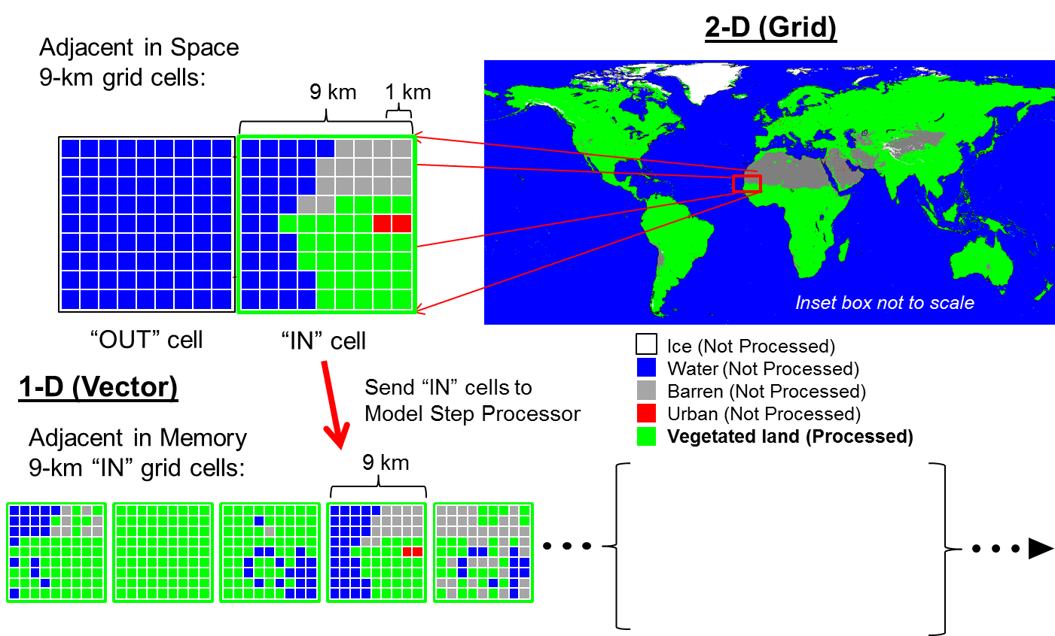
L4C Land Mask and Vectorization Procedure
2-D (Grid)
Adjacent in Space
9-km grid cells:
9 km
1 km
“OUT” cell
“IN” cell
Ice (Not Processed)
Water (Not Processed)
Barren (Not Processed)
Urban (Not Processed)
Vegetated land (Processed)
1-D (Vector)
Send “IN” cells to
Model Step Processor
Adjacent in Memory
9-km “IN” grid cells:
9 km
Read multi-resolution input data cells in nested loops
[9 km – 3 km – 1 km] then do model step @ 1 km for all global veg. cells.

Slide 23
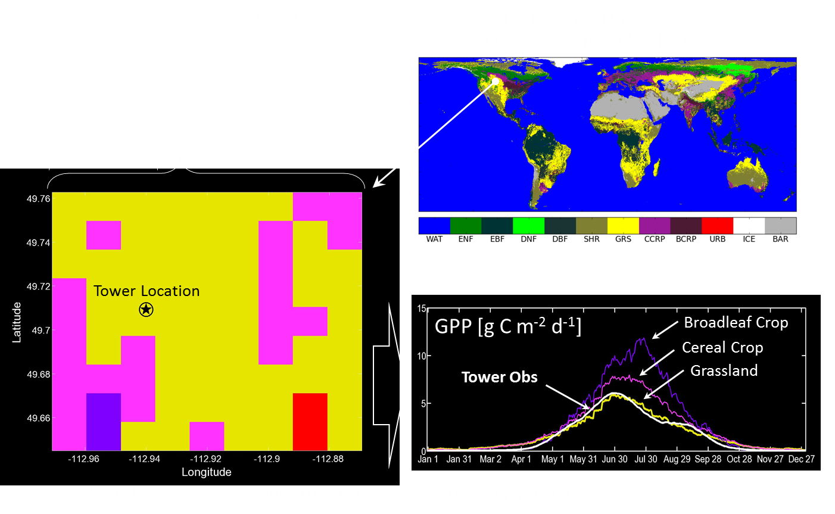
Spatially Nested L4C Processing and Gridding

Slide 24
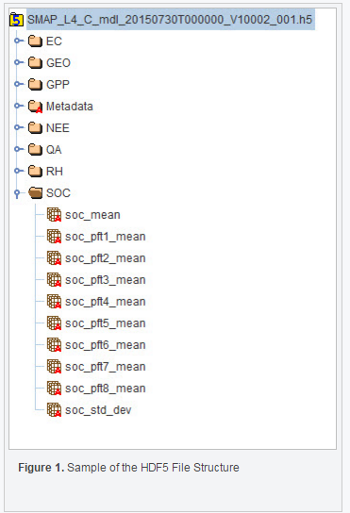
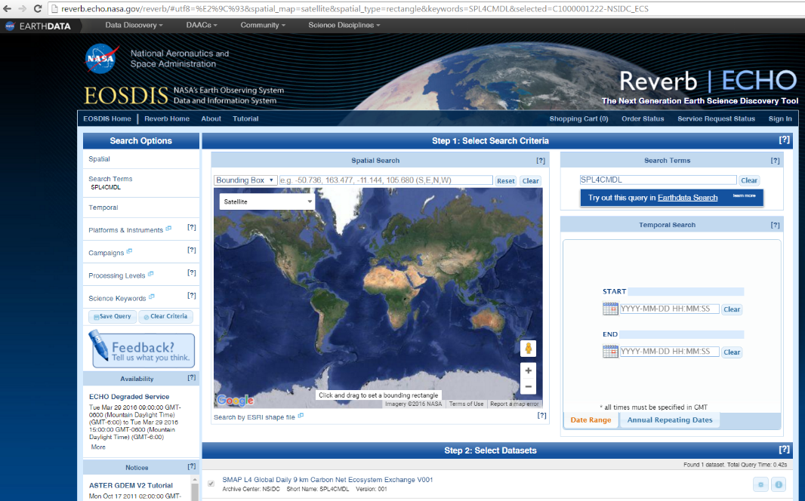
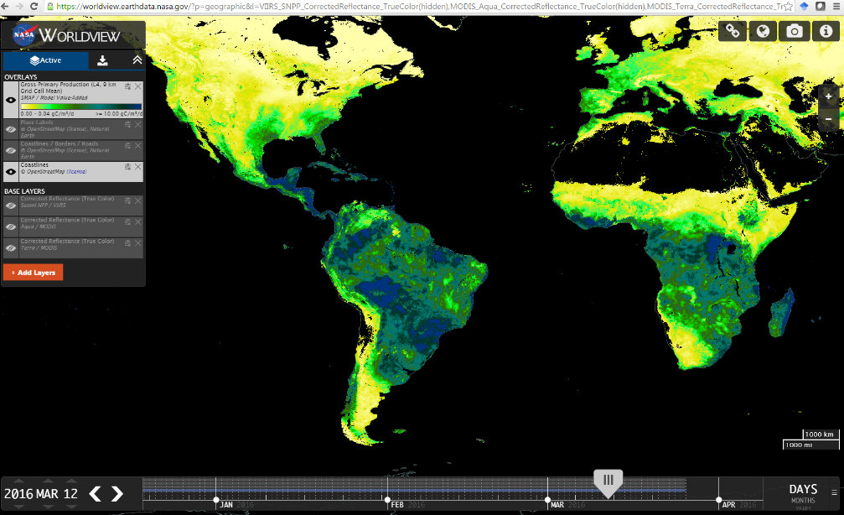
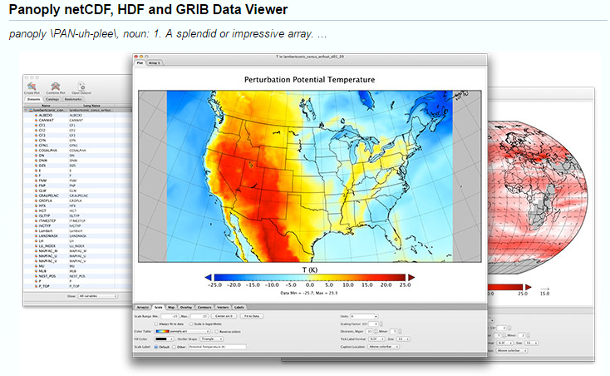
NSIDC and NASA Tools
HDFView
(File Info & Visualization)
Reverb
(Subsetting, Reformatting & Download Tool)
Panoply (Visualization)
WorldView
(Online
Visualization)

Slide 25

Useful Links and Acknowledgement
National Snow and Ice Data Center (NSIDC) Data, Tools, and Documentation:
  http://nsidc.org/data/docs/daac/smap/sp_l4_cmdl/index.html
Worldview SMAP Browse Images:
  https://worldview.earthdata.nasa.gov
  L4C Algorithm Theoretical Basis Document (ATBD):
  http://smap.jpl.nasa.gov/documents/
  Acknowledgement: L4C Cal/Val Partners: Andreas Colliander (JPL), J. Beringer (Monash U), L. Hutley (Charles Darwin U), J. Cleverly (U Tech. Sidney), C. McFarlane (CSIRO), J. Pulliainen (HUT), D. Baldocchi (UCB), E. Euskirchen (UAF), R. Scott (USDA), B. Law (OSU), W. Oechel (SDSU), H. Wheater (U Sask.).
[link list, pretty picture]

