Slide 1
Climate affects on streams

Slide 2
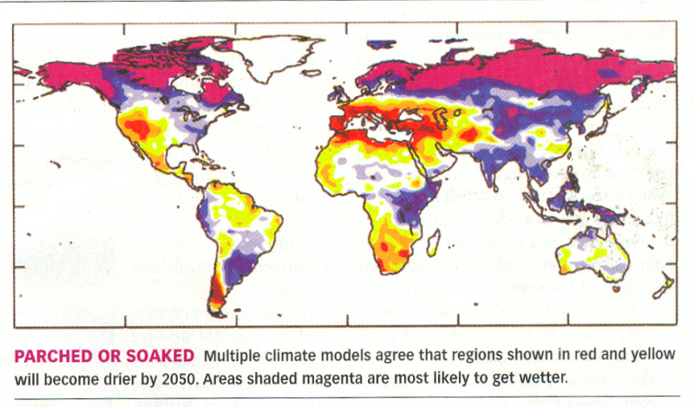
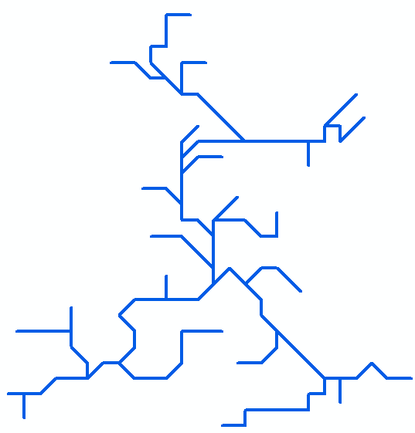
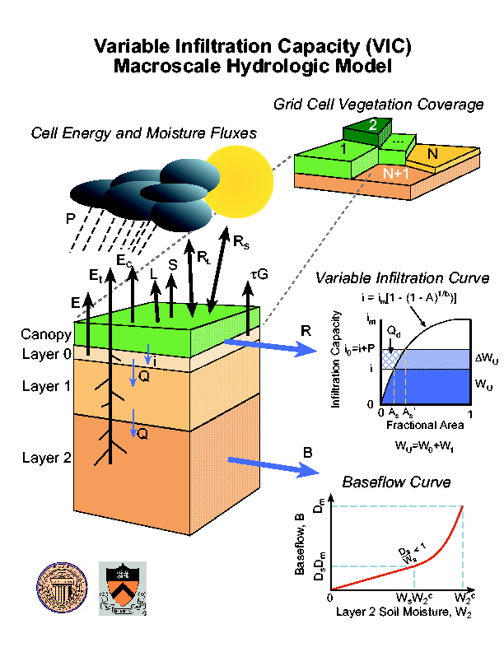
Calibration: SCE-UA: a global optimization algorithm
Validation: Gauged stations
IPCC: Observation based simulations 1915-2005
Thermal energy budget simulations
Skeena
UW (Fengge): Downscale results of 15-20 GCM models to work as forcing variables (precip, air temp, wind speed, air pressure, humidity, vapor pressure) (1/16th degree PNW and 1/8th degree NPR) for future predictions 2005-1994
UM (Huan): VIC: Generates runoff to create streamflow
DRT: Routes water through gridded stream networks
Notes:
To study current patterns of freshwater salmon habitat and associated productivity of North Pacific Rim (NPR) basins and their response to projected climate change, a regional scale hydrologic simulation scheme was developed to predict stream flow and temperature changes under historical (1979-1999) and future (to 2098) climate change scenarios (IPCC AR4). An efficient simulation scheme was developed, including: a hierarchical Dominant River Tracing (DRT) algorithm for automated extraction and spatial upscaling of flow directions and river networks from baseline fine scale hydrography; a Shuffled Complex Evolution method (SCE-UA) for automatic calibration of Variable Infiltration Capacity (VIC) hydrologic model simulations for more than 1500 NPR basins; and a DRT based routing scheme and coupled stream temperature model.
For historic climate-meteorology, we used the National Centers for Environmental Prediction-National Center
for Atmospheric Research (NCEP-NCAR) reanalysis products (Kalanay et al.
1996) as the primary sources for precipitation,temperature and wind speed.
The 1/8th degree spatial resolution data set of daily historical
Precipitation and daily temperature maxima and minima (Tmax, Tmin) were
downscaled from NCAR/NCEP reanalysis products but were ajusted by scaling
the monthly means to match the monthly climate normals from National
Climatic Data Center Cooperative Observer (Co-Op) network and Environment
Canada (EC) daily station data. Daily wind speed values were directly
downscaled from NCAR/NCEP reanalysis products.
For futural climate-meteorology, we downscale the climate forcing fields (e.g.precipitation, temperature)
for NPR region at 1/8 degree resolution from 20 General Circulation Models
(GCMs) under two IPCC emissions scenarios (i.e. lower B1 and mid-high A1B)
for next 100 years.The bias-correction and spatial disaggregation (BCSD,
Wood et al., 2004) downscaling approach is used for translating the
transient monthly climate model output into continuous daily forcings for
the hydrologic analysis.
We developed a hierarchical Dominant River Tracing algorithm (DRT) for automated extraction and spatial upscaling of basin flow directions and river networks (the right bottom figure). Based on the DRT, we developed a routing model and a coupled stream temperature model.

Slide 3
Stream flow Calibration/Validation-Columbia basin
Notes:
The mean annual relative error is ~12% ranging from 6% to 18%. The mean monthly Nash-Sutcliffe model efficiency coefficient is ~60% ranging from 40% to 85%.

Slide 4
Stream T Calibration/Validation-Columbia basin
Notes:
Given a specific basin, both the DRT stream flow and T models can
give very promising performance. It is difficult to give such good
performance for each grid cell of the given region, especially huge region,
however, our model can give the generally consistancy performance for all
grid cells accross a huge region. We have been keeping efforts on improving
the performance of the model in runing a regional mode for each grid cell
simulation.

Slide 5
Stream flow Calibration/Validation-Skeena basin
Notes:
Based on the DRT river network upscaling algorithm, we improved the flow distance calculation using high resolution DEM. The stream flow simulation on Skeena at 1/8 degree are generally well consistent the gauged discharge. The relative worse simulation at “ZYMOETZ RIVER” mainly because the scale problem. The upstream area of the station is about 2000km2 which is only about 20 grid cells at 1/8 degree.

Slide 6
Stream T Calibration/Validation-Skeena basin
Notes:
The performance on Skeena at 1/8 degree is consistent with the Columbia basins at 1/16 degree after calibration. We need be careful to explain the simulated water temperature at each 1/8 degree grid cell.
There are only 385 grid cells at 1/8 degree resolution. The
DRT_T (the temperature model) calculates the water temperature using the
runoff evenly distributed from each grid cell which is output from VIC
model. The flow direction and river networks are defined by the DRT algorithm
in which the flow direction for each grid cell is determined by the dominant
river draining through the grid cell. So the reasonable explanation of the
simulated water temperature for each grid cell is the "mixed" or "bulk"
temperture for all streams in the grid cell by more close to temperature of
the dominant river of the grid cell. Given a grid cell, if there is only one
major river draining through it, the simulated temperature is more
reasonably to be explained as the temperature of this major river. When
calibration and validation of the model, we usually look for such grid cell
in which there is only one major river and there is a gauge in it.

Slide 7
Notes:
These simulations also show seasonal changes in river flow, with a consistent pattern of flow increase in winter and decrease in summer over the next 100 years

Slide 8
Notes:
These simulations also show seasonal changes in stream temperature, with a consistent warming trend over the next 100 years

Slide 9
Columbia
The change of mean annual stream flow rate (m³/s )(1976-2005;2065-2094) for rivers (>500 km²)
The change of the mean annual water T of rivers(>2,500km²)(1976-2005;2065-2094)
Notes:
Initial implementation and testing of these algorithms was conducted over the Pacific Northwest (PNW), including simulated natural flows of the Columbia River basin. These simulations show spatially variable trends in mean annual large (drainage area > 2,500 km2) PNW river flows ranging from -2.61% to 1.98% with a mean increase of 0.68% per decade, while the lower mainstem Columbia River shows a significant, positive river discharge trend of 0.87% (632m3/s) per decade (p<0.02) under projected climate change. These simulations also show seasonal changes in river flow, with a consistent pattern of flow increase in winter and decrease in summer over the next 100 years while indicating warming trends in mean annual water temperatures for PNW rivers (drainage area > 2,500 km²) with maximum of 0.27°C and a mean of 0.19°C per decade, and with greater warming (0.21 °C per decade) of southerly rivers over northerly rivers (0.18°C per decade) in the PNW region. These results also indicate that the mean annual frequency of continuous 7-day average temperatures exceeding 21°C increases from 3.4 (1976-2005) to 5.9 (2065-2094) over all PNW rivers with drainage area> 2,500 km², which indicates a future with increasing summertime thermal stress for coldwater fish in these watersheds.

Slide 10
Columbia
The mean annual flow rate (m³/s )(2069-2098) for rivers (>300 km²)
The Number of 7-day with T>21˚(2065-2094) for rivers (>500 km²)

Slide 11
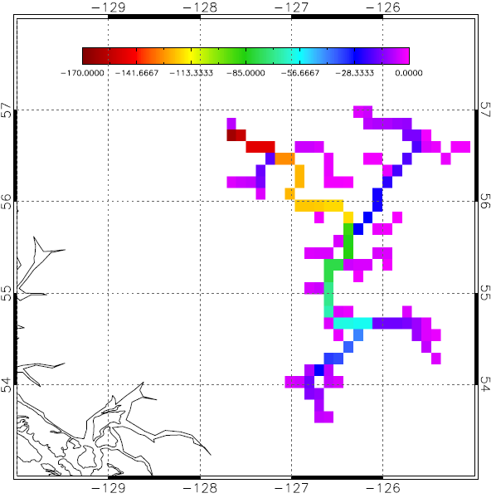
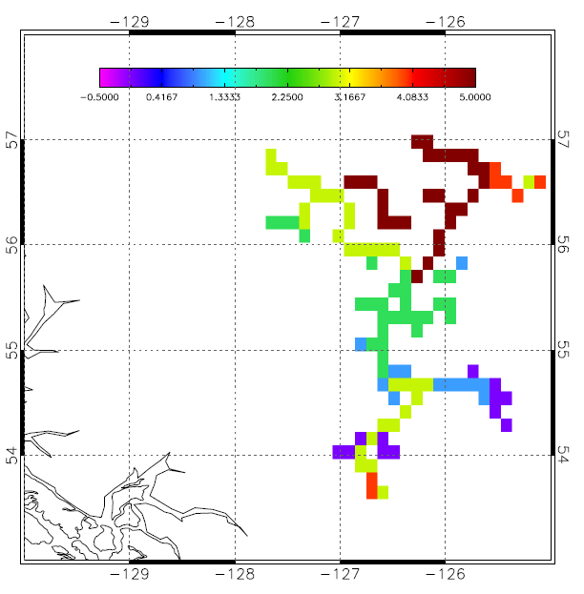
Skeena
The change of mean annual stream flow rate (m³/s )(1979-1999;2069-2098) for rivers (>300 km²)
The change of the mean annual water temperature (°C)of rivers(>300km²)(1979-1999;2069-2098)
Notes:
These simulations show spatially variable trends in mean annual large (drainage area > 300 km2) Skeena river flows ranging from -4.23% to -0.29% with a mean decrease of 1.90% (2.80m³/s) per decade under projected climate change. These simulations also show seasonal changes in river flow, with a consistent pattern of flow increase in winter and decrease in summer over the next 100 years while indicating warming trends in mean annual water temperatures for all Skeena rivers (drainage area > 300 km²) with maximum of 0.48°C and a mean of 0.27°C per decade. The mean summer water temperature over all river segments will warm 0.22 ˚C per dacade associated with a 7.2% decrease of mean summer stream flow in the next 100 years.

Slide 12
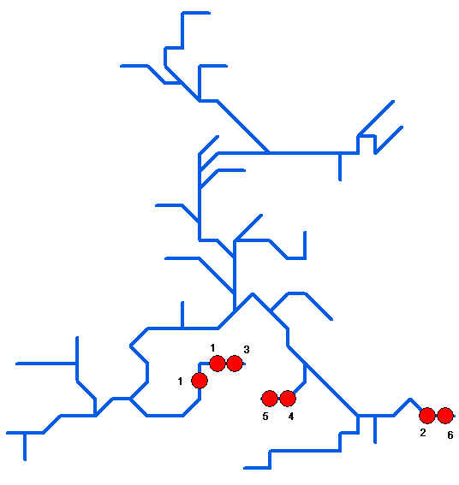
Notes:
The simulations also indicated that there will be several river segments with the mean annual frequency of continuous 7-day average temperatures exceeding 21°C ranging from 1-6. Though they are mainly located in headwater area, it is warning signs for these river and it may lead potential thermal stress for salmon. The numbers aside of the red circle is the annual number of the 7-day with average temperatures exceeding 21°C.

Slide 13
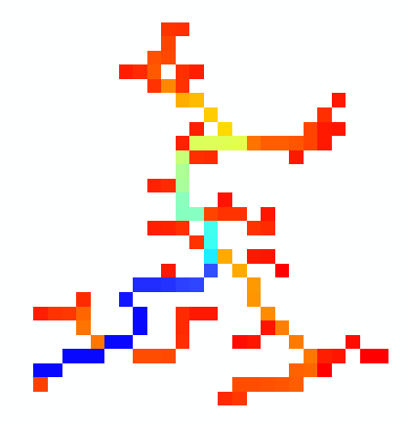
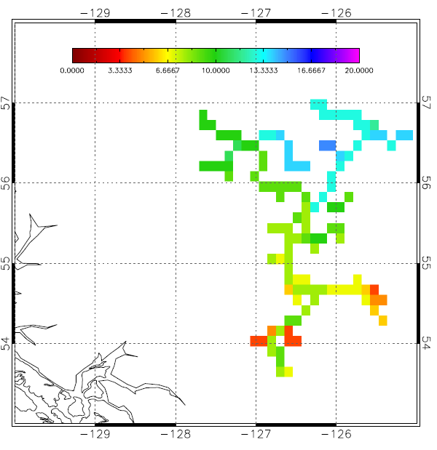

Skeena
The mean annual flow rate (m³/s )(2069-2098) for rivers (>300 km²)
The mean annual stream temperature (m³/s )(2069-2098) for rivers (>300 km²)

Slide 14
Stream flow and T changes per dacade for both basins
 | Flow | Mean flow | Maximum T | Mean T
Columbia | -2.61% to 1.98% | +0.68% | +0.27˚C | +0.19˚C
Skeena | -4.23% to -0.29% | -1.90% | +0.48˚C | +0.27˚C

Slide 15
Stream affects on biota for 4 Pacific regions (major ocean currents) for each salmon species and salmonids in general for 4 life history stages (egg, parr, smolt, adult)

Slide 16
Method 1
Calculate historic mean weekly T
Use literature for timing (river use for each life history stage) compared to historic T conditions to produce quantiles describing Topt and Tcrit
Adjust/verify with salmon literature T thresholds
Determine the number of weeks a year a given watershed will fall outside the allowable values for future scenarios

Slide 17
Method 2
Calculate historic mean weekly T
Use literature T thresholds (salmon thermal tolerances) to produce quantiles describing Topt and Tcrit
Determine the number of weeks a year a given watershed will fall outside the allowable values for future scenarios

Slide 18
Method 3
Calculate historic mean weekly T
Calculate future conditions
Use the statistical difference (a 1-p weighted difference in means) to determine the number of weeks a year a given watershed will exhibit statistically different conditions

Slide 19
 | Columbia |  |  |  | Skeena
 | Spawn-ing | Incub-ation | Growth | Smolt-ification | Spawn-ing | Incub-ation | Growth | Smolt-ification
Chinook | 4.4 -18 | 6.4 -14.2 | 10 -15.2 | 4.5 -13 |  |  | 12.2-15
Chum | 4 -12.8 | 2.8 -14 | NA | 11.2 -13.7 | 9.8 -13.6 | 1.5 -10 | NA
Coho | 7.2 -15.6 | 8.9 - 10.7 | 5 - |  | 5 - 11.4 | 4 – 14 | 10 – 15 | 2.5 – 13.3
Pink | 8.5 – 15.6 | 3.5 – 9 | NA |  | 9 – 14.5 | 3.4 – 12.3 | NA
Sockeye | 7.2 – 15.5 | 4.4 – 13.3 | 8 - |  | 12.7 – 20 | 2 – 8 | - 18 | 3.3 -
Steelhead | 7.8 – 11.1 | 7 – 12 | 9.8 – 21 | 10 – 12.8 | - 16
All

Slide 20
 | Columbia |  |  |  | Skeena
 | Spawn-ing | Incub-ation | Growth | Smolt-ification | Spawn-ing | Incub-ation | Growth | Smolt-ification
Chinook | 30 -189 | 30 – 90 | 0 -40 | 34.3 – 58.3
Chum | 10 - 83.8 | 33 – 66 |  | 20 - 80
Coho | - 150 | 30 – 75 | 0 - 15
Pink |  |  |  |  | 30 - 150
Sockeye
Steelhead | 23 – 155 |  | 10 -22 | 30.48 – 76.2
All

Slide 21
Orlay, John W., and Grant W. Stewart , Robert G. Kope, Kathleen Neely, F. William Waknitz, and Robin S. Waples. 1997. Status Review of Chum Salmon from Washington, Oregon, and California. NOAA Technical Memorandum NMFS-NWFSC-32. 298 pp
EBMUD Supplemental Water Supply Project, Draft EIR/EIS, Appendix E: Temperature Criteria for Evaluating the Risk of Chinook Salmon and Steelhead Impacts. Report #C-085270
Raleigh, R.F., W.J. Miller, and P.C. Nelson. 1986. Habitat suitability index models and instream flow suitability curves: chinook salmon. US Fish and Wildlife Service Biol.Rep. 82(10.122). 63 pps
Independent Scientific Advisory Board. 2007. Climate change Impacts on Columbia River Basin Fish and Wildlife. ISAB Climate Change Report ISAB 2007-2. 146 pp
Groot C. and L. Margolis, eds. 1991. Pacific Salmon Life Histories. UBC Press: Vancouver, Canada.
Degree days or temperature units. http://fisheries.btc.ctc.edu/Handout/TUs.PDF. Accessed on May 22nd, 2009.
Gottesfeld, Allen S. and Ken A. Rabnettt. 2008. Skeena River: Fish and Their Habitat. Ecotrust, Portland: Oregon.
Department of Water Resources for the State of California. Evaluation of Flow Fluctuation Effects on Chinook Salmon Redd Dewatering in the Lower Feather River SP-F10, Task 2D. Oroville Facilities Relicensing FERC Project No. 2100. 59 pps.
Van der Naald, Wayne, Caneron Duff, Thomas A, Fiesen, Robert R. Brooks, and Londi M. Tomaro. 2006. Evaluation of Fall Chinook and Chum Salmon Spawning Below Bonneville Dam. Annual Report to ODFW. Project #: 1999-03-01
Armour, Carl. 1991. Guidance for Evaluating and Recommending Temperature Regimes to Protect Fish. US Fish and Wildlife Service Biol. Rep. 90(22). 13 pps
Kemp, Paul S. and John G. Williams. 2008. Response of Migrating Chinook Salmon (Onchorynchus tshawytscha) Smolts in In-stream Structure Associated with Culverts. River Research and Applications. 24: 571-579.
Quinn, Thomas P. 2005. The Behavior and Ecology of Pacific Trout and Salmon. American Fisheries Society, Bethesda.
MD.Bianchi, E.W., W. Walsh, and C. Marzuola. 1992. Task Reports of Fisheries Studies on the Mokelumne River, 1990-1992 (Appendix A of the Lower Mokelumne River Management Plan). Report to East Bay Municipal Utility District, Oakland, California. BioSystems Analysis, Inc., Tiburon, California.
Pauley, G.B., K.L. Bowers, and G.L. Thomas. 1988. Species profile: life histories and environmental requirements of coastal fishes and invertebrates (Pacific Northwest) -- chum salmon. US Fish and Wildlife Service Biol. Rep 82(11.81) US Army Corps of Engineers. TR EL-82-4. 17 pp.
Uusitalo, Nancy M. 2003. Evaluate Factors Limiting Columbia River Gorge Chum Salmon Populations. Project No. 2000-01200. 12 electronic pages (BPA Report DOE?BP_00004669-2.)
Belyaev, V.A. and S.F. Zolotukchin. 2001. Monitoring of Salmon Smolt Numbers in the Khabaovsk Region. NPAFC Technical Report No 2.
Azumaya, Tomonori and Yukimasa Ishida. 2001. Effects of ocean Currents on Juvenile Chum Salmon Migration. NPAFC Technical Report No 2.
Burke, Judith R. Sooke River Twelve Month Baseline Water Quality Study for Salmonids. Waterose Environmental Services, Vancouver BC. Accessed on May 22, 2009. http://www.geocities.com/RainForest/Vines/4301/sooke02b.html .
Lee, G.C., A.P. Farrell, A. Lotto, M.J. MacNutt, S.G. Hinch, and M.C. Healey. 2006. The effect of temperature on swimming eprformance and oxygen consumption in adult sockeye (Onchorhynchus nerka) and coho (O. Kisutch) salmon stocks. The Journal of Experimental Biology: 3239-3251.
McMahon, Thomas E. and Gordon F. Hartman. 1989. Influence of Cover Complexity and Current Velocity on Winter Habitat Use by Juvenile Coho Salmon (Onchorhynchus kisutch). Canadian Journal of Fisheries and Aquatic Sciences. 46: 1551-1557.
Pennell, William and Bruce A. Barton. 1996. Principles of salmonid culture. Elsevier Publishing. 1039 pps.
Clarke, W.C., J. E. Shelbourn, and J.R. Brett. 1978. growth and adaptation to sea water in 'underyearling' sockeye (Onchirrhynchus nerka) and coho (O. kisutch) salmon subjected to regimes of constant of changing temperature and day length. Canadian Journal of Zoology. 56: 2413-2421.
Testing new electronic archival tags in Alaska salmon. Alaska Science Center- Biological Science Office, USGS.
Cultured Species Information Programme. Oncorhynchus kisutch. Food and Agricultural Organization of the United Nations. Accessed on 5/21/09. http://www.fao.org/fishery/culturedspecies/Oncorhynchus_kisutch/en
Quinn, Thomas P. and Dean J. Adams. 1996. Environmental changes affecting the migratory timing of American shad and sockeye salmon. Ecology.
Mathes, Martin Todd. 2009. Effect of Water Temperature, Timing, Physiological Condition and lake Thermal Refugia on Success of Migrating Adult Sockeye Salmon. Master's Thesis. School of Forestry, The University of British Columbia.
Gottesfeld, Allen S., Ken A Rabnett, and Peter E. Hall. 2002. Conserving Skeena Fish Populations and their Habitat. Skeena Fisheries Commission. Hazelton, BC.
Welch, D.W., Y. Ishida, and K. Nagasawa. 1998. Thermal limits and ocean migrations of sockeye salmon (Onchorhynchus nerka): longterm consequences of global warming. Canadian Journal of FIshereis and Aquatic Sciences 55: 937-948.
Williamson, C.J. 2000. Enumeration of Adult Steelhead in the Upper Sustut River 1999. BC Ministry of Environment, Lands, and Parks. Skeena Fisheries Report SK 126. Spina, Anthony P. 2007. Thermal Ecology of juvenile steelhead in a warm-water environment. Environmental Biology of Fishes. 80: 23-34.
Hill, Megan S., Gayle Barbin Zydlewski, and William L. Gale. 2006. Comparisons between hatchery and wild steelhead trout (Onchorhynchus mykiss) smolts: physiology and habitat use. Candian Journal of Fisheries and Aquatic Sciences. 63: 1627-1638.
Steig, Stacey W., Bruce H. Ransom, and Mark. A. Timko. 2001. Monitoring the Behavior of Acoustically Tagged Chinook and Steelhead Smolts Approaching Rocky Reach Dam on the Columbia River. Presented at Waterpower XIII, July 9-11, 2001. Salt Lake City, Utha, USA. 12 pps.
Cannata, Stephen P. 1998. Observations of Salmonid Use, Water Quality, and Channel Morphology of the Navarro River Estuary/Lagoon. Humboldt State University Foundation.

