Slide 1
Climate Change &
The Oceans
The Cryosphere Part II: The Wet Stuff
September 28, 2023
K. Arthur Endsley
Research Scientist
W.A. Franke College of Forestry and Conservation

Slide 2
Climate Change &
The Oceans
The Cryosphere Part II: The Wet Stuff
September 28, 2023
K. Arthur Endsley
Research Scientist
W.A. Franke College of Forestry and Conservation

Slide 3
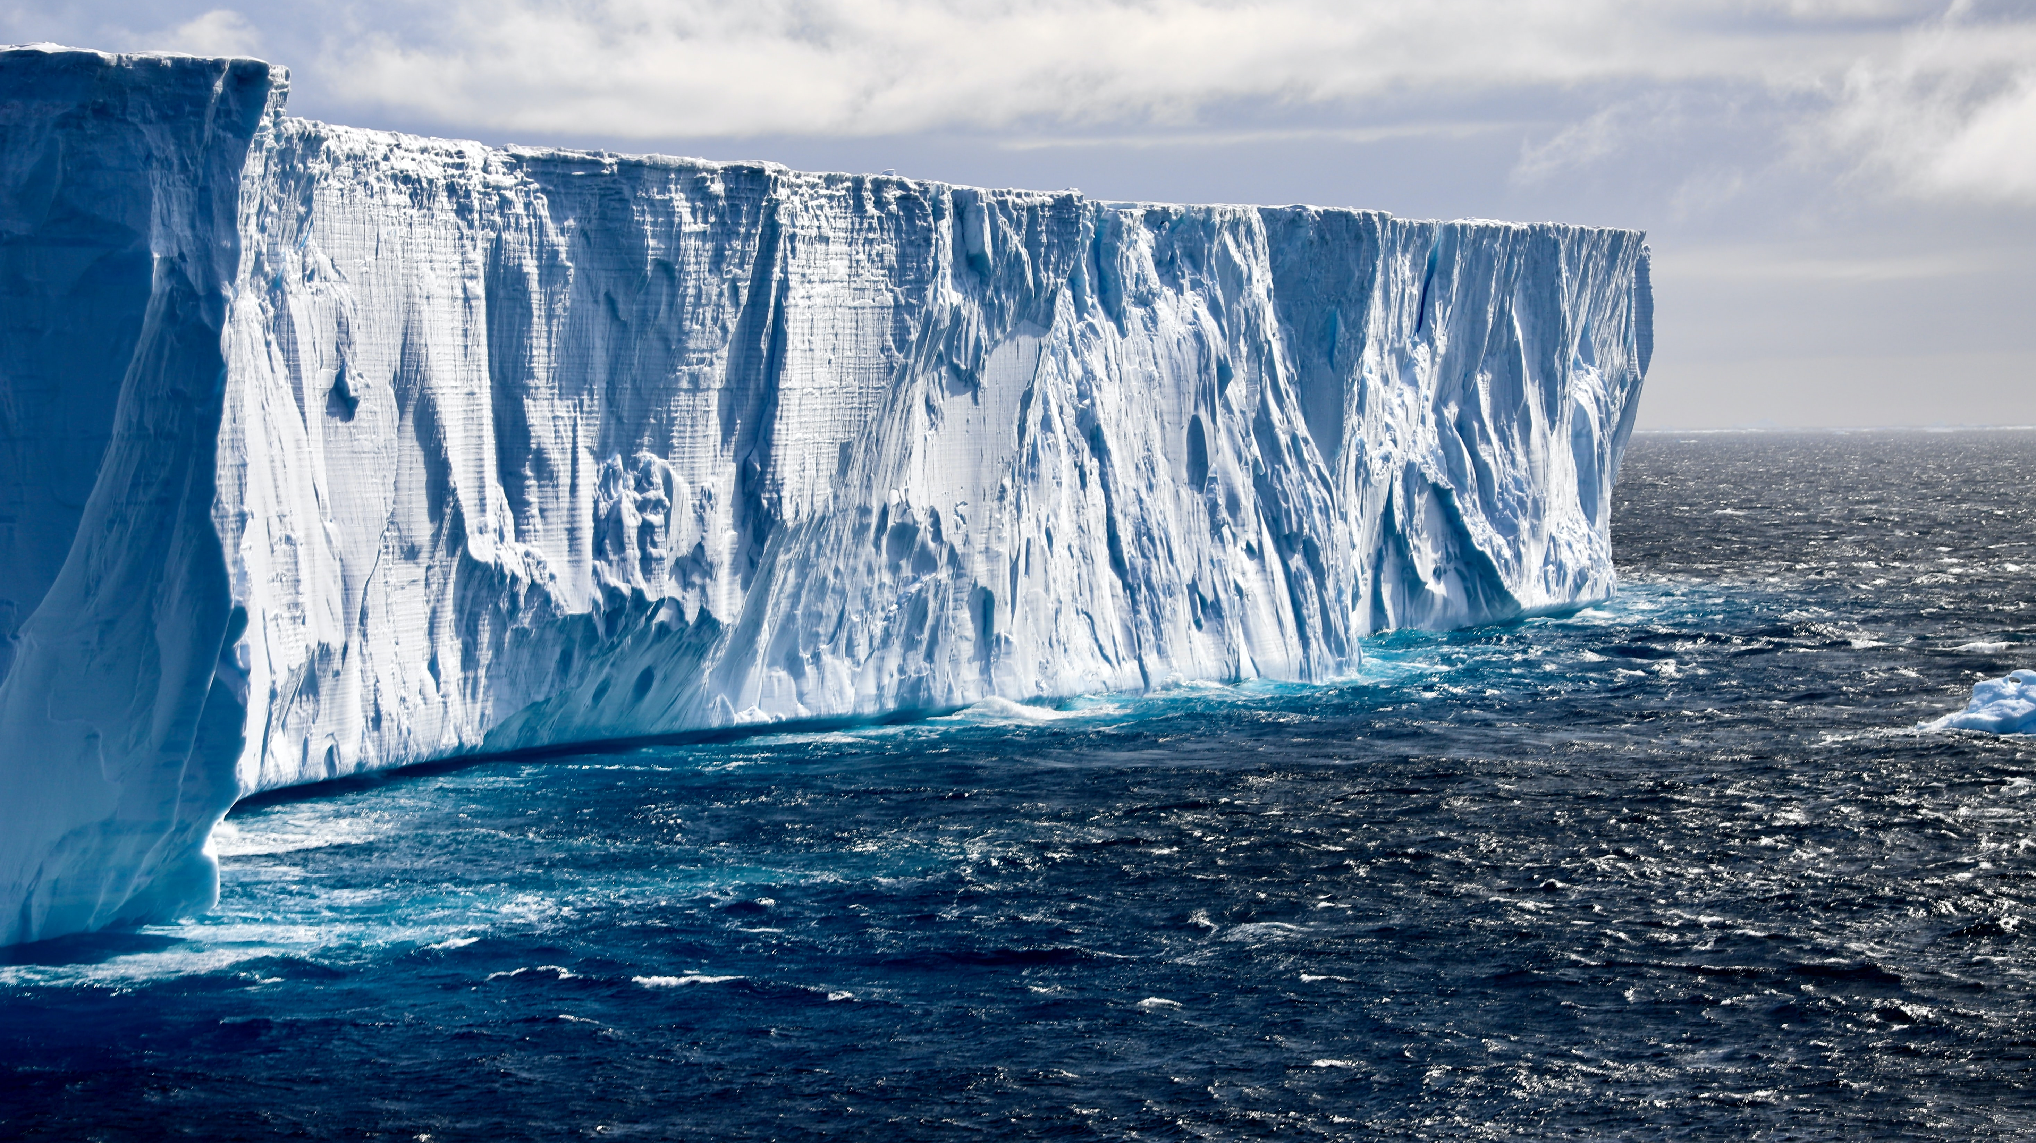
How does climate change in the Cryosphere affects the world’s oceans?
What role do oceans and currents
play in the carbon cycle?
How does climate change affect ocean biogeochemistry?

Slide 4
Key Concepts in Projecting Future Changes Like
Sea-Level Rise

Slide 5
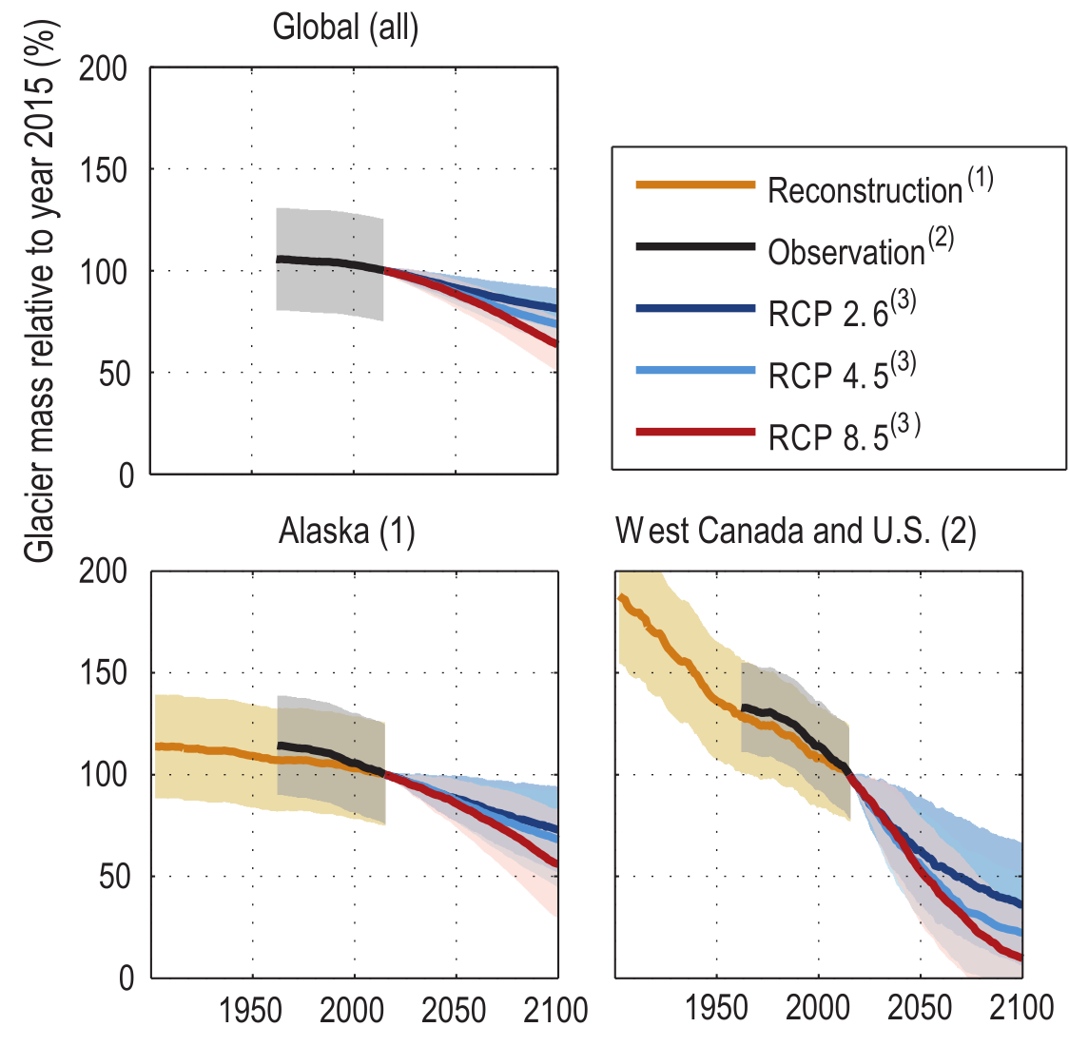
Modeling Future Changes
To understanding climate change impacts, we try to match observations with models.
The more models, the better!
Reconstruction: We can simulate the past to determine how good models predict what we already know.
Scenarios: Or what we think will happen under certain conditions.
IPCC Assessment Report 6 (2021)
Notes:
Many different kinds of models.
If you’re trying to guess the number of pennies in a jar…
…Could get close to the true number by polling a large number of people and taking the average.
e.g., models of glacier mass loss

Slide 6
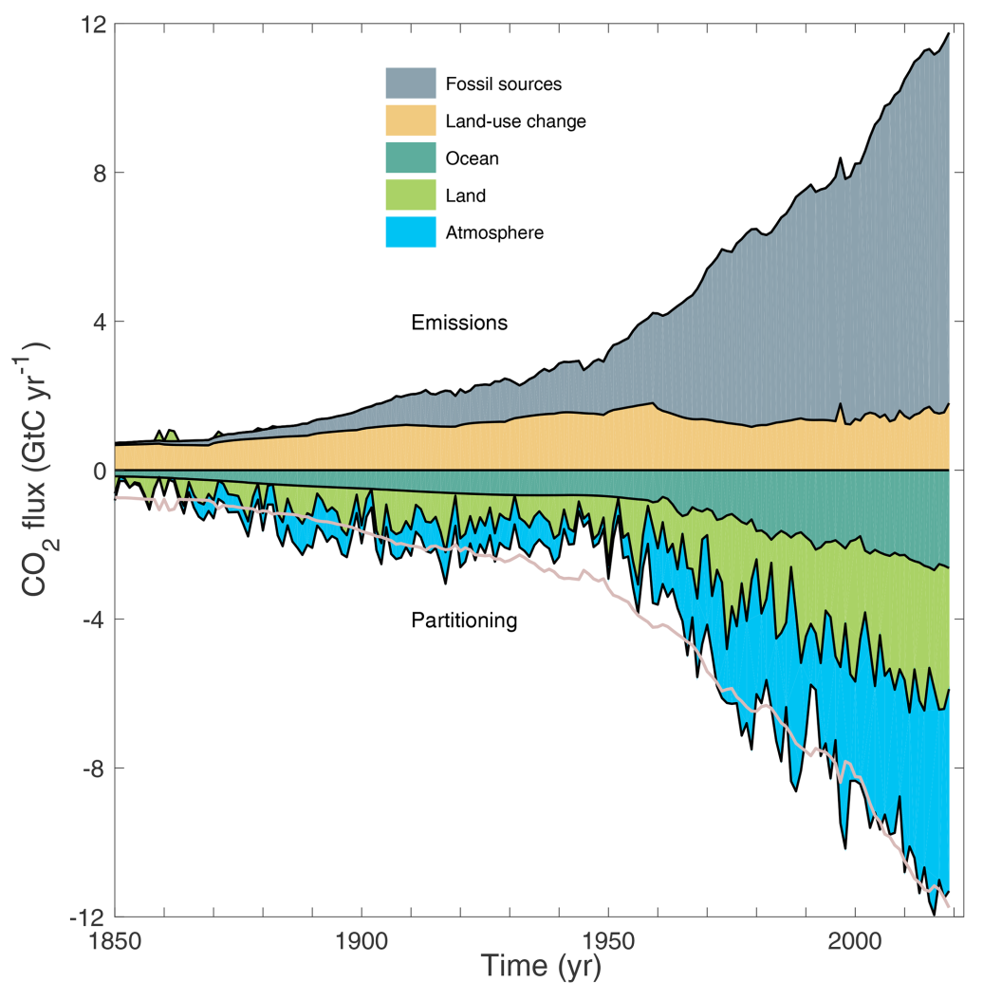
Carbon, Energy, and Mass Budgets
Conservation of energy and mass imply that we can calculate budgets for how carbon or heat are stored (in the oceans).
The budget imbalance is the mismatch between model estimates and observations.
Total emissions
Friedlingstein et al., Global Carbon Budget (2020)
Notes:
If energy and mass are conserved, then we should be able to calculate where all the excess greenhouse gases and their associated heating ends up.

Slide 7
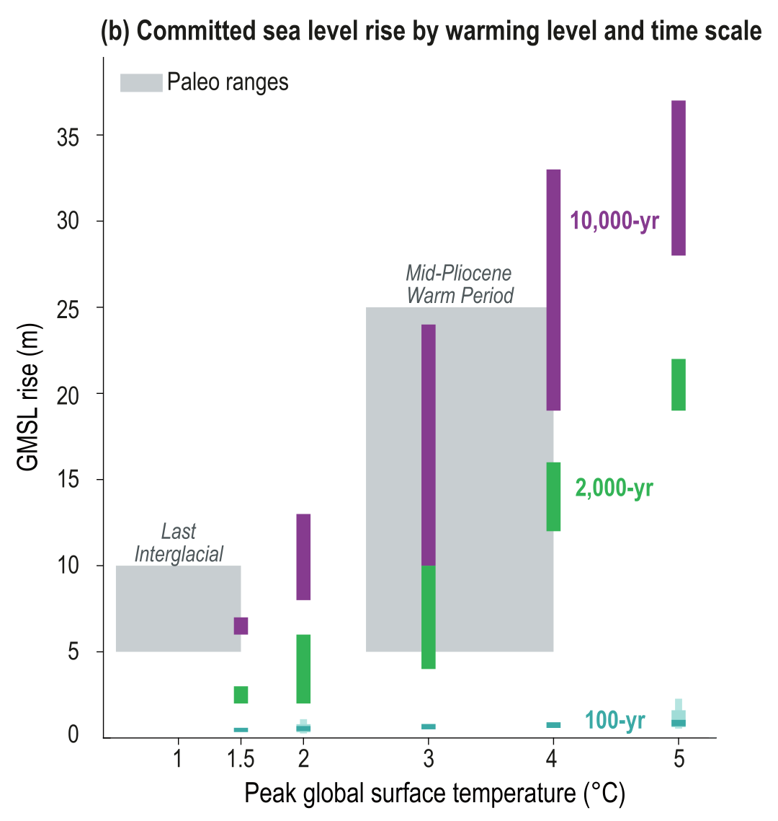
Ice and Sea-Level Rise
Parts of the Earth System respond slowly to climate change; slower than surface temperatures. Consequently, there are already substantial committed changes (“commitments”) caused by GHG emissions!
What will drive future changes in global mean sea level (GMSL)?
IPCC Assessment Report 6 (2021)
Notes:
The slow response of sea level to warming leads to long-term committed sea-level rise, associated with ongoing ocean heat uptake and slow adjustment of the ice sheets, which will continue for millennia after cessation of emissions.
Mid-Pliocene, 2-5 MYA
Last Inter-glacial, 130,000 YA
In the figure, peak global surface temperatures are anomalies, relative to either a 2081-2100 baseline (100-year commitments) or a 1850-1900 baseline. Shaded areas show paleo constraints on temperature and sea-level changes.

Slide 8
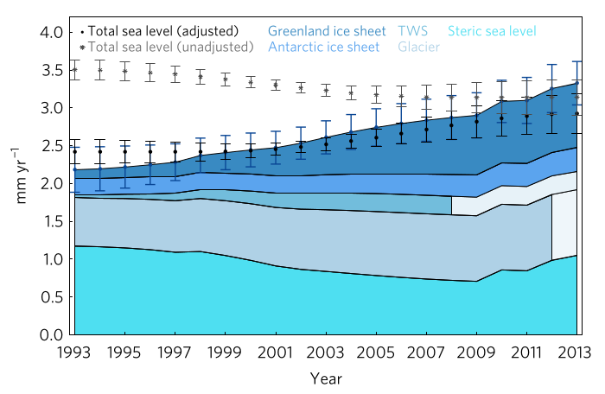
Present Contributions to Sea-Level Rise
Main sources:
Ice sheets
Glaciers on land
Aquifer depletion
Density
changes
(e.g., thermal expansion of water)
Missing anything?
(Glaciers)
Chen et al. (2017, Nature Climate Change)
Notes:
Rate of SLR in 1993 was 2.2 mm y-1; in 2014 it was 3.3 mm yr-1
Sea ice is not included here because the volume of water displaced by sea ice (90% of the ice volume is below the water line) is about equal to the relative density of the ice (91% as dense as water).

Slide 9
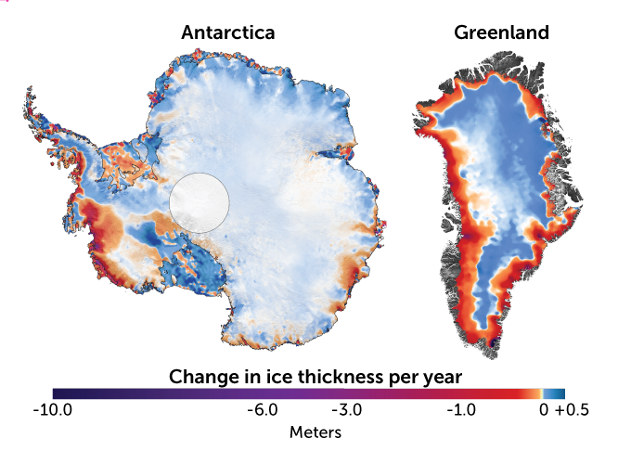
Contribution of Ice Sheets to Sea Level Rise
Antarctic Ice Sheet (AIS)
Greenland Ice Sheet (GIS)
If ALL the land ice melted…
Ice on land | Sea level equivalent (m)
Antarctic (AIS) | 57.9
Greenland (GIS) | 7.4
All other ice | 0.3
Left: Smith et al. (2019, Science) and ScienceNews.org
Table: Morligheim et al. (2017, 2019) and Farinotti et al. (2019)
Notes:
Big question for Greenland: Contribution dominated by surface melt or calving?
If dominated by calving, under moderate warming, Greenland might contribute only 3 cm before 2200
Most extreme scenario: Greenland might contribute 6.3 inches to SLR by 2100

Slide 10
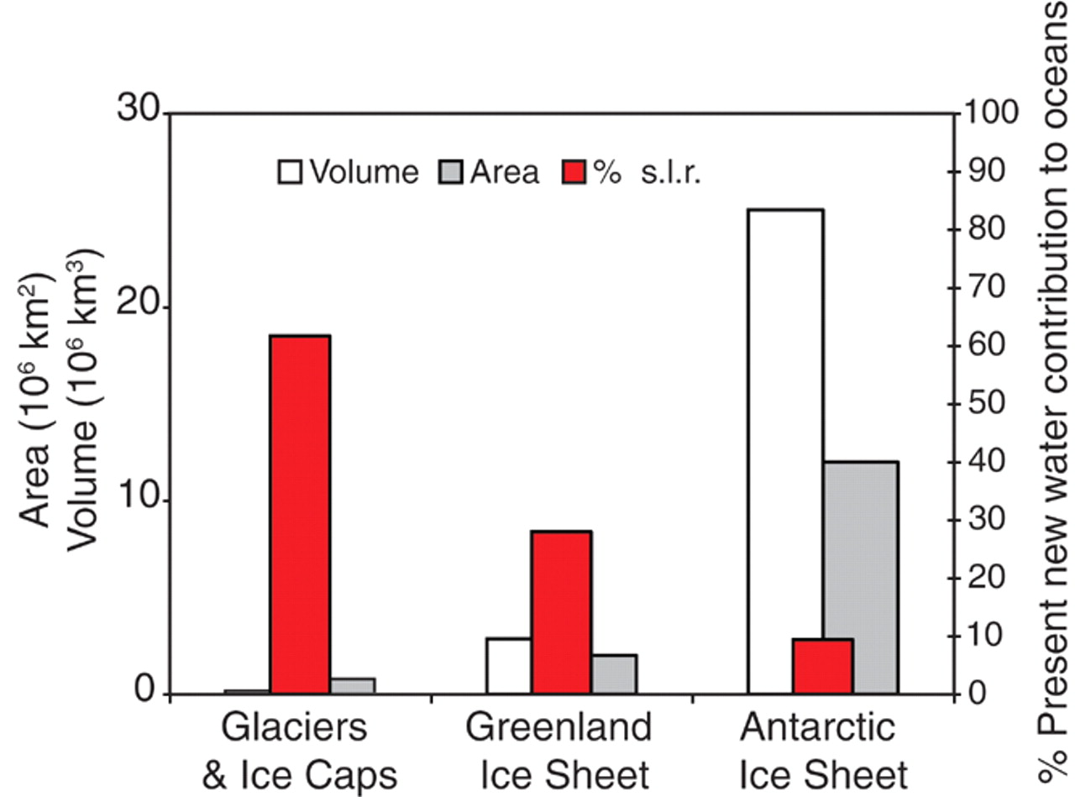
Antarctic Ice Sheet (AIS) Stable So Far…
Though it contains far more ice, AIS has so far contributed the least to sea level rise.
Since 1992…
Greenland ice sheet
(GIS) melt: 13.5 mm s.l.r.*
AIS melt: 7.4 mm s.l.r.
*sea level rise
Chen et al. (2017, Nature Climate Change)
Meier et al. (2007, Science)

Slide 11
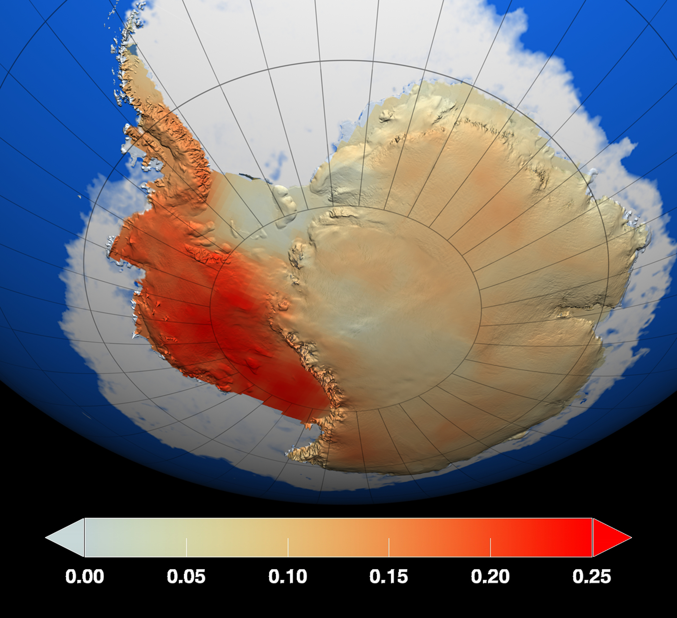
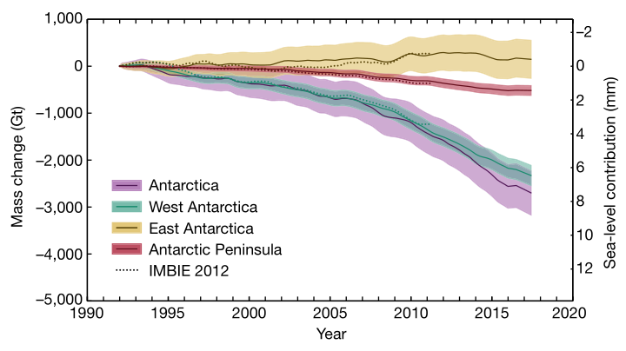
Why is GIS Melting Faster than AIS?
Recall that Arctic (including Greenland) is warming 3x faster than rest of the globe!
High elevation of Eastern AIS?
IMBIE (2018, Nature)
Surface Temperature Trend (1957-2009, deg C)
Steig et al. (2009, Nature)
Notes:
Eastern AIS has been stable for decades! Average surface temperatures, too!
Where temperatures have increased is very revealing…
…West Antarctica and the Antarctic Peninsula; because of their elevations, their climate is impacted by sea ice-atmosphere feedbacks.
Sea ice cover reduces the transfer of heat from ocean to atmosphere in winter
Also reduces the amount of solar energy absorbed by the ocean

Slide 12
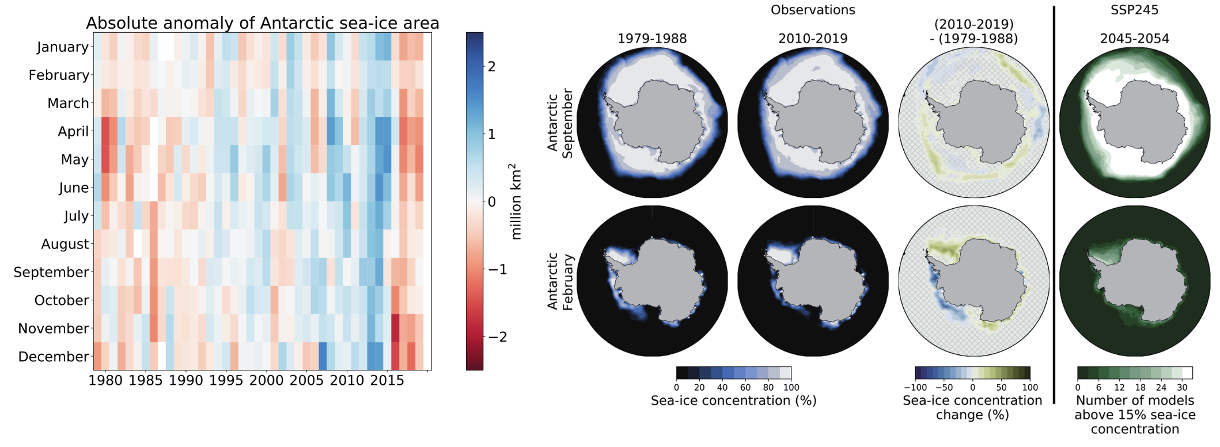
Stable and Growing Antarctic Sea Ice?
“No significant trend in annual mean Antarctic sea-ice area over the period of reliable satellite retrievals starting in 1979 (high confidence).”
IPCC Assessment Report 6 (2021)
Notes:
Between 2005 and 2015, we actually saw several years in which Antarctic sea ice area increased.

Slide 13
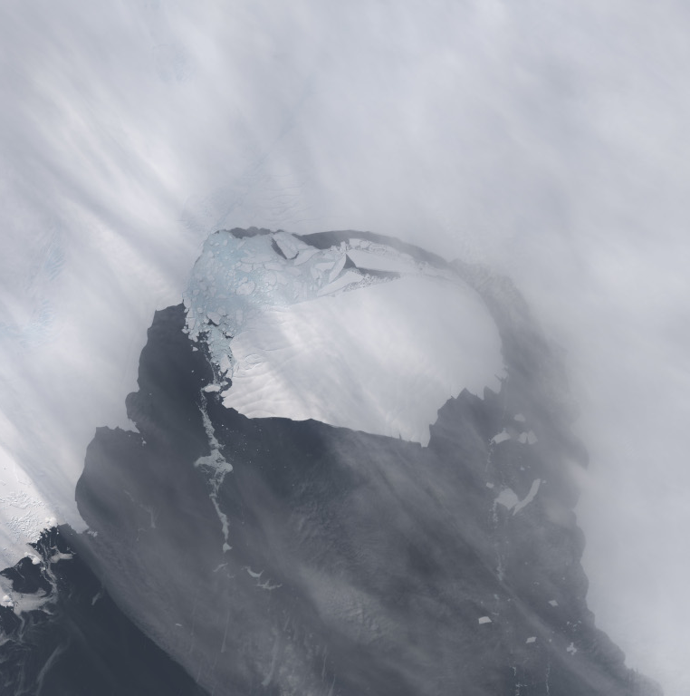
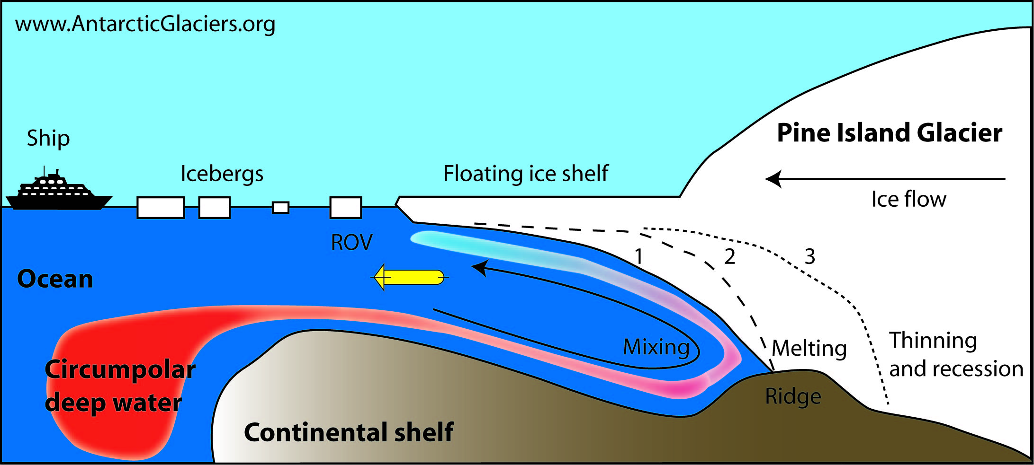
If ice shelves are deteriorating, why is Antarctic sea ice growing?
Meltwater from ice shelves cools and freshens the Southern Ocean, increasing stratification and insulating sea ice, promoting growth.
35 km
Pine
Island Glacier
Notes:
In 2020, a massive iceberg calved off of Pine Island Glacier; about as large as the Missoula valley
Pine Island Glacier itself is now moving at speeds of up to 33 feet per day
Circumpolar deep water is to blame
As ice shelves melt: cool freshwater is released; combine with floating icebergs, this serves to insulate sea ice, promoting ice growth
In some parts of Southern Ocean, layer of cold freshwater is 100 m thick
What’s another reason that surface freshwater might promote sea ice formation?

Slide 14
Climate Surprises: A New Low
“We never thought extreme events could happen here.”
Notes:
Lowest winter extent of sea ice in recorded history! 1.5 million km² less ice than this time last year.
Because of the connection between sea ice cover and Western Ice Sheet temperatures, we may be entering a period of greater AIS ice mass loss

Slide 15
Impacts of Sea-Level Rise on Human Societies

Slide 16
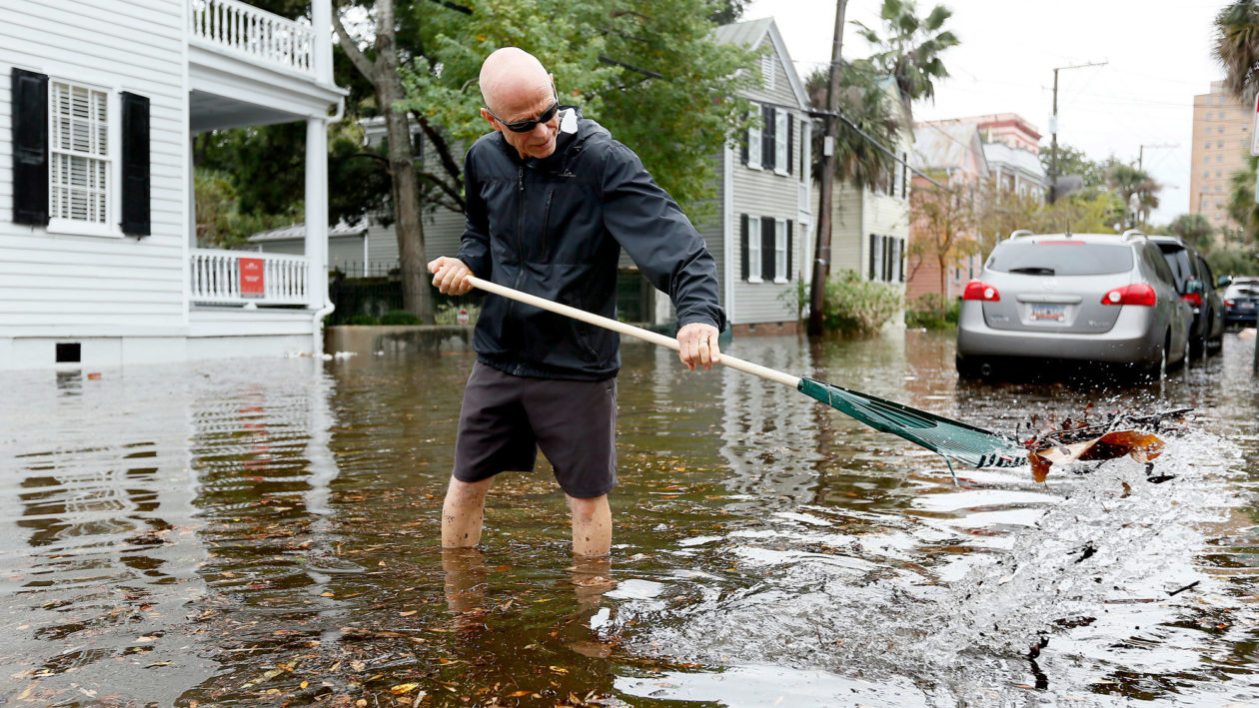
“Blue sky flooding:” rising waters regardless of precipitation, due to high tides; Charleston, SC now has 50 sunny-day floods a year.
Yale Environment 360

Slide 17
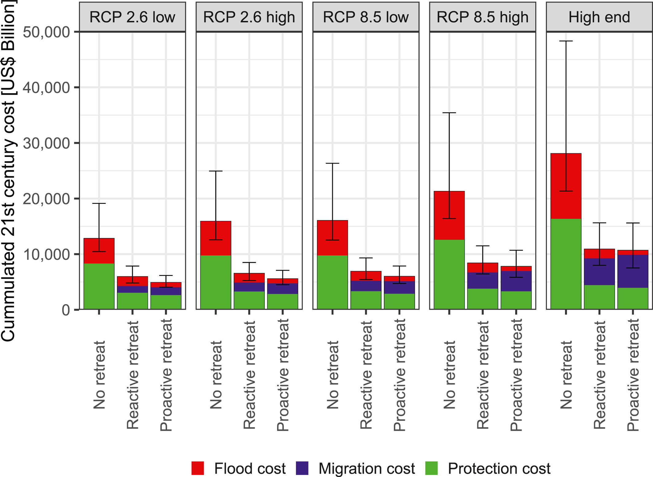
Future Sea-Level Rise (SLR)
By 2100, total SLR
could be:
+1.3 ft (RCP 2.6/ +1.8°C) +2.6 ft (RCP 8.5/ +3.7°C)
Only 3-13% of the global coastline is likely to be defended.
IPCC Assessment Report 6 (2021);
Lincke & Hinkel (2018, 2021)
Notes:
Defending against SLR is expensive!
When Boston’s mayor proposed an artificial harbor wall to protect the City they found it would cost $30 million dollars a year!
Consequently, no more than 13% of global coastline is likely to be defended
Cost of SLR can be cut in half by migration away from coastal areas
Migration rates could be as high as 72 million people, but this is less than previously thought now that local adaptation is being considered

Slide 18
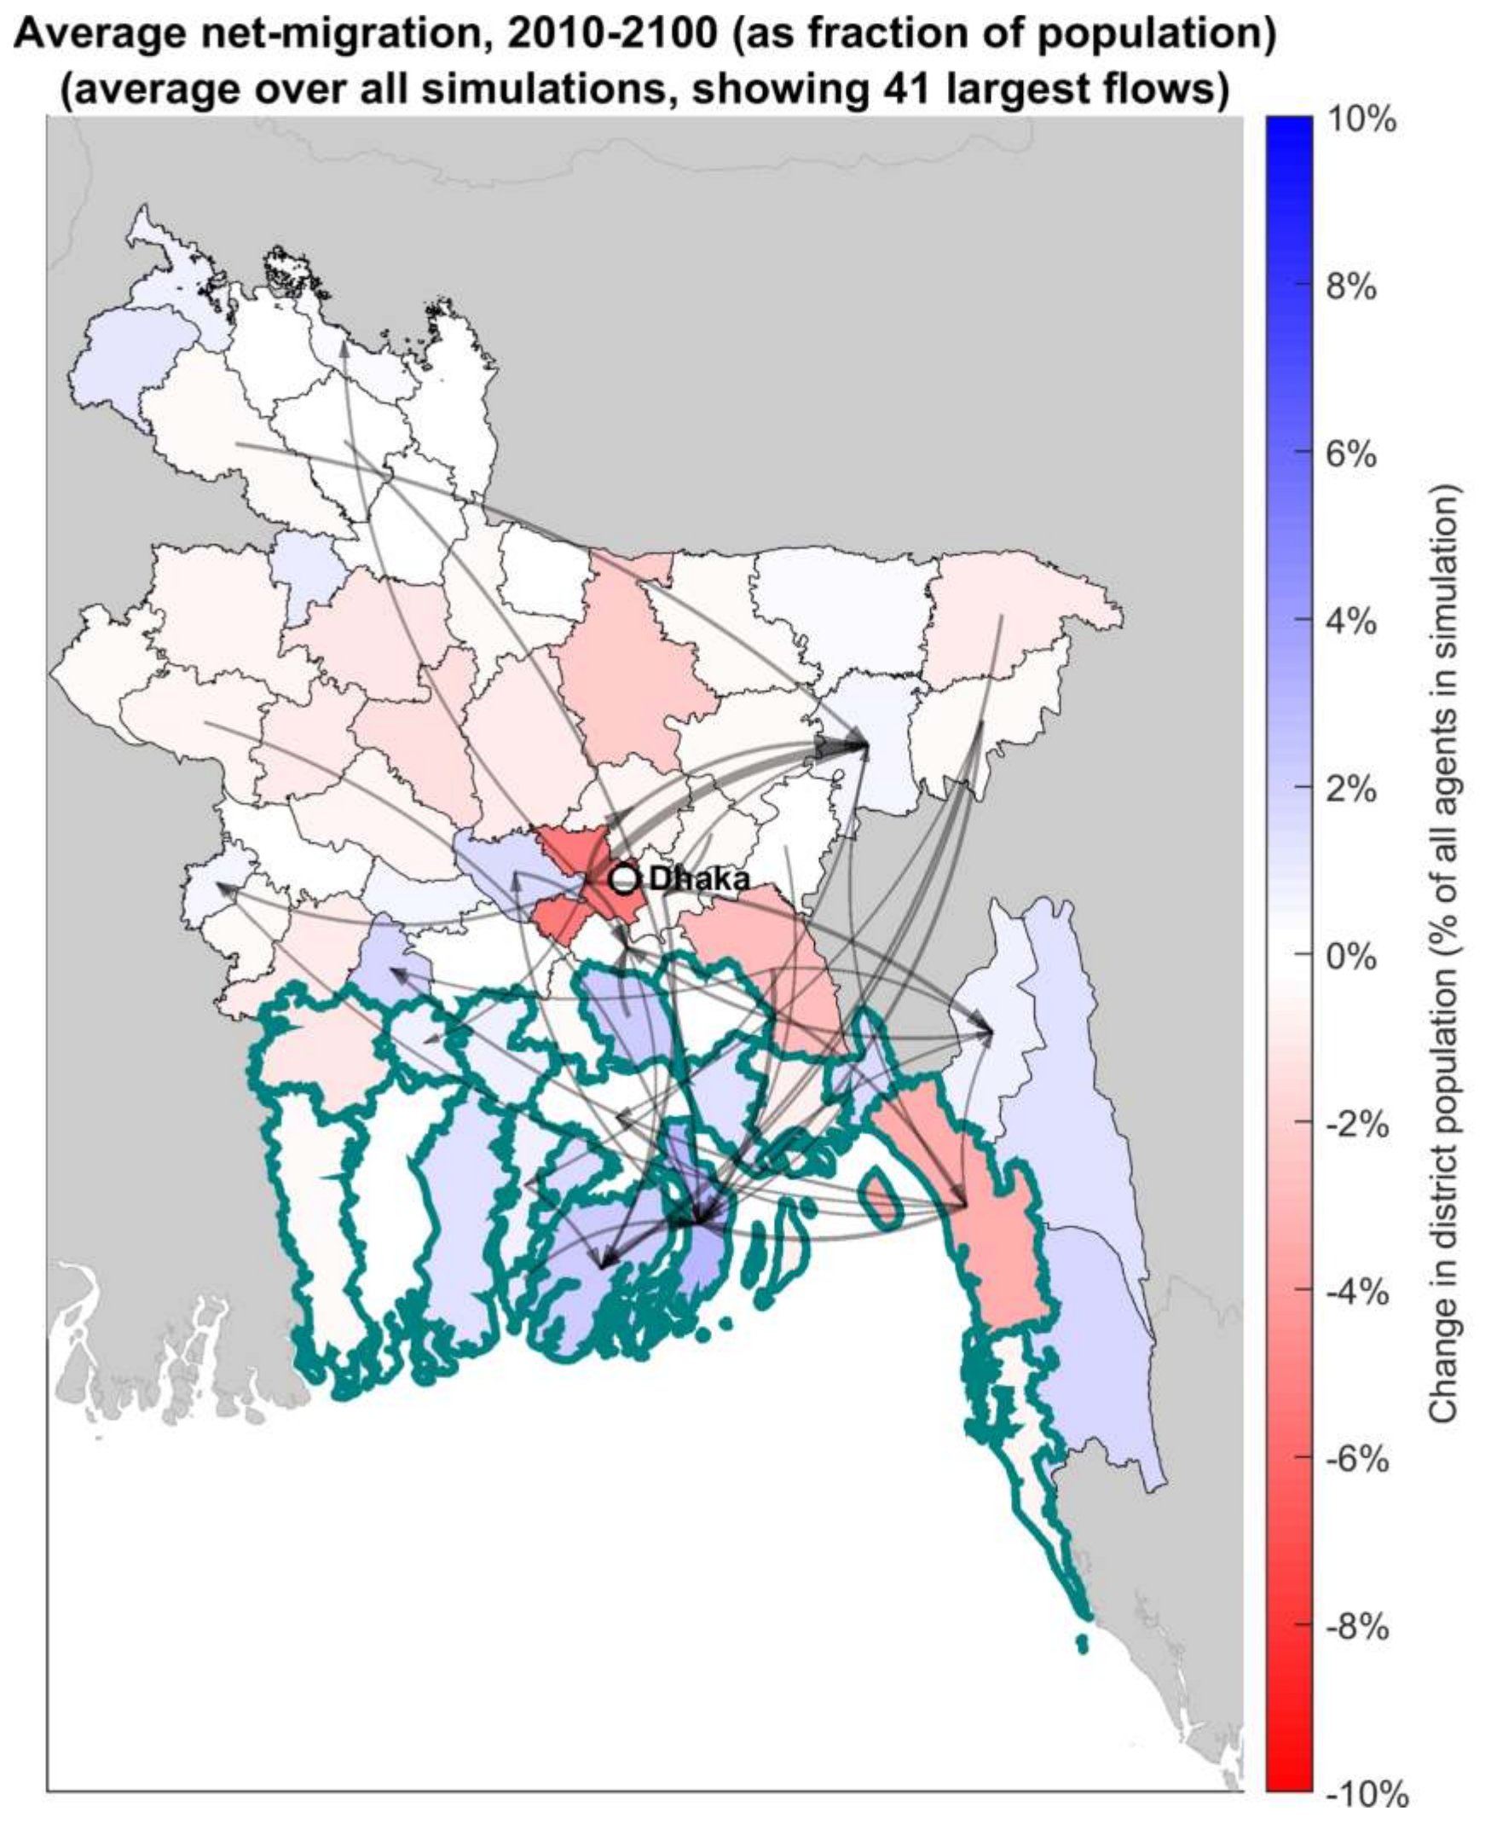
But Migration to
Coastal Cities
Could Keep Rising
What are some of the push/ pull factors that could drive net migration to coastal cities, despite rising floodwaters?
Bell et al. (2021, Env. Research Letters)
Notes:
“One reason is that while flooding does accelerate a transition from [ag to non-ag] income…” these opportunities are most abundant in coastal cities.
“Trapped populations”

Slide 19
Ocean Circulation and the Carbon Cycle

Slide 20

The world’s oceans store 50 times more carbon than the atmosphere.
Where does ocean-absorbed CO₂ end up?

Slide 21
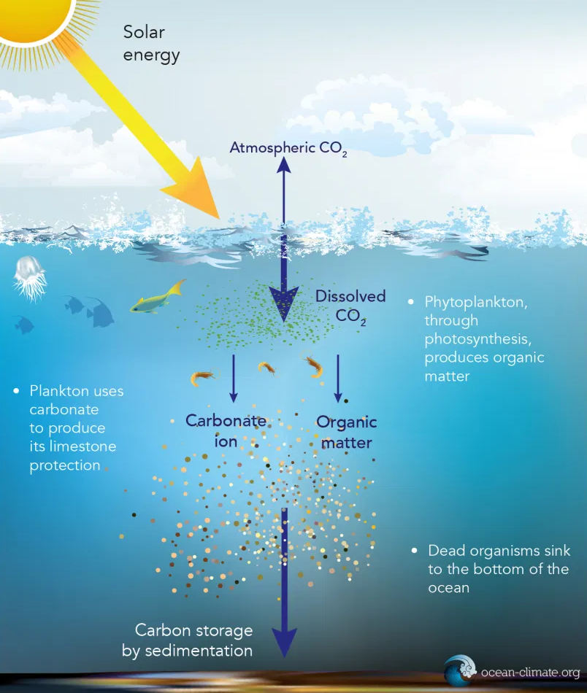
Biological C Pump
C on ocean floor can be sequestered for millions of years!
When trying to explain historical changes in atmospheric C, we first look to the ocean carbon cycle.

Slide 22

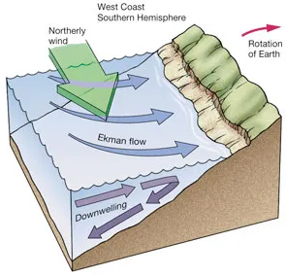
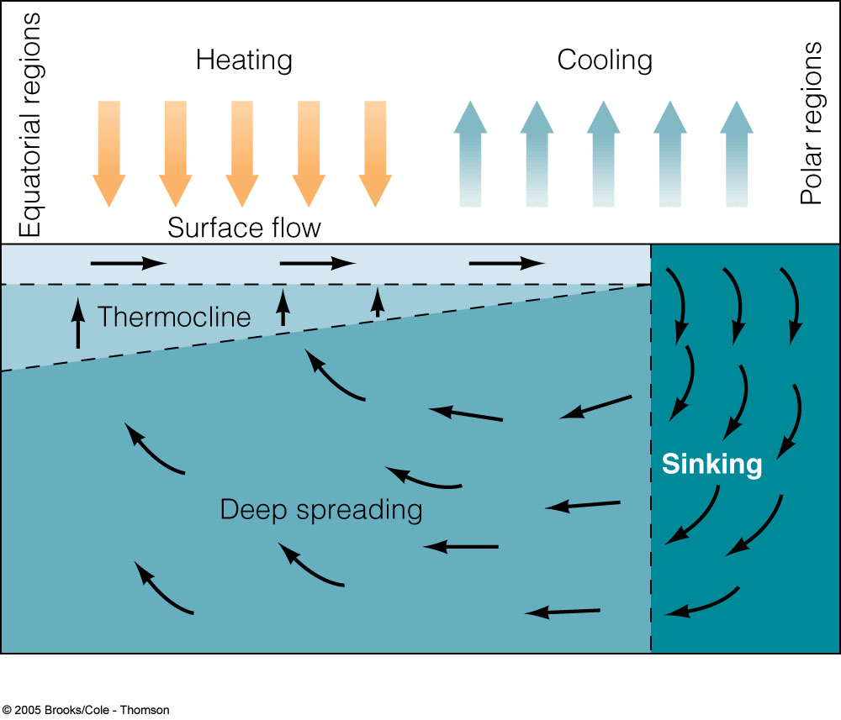
Physical C Pump (Thermohaline Circulation)
Evaporation
Halocline
Dissolved C
It’s the
Coriolis effect!

Slide 23
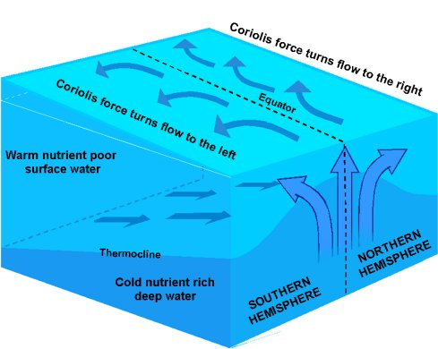
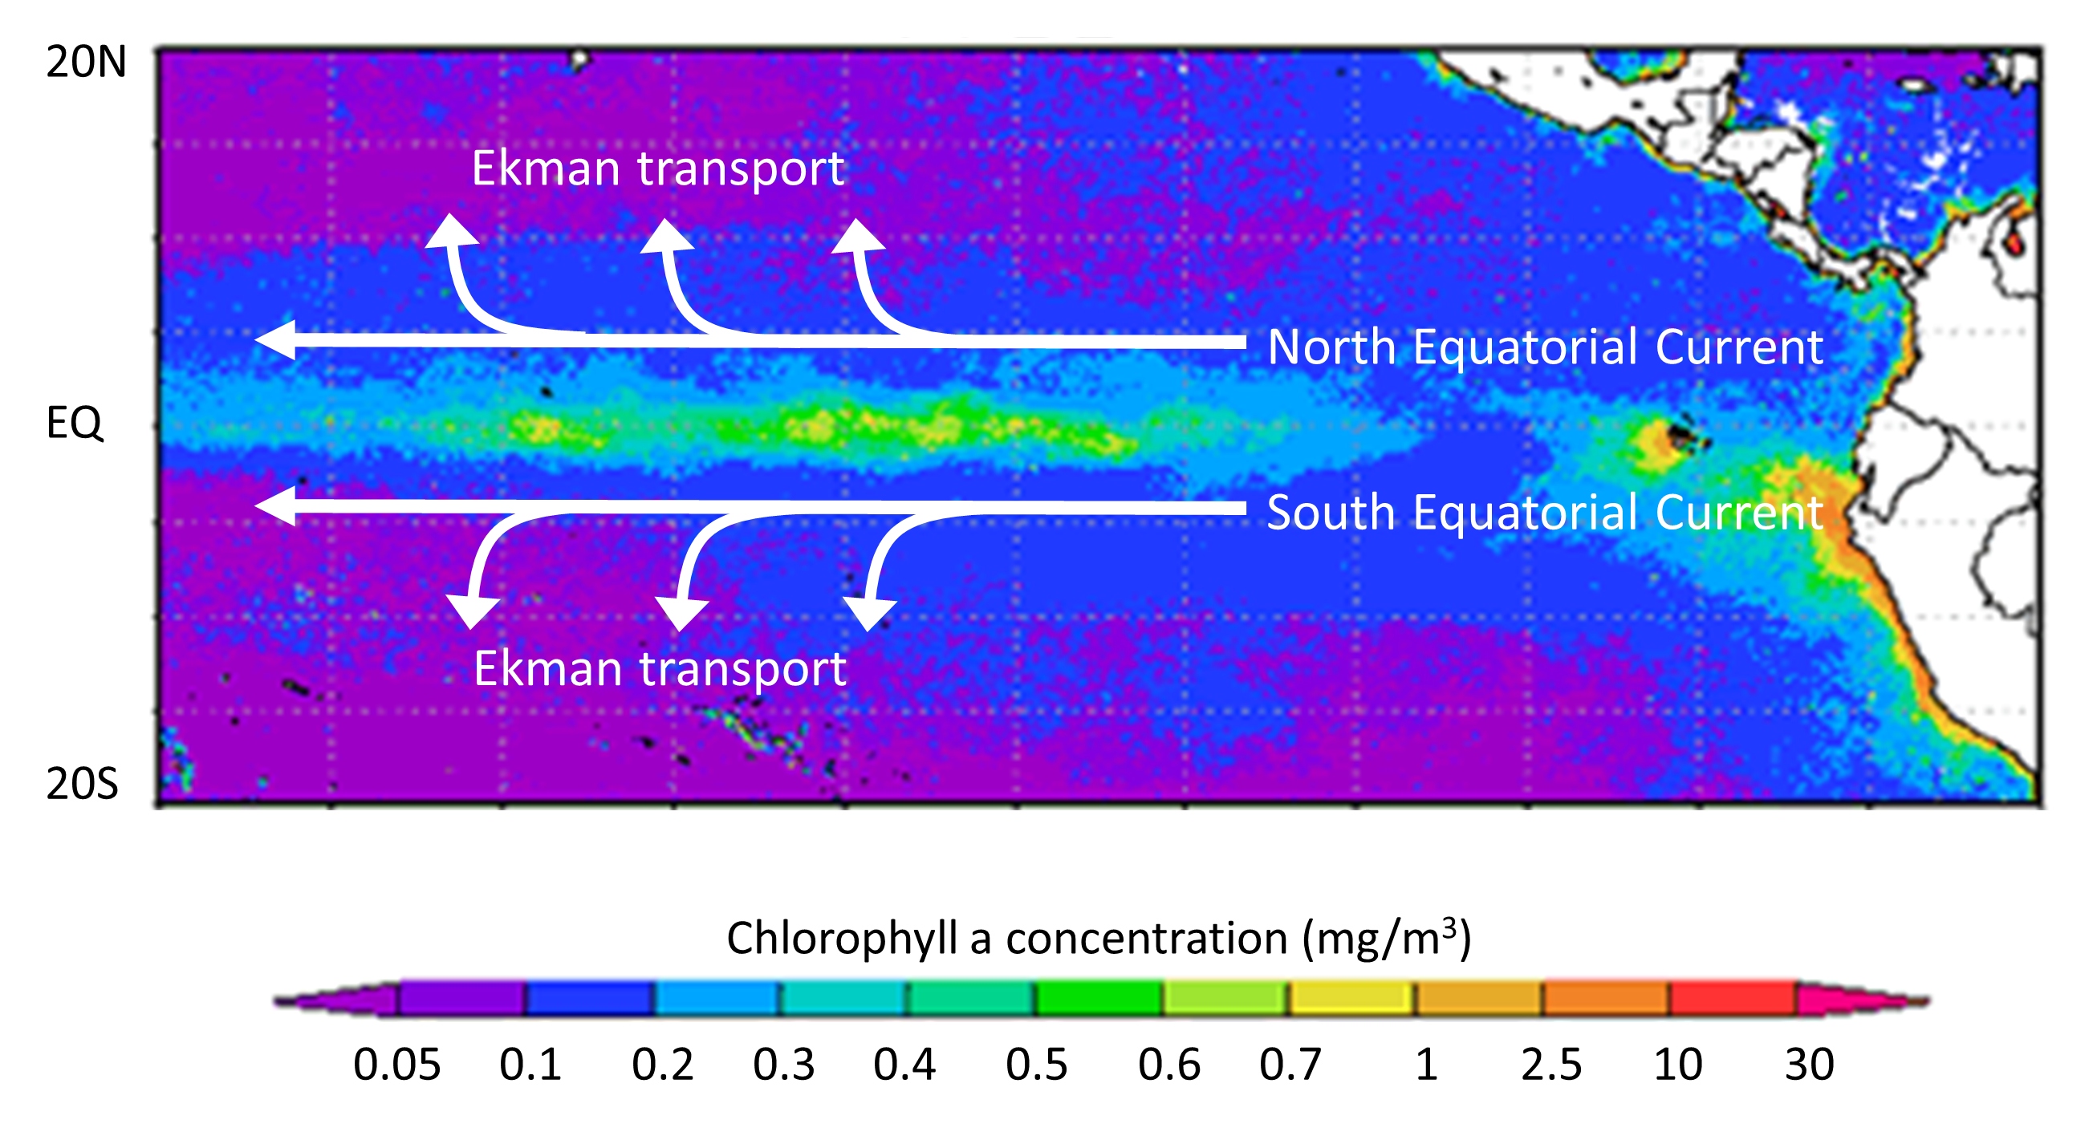
Upwelling of Critical Nutrients
20 N
20 S

Slide 24
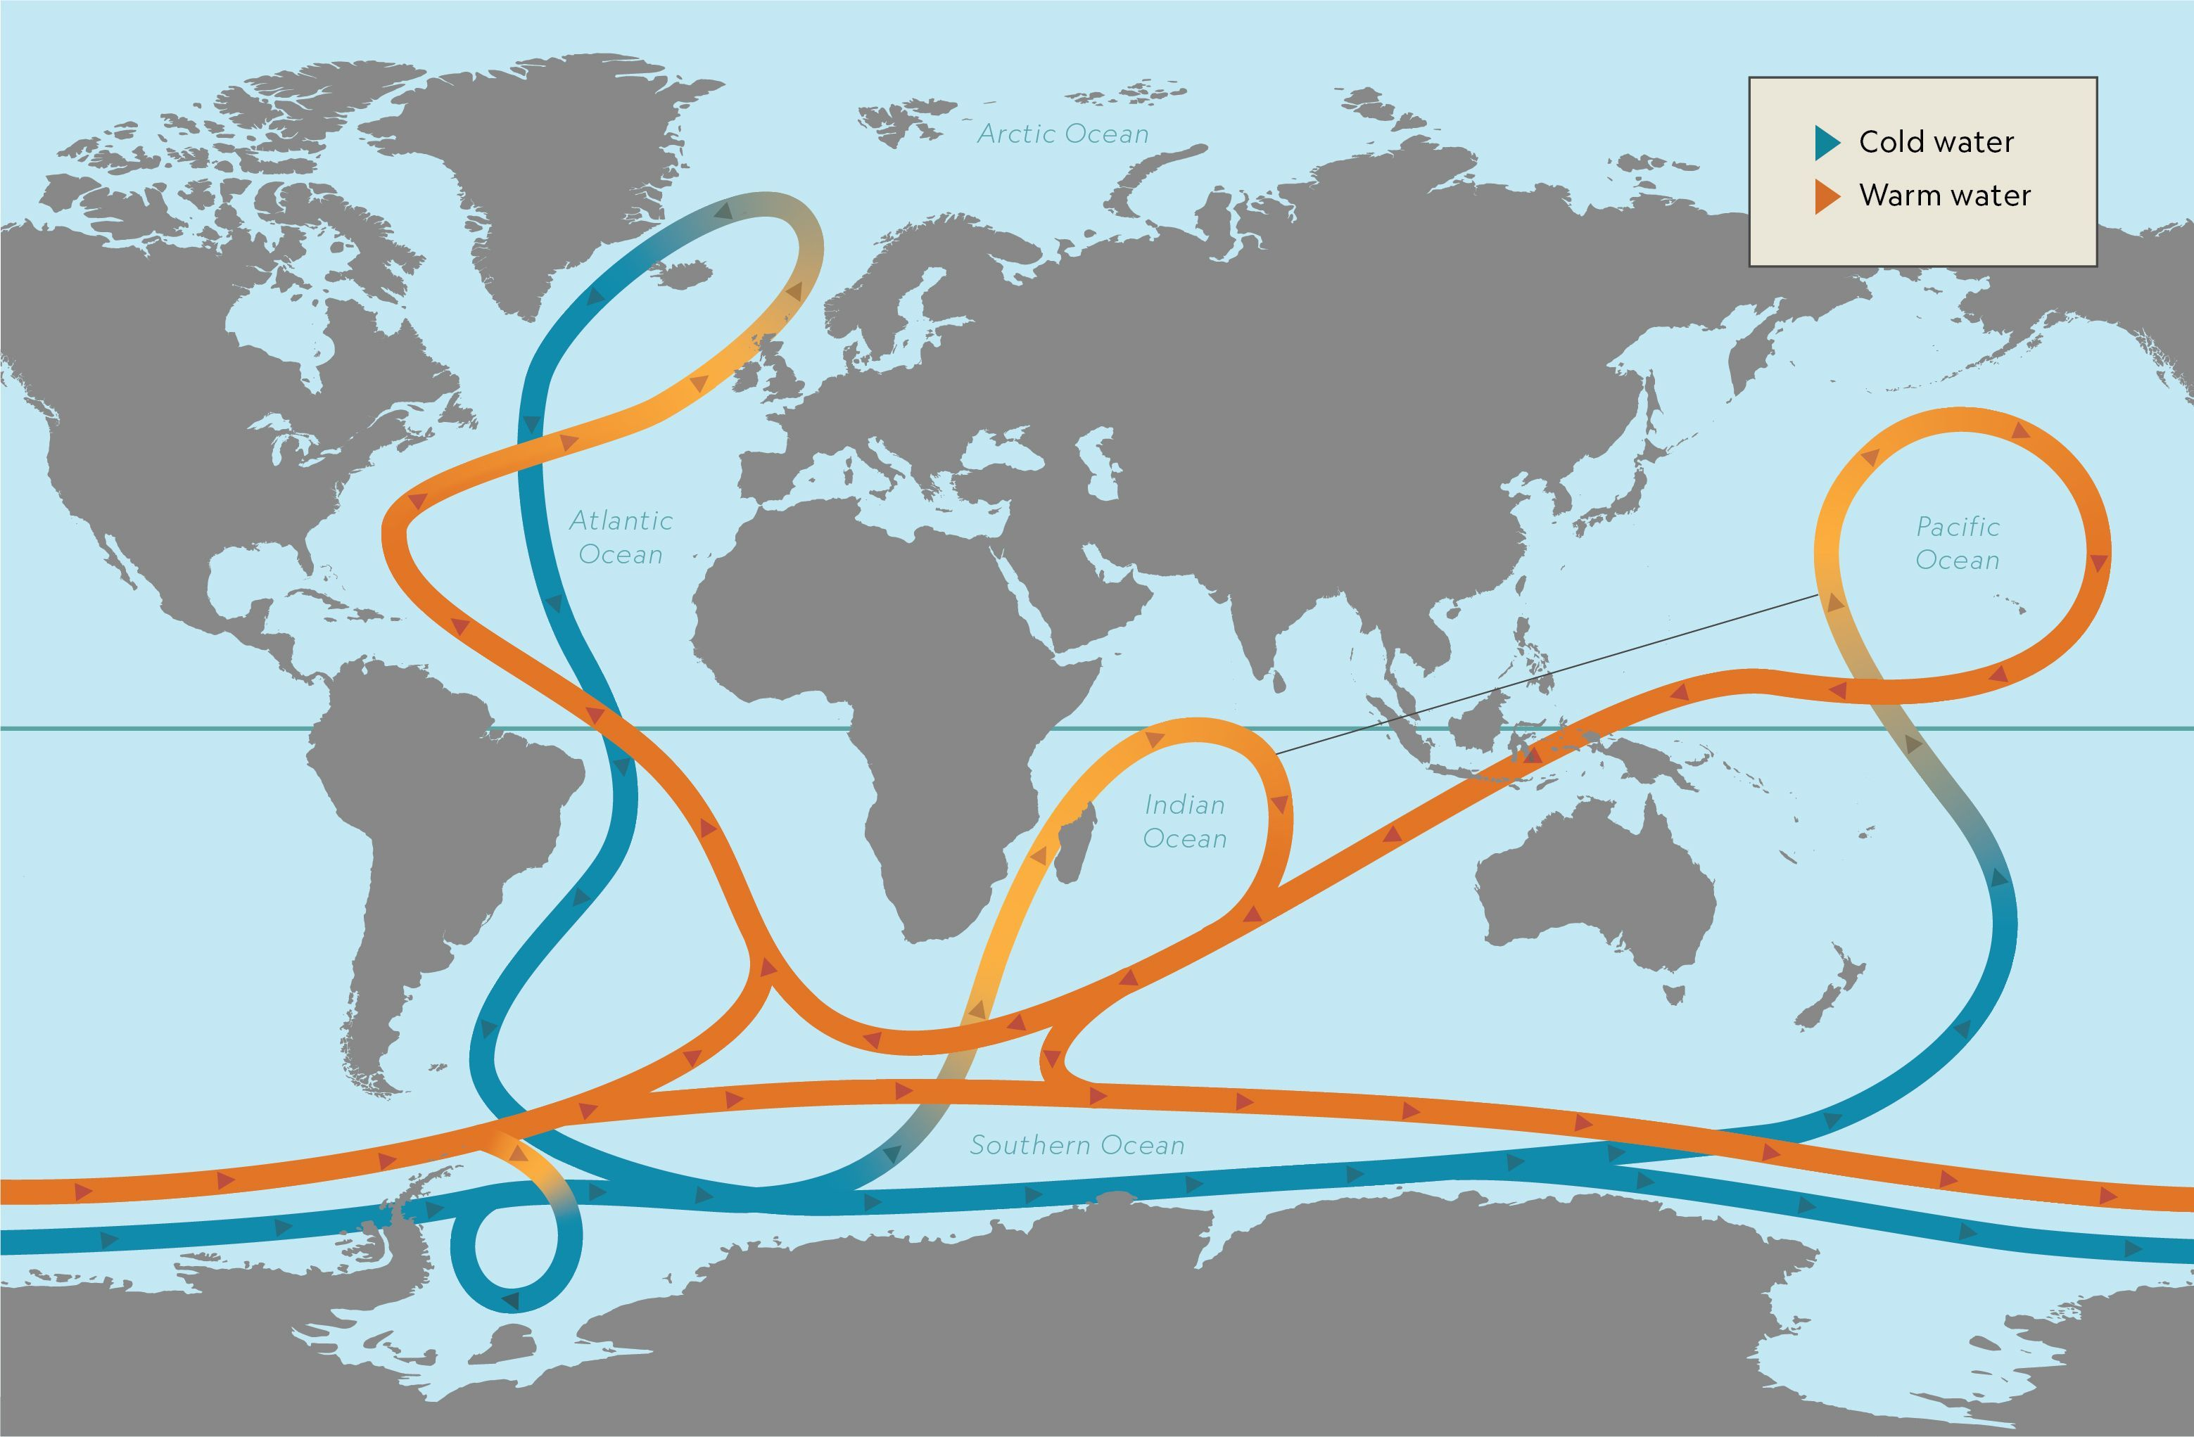

Slide 25



Changes in Ocean Temperature, Salinity, and Acidity

Slide 26
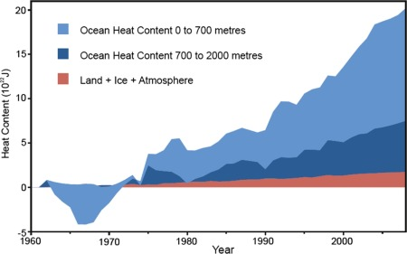
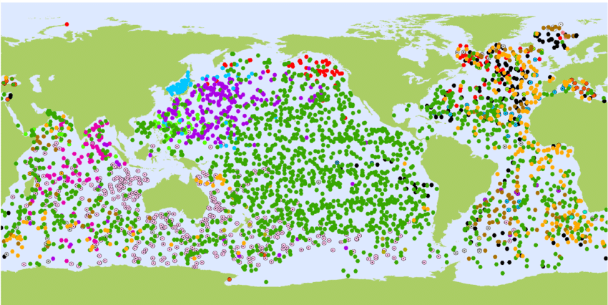
Rising Ocean Temperatures
Oceans dominate Earth’s changing heat budget because of the high heat capacity of water (and they cover 70% of Earth’s surface).
Intuition: Has anyone lived in a coastal city?
Nucitelli et al. (2012, Physics Letters A)
Levitus et al. (2012, Geophysical Research Letters)
Notes:
Because of their higher heat capacity, oceans can hold 700 times more heat than the atmosphere

Slide 27
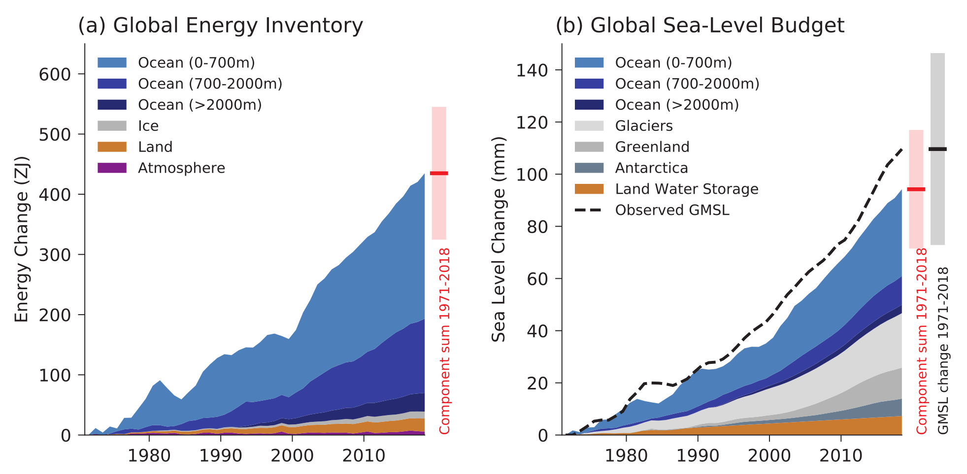
Oceans Absorbed 90% of GHG Warming
IPCC Assessment Report 6 (2021)
Notes:
Since 1950

Slide 28
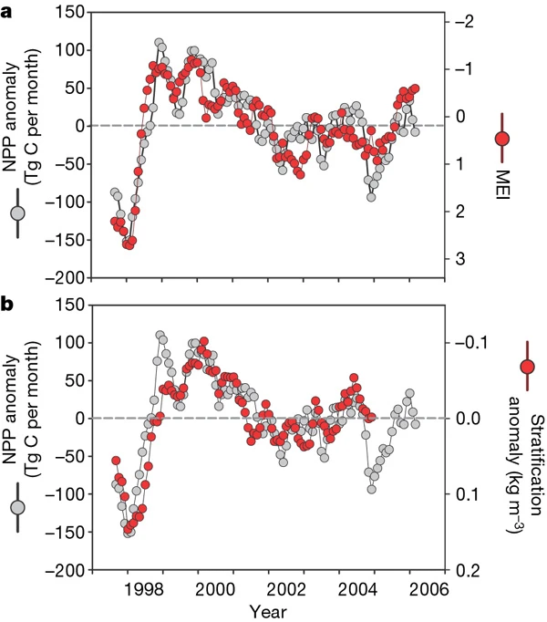
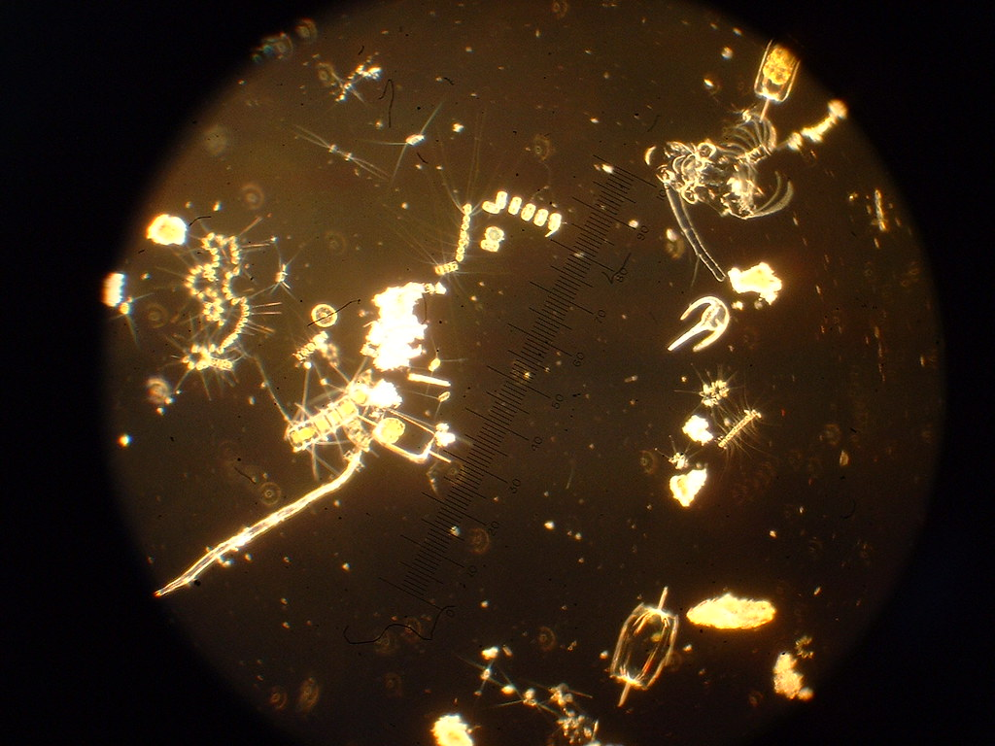
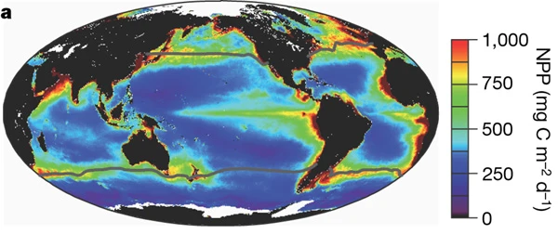
Productivity Linked to Ocean Temperatures
In seas that are warming the fastest, particularly near the equator, declines in phytoplankton productivity are associated with warming events.
Behrenfeld et al. (2006, Nature)
Notes:
What do you notice about the zones of highest productivity?
As surface waters warm, they become less dense, enhancing the contrast between the surface and deeper water
This enhanced stratification suppresses vertical mixing, limiting nutrient exchange

Slide 29
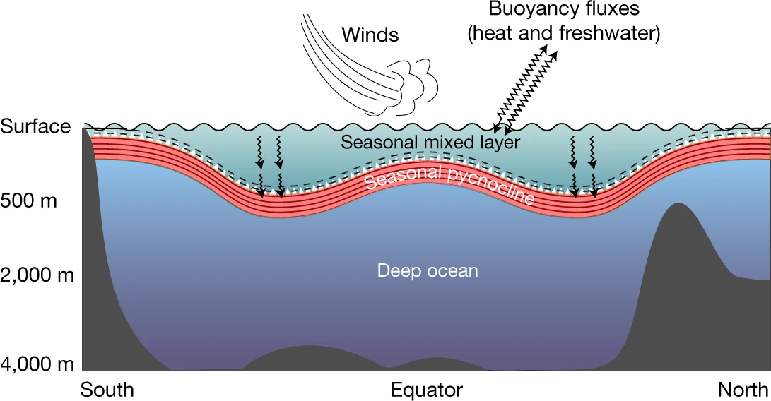
Increasing Stratification, Inhibited Mixing
Stronger stratification → Harder to mix layers
(less nutrient and oxygen upwelling)
Deeper mixed layer → ??? (Counteracts stratification? Negative climate feedback? Or creates poor light conditions for primary productivity?)
Sallée et al. (2021, Nature)
Notes:
Despite increased stratification, there’s evidence that the mixed layer is deepening.
What are the consequences of this change? The surface layer is the most productive layer in the ocean.

Slide 30
Atlantic Meridional Overturning Circulation (AMOC)
Notes:
Another consequence of global surface ocean warming is that the general circulation of the world’s oceans could be disrupted!

Slide 31
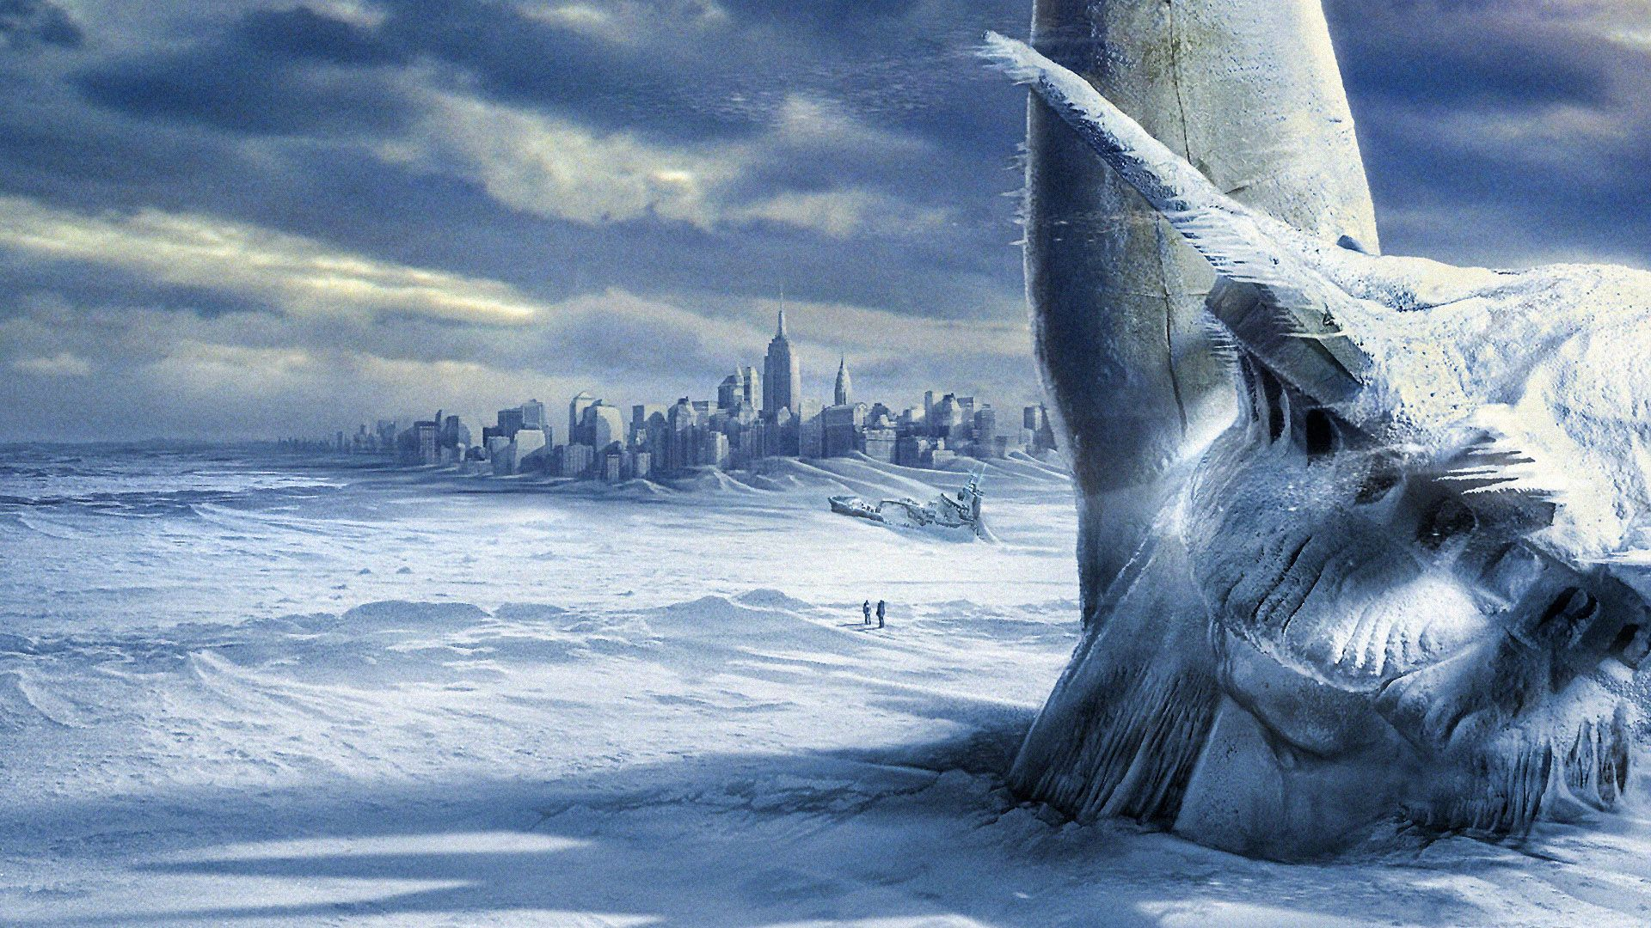
Coming to a Planet Near You?

Slide 32
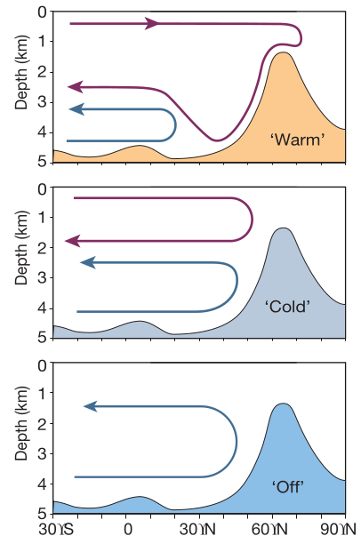
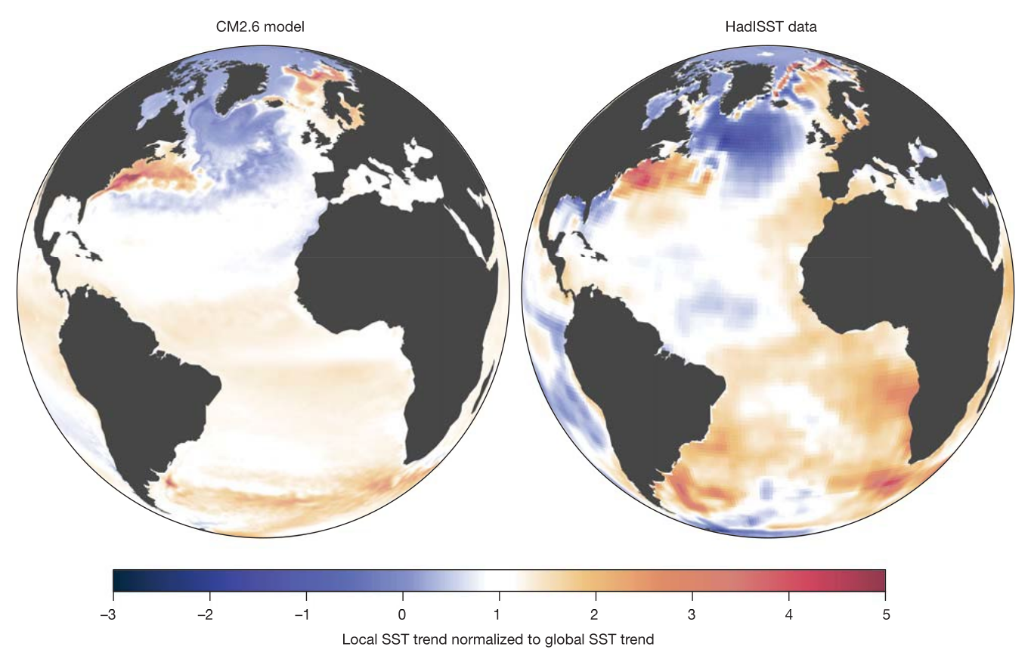
Disruption of Atlantic Ocean Circulation?
Trends Modeled by Rising Atmospheric CO2
Observed SST Trends: 1870-2016
Warm Gulf Stream →
Rahmstorf (left, 2002); Caesar et al. (right, 2018)
Notes:
Warming surface waters and increased freshwater inputs into the North Atlantic may disrupt the AMOC.
Topographic rise in the plot on the left is a shallow sill between Greenland and Scotland.

Slide 33
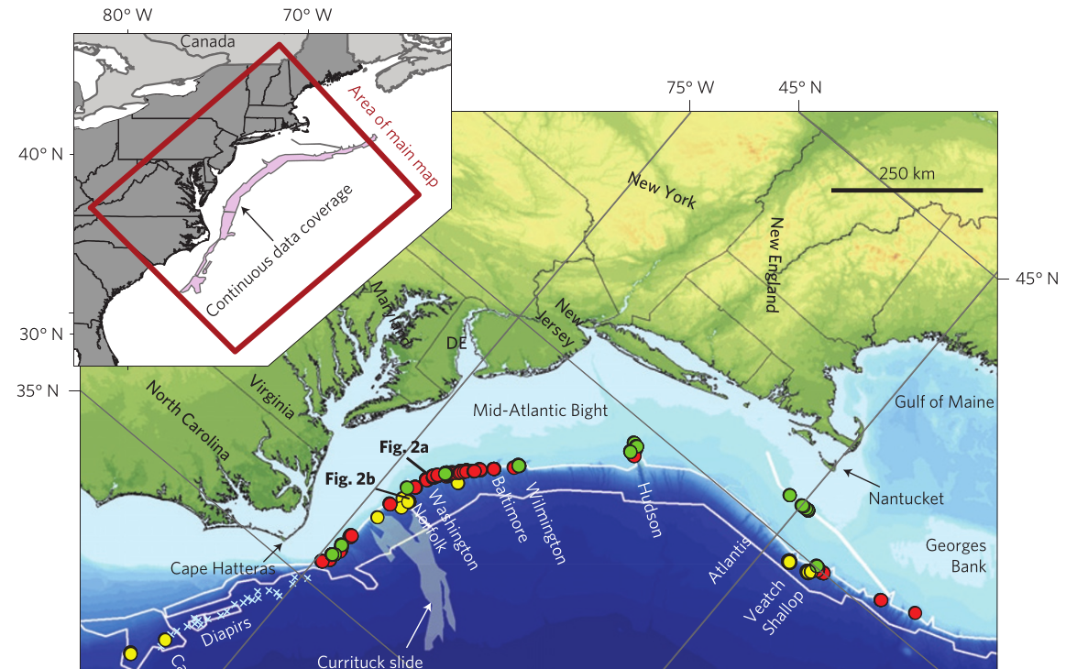
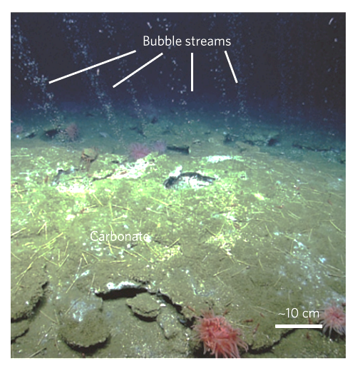
Some Effects of AMOC Collapse
Less precipitation in northern mid-latitudes¹
Strengthening of the North Atlantic storm track¹
Northward migration of Gulf Stream^{2,3}
¹Jackson et al. (2015); ²Caesar et al. (2018); ³Skarke et al. (2014)

Slide 34
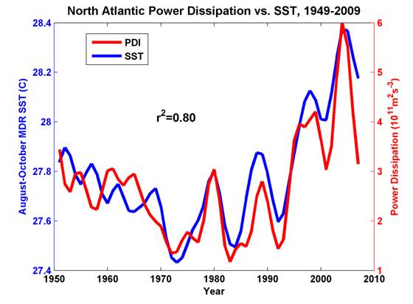
Ocean Temperatures and Tropical Cyclones
The billion(s of dollars) question:
Have warmer ocean temperatures contributed to extreme weather?
Cyclone frequency:
No trend, likely decrease globally; slight increase in North Atlantic^{1,2,3}
Cyclone intensity (wind speeds):
Likely increase³
Precipitation rates:
Likely increase³
Sea Surface Temperature (SST)
Total Cyclone Energy
¹Patricola & Wehner (2018, Nature); ²Walsh et al. (2015);
³Knutson et al. (2010, Nature Geoscience)
Kerry Emanuel (2005); Coumou and Rahmstorf (2012)

Slide 35
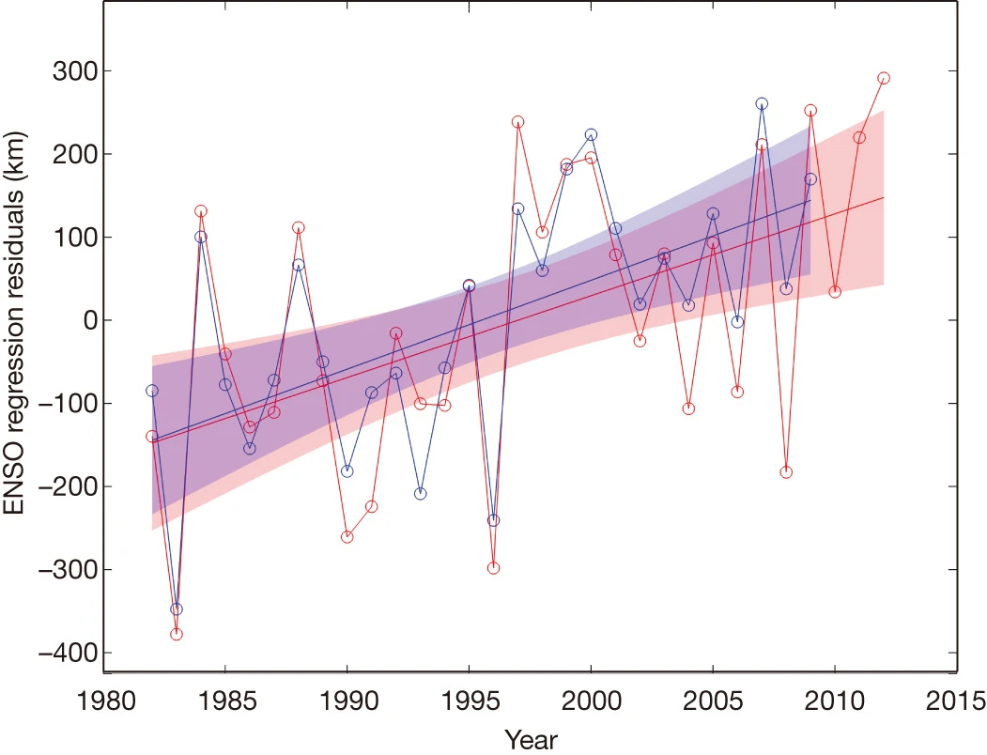
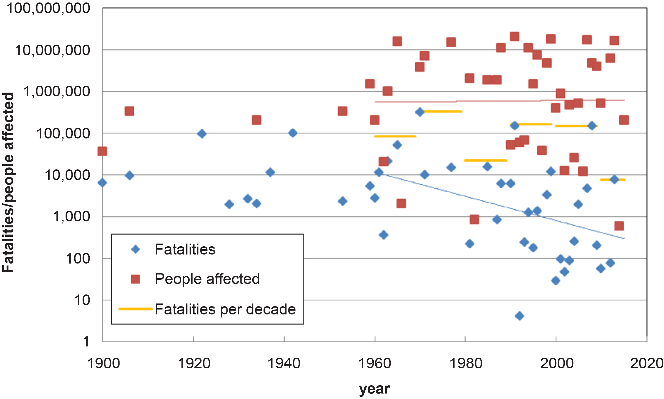
Future cyclone damage will be primarily due to rainfall and storm surges, not winds or frequency…¹
…But early warning, evacuation, and flood protection have reduced mortality so far.²
Change in Distance from Equator
Bouwer & Jonkman (2018)
Kossin et al. (2014)
²Bouwer & Jonkman (2018); ¹Garner et al. (2017) and Rahmstorf (2017)

Slide 36
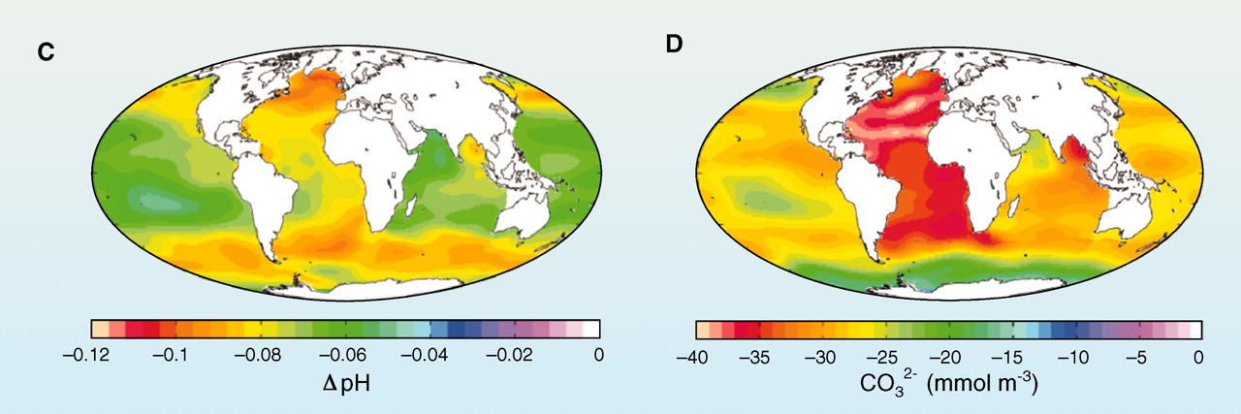
Ocean Acidification
CO₂ dissolves in water, raising ocean pH and reducing calcium carbonate concentrations.
Change in mean surface pH (C) and in annual mean surface carbonate concentration (D) since 1700s
Hoegh-Guldberg and Bruno (2010, Nature)

Slide 37
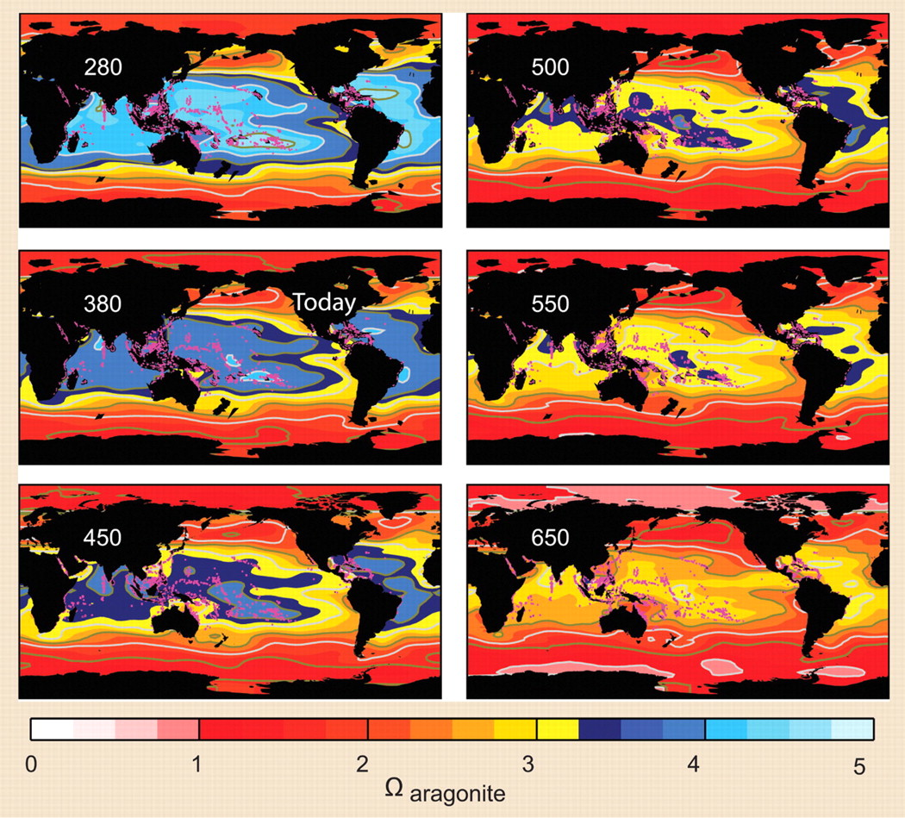
Coral Reefs
ppm CO2
Changes in pH and carbonate happening 100x faster than before.¹
Mean ocean pH levels today have not been seen in at least 40 million years.¹
Today: ~410 ppm CO₂
2007
¹Pelejero et al. (2010, Trends Ecol. Evo.)
Hoegh-Guldberg et al. (2007, Science)

Slide 38


Slide 39
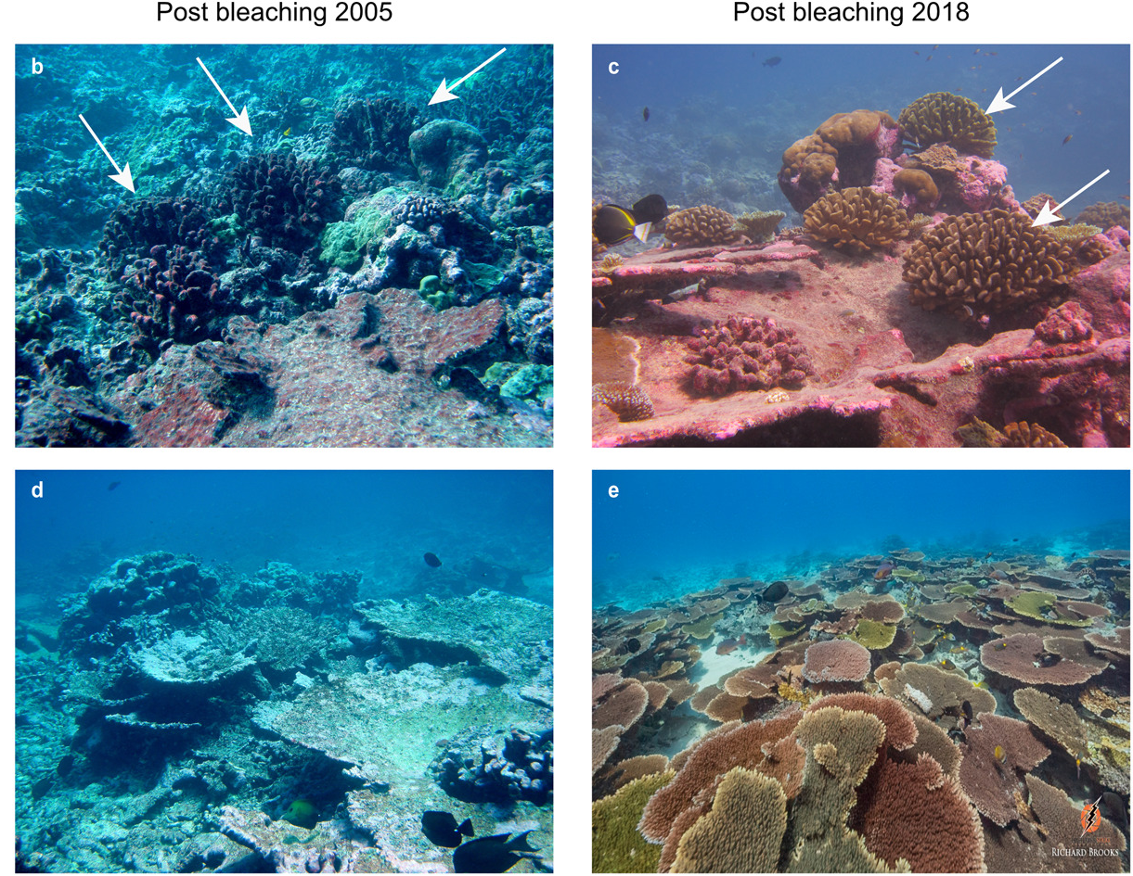
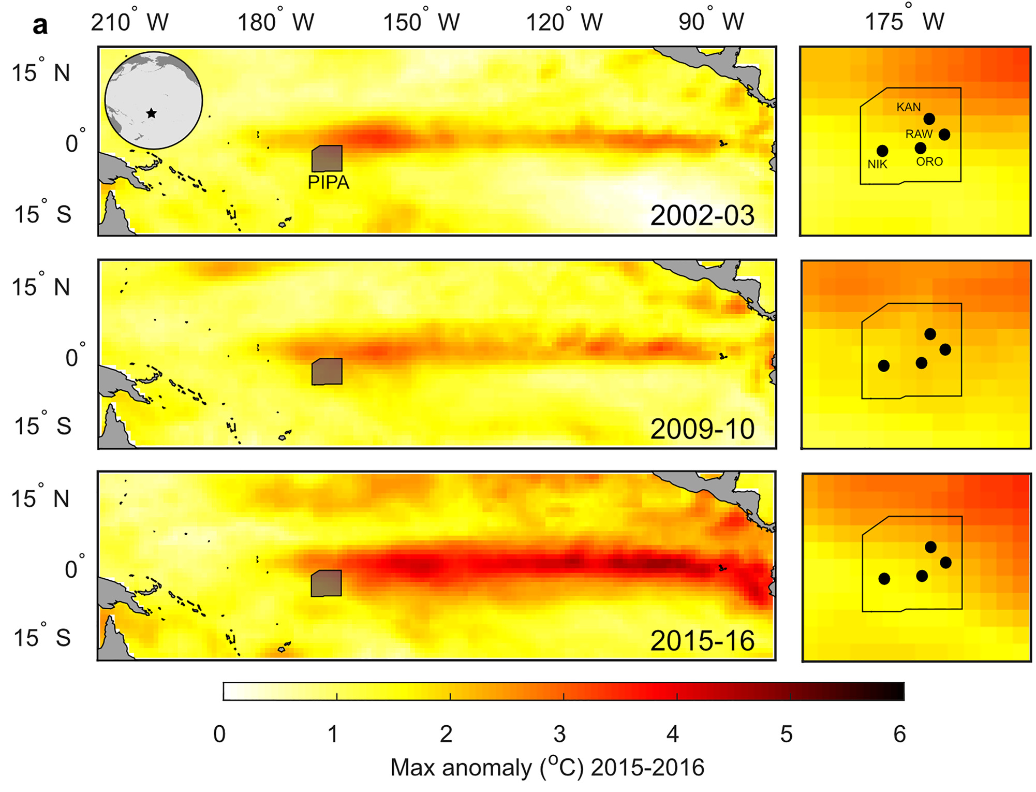
Resilience of Pacific Coral Reefs
Fox et al. (2021, Geophysical Research Letters)
Notes:
18-year record spanning three marine heat waves

Slide 40
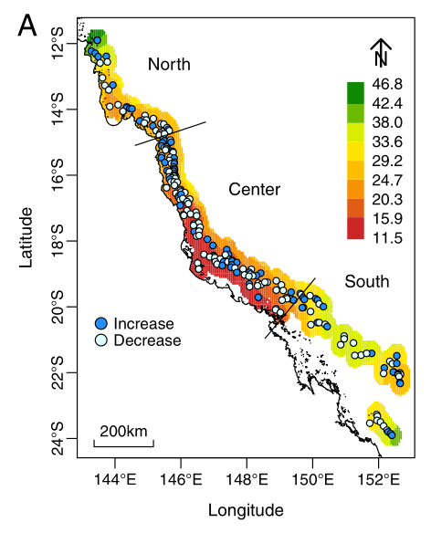
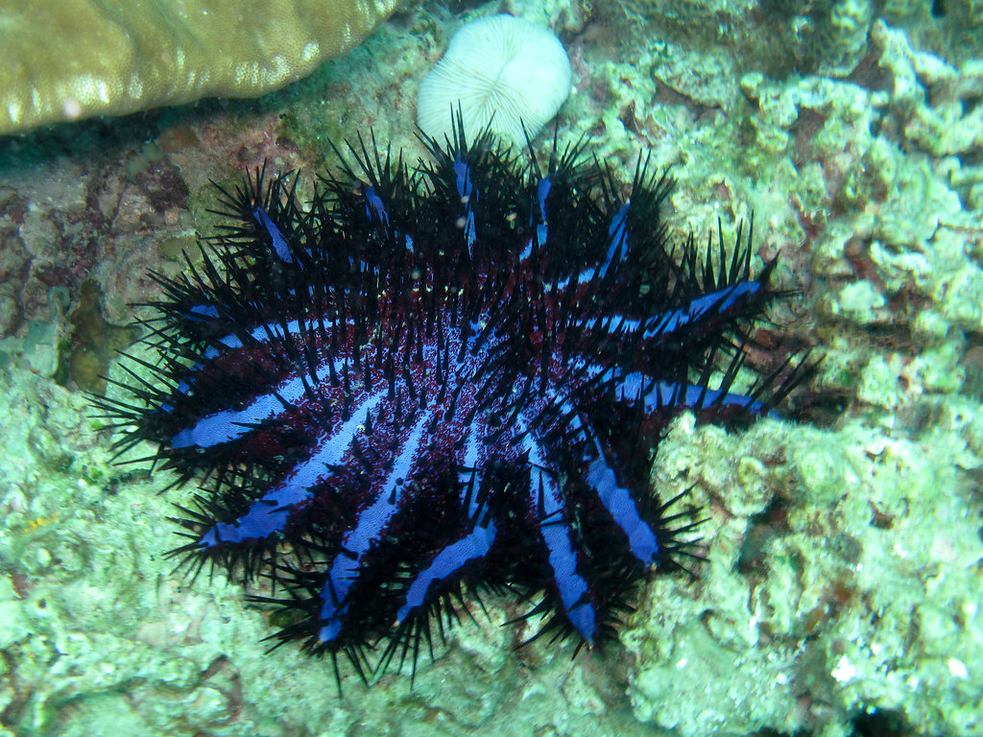
Coral Protection is Possible
De’ath et al. (2012, PNAS)
Primary causes of 27-year decline of Great Barrier Reef are cyclones and the Crown-of-Thorns Starfish.
Similarly, Caribbean corals most threatened by cyclones and disease, not bleaching!

Slide 41
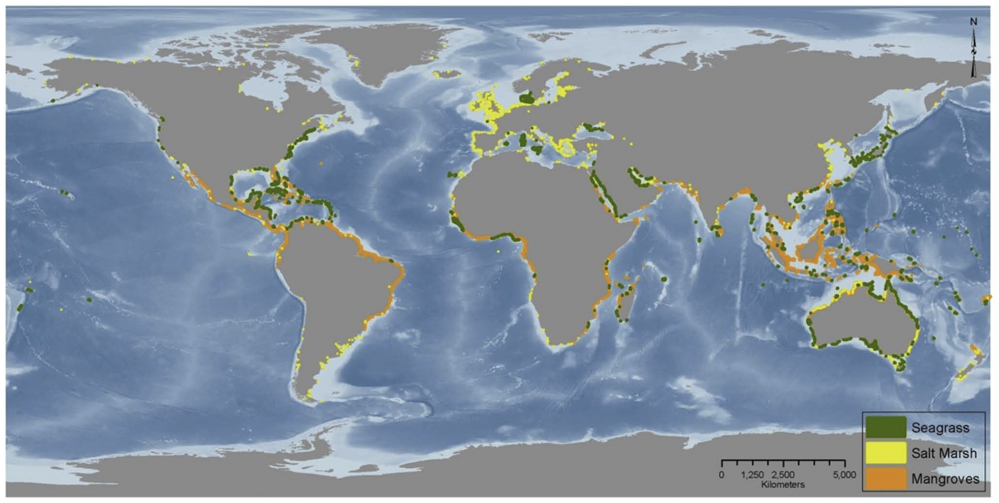
Removal of coastal vegetation releases CO2 emissions around
3-19% that of global deforestation.
Also results in up to $US 42 billion a year in global damages!
Pendleton et al. (2012, Plos One)

Slide 42
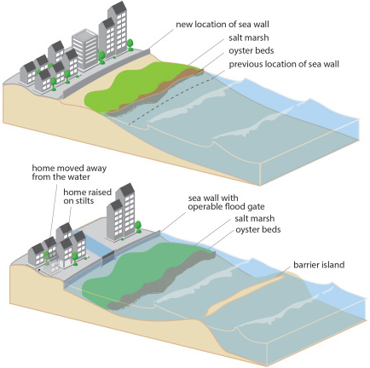
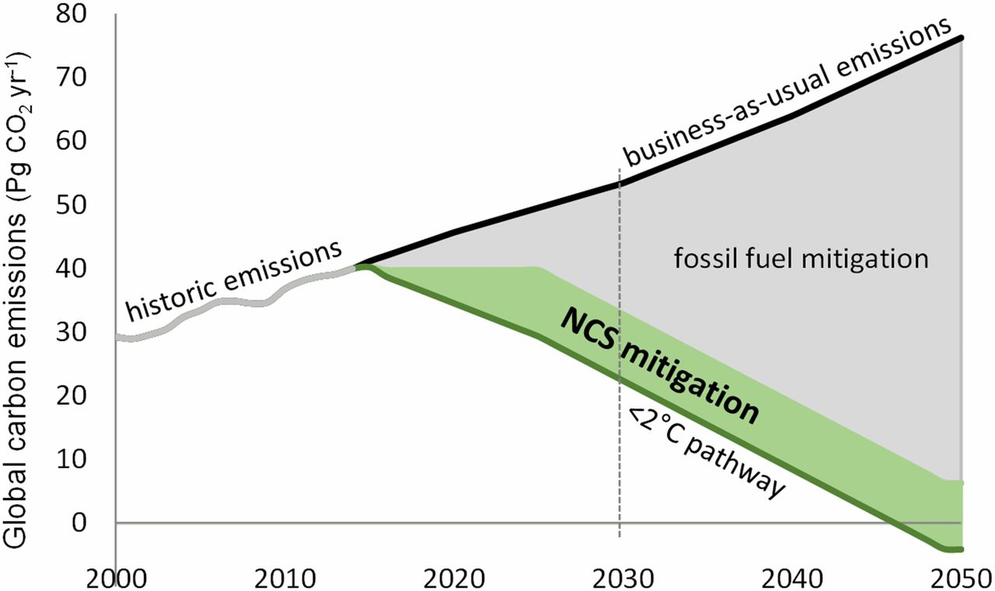
“Double Duty”
e.g., Protecting Indonesian coastal mangroves, alone, could offset 10-31% of all land-use change emissions.¹
NCS = Natural Climate Solutions;
Griscom et al. (2017, PNAS)
¹Murdiyarso et al. (2015, Nature); Sutton-Grier et al. (2015, Env. Sci. & Policy)

Slide 43

Questions?

Slide 44
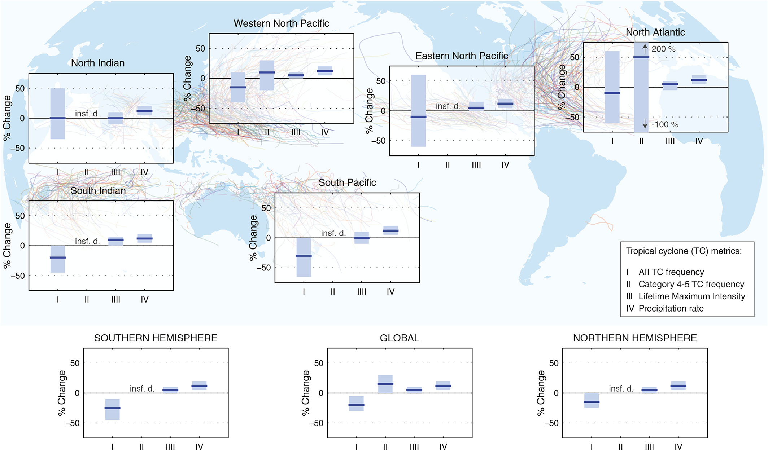
Walsh et al. (2015)

