Slide 1
Public Discourse
&
Climate Change
Steve Schwarze
Chair & Associate Professor
Dept. of Communication Studies
CCS Intro course, October 2013

Slide 2
How do we communicate about climate change?
Let me count the ways…

Slide 3

Notes:
If you’re not angry, you’re not paying attention.
If you’re not completely confused, you’re not digging into your work. Part of the job of a liberal arts education is to completely confuse you.
From a climate advocacy group in the Southeastern US

Slide 4
Based on concentration changes, the RF of all WMGHG in 2011 is 2.83 [2.54 to 3.12 W W m-2 (very high confidence). This is an increase since AR4 of 0.20 [0.18 to 0.22] W m-2, with nearly all of the increase due to the increased abundance of CO2 since 2005.
IPCC AR5 Technical Summary, 2013
Notes:
From the IPCC 4th AR

Slide 5
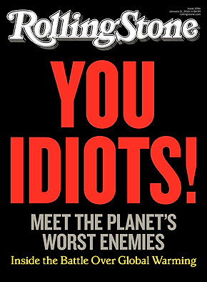

Slide 6

We Can Solve It (2008)
Notes:
2008 ad campaign by a group led by Al Gore

Slide 7
A massive carbon tax or a cap-and-trade rationing system would likely cost more than the damages it would prevent.
Either would be an impractical, panicky reaction that would be both more expensive and less effective than targeted technology development.
~Jim Manzi, The New Republic June 22, 2010
Notes:
Summary by one of the leading lights in the blogosphere

Slide 8
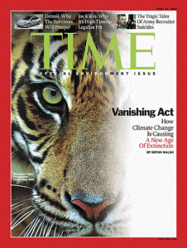
Vanishing Act: How Climate Change is Causing a New Age of Extinction

Slide 9
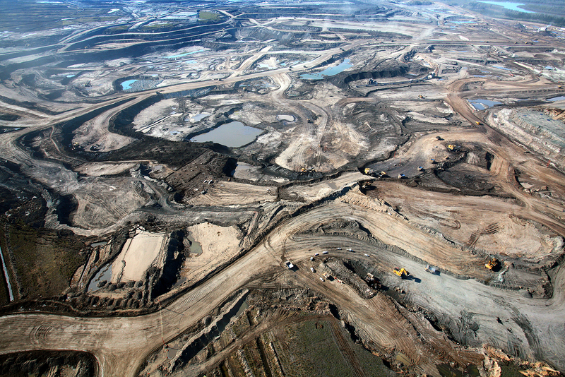
Notes:
Tar Sands of northern alberta

Slide 10
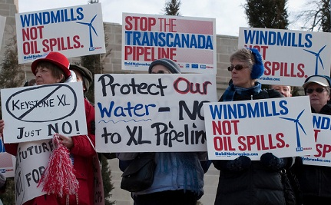
Notes:
Or perhaps the image of climate change you have is an image of protest/demonstration…

Slide 11
Climate change is a
cultural idea,
not simply a physical reality.
Notes:
This is the basic idea for the day…if I can help you see how climate change is an idea and not just a physical reality, we will have made some headway.

Slide 12
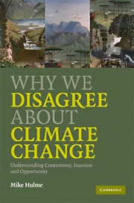
Why We Disagree about Climate Change
Mike Hulme; Tyndall Centre, UK
Environmental scientist by training
Climates have both physical reality and cultural meaning
Notes:
Hulme is one of the most prominent voices in the climate science community.
Went back to study the history and sociology of science after establishing his career as a geographer and environmental scientist.
A hard scientist who believes in numbers, but also believes in meaning. Climates have both physical reality and cultural meaning…thus stories

Slide 13
Climate change is an idea that carries as many different meanings and interpretations in contemporary political and cultural life as do [“democracy,” “terrorism,” or “nationalism”].
(pg. 322)
Notes:
This passage from the end of MH’s book really sums up his basic assumption-this is what my intro was trying to suggest.
Just like any of the big issues/ideas of the day, CC is wrapped up with all kinds of metaphors, stories, imagery that shapes how we think about it. Climate change is NOT ONE THING, means different things to different people.

Slide 14
The Fundamental Issues
What meanings get attached to climate and climate change?
How do these meanings shape belief and action?
How do these meanings empower some interests over others?
Notes:
The core issue for a communication scholar who comes at climate change from a humanistic perspective is this:
What does CC mean?
What are the meanings that we attach to our climate and to climate changes?
Whose interests get expressed, whose voices and interests are downplayed?

Slide 15
Not…
What is the physical reality of climate change?
What will get people to accept the scientific evidence?
How do we persuade people to support climate-related policies?
Notes:
Not, what is the physical basis of climate change? Quantification and empirical science is only one way to understand climate and climate change.
In addition, the question of meaning is much broader than the other two questions.
These are important practical questions, but they do not exhaust the range of public discourses that address climate and climate change.
In order to make sense of the complex public discourses around climate changes, need a broader set of models and and concepts

Slide 16
Today’s Agenda
Provide models of comm relevant to CΔ
Explain framing
Observe rhetorical strategies
  Visual rhetoric—images and image events
  Narrative patterns
Notes:
Framing as a useful concept for understanding Climate change
Journalistic Norms as patterns of newswriting—that journalism has a rhetoric all its own that shapes what you see and don’t see
Rhetorical appeals and strategies in C-change discourse
To get started on the right foot, need to understand that there are very different ways of thinking about communication itself

Slide 17
Information-Deficit Model
Scientists possess information
Public lacks information (“deficit”)
Correct info leads to “right” action decisions
Media’s job: conduit for information
Notes:
Standard naïve model of information transfer or information deficit.
This is the model that has dominated science communication for the past 30 years
Good for some things, not others.

Slide 18
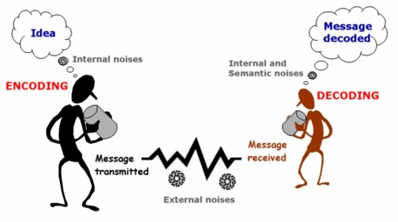
Deficit Model
Communication as “transmission” or “transfer”
Notes:
Get the ideas out of my head and into yours with the least amount of distortion.
This was a model that was developed by telephone engineers at Bell Labs

Slide 19
Deficit Model: Problems
Views communication as one-way flow
Treats mediating factors as “noise”
  Individual attitudes & values
  Social & political contexts
  Other messages …Al Gore…
Presumes “rational actors”
Privileges “technocratic” (expert-driven) decision-making
Notes:
Terrible model of comm
Mediating factors—things that “get in the way” but are actually crucial. These kinds of things don’t matter to telephone engineers. “That’s quite an outfit you’re wearing.” “Al Gore”
Rational actors—the presumption that there is only one way to reason from information to conclusions…people always pursue self-interest, we all value the future in the same way
Privileges technocratic decision-making—essentially, let the experts decide (since of course they have the information). Comm is largely about getting everyone on board to support a conclusion that experts have already decided is best.

Slide 20
“People and organizations who adopt this mode of reasoning are very likely to end up frustrated.”
(Hulme 218)
Notes:
Why would they end up frustrated?
The model shapes how we think that communication “Ought” to work.
In fact, it doesn’t even do a good job of modeling how communication does work!

Slide 21
Cultural Circuits Model
Communication viewed as “circulation”
Multiple messages, constantly reinterpreted
Everyone is sender and receiver
Media as main “site of struggle” over meaning
(Carvalho and Burgess, Risk Analysis 2005)
Notes:
A better model or metaphor for understanding the complexity of climate discourse is a CIRCULATION model
I take it as a model that emphasizes humility. Your message is not the only one out there and it’s probably not one that people really care about. Get over yourself.

Slide 22
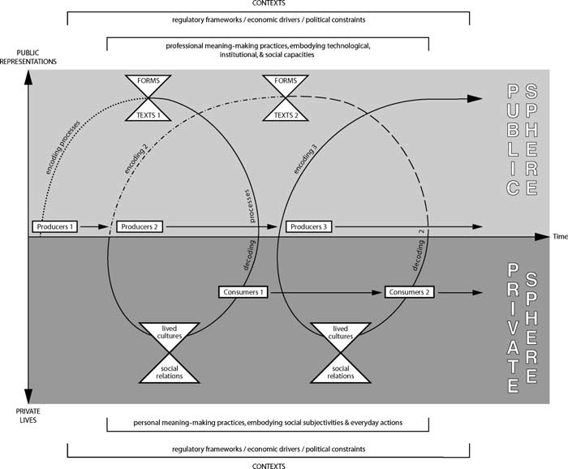
Notes:
Don’t bother trying to read this. The important point is, IT’S NOT LINEAR. Texts are produced, but they are shaped by technology, social contexts, political constraints.
Gore could not have produced Inconvenient Truth while in office. Your powerful message about climate change is not as amplified as that of the Wall Street Journal. The appeal of the Polar Bear means something different to a native Alaskan than it does to someone in Bangladesh.
And all of this is occurring in the context of other messages that compete for your time, $, attention.

Slide 23
One of the reasons we disagree…
“…we receive multiple and conflicting messages about climate change
and
we interpret them in different ways.”
(Hulme 215)
Notes:
So, how can we make sense of these messages?
Even as we receive multiple conflicting messages, there are still patterns that can be observed in these messages—that’s what a careful study of the rhetoric of climate change can help you observe.
Both to be a better consumer and a better producer of messages.

Slide 24
Steve’s Top Ten
Know your audience
Identify credible messengers
Focus on local/observable impacts
Focus on immediate impacts
Focus on health impacts

Slide 25
Steve’s Top Ten
Focus on solutions, not just problems
Link personal action to political action
Link climate change to related issues
Build communication among peers
Tell stories

Slide 26
Frames
Frames = organizing themes or storylines that give meaning to events
Used by journalists to tell a familiar story
Used by advocates to strategically advance interests, preferred policies

Slide 27
Frames
“To frame is to select some aspects of a perceived reality and make them more salient in a communicating text,
in such a way as to promote a particular problem definition, causal interpretation, moral evaluation, and/or treatment recommendation.”
(Entman, J of Comm 1993)
Notes:
Selection and deflection—here’s what’s important
Can encourage our thinking along certain lines. War v. dance. Laboratory v. prison

Slide 28
“This is a story about…”
Scientific uncertainty
Progress/innovation
Economic competitiveness
Justice/equity
Pandora’s box
Public accountability
Political tactics & personalities
Adapted from Nisbet & Scheufele, 2007
Notes:
Where is the focus of the story--what broader theme that drives it or helps it make sense
Frames apply across topics--you can see these frames in lots of different controversies.
In other words…”we’ve already heard this story” even if the details, context is different
Initially used to characterize news stories/articles…BUT ALSO APPLIES TO ADVOCACY. Frames migrate through the cultural circuits.
Frames are not policy positions—they can be used across the political spectrum, and debates can take place within a frame (ECON COMP, Pandora’s Box)

Slide 29
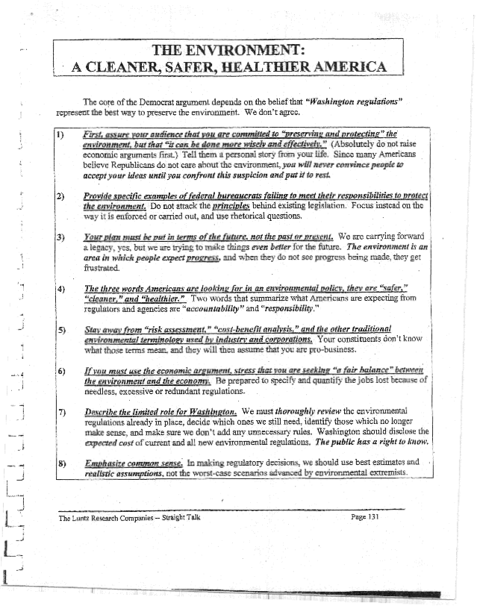
The “Luntz Memo”
Frank Luntz, 2001-02
Rhetorical handbook for Republican candidates
Based on survey rsch, in-depth focus groups
Notes:
You can see how frames are used strategically when you look at some of the documents that have been prepared for political advocates.
TWO EXAMPLES from the past decade…

Slide 30
“Winning the Global Warming Debate”
“The scientific debate remains open.”
“Americans want a free and open discussion.”
“Technology and innovation are the key in arguments on both sides.”
“The ‘international fairness’ issue is the emotional home run.”
“There is still a window of opportunity to challenge the science.”
Notes:
Free-open discussion…make the “right decision” not the quick decision
Tech and innovation…agree that American ingenuity is premier, but disagree that it must be forced by govt…free-market!!
International fairness--trying to turn the justice/equity argument

Slide 31

Climate & Energy Truths
ecoAmerica 2009, with Lake Rsch, Westen Strategies
Rhetorical handbook for climate advocates
Based on survey rsch, in-depth focus groups

Slide 32
“Trans-Partisan, Winning Messages:”
Freedom & self-sufficiency
Key finding: Voters are more engaged around the energy debate than the climate change debate.
“Freedom, independence, and self-sufficiency are at the heart of who we are as a nation, and they should be at the heart of our strategy for energy independence in the 21st century.”
Notes:
Appealing to certain kinds of values, national pride.
IF you want to address climate, you need to talk about ENERGY.

Slide 33
“Trans-Partisan, Winning Messages:”
Made in America
“The best way to bring jobs and prosperity back to this country is also the best way to end our dependence on foreign oil and protect the Earth we leave our children:
to build things in America again, starting with wind turbines, solar panels, and energy-efficient products that say ‘Made in America.’”
Notes:
A turn on the same themes…emphasizing NATIONALISM

Slide 34
Notes:
Frames are not the same as a policy position---they can be deployed by anyone int eh cultural circuit.
Natural Gas industry: Where is America finding more than a century’s worth of clean domestic energy? Right Beneath our Feet?

Slide 35
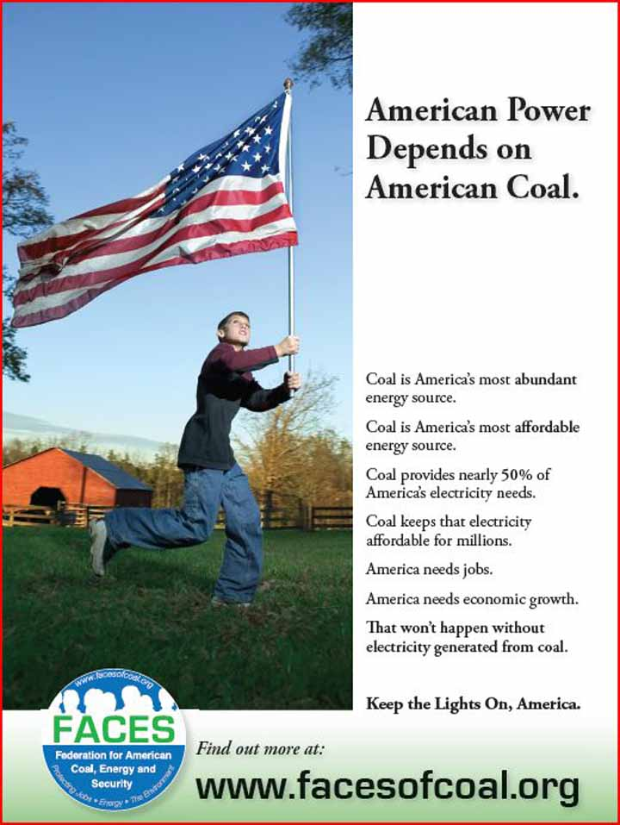
Notes:
Frames are not the same as a policy position---they can be deployed by anyone int eh cultural circuit.
Natural Gas industry: Where is America finding more than a century’s worth of clean domestic energy? Right Beneath our Feet?

Slide 36

Are Frames Enough?
Env Comm 4.1 (2010)
Perpetuates top-down, one-way communication
Generates weak support for means, rather than deliberation about ends.
Fails to mobilize
Notes:
Interesting discussion in a journal I help edit

Slide 37
Journalistic Norms
Personalization—persons, not issues
Dramatization—conflict, not continuity
Novelty—what’s new, not what’s chronic
Authority-Order—voices of establishment, reassurance
Balance—equal coverage, regardless of validity
Bennett, Pol.Comm ’96, ‘02
Notes:
In the media, framing is also influence by journalistic norms. If you are practicing journalist, you can’t just tell any story—it has to be newsworthy.
The first three are considered first-order (shape the other two). They can shape the framing of journalistic coverage by giving greater emphasis to certain issues over others, and certain aspects over others. EX: novelty privileges unusual scientific findings over the steady drumbeat of those that confirm consensus thinking.
They also drive the second order norms. So, a focus on dramatic conflict b/w personalities can lead to a stories that are balanced, giving equal attention to both sides in a dispute, regardless of how meaningful or substantive that dispute is.

Slide 38
“Balance as Bias”
Prestige press 1988-2002
On causes of warming, majority (52%) of articles gave “balanced” treatment (human v. natural)
On solutions, 78% gave balanced treatment (immediate & mandatory vs. voluntary, cautious)
Boykoff & Boykoff, GlobEnvChg 2004
Notes:
NYT, LAT, WAPO< WSJ
INACCURACY-creates an informational bias regarding scientific research on human contributions to climate change
On ACTION, significant incongruence between solutions discussed in articles and policy recommendations of scientific bodies. Explain in part by well-organized advocacy by fossil fuel industry (“contrarians” enlisted as spokespersons)

Slide 39
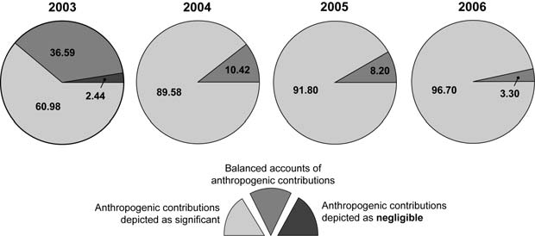
But things have changed…
Boykoff, Area 2007
Notes:
Boykoff speculates that the shift is due to POLITICAL factors--potential shift in US position before G8, SCIENTIFIC--evidence of Cooney watering down a climate science report, and PHYSICAL--Katrina
But again, think in terms of journalistic norms…PERSONALIZATION, DRAMA/CONFLICT, attention to AUTHORITY
Also, a mix of CULTURAL and NATURAL forces

Slide 40
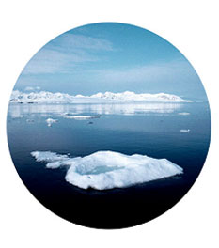
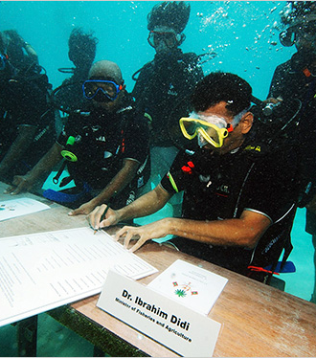
Visual Rhetoric
Notes:
Visual Rhetoric—a whole range of visual practices that are used to shape how we think about climate change and esp its impacts.
David Buckland: project called Cape Farewell, centered around a series of sailing voyages into Arctic through newly open routes
Take teams of artists, educators, writers, musicians…engage with scientists as an alternative way of drawing people’s attention to climate change
Second picture from NYT this weekend. The cabinet of the country of Maldives, Indian Ocean, 20ft under water. Calling on all countries to reduce emissions.

Slide 41
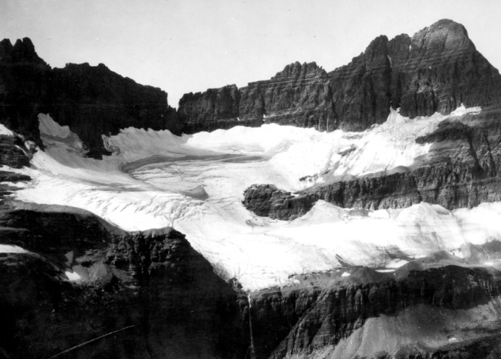
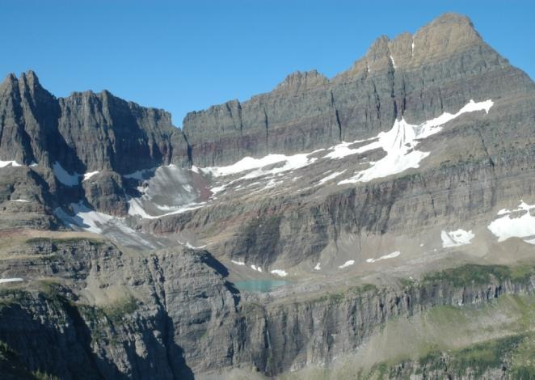


Shepard Glacier
Glacier National Park, MT
1913
W. C. Alden photo
USGS Photographic Library
2005
Blase Reardon photo
USGS
USGS Repeat Photography Project
http://nrmsc.usgs.gov/repeatphoto/
Notes:
You may have seen these…
The USGS has taken scores of repeat photos and posted them on their website that document changes in the glaciers over time.

Slide 42
Images
  Not just neutral “icons” that reflect reality!
  Inhabit a point-of-view
  Resonate with certain ways of seeing nature (as resource, as ‘sublime’)
  Leave things out of the frame
  Are interpreted differently by different people
Notes:
Image Events recognize the norms of journalism and figure out how to turn them on their head. Basically, clever PR for resource-poor enviros.

Slide 43
Image Events
Staged events that attract TV, photojournalists
  Capitalize on journalistic norms
  Function as an attention-getting device
But what else can they do…?
  Reveal hidden practices
  Reach far-flung audiences
  Contest dominant meanings
Notes:
Image Events recognize the norms of journalism and figure out how to turn them on their head. Basically, clever PR for resource-poor enviros.

Slide 44
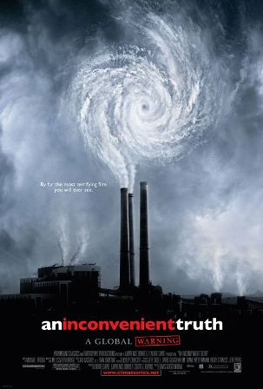
Rhetorical Strategies:
Narratives
Recurring stories with similar plotlines, conflicts, characters
Can be fictional or factual (or both)
Can shape perception, motivate action

Slide 45
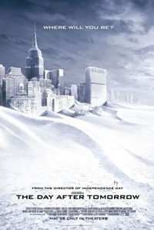
Apocalyptic Rhetoric
Issues warnings of crisis, catastrophe
Challenges assumptions of Progress
Invites charges of exaggeration, alarmism,
Killingsworth & Palmer 1996
Notes:
Leading scholars on apocalyptic…point is not to predict the future but to change it…therefore, focusing solely on “accuracy” of the prediction is misplaced.
Historically, apocalyptic emerges at times when situation is static.

Slide 46
Industrial Apocalyptic
Narratives that constitute the imminent demise of an industry or a broader economic system
Combines with burlesque frame:
Gross violation of traditional principles
Caricature and scoffing dismissal of one’s opponents
Peeples et al, under revision
Notes:
Leading scholars on apocalyptic…point is not to predict the future but to change it…therefore, focusing solely on “accuracy” of the prediction is misplaced.
Historically, apocalyptic emerges at times when situation is static.

Slide 47

Industrial Apocalyptic

Slide 48
Industrial Apocalyptic
Neoliberal (anti-regulatory, free market) appeals
Neoconservative (patriotic) appeals
Solution: not radical social change, but rejection of opponents & return to tradition
Notes:
Leading scholars on apocalyptic…point is not to predict the future but to change it…therefore, focusing solely on “accuracy” of the prediction is misplaced.
Historically, apocalyptic emerges at times when situation is static.

Slide 49
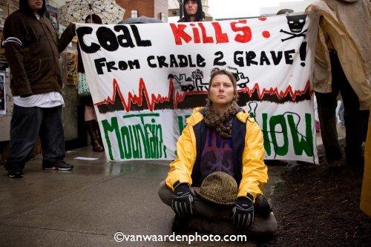
Environmental Melodrama
Clear hero, victim, and villain roles
Moral, emotional appeals sharpen conflict
Invites charges of polarization
Schwarze, QtlyJSpch 2006
Notes:
My work on Libby
Melodrama as a frame that translates private troubles into a clear moral framework that demands reform/change.
Pity for victims, anger at viillains, support for heroes

Slide 50
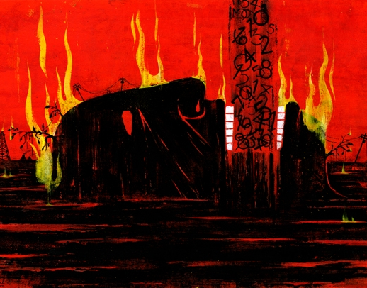
Environmental Melodrama
“But what all these climate numbers make painfully, usefully clear is that the planet does indeed have an enemy – one far more committed to action than governments or individuals. Given this hard math, we need to view the fossil-fuel industry in a new light. It has become a rogue industry, reckless like no other force on Earth. It is Public Enemy Number One to the survival of our planetary civilization.”
Bill McKibben, “Global Warming’s Terrifying New Math,” Rolling Stone July 19, 2012
Notes:
My work on Libby
Melodrama as a frame that translates private troubles into a clear moral framework that demands reform/change.
Pity for victims, anger at viillains, support for heroes

Slide 51
A Question of Conflict
Which conflicts are emphasized/downplayed?
How does the conflict shed light on a larger, more systemic problem?
Does the conflict focus on short-term problems or long-term challenges?
Whose voices are included/ignored?
Foust & Murphy, EnvComm 2009
Notes:
For

Slide 52
Parting Thoughts
What are the fundamental barriers to climate action?
“[The] state of public opinion raises critical questions as to the effectiveness of 20 or more years of public education, outreach, and engagement approaches used to render a complex scientific issue meaningful and actionable for lay audiences.”
Moser and Dilling, Oxford Hbk Climate Society, 2011
Notes:
For

Slide 53

What Stories are Needed?
Notes:
For

Slide 54
Spring 2014
COMX 347/ CCS 379/ ENST 391
Communication, Consumption, and Climate
TR 9:40-11:00 am

Slide 55
An Inconvenient Truth
“Tempered” apocalyptic for scientific citizenship (Johnson, RhetRvw 2009; Spoel et al., TechCQ 2009)
Mythic quest uniting jeremiad, autobiography, documentary (Rosteck & Frentz, QJSpch 2009)
Notes:
Johnson—impending doom, but tempered by his emphasis on science
Rosteck and Frentz: AIT unites jeremiad, auto-biog., documentary
JEREMIAD: Political sermon. A covenanted people, break the covenant, but can be redeemed

Slide 56
An Inconvenient Truth
As this popular documentary reflects, our contemporary cultural meanings of nature [climate change??] may not be either one or the other, but may well be as contradictory and as incongruous as the symbolic action that animates this film.
(Rosteck & Frentz, 16)
Notes:
Johnson—impending doom, but tempered by his emphasis on science
Rosteck and Frentz: AIT unites jeremiad, auto-biog., documentary
JEREMIAD: Political sermon. A covenanted people, break the covenant, but can be redeemed

