Slide 1
European Union: Perspectives on Climate Change
Ulrich Kamp
Ph.D., Associate Professor
Department of Geography

Slide 2
Part 1 What is the European Union?

Slide 3
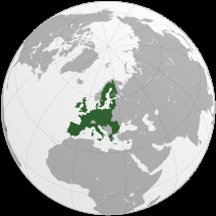
What is the European Union?
A unique economic and political partnership between 28 democratic European countries with 507 million citizens and 24 languages.

Slide 4
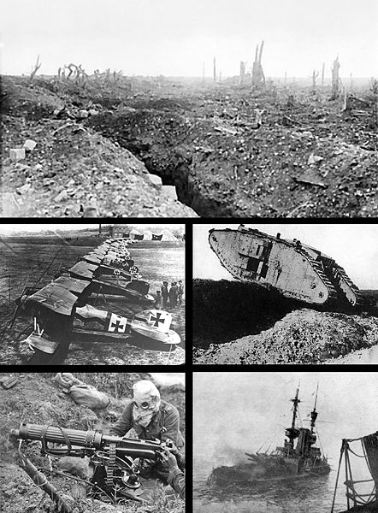
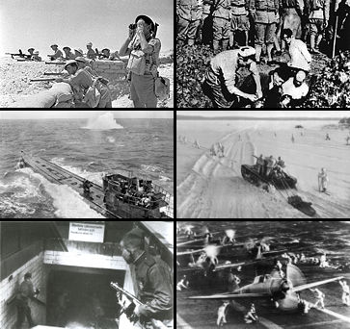
Enough! The “Pre-History” of the European Union

Slide 5
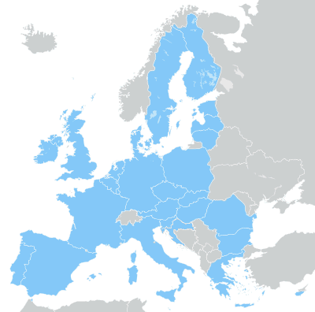
History of the European Union From 6 to 28

Slide 6
Part 2 Environmental Awareness in the EU

Slide 7
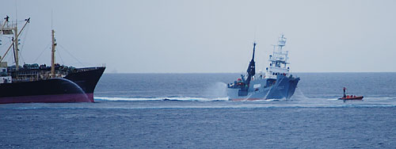
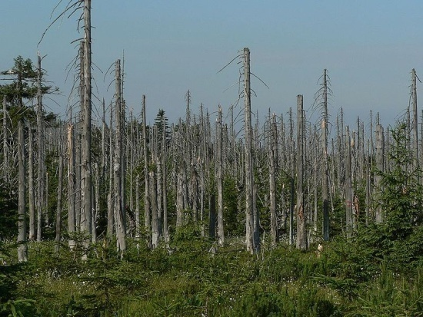
“Green” History in Europe
1970s: Oil Crisis; “Acid Rain”; Greenpeace

Slide 8
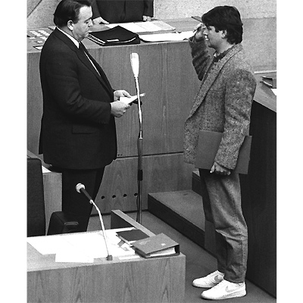
“Green” History in Europe
1980s: “The Greens”
1980: Foundation
Since 1983: Part of German Parliament
1998-2005: Part of German Government

Slide 9
“Green” History in Europe
1990s: “The Green Dot”
1990: Introduction of Dual Waste Management System in Germany.
Today: Introduced in 23 other European countries.

Slide 10
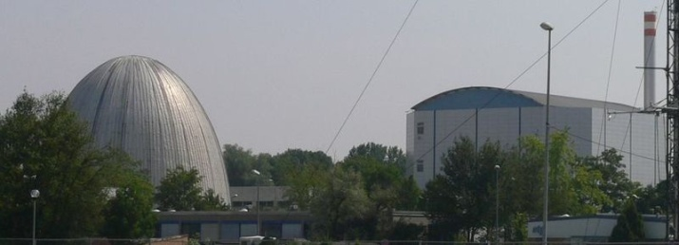
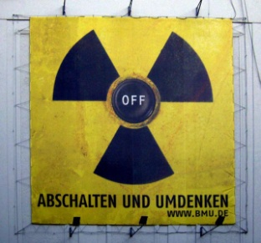
“Green” History in Europe
2000s: Phasing out of Nuclear Power
1978: Austria
1980: Sweden
1987: Italy
1999: Belgium
2000: Germany

Slide 11
Germany: A “Green Nation”
http://www.thesolutionsjournal.com/node/981

Slide 12
Part 3 Resource Consumption in the Eu

Slide 13
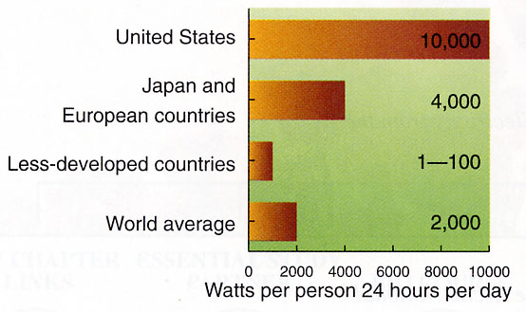
Energy Consumption per capita per day

Slide 14
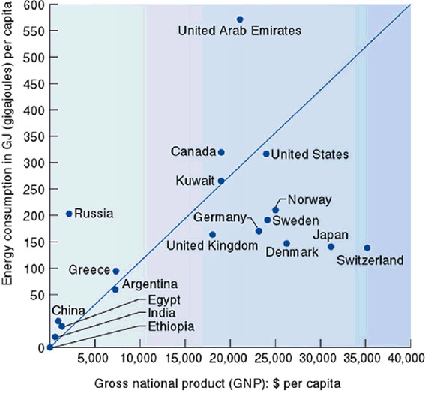
Energy Consumption and GDP

Slide 15
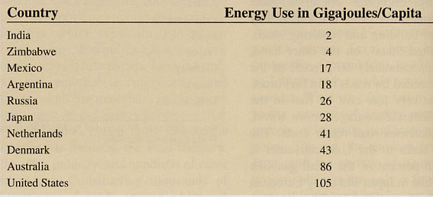
Energy Use for Transportation in gigajoules per capita

Slide 16
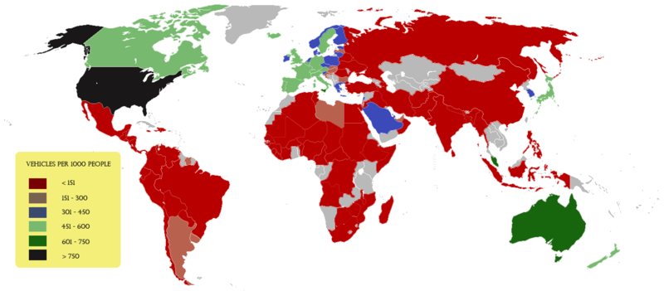
Passenger Cars and Population Vehicles per 1,000 people

Slide 17
Transportation Mode for Land-based Trips
Europe U.S.A. World
Walking/Bicycling 40-50 % 2 %
Mass Transit 10 % 3 %
Automobile 40-50 % 95 % 10 %

Slide 18
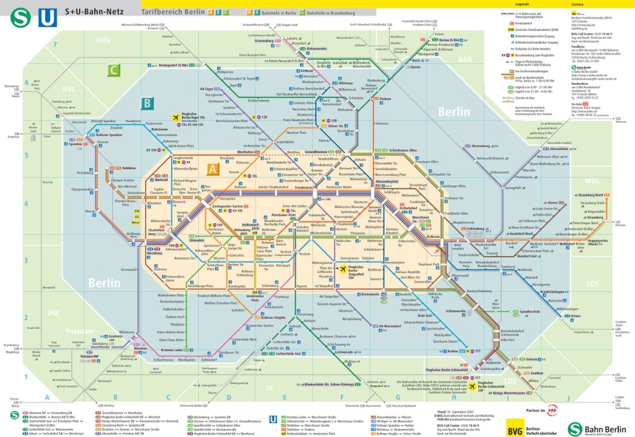
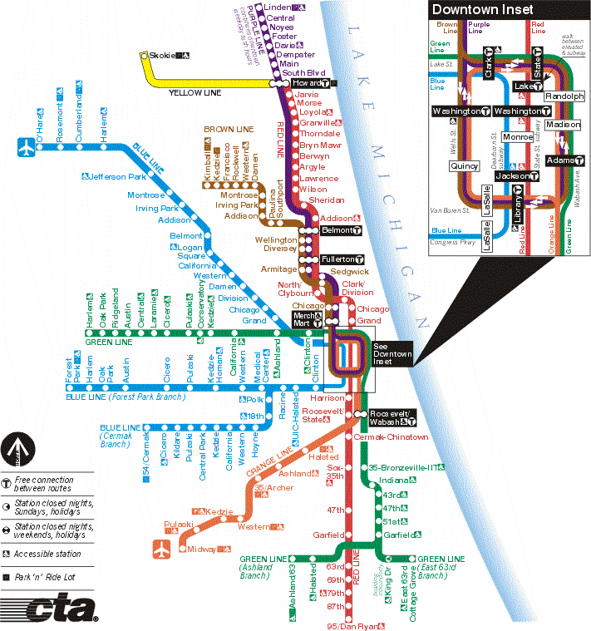
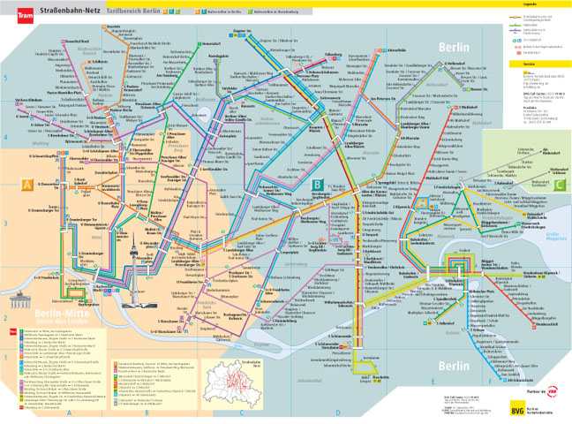
Subway/Streetcar Networks Chicago vs. Berlin

Slide 19
Part 4 Eu’s GHG Emissions

Slide 20
Global GHG Emissions
Seven largest emitters:
U.S., EU, China, Russia, Japan, India, Canada.
Account for >70% of energy-related CO2 in 2004.

Slide 21
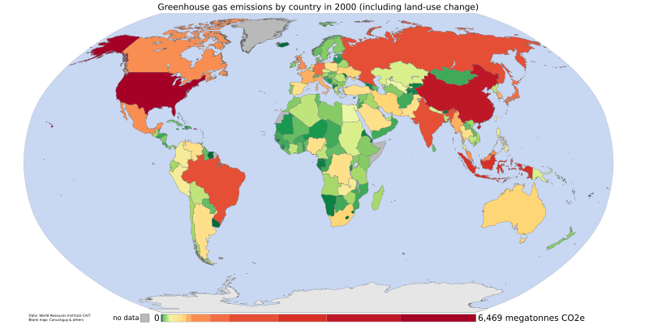
Global CO₂ Emissions Megatonnes by country

Slide 22
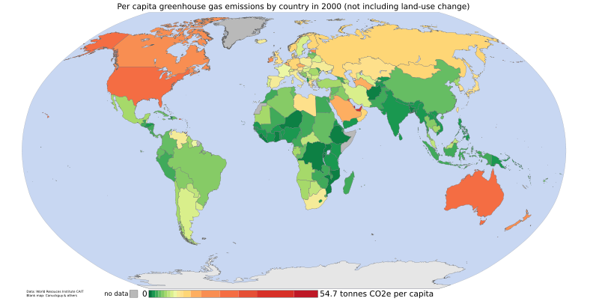
Global CO₂ Emissions Tons of CO₂ per capita

Slide 23
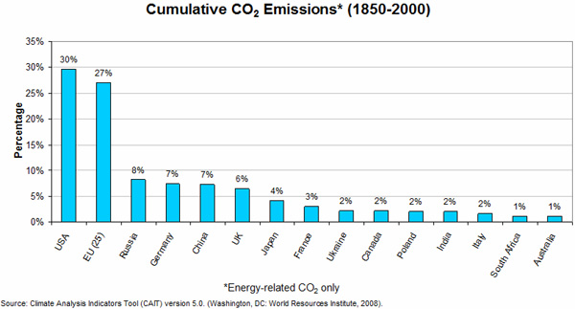
Cumulative CO₂ Emissions 1850-2000 (Energy-related)

Slide 24
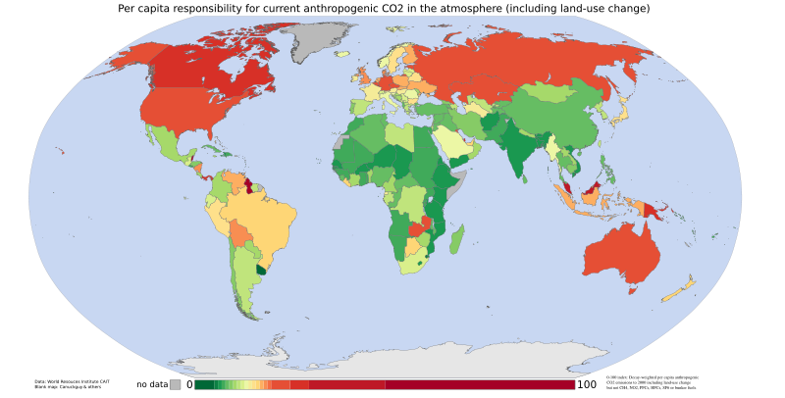
Cumulative CO₂ Emissions 1950-2000, per capita responsibility

Slide 25
Global CO₂ Intensity 2002, (Tons of CO₂ per $1,000 of GDP)

Slide 26
Part 5 Eu and Climate Change

Slide 27
The EU and Climate Change Official European Commission Website
“Climate change is already happening and represents one of the greatest environmental, social and economic threats facing the planet. The European Union is committed to working constructively for a global agreement to control climate change, and is leading the way by taking ambitious action of its own. The warming of the climate system is unequivocal, as is now evident from observations of increases in global average air and ocean temperatures, widespread melting of snow and ice, and rising global mean sea level. The Earth's average surface temperature has risen by 0.76° C since 1850. Most of the warming that has occurred over the last 50 years is very likely to have been caused by human activities.”

Slide 28
Climate Change Impacts in EU
Many mountain plant species may face extinction.
Increasing water demand for agriculture.
Glacier retreat.
Extreme weather events are projected to increase.
Human health is also significantly affected.

Slide 29
Impacts in Germany by 2100
Increase of temperature of 0.9° C in last 100 years (0.7 ° C globally); 1.5 ° C in the Alps.
Increase of temperature of up to 4 ° C.
Up to 30% less summer precipitation → more and stronger heat waves and droughts.
Up to 30% more winter precipitation → more and higher floods in spring.
Total melting of all Alps glaciers possible → flooding and water scarcity.

Slide 30
Climate Change Initiatives
1979: Geneva Convention
1987: Montreal Protocol
1991: First strategy to limit CO2 and improve energy efficiency
1992: 'Earth Summit’, Rio
1997: Kyoto Protocol.
1998: EU-15 signs Kyoto Protocol.
2000: European Climate Change Program (ECCP I)
2001: EU-15 ratifies Kyoto Protocol.
2001: Clean Air For Europe (CAFE) programme
2005: European Climate Change Program (ECCP II)
2005: Clean Air Strategy

Slide 31
EU calls for…
Pro-active adaptation measures needed.
Improved monitoring and reporting of data.
More spatial and socio-economic scenarios.
Better information on vulnerability.

Slide 32
Solutions
EU Greenhouse Gas Emission Trading Scheme (EU ETS).
Greenhouse Gas Emissions Allowance Trading Scheme.
Landfill of Waste Directive.
Intelligent Energy for Europe Program.
Renewable Electricity Directive.
Biofuels Directive.
Agreement with Automakers.
“Carbon tax”.

Slide 33
Emission Trading Scheme (ETS)
Limitation of emissions from ~ 10,500 industrial facilities across Europe that together produce ~ 50% of EU’s CO2 emissions.
Large CO2 emitters must monitor and annually report their emissions; obliged every year to return an amount of emission allowances to the government that is equivalent to their CO₂ emissions in that year. Emission allowance prices between 7 and 30 Euros (per ton CO2).
Excess emissions in 2008-2012 incur penalty (100 Euro per ton CO2) and must be made up in next phase.
Will continue beyond 2012 with or without new international climate agreements.

Slide 34
Emission Trading Scheme (ETS)
Operators may reassign or trade allowances by several means:
privately, moving allowances between operators within a company and across national borders.
over the counter, using a broker to privately match buyers and sellers.
trading on the spot market of one of Europe's climate exchanges (the most liquid being the European Climate Exchange).

Slide 35
Part 6 Eu and The Kyoto Protocol

Slide 36
The EU and the Kyoto Protocol Press Release, 16 October 2008
“Climate change: projections show EU on track to meet Kyoto emission targets”
Projections for EU-15 and EU-27
EU-15 greenhouse gas emissions in 2006 were 2.7% lower than 1990. This contrasted with economic growth of around 40% over the same period. For the EU-27 as a whole, emissions fell by 10.8% between 1990 and 2006.
Existing policies and measures – those already implemented – were expected to reduce EU-15 emissions to 3.6% below 1990 levels by 2010.

Slide 37
Global GHG Emissions Trends 1990-2005/06
EU-15 -2.7%
EU-27 -10.8%
Germany -18%
U.S. +16%

Slide 38
Global GHG Emissions Trends Projections against 2004
Japan -5% by 2010.
EU steady by 2010.
U.S. +8% by 2010 and +25% by 2025.
China +50% by 2025.
India +80% by 2025.

Slide 39
Part 7 The Post-Kyoto EU

Slide 40
The EU and Post-Kyoto after 2012
With the Kyoto Protocol targets expired in 2012, the EU was pressing for a new international agreement to ensure that global warming is stopped before it exceeds the temperature in pre-industrial times by more than 2°C. Scientists view a 2°C rise as the threshold beyond which climate change could trigger irreversible and possibly catastrophic planetary changes.

Slide 41
The EU and Post-Kyoto after 2012
2006: “Bali Roadmap” describes activities for implementation of a post-Kyoto agreement.
2007: “Energy Policy for Europe” → “First Mover Advantage”:
EU will cut its greenhouse gas emissions to at least 20% below 1990 levels by 2020, and will increase this reduction to 30% if the other industrialized countries (particularly, the U.S.A.) agree to do likewise and developing countries also take action. EU agreed on reduction by 60-80% until 2050.

Slide 42
The EU and Post-Kyoto after 2012
2007: G8 meeting in Heiligendamm; global goal: reduction by 50% until 2050 “should be seriously discussed”; China and India should be included; acceptance of all three IPCC reports.

Slide 43
Solutions Targets by 2020
20% of energy consumption from clean, renewable energy.
10% renewable transport fuels.
Carbon Capture and Storage (CCS) technology commercially viable.
CO₂ emission limit for new cars at 95 g/km.
Increased research and development budget.
Improvement of energy efficiency and security.
Triple employment in eco-industries.

Slide 44
The EU and Post-Kyoto after 2012 - Reactions
Many EU member states expressed concerns about EU Parliament ‘s vote for using profits from emission trade exclusively for climate protection activities/initiatives.
Italy against stricter conditions.
Germany against stricter CO₂ emission limit (120 g/km) for new cars in 2012 (Germany: 2015). (Audi; BMW; Mercedes; Porsche; VW).

Slide 45
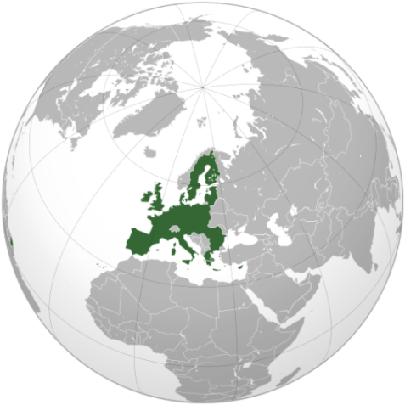
The EU and Post-Kyoto EU Heads Meeting, March 2007
Transforming Europe into a
highly energy-efficient,
low-carbon economy.

