Slide 1
Legislative Action to Limit GHGs
Cap and Trade bills
Waxman Markey went the furthest- passed House with a putative 17% reduction in GHG emissions by 2020
Cap and Dividend
Carbon Tax

Slide 2
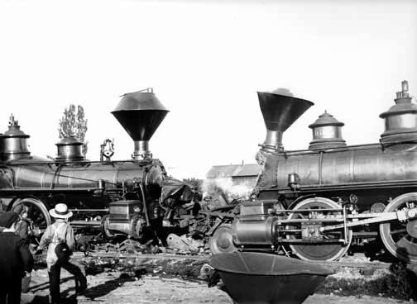
What Happened In Senate
Total Fail!

Slide 3
Into the Legislative Vacuum..
Massachusetts v. EPA- US Supreme Court rules GHG air subject to CAA regulation
EPA makes “endangerment finding” necessary to trigger regulatory authority under CAA
EPA begins to promulgate rules under the Clean Air Act

Slide 4
CAA Utility Regulation
Cross-State Air Pollution Rule
Mercury/Toxics Rule
GHG tailoring rule
GHG New Source Performance Stds

Slide 5
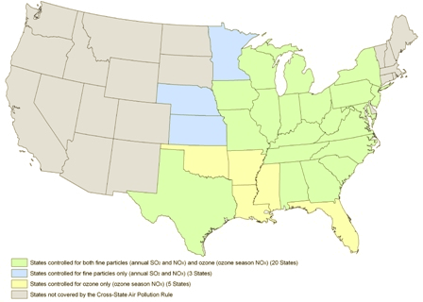
Cross-State Air Pollution Rule
The rule requires significant reductions in sulfur dioxide (SO₂) and nitrogen oxide (NO_{X}) emissions that cross state lines
Applies in eastern US

Slide 6
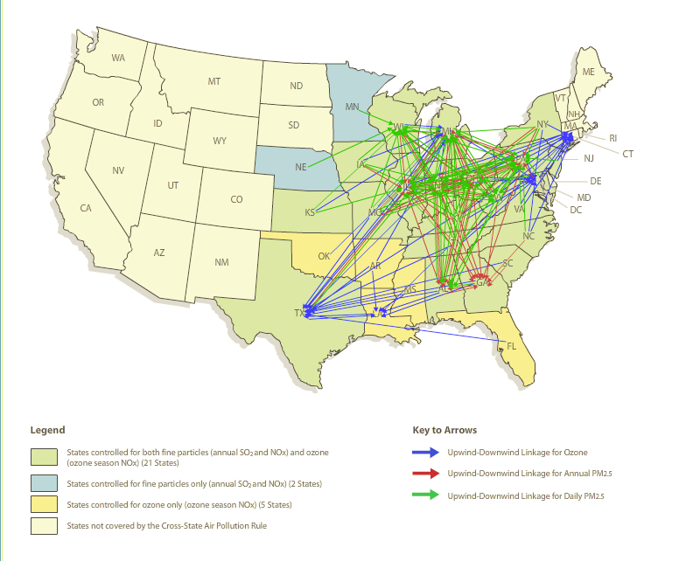
Cross-State Air Pollution Rule
Deals with SO₂ and NO_{x} under provision of CAA called the “good neighbor” provision
Air pollution in another state contributing to non-attainment for
ozone or PM
Currently invalidated
by court order
On appeal to US Supreme Ct

Slide 7
Cross-State (cont’d)
Emission reductions starting January 1, 2012 for SO₂ and annual NO_{X} reductions, and May 1, 2012 for ozone season NO_{X} reductions
By 2014 the Cross-State Air Pollution Rule would reduce:
power plant SO₂ emissions by 73 percent
NO_{X} emissions by 54 percent from 2005 levels in the CSAPR region.

Slide 8
Impact of regulating the eastern US
http://www.epa.gov/mats/where.html

Slide 9
GHG Tailoring Rule
Two phases
Uses Prevention of Significant Deterioration authority under CAA (PSD)

Slide 10
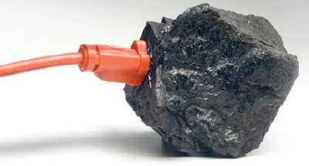
Tailoring Rule GHGs
The final rule addresses emissions of a group of six GHGs:
1. Carbon dioxide (CO2)
2. Methane (CH4)
3. Nitrous oxide (N2O)
4. Hydrofluorocarbons (HFCs)
5. Perfluorocarbons (PFCs)
6. Sulfur hexafluoride (SF6)

Slide 11
Tailoring Phase 1
o Only sources currently subject to the PSD permitting program (i.e., those that are newly-constructed or modified in a way that significantly increases emissions of a pollutant other than GHGs)
o For these projects, only GHG increases of 75,000 tpy or more of total GHG, on a CO2e basis, would need to determine the Best Available Control Technology (BACT)
o Similarly for the operating permit program, only sources currently subject to theprogram (i.e., newly constructed or existing major sources for a pollutant other thanGHGs) would be subject to title V requirements for GHG.

Slide 12
Tailoring Phase 2
PSD permitting requirements will cover for the first time new construction projects that emit GHG emissions of at least 100,000 tpy even if they do not exceed the permitting thresholds for any other pollutant.
Modifications at existing facilities that increase GHG emissions by at least 75,000 tpy will be subject to permitting requirements, even if they do not significantly increase emissions of any other pollutant.
In Step 2, operating permit requirements will, for the first time, apply to sources based on their GHG emissions even if they would not apply based on emissions of any other pollutant. Facilities that emit at least 100,000 tpy CO2e will be subject to title V permitting requirements.

Slide 13
Mercury Rule
50% US mercury emissions from power plants (coal fired and oil fired)
http://www.epa.gov/mats/powerplants.html
Puts pressure on to upgrade or retire old, inefficient powerplants
Business has sued to block rule

Slide 14
GHG NSPS
“As a result of legal petitions filed by a number of states and environmental groups challenging the USEPA’s failure to establish greenhouse gas new source performance standards for fossil fuel power plants, the agency entered into a settlement agreement in December 2010”
“Under the modified settlement agreement, the USEPA was to propose greenhouse gas new source performance standards for fossil fuel power plants by September 30, 2011, and a final rule no later than May 26, 2012. The agency missed the September 30 proposal deadline.”
From: http://www.nescaum.org/

Slide 15
EPA Announces NSPS Rule
Carbon Pollution standard for New Power Plants
Applies to NEW EGU plants > 25 MW that burn fossil fuels
These plants <=1000 lbs of CO₂/MWh
Natural Gas Combined Cycle plants can meet this target
Coal or petroleum coke need tech such as CCS

Slide 16
Obama Climate Action Plan
3 Pillars
Cut Carbon Pollution in America
Prepare US for Impacts of Climate Change
Lead International Efforts to Combat Climate Change and Deal with its Effects

Slide 17
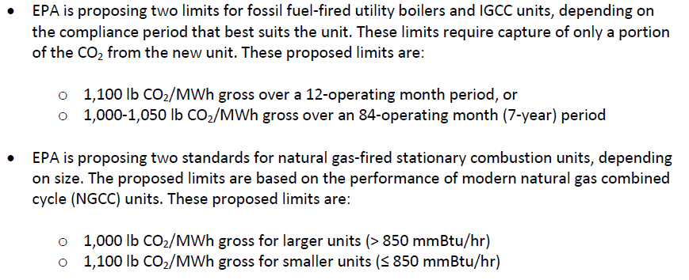
Update to NSPS- 9/30/13

Slide 18
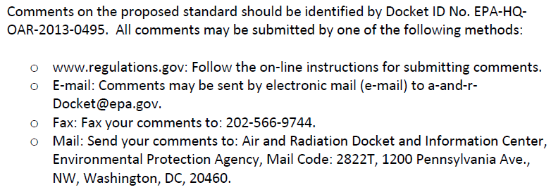
Comment for 60 days

Slide 19
Existing Plant Standards to Follow
http://www.youtube.com/watch?v=4k-cNN8J6wY

Slide 20
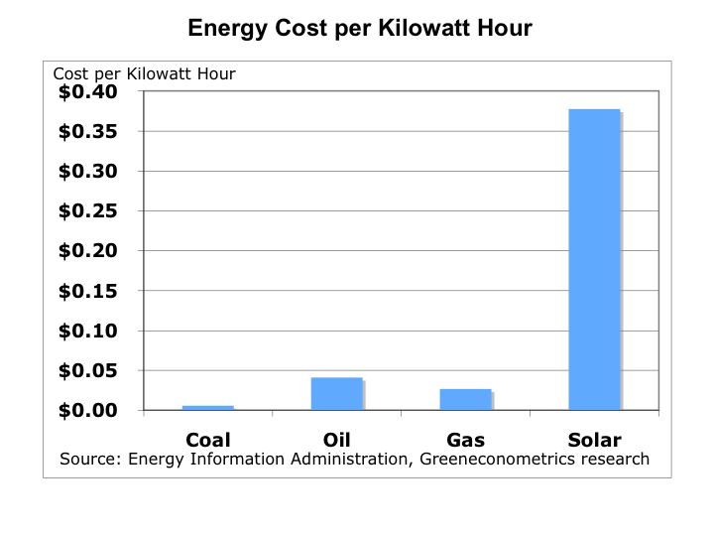
From: http://greenecon.net/understanding-the-cost-of-solar-energy/energy_economics.html

Slide 21
Costs of Pollution Control Technology
http://peswiki.com/index.php/Directory:Cents_Per_Kilowatt-Hour

Slide 22
Results
http://www.startribune.com/business/134647533.html
http://www.ohio.com/news/break-news/firstenergy-closing-6-coal-fired-power-plants-1.257090
http://www.jsonline.com/business/clean-air-rules-cloud-future-of-up-power-plant-5c340j8-134219868.html
http://www.post-gazette.com/pg/12012/1203000-56-0.stm

Slide 23
Analysis of EGU Closures
64 plant closures announced in 2011
Represents 223 million tons of CO2 emissions
Represents about 3.2% of total US emissions CO2eq in 2010
Sources:
CARMA 2007 CO2 figures www.carma.org
Plant closure listing www.sourcewatch.org
EPA emisssions estimate http://www.epa.gov/climatechange/ghgemissions/usinventoryreport.html

Slide 24
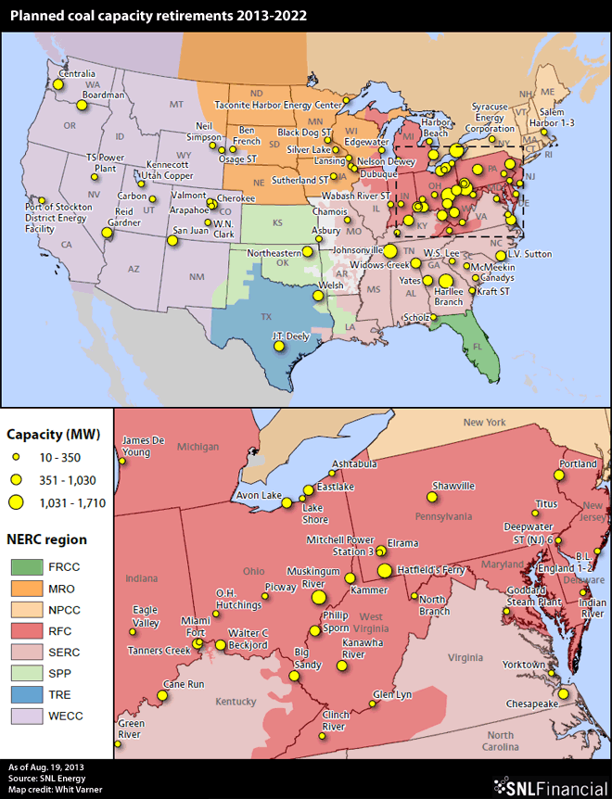
2012 + Closures

Slide 25
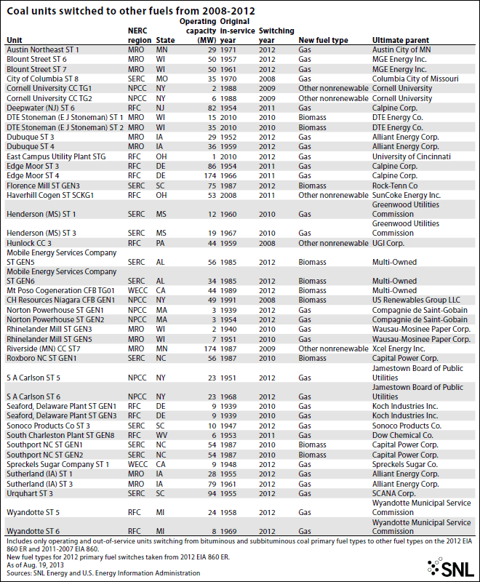

Slide 26
UN Framework Convention on Climate Change
Created at 1992 Rio Earth Summit
Goal: avoid climate change that would result in dangerous interference with Earth’s climate system
Basic Principles
Common but differentiated responsibilities
Developed nations would lead
Nationally appropriate actions in the context of sustainable development

Slide 27
Common but Differentiated
Responsibility to act keyed to development status
Historical contribution to climate change

Slide 28
Kyoto Protocol
In effect 2008-2012
Common but differentiated embodied in hard emissions reduction targets for developed countries (Annex I)
Also in the Clean Development Mechanism that was intended as an offset under Kyoto but also could jump start sustainable energy development in developing countries (non-Annex I)
US signed but never ratified

Slide 29
US Position Post-Kyoto
Bush Administration took the position that developing countries like China and India needed to agree to real reductions in emissions before US would commit
As Obama Administration followed China surpassed US in total GHG emissions, becoming worlds largest emitter
Obama government negotiators also pressed for Chinese participation in emissions reductions as a necessary precursor to US commitments

Slide 30
Copenhagen
Developed countries pushed for reductions so that temp would not increase by more than 2 C.
Developing countries balked feeling “level of ambition” of developed was too low
http://www.youtube.com/watch?v=Vg60wxCtSqs
http://www.youtube.com/watch?v=JwwQq03Sf1E
5 am 12-19 COP webcast Grenada at 1:10:45
http://cop15.meta-fusion.com/kongresse/cop15/templ/play.php?id_kongresssession=2761&theme=unfccc
Chinese were key players- refusing to go lower for temp target

Slide 31
Cancun
Developing countries agreed to Nationally Appropriate Mitigation Actions as part of an overall agreement
Reshaped the meaning of common but differentiated

Slide 32
Durban
Kyoto parties agreed to extend the protocol to 2020 with uncertain level of reduction commitments
Agreement to negotiate a successor agreement by 2015 that would go in place in 2020
No hard commitments made

Slide 33
Doha
Retired some negotiating frameworks (i.e., AdHoc Working Group on Kyoto)
Now just the SBSTA and Ad hoc Working Group on the Durban Platform for Enhanced Action (ADP)

Slide 34
On to Warsaw!
Lingering issues about the level of ambition
Emissions are on track for 4 C increase according to a World Bank analysis
China and US have yet to agree to anything binding

Slide 35
Chinese-US cooperation
Xie Zhenhua
Deputy Director of the National Development and Reform Commission
Co-Chair of the China-US Working Group on Climate Change
China: an ideal agreement would reflect the principle of common but differentiated responsibilities. “It should be a fair and reasonable agreement that is acceptable to all and one the reflects the pace and level of a country’s development. China will play a constructive role towards achieving the goal”

Slide 36
China-US Agreement
5 New Action Initiatives
Reduce emissions from heavy duty vehicles
Increase carbon capture, utilization and storage
Increasing energy efficiency in building industry and transport
Improving GHG data collection
Promoting smart grids

