Slide 1
Climate Action Planning for the City of Missoula
Professor Robin Saha, Environmental Studies Program
CCS 103X Climate Change Science and Society
November 18, 2013

Slide 2
Why Cities?
Pressing global problem
Policy gridlock in Helena & Washington D.C.
>80% of U.S. population lives in urban areas
Municipal government decisions directly affect 30-50% of nation’s GHG emissions (Lindseth 2009)
Local leadership needed to develop long-term and effective solutions
Integrating climate change mitigation into municipal planning, infrastructure, and decision-making processes
Building public-private partnerships

Slide 3
Pre-CAP Missoula’s Milestones
1996 – U.S. Conference of Mayors’ Climate Protection Agreement Signed
1996 – Cities for Climate Protection Campaign
2004 – Missoula Greenhouse Gas – Energy Efficiency Plan
2004 – Greenhouse Gas and Energy Conservation Team Established
2007 – City Council Resolution #7241 – Energy Efficiency and Greenhouse Gas reduction policy for municipal building
2007 – Mayor’s Advisory Group on Climate Change & Sustainability Established
2008 – City Council Resolution #7375 – Fuel and energy reduction policy
2008 – First City “Green Team” forms with staff from 18 departments
2009 – Mayor’s Memorandum on new employee Green Policy
2009 – Missoula Greenhouse Gas Emissions Inventory & Analysis
2009 – Energy Efficiency & Conservation Block Grant (EECBG)

Slide 4
5 Milestones of U.S. Mayors Climate Protection Agreement
Conduct a Greenhouse Gas Emissions Analysis (Baseline Inventory and Forecast)
Establish a Reduction Target
Develop a Climate Action Plan
Implement the Climate Action Plan
Monitor Progress and Report Results
Notes:
ICLEI, now the Local Governments for Sustainability, founded in 1990 at its inaugural conference at the United Nations in New York
Now 1075 local governments representing over 400 million people worldwide
Missoula, Bozeman, Helena and Red Lodge belong
Framework of 5 milestones for local governments to achieve emissions reductions

Slide 5
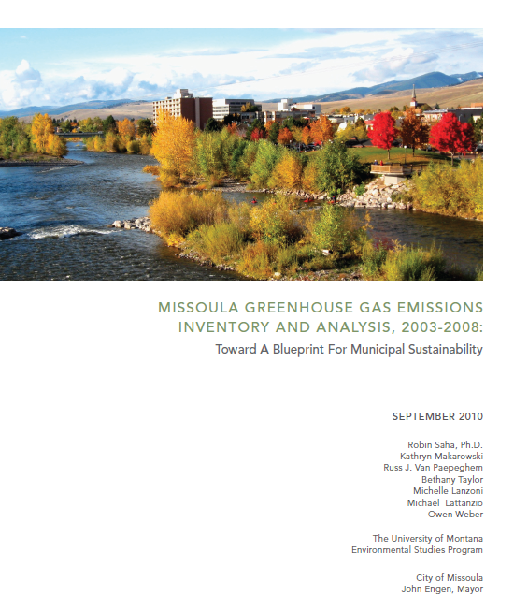
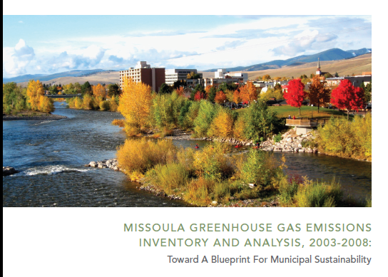
Recent Timeline
Sept. 2010 – Greenhouse Gas Emissions Inventory released
Apr. 2011 – Mayor Engen formed Climate Action Plan Task Force
2012 - Energy Conservation Coordinator position created and filled (Chase Jones)
Nov. 2012 – Missoula Conservation and Climate Action Plan (CCAP) released
Jan. 2013 – Missoula City Council adopts the CCAP, calling for establishment of a technical advisory team
Oct. 2013 – Technical Advisory Team holds first meeting
Notes:
ICLEI, now the Local Governments for Sustainability, founded in 1990 at its inaugural conference at the United Nations in New York
Now 1075 local governments representing over 400 million people worldwide
Missoula, Bozeman, Helena and Red Lodge belong
Framework of 5 milestones for local governments to achieve emissions reductions

Slide 6
Emissions Inventory Objectives
To present a baseline emissions inventory
quantifying municipal energy use and associated GHG emissions for each municipal sector
To identify major sources of municipal emissions
relative contributions within and among the sectors
To examine changes and trends in energy use, costs and emissions from FY 2003 to FY 2008
To offer recommendations to reduce municipal GHG emissions
Notes:
Forecasting future emissions and analyses of costs of emissions reduction measures will be needed to make good decisions regarding an appropriate and achievable emissions reduction target. Such analyses, however, were beyond the scope of this project.

Slide 7
Approach - What We Included
Examined energy use, costs and emissions from:
Wastewater treatment (electricity, natural gas, biogas)
Operation of 29 municipal buildings (electricity & natural gas)
Municipal vehicle fleet and equipment, over 500 including ~330 vehicles (unleaded, diesel & biodiesel)
Employee Commuting (unleaded and diesel)
Outdoor lighting including Street Light Districts (electricity)
Water for streets, buildings and parks (electricity)

Slide 8
What Was Not Included
Solid waste
Embedded energy in products consumed and materials used
Energy associated with construction projects performed by outside contractors
“Agriculture” and urban forests
Solar electricity generation

Slide 9
Primary Data Sources
NorthWestern Energy – Vicki Judd (272 accounts in FY08)
Mountain Water – John Kappes
Msla Finance Dept. – Mary Kay Wedgwood
Msla Wastewater Division – Starr Sullivan/Gene Connell
Msla Vehicle Maintenance Dept. – Jack Stucky
Msla Fire Dept. – Jason Diehl, Cheryl Schatz
Msla Human Resources Dept.
Msla Public Works Dept.
National Climatic Data Center
U.S. Census Bureau
125 anonymous city employees

Slide 10
EVST Student Researchers / Co-authors
Kathryn Makarowski
Russ J. Van Paepeghem
Bethany Taylor
Michelle Lanzoni
Michael Lattanzio
Owen Weber

Slide 11
Greenhouse Gas Emission Estimates
Used ICLEI’s Clean Air and Climate Protection (CACP) Software – a collaborative product of the National Association of Clean Air Agencies (NACAA) and the U.S. EPA

Slide 12
Summary of Findings

Slide 13
Total emissions in FY08: 11,540 tons of CO2e

Slide 14
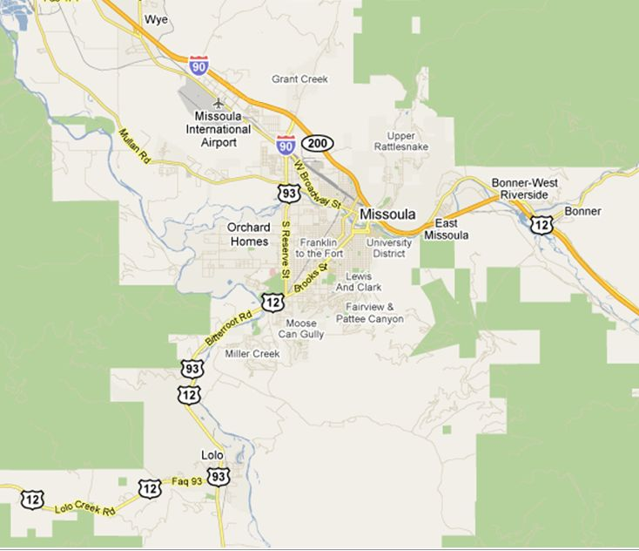
Total emissions in FY08
11,540 tons of CO2e =25.5 million pounds = = Weight of 7,500 Subaru Outback Wagons, stretching from Missoula to Lolo and back

Slide 15
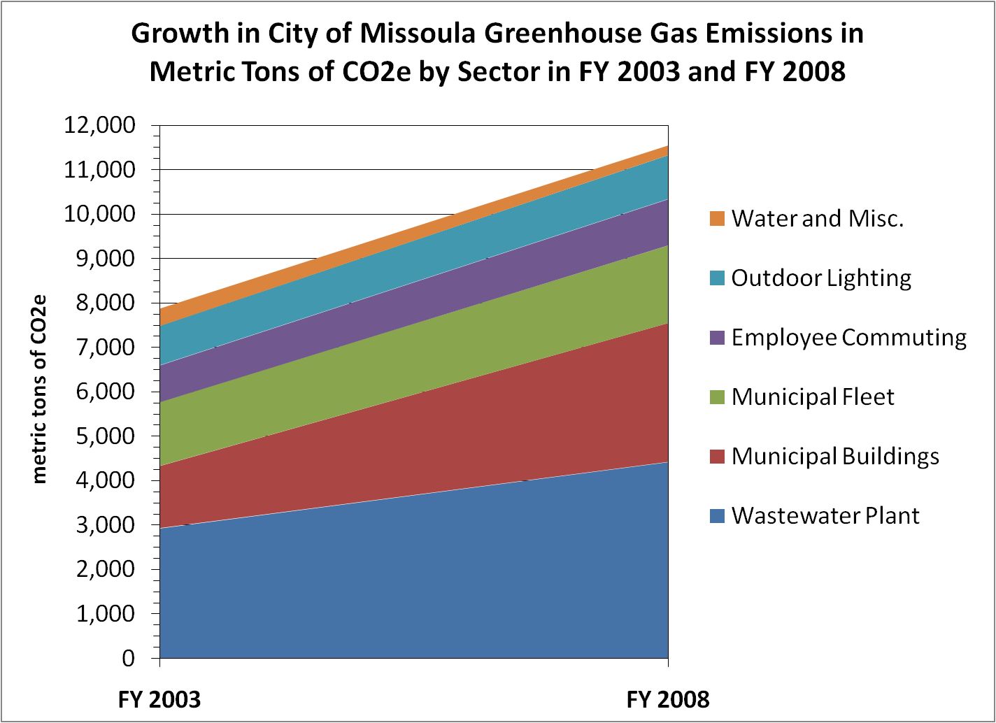

Slide 16
Drilling Down
Electricity Use

Slide 17
11.2 million kWh is equivalent to about 1,200 homes

Slide 20
Drilling Down
Natural Gas Use

Slide 24
“Quick and Dirty” Emissions Forecast

Slide 25
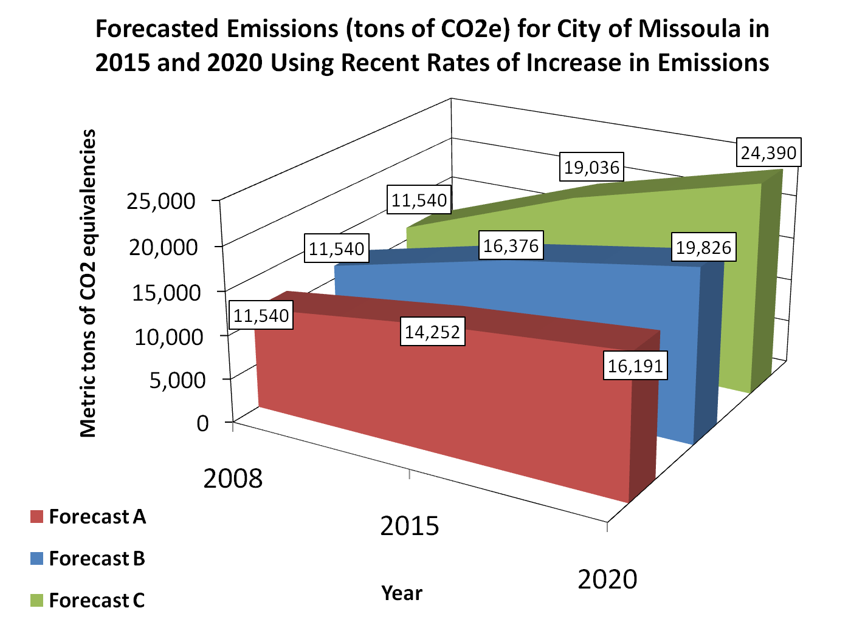
(excluding all new building)
(excluding Currents & Splash)
(including all new buildings)

Slide 26
Where Does Missoula Stack Up?
Milestone | Helena | Bozeman | UM | Missoula
Conduct Emissions Inventory |  |  |  | 
Establish a Reduction Target |  |  | 
Develop Climate Action Plan |  |  | 
Implement Climate Action Plan |  |  | 
Monitor Progress and Report Results

Slide 27
Greenhouse Gas Emission Trends and Emission Reduction Targets for Bozeman, Helena, and the University of Montana
 | Base Year / Comp. Year | Base Year Emissions (tons CO2e) | Comp. Yr. Emissions (tons CO2e) | % Change | Ave. Annual % Change | Emissions Reduction Target
Missoula | 2003 / 2008 | 7,883 | 11,540 | 46.4% | 9.4% | N/A
Bozeman | 2000 / 2006 | 6,083 | 7,866 | 29.3% | 4.9% | 15% below 2000 level by 2020
Helena | 2001 /2007 | 12,691 | 10,397 | -18.1% | -3.0% | 15% below 2007 level by 2020
UM | 2000 / 2007 | 36,657 | 42,687 | 16.4% | 3.3% | 100% below 2007 level by 2020
Sources: Bozeman Climate Protection Task Force 2008; Helena Climate Change Task Force 2009; Davie 2007; and Peacock and Bloom 2010.

Slide 28
Conclusions & Recommendations

Slide 29
Conclusions
Missoula’s municipal GHG emissions have increased rapidly in recent years
At a far greater rate than other cities in Montana
Rate outpaces our population growth
Outpaces Montana as a whole … and the nation
Emissions contribute to threats to the things Missoulians value:
Our open space, rivers and streams, forests and parks, clean air, and our health
City budget and our economy
Our sense of civic responsibility and sustainability

Slide 30
More … Costly Conclusions
Energy costs have also risen substantially in recent years (233%)
Increases in energy costs are unsustainable and may undermine City’s ability to efficiently provide services Missoulians expect

Slide 31
The Good News Is …
Climate protection and energy costs savings, fiscal responsibility, are mutually-beneficial civic goals

Slide 32
A Four Part Strategy … building on existing successes
Set a greenhouse gas emissions reduction target, e.g., zero net emissions by 2020
-- without a clear goal, progress will be hard to achieve or measure
Carry out a climate action planning process
-- to identify, prioritize, and adopt policies to support emission reduction goals.
Develop an efficient energy use monitoring and reporting system
-- to assure accountability and gauge progress toward emission reduction goals
Delegate responsibility for implementing, managing and reporting on energy-saving measures – being accountable!
-- climate action takes dedicated personnel.

Slide 34
Local Climate Action Plans (from Boswell et. al. 2012*)
Plan for reducing (mitigation) emissions and also for adapting to impacts
Cities for Climate Protection Milestones Guide is often used (5 steps)
Typical categories: land use, transportation, energy use, and waste
May distinguish between community-wide actions and local gov’t operations
May be stand-alone document or integrated into comprehensive land use and other plans
Vary by role (i.e., function in community) and content
* Boswell, Michael R., Adrienne I. Greve, and Tammy L. Seale. 2012. Local Climate Action Planning. Washington D.C.: Island Press.

Slide 35
CAP Functions (from Boswell et. al. 2012)
Establishes actions necessary to reduce local GHG emissions and meet desired targets
Establishes action for adapting to climate-change induced impacts and hazards
Establishes accountability for action
Brings stakeholder groups together
Informs the public
Integrates actions with various community plans
Integrates actions across different scales (local, regional state, national, etc.)
Saves money through energy efficiency and builds the local economy
Improves community health and livability
Responds to local context and conditions

Slide 36
Typical CAP Content (from Boswell et. al. 2012)
Background on climate change and potential impacts
Inventory of local emissions using standard protocol
Forecasts of future GHG emissions
Emission reduction strategies (quantified and based on best available science and appropriate for the jurisdiction)
Covering energy, transportation, waste, land use etc.
Adaptation strategies that reflect community history, local values and traditions
Implementation program, including assignment of responsibility, timelines, costs and financing mechanisms
Monitoring and evaluation programs

Slide 37
Reasons to Prepare a CAP (from Boswell et. al. 2012)
Global leadership
Energy Efficiency
Green Community (create image possibly to promote tourism or economic development
State Policy (comply with directives or anticipate looming mandates)
Grant Funding
Strategic Planning
Public Awareness
Community Resiliency

Slide 38
3 Phases to CAP Preparation PHASE 1 – Preliminary Activities PHASE 2 – CAP Development PHASE 3 – Implementation & Monitoring
Notes:
Phase 1
Establish community commitment Build community partnerships Establish the role of the plan Assemble a Climate Action Team (CAT) Consider logistics of plan development Establish public education and outreach program Audit existing community policies and programs
Phase 2
Conduct baseline GHG inventory and interim forecast
Formulate plan vision and goals
Identify GHG emission reduction target
Develop, evaluate, and specify GHG emission reduction strategies
Quantify the strategies
Phase 3
13. Develop and administer an implementation program
14. Monitor and evaluate implementation and reduction targets
15. Modify and update the plan

Slide 39
Creating a Task Force
Conservation and Climate Action
Plan Task Force
Mayor’s Advisory Group on Climate Change and Sustainability
Climate and Energy Team
Experts and professionals from the Missoula Community
City Staff

Slide 40
Task Force Members
Amy Cilimburg, Montana Audubon (Task Force Co-Chair)
Ross Keogh, Sagebrush Energy (Task Force Co-Chair)
Jill Alban, Clark Fork Coalition
Dan Daly, Roseburg Forest Products Co.
Steve Loken, Loken Builders
Bryan von Lossberg, Alternative Energy Resources Organization
Ginny Merriam, City of Missoula
Cherie Peacock, PE, LEED AP, University of Montana
Robin Saha, Ph.D., University of Montana
Beth Schenk, St. Patrick Hospital and Health Sciences Center
Ben Schmidt, Missoula City-County Health Department
Jack Stucky, City of Missoula
Andrew Valainis, Climate Ride (Previous Energy Corps Member)
Krisztian Varsa, (Previous Energy Corps Member)

Slide 41
Why are we doing this? Why is it important?
Conservation & Climate Action Planning
Operating efficiently and saving money
Energy and resource conservation
Climate Change - Maintaining a healthy environment and community
Government leading by example

Slide 42
The Conservation & Climate Action Plan
Scope
Municipal Operations
Mitigation
Objectives
Document current activities
Identify potential reduction strategies
Evaluate feasibility of the strategies
Establish a reduction target and date
Research and consider monitoring, tracking and reporting system
Notes:
Get house in order before expanding to community

Slide 43
The Bottom Line – Where do we want to go? Emissions Reduction Targets
11,540 mtCO2e
10% below 2008 levels by 2015
30% below 2008 levels by 2017
50% below 2008 levels by 2020
CARBON NEUTRALITY BY 2025
Notes:
Carbon neutrality means that through conservation and reduction measures, along with the purchase of Carbon Offsets, the City’s net greenhouse gas emissions will be zero. Achieving carbon neutrality requires the purchase of some form of Carbon Offsets to account for emissions that remain after conservation and other forms of reduction have been fully explored. A Carbon Offset is one metric ton of carbon dioxide equivalent (CO₂e) that is taken out of the atmosphere, or one metric ton of CO₂e that is not emitted to the atmosphere. Carbon Offsets are generated by carbon sequestration or emissions reduction activities that are quantified, reported, verified, validated, and certified via the regulatory or voluntary market. ClearSky Climate Solutions: www.clearskyclimatesolutions.com

Slide 44
Working Groups
Fleet & Facilities
Renewable Energy & Offsets
Internal Policies & Practices

Slide 45
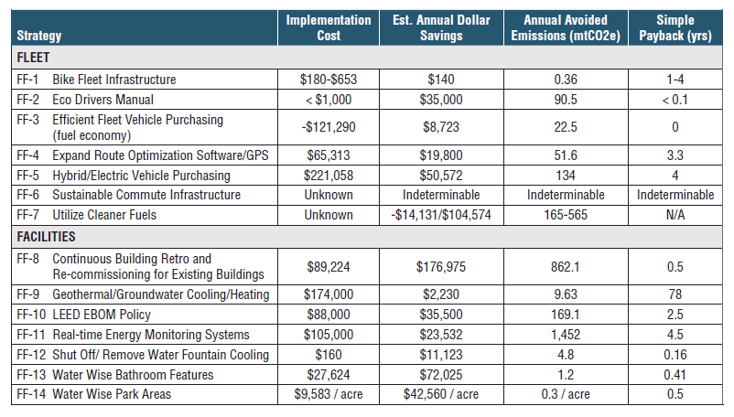
Fleet and Facilities
Notes:
Infrastructure, building energy use, vehicles and equipment, fuel use, and staff commuting

Slide 46
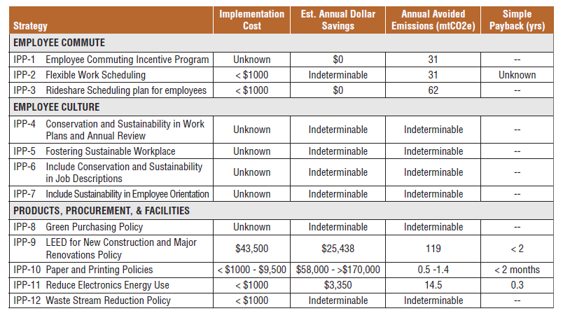
Internal Policies and Practices
Notes:
Operations policies, workplace culture, purchasing, employee health and wellbeing

Slide 47
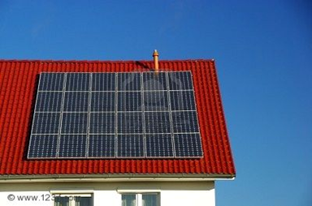
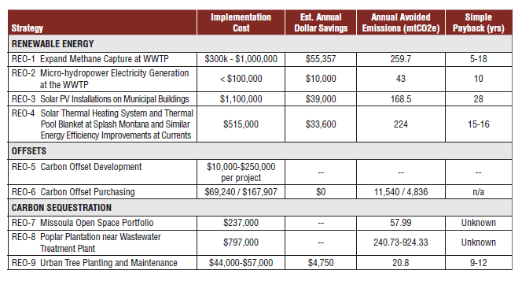
Renewable Energy and Offsets
Notes:
Renewable energy generation, carbon sequestration projects, and carbon offsets

Slide 48
Adding it up...
6,762 mtCO2e*
Carbon Neutrality
11,540 mtCO2e
Identified strategies
Future strategies + Offsets
*Some strategies not yet quantified
Notes:
We were at 11,540 in 2008, and from all the strategies we’ve identified, we can get down to at least 6,762
There are always uncertainties, but note that the behavior and culture strategies are not quantified

Slide 49
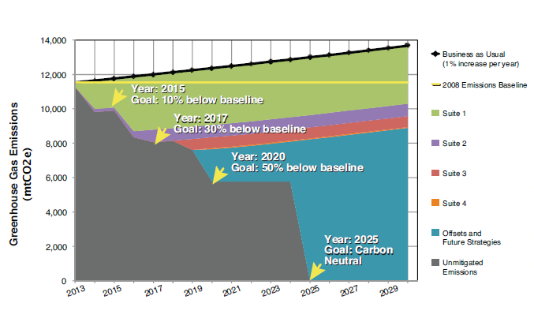

Slide 50
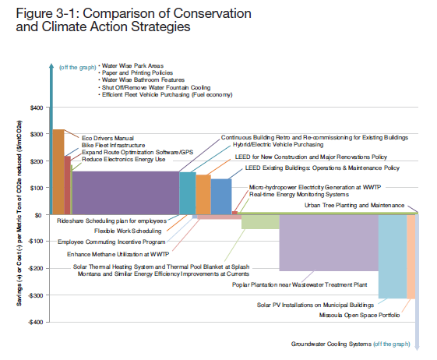

Slide 51
Plan to Succeed
Energy Conservation Coordinator
Budget and Financing Strategy
Data Monitoring, Tracking and Reporting
Technical Advisory Committee
Implementation and Timeline

Slide 52
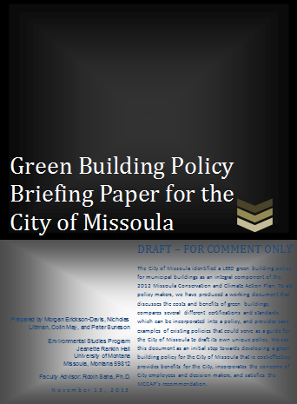
Getting Started!

Slide 53
“This is a good thing, a long time in the making, that will have consequences for many years to come. With this plan, we further commit to doing the right thing.”
-John Engen
Mayor
FOR MORE INFORMATION ON MISSOULA’S CCAP, CONTACT:
Chase Jones
Energy Conservation Coordinator, City of Missoula
406-552-6389
cjones@ci.missoula.mt.us
ci.missoula.mt.us

Slide 54
To jump into climate action …
Take ENST 476/CCS 485 Environmental Citizenship / Srv Lrng
Spring 2014
Meets Mon. 11-12 and Wed. 11-1
CRN 32861
Project class with focus on individual behavior change, fostering sustainable behaviors, leadership development, and environmental organizing
Take CCS 395 Climate and Clean Energy Policy (co-convenes with ENST 367 Environmental Politics and Policy
Also Spring 2014, MW 3:10 to 4:30 PM
CRN 35388
Topics include:
critical analysis of “clean energy”
renewable energy impacts and impact mitigation
campus, local, state and federal climate and energy policy
climate action planning
climate activism

Slide 55
Questions?

Slide 56
Greenhouse Gas Emissions in MT
60% higher per capita than the rest of the country (40 vs. 25 metric tons/year)
Estimated increase of 14% between 1990 and 2005 or 1% per year
Net annual GHG emissions average ~12 million metric tons of carbon dioxide equivalents (tons of CO₂e)
A metric ton is 1000 kilograms (approx. 2,205 lbs)
Source: Montana Climate Change Advisory Committee 2007

Slide 57
Impacts in Montana
Agriculture and water supply
Water temperatures and timing of run-off
Extreme weather events
Terrestrial and aquatic habitats
Threatened and endangered species
Invasive species
Tourism and related industries and local economies

Slide 58
Coordination with the City
Scoping meeting with Mayor’s Administrative Leadership Team (ALT) and other city staff, 2/09
Technical assistance meeting with Helena Utility Billing Dept. personnel, 2/09
Presentation to the Missoula GHG Energy Cons. Team, 3/09
On-going collaboration with city personnel
Staff comment and review of all chapters
Presented preliminary findings to:
GHG Energy Conservation Team on Apr. 8, 2009
Mayor’s Advisory Group on Climate Change and Sustainability on May 12, 2009
ALT on June 16, 2009
Presentation to Mayor’s Advisory Group on Climate Change and Sustainability on Sept. 9, 2010

Slide 59
Number of NorthWestern Energy (NWE) Accounts by Energy Type and Sector, FY03 and FY08
Sector and Energy Type | FY03 | FY08
Municipal Buildings | 31 | 48
Electricity | 18 | 26
Natural Gas | 13 | 22
Wastewater Treatment | 28 | 35
Electricity | 28 | 34
Natural Gas | 0 | 1
Lighting | 113 | 124
Electricity | 113 | 124
Natural Gas | 0 | 0
Other Miscellaneous | 71 | 65
Electricity | 68 | 64
Natural Gas | 3 | 1
Total (All Sectors) | 243 | 272
Electricity | 227 | 248
Natural Gas | 16 | 24

Slide 60
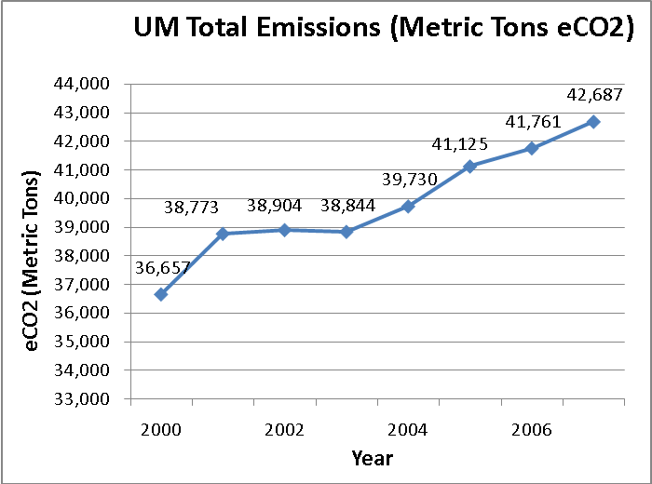
UM’s Greenhouse Gas Inventory
Notes:
Again, you can see the overall increase in all sectors.

Slide 61
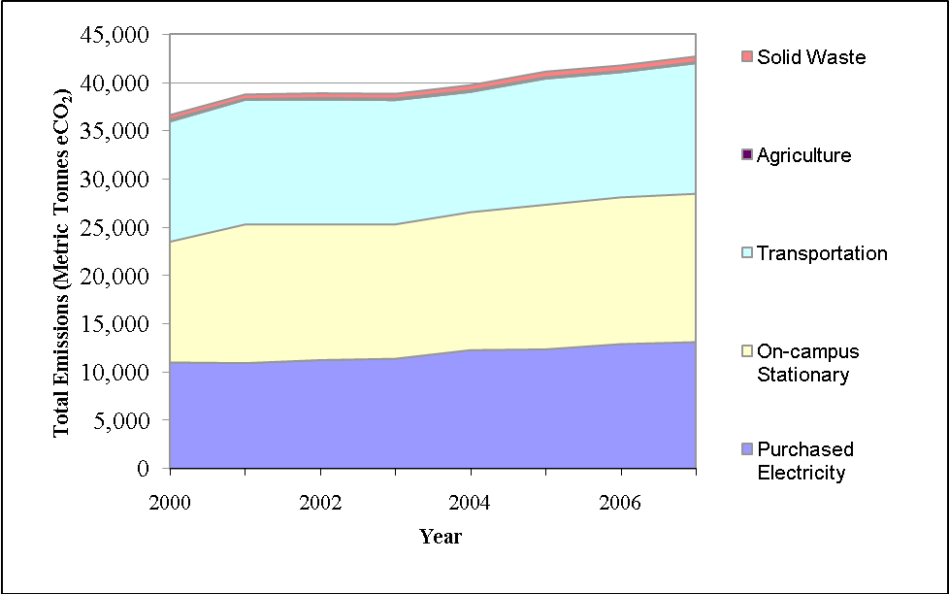
UM’s Greenhouse Gas Inventory
Transportation
Steam Plant
Purchased Electricity
Notes:
Again, you can see the overall increase in all sectors.

Slide 62
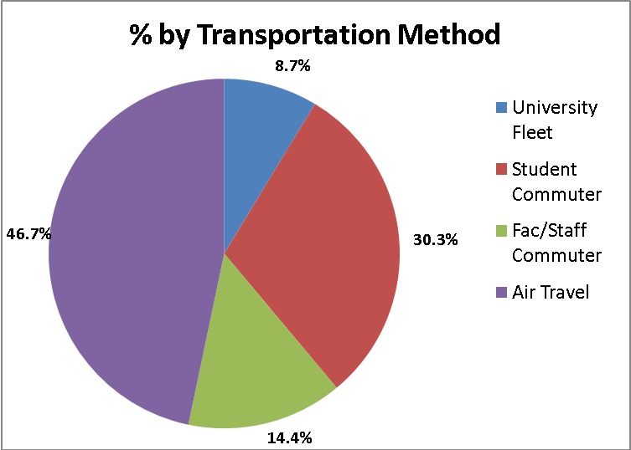
UM’s Greenhouse Gas Inventory
Fleet
Student
Commuting
Air Travel
Fac/Staff
Commuting
*Athletics not included
Notes:
Again, you can see the overall increase in all sectors.

Slide 63
Drilling Down
Energy Costs

Slide 66
Overarching Recommendations (see report for sector-specific recommendations)
Set an Emissions Reduction Target & Develop a Climate Action Plan
Form a Climate Action Plan Task Force
Develop Energy and Emissions Monitoring and Reporting System
Consider a Four-day Work Week and Work-at-Home
Create a Revolving Energy Loan Fund
Explore Renewable Energy Partnerships
Consider Municipal Energy Bond or Renewal Energy Loan Fund
Establish Renewable Energy Certificate and/or Carbon Offset Program
Hire a Full-time Permanent Sustainability Coordinator
Integrate GHG Emissions into Planning and Decision Making

Slide 67
Costs of Inaction
Continued increase in energy costs
Bites into municipal and household budgets
Higher costs of goods and services
Less to spend and invest on city services and local economy
Threats of climate change go unabated
Impacts to the things Missoulians value
Parks and open space
Forests and streams
Wildlife habitat
Quality of life and livability of our neighborhoods
Our economy

Slide 68
Moving Forward – How To, How Not To
Steps toward sustainability that rely on planning, policy and practice have proven successful in cities (Zahran et al. 2008; Portney 2003; Bulkeley and Betsill 2003)
Local initiatives are less successful if disconnected and piecemeal actions occur outside of a broader context of sustainability
Local climate solutions are less successful when environmental priorities are seen as being in conflict with other municipal agendas (Portney 2003)

Slide 69
Local Solutions to Climate Change
Build on efforts already underway
Use the Mayors Climate Protection Agreement framework – Develop a climate action plan
Adopt emissions reduction strategies to Missoula that:
Use less energy and use what we use more wisely
Recover waste energy
Developing renewable energy capacity
Attend to staffing and funding needs
Build public-private partnerships
Draw of leadership and skills of movers-and-shakers, citizens, technical and policy wonks

Slide 70
Thank You!
City of Missoula
Mayor John Engen
Mayor’s Advisory Group on Climate Change & Sustain. Ginny Merriam
Bruce Bender
Jacky Stucky
Starr Sullivan
Gene Connell
Brentt Ramharter
Mary Kay Wedgwood
Marty Rehbein
Chase Jones
Anne Guest
Mike Painter
Jason Diehl
Cheryl Schatz
Roger Millar
City of Missoula cont.
Melissa Bache
Jackie Corday
Ben Schmidt
Rick Larson
Jolene Ellerton
Missoula Greenhouse Gas & Energy Conservation Team
Others
Vicki Judd, NorthWestern Energy
John Kappes, Mountain Water
Alex Stockman, Msla In Motion
Laura Millin, Msla Art Museum
WGM Group, Inc
Tim Magee, City of Helena
Liz Hirst, City of Helena
Carrie Hahn, City of Helena
Pat Judge, Helena
Ben Brouwer, AERO
MCV Conservation Roundtable
Six Pony Hitch
University of Montana
Environmental Studies Program
President Royce Engstrom
Sustainable Campus Committee
Cherie Peacock
Matt Hodges
Laura Goldberg
Brian Kerns
Chuck Harris
Lisa Swallow

Slide 71
References
Available by request or see full report

Slide 73
Sector-specific Recommendations

Slide 74
Wastewater Recommendations
Increase biogas reclamation and use – sell as RECs under MT Renewable Energy Portfolio Standard
Install other on-site renewable energy production, solar or wind power production
Support water conservation measures to reduce the total quantity (gallons) of influent wastewater that the plant receives for treatment
Expand ecological treatment / wastewater reclamation by growing biomass, i.e., hybrid poplars (carbon sinks)
Improve energy efficiency in design of future upgrades

Slide 75
Buildings Recommendations
Strengthen energy efficiency standards for new buildings
Adopt energy efficiency policies or standards for office equipment and lighting to be ENERGY STAR certified.
Conduct additional energy audits of all municipal buildings and performance contracting
Develop a new program to assess and monitor building performance and set goals, benchmarks, and a monitoring plan
Hire a new position to manage energy use for buildings, or train and reassign existing staff to serve in that capacity
Consider using Energy Performance Certificates, “energy identity cards” (Directgov 2009)
Inventory personal space heaters and other office appliances and consolidate or prohibit their use.
Reduce the number of vending machines in City buildings

Slide 76
Fleet Recommendations
Implement the Missoula Fuel Use Reduction Plan
Amend Administrative Rule #11 regarding vehicle use and anti-idling policy, or if necessary, pass an ordinance to accomplish same goals
Further encourage the use of alternative transportation (such as Mountain Line buses) for city business-related trips, minimization of vehicle use and other voluntary measures by City employees
Establish Green fleet policy whereby fleet size is reduced, smaller and more fuel efficient vehicles are purchased, and unneeded uses are eliminated

Slide 77
Employee Commuting Recs
Fund and implement the City employee “cash for commuters”
Encourage more employees to participate in vanpools carpools, and ride sharing
Provide free parking for employees who carpool
Incentivize living in Missoula or closer to work
Empower division and department heads and supervisors to allow four-day work weeks (see above).
Partner with Missoula In Motion on an employee car share program.
Further research ways to incentivize low-carbon and carbon-free employee commuting.

Slide 78
Lighting Recommendations
Investigate high annual ownership, operation and maintenance charges for Streetlight Districts and other outdoor lighting
Facilitate community dialog about reducing lighting costs for Streetlight Districts
Consider renegotiating contracts with NorthWestern Energy regarding light maintenance services
Consider transfer of responsibility for ownership, operations, and maintenance to the City for certain districts or lighting groups
Consider partner with NorthWestern Energy to install energy-saving Light-Emitting Diode (LED) luminaries for streetlights
Initiate outdoor lighting replacement projects for City-owned lights
Conduct other energy efficient lighting upgrades, such as installing small solar power cells on outdoor lighting fixtures

