Slide 1
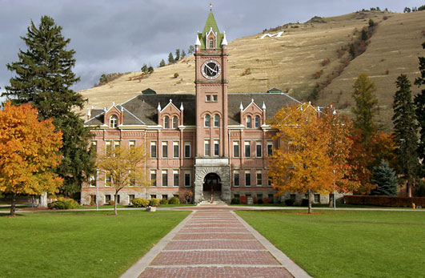
Sustainability at The University of Montana
Cherie Peacock, Sustainability Coordinator
The University of Montana-Missoula

Slide 2
Sustainability:
A Core Value at UM
“Consistent with the broader concept of sustainability, the University’s initiatives ultimately seek to enhance students’ understanding of the interconnectedness of ecological, social, and economic issues.”
--UM Strategic Plan

Slide 3
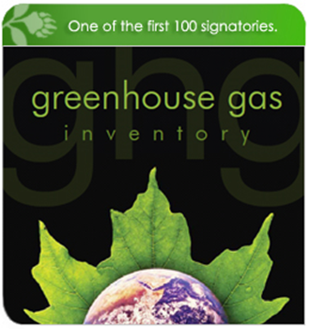
Committing to Action
2007 American College and University Presidents Climate Commitment
2008/2010/2012 Greenhouse
Gas (GHG) Inventories
2010 Climate Action Plan
Climate Neutral by 2020

Slide 4
UM Total Emissions MTeCO2 (Metric Tonnes of CO2 Equivalent)
Air Travel

Slide 5
Total Greenhouse Gas Emissions, MTeCO2
Air Travel
2015 goal
10% below 2007 levels

Slide 6
Steam Plant Emissions, MTeCO2 (not normalized for weather)
Air Travel
Heating Degree Days

Slide 7
Purchased Electricity Emissions, MTeCO2
Air Travel

Slide 8
Commuting Emissions, MTeCO2
Campus Population
Air Travel

Slide 9
Air Travel Emissions, MTeCO2
Air Travel

Slide 10
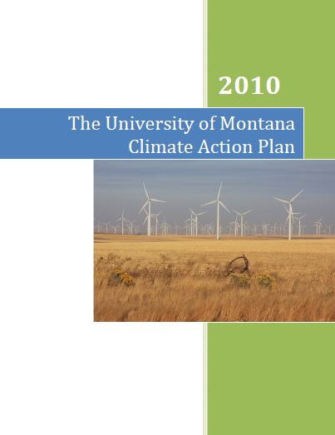
Climate Action Plan
Strategies to reduce
GHG Emissions
Strategies to include
sustainability in
education, outreach,
and research
Public Involvement

Slide 11
Energy Efficiency and Conservation
Energy manager
Smart meters
Real-time monitoring
Energy audits
Equipment retrofits
Retro-commission HVAC systems
Behavior change

Slide 12
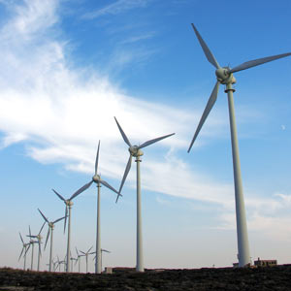
Renewable Energy
Biomass
Solar photovoltaic
Solar thermal
Wind Power

Slide 13
Green Buildings
LEED New Construction (NC) Silver certification required for all new buildings

Slide 14
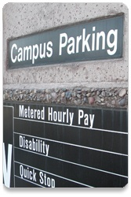
Transportation
Increase incentives to bike, walk, and bus
Disincentives for parking
Replace fleet with fuel efficient vehicles
Increase teleconferencing
Purchase carbon offsets for
air travel

Slide 15
Offsetting Emissions
Carbon Offsets
Renewable Energy Credits

Slide 16
Climate Action Plan Interim Goal-
10% by 2015
Projected Emissions Growth
Reductions due to strategies
10% below 2007 greenhouse gas emission levels by 2015

Slide 17
Climate Action Plan Neutrality Target-
Carbon Neutral by 2020
Off- Campus
Wind
Offsets
Carbon Neutral by 2020
Biomass Plant

Slide 18
Sustainability in the Curriculum
Climate Change Studies Minor
Available to students of any discipline
Green Thread
Faculty training workshop
Infuses sustainability throughout the curriculum

Slide 19
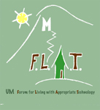
Campus Sustainability
Recycling
Campus-wide
Student fee funded
UM FLAT
Forum for Living with Appropriate Technology
House dedicated to student experiential learning

Slide 20
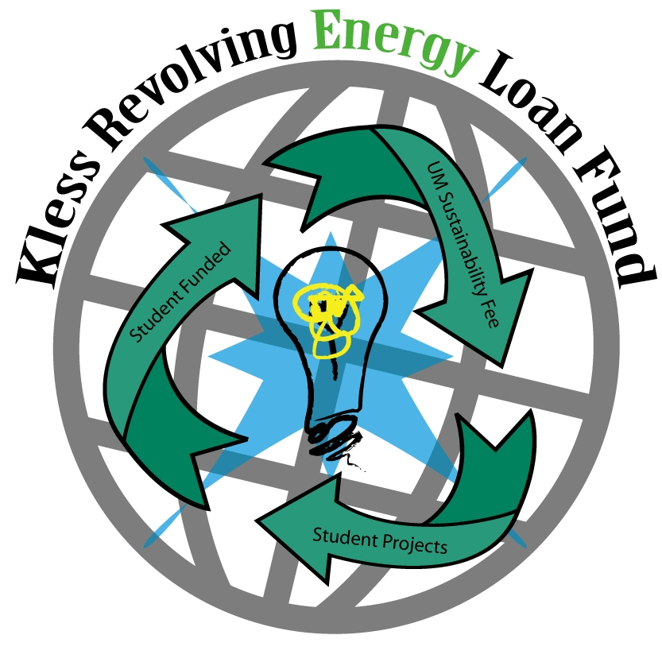
Campus Sustainability
Farm-to-College
Locally grown food
Campus gardens
Composting
Kless Revolving Energy Loan Fund
Student fee created
Energy-saving projects
Savings pay back loan

Slide 21
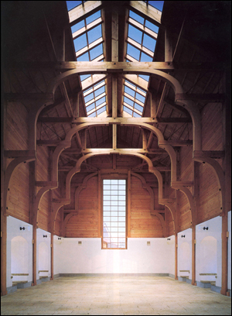
Architecture and Sustainability
“What is ecologically appropriate, what is socially and psychologically valuable, what is beautiful to the eye, what is comforting to the soul - these are all wrapped up together in the global judgment of wholeness.”
Christopher Alexander, author, architect, professor

Slide 22
Architecture and Sustainability
Why is architecture important to sustainability?
48% of energy consumed in the US is attributed to the building sector
Other sectors are transportation and industry
42% of electricity in US comes from coal
76% of this electricity is consumed by the building sector
Architecture 2030 and US Energy Information Administration

Slide 23
Architecture and Sustainability
Why is architecture important to sustainability?
Embodies human values
Buildings as connection or barrier with nature
Dwelling in alignment with values can create positive feelings

Slide 24
LEED
Leadership and Energy and Environmental Design
Internationally recognized green building program
LEED certification program is managed by the US Green Building Council
Provides a framework to identify and measure green building strategies
Payne Family Native American Center achieved LEED Platinum, the highest rating possible

Slide 25
LEED Certification Process
Select rating system
New Construction and Major Renovation
Commercial Interior
Core and Shell
Retail
Schools
Homes
Healthcare
Neighborhood Development
Existing Buildings Operation and Maintenance

Slide 26
LEED Certification Process
Register project and pay fee ($1200)
Submit certification application and pay fee (varies according to scope of project)
Application includes templates filed out for each credit
Back-up data can be extensive
Credits are worth points
The more point earned, the higher the rating: Certified, Bronze, Silver, Gold, Platinum

Slide 27
LEED Certification Process
Credits, or points, are given for things like:
Energy efficiency
Green cleaning
Using local or recycled-content materials
Water efficiency
Daylight and views for people occupying building
Renewable energy
USGBC reviews application and grants certification

Slide 28
LEED Credentials
LEED professionals
LEED Green Associate
LEED Accredited Professional with specialty
LEED Fellow
LEED at UM
All new buildings will be minimum LEED Silver
LEED EBOM (Existing Building Operation and Maintenance) researched and implementation planned if funded

Slide 29
Payne Family Native American Center
LEED Platinum certified
Second-most energy efficient building on campus
for heat and power
(Rankin Hall most energy efficient but it is not fully conditioned
and the NAC is.)

Slide 30
More Information
http://www.umt.edu/greeningum/
Office of Sustainability
Cherie Peacock, Sustainability Coordinator
cherie.peacock@umontana.edu
406-243-6001

