Slide 1
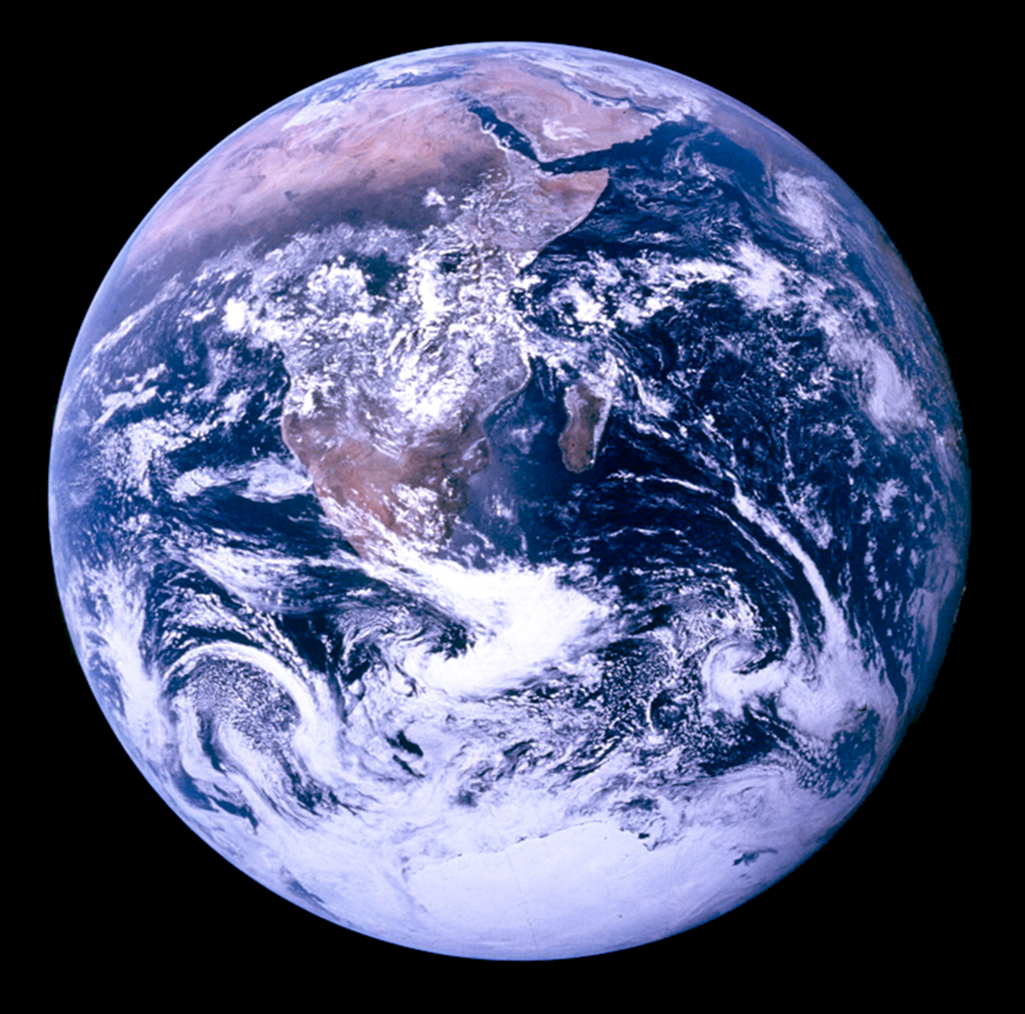
Principles of the
Global Climate System II
Bill Smith
CCS103, 2013

Slide 2
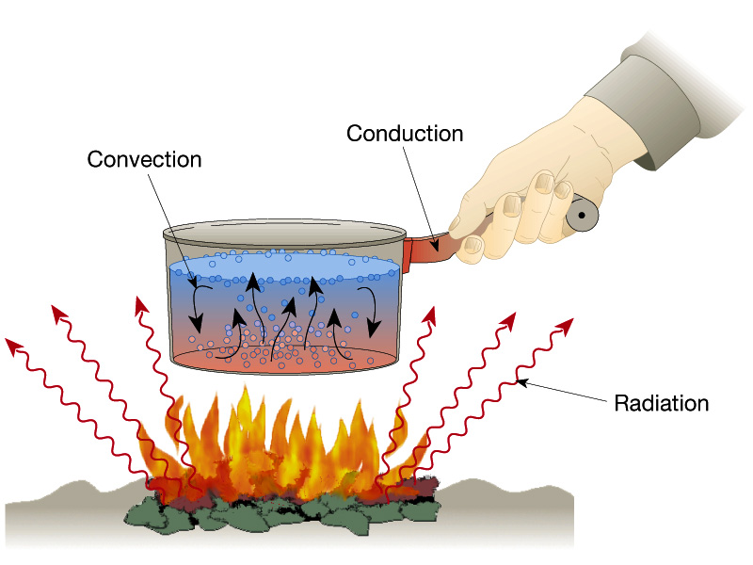
Energy Transfers in 3 Ways
Conduction
  Molecule-to-molecule transfer
Convection
  Heat energy transferred by movement
Radiation
  The transfer of heat by the movement of electromagnetic waves
  Does not require a medium

Slide 3
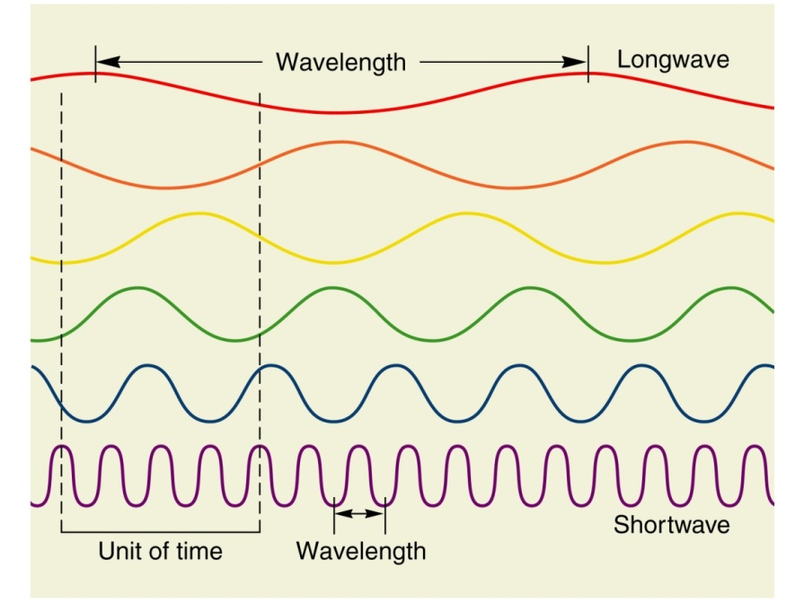
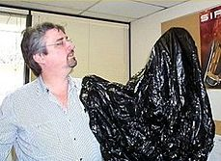
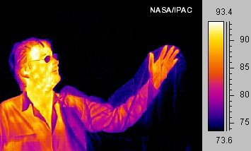
Electromagnetic (EM) Radiation
All objects emit electromagnetic radiation

Slide 4
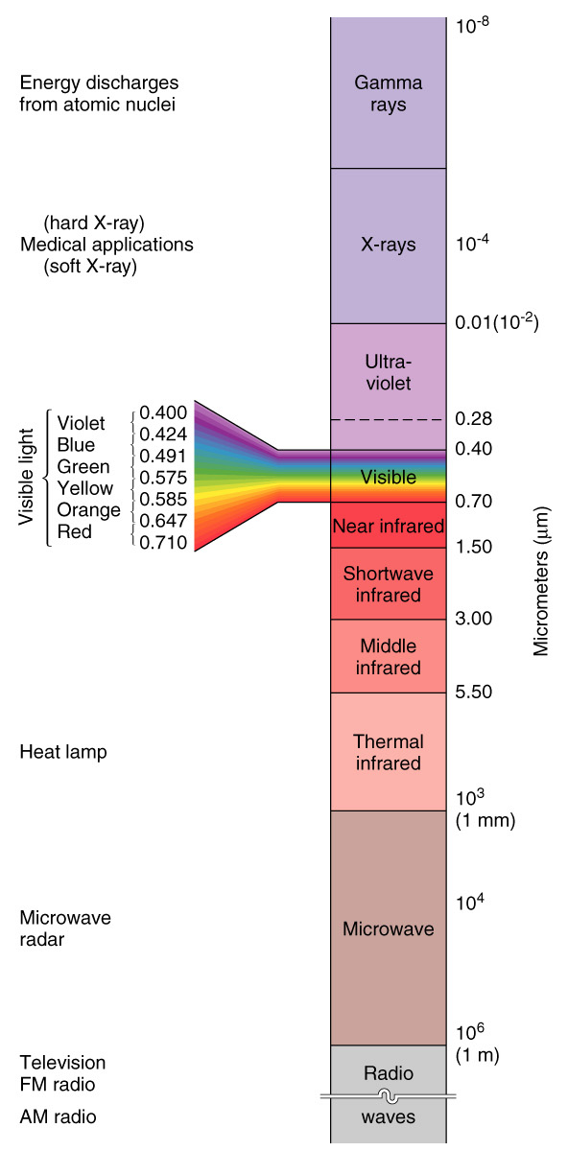
EM Spectrum
Shortwave Radiation
  Shorter than 3 μm
  Visible, UV, x-rays, etc.
  Emitted from the Sun
Longwave Radiation
  Longer than 3 μm
  Thermal, microwave, radar, etc.
  Emitted from Earth

Slide 5
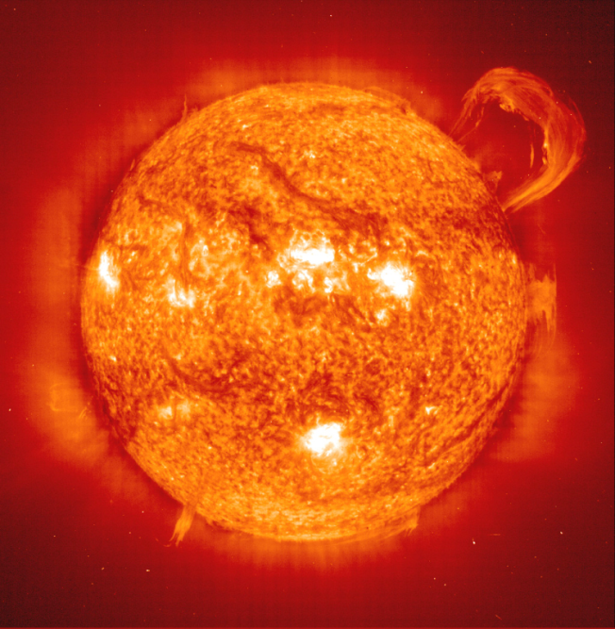
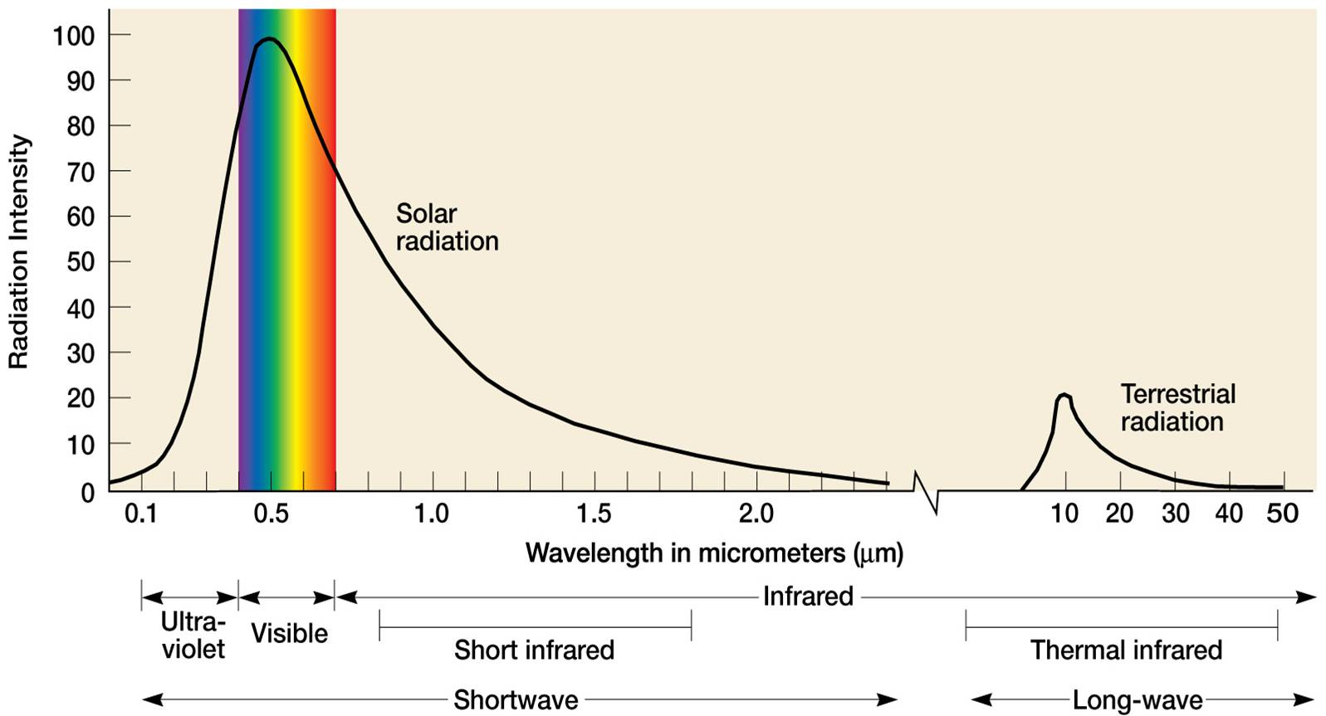
The Sun
Surface temperature
~5505 °C (9941 °F)

Slide 6
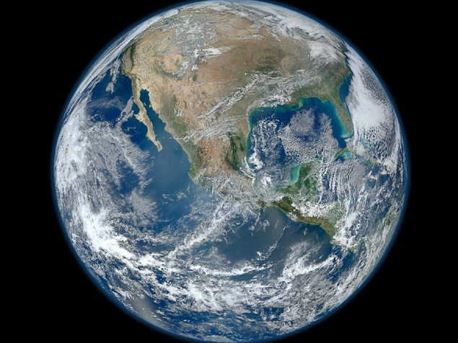
The Earth
Surface temperature
~15 °C (59 °F)

Slide 7



Solar (Shortwave) Radiation
GHG
GHG
DUST
Terrestrial (Longwave) Radiation

Slide 8
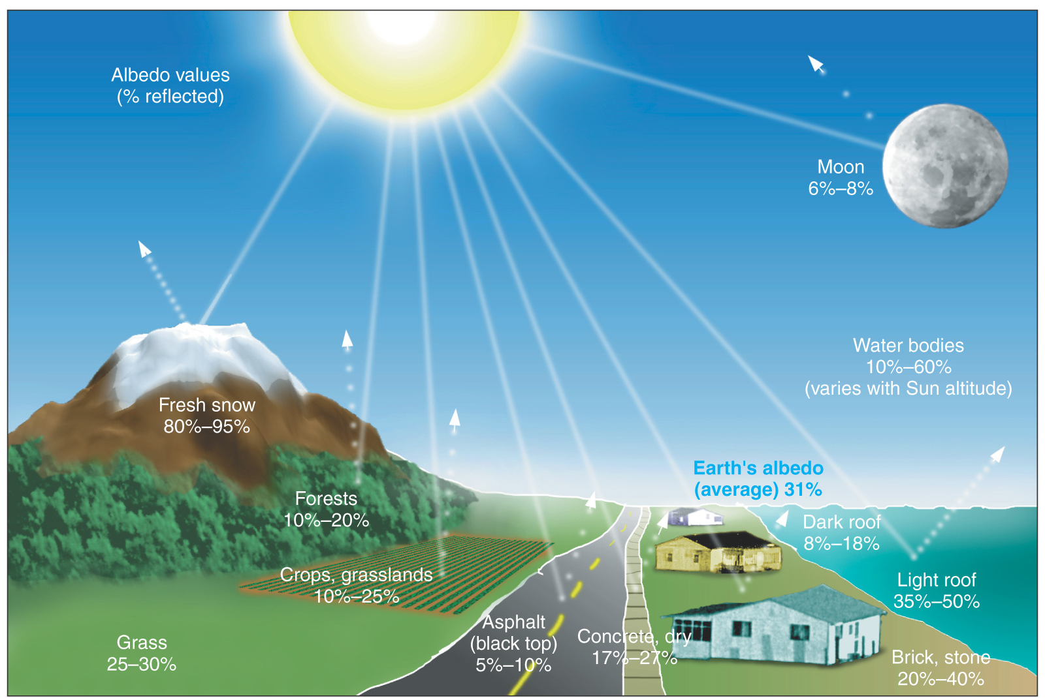
Albedo

Slide 9
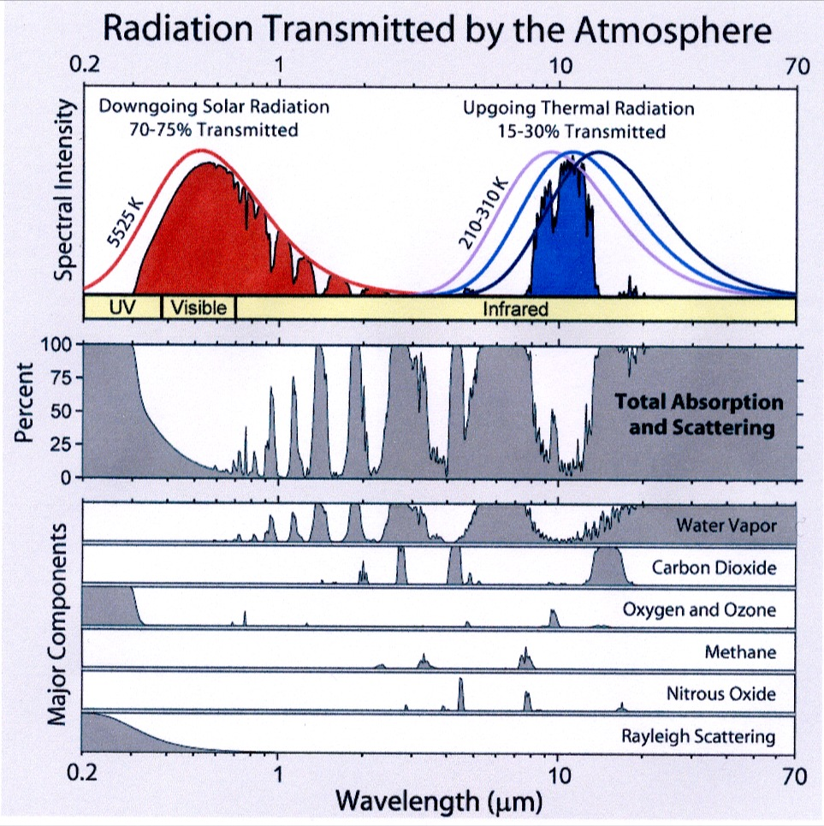
Greenhouse Gases
Water Vapor
  ~3 pph maximum
  Most important GHG
  Equilibrium temp.
  -20 °C (-4 °F)
  Observed temp.
  15 °C (59 °F)
  Only changing by about 1% / decade.
Notes:
What is absorption??

Slide 10
Greenhouse Gases
Carbon Dioxide
  ~394 ppm
  1-3 ppm annually
  Produced by:
    Fossil fuel combustion
    Animal Respiration
    Plant Respiration

Slide 11
Greenhouse Gases
Ozone
  ~34 ppb
  Forms only secondarily
  Roughly 34 ppb
  Global increase of roughly 30% since industrial revolution.
Notes:
Ozone

Slide 12
Greenhouse Gases
Methane
  2ppm
  A by-product of agriculture and farming, vehicles, factories, …
  25x more potent than CO2
  1/3 contribution to global warming relative to CO2

Slide 13
Greenhouse Gases
Nitrous Oxide
  300 ppb
  By product of agriculture and industry
  300x more potent than CO2
  Relatively long atmospheric residency time

Slide 14
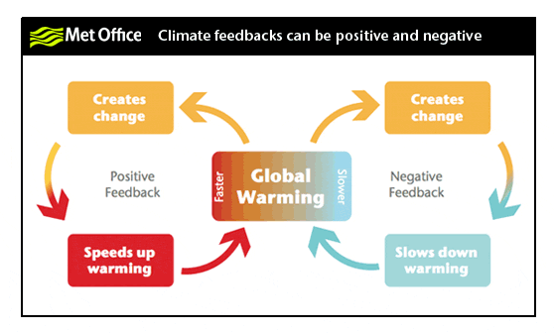
Climate Feedbacks
“An interaction mechanism between processes in the climate system is called a climate feedback, when the result of an initial process triggers changes in a second process that in turn influences the initial one. A positive feedback intensifies the original process, and a negative feedback reduces it.” Open Source Systems, Science, Solutions

Slide 15

An Example:
CO₂ in the oceans
Increased ocean water temperature
Increased Temperature
Positive
Feedback
Decreased CO₂ storage capacity
Increased atmospheric CO₂

Slide 16
Group Work
Group 1: Forest Fires
Group 2: Clouds
Group 3: Snow/Ice
Group 4: Water Vapor
Group 5: Desertification
Group 6: Growing Season Length
Group 7: Permafrost

Slide 17
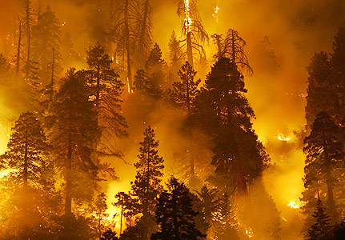
Forest Fires
Increased Fire Frequency
Increased Temperature
Positive
Feedback
Decreased CO₂ storage capacity
Increased atmospheric CO₂

Slide 18

Clouds
Increased evaporation
Increased evaporation
Increased Cloud Cover
Negative
Feedback
Increased Temperature
Positive
Feedback
Increased Cloud Cover
Increased SW Reflectivity (albedo)
Increased LW insolation (Greenhouse)

Slide 19
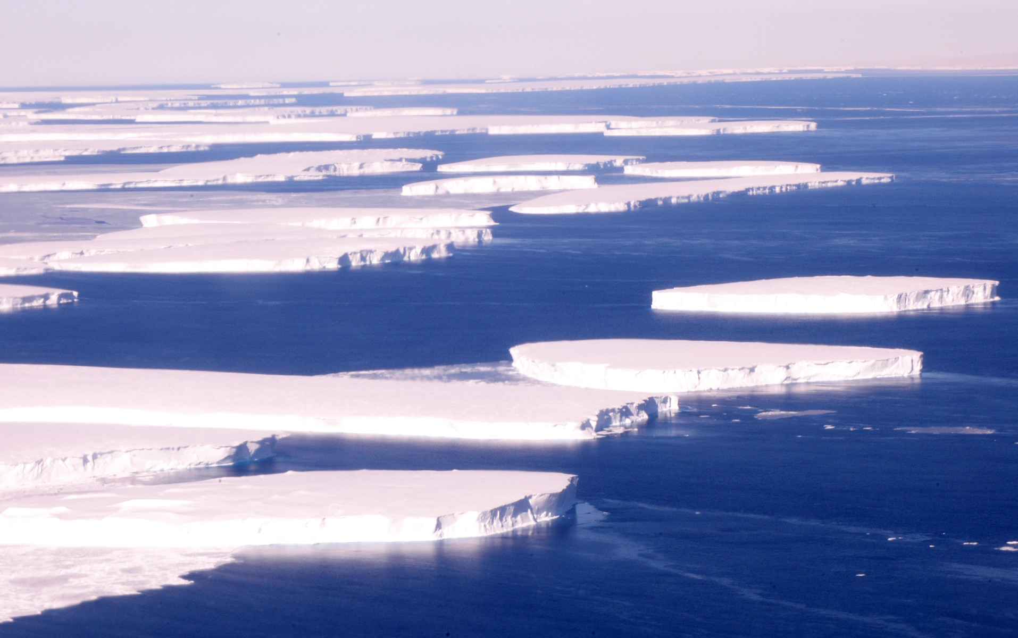
Snow/Ice
Increased snow/ice melt
Increased Temperature
Positive
Feedback
Decreased reflectivity (albedo)
Increased SW absorbtion

Slide 20
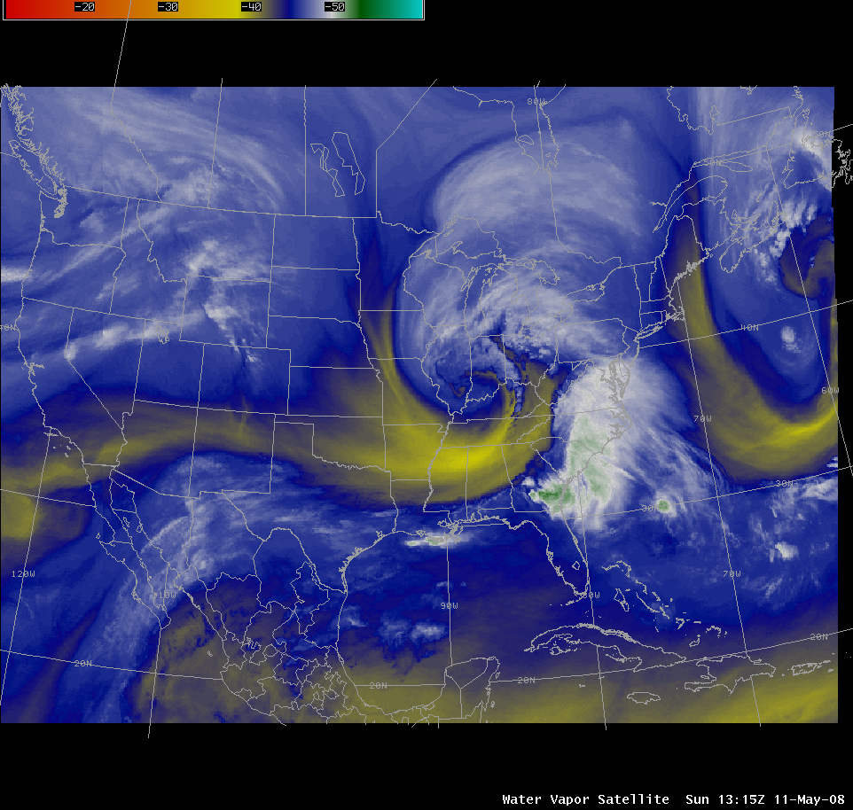
Water Vapor
Increased evaporation
Increased Temperature
Positive
Feedback
Increased atmospheric water holding capacity
Increased insolation (greenhouse)

Slide 21
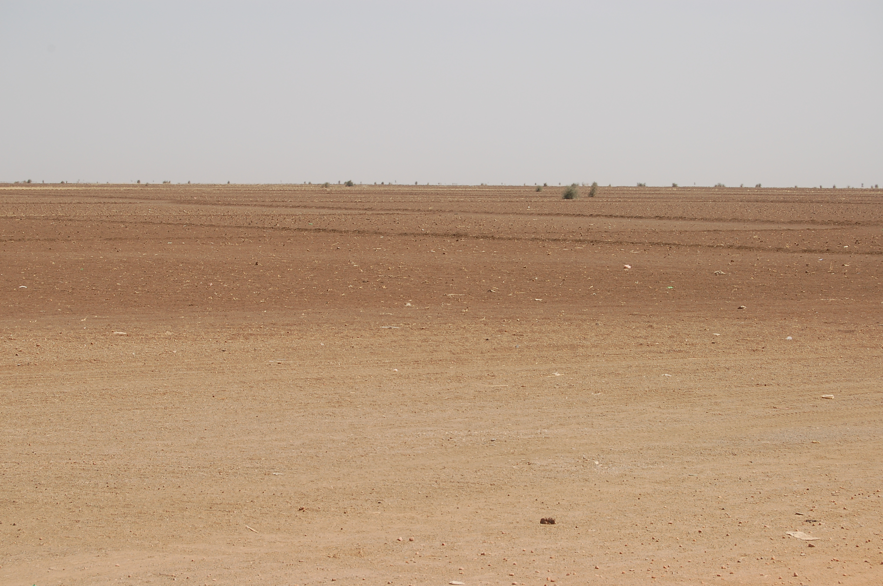
Desertification
Increased plant water-stress
Increased plant water-stress
Decreased vegetation cover
Negative
Feedback
Increased Temperature
Positive
Feedback
Decreased vegetation cover
Increased SW Reflectivity (albedo)
Decreased carbon storage

Slide 22
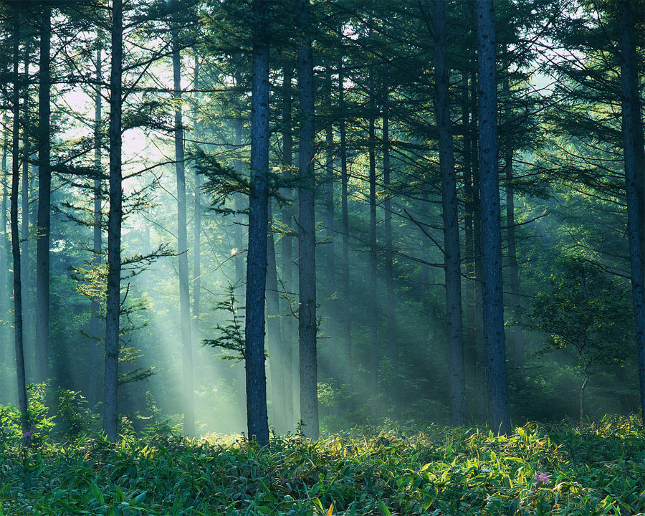
Growing Season Length
Increased duration of suitable temps.
Increased plant water-stress
Increased plant growth
Negative
Feedback
Increased Temperature
Positive
Feedback
Increased disturbance (fire)
Increased carbon storage
decreased carbon storage

Slide 23
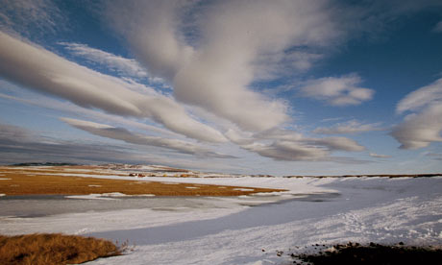
Permafrost
Increased thaw
Increased thaw
Increased plant growth
Negative
Feedback
Increased Temperature
Positive
Feedback
Increased decomposition
Increased carbon storage
Decreased carbon storage
**Another positive feedback mechanism could be the release of large pockets of methane as permafrost thaws. This process is more commonly referred to as a tipping point due to the potential for drastic alteration of the insolation of the atmosphere.**

Slide 24
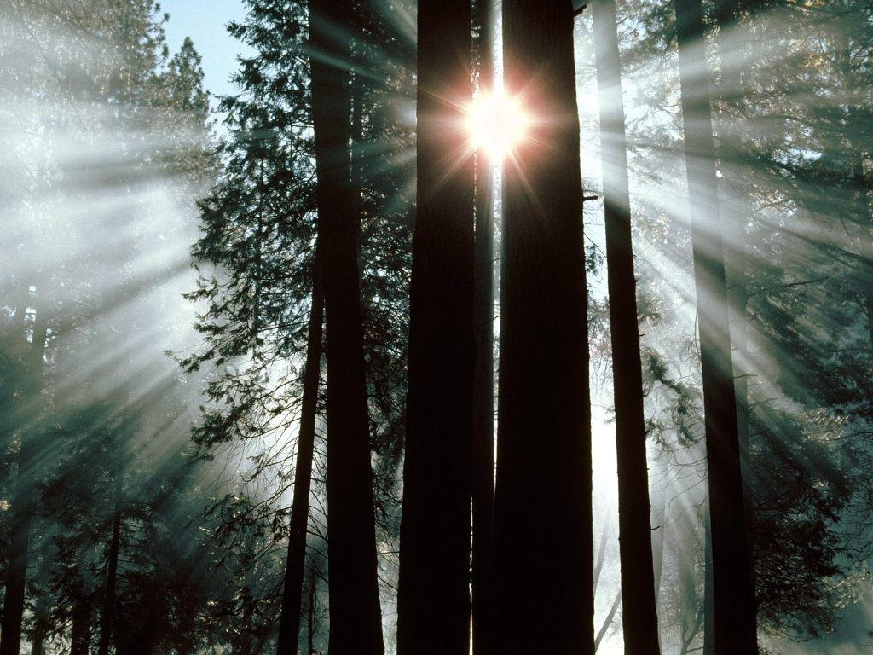
The Global
Carbon Cycle
Notes:
First we will look at some forest statistics and talk a little about the importance of forest not only for economic reasons but for their role in the carbon cycle.
Then we are going to move into a discuss on what recent research is telling us concerning the influence of climate change on forest dynamic
Finally we will end up look at a global picture of net change in vegetation dynamics.

Slide 25

The Global Carbon Cycle
Fossil Fuels
6.4 Pg/yr
The Atmosphere
760 Pg
Photosynthesis
92 Pg/yr
Land Use Change
2 Pg/yr
Photosynthesis
120 Pg/yr
Respiration
91 Pg/yr
Land Use Change
1 Pg/yr
Respiration
60 Pg/yr
Oceans
38,000 Pg
Decomposition
58 Pg/yr
Vegetation
650 Pg
Litter Fall
60 Pg/yr
Soils
1,500 Pg

Slide 26
What Would Cause a Shift from Carbon Sink to Source??
The Atmosphere
A carbon sink can be converted to a carbon source when the amount of CO₂ respired to the atmosphere is greater than the amount fixed during photosynthesis (a net reduction of the source pool and a net increase in the atmospheric pool). Processes that can drive the conversion of a system from a sink to a source include wildfire, insect infestation, and drought.
Photosynthesis
Respiration
Vegetation
Soils
Decomposition

