Slide 1
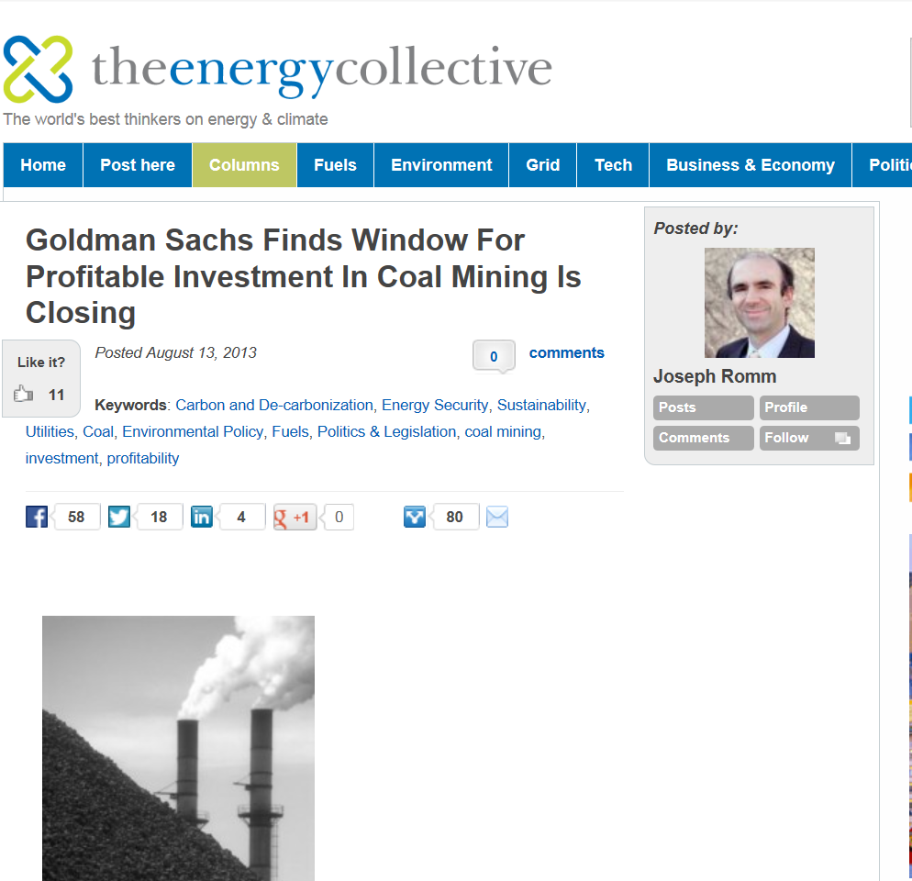

Slide 2
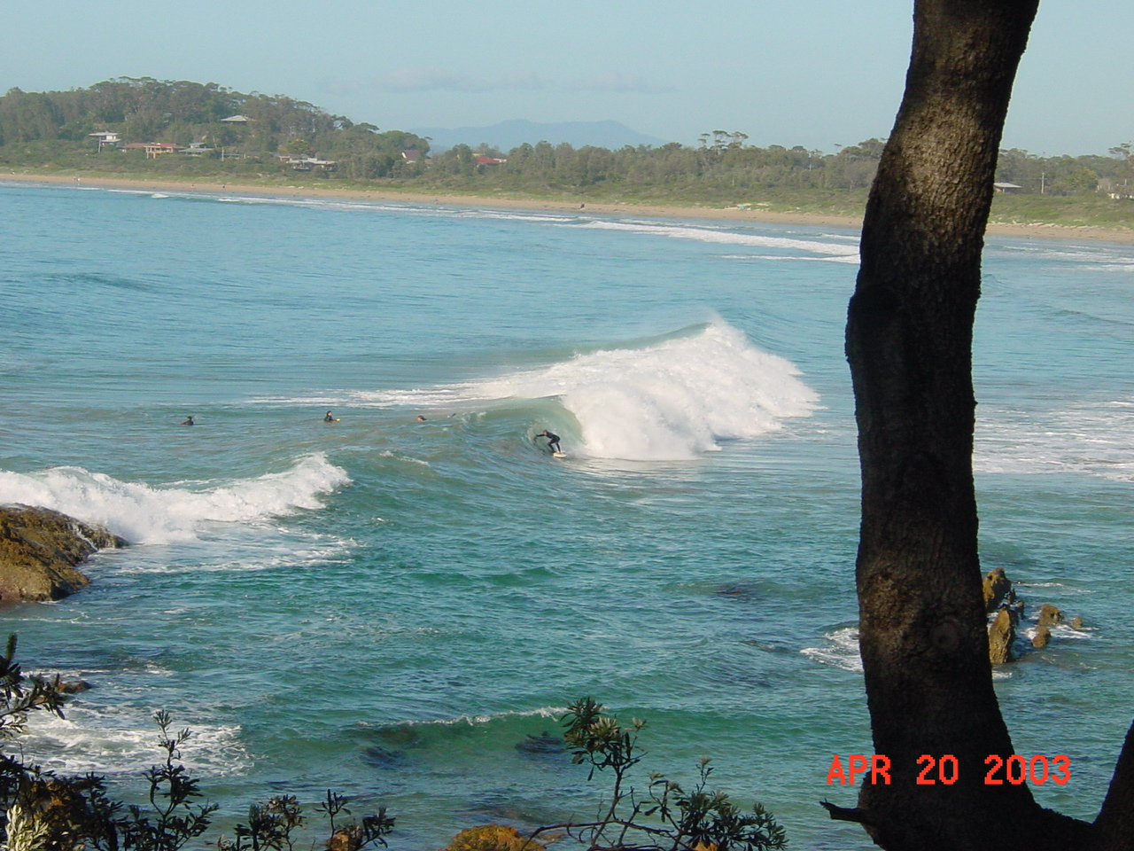
Global Change and Oceans
Fall 2013
Textbook pages 116 - 161

Slide 3
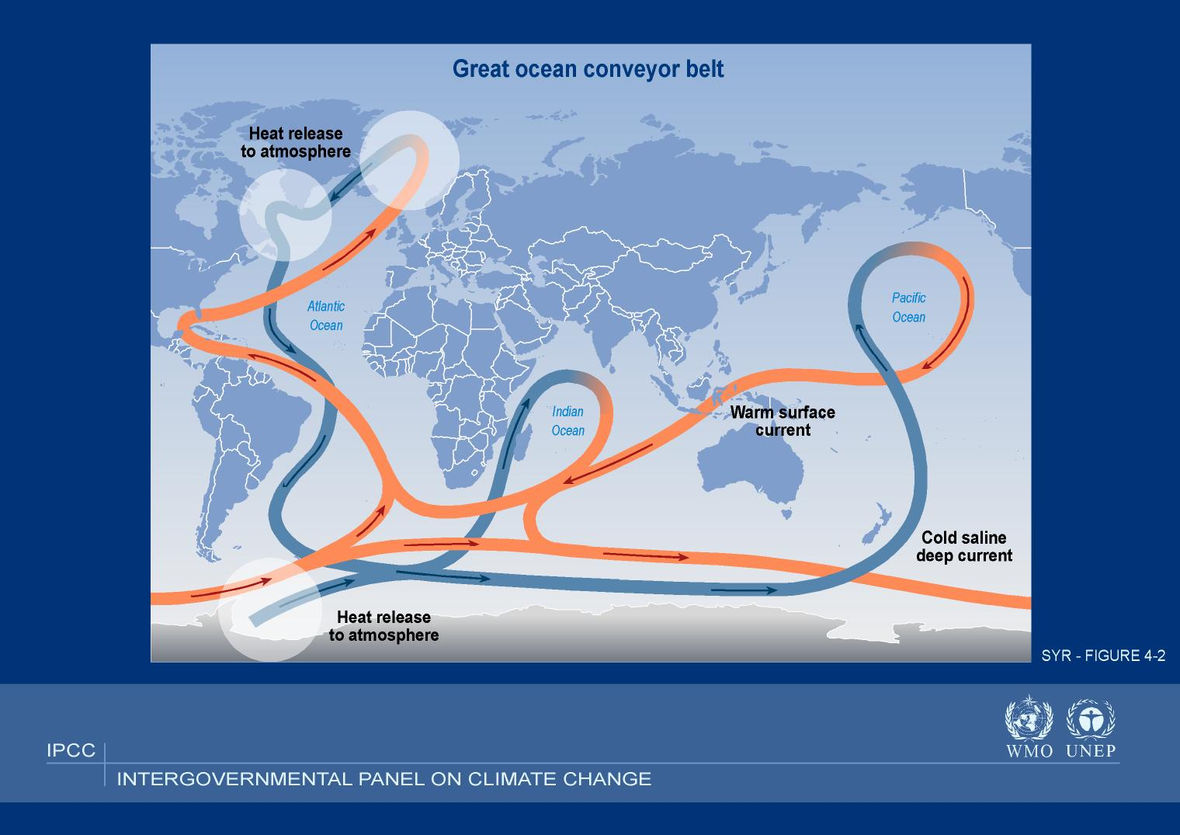

Slide 4
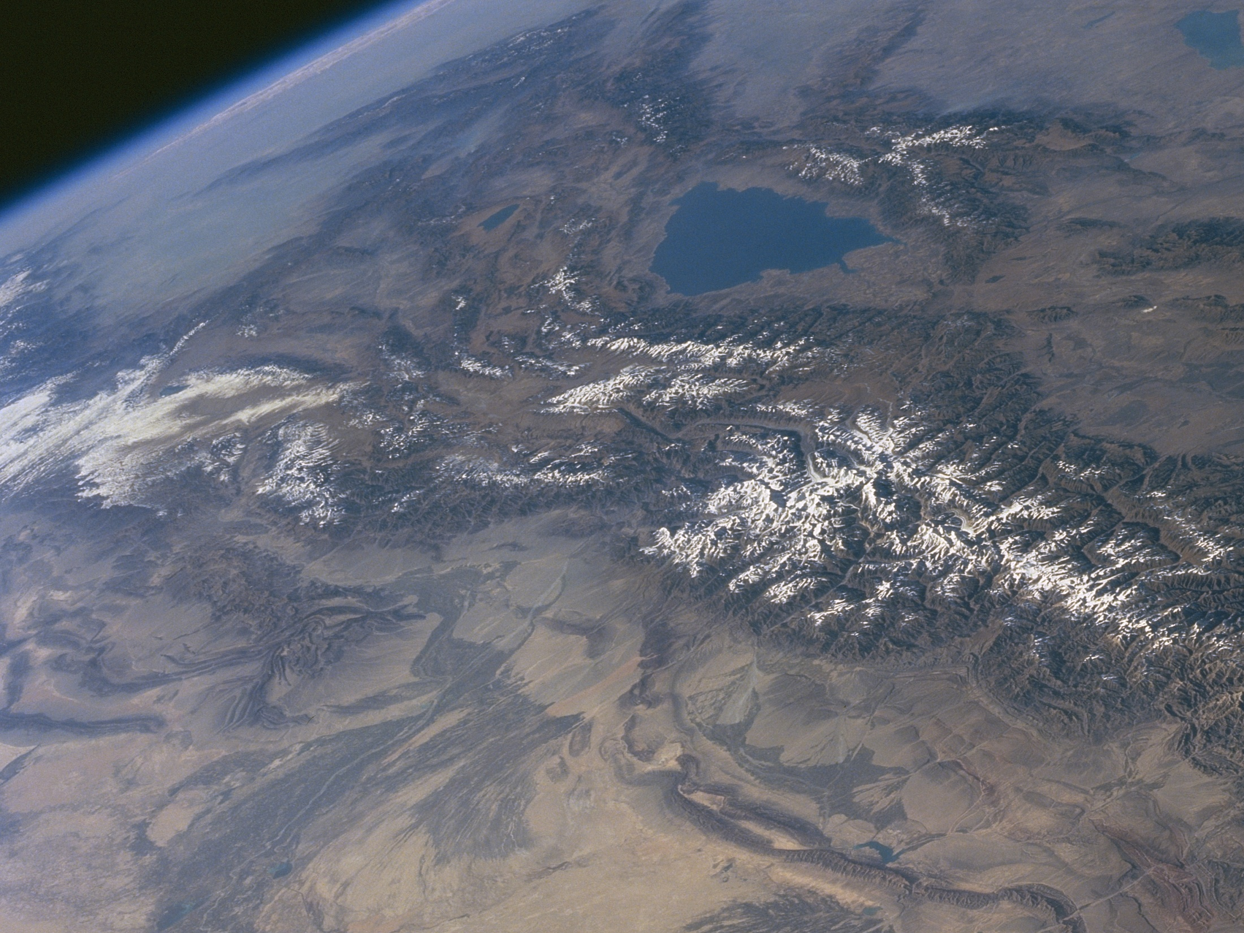
The Atmosphere is very
small

Slide 5
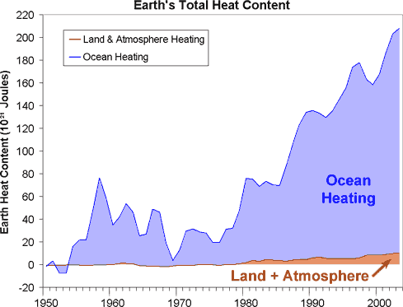
Data From Murphy et al 2009, Domingues et al 2008
Graph from http://www.skepticalscience.com/

Slide 6
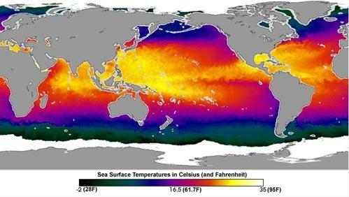
OCEAN SURFACE TEMPERATURES
70% OF LAND IS IN NORTHERN HEMISPHERE

Slide 7
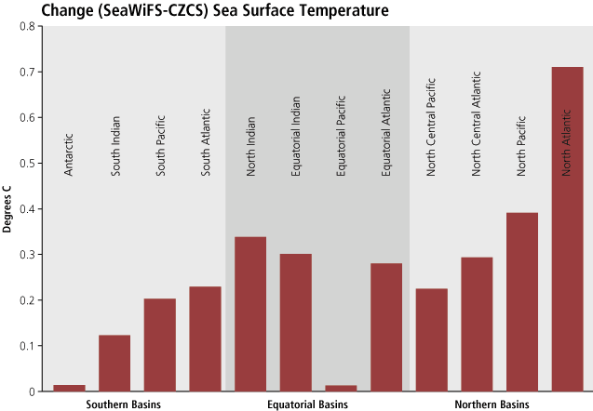
[1979 – 2002]

Slide 8
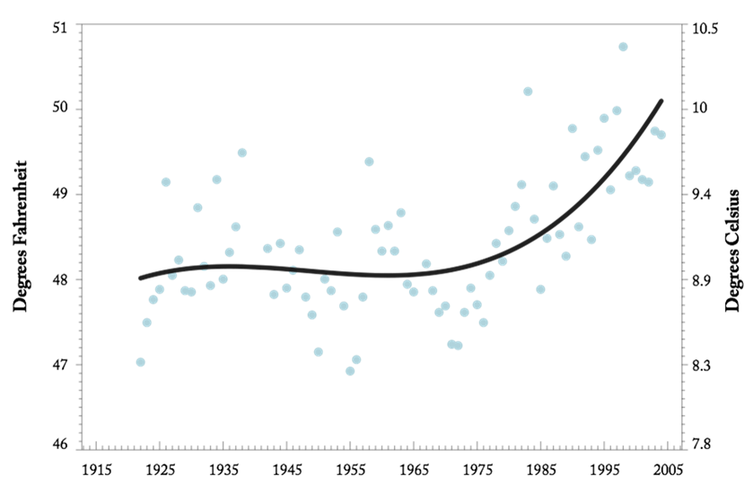

Sea Surface Temperature
(Race Rocks lighthouse, Victoria)
Notes:
Corroborating evidence of the regional warming comes from the measurements of sea surface temperature at Race Rocks lighthouse near Victoria, BC. The warming rate since 1970 is over 2°F and the shape of the curve is similar. Note too that the average temperature is somewhat lower and the interannual variability is much lower.

Slide 9
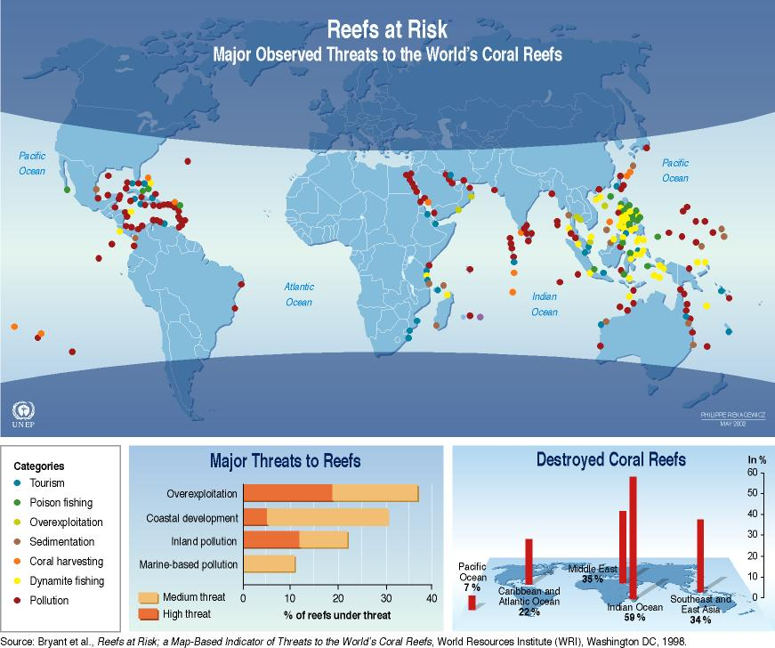
Locations of Coral Reef Bleaching

Slide 10
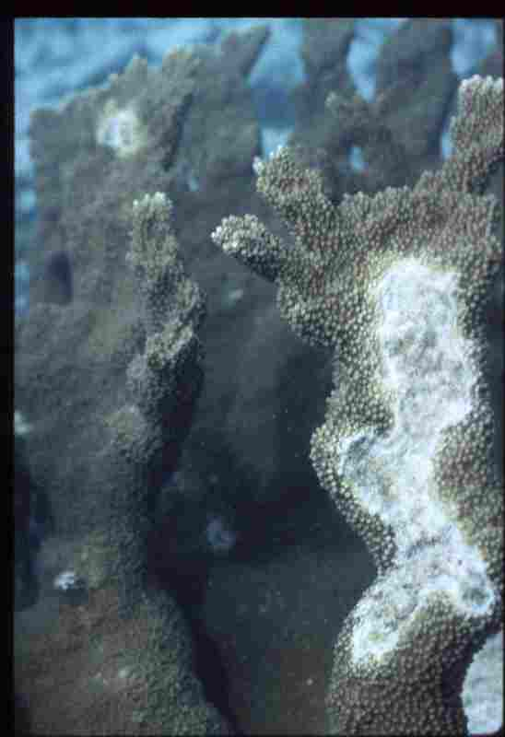

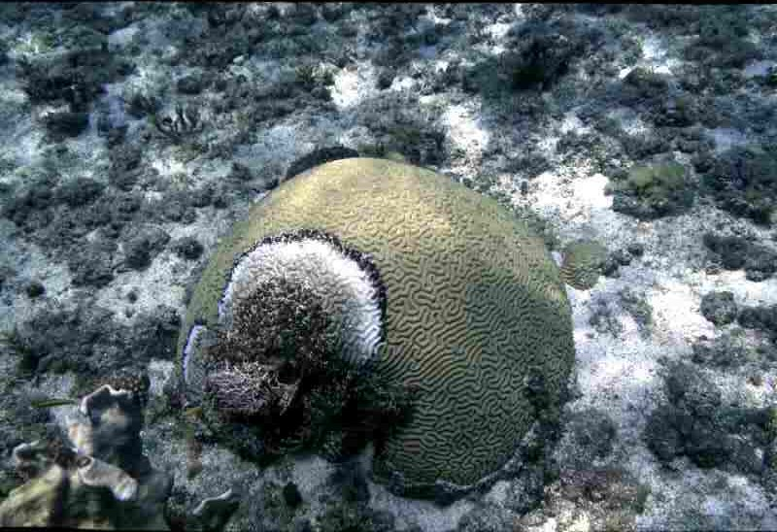
BLEACHING OF CORAL REEFS BY OCEAN TEMPS > 85deg

Slide 11
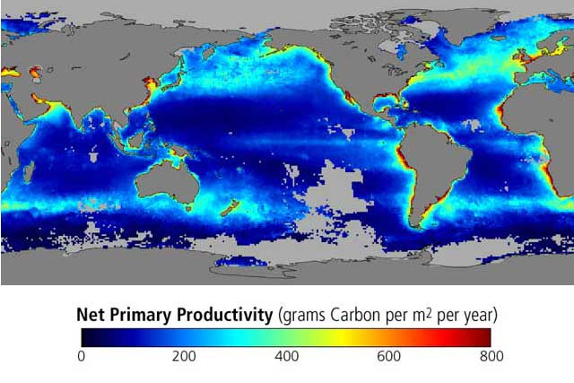

Slide 12
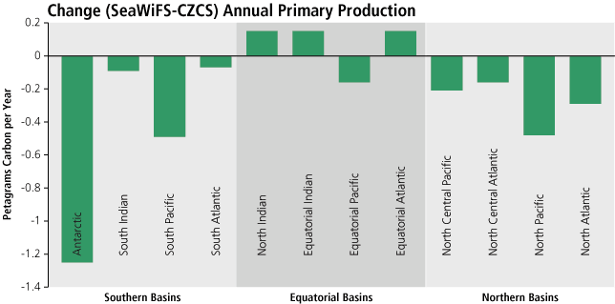
CHANGE IN OCEAN NPP [1979 – 2002]

Slide 13

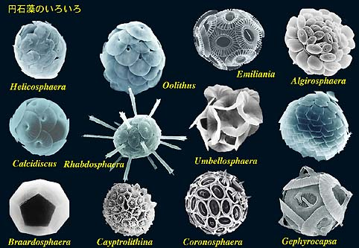
Ocean acidification
CO₂ is corrosive to the shells and skeletons of many marine organisms
Corals
Calcareous plankton
Photo: Missouri Botanical Gardens
http://www.biol.tsukuba.ac.jp/~inouye

Slide 14
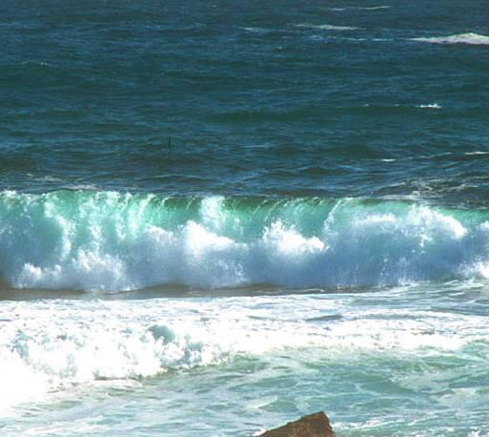
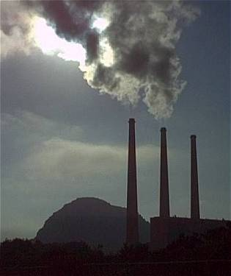
Ocean Acidification
Over the last 200 years, about 50% of all CO₂ produced on earth has been absorbed by the ocean.
(Royal Society 6/05)
Remains in the atmosphere (greenhouse gas)
Dissolves in sea water
CO₂ + H₂0 HCO₃⁻ + H⁺
Global Warming: The Greatest Threat © 2006 Deborah L. Williams
CO₂
(ACID)
CO₂
Water becomes more acidic.

Slide 15
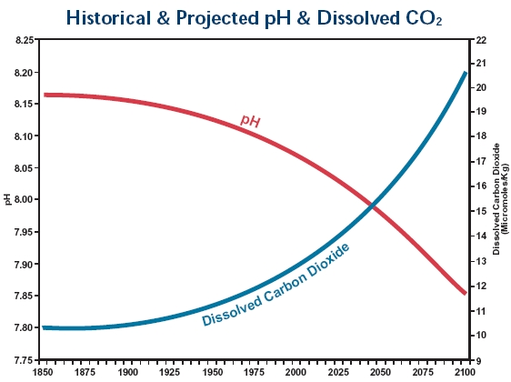
Ocean Acidification
Since 1850, ocean pH has decreased by about 0.1 unit (30% increase in acidity). (Royal Society 2006)
At present rate of CO₂ emission, pH predicted to increase by 0.4 units (3-fold increase in H ions) by 2100.
Carbonate ion concentrations decrease.
Lower pH = MORE ACID
Historical and Projected pH and Dissolved CO2
Feely, Sabine and Fabry, 2006
pH
Dissolved
CO₂
1850
2000
2100

Slide 16
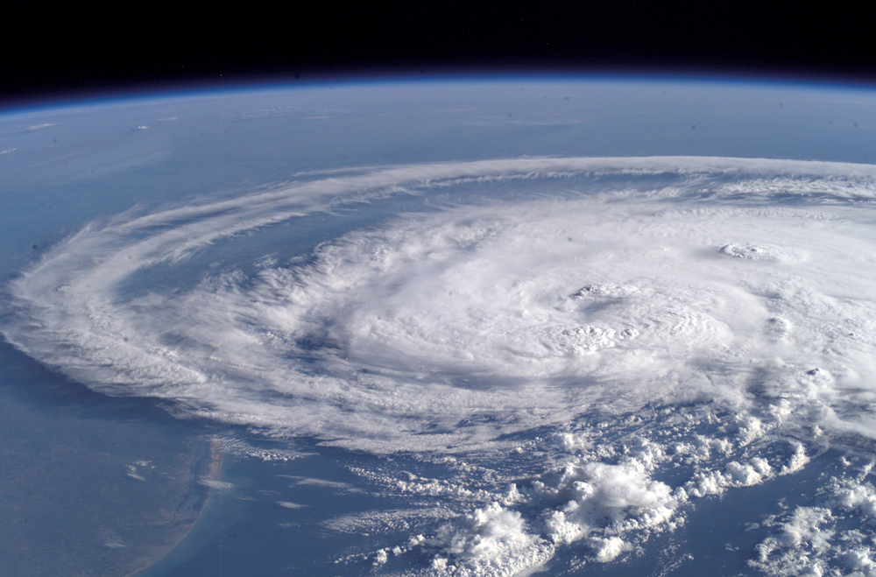

Slide 17
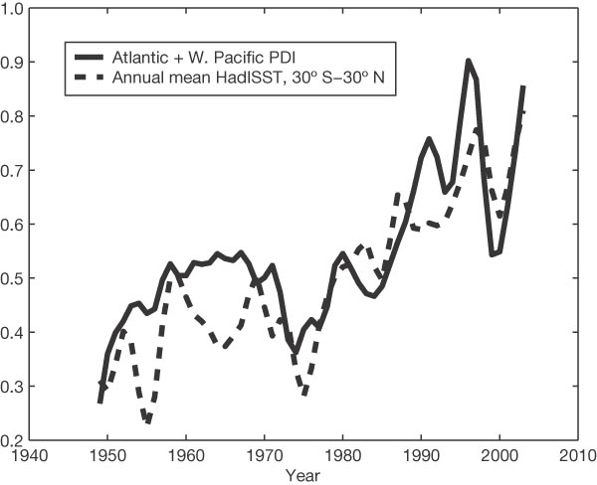
Increase in Hurricane Intensity
PDI = Potential Destructiveness Index
Emanuel, Nature 4 August 2005

Slide 18
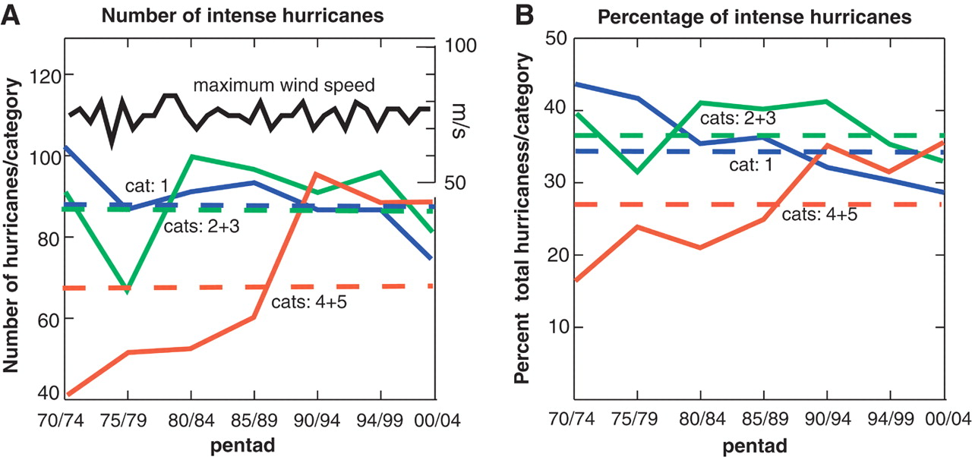
Increase in Category 4-5 Hurricanes 1970 - 2004
Webster et al, Science, Sept 16 2005

Slide 19
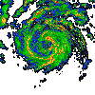
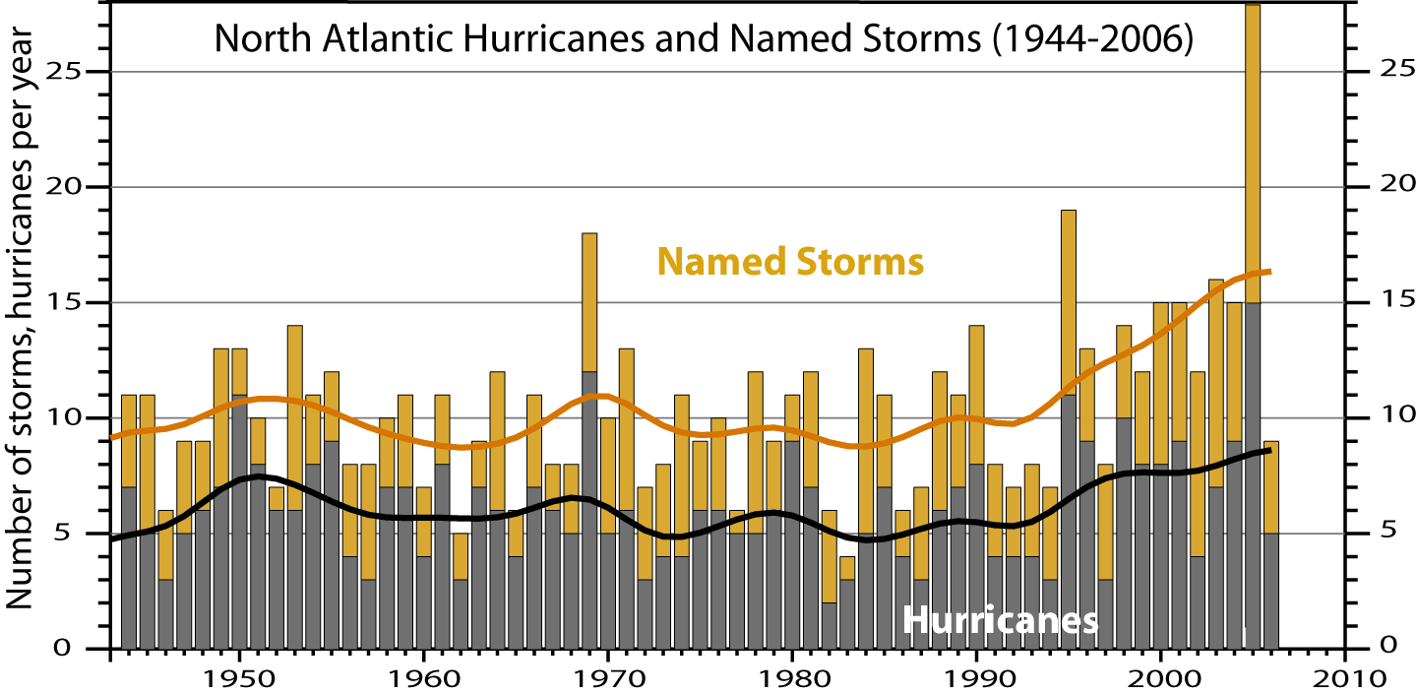
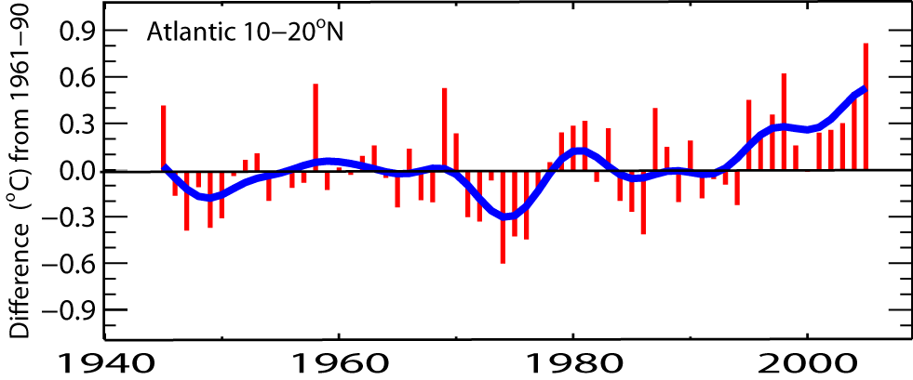
North Atlantic hurricanes have increased with SSTs
N. Atlantic hurricane record best after 1944 with aircraft surveillance.
Global number and percentage of intense hurricanes
is increasing
Marked increase after 1994
(1944-2005)
SST

Slide 20
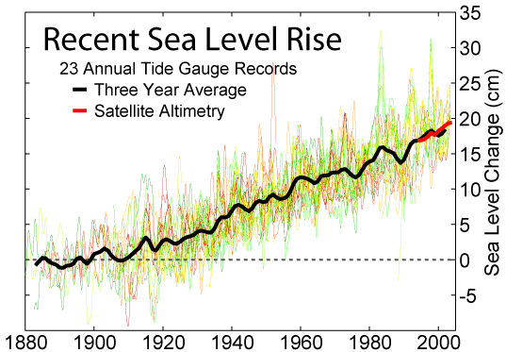

Slide 21
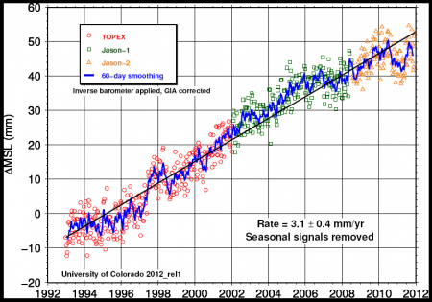
SEA LEVEL RISE

Slide 22
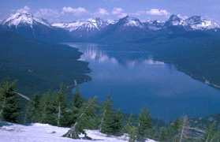
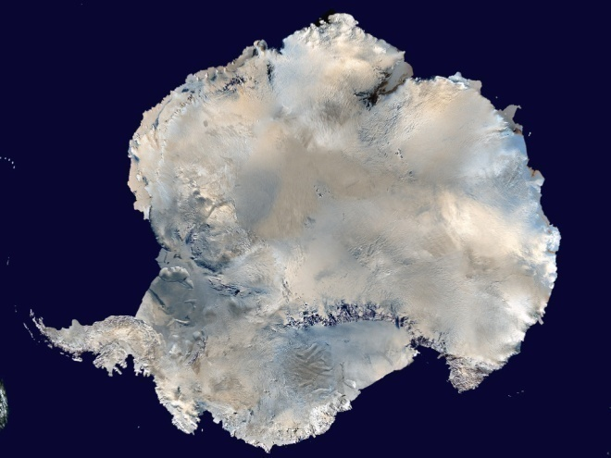
Sea-level Rise Projections Include:
•ocean expansion resulting from increased water temperatures;
meltwater runoff from mountain glaciers around the world; and
a contribution due to increased ice flow from Greenland and Antarctica at the rates observed for 1993-2003.
National Park Service
NASA
Source: IPCC Climate Change 2007: The Physical Science Basis—Summary for Policymakers.
Notes:
Compared with its prior assessment, the IPCC has used improved statistical methods for calculating several factors that contribute to global sea-level rise.
These factors include:
• ocean expansion resulting from increased water temperatures;
• meltwater runoff from mountain glaciers around the world; and
• meltwater runoff and calving (breaking off ) of ice from the Greenland and Antarctica ice sheets.

Slide 23
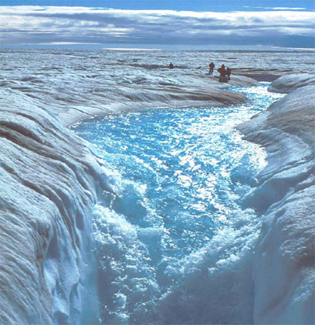
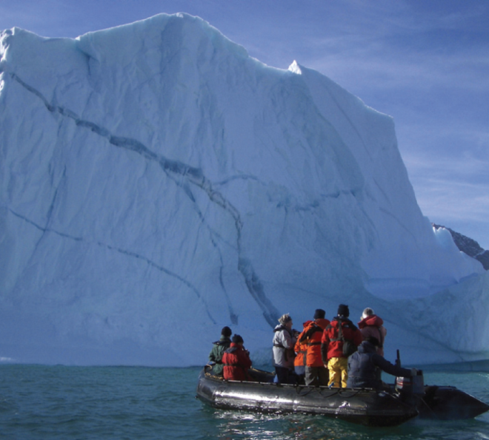
Sea-level Rise Projections DO NOT Include:
• Ice sheet instability
Carbon dioxide uptake changes
IPCC: “Larger values cannot be excluded, but understanding of these effects is too limited to assess their likelihood or provide a best estimate or an upper bound for sea-level rise.”
Photo Roger Braithwaite
iStockphoto.com
Source: IPCC Climate Change 2007: The Physical Science Basis—Summary for Policymakers.
Notes:
Ice sheet instability. Recent observations show that meltwater can run down cracks in the ice and lubricate the bottom of ice sheets, resulting in faster ice flow and increased movement of large ice chunks into the ocean. This process, and others related to ice flow dynamics, directly contributes to sea-level rise.
Carbon dioxide uptake. Evidence suggests that warming tends to reduce land and ocean uptake of atmospheric carbon dioxide, increasing the portion of carbon dioxide emissions that remain in the atmosphere. This would result in further warming and cause additional sea-level rise.
While calling attention to these processes, which could result in a significantly higher global sea-level than that projected in its new report, the IPCC is careful to alert policy makers to the limits of our current ability to quantify these mechanisms: “Larger values cannot be excluded, but understanding of these effects is too limited to assess their likelihood or provide a best estimate or an upper bound for sea-level rise.”
Also, if the observed contributions from the Greenland and Antarctic ice sheets between 1992 and 2003, the IPCC states, “were to grow linearly with global average temperature change,” the upper ranges of sea-level rise would increase by 3.9 to 7.9 inches (0.1 to 0.2 meters). In other words, in this example, the upper range for sea-level rise would be 31 inches (0.79 meters).

Slide 24
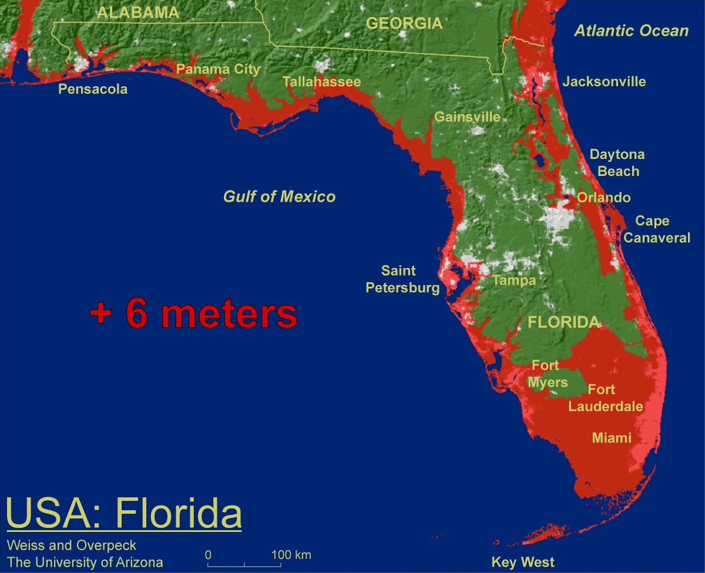
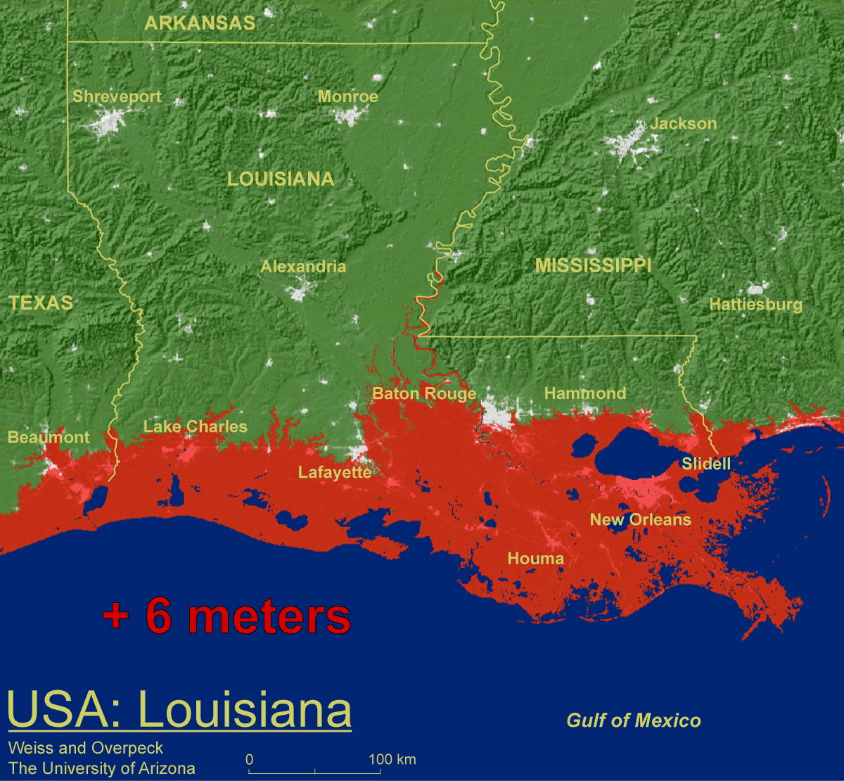
Threshold risks:
Some models do suggest that sustained warming between 2-7ºF above today’s global average temperature would initiate irreversible melting of the Greenland ice sheet—which could ultimately contribute about 23 feet to sea-level rise.
+ 19.7 feet
Weiss and Overpeck U. Arizona
+ 19.7 feet
Source: IPCC Climate Change 2007: The Physical Science Basis—Summary for Policymakers.
Notes:
Some models do suggest that sustained warming between 2 and 7 degrees Fahrenheit above today’s global average temperature would initiate irreversible melting of the Greenland ice sheet—which could ultimately contribute about 23 feet to sea-level rise. This threshold is similar to the IPCC’s best estimate range for temperature increase by the end of this century. The risk for crossing this threshold could occur within our generation, while the consequences would be felt by future generations.

Slide 25
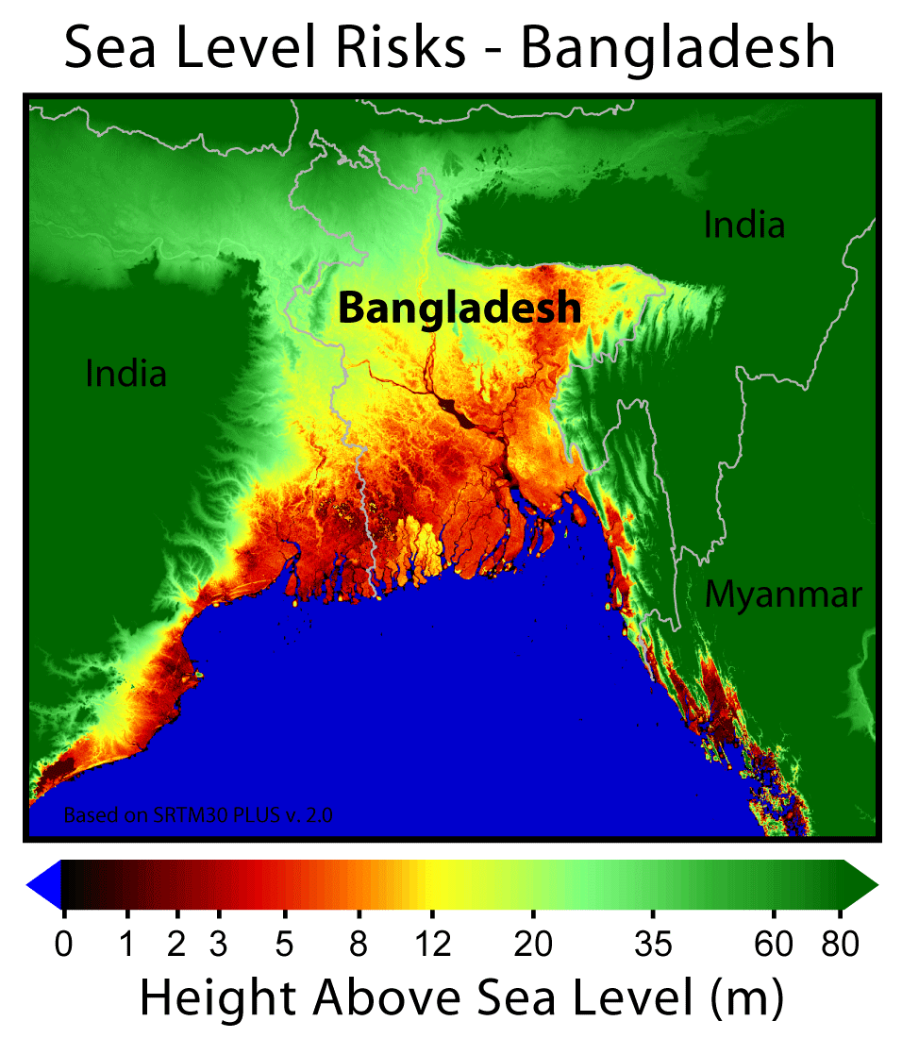

Slide 26
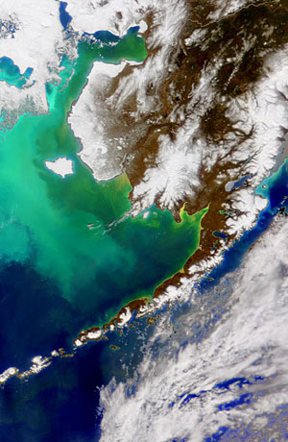
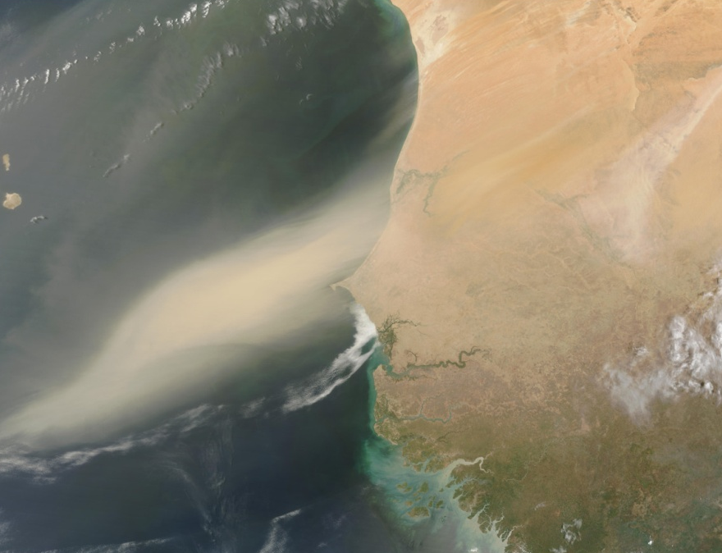
Iron in the Oceans
Sources of naturally occurring iron
  Volcanic coastal shelves
  Dust in blown in from land
  Upwellings
Role in ecosystems
  Key nutrient that helps
  plants take up nitrogen

Slide 27
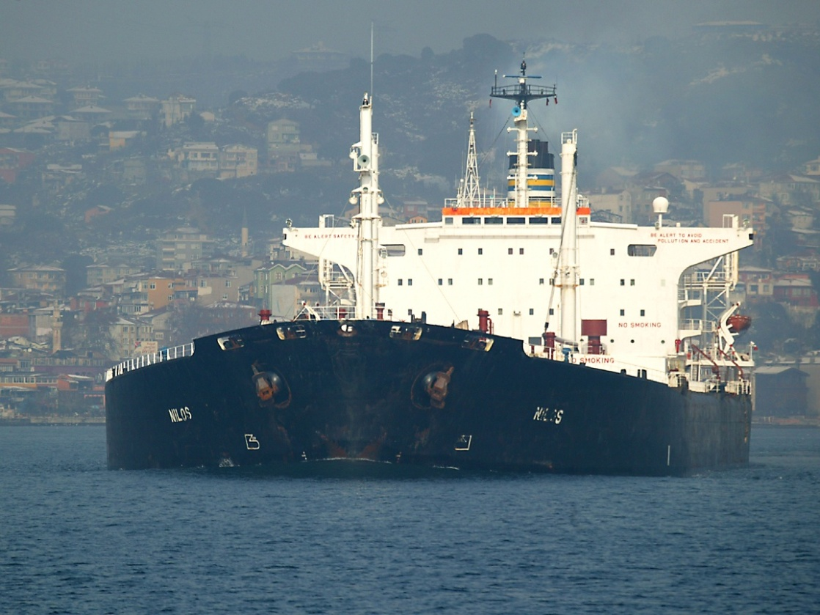
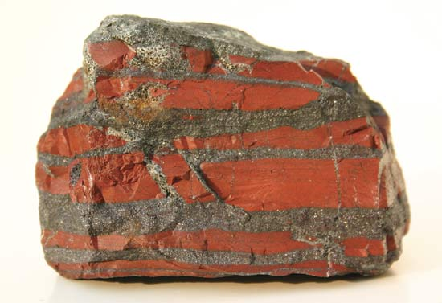
“Give me a few oil tankers full of iron, and I’ll give you an ice age.”
– John Martin, WHOI Scientist

Slide 28
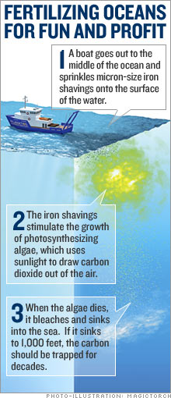
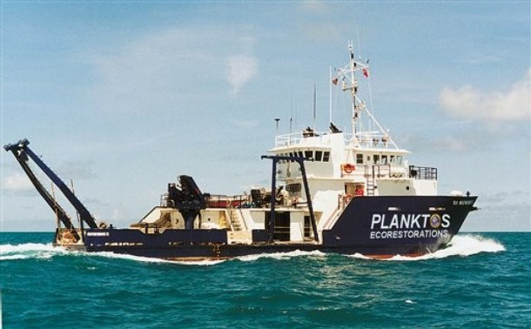
Cashing in on Carbon Offsets
Climos taking over with $3.5 million in funding
Planktos bottom up after Galapagos proposal

Slide 29
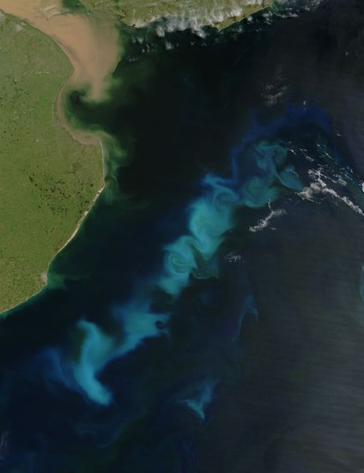
Will the Carbon stay sequestered long enough to help?
NOPE!

