Slide 1
Climate Change
The Cryo
sphere &
Fall 2013 Textbook pp.82-115
Notes:
Todays lecture is on the Cryosphere. To give you an idea of where we will be heading first we will cover the main component of the Cryosphere, then we will talk about measurement technique, followed by a brief summary regarding the status of each of the components of the Cryosphere. Finally we will talk about some of the mechanisms driving the observed changes in the Cryosphere. To get us into lecture mode we will start off with a couple videos.

Slide 2
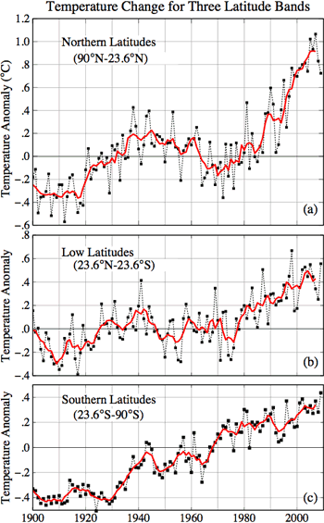
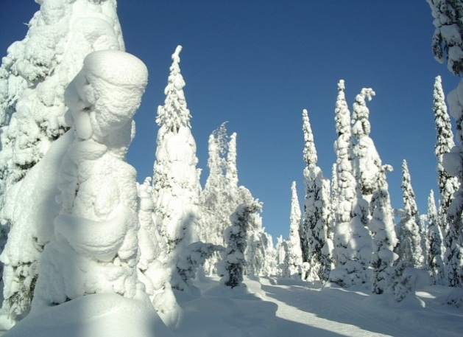
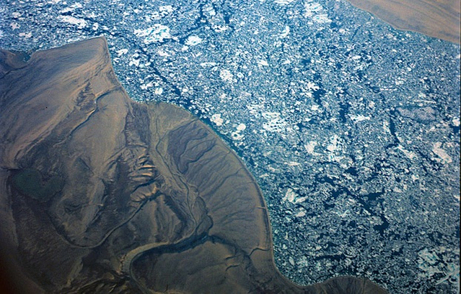
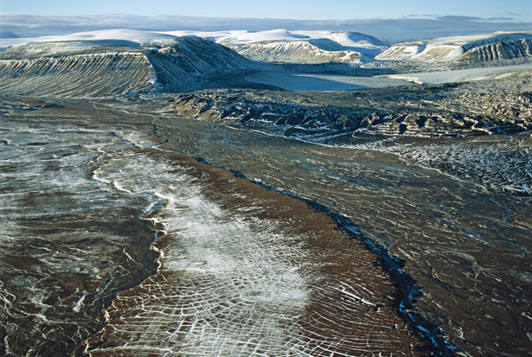
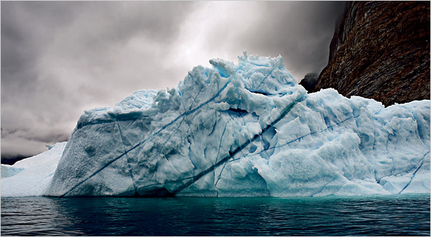
Is the Cryosphere Sending Signals About Climate Change?
Snow
Glaciers
Sea Ice
Permafrost
Ice Sheets
Notes:
The main question we will try to address in this lecture is … Before we can do that however we need to know the components of the Cryosphere. Does anyone know what the main components are? On the left is the temperature record over the past 100 years and we all know by now that temperatures are rising. However in this figure we can see that temps are actually increasing significantly more at northern latitudes. I wanted to show this figure now so that while we dicuss the components we can keep in mind this increase and think about why we are seeing the trend.

Slide 4
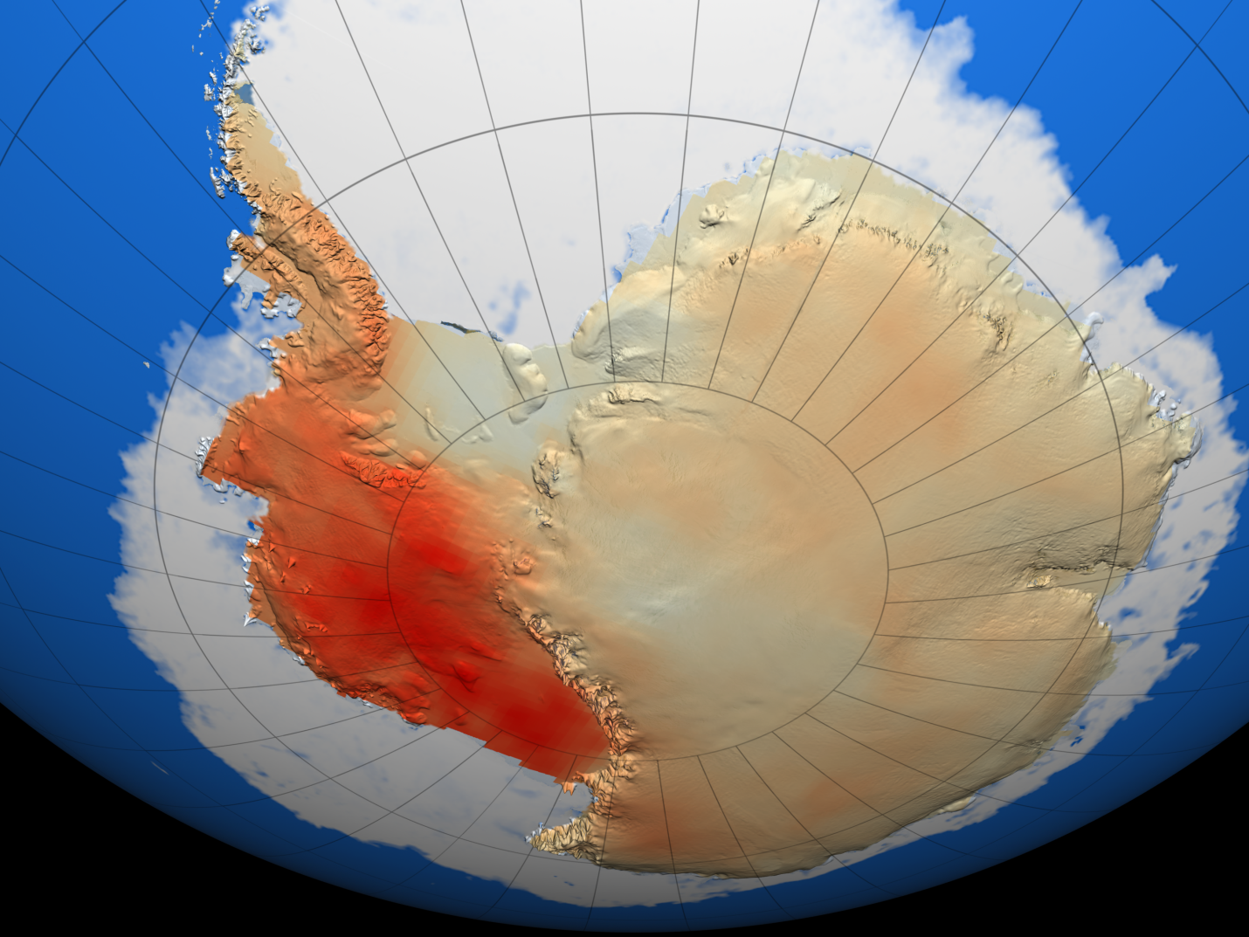
Figure 14: Observed Antarctic Warming Trend (°C/decade) from 1957-2006

Slide 7
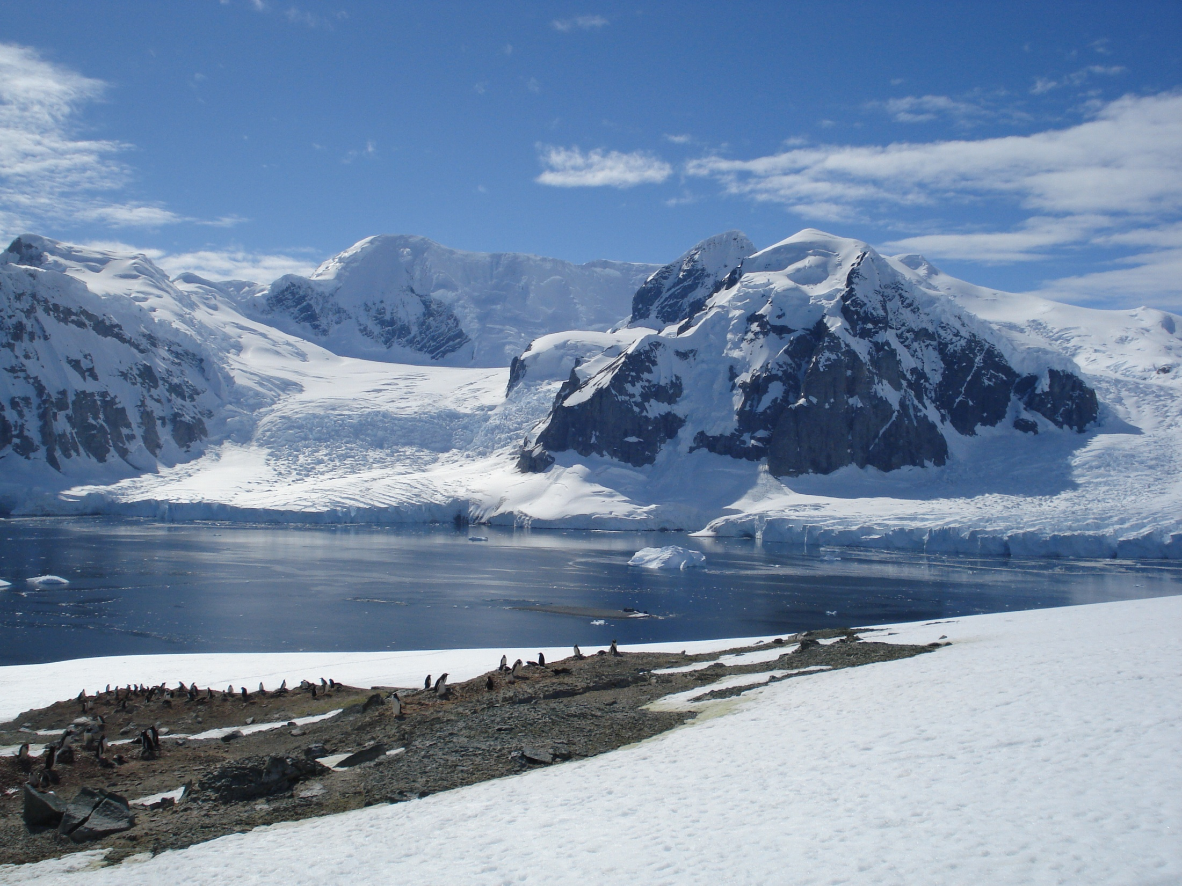

Slide 11
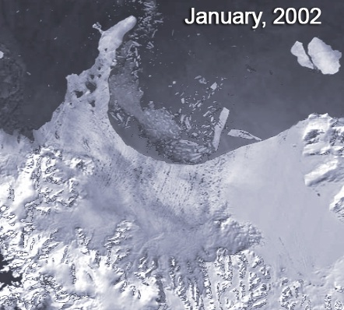
Breakup of Larsen ice shelf (Antarctic Peninsula)
220 metres thick Larsen B shelf existed for at least 400 years prior to breakup
Notes:
The Larsen ice shelf is situated in the north-west part of the Weddell Sea. It consist of three ice-shelves, Larsen A which is the smallest, Larsen B and Larsen C, the largest. Larsen A disintegrated in January 1995 and Larsen B in January 2002.
About 3,250 square km of the Larsen B ice shelf area disintegrated in a 35 day period beginning January 31, 2002 (National Snow and Ice data center). These events are being linked to global warming and the rate of warming has been 0.5 degrees Celsius per decade since 1940s in the Antarctic Peninsula.

Slide 12
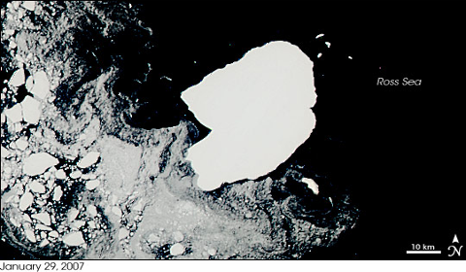
Breakup of Antarctica’s Ross Ice Shelf
An iceberg (B-15J) of size of a small United States state cracked off the Antarctica’s Ross Ice Shelf in March 2000
On February 1, 2007, three new icebergs were formed due to the break up of the original iceberg
NASA Earth Observatory
Notes:
The iceberg (B -15 J) that cracked off the original berg B-15 was approximate to the size of Connecticut. This MODIS image shows B-15J on January 29, 2007 and February 1, 2007. On February 1, 2007, three icebergs split off the original B-15J berg. The largest piece was named as B-15S and was 18.5 km long and 3.5 km wide. In the past years, the calving of the B-15 has influenced the circulation pattern of the Ross Sea and has trapped tremendous amount of sea ice near the shoreline. The break up occurred within a a gap of 2 days from the day the first image was taken.

Slide 13
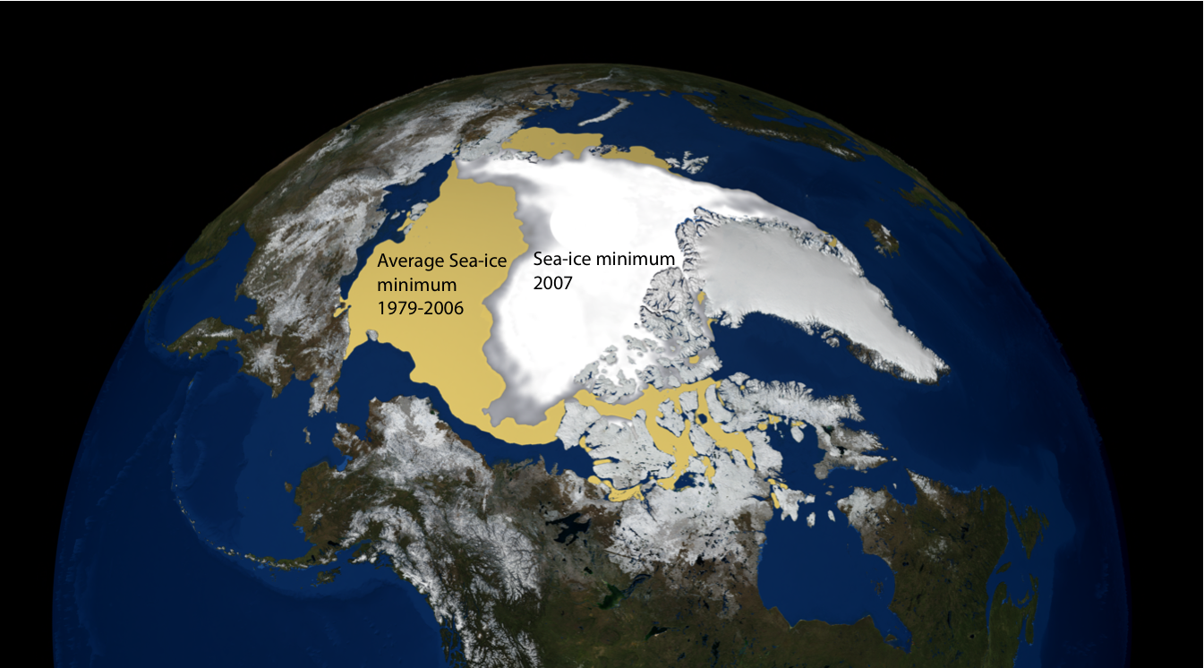
Figure 12: Minimum arctic sea-ice extent from 1979 to 2007

Slide 14
NEW RECORD IN 2012!!

Slide 15
Superb May 1987 – North Pole (plus USS Sea Devil)

Slide 16
Upward sonar profile

Slide 17
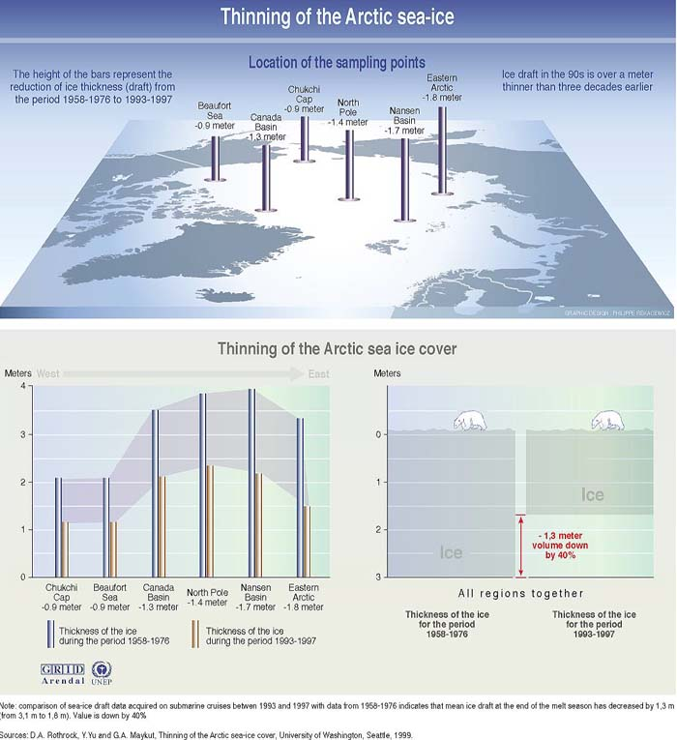

Slide 18
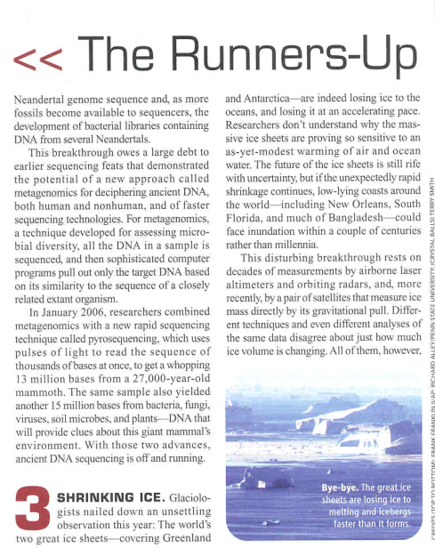
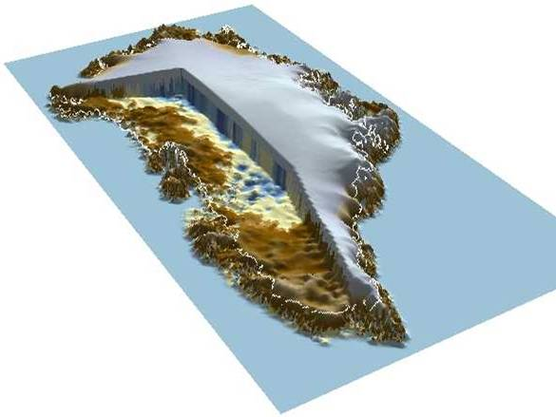
Greenland
Science Breakthrough of the Year 2006

Slide 20
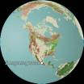
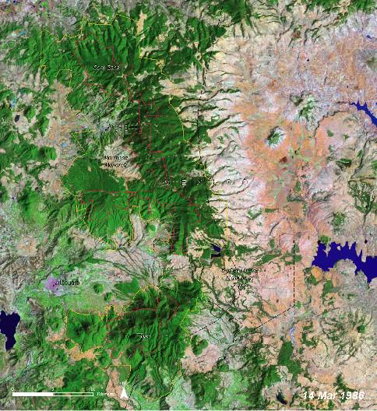
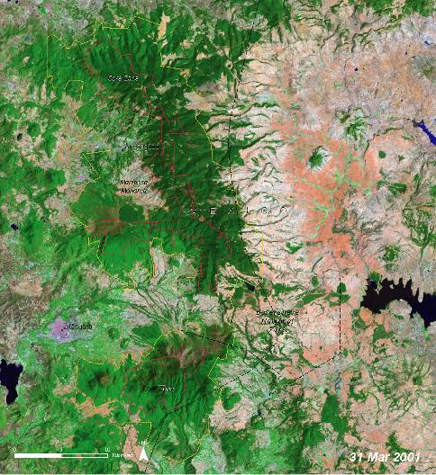
North America: Angangueo
Glacier National Park, Montana, United States
1986: Images show Degradation of forest area
2001: Between 1984 and 1999, 38 per cent of forests were degraded
Notes:
The response to climate change is being observed with the receding glaciers.

Slide 21
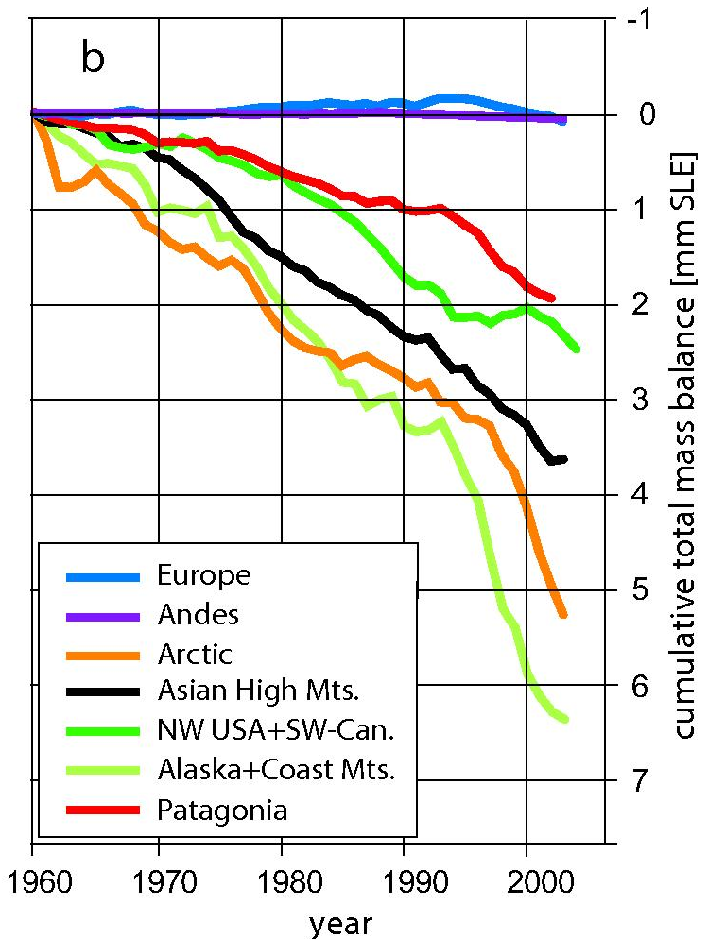
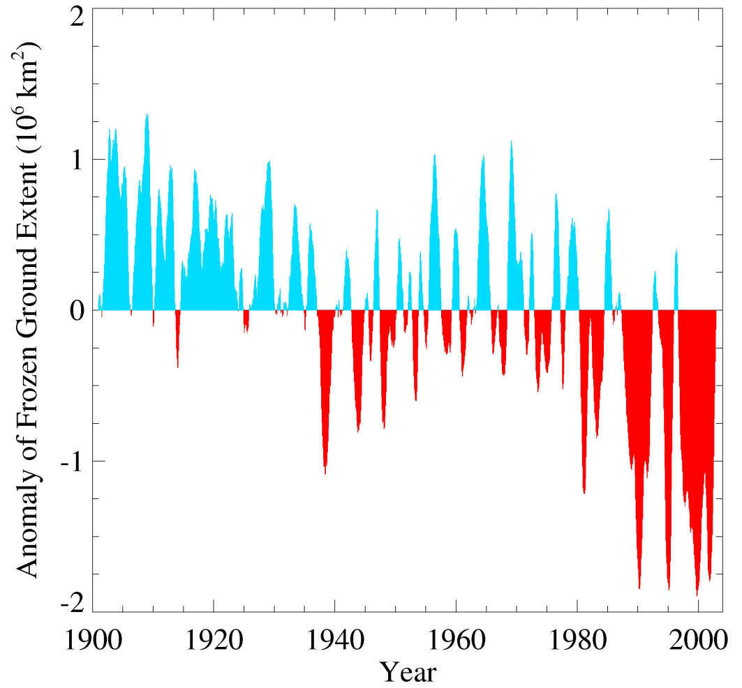
Glaciers and frozen ground are receding
Area of seasonally frozen ground in NH has decreased
by 7% from 1901 to 2002
Increased Glacier retreat since the early 1990s

Slide 22
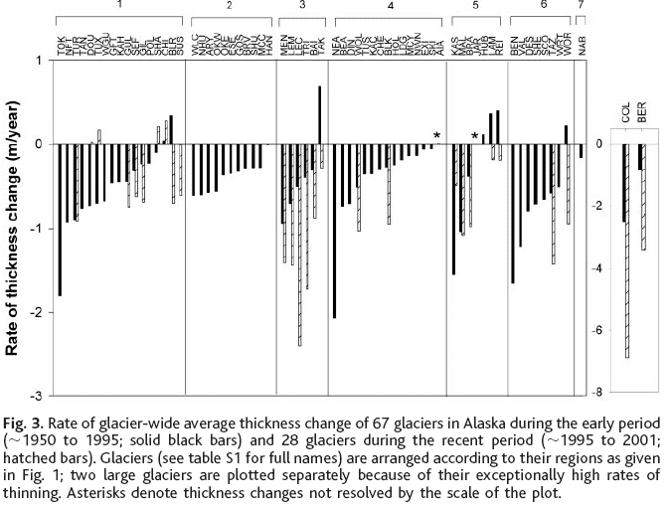
ALASKAN GLACIER MASS BALANCES 1950 - 2001
Arendt et al 2002. Science.

Slide 23
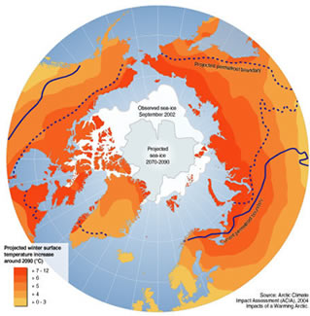
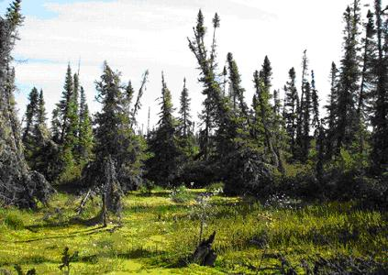
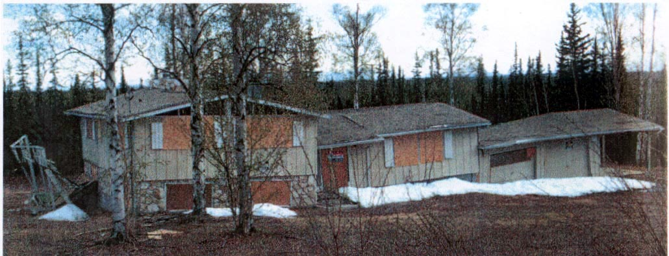
Permafrost Anomaly

