Slide 1
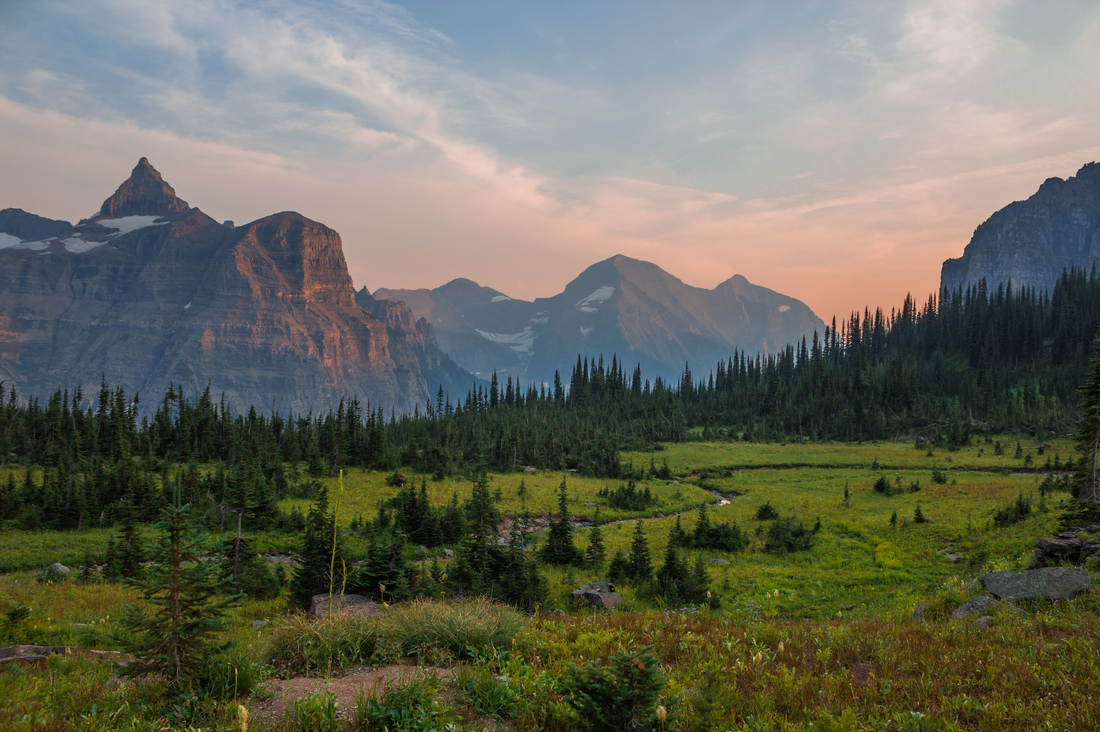
Climate and Climate Change in Montana
Jared W. Oyler
Graduate Research Assistant
Software Engineer
jared.oyler@ntsg.umt.edu
Numerical Terradynamic
Simulation Group
Montana Climate Office
University of Montana

Slide 2
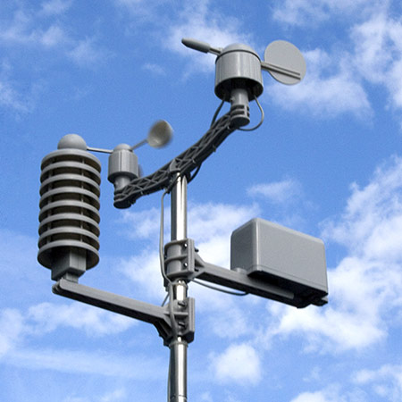
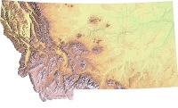
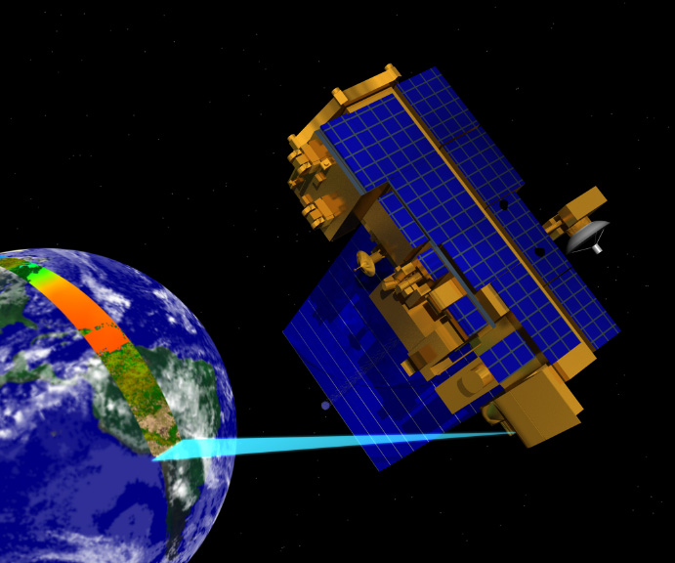
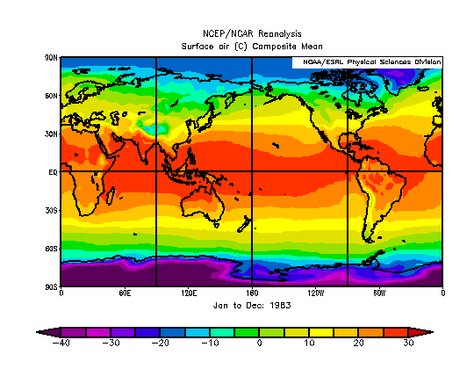
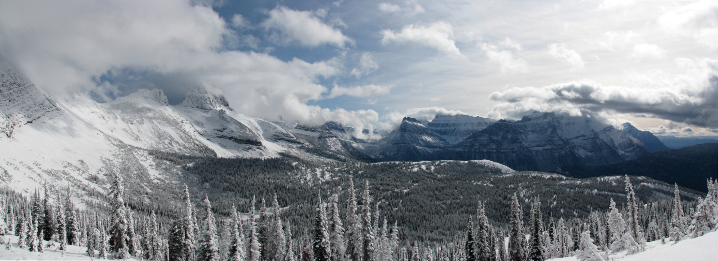
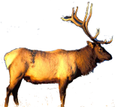
How do I spend my time?
Weather Station Data
Topographic Data
Satellite Data
Large-scale Atmospheric Data
I wonder what the climate has been like up there?

Slide 3
Outline
Review of weather and climate basics
General climate of Montana
Large-scale natural climate variability
Climate trends in Montana
Snowpack trends
Climate projections

Slide 4
The Basics
Weather: the condition of the atmosphere at any particular place and time
Meteorology: scientific study of the atmosphere and the phenomena that we usually refer to as weather
Climate: represents the long-term behavior of the atmosphere at a given region. A description of aggregate weather conditions; the sum of all statistical weather information that helps describe a place or region
Climatology: scientific study of climate and climatic patterns and the consistent behavior of weather, including its variability and extremes, over time in one place or region; includes the effects of climate change on human society and culture

Slide 5
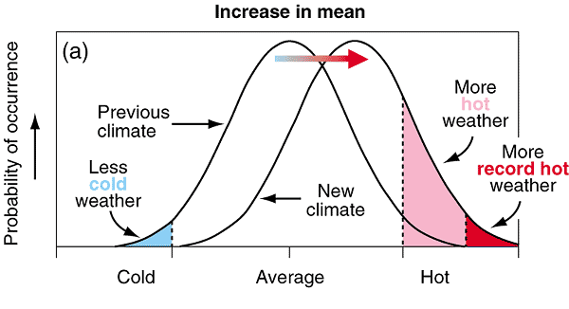
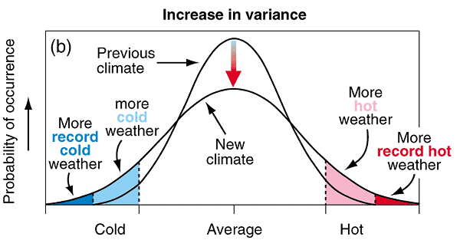
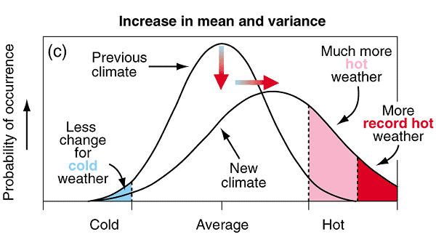
Climate Change
IPCC AR3 2001

Slide 6
Weather vs. Climate

Slide 7
Basic Elements
Basic elements of both weather and climate:
Temperature
Humidity
Type/amount of cloudiness
Air pressure
Type/amount of precipitation
Wind speed/direction

Slide 8
Climate of Montana

Slide 9
Climate of Montana
East of the continental divide, mainly a continental climate
Large annual temperature range
Cold winters and hot, dry summers
The continental divide forms a transition zone between maritime and continental climates
Maritime air masses bring storms during the winter with increased precipitation at many higher elevations
More moderate winter temperatures in the valleys
More stability in July/August with clear and dry conditions

Slide 10
Climate of Montana
Example Pacific storm in winter

Slide 11
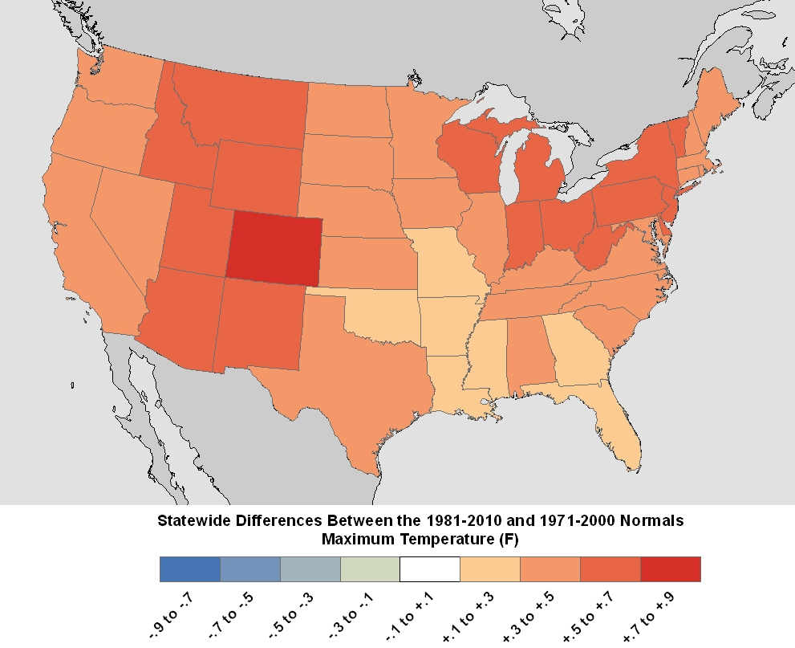
Climate Normals
Climate Normal: a 30-year average of a weather/climate variable (e.g.—temperature). Also includes degree days, probabilities, standard deviations, etc.
The latest climate normals are for 1981 – 2010. Updated on a decadal basis.
http://www.ncdc.noaa.gov/data-access/land-based-station-data/land-based-datasets/climate-normals/1981-2010-normals-data

Slide 12
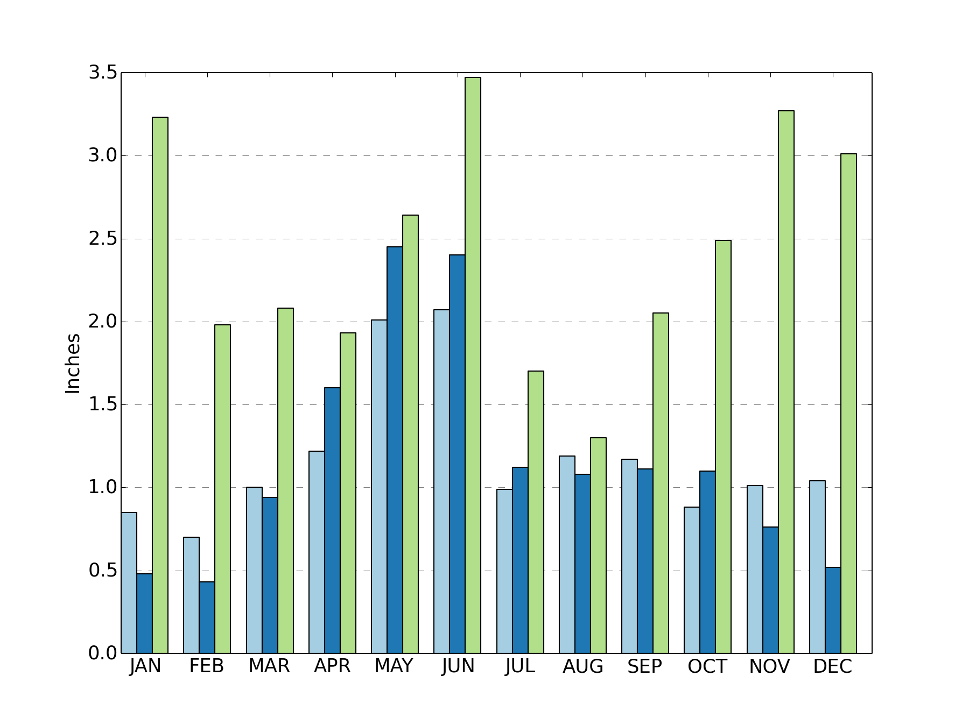
Climate of Montana
Precipitation: 1981 – 2010 Monthly Normals

Slide 13
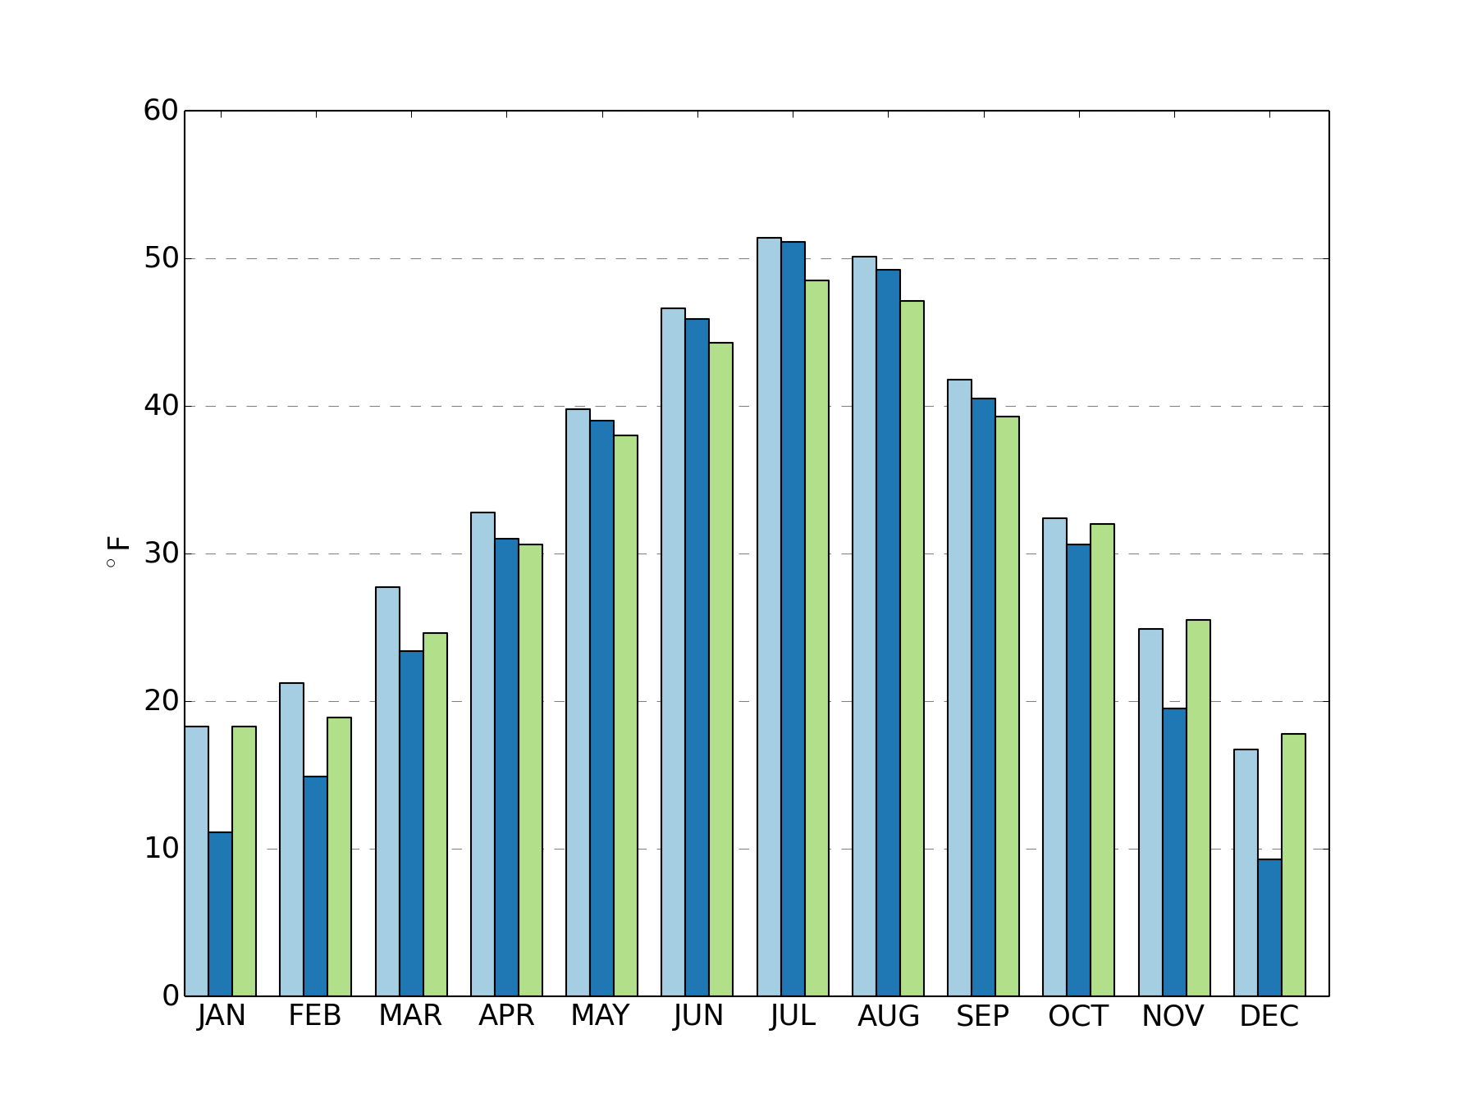
Climate of Montana
Minimum Temperature: 1981 – 2010 Monthly Normals

Slide 14
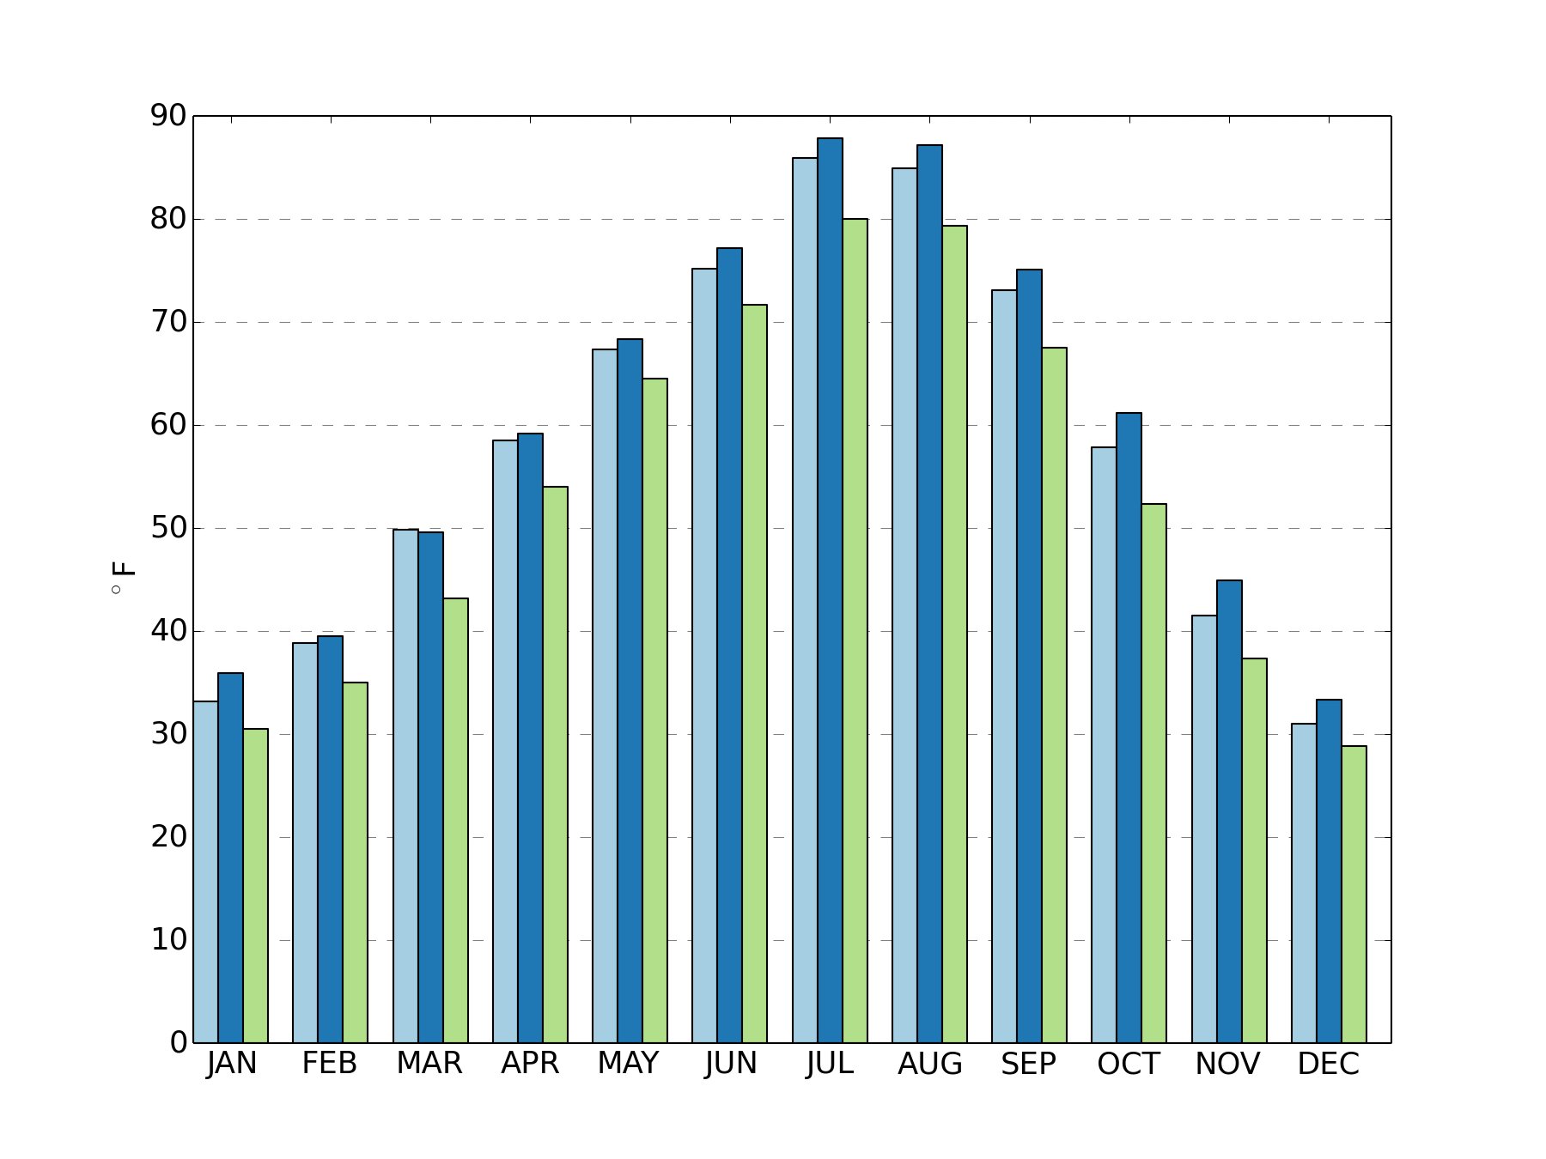
Climate of Montana
Maximum Temperature: 1981 – 2010 Monthly Normals

Slide 15
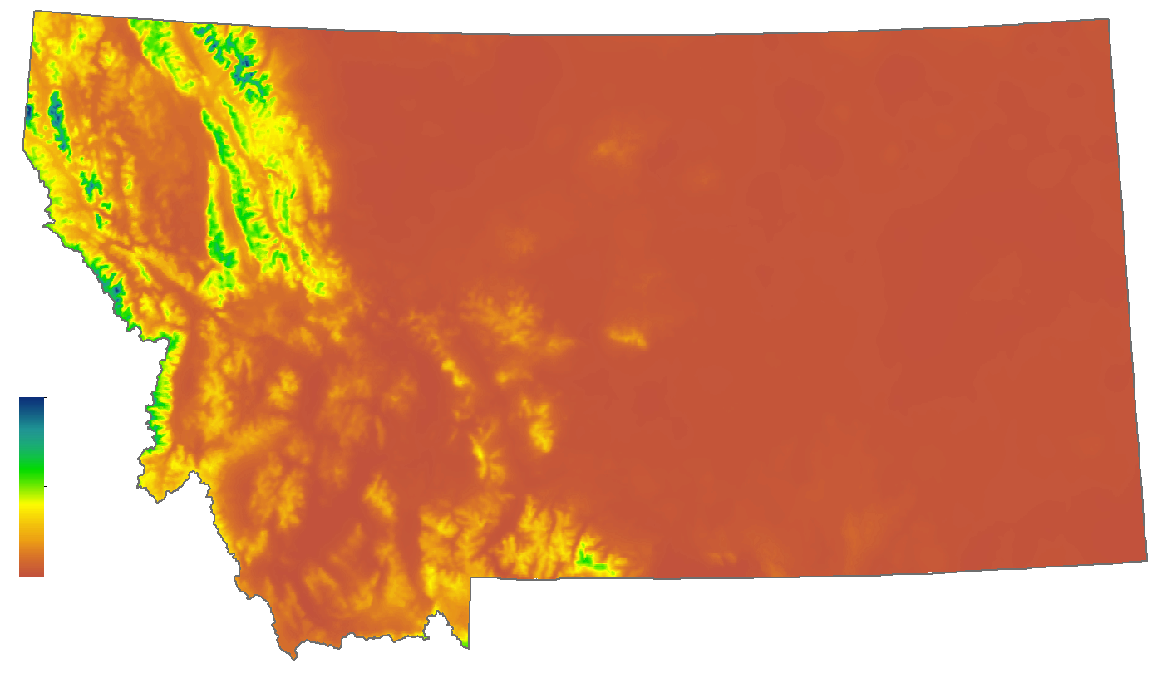
Climate of Montana
Precipitation: 1981 – 2010 January Normals
PRISM or LST maps
35.5 cm
0.3 cm
http://www.prism.oregonstate.edu/

Slide 16
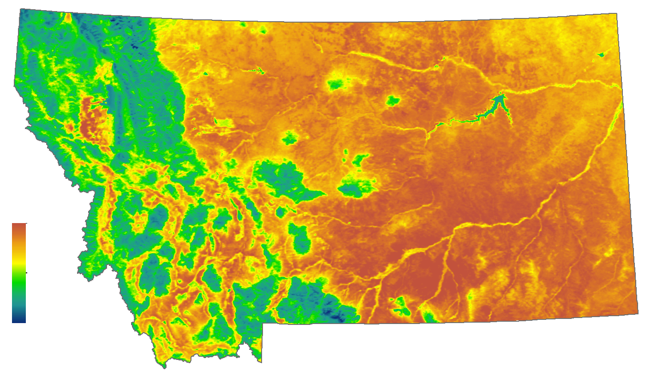
Climate of Montana
Tmax Avg. Land Skin Temperature : August 2003-2012
45.95 °C
12.25 °C

Slide 17
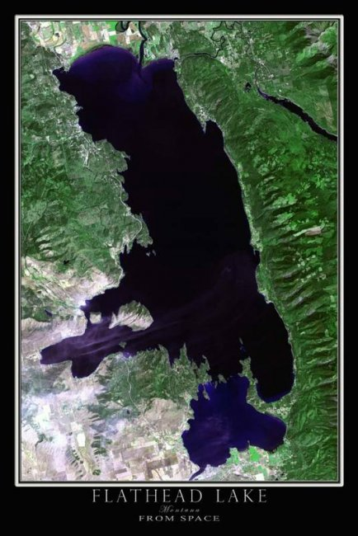
Mesoscale Climate Features
Moderating influence of Flathead Lake
Cherry orchards and
vineyards in Montana!?

Slide 18
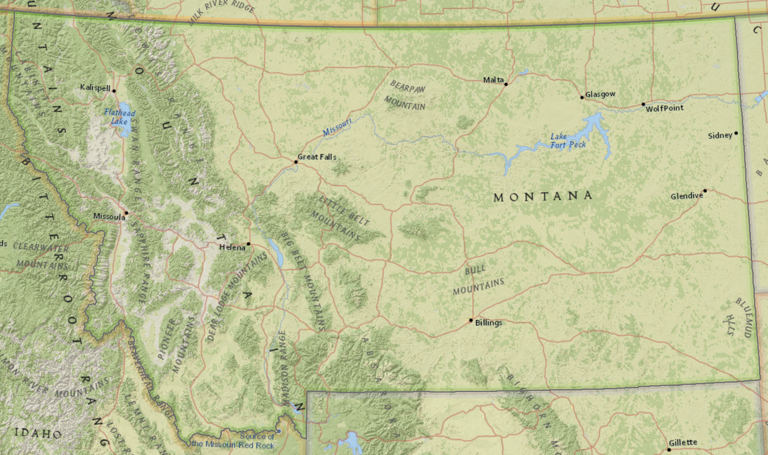
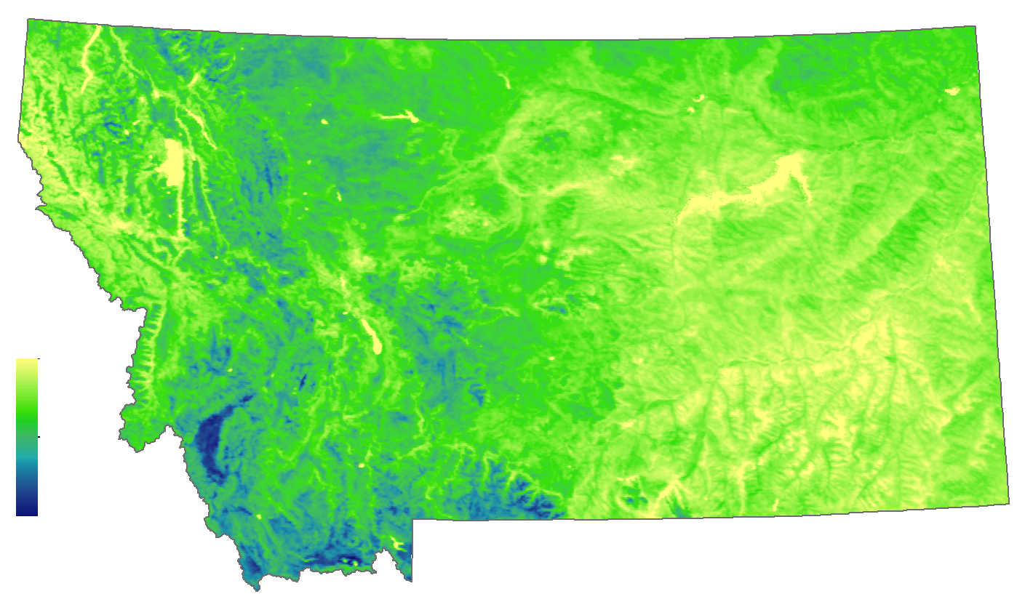
Mesoscale Climate Features
Tmin Avg. Land Skin Temperature : August 2003-2012
Temperature Inversions
Colder at lower elevations.
Most commonly associated with minimum temperatures.
19.81 °C
Why is it colder here?
-0.79 °C

Slide 19
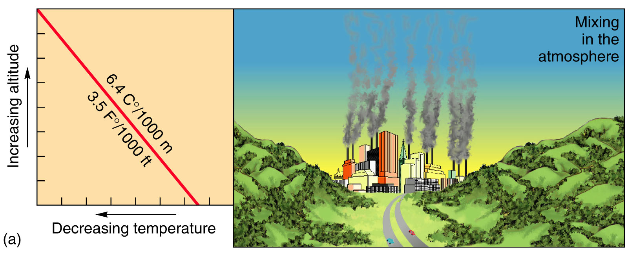
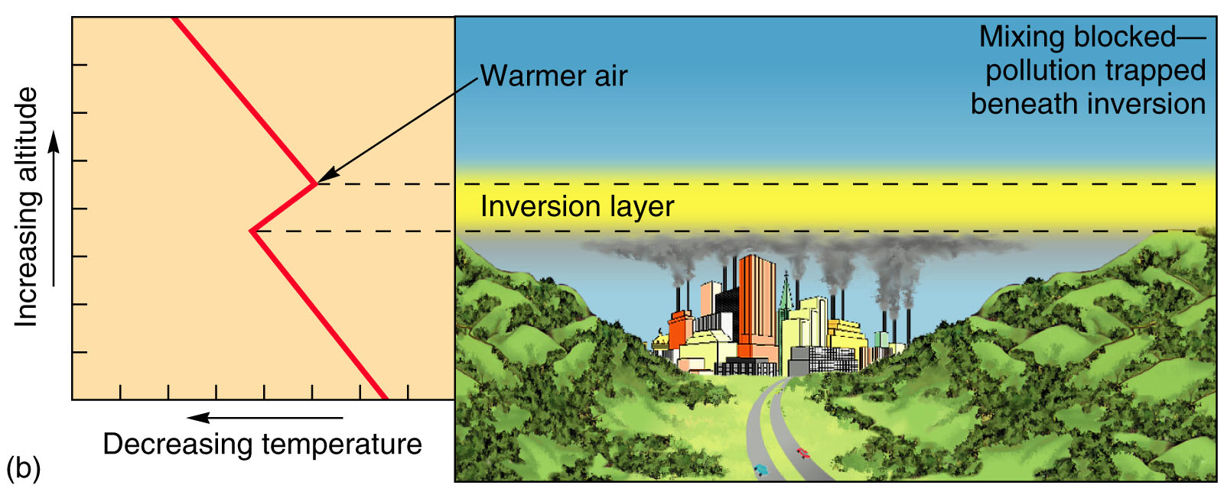
Mesoscale Climate Features
Radiation Inversion: on cold clear calm nights, longwave radiation can radiate from the ground quickly, escape into upper atmosphere and the air near the surface will be very cool (usually very shallow)

Slide 20
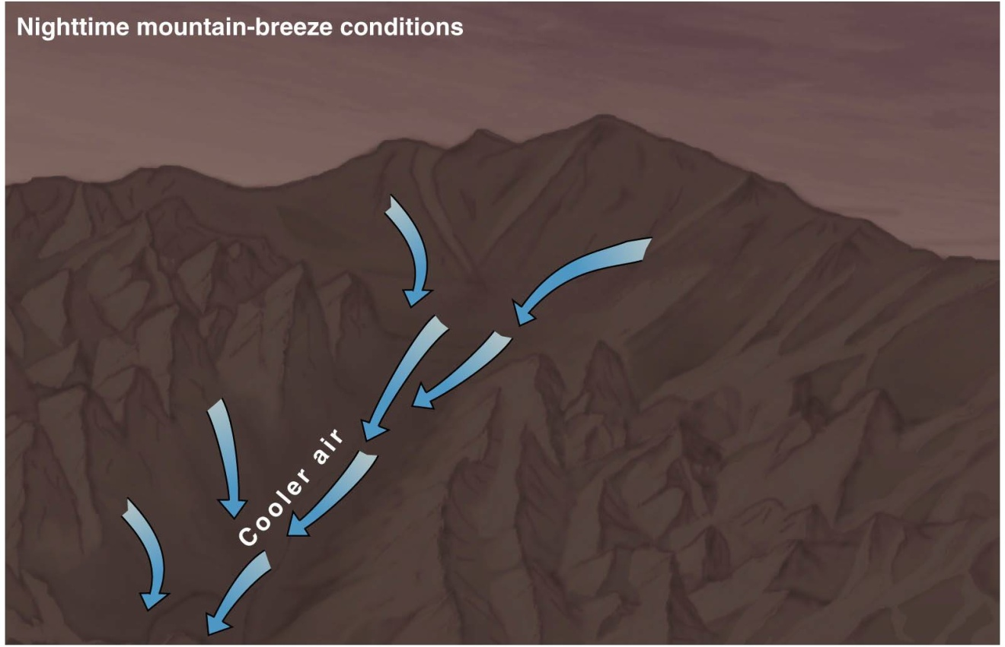
Mesoscale Climate Features
Cold-Air Drainage: cold air sinking into valleys can lead to inversions.
Cold air is more dense than warm air.
This causes the cold air to “drain” (like water) downhill!

Slide 21
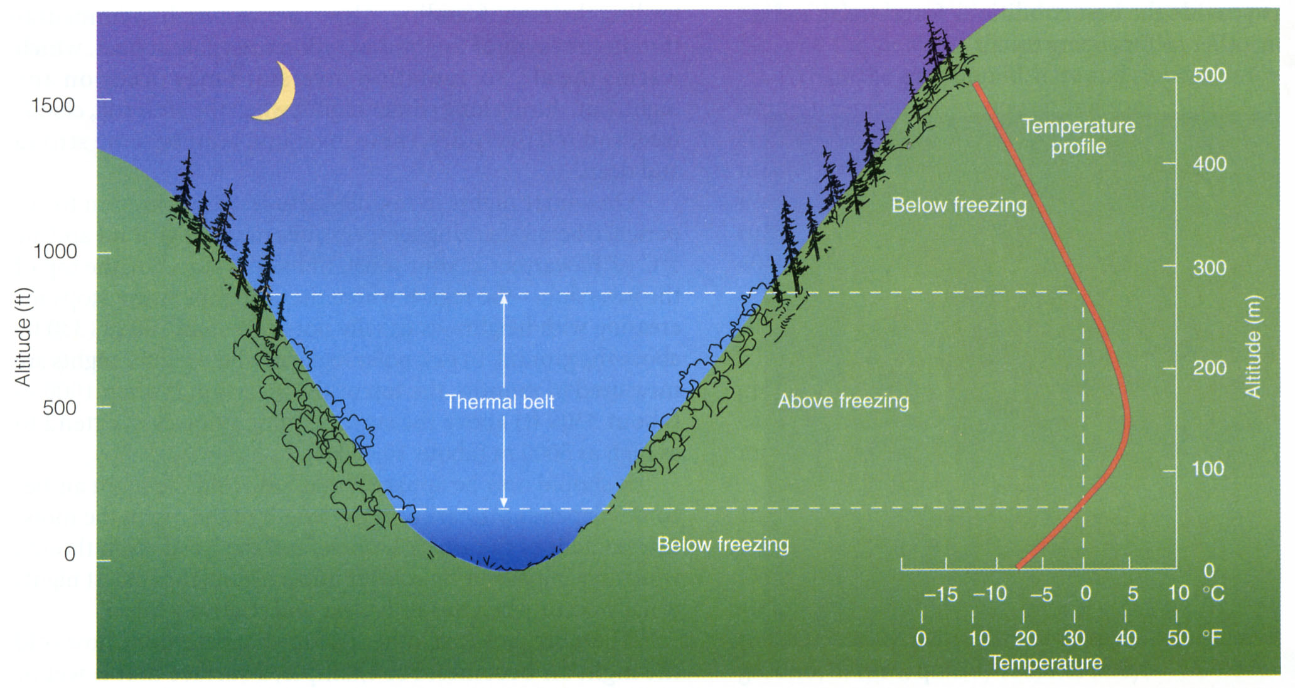
Mesoscale Climate Features
Thermal Belts

Slide 22
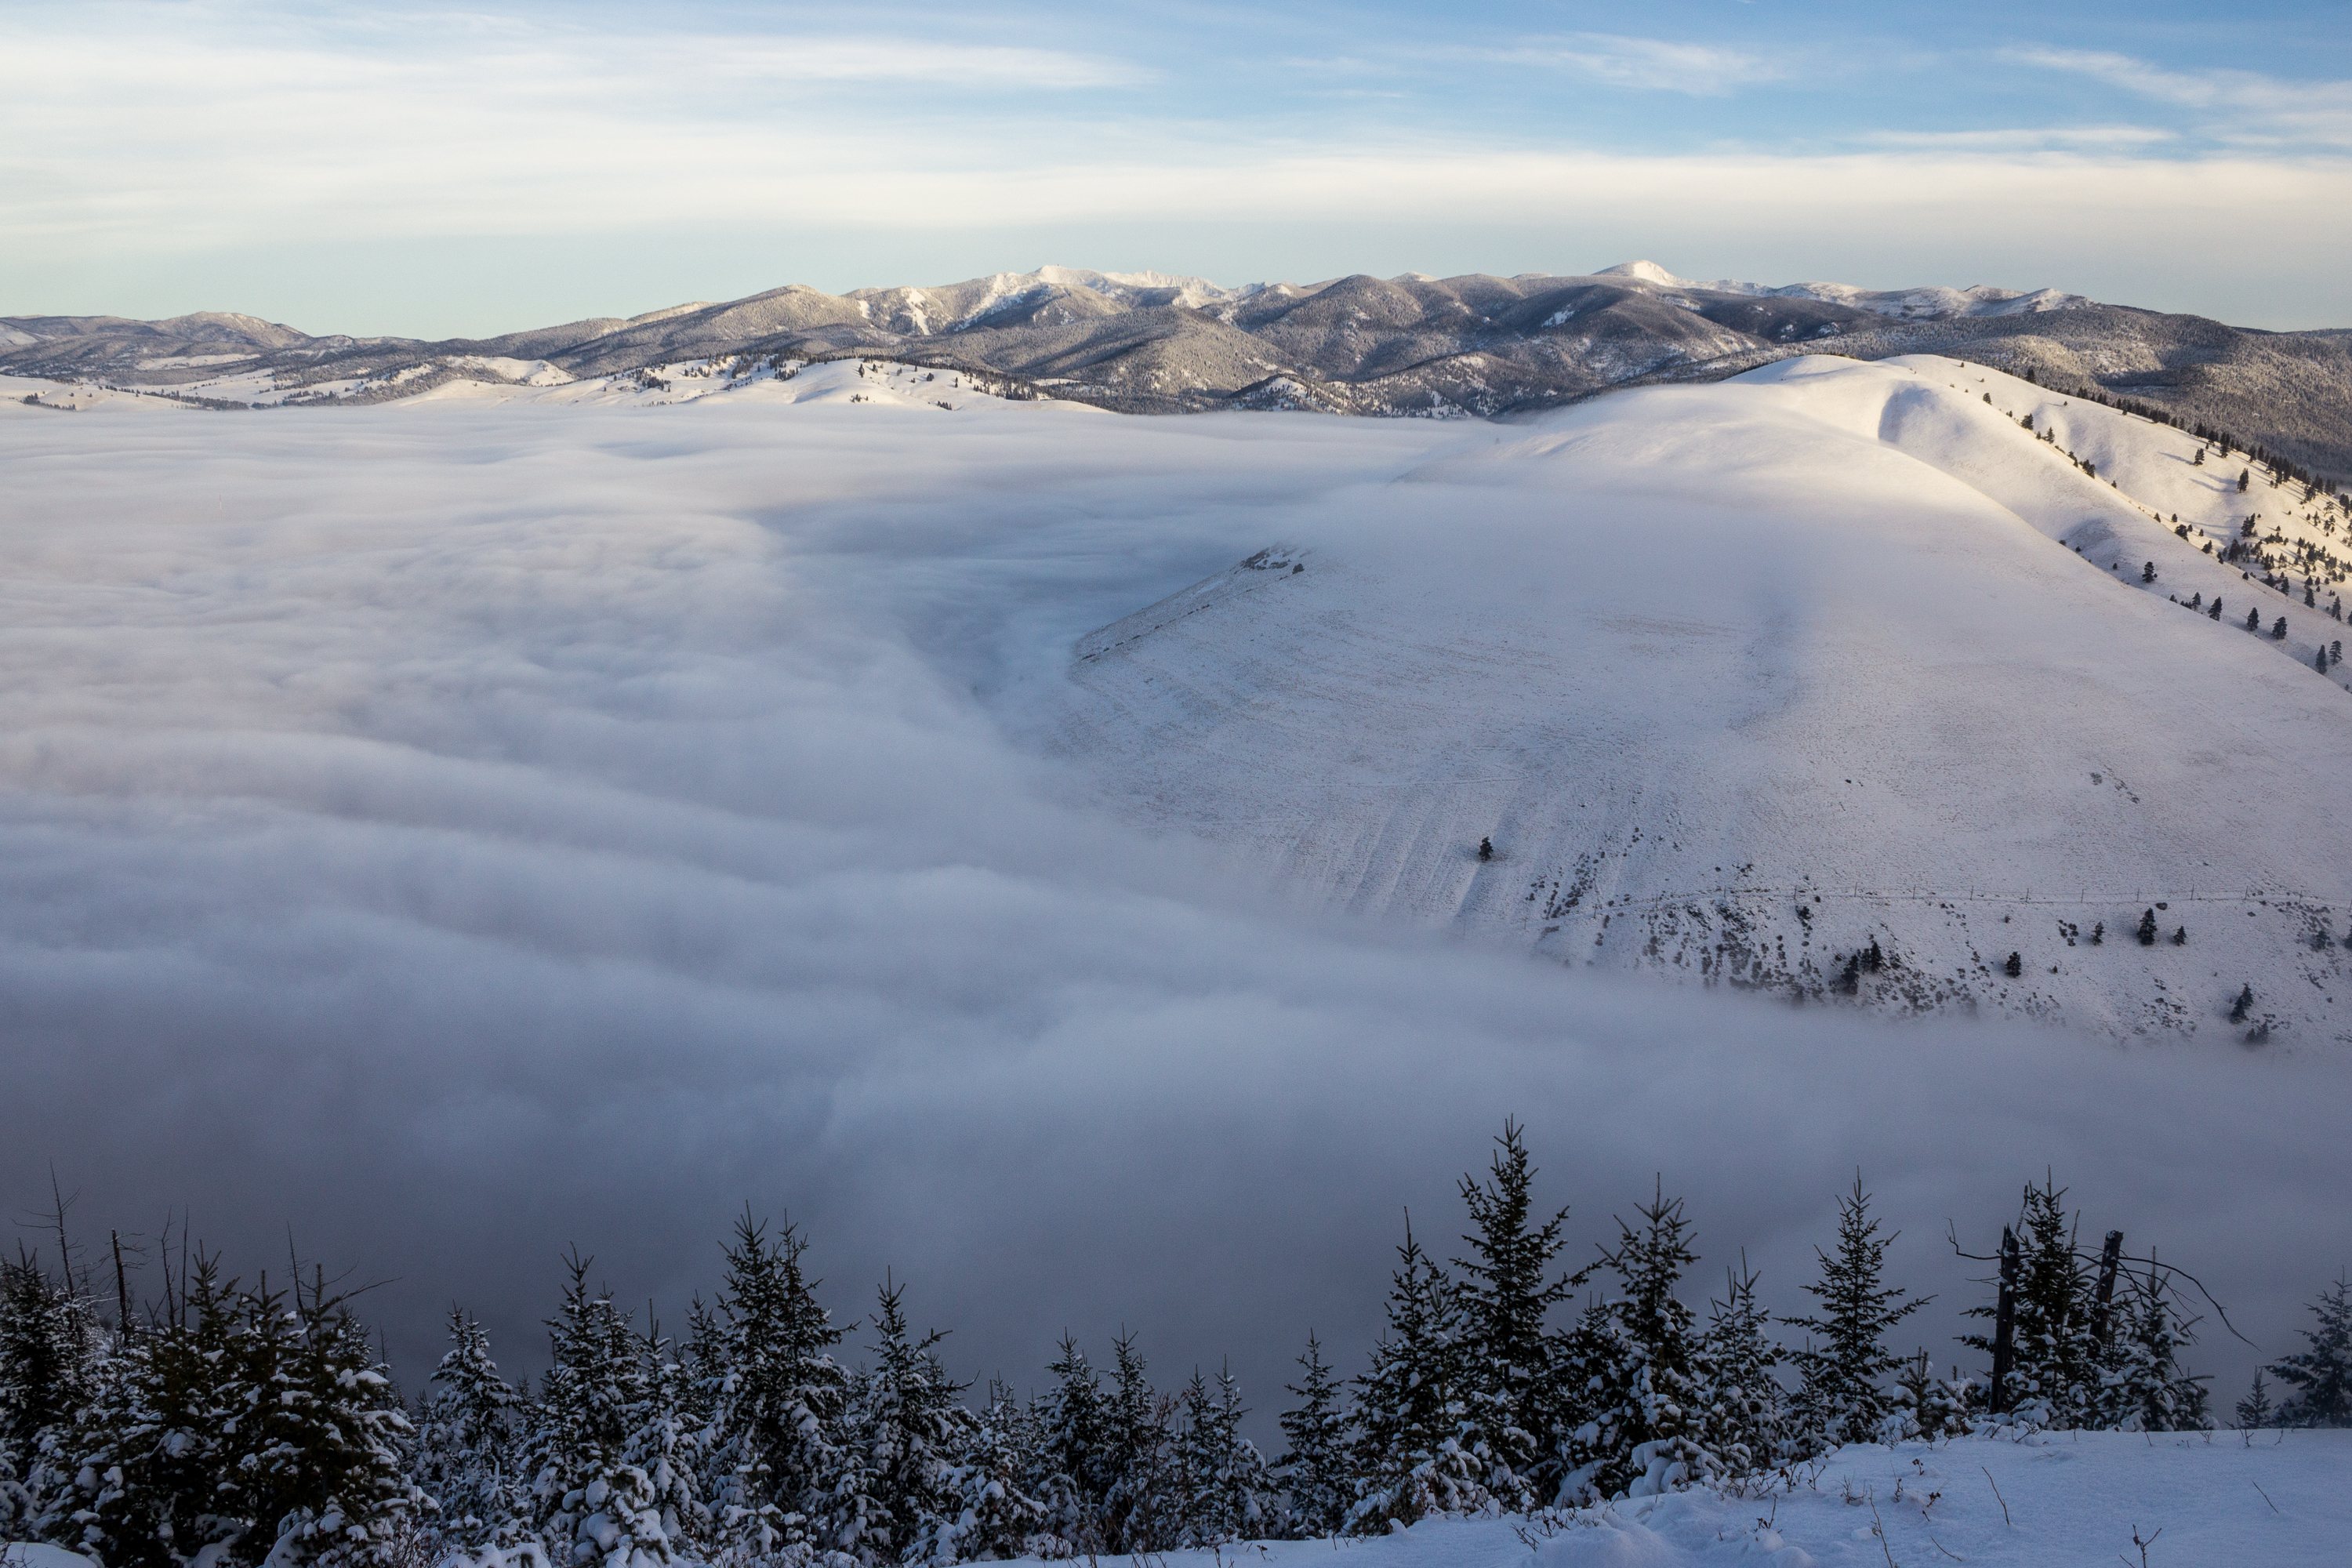

Slide 23
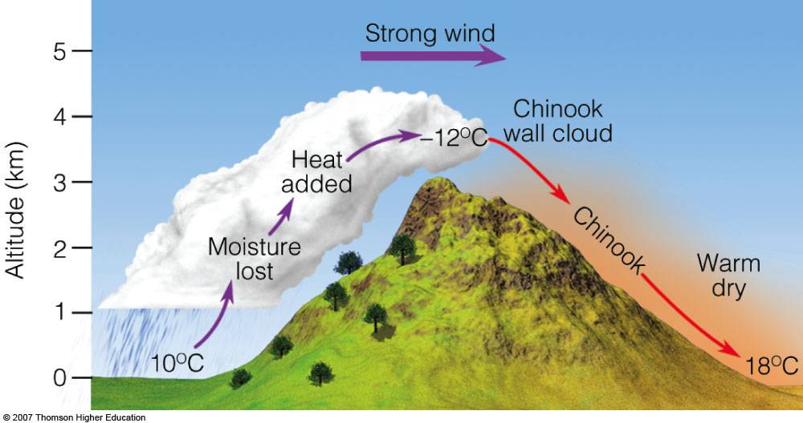
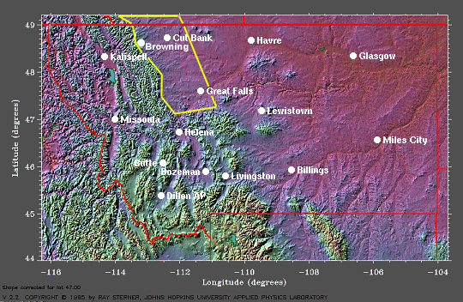
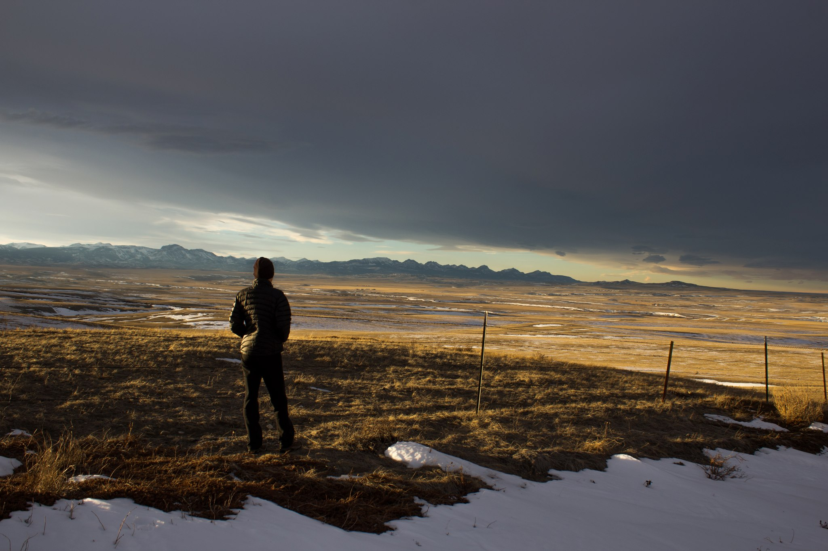
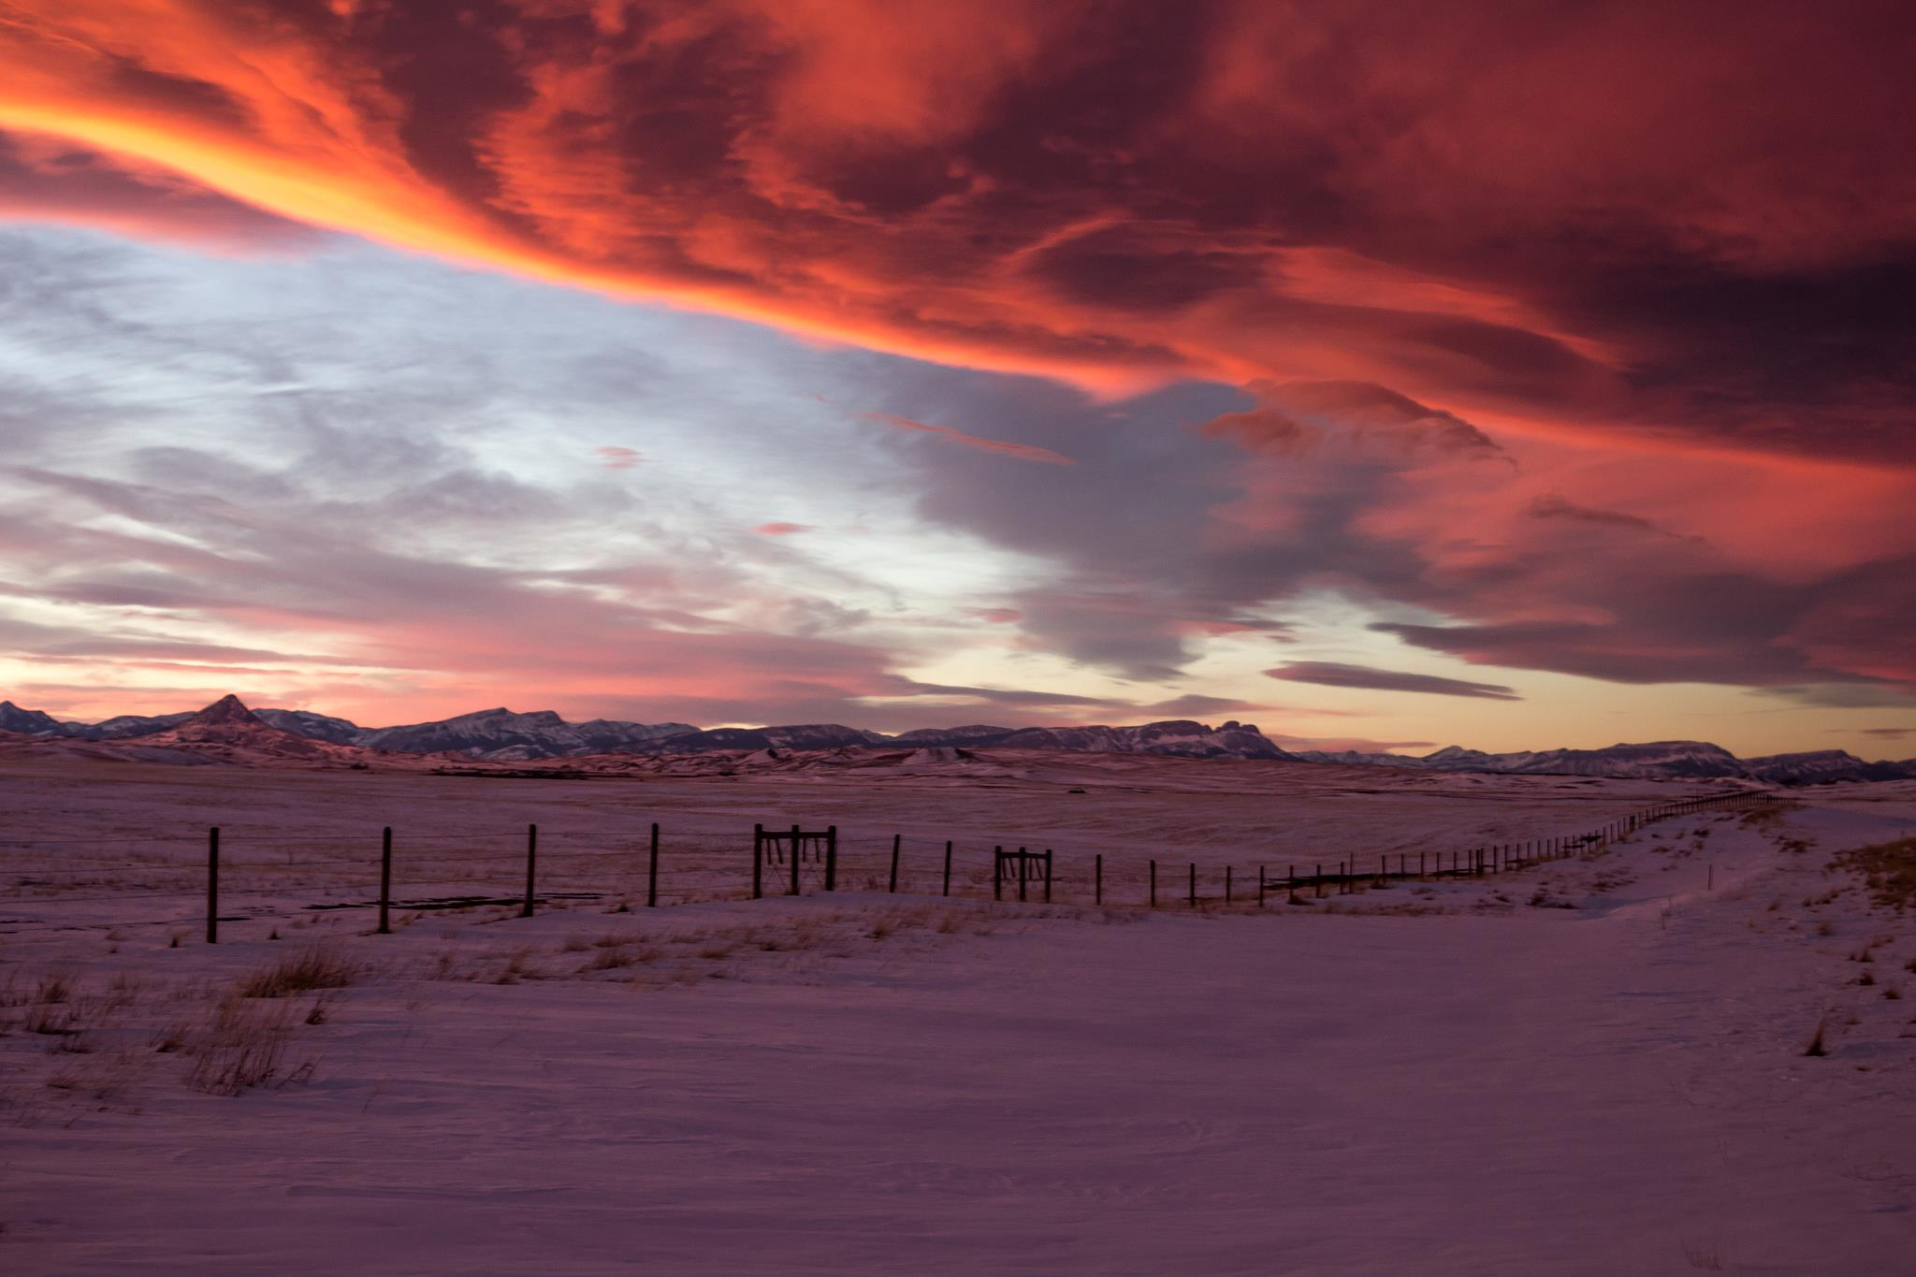
Mesoscale Climate Features
Chinook Winds (Foehn)
http://formontana.net/chinook.html

Slide 24
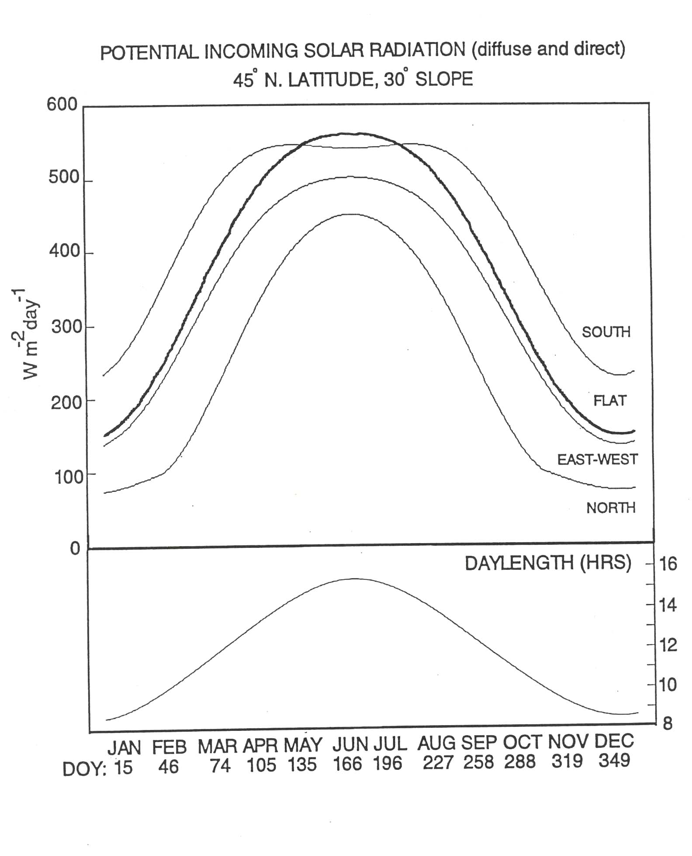
Slope and Aspect
Microscale Climate Features
South
North
90°
45°
Slope Angle of Incidence
45° facing Sun 90°
Flat 45°
45° away from Sun 0°

Slide 25
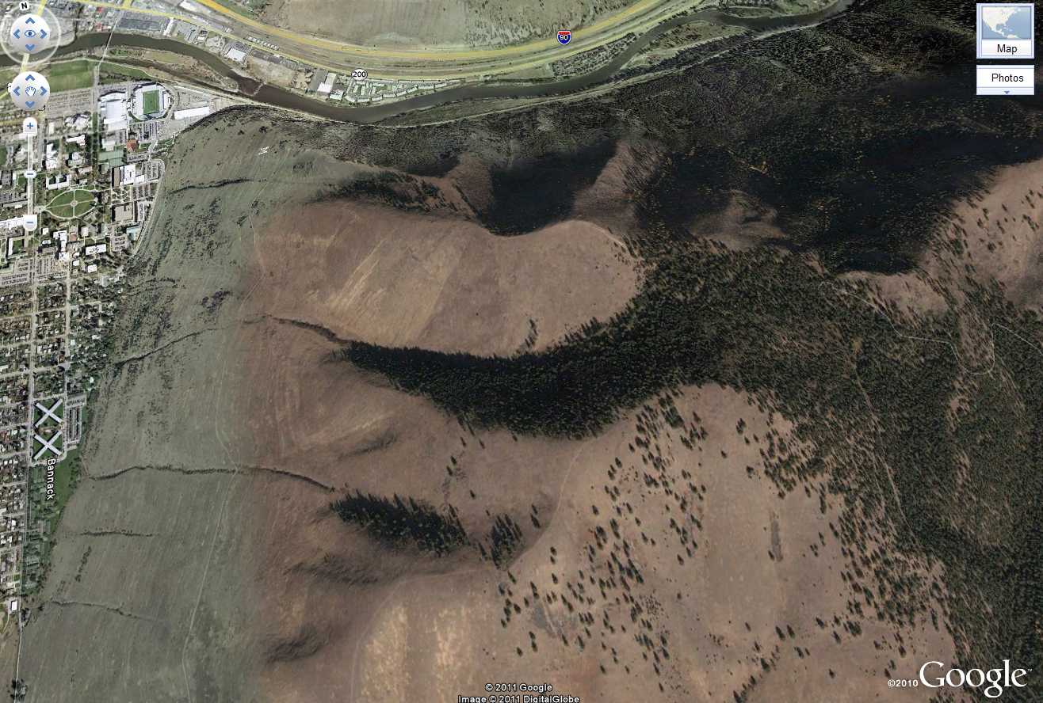

Slide 26
Natural Climate Variability in Montana

Slide 27
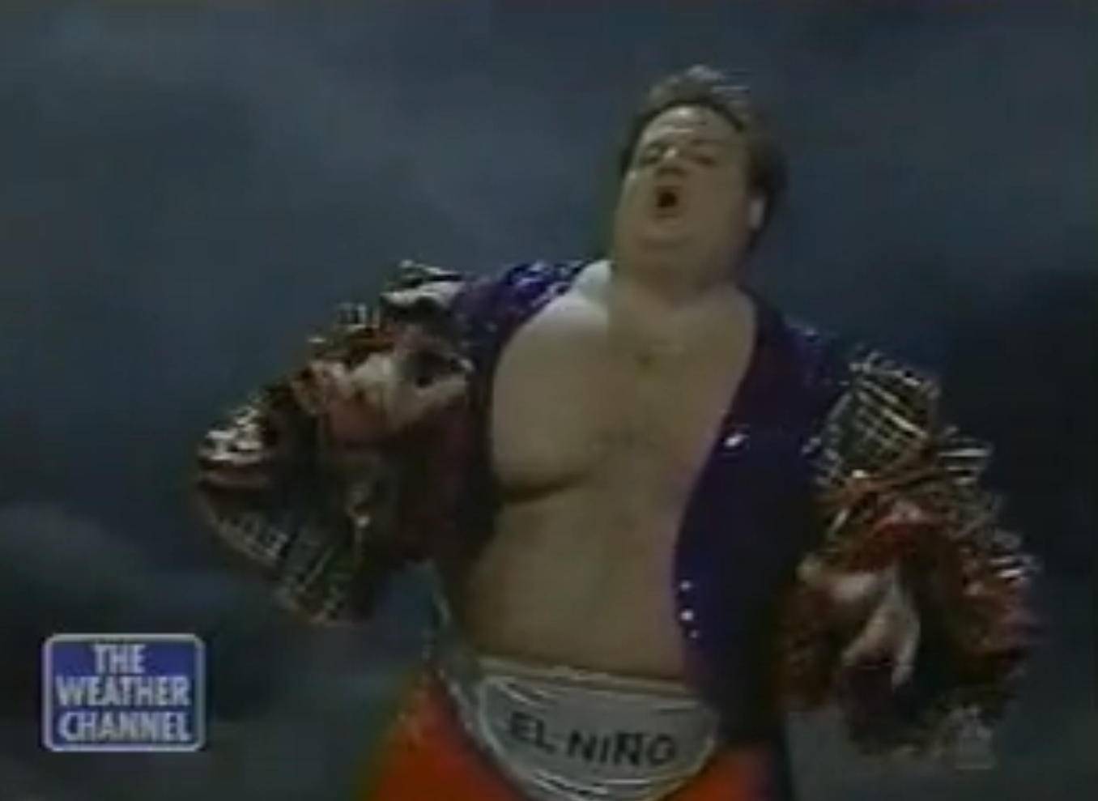
El Niño-Southern Oscillation (ENSO)

Slide 28
El Niño-Southern Oscillation (ENSO)
A system of interactions between the tropical Pacific Ocean and the atmosphere above it
El Niño: warm phase
La Niña: cold phase
Interval of El Niño occurrence is 3 – 5 years but can be anywhere from 2 – 12 years
Produces the greatest interannual variability of temperature and precipitation on a global scale

Slide 29
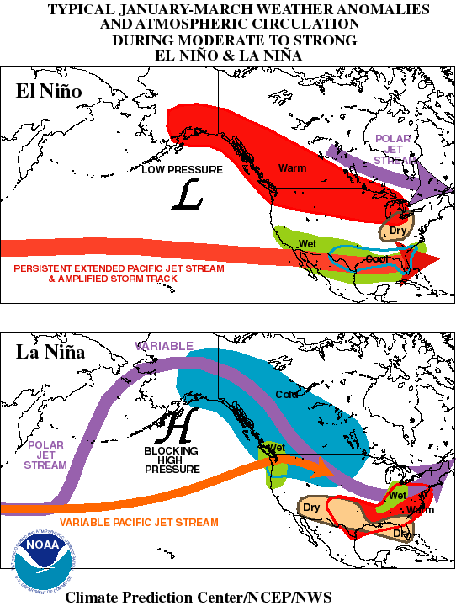
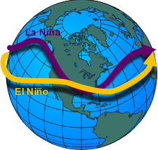
El Niño/ La Niña Impacts
Shift in jet streams

Slide 30
ENSO
Multivariate ENSO Index
Outlook
ENSO-neutral conditions.
http://www.cpc.ncep.noaa.gov/products/analysis_monitoring/enso_advisory/
http://www.bom.gov.au/climate/enso/

Slide 31
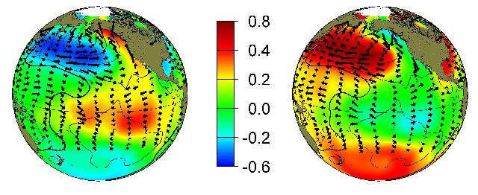
Pacific Decadal Oscillation
Similar to ENSO, but more long lived
Shifts on inter-decadal time scale: every 20 – 30 years
Warm/positive phase: drier in Montana
Cool/negative phase: wetter in Montana
Recently transitioned to cool/negative phase
Warm Phase Cool Phase
http://jisao.washington.edu/pdo/
http://www.montana.edu/wwwvr/activities/activities02/drought.html

Slide 32
Climate Trends in Montana

Slide 33
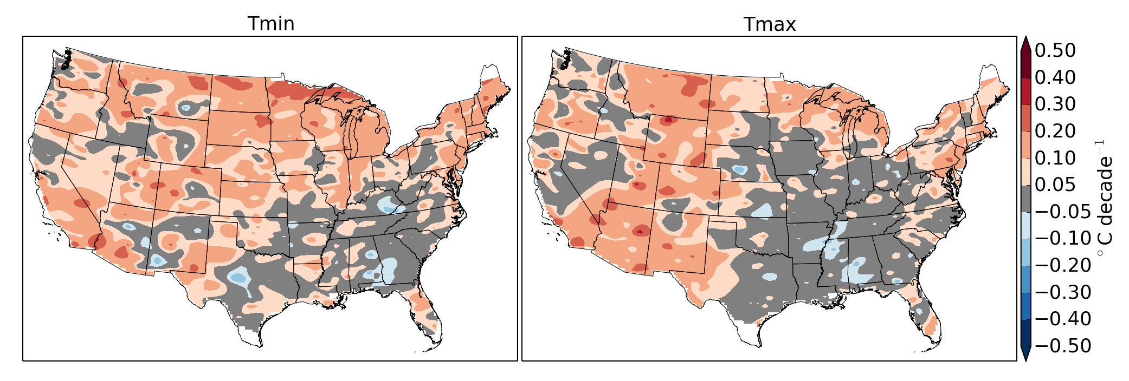
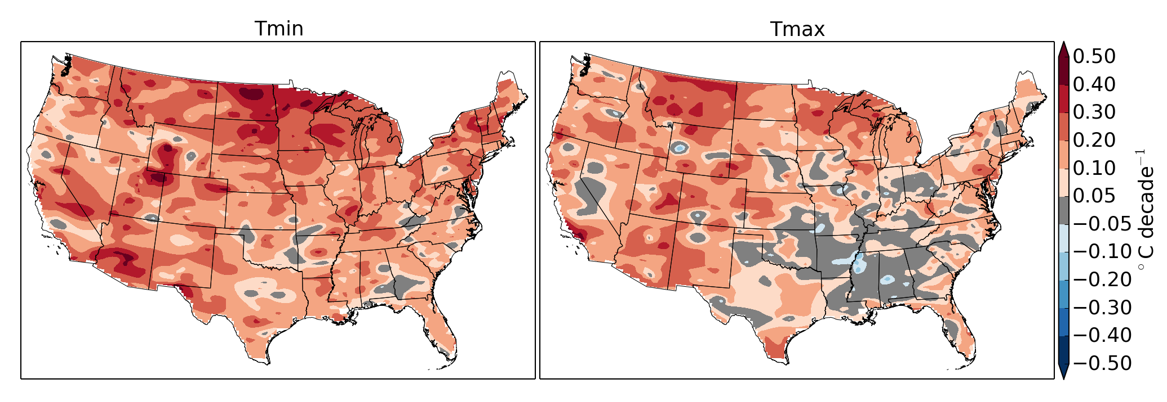
Montana Temperature Trends
1895 – 2012 Trend in Annual Temperatures
1948 – 2012 Trend in Annual Temperatures

Slide 34
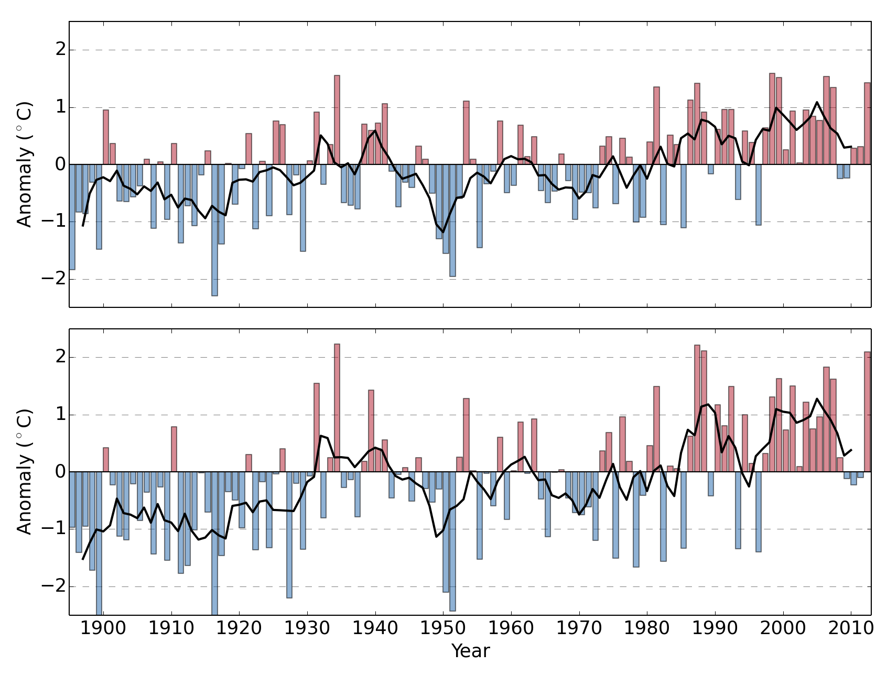
Montana Temperature Trends
Montana Annual Temperature Anomalies
(1961-1990 baseline)
Tmin
Increase in annual temperature
1895-2012
 | Tmin (°C) | Tmax (°C)
Montana | 1.241 | 1.745
CONUS | 0.970 | 0.792
Tmax

Slide 35
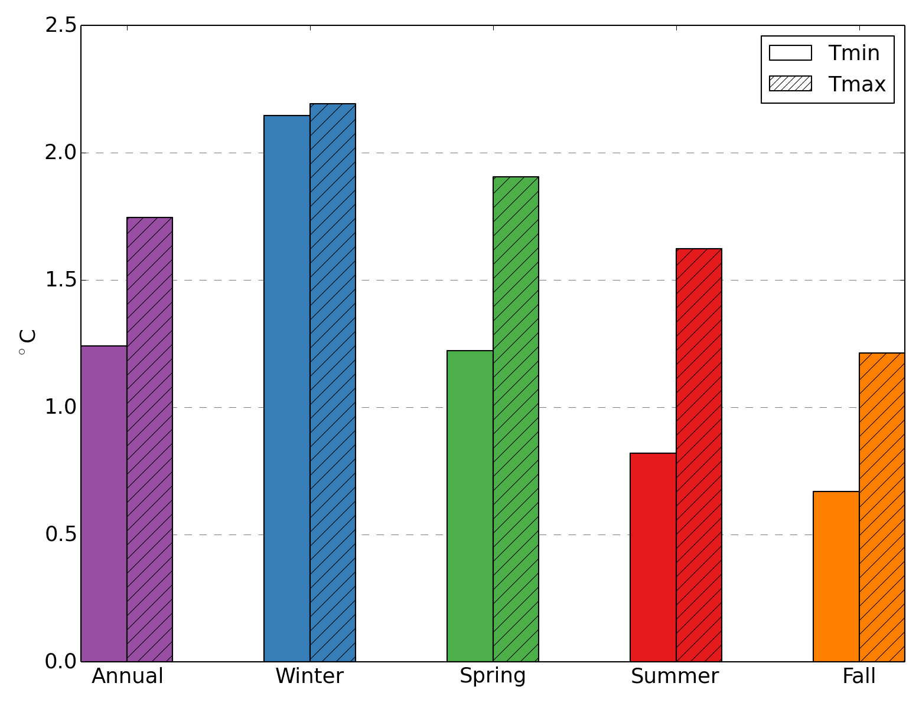
Montana Temperature Trends
Increase in seasonal Montana temperature
1895-2012

Slide 36
Montana Precipitation Trends
Linear trends of annual precipitation from the 1895–2009 (% per century)
McRoberts, D. B., & Nielsen-Gammon, J. W. (2011). A New Homogenized Climate Division Precipitation Dataset for Analysis of Climate Variability and Climate Change. Journal of Applied Meteorology and Climatology, 50(6), 1187–1199. doi:10.1175/2010JAMC2626.1

Slide 37
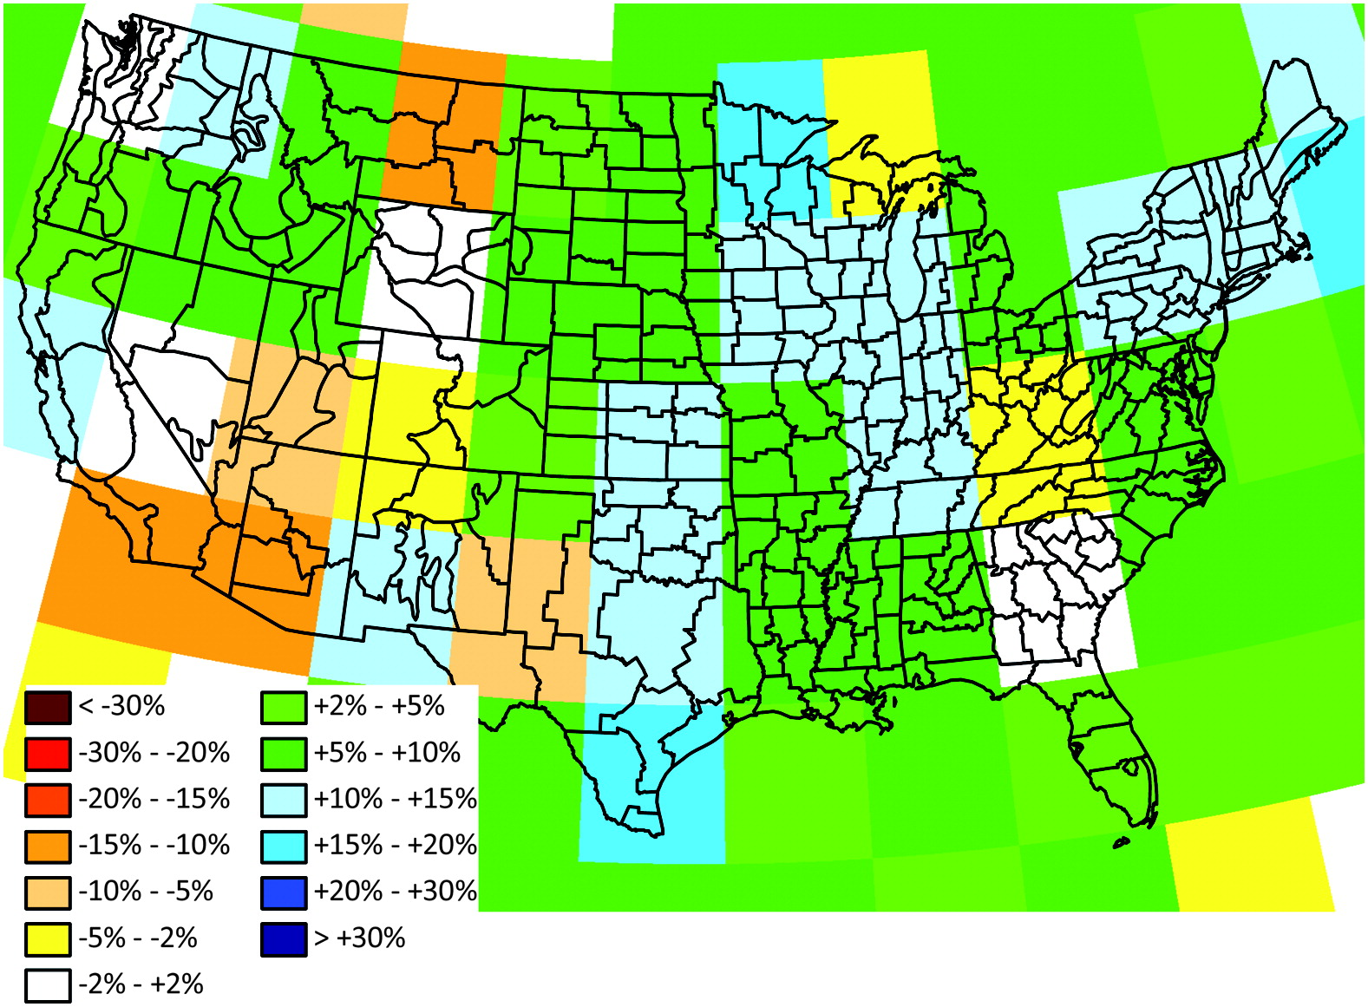
Montana Precipitation Trends
Linear trends of annual precipitation from the 1900–2009 (% per century)
McRoberts, D. B., & Nielsen-Gammon, J. W. (2011). A New Homogenized Climate Division Precipitation Dataset for Analysis of Climate Variability and Climate Change. Journal of Applied Meteorology and Climatology, 50(6), 1187–1199. doi:10.1175/2010JAMC2626.1

Slide 38
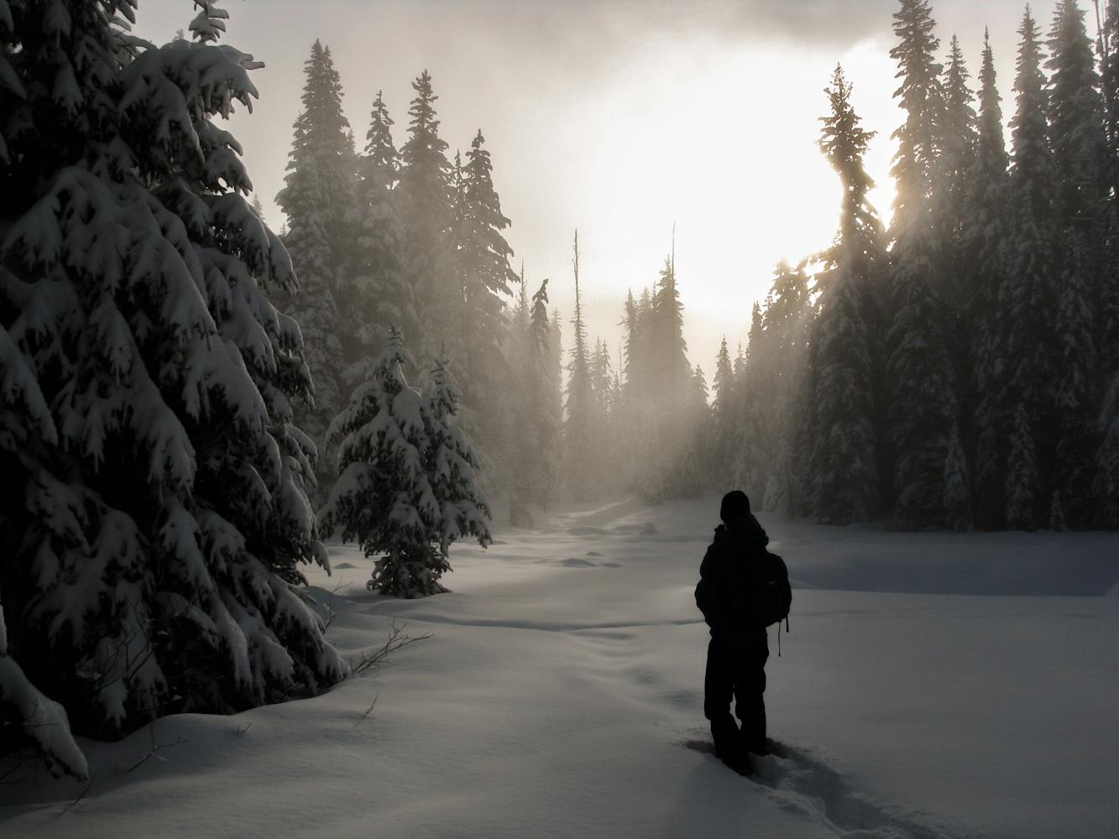
Montana Precipitation Trends
Harder to separate natural variability and anthropogenic climate change contributions to regional precipitation trends
Precipitation has large variability in space and time
Precipitation components
Amount
Frequency
Intensity
Duration
Type
Timing

Slide 39
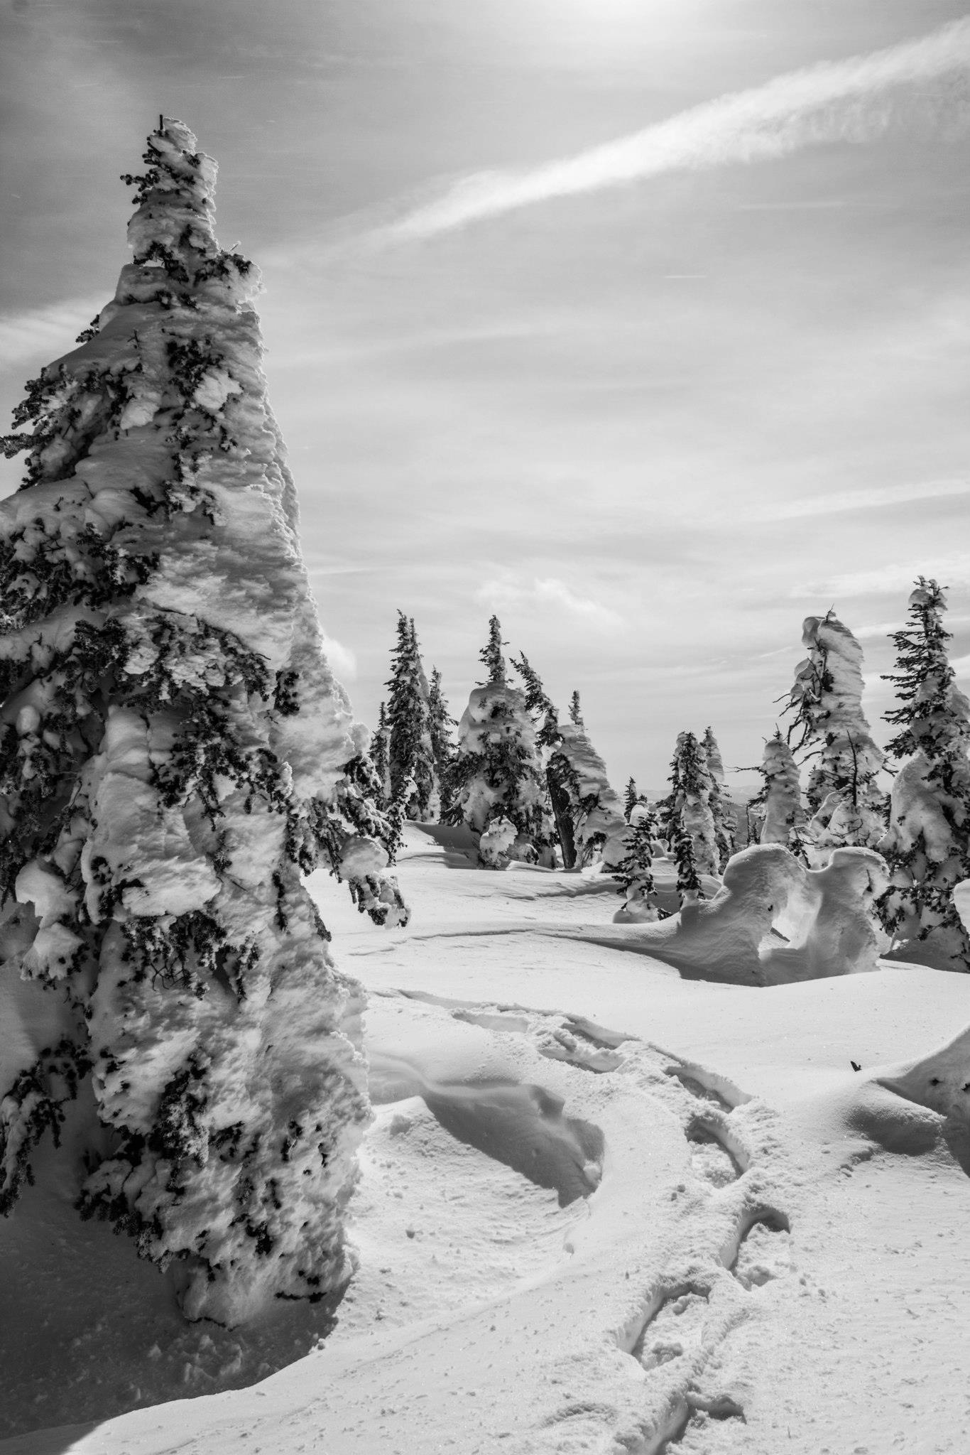
Snowpack
Much of Montana is semi-arid
Majority of surface water comes from mountain snowpack
Municipal and industrial water supplies
Energy production, agriculture, and ecosystems
Quantity and timing of water released from snowpack are critical societal and environmental concerns
Import snowpack components
Snowpack duration
Peak SWE
April 1 SWE
Timing of melt

Slide 40
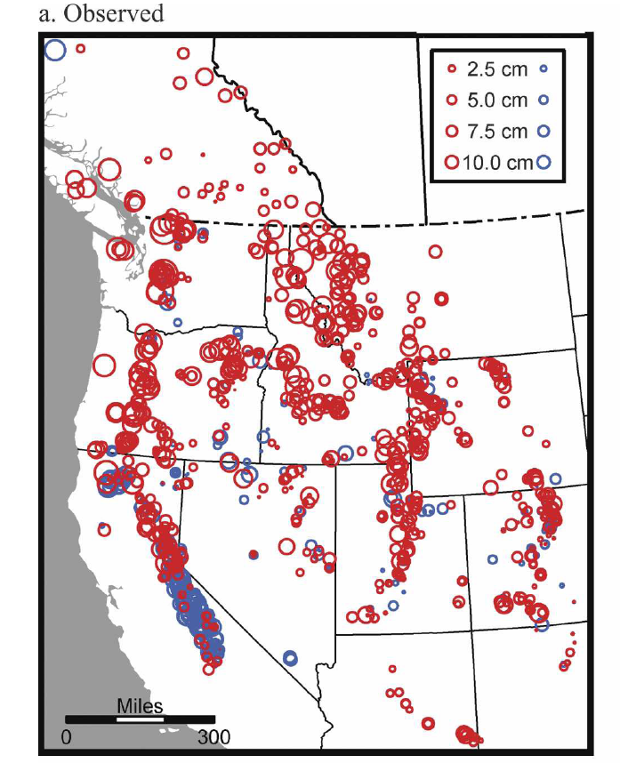
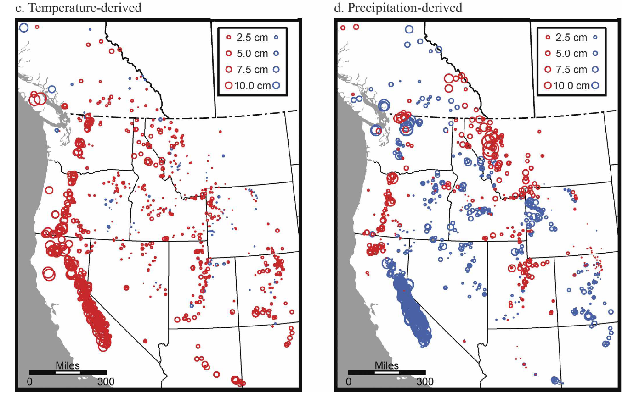
Trends in Snowpack
Trend in April 1 SWE 1960-2002
Temperature Only Trend
Prcp Only Trend
Mote, P. (2006). Climate-driven variability and trends in mountain snowpack in western North America. Journal of Climate, 19(23), 6209–6220.

Slide 41
Trends in Snowpack
Pederson, G. T., Betancourt, J. L., & McCabe, G. J. (2013). Regional patterns and proximal causes of the recent snowpack decline in the Rocky Mountains, U.S. Geophysical Research Letters, 40(9), 1811–1816. doi:10.1002/grl.50424

Slide 42
Trends in Snowpack
Regional estimates of the seasonal temperature and precipitation contributions to 1 April SWE
Pederson, G. T., Betancourt, J. L., & McCabe, G. J. (2013). Regional patterns and proximal causes of the recent snowpack decline in the Rocky Mountains, U.S. Geophysical Research Letters, 40(9), 1811–1816. doi:10.1002/grl.50424

Slide 43
Trends in Snowpack
Summary for N. Rockies
The bad news:
Overall decreases in regional snowpack
Peak SWE and melt out occurring earlier
Decrease in duration of snowpack
The good news:
Increase in later spring precipitation has likely helped buffer some of the decreases in snowpack
A decadal shift in large-scale Pacific climate variability around 1976-1984 may account for 30%-50% of:
Western North America springtime warming
Decreasing winter precipitation in the N.Rockies
Abatzoglou, J.T., 2011. Influence of the PNA on declining mountain snowpack in the Western United States. International Journal of Climatology 31, 1135–1142.
Pederson, G.T., Gray, S.T., Ault, T., Marsh, W., Fagre, D.B., Bunn, A.G., Woodhouse, C.A., Graumlich, L.J., 2011. Climatic Controls on the Snowmelt Hydrology of the Northern Rocky Mountains. Journal of Climate 24, 1666–1687.
Pederson, G.T., Gray, S.T., Woodhouse, C.A., Betancourt, J.L., Fagre, D.B., Littell, J.S., Watson, E., Luckman, B.H., Graumlich, L.J., 2011. The Unusual Nature of Recent Snowpack Declines in the North American Cordillera. Science 333, 332.

Slide 44
Glaciers in Glacier NP
Boulder Glacier
Glacier maximum occurred in 1850s
Produced by ~70 years of cool/wet summers with high winter snowpack.
After 1850, glacial retreat starts
Extended period (>50 yr) of summer drought and low snowpack
1917 – 1941: Exceptional drought, low snowpack accelerated retreat
1940s-1970s: retreat slowed, some small advances
1970s-present: retreat has increased
Like overall snowpack trends, likely related to Pacific climate variability (e.g.—PDO) and anthropogenic climate change
1932
1988
Hall, M.H.P., Fagre, D.B., 2003. Modeled climate-induced glacier change in Glacier National Park, 1850-2100. BioScience 53, 131–140.
Pederson, G.T., 2004. Decadal-scale climate drivers for glacial dynamics in Glacier National Park, Montana, USA. Geophysical Research Letters 31, L12203.

Slide 45
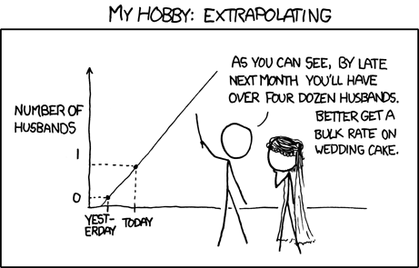
Future Climate Projections in Montana

Slide 46
Climate Projections
Basic story
Continued long-term increase in temperatures are highly likely
Trends in precipitation are less certain, but likely to have increased precipitation in all seasons except for a decrease in summer precipitation

Slide 47
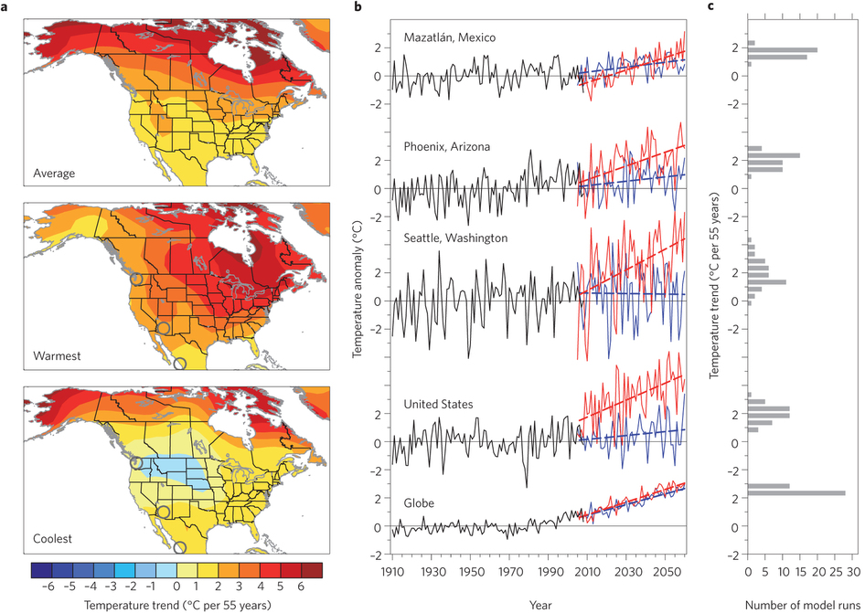
Winter temperature trends 2005–2060
Deser, C., Knutti, R., Solomon, S., Phillips, A.S., 2012. Communication of the role of natural variability in future North American climate. Nature Climate Change 2, 775–780.

Slide 48
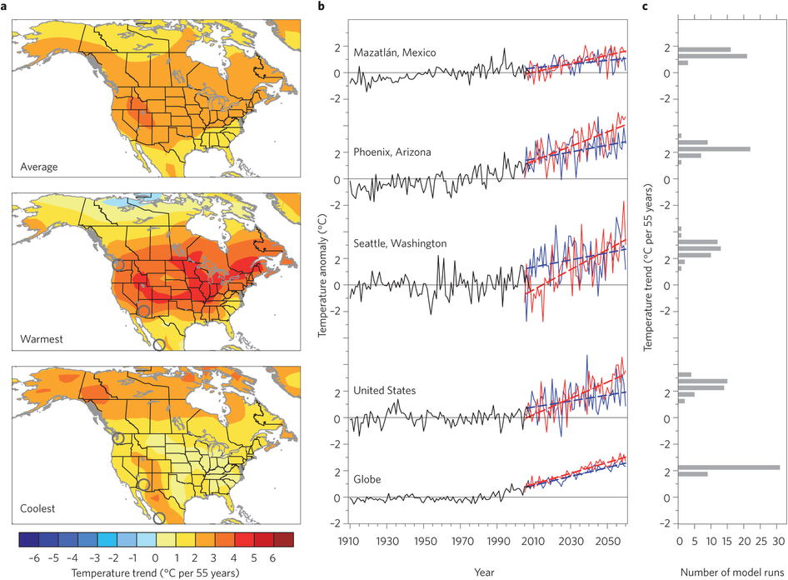
Summer temperature trends 2005–2060
Deser, C., Knutti, R., Solomon, S., Phillips, A.S., 2012. Communication of the role of natural variability in future North American climate. Nature Climate Change 2, 775–780.

Slide 49
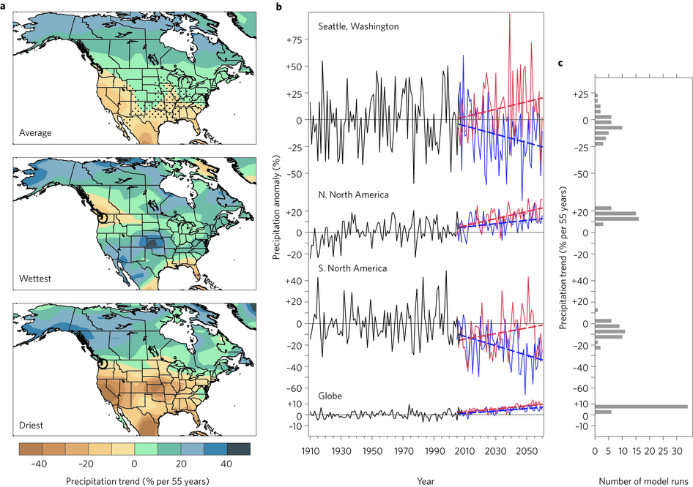
Winter precipitation trends 2005–2060
Deser, C., Knutti, R., Solomon, S., Phillips, A.S., 2012. Communication of the role of natural variability in future North American climate. Nature Climate Change 2, 775–780.

Slide 50
Main Takeaway
External Global Climate Forcing (e.g.—greenhouse gas emissions)
Greenhouse gas emissions
Internal hemispheric/synoptic-scale natural variability
ENSO,PDO,PNA
Local Meso/Micro-scale Climate Features
Topography
Climate Trends in Montana

Slide 51
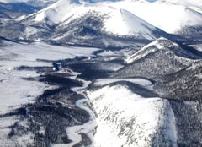
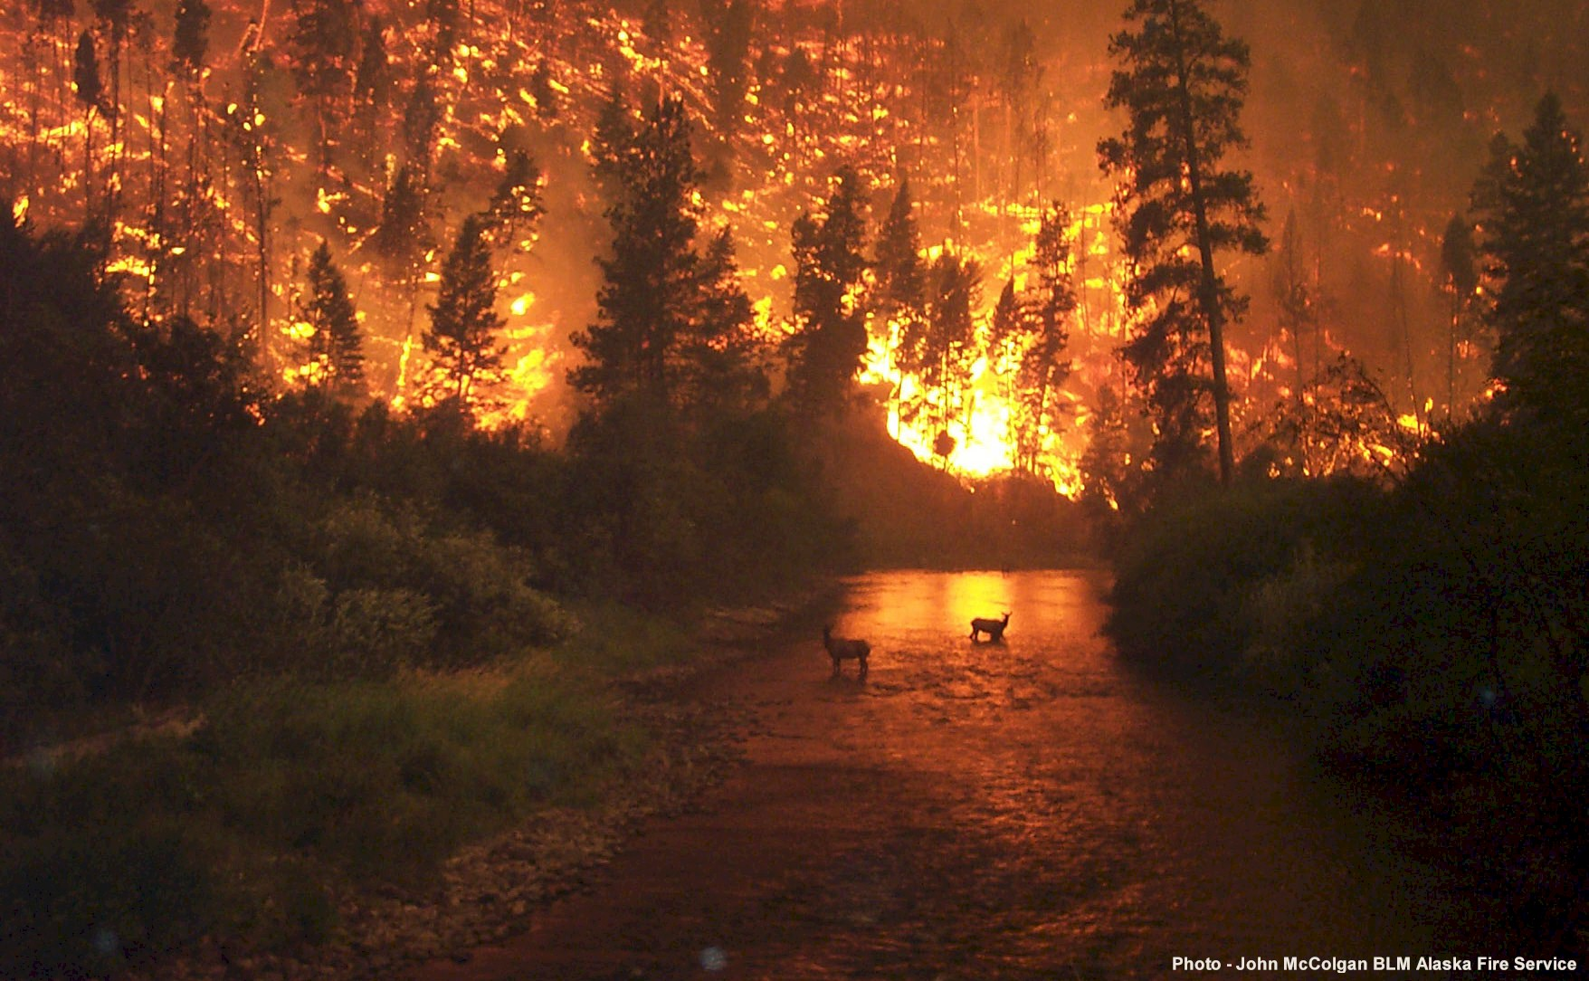
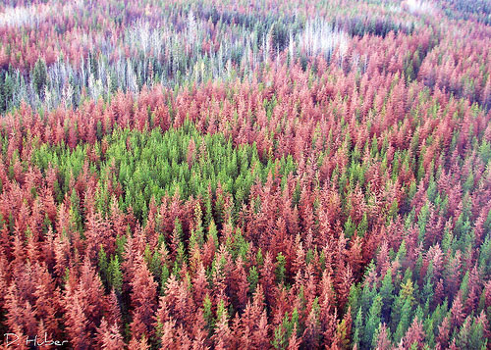
Climate Change Impacts
Regional impacts for Montana and Northern Rockies

