Slide 1
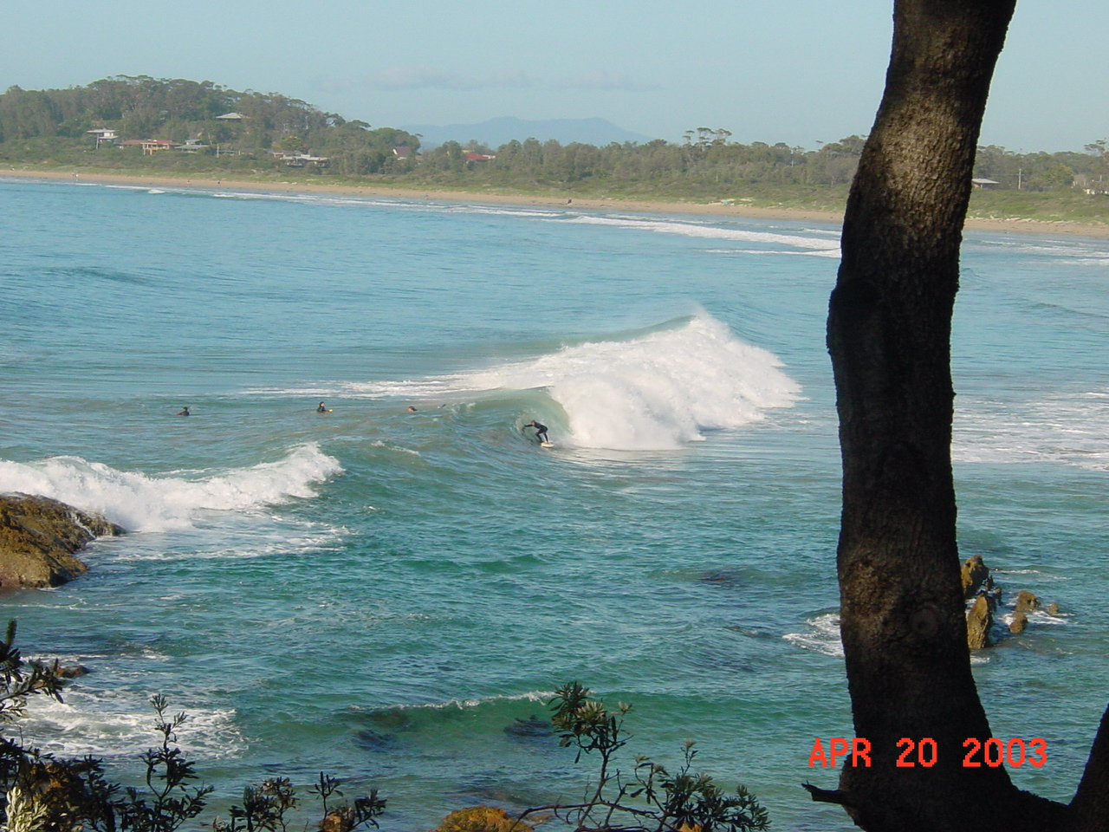
Global Change and Oceans
Fall 2015

Slide 2
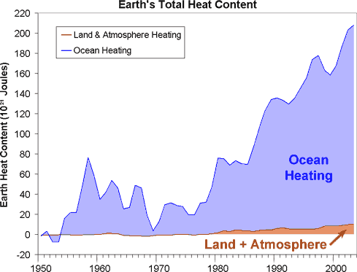
Data From Murphy et al 2009, Domingues et al 2008
Graph from http://www.skepticalscience.com/

Slide 3
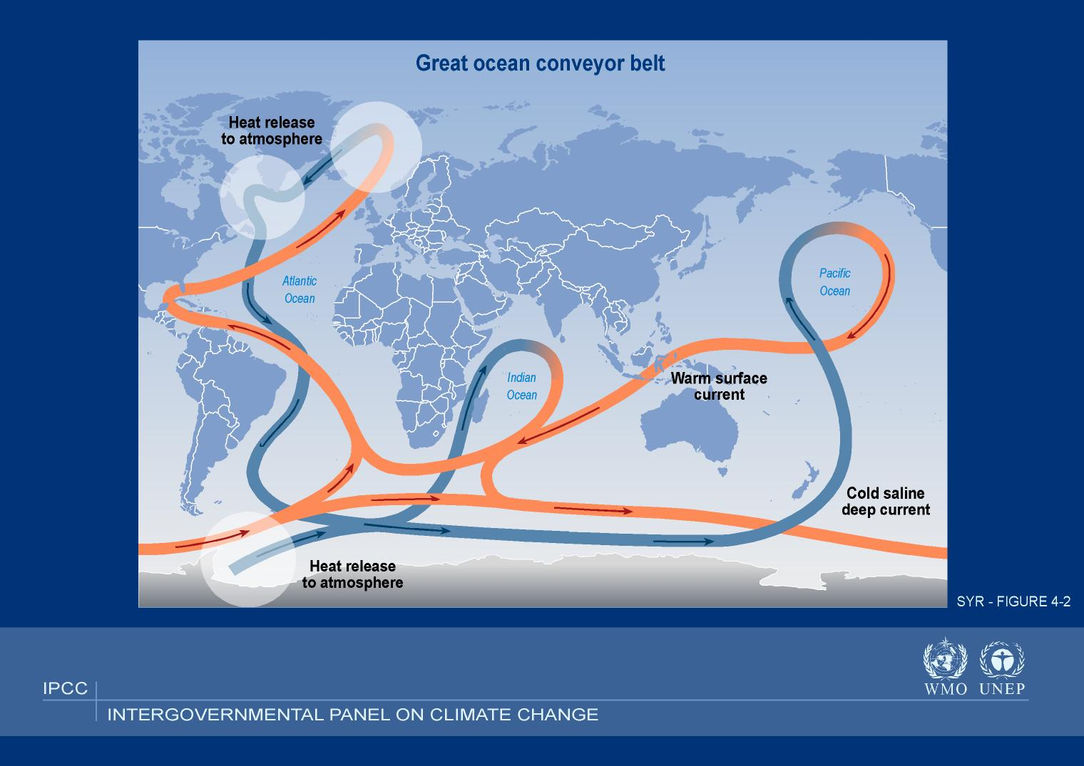

Slide 4
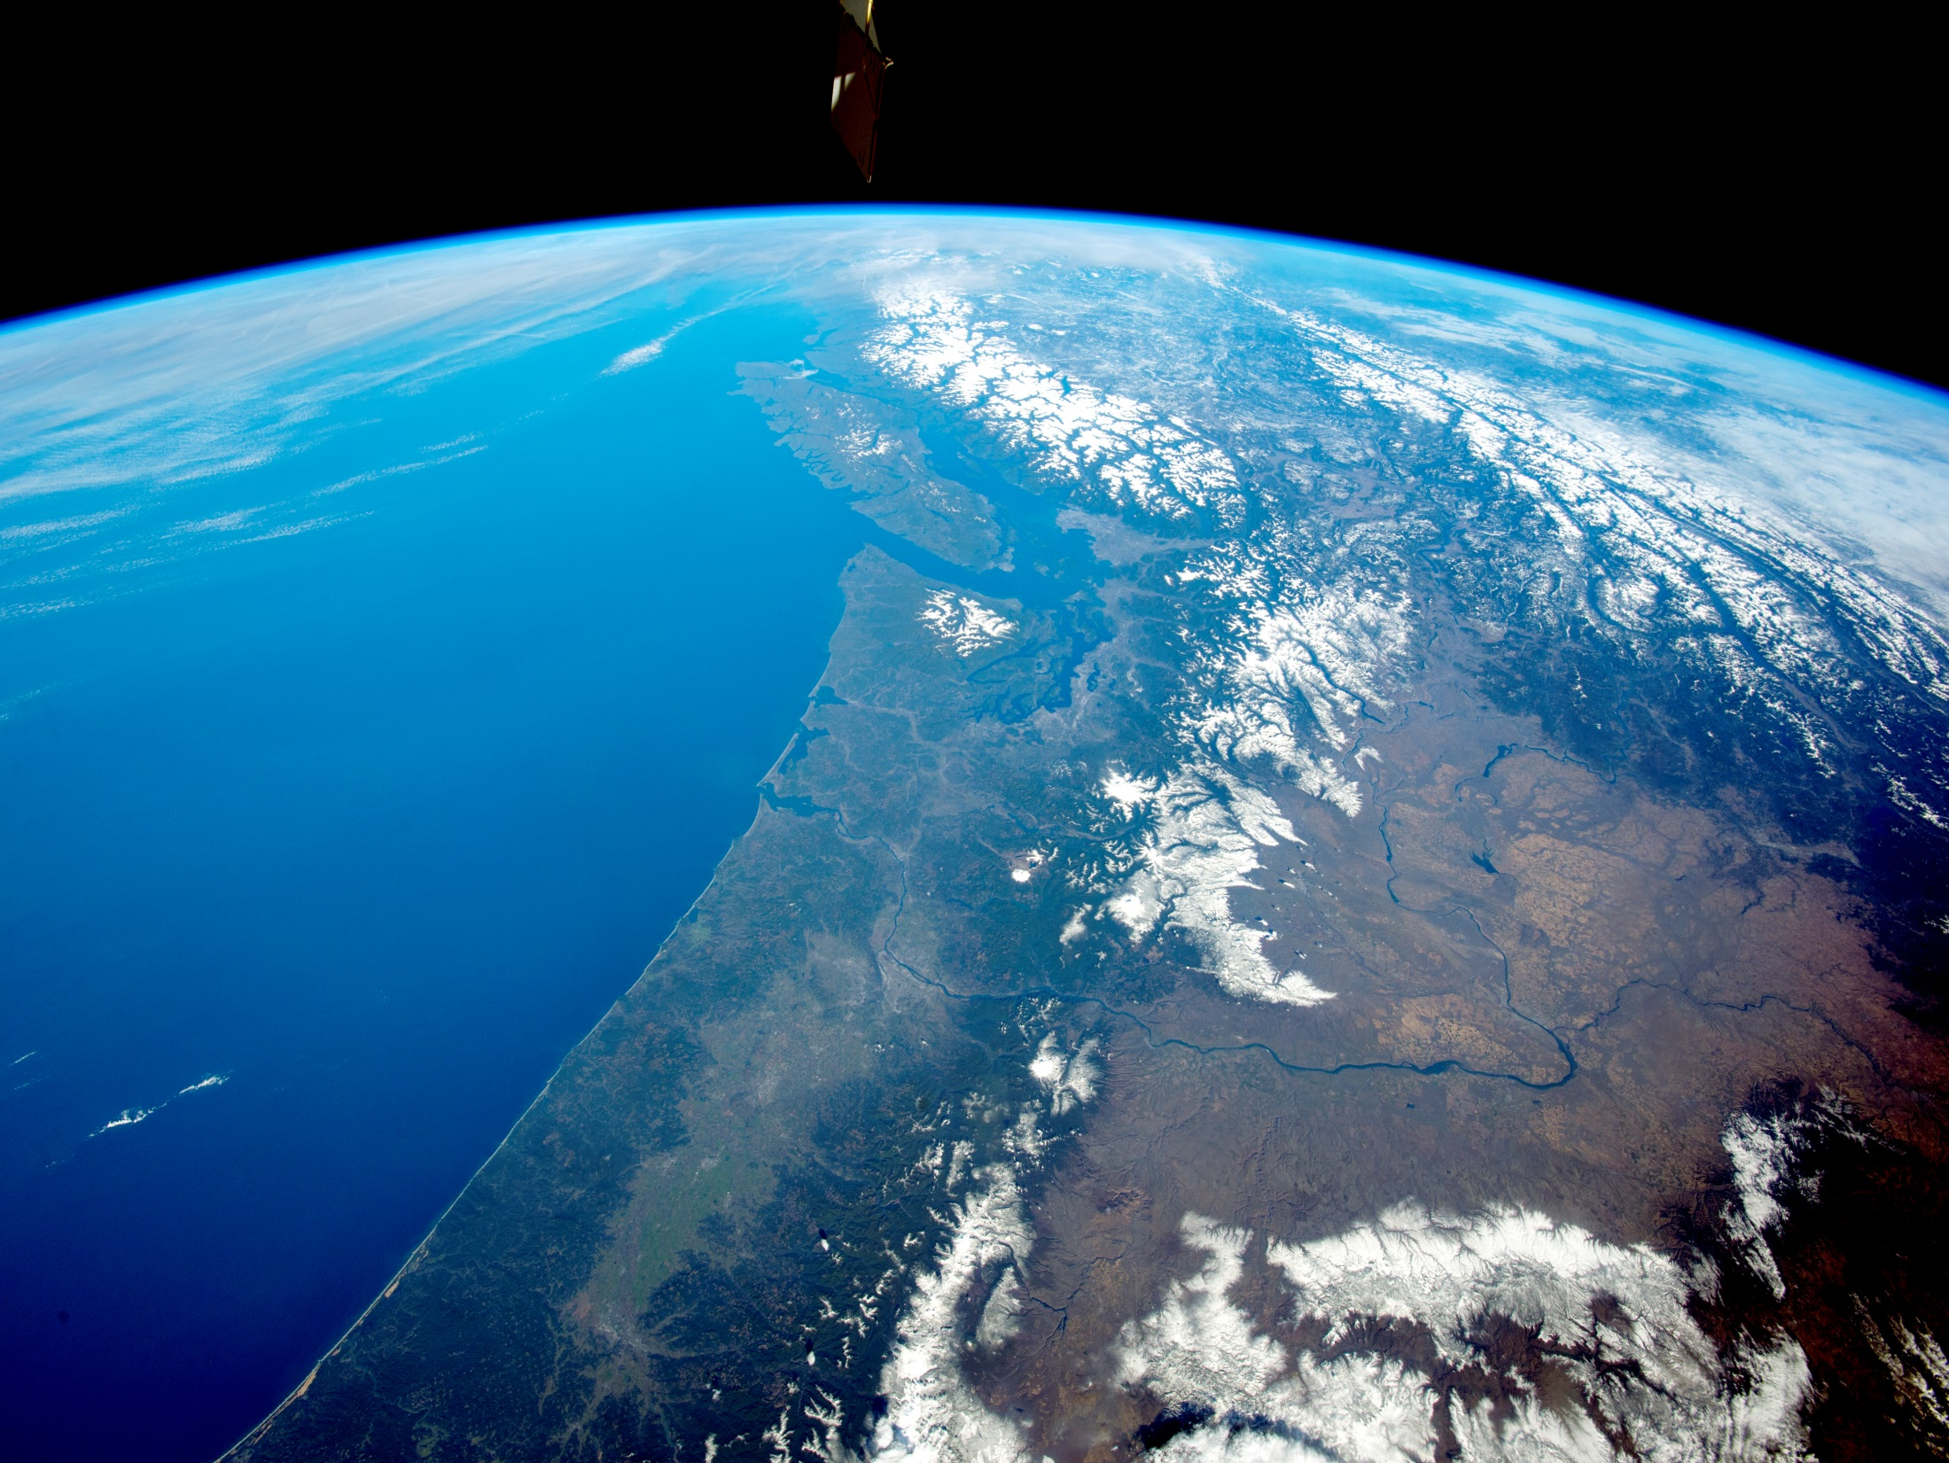
The Atmosphere is very
small

Slide 5
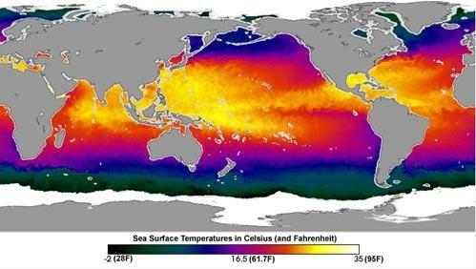
OCEAN SURFACE TEMPERATURES
70% OF LAND IS IN NORTHERN HEMISPHERE

Slide 6
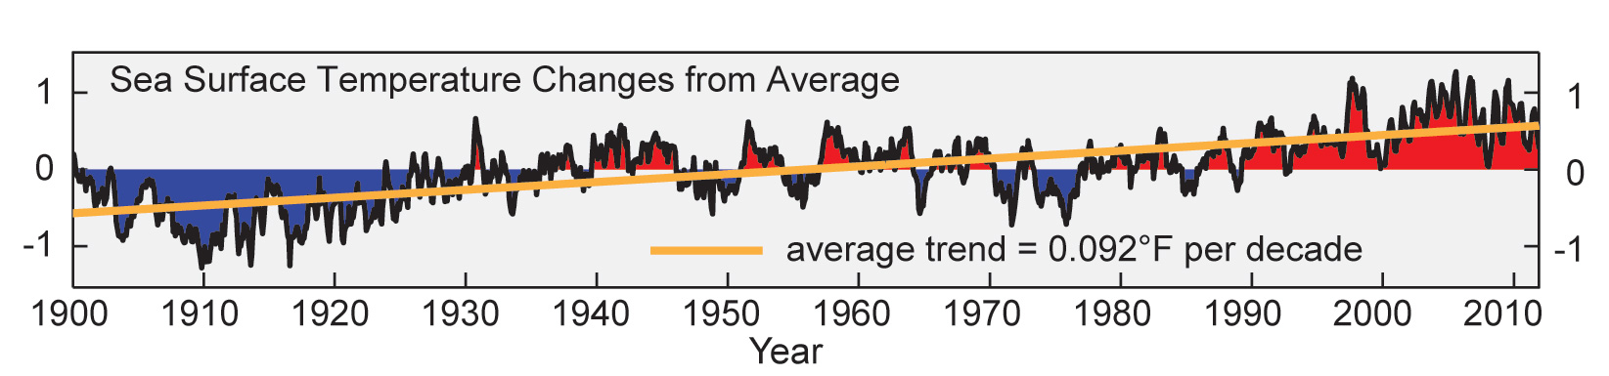
Observed Ocean Warming
Nat Clim Assessment 2014
Notes:
Sea surface temperatures for the ocean surrounding the U.S. and its territories have risen by more than 0.9°F over the past century. (Figure source: adapted from Chavez et al. 2011³).

Slide 7
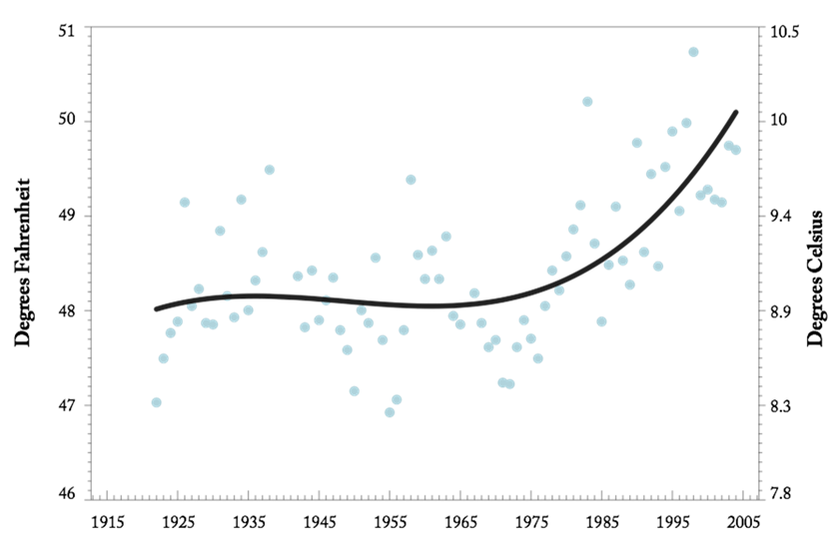

Sea Surface Temperature
(Race Rocks lighthouse, Victoria)
Notes:
Corroborating evidence of the regional warming comes from the measurements of sea surface temperature at Race Rocks lighthouse near Victoria, BC. The warming rate since 1970 is over 2°F and the shape of the curve is similar. Note too that the average temperature is somewhat lower and the interannual variability is much lower.

Slide 8
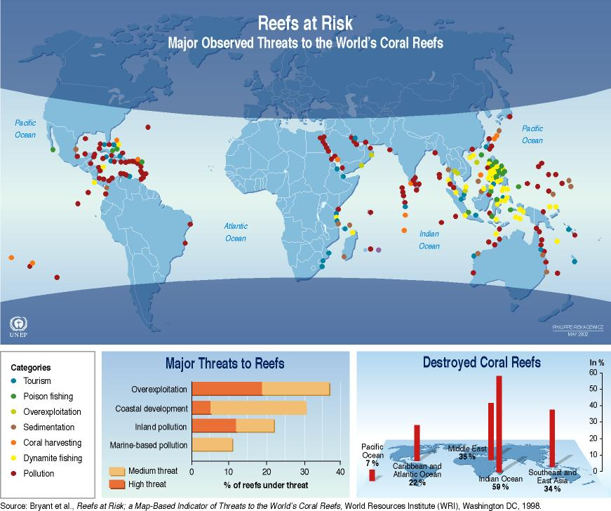
Locations of Coral Reef Bleaching

Slide 9
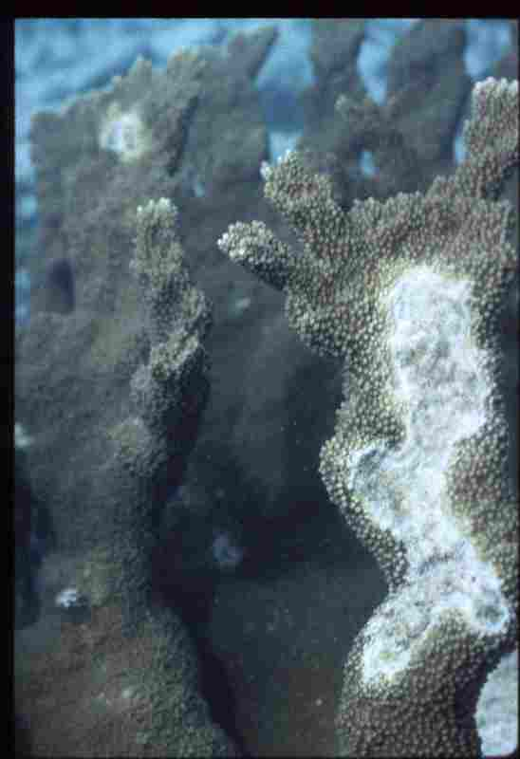

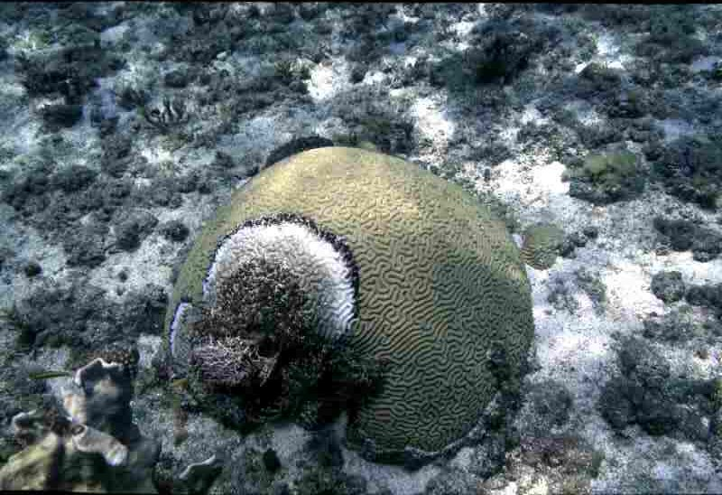
BLEACHING OF CORAL REEFS BY OCEAN TEMPS > 85deg

Slide 10
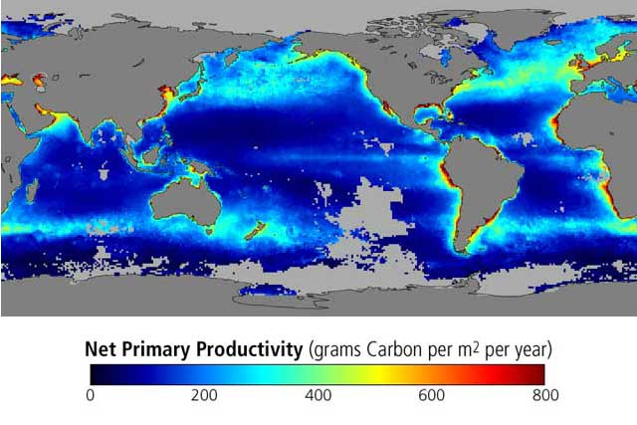

Slide 11
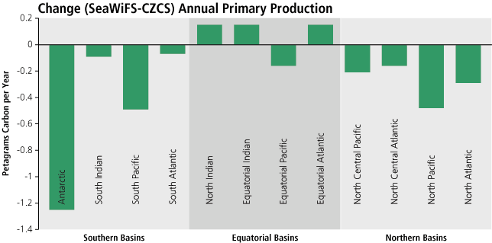
CHANGE IN OCEAN NPP [1979 – 2002]

Slide 12

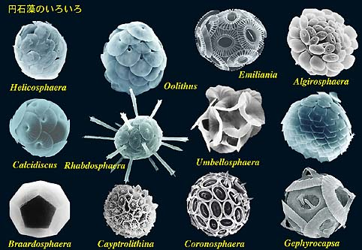
Ocean acidification
CO₂ is corrosive to the shells and skeletons of many marine organisms
Corals
Calcareous plankton
Photo: Missouri Botanical Gardens
http://www.biol.tsukuba.ac.jp/~inouye

Slide 13
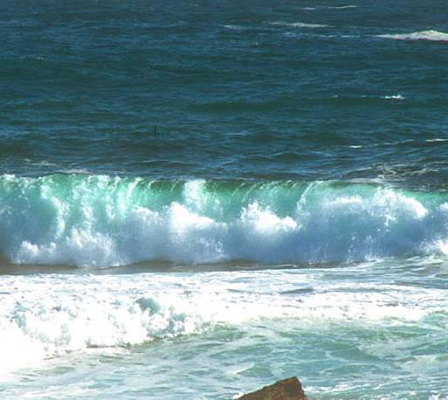
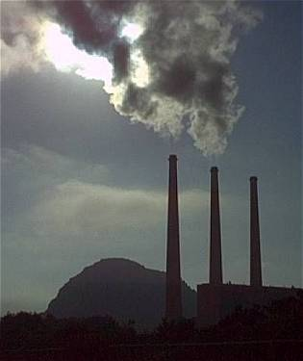
Ocean Acidification
Over the last 200 years, about 50% of all CO₂ produced on earth has been absorbed by the ocean.
(Royal Society 6/05)
Remains in the atmosphere (greenhouse gas)
Dissolves in sea water
CO₂ + H₂0 HCO₃⁻ + H⁺
Global Warming: The Greatest Threat © 2006 Deborah L. Williams
CO₂
(ACID)
CO₂
Water becomes more acidic.

Slide 14
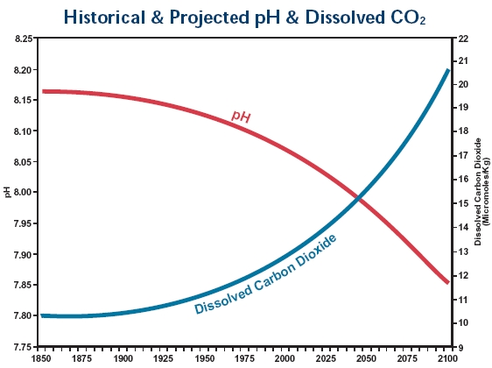
Ocean Acidification
Since 1850, ocean pH has decreased by about 0.1 unit (30% increase in acidity). (Royal Society 2006)
At present rate of CO₂ emission, pH predicted to increase by 0.4 units (3-fold increase in H ions) by 2100.
Carbonate ion concentrations decrease.
Lower pH = MORE ACID
Historical and Projected pH and Dissolved CO2
Feely, Sabine and Fabry, 2006
pH
Dissolved
CO₂
1850
2000
2100

Slide 15
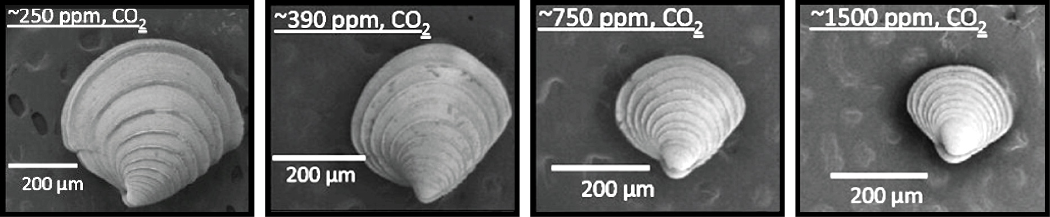
Ocean Acidification
Reduces Size of Clams
Notes:
These 36-day-old clams are a single species, Mercenaria mercenaria, grown in the laboratory under varying levels of carbon dioxide (CO₂) in the air. CO₂ is absorbed from the air by ocean water, acidifying the water and thus reducing the ability of juvenile clams to grow their shells. As seen in the photos, 36-day-old clams (measured in microns) grown under elevated CO₂ levels are smaller than those grown under lower CO₂ levels. The highest CO₂ level, about 1500 parts per million (ppm; far right), is higher than most projections for the end of this century but could occur locally in some estuaries. (Figure source: Talmage and Gobler 2010¹³).

Slide 16
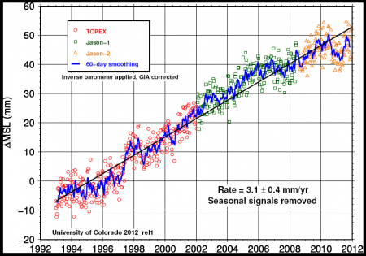
SEA LEVEL RISE

Slide 17
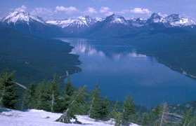
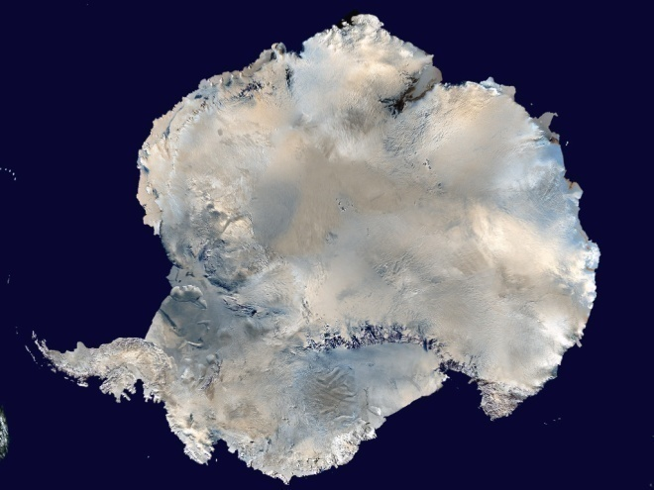
Sea-level Rise Projections Include:
•ocean expansion resulting from increased water temperatures;
meltwater runoff from mountain glaciers around the world; and
a contribution due to increased ice flow from Greenland and Antarctica at the rates observed for 1993-2003.
National Park Service
NASA
Source: IPCC Climate Change 2007: The Physical Science Basis—Summary for Policymakers.
Notes:
Compared with its prior assessment, the IPCC has used improved statistical methods for calculating several factors that contribute to global sea-level rise.
These factors include:
• ocean expansion resulting from increased water temperatures;
• meltwater runoff from mountain glaciers around the world; and
• meltwater runoff and calving (breaking off ) of ice from the Greenland and Antarctica ice sheets.

Slide 18
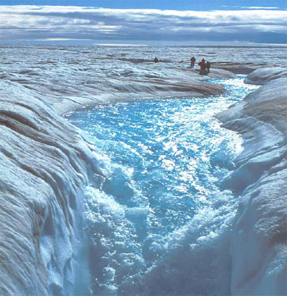
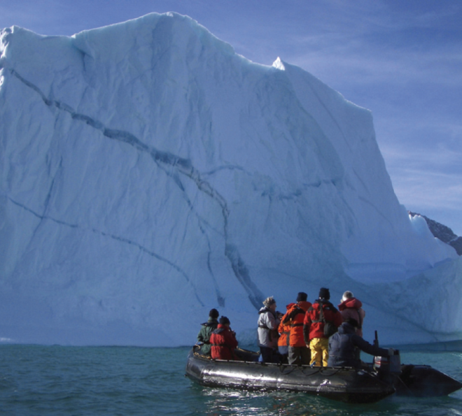
Sea-level Rise Projections DO NOT Include:
• Ice sheet instability
Carbon dioxide uptake changes
IPCC: “Larger values cannot be excluded, but understanding of these effects is too limited to assess their likelihood or provide a best estimate or an upper bound for sea-level rise.”
Photo Roger Braithwaite
iStockphoto.com
Source: IPCC Climate Change 2007: The Physical Science Basis—Summary for Policymakers.
Notes:
Ice sheet instability. Recent observations show that meltwater can run down cracks in the ice and lubricate the bottom of ice sheets, resulting in faster ice flow and increased movement of large ice chunks into the ocean. This process, and others related to ice flow dynamics, directly contributes to sea-level rise.
Carbon dioxide uptake. Evidence suggests that warming tends to reduce land and ocean uptake of atmospheric carbon dioxide, increasing the portion of carbon dioxide emissions that remain in the atmosphere. This would result in further warming and cause additional sea-level rise.
While calling attention to these processes, which could result in a significantly higher global sea-level than that projected in its new report, the IPCC is careful to alert policy makers to the limits of our current ability to quantify these mechanisms: “Larger values cannot be excluded, but understanding of these effects is too limited to assess their likelihood or provide a best estimate or an upper bound for sea-level rise.”
Also, if the observed contributions from the Greenland and Antarctic ice sheets between 1992 and 2003, the IPCC states, “were to grow linearly with global average temperature change,” the upper ranges of sea-level rise would increase by 3.9 to 7.9 inches (0.1 to 0.2 meters). In other words, in this example, the upper range for sea-level rise would be 31 inches (0.79 meters).

Slide 19
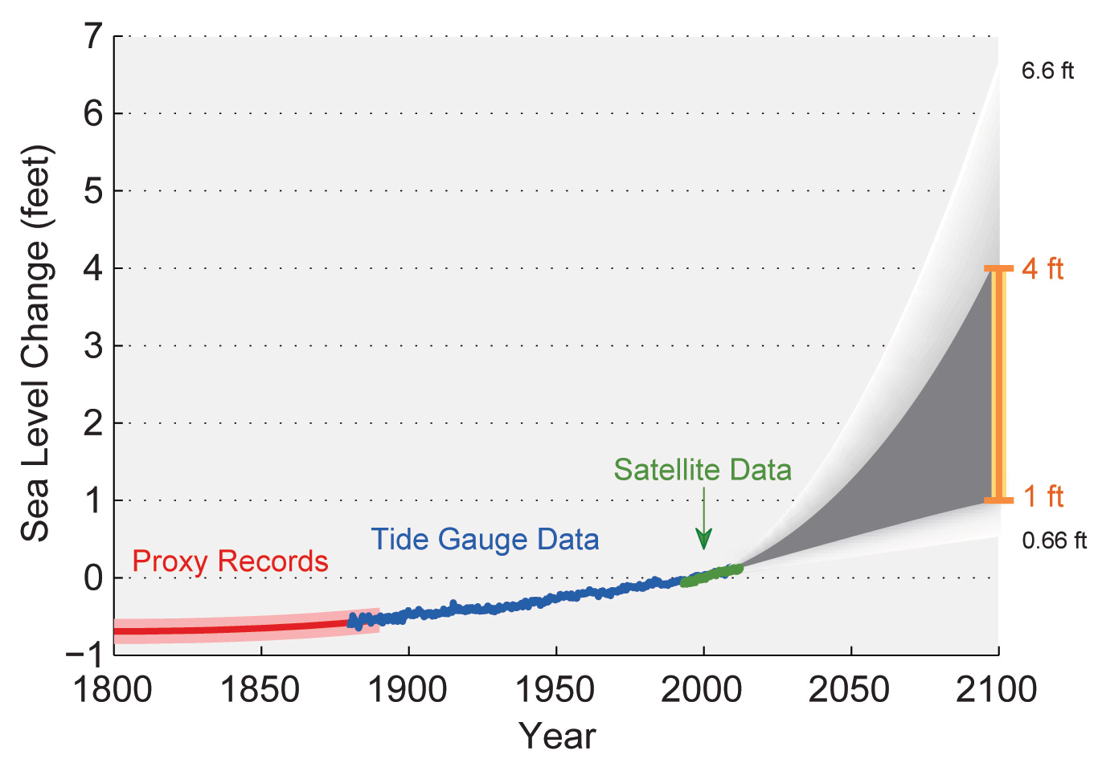
Past and Projected Changes in
Global Sea Level
Notes:
Figure shows estimated, observed, and possible amounts of global sea level rise from 1800 to 2100, relative to the year 2000. Estimates from proxy data⁴ (for example, based on sediment records) are shown in red (1800-1890, pink band shows uncertainty), tide gauge data in blue for 1880-2009,⁵ and satellite observations are shown in green from 1993 to 2012.⁶ The future scenarios range from 0.66 feet to 6.6 feet in 2100^{.7} These scenarios are not based on climate model simulations, but rather reflect the range of possible scenarios based on other kinds of scientific studies. The orange line at right shows the currently projected range of sea level rise of 1 to 4 feet by 2100, which falls within the larger risk-based scenario range. The large projected range reflects uncertainty about how glaciers and ice sheets will react to the warming ocean, the warming atmosphere, and changing winds and currents. As seen in the observations, there are year-to-year variations in the trend. (Figure source: NASA Jet Propulsion Laboratory).

Slide 20
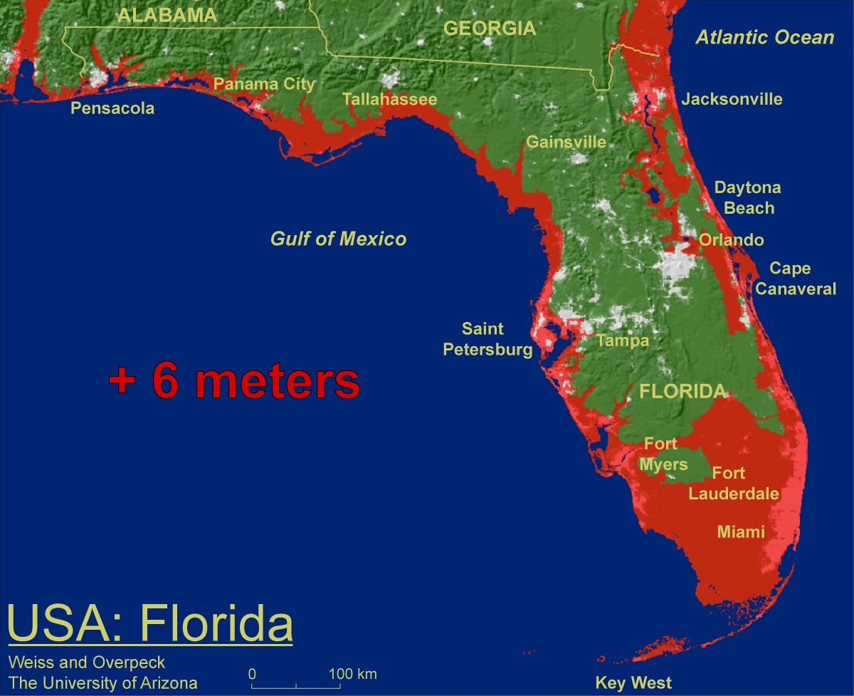
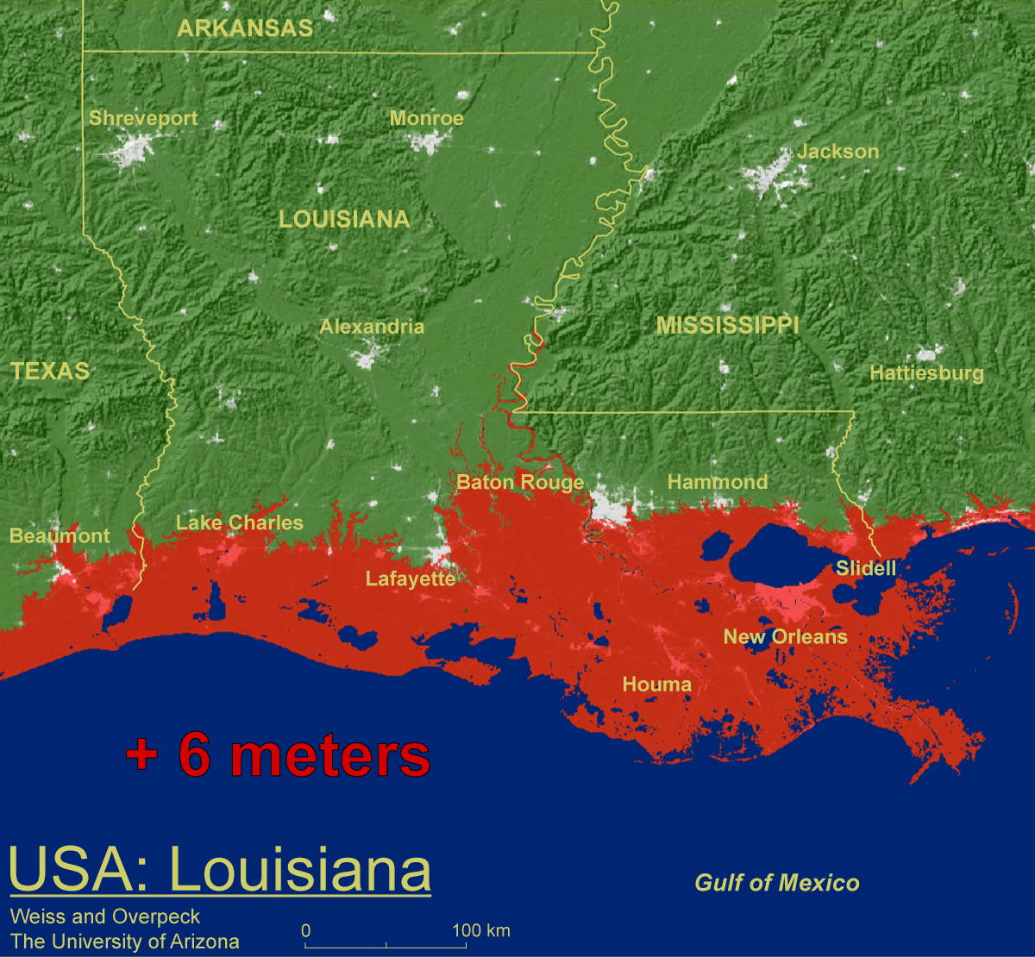
Threshold risks:
Some models do suggest that sustained warming between 2-7ºF above today’s global average temperature would initiate irreversible melting of the Greenland ice sheet—which could ultimately contribute about 23 feet to sea-level rise.
+ 19.7 feet
Weiss and Overpeck U. Arizona
+ 19.7 feet
Source: IPCC Climate Change 2007: The Physical Science Basis—Summary for Policymakers.
Notes:
Some models do suggest that sustained warming between 2 and 7 degrees Fahrenheit above today’s global average temperature would initiate irreversible melting of the Greenland ice sheet—which could ultimately contribute about 23 feet to sea-level rise. This threshold is similar to the IPCC’s best estimate range for temperature increase by the end of this century. The risk for crossing this threshold could occur within our generation, while the consequences would be felt by future generations.

Slide 21
