Slide 1
Point Extrapolation, Spatial Interpolation, and Downscaling of Climate Variables
Jared Oyler – FOR 532
11/17/2010

Slide 2
Climate Variables
What are the minimum required climate variables to drive an ecosystem model like Biome-BGC?
Surface air temperature
Precipitation
Surface air humidity
Incident shortwave radiation

Slide 3
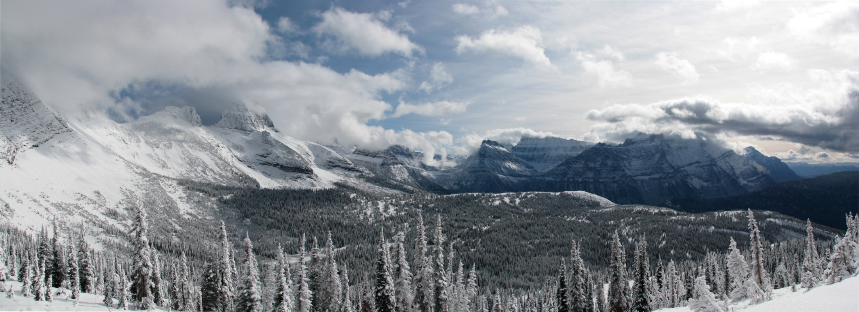
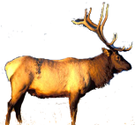
Point Extrapolation: MT-CLIM
Site
I wonder what the weather is like up there?
Extrapolate
Base Station

Slide 4
MT-CLIM
Temperature
T_{max/min} =
TBase_{max/min} + (ElevDifference * LapseRate)
T_{day} = ((T_{max} – T_{min})*0.45) + T_{mean}
Precipitation
Precip =
PrecipBase *(Site Isohyet / Base Isohyet)

Slide 5
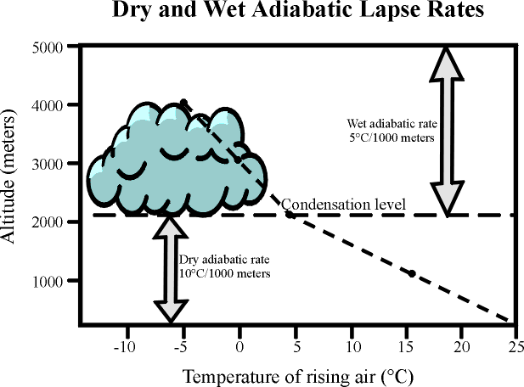
MT-CLIM
Standard Environmental Lapse Rate
6.5°C/1000m

Slide 6
MT-CLIM
Humidity
If don’t have T_{dew}, assumes T_{dew} = T_{min}
Has a correction for arid environments
Uses comparison of PET to annual prcp to determine aridity
VPD calculated as a function of T_{dew} and T_{day}

Slide 7
MT-CLIM
Solar Radiation
Calculates potential srad and day length using Sun-Earth geometry:
Latitude
Slope/Aspect
East/West Horizons
Total solar radiation is a combination of direct and diffuse radiation
Need to calculate transmittance to determine actual srad reaching the site

Slide 8
MT-CLIM
Solar Radiation (cont.)
Transmittance is calculated based on:
Elevation
Rainy day
Diurnal Temp Range
VPD
Snowpack
Modify final total srad estimate based on transmittance

Slide 9
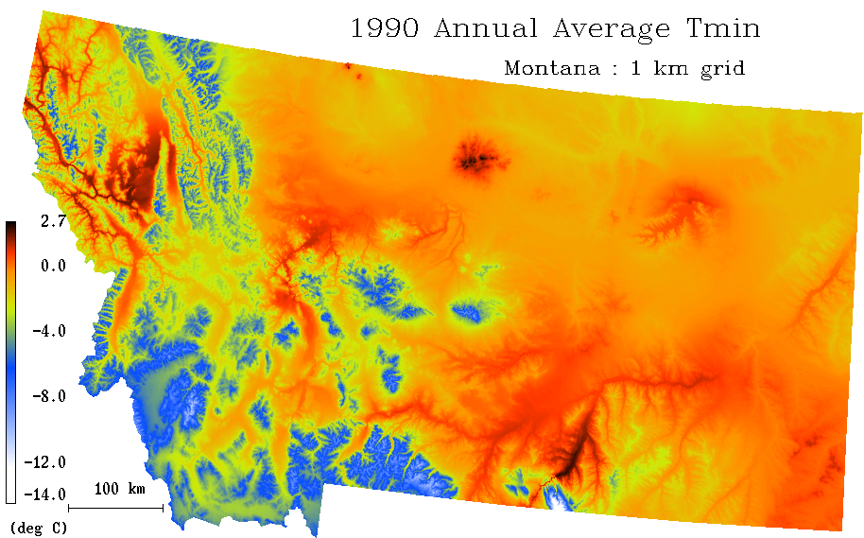
Spatial Interpolation
MT-CLIM does a single point extrapolation
A spatial surface of meteorological variables is often required for larger-scale spatial ecosystem modeling

Slide 10
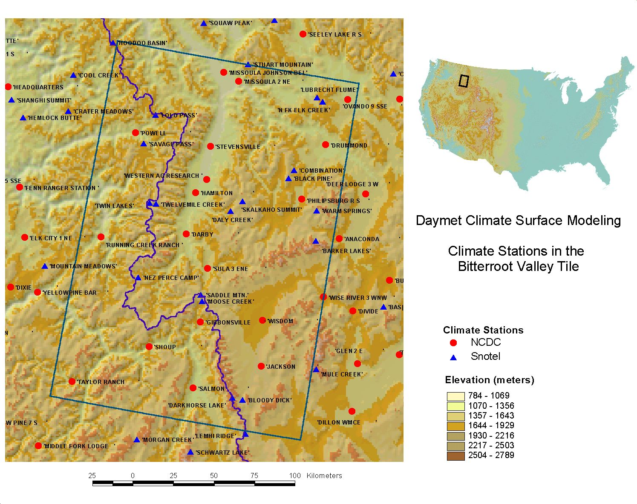
Interpolating Surfaces
How do you create a continuous surface from point data?

Slide 11
Common Interpolation Methods
Nearest Neighbor
Use observation closest to prediction point
Too far?

Slide 12
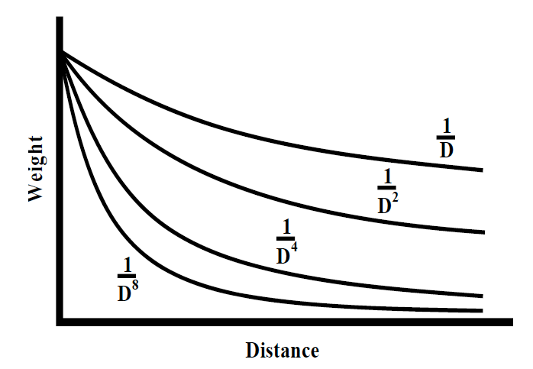
Common Interpolation Methods
Inverse Distance Weighting (IDW)
Calculate weights for each station based on distance and take weighted average

Slide 13
Common Interpolation Methods
Inverse Distance Weighting (IDW)
Use all stations?
Only those within a certain radius?
A specific number of stations?
Data rich vs. data poor regions?

Slide 14
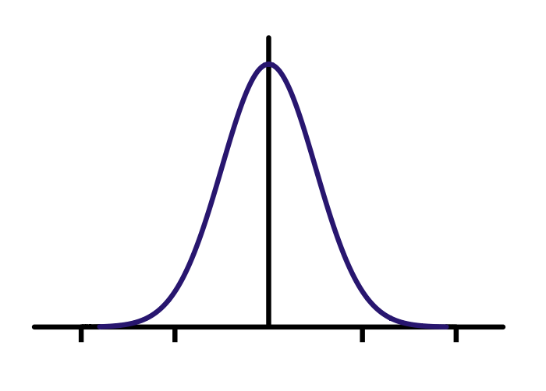
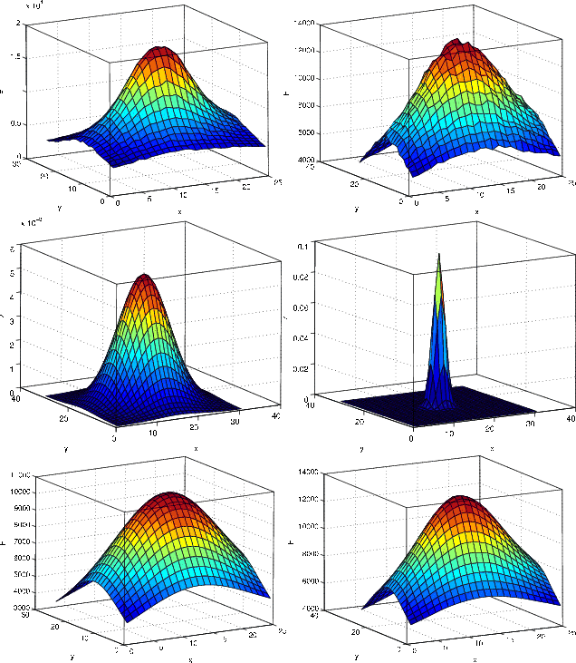
Common Interpolation Methods
Truncated Gaussian Filter
Like IDW, but calculate weights based on Gaussian kernel
Can modify shape of the kernel

Slide 15
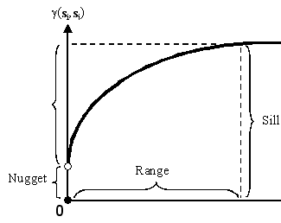
Common Interpolation Methods
Geostatistical Techniques (Kriging)
Assigns weights according to a data-driven weighting function
Models spatial autocorrelation with semi-variogram

Slide 16
Common Interpolation Methods
Kriging (cont.)
Helps to compensate for the effects of data clustering, assigning individual points within a cluster less weight than isolated data points
Gives estimate of estimation error

Slide 17
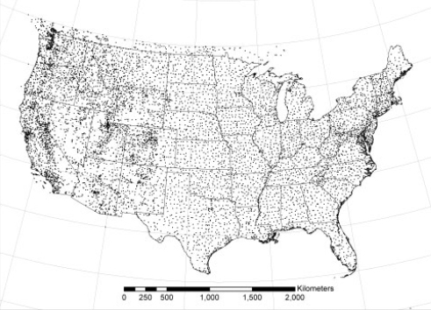
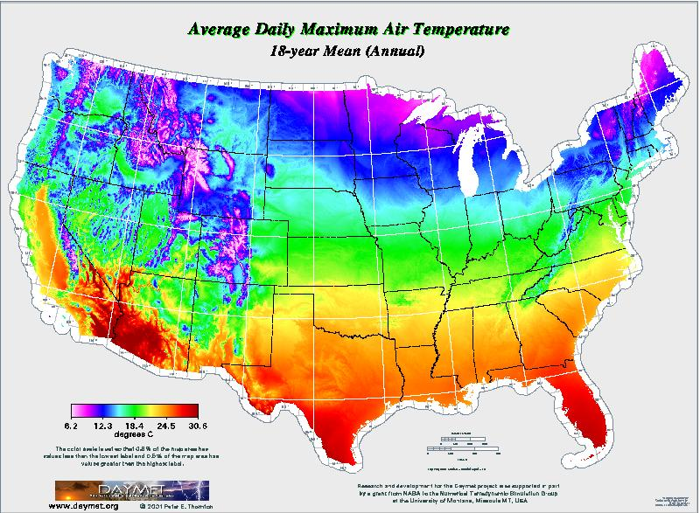
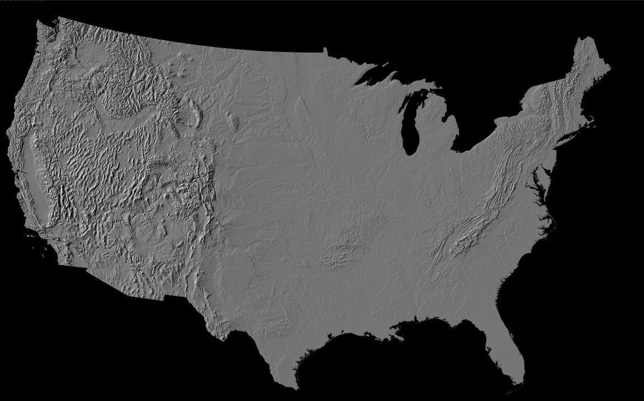
Daymet
Station Data
1980 – 1997 1km resolution dataset
available at http://www.daymet.org
Digital Elevation Model

Slide 18
Daymet
Interpolation Method
Gaussian Truncated Filter
Uses iterative station density algorithm to account for spatially heterogeneous distribution of observations (i.e.—varies radius of the Gaussian filter)
Combines interpolation with modeling of empirical relationship between temp/prcp and elevation

Slide 19
Daymet
Temperature
Uses weighted least-squares regression and station observations to model relationship between temperature and elevation for each day
Difference in elevation → Difference in temp
A station’s observed temp is then modified based on the model before being used in interpolation
Uses a temporal and spatial smoothing algorithm for the regressions

Slide 20
Daymet
Precipitation
First predict precipitation occurrence based on station data
Uses same methods that were used for temp to model relationship between temp and elevation
Difference in elevation → Difference in prcp

Slide 21
Daymet
Humidity and solar radiation
Uses the same methods as MT-CLIM

Slide 22
Daymet
Strengths
Daily timestep
Temperature, precipitation, humidity and solar radiation variables
Weaknesses
Poor data availability (1980-2003)
Hard to get data in spatial format
Cold air drainage?
Solar radiation effects on temperature?

Slide 23
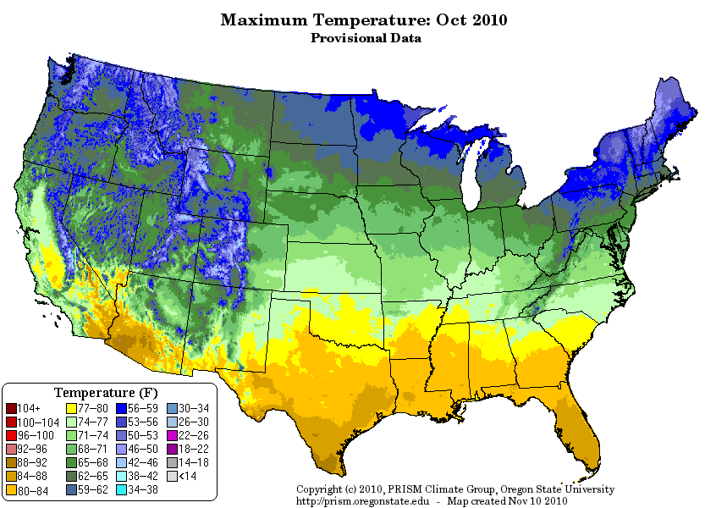
Other Interpolators
http://www.prism.oregonstate.edu/index.phtml
Parameter-elevation Regressions on Independent Slopes Model (PRISM)
Uses a simple regression, but weights stations according to physiographic similarity to the site grid cell
Accounts for
Elevation
Effectiveness of terrain barriers
Terrain-induced climate transitions
Cold air drainage and inversions
Coastal effects

Slide 24
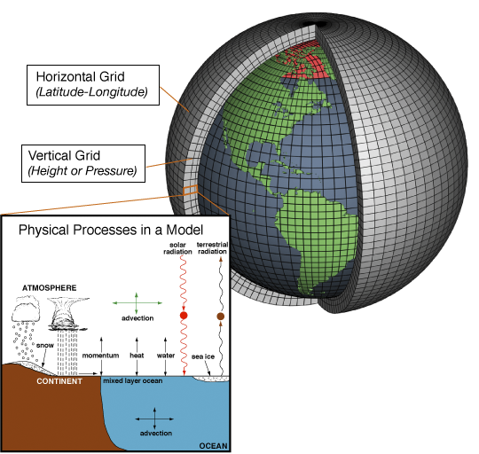
GCM Downscaling
Global Climate Models
Physically-based complex mathematical representations of the planet’s atmosphere, ocean, atmosphere, land, and ice.
Today’s modern GCMs have fully coupled atmosphere and ocean components and are referred to as atmosphere-ocean general circulation models (AOGCMs).

Slide 25
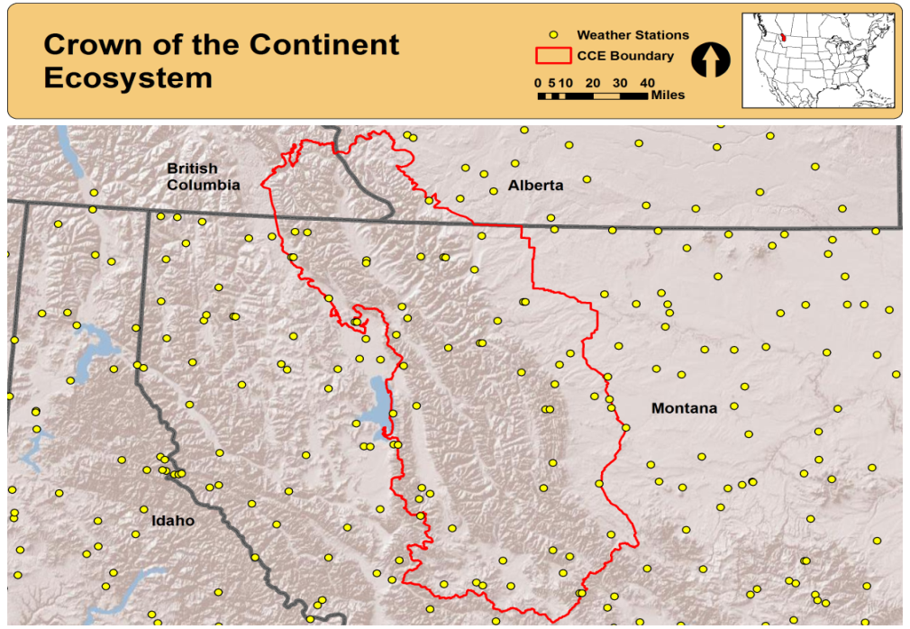
GCM Downscaling
Want to conduct a climate impacts assessment on the Crown of the Continent Ecosystem (CCE) using Biome-BGC

Slide 26
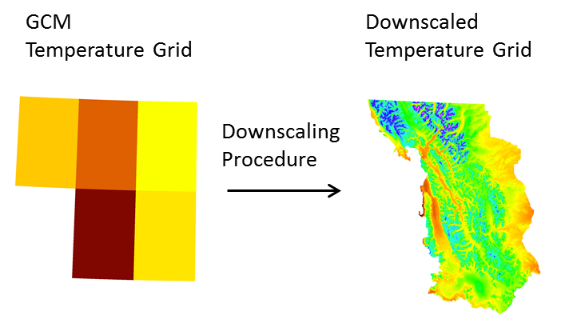
GCM Downscaling
Issues with GCM projections when applied regionally
Over 20 models used in the IPCC. Which one do you use?
Coarse resolution. Maybe only one or two grid cells for entire CCE
Can’t adequately represent topographic complexity, a very important determinant of climate in the region
Need to downscale!

Slide 27
GCM Downscaling
Two main approaches to downscaling
Statistical Methods
Use empirical relationship between a high-resolution climatology and coarse GCM variables
Dynamical Methods
Embed higher resolution regional climate model within a GCM
Excellent review in Fowler et al. 2007 Int. J. Climatol.

Slide 28
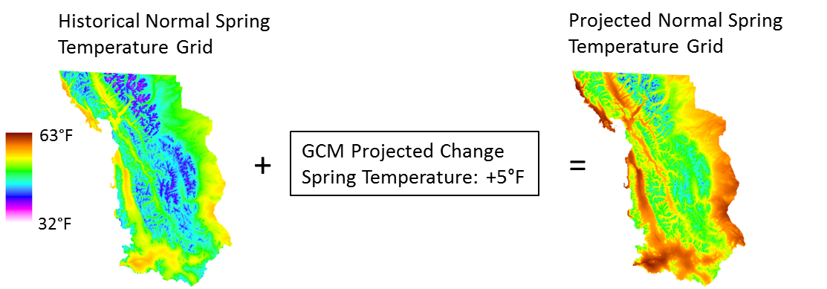
GCM Downscaling
Simplest statistical approach: the delta method
Simply add on projected changes to high resolution climate grid

Slide 29
GCM Downscaling
Delta Method Step 1
Synthesize the regional GCM model projections for the region

Slide 30
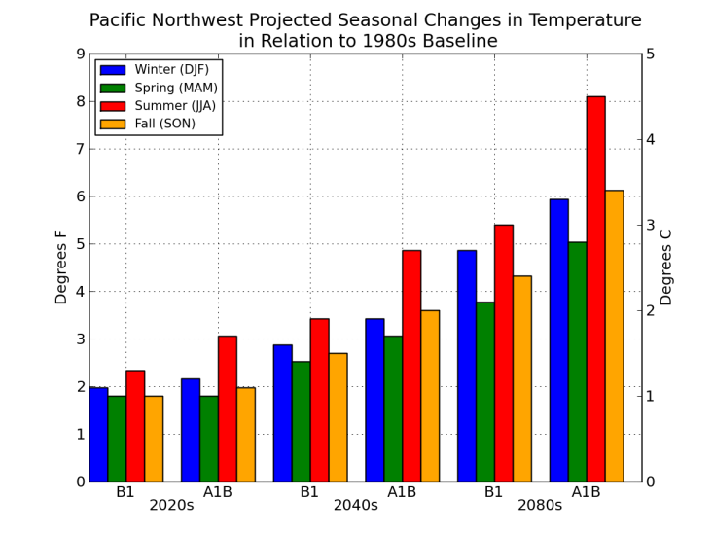
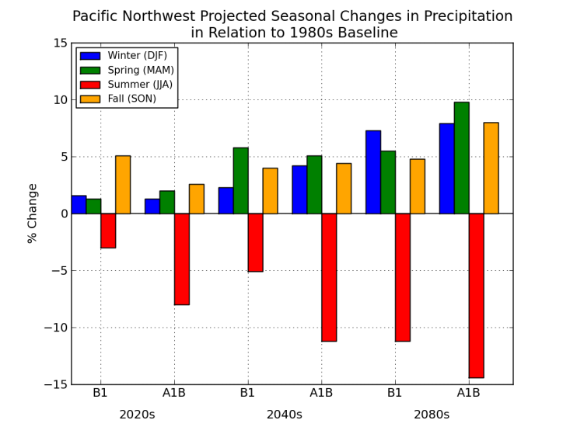
GCM Downscaling

Slide 31
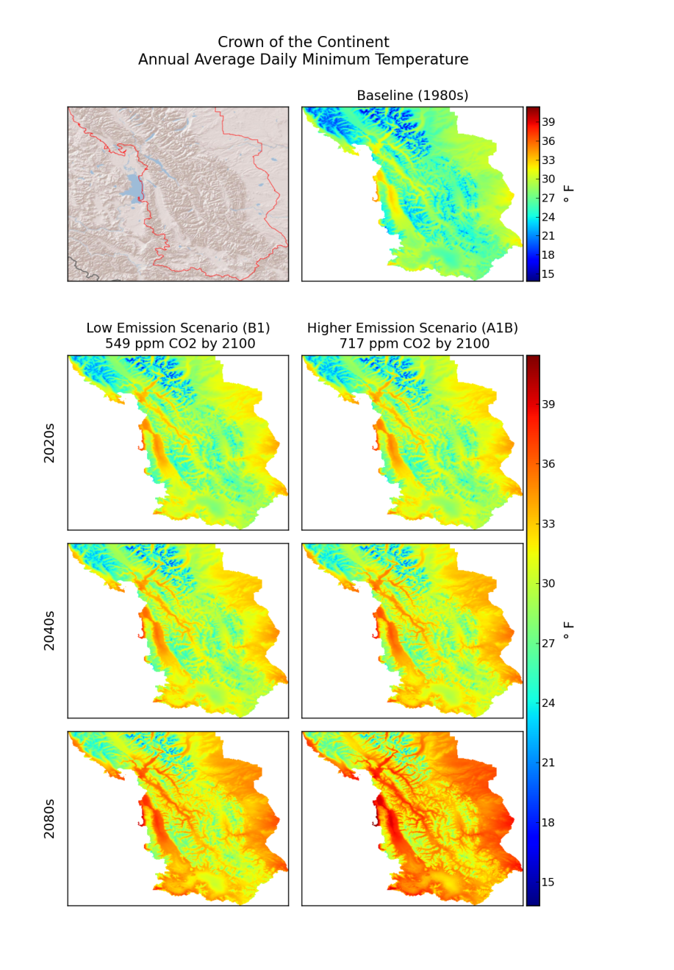
GCM Downscaling
Delta Method Step 2
Perturb fine-scale historical observations with the projected seasonal/decadal regional changes to produce climate change scenarios
Provides climate data sequences that preserve the historically observed fine-scale spatial/temporal variability but are modified for a climate change scenario

Slide 32
GCM Downscaling
Delta Method Advantages
Quick and easy
Easy comparison to historical conditions
Delta Method Disadvantages
Does not account for changes in variability or extremes
Assumes entire landscape will change by the same amount

Slide 33
GCM Downscaling
Wiens and Bachelet 2010
GCM downscaling must be done judiciously
High resolution vs. realism (uncertainties!)
Climate a important factor at scale of analysis?
Topography can override broad-scale climate projections
Can we identify areas of the landscape that are likely to buffer effects of climate change? Microrefugia?
Changes in variability and extremes

