Slide 1
Integrated Assessments and Their Role in Providing Essential Information for Decision-Making
NASA Carbon and Ecosystems PI’s Meeting
4 October 2011
Anthony C. Janetos, Director
Joint Global Change Research Institute
PNNL/UMD

Slide 2
Outline
What are integrated assessments?
What are integrated assessment models?
Demonstrated and potential uses for IAMs
How is this modeling science evolving?
Roles of integrated modeling and remote sensing observations
Research needs moving forward

Slide 3
Integrated Assessments
An interdisciplinary study of a particular environmental problem
Investigating both human and physical/natural sciences dimensions of the problem
Goal of understanding the interactions among the problem’s various dimensions, and not just each individually
Most often used to describe modeling tools that are used to explore these interactions
Most often applied to global change/climate change issues

Slide 4
Integrated Assessment Models

Slide 5
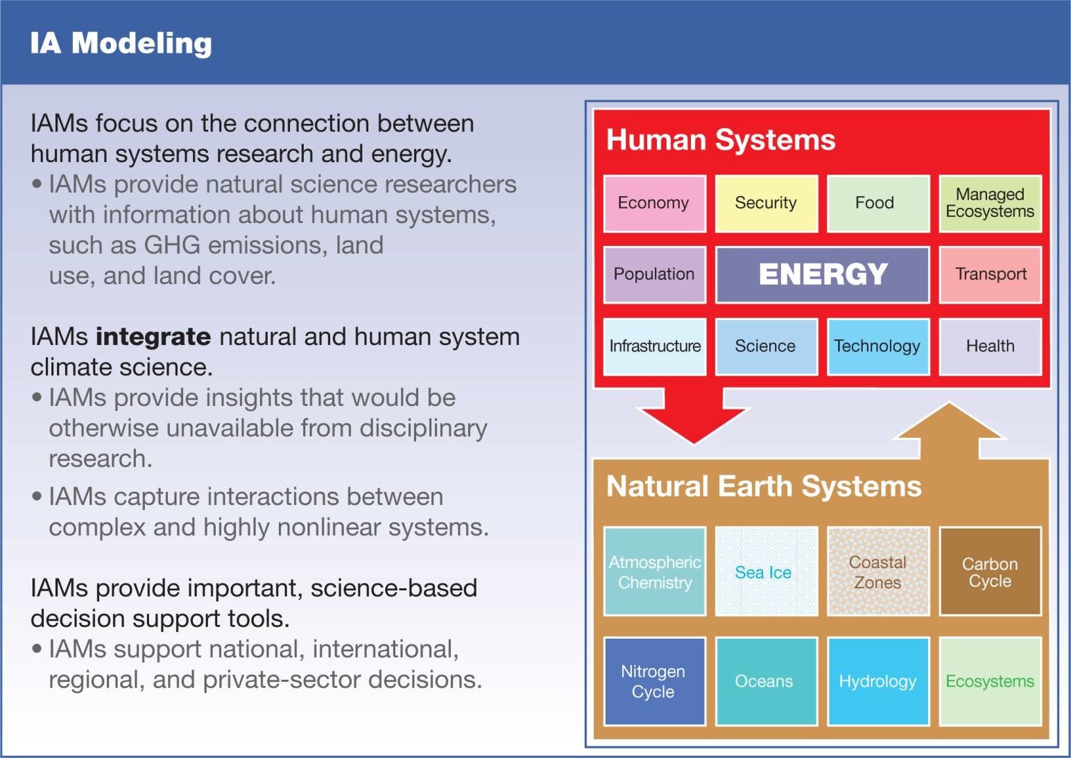

Slide 6
Traditional Focus of Integrated Assessment
The traditional focus of IA research has been on providing data and models relevant to understanding the scale and timing of the drivers of climate change over decades to century time scales.
  What are potential long-term, future emissions trajectories of fossil fuel CO₂, land-use change CO₂, non-CO₂ greenhouse gases, chemically active gases and aerosols?
  What would stabilizing radiative forcing imply?
The decision-making communities that have desired this information have included national policy-makers from many countries, private sector businesses, and the broader scientific community – especially climate modelers who require long time-series of emissions as external forcings for their models

Slide 7
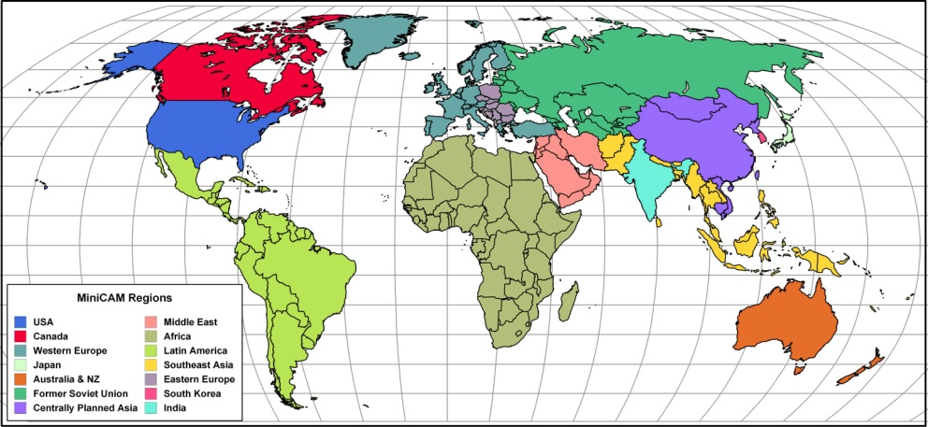
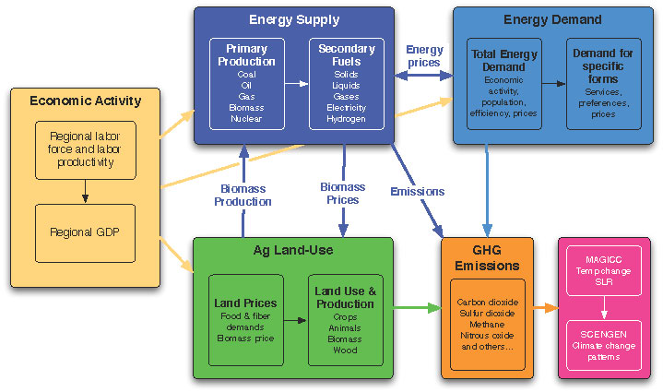

The PNNL Global Change Assessment Model (GCAM)
Energy-Agriculture-Economy Market Equilibrium
14 Global Regions – Fully Integrated
Explicit Energy Technologies – All Regions
Fully Integrated Agriculture and Land Use Model
15 Greenhouse Gases and Short-lived Species
Typically Runs to 2100 in 15-year time steps
Notes:
7

Slide 8
A global commitment to stabilizing CO₂ concentrations requires a carbon price that escalates over time
Price of carbon should start low and rise steadily to minimize society’s costs.
Eventually all nations and economic sectors need to be covered as the atmosphere is indifferent as to the source of CO₂ emissions.
The response to this escalating price of carbon will vary across economic sectors and regions.
$102/tC
$19/tC
$10/tC
$4/tC

Slide 9
Baseline vs. policy scenario
Show global Primary Energy mix for a Reference and a climate policy case (e.g. stabilisation at 450 ppm CO2-e)
Reference
2.6 W/m2 EMF22 Delay + Overshoot

Slide 10
How Are IAMs Evolving?

Slide 11
Evolution of IAM’s Driven by New Information Demands
From policy and decision-making communities, a desire to understand the regional and shorter-term nature of possible energy and land-use changes
From new decision-making communities, a desire to understand the interaction of impacts/adaptation decisions and mitigation decisions
From scientific communities, a desire to understand the linked dynamics of human decision-making about energy and land-use and the evolution of landscapes and the physical climate system

Slide 12
DOE Research Directions Workshop
Members of the scientific communities from integrated modeling, climate modeling, land modeling, energy modeling
Two days of discussion to find common ground on major priorities for a research agenda
Report summarizing major conclusions and more detailed scientific questions for each topic

Slide 13
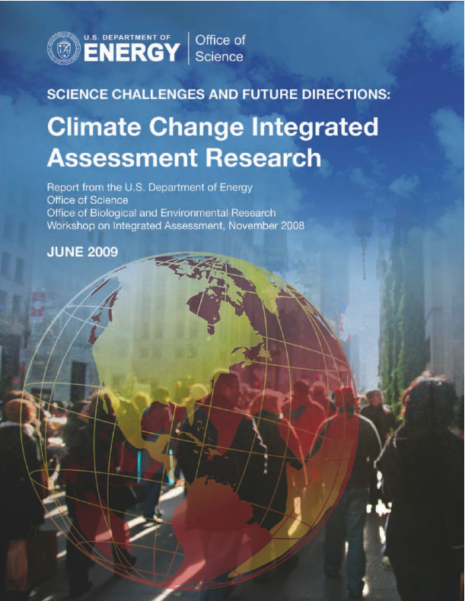

Slide 14
Major Challenges
Incorporating Impacts,
Adaptation and Vulnerability
Extending to Regional Scales and Shorter Times
Linking Climate Models and Communities – ESM’s, IAM’s, IAV
Strengthening Complex Interactions Among Energy, Environment, Economics
Quantifying Uncertainties in Models and Data
Advancing Community Modeling Approaches and Accessibility

Slide 15
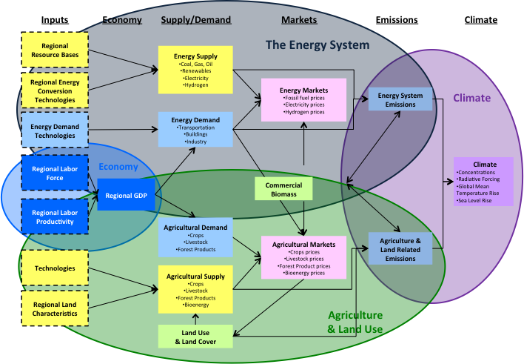
Another View of GCAM

Slide 16
Regional Scales and Shorter Time Steps
Global calculations with large geopolitical regions over long time periods are quite reasonable for long-lived GHG’s and strategic questions about mitigation strategies that focus on changes in energy technologies
But provides limited information about regional scales and periods of a few years to a few decades
Limited insight into how strategies for adaptation to change might interact with mitigation strategies
Limited insight into possible limiting environmental factors: water supply, good agricultural soils, climate change itself
So have focused on technical issues of shortening the time step of the model and incorporating significantly more regional specificity

Slide 17
Variable time-step version of GCAM
From 15 year interval to 5 year interval
CCSM/CLM
GCAM
Notes:
One major priority has been to modify GCAM to do tighter time steps. The major work on this has been completed, and will soon be ready to share with the other iESM project members. One thing this means is that we will soon begin using the increased computer capacity being installed at JGCRI with ARRA funding in order to handle the higher computational burden of the 5 year time step, and potentially to test tighter time steps with the model.

Slide 18
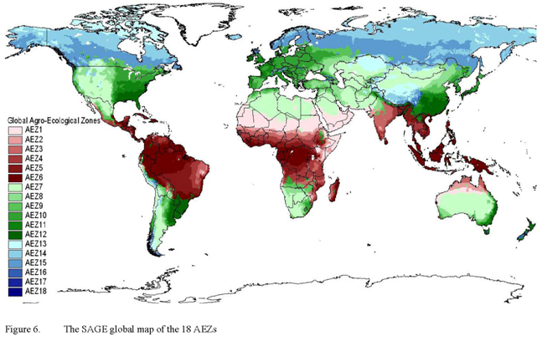
Redevelopment of agriculture and land-use modeling within GCAM
Objective: Shift from statistically to physically determined land productivity and create a flexible scale model
Step 1: Develop new GCAM AgLU code that allows for subregionalization based on data inputs
Step 2: Compile subregionalized input data set
Data for climate-defined agro-ecological zones (AEZs) selected for first application
GCAM scheme derived from GTAP and associated work from Ramankutty et al.

Slide 19
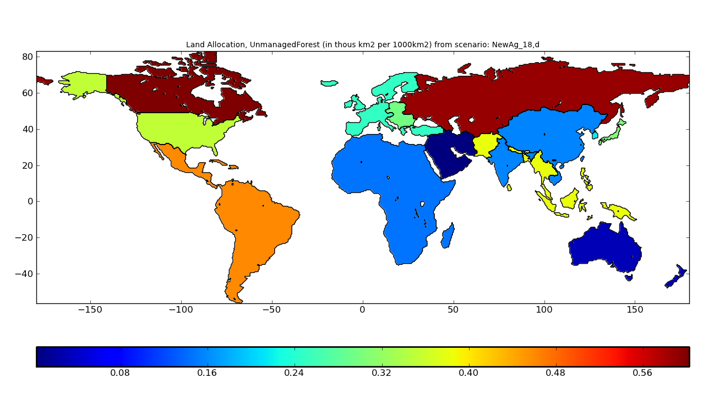
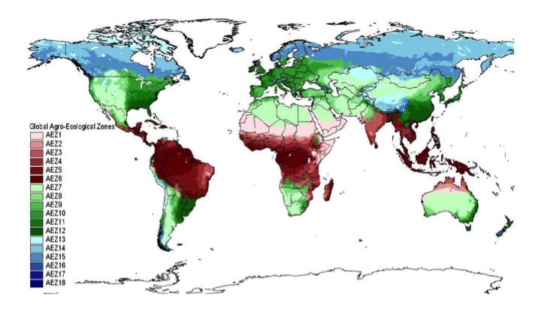
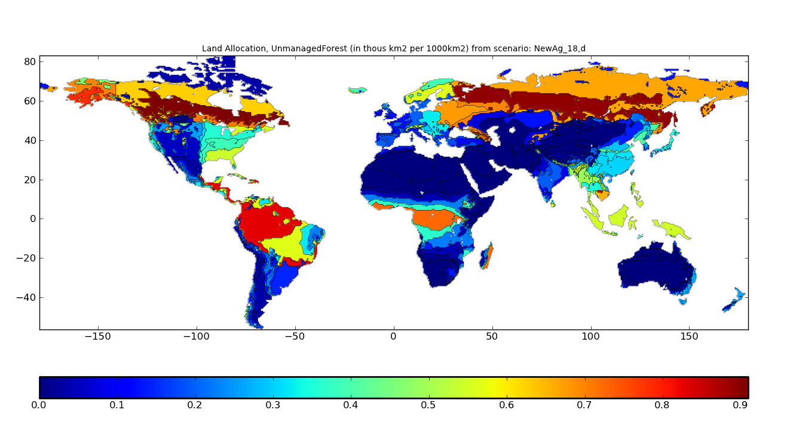
Increases the Geographic Specificity of the Model: e.g. Where are Forested Lands?

Slide 20
Overarching Questions for Regional IAM Studies

Slide 21
Incorporating IAV
Integrated models have been “soft-coupled” to impacts models before, often for understanding agricultural impacts
But in addition, would prefer to examine impacts and potential response strategies to other sectors
Addressing impacts and adaptation strategies can only sensibly be done with more careful attention to geographic specificity and more sophisticated process representation

Slide 22
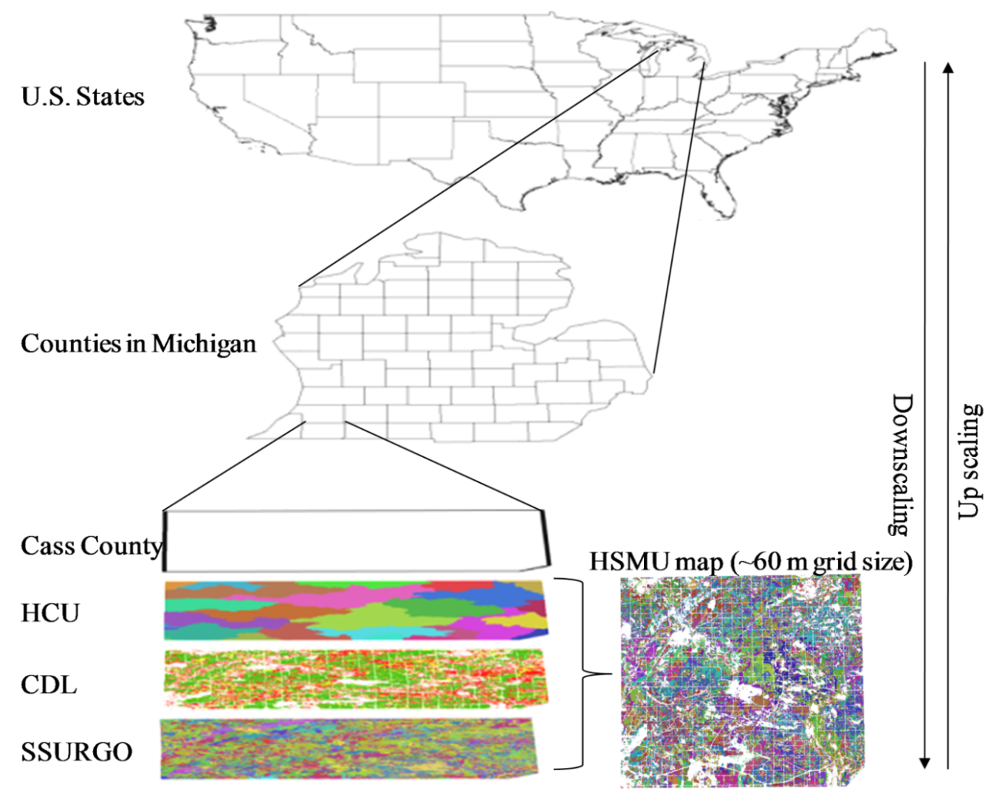
EPIC Application for R-GCAM
EPIC can simulate multiple potential crops (including bioenergy) and management practices.
Results are scalable to political units in R-GCAM
This approach will
Provide an improved, consistent calibration data set for R-GCAM
Establish an approach for process-based climate impacts on agriculture in R-GCAM
Zhang et al., 2010, GCB Bioenergy, doi: 10.1111/j.1757-1707.2010.01046.x

Slide 23
Climate Impacts on Forest Ecosystems and the Implications for Carbon Mitigation
Couple GCAM with the Ecosystem Demography model
  How can remote sensing and mechanistic ecosystem models be used to improve integrated assessments of coupled human-forest dynamics?
  Evaluate afforestation and bioenergy mitigation opportunities
Ecosystem disturbance in GCAM
  How could disturbance, such as from hurricanes and forest fires, influence the carbon cycle and the ability of ecosystems to supply fiber and bioenergy?
  Will change in such disturbances influence mitigation from terrestrial systems?

Slide 24
Linking Climate Models and Other Communities
Challenge of beginning to incorporate climate feedbacks on both energy and land processes within the framework of an integrated model
Moving from a one-way pass of information (IAM to GCM) to an evaluation of feedbacks in the evolution of the energy-land-climate system
Requires moving from reduced form representation of the climate system in IAM frameworks to a sophisticated representations, including coupling with full GCMs/ESMs
Requires the ESMs to have a representation of land-cover changes that goes beyond either specification or reduced-form DGVMs

Slide 25
Why is Specifying Land-Cover and Land-Use a Problem?
The effects of human activities are the largest direct driver of changes and processes on most of the terrestrial biosphere
  About half of original forest area converted to agricultural production
  Roughly doubled the amount of biologically available nitrogen
  Increases in atmospheric concentrations of CO₂
  Biggest contribution to loss of biological diversity
We understand in general terms why many of the transformations have happened
We can document and observe many of the recent changes

Slide 26
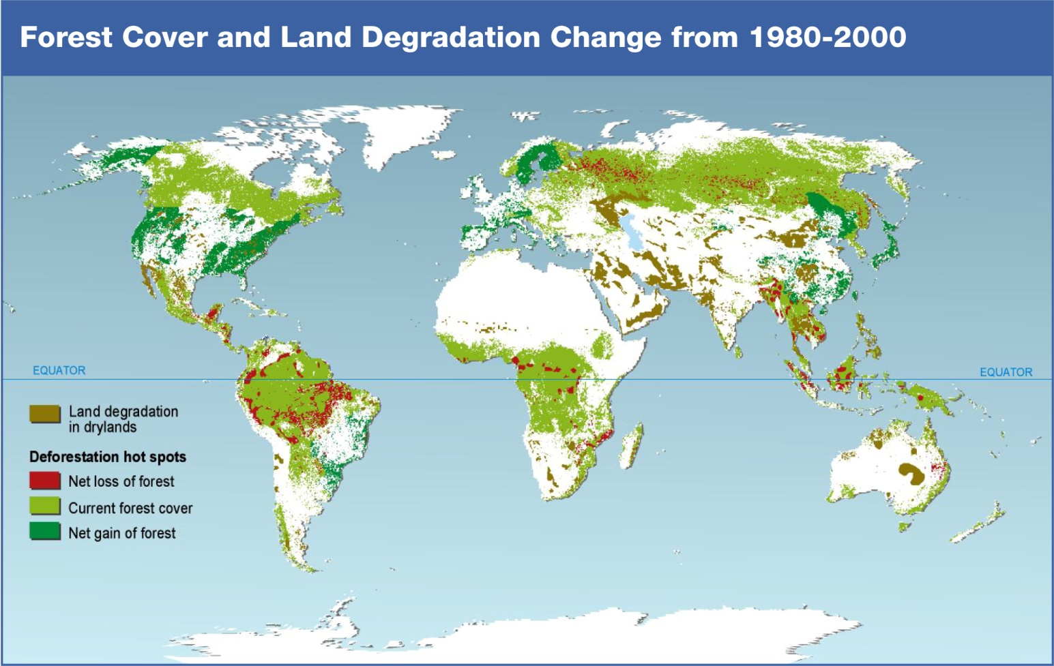

Slide 27
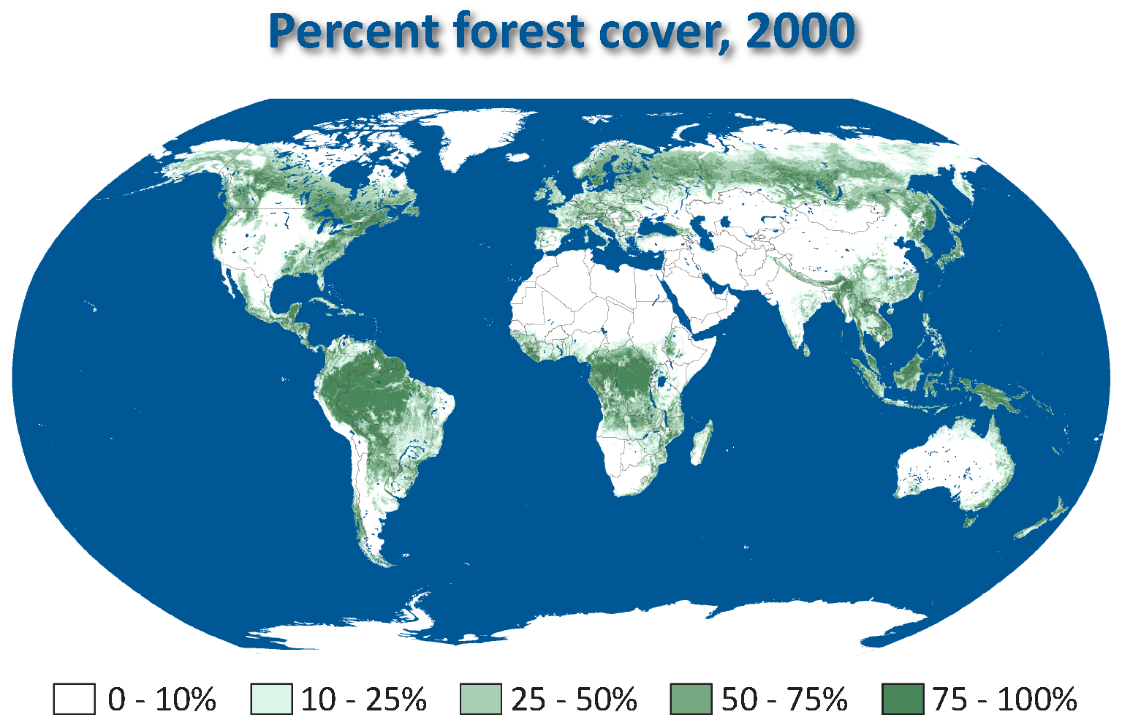

Slide 28
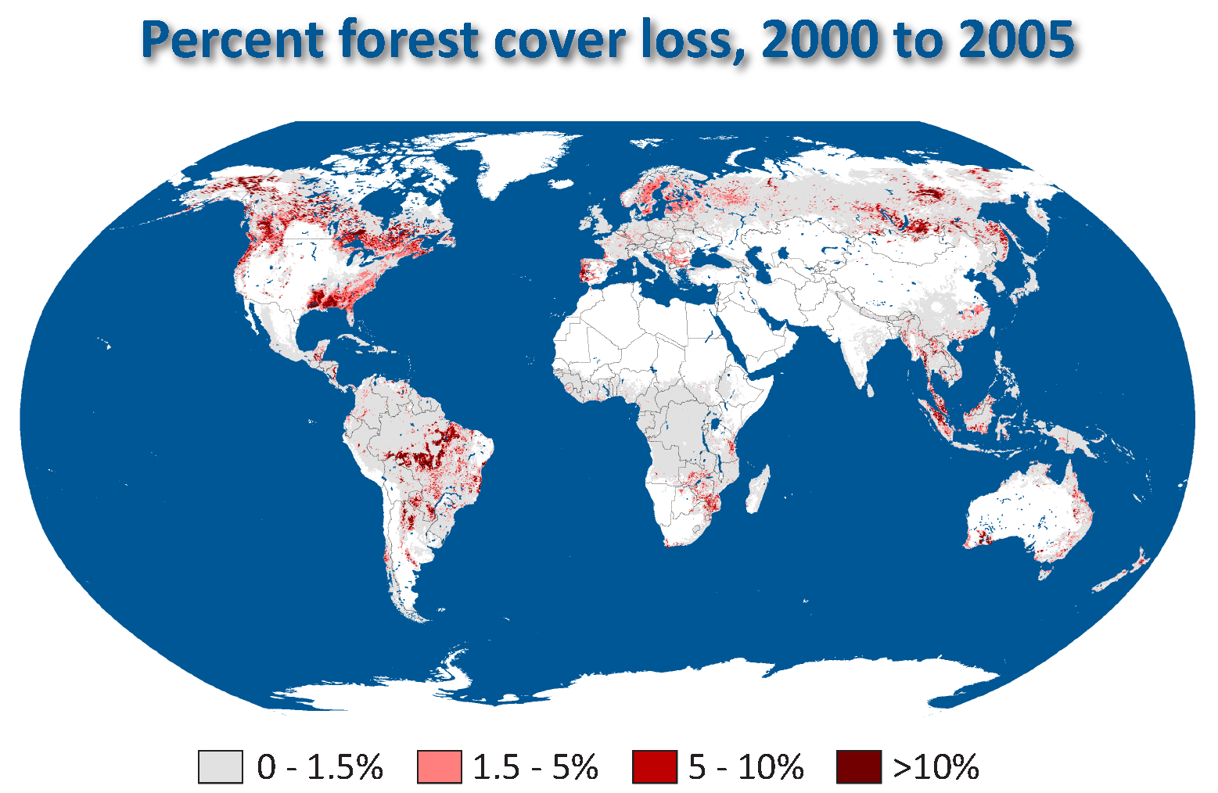

Slide 29
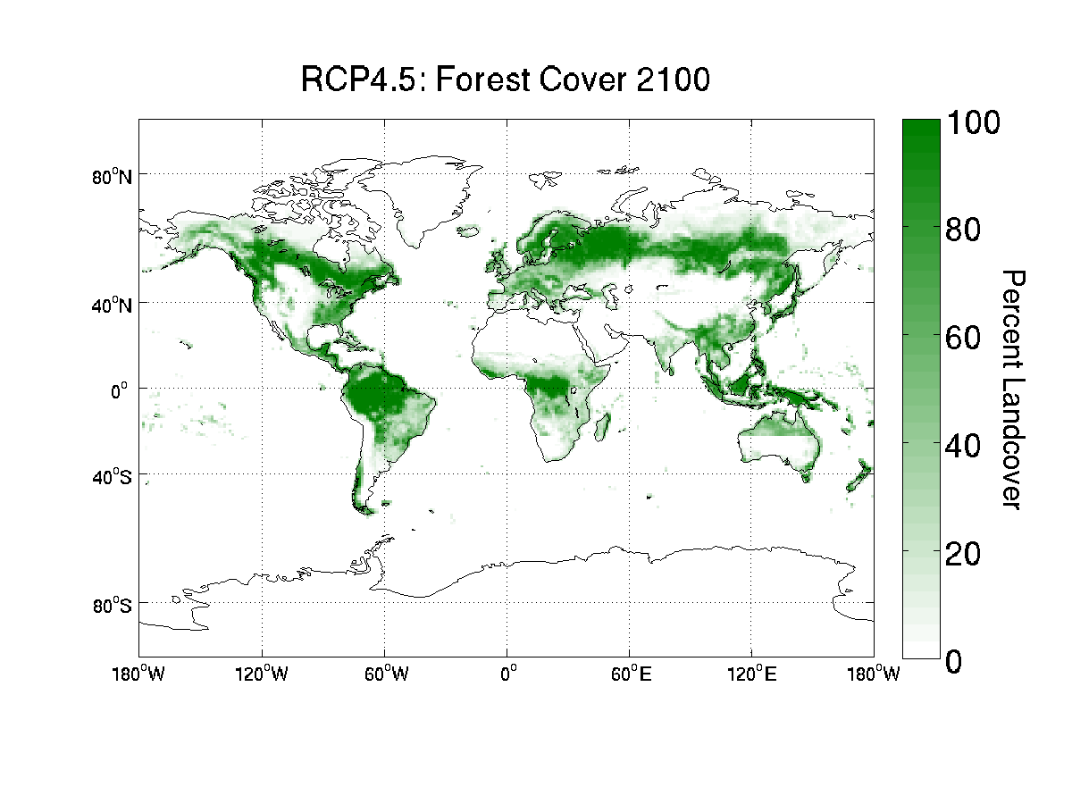
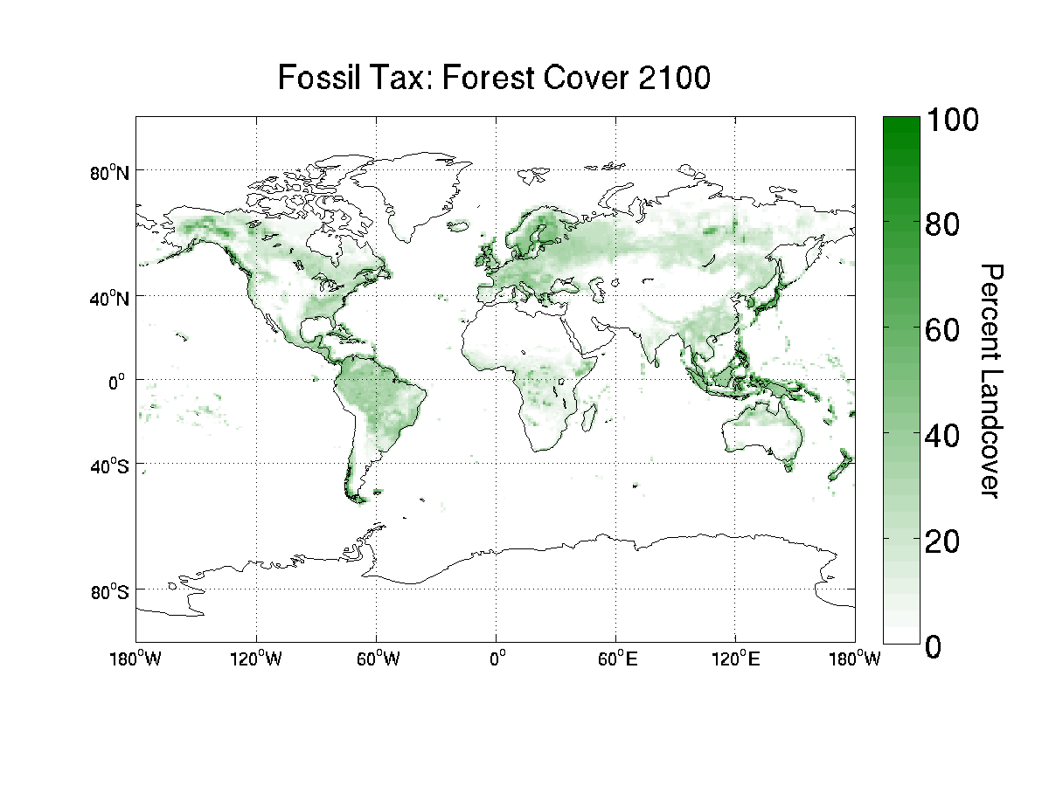
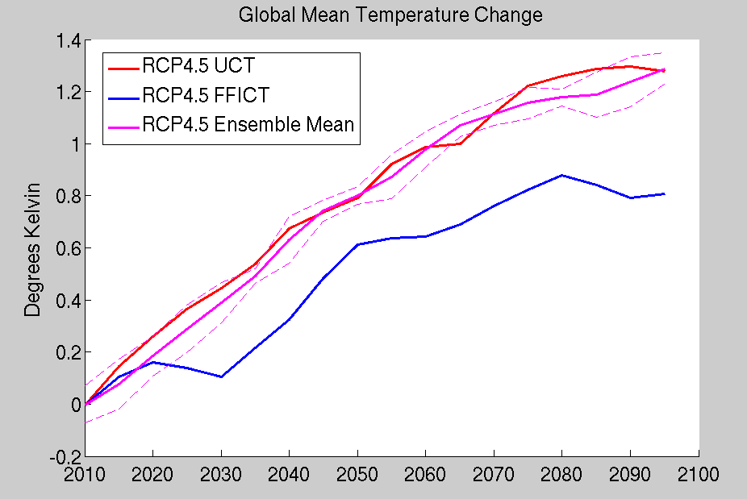
iESM Preliminary Results

Slide 30
Representing Complex Interactions: Energy/Water/Land
In the real world, energy demand and use are contingent on the availability of both land and water resources
Have typically analyzed these as though they were independent of each other and of variation in the climate system – e.g. assumed that there was plenty of water to satisfy energy demand, or have assumed there was plenty of land to satisfy increased demand for agricultural productivity and bioenergy
But how constraining are these factors? Must be included in the accounting of IAMs to understand how they interact with each other and with the climate system

Slide 31
The GCAM Water Module
Agricultural Sector Demands
Key
Largely Completed
Energy Sector Demands
In Progress
Industrial Sector Demands
Scoping Activities
Water Demand
Household Sector Demands
Commercial Sector Demands
Ecosystem, Navigation, Inter-basin Transfers (prescribed)
Water Markets
Water Allocation and Use
Climate
Surface Water
Water Supply
Ground Water Recharge
Desalinization
Energy Demand
31

Slide 32
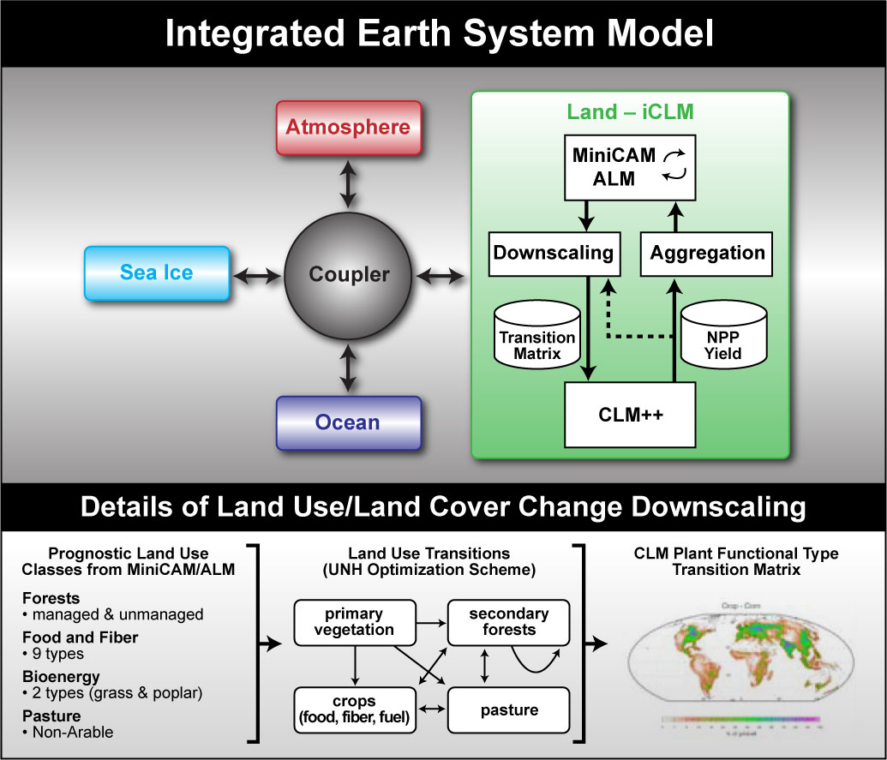
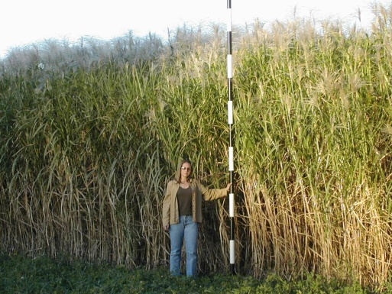
Integrated modeling biofuels and feedbacks
Objectives of iESM team:
Investigate biofuel sustainability
under future climate change.
Study feedbacks from climate
and CO₂ to the energy markets
(phases 2 and 3)
Quantify irrigation demand/costs
for biofuels and energy markets.

Slide 33
Characterizing Uncertainties
This is a bigger challenge than the technically demanding problem of parameter estimation in complex models – focus of many UQ efforts
How do we think about characterizing a variety of uncertainties about the future characteristics of features of integrated energy-land-climate systems that affect the drivers of change?
How do different models perform on similar tasks?
How do we map the many possible combinations of parameters in an arbitrary number of scenarios?

Slide 34
FOUR RCPs developed by the IAMC to provide emissions scenarios to the climate/Earth system modeling (ESM) community to jumpstart the assessment process.
RCP8.5 (IIASA/MESSAGE)
  >8.5 W/m² in 2100,
  Rising
RCP6.0 (NIES/AIM)
  ~6 W/m² at stabilization after 2100
  Stabilization without exceeding target
RCP4.5 (PNNL/MiniCAM)
  ~4.5 W/m² at stabilization after 2100
  Stabilization without exceeding target
RCP2.6 (PBL/IMAGE)
  <3 W/m² in 2100
  peak & decline stabilization

Slide 35

Special Issue on RCPs
1. Overview (van Vuuren et al.)
2. MESSAGE paper (Riahi et al.)
3. AIM paper (Matsui et al.)
4. GCAM paper (Thomson et al.)
5. IMAGE paper (van Vuuren et al.)
6. Land use paper (Hurtt et al.)
7. Emission inventory (Garnier et al.)
8. Atm. Chem. (Lamarque et al.)
9. GHG conc./extension (Meinshausen et al)
Published in Climatic Change

Slide 36
Community Modeling
Have needed to find a way to harness the ingenuity and energy of a broader community
Have now fully implemented GCAM in a community modeling framework
  Strict version control of the core model
  Allowing research versions to proliferate
Over 70 research groups around the world have already started using GCAM, and tailoring it to their own purposes
About to have the second International Users Conference

Slide 37
The Challenges of Space-Based Observations
At one-level, we are already beginning to use remote-sensing derived data sets
  Ramankutty, de Fries, Hansen’s work on global characterization of land-cover and land-use change
  Landsat and MODIS time series of extent and change in agricultural area
But at same time are also wrestling with a fundamental problem in scientific communication
  What the human system models want is land use
  What we typically observe remotely is land-cover
Are there clever ways to make the connection between the two more explicit?

Slide 38
The Challenges of Space-Based Observations
At another level, we could amplify the use of models that are parameterized or forced by remote sensing observations
We are attempting to model the major biogeochemical and hydrologic cycles, after all
But with the human use component explicitly simulated, not specified
Earth system models that depend on remote sensing observations for parameterization or validation are going to be critical
Continuing to look for ways to confront these integrated models with data to evaluate them properly

Slide 39
Incorporating Impacts,
Adaptation and Vulnerability
Extending to Regional Scales and Shorter Times
Significant progress in each area highlighted by the IARP report
Rapid expansion of capabilities
Uncovering insights into the interaction of human decision-making and Earth system processes
Linking Climate Models and Communities – ESM’s, IAM’s, IAV
Strengthening Complex Interactions Among Energy, Environment, Economics
Quantifying Uncertainties in Models and Data
Advancing Community Modeling Approaches and Accessibility

Slide 40
Conclusions
Interactions of the IAM community and the carbon, Earth system modeling, and remote sensing communities are critically important
Development of new model structures to understand the ways in which human decisions can affect land-cover, the carbon cycle, and the climate system over the next several decades
Explicit representation of decision-making to explore the consequences of different possible choices
Expansion of the kinds of decision-making institutions which are interested in the models – expansion into adaptation issues
Backed up by sophisticated representations of processes, constrained by observational data

