Slide 1
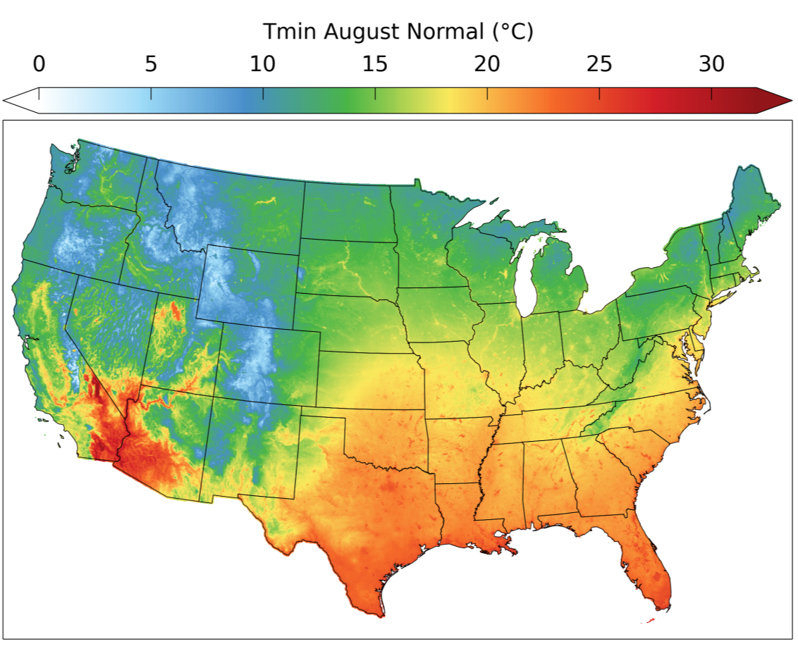
A Topoclimatic Air Temperature Dataset for the Conterminous U.S.
Jared W. Oyler^{1,2}
Ashley Ballantyne¹
Kelsey Jencso¹
Michael Sweet¹
Steven W. Running²
Ruben Behnke^{1,2}
¹Montana Climate Office
²Numerical Terradynamic
Simulation Group (NTSG),
University of Montana
Avg. July ET: 2000-2012

Slide 2
Outline
Review of gridded topoclimatic datasets
TopoWx (“Topographical Weather/Climate”) Product
30-arscec (~800m) 1948-present daily Tmin/Tmax dataset for the CONUS
Processing steps
Results
Example output and comparisons
Technical details and data availability

Slide 3
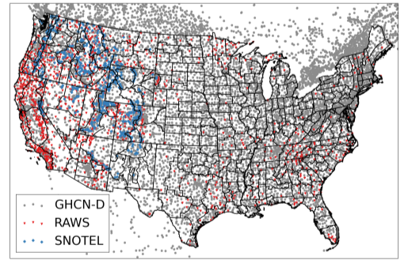
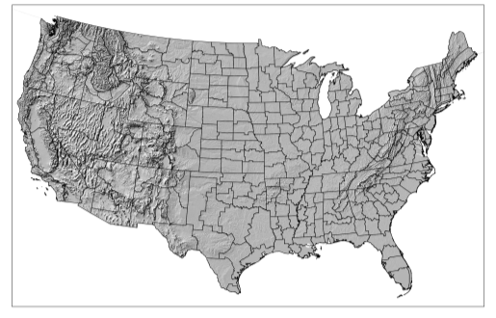
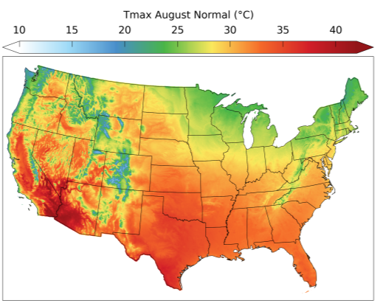
Topoclimatic Datasets
Interpolated Topoclimatic Datasets: use point-source weather station data and a DEM to incorporate the effects of topoclimatic factors and statistically interpolate climate variables to a regular grid.
PRISM
DAYMET
Maurer et al. and Livneh et al.
DEM and
DEM-Derived
Variables
Weather
Stations
Interpolated
Topoclimatic Dataset

Slide 4
Topoclimatic Datasets
Since there are existing CONUS topoclimatic datasets, why not use what is already available? Why reinvent the wheel?
Main motivations for creating TopoWx:
No topoclimatic datasets make use of remote sensing data that have potential to improve spatial representations of topoclimatic air temperature.
No topoclimatic datasets currently homogenize input station data.
No topoclimatic datasets provide estimates of spatial uncertainty.
Most topoclimatic datasets are proprietary and closed source.
Notes:
Can we do better with a community-based, open source approach?

Slide 5
TopoWx Process Flow

Slide 6
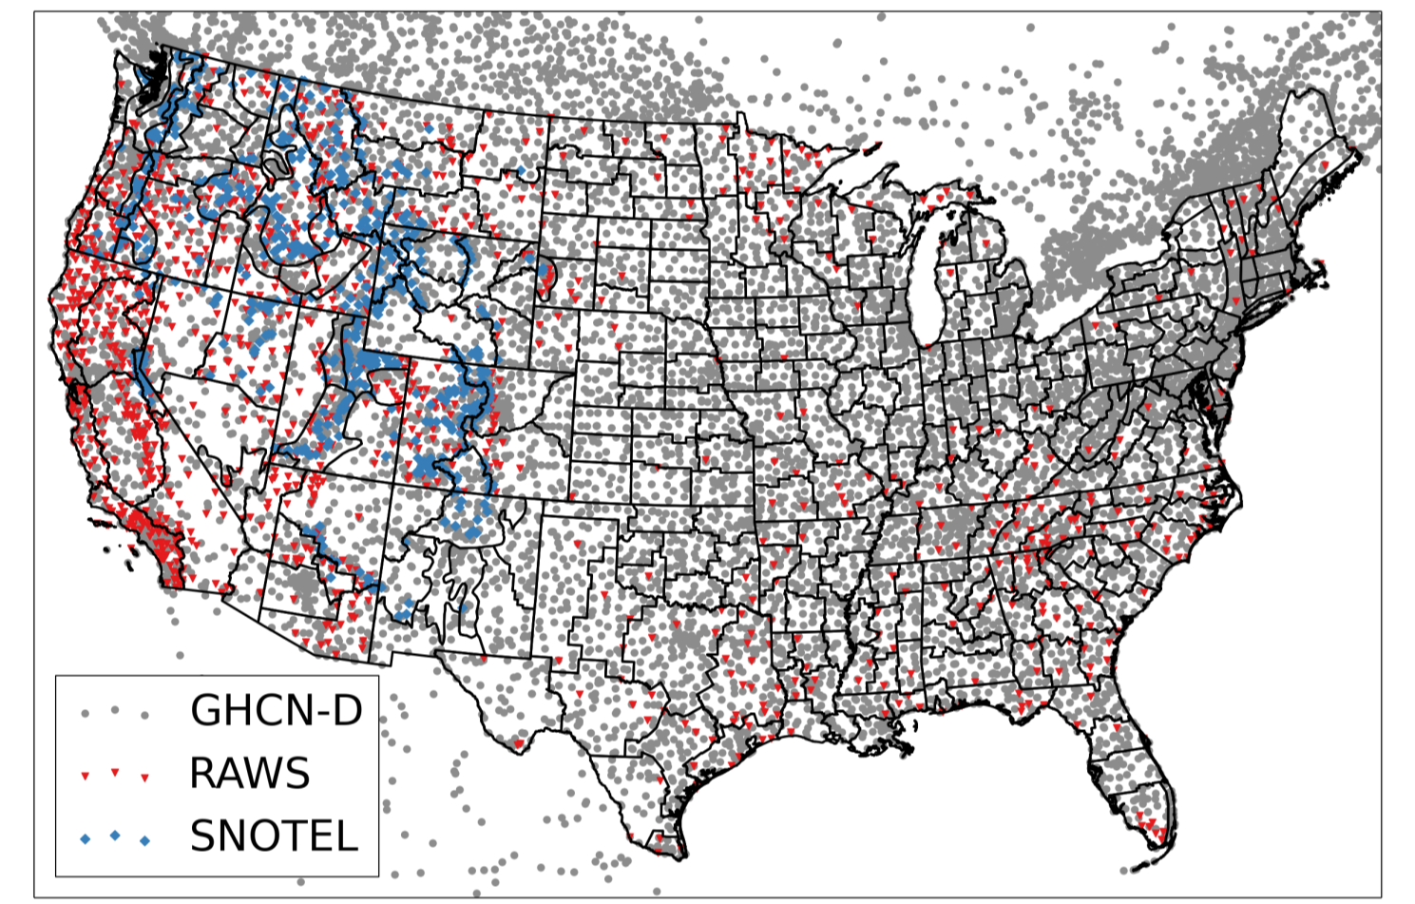
Input Weather Station Data
14,087 input stations
Each station has >= 5 years of raw data, 1948 – 2012
GHCN-D QA procedures (Durre et al. 2010)
Durre, I., Menne, M.J., Gleason, B.E., Houston, T.G., Vose, R.S., 2010. Comprehensive Automated Quality Assurance of Daily Surface Observations. Journal of Applied Meteorology and Climatology 49, 1615–1633.

Slide 7
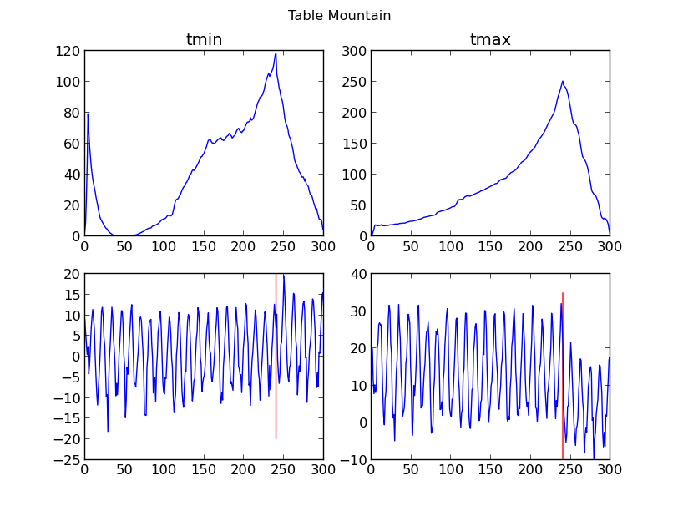
Homogenization
Inhomogeneity: an artificial climate trend/jump at a station caused by changes in reporting practices, instrumentation, station location, etc.
Homogenization: removal of inhomogeneities through advanced statistical procedures.
Apply the Pairwise Homogenization Algorithm (PHA; Menne and Williams 2009).
Menne, M.J., Williams, C.N., 2009. Homogenization of Temperature Series via Pairwise Comparisons. Journal of Climate 22, 1700–1717.
Notes:
Standard Normal Homogeneity Test (SNHT)

Slide 8
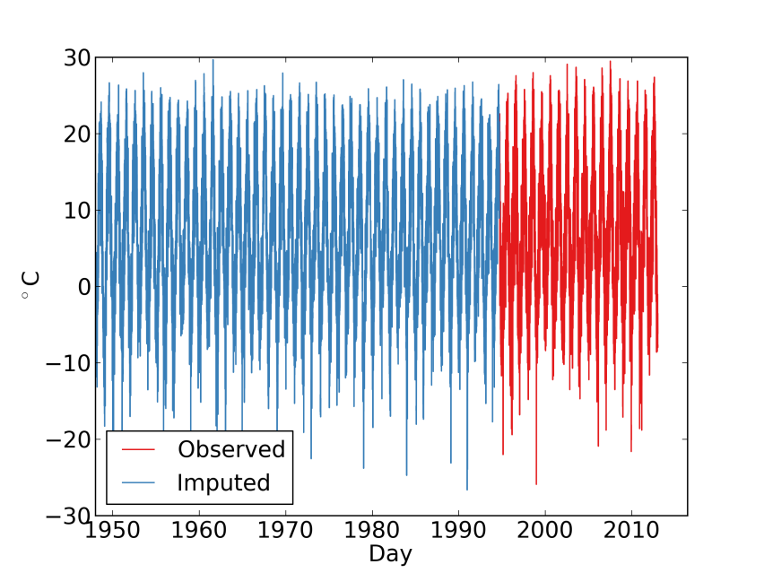
Missing Observation Infilling
How to handle incomplete 1948-2012 data records and missing data?
Simply interpolating raw incomplete data could produce inhomogeneities in the gridded output as the number of stations and station spatial coverage vary during the 1948-2012 time period
Don’t want to throw away key observations, though (i.e.—SNOTEL, RAWS)
Expectation maximization and principal component analysis-based infilling of missing station observations using:
Long-term stations
NCEP/NCAR Reanalysis: temperature, thickness, geopotential height, wind, sea level pressure
Stuart Peak SNOTEL Tmax
Near Missoula, MT.
Observing since 1994
Observed
Infilled

Slide 9
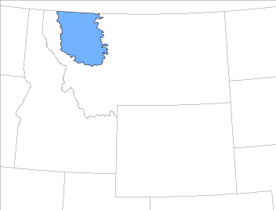
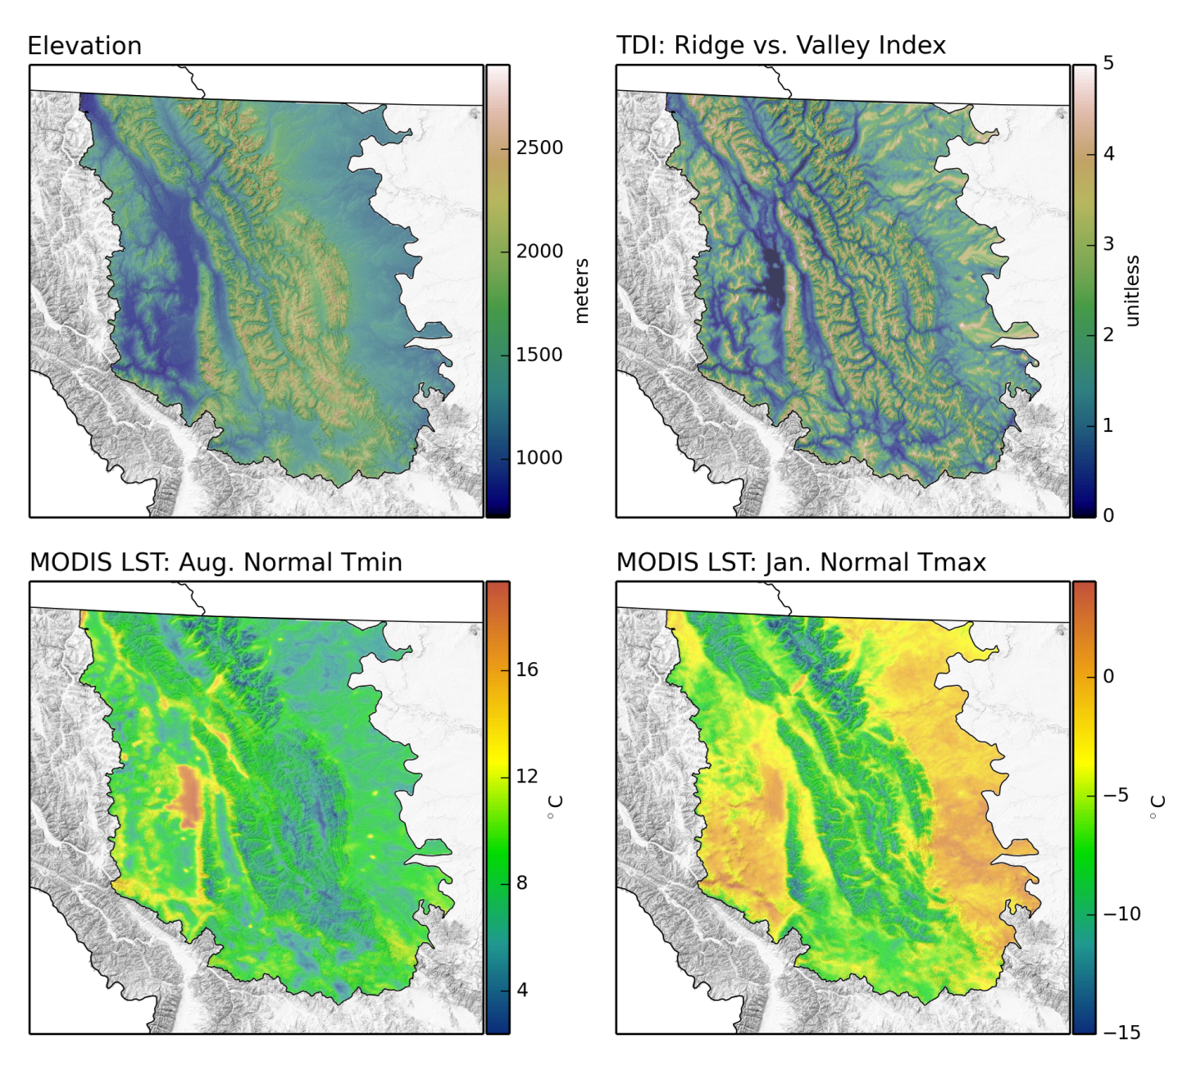
Auxiliary Predictors of Temperature
Interpolation
Methods
Crown of the Continent Ecosystem, Montana
Elevation
MODIS Land Skin Temperature
Topographic Dissection Index

Slide 10
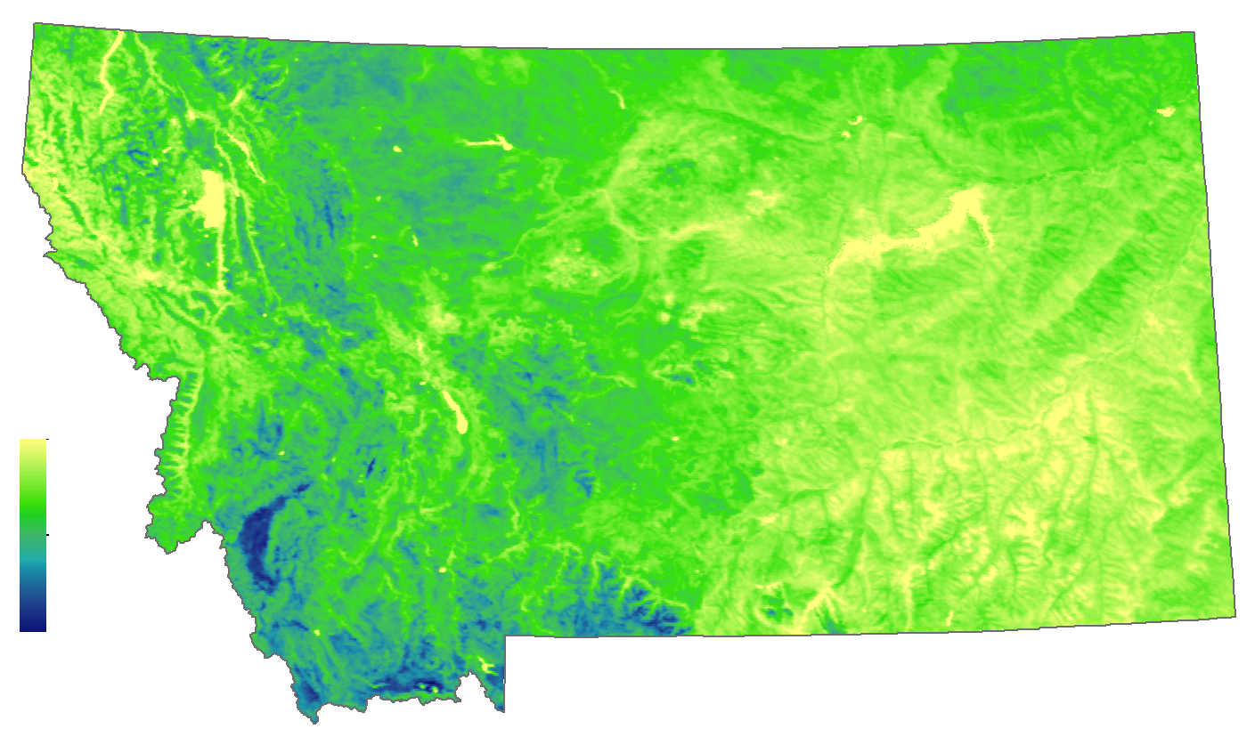
Interpolation Methods: MODIS Land Skin Temperature
Tmin Avg. Land Skin Temperature: August 2003-2012
Climatological MODIS LST
Key integrator of landscape-scale influences such as elevation, cold air drainage patterns, slope/aspect, water bodies, and land cover
19.81 °C
-0.79 °C

Slide 11
Interpolation Methods Basic Model
Split interpolation into 2 steps:
Step 1: Interpolate Tmin/Tmax monthly normals (1981-2010) using Moving Window Regression Kriging
$\overline{T}=f(x+y+z+lst)$
Step 2: Interpolate daily Tmin/Tmax anomalies around $\overline{T}$ normals using a daily-varying Geographically Weighted Regression
$δT=f(x+y+z+lst+tdi)$
$tdi$ = topographic dissection index* 0 = deep valley; 5 = ridge/peak. Indicator of cold air drainage potential.
$lst$ = MODIS 2003-2012 10 year monthly mean land skin temperature (1-km resolution)
*Holden, Z.A., Abatzoglou, J.T., Luce, C.H., Baggett, L.S., 2011. Empirical downscaling of daily minimum air temperature at very fine resolutions in complex terrain. Agric. For. Meteorol. 151, 1066–1073.

Slide 12
Results: Homogenization CONUS Annual Anomalies
Tmin
Tmax

Slide 13
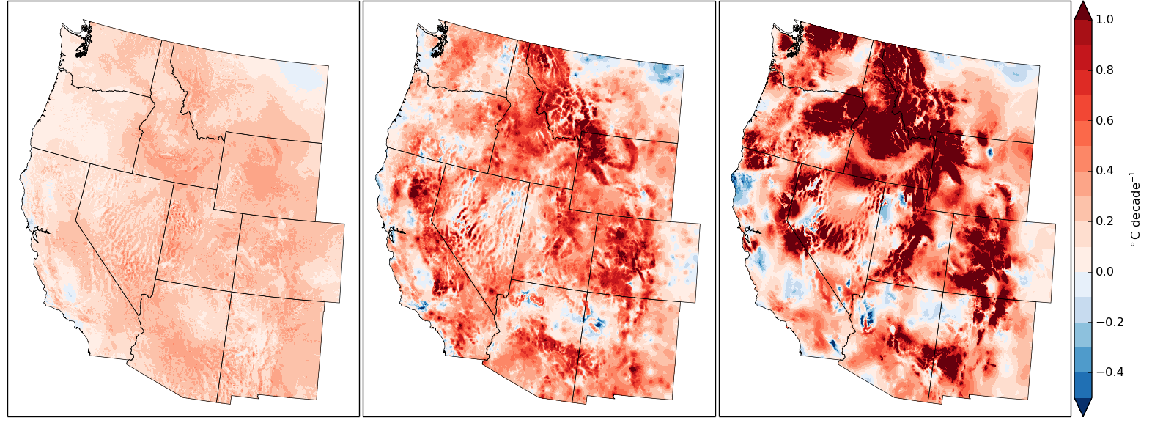
Results: Homogenization 1981-2012 Western U.S. Tmin Trends
TopoWx
PRISM
Daymet

Slide 14
Results: Monthly Normal Predictors Western U.S.
Tmin
Tmax

Slide 15
Results: Land Skin Temperature Predictor Western U.S.
Tmin
Tmax

Slide 16
Results: Uncertainty
Uncertainty in August Normal Tmin

Slide 17
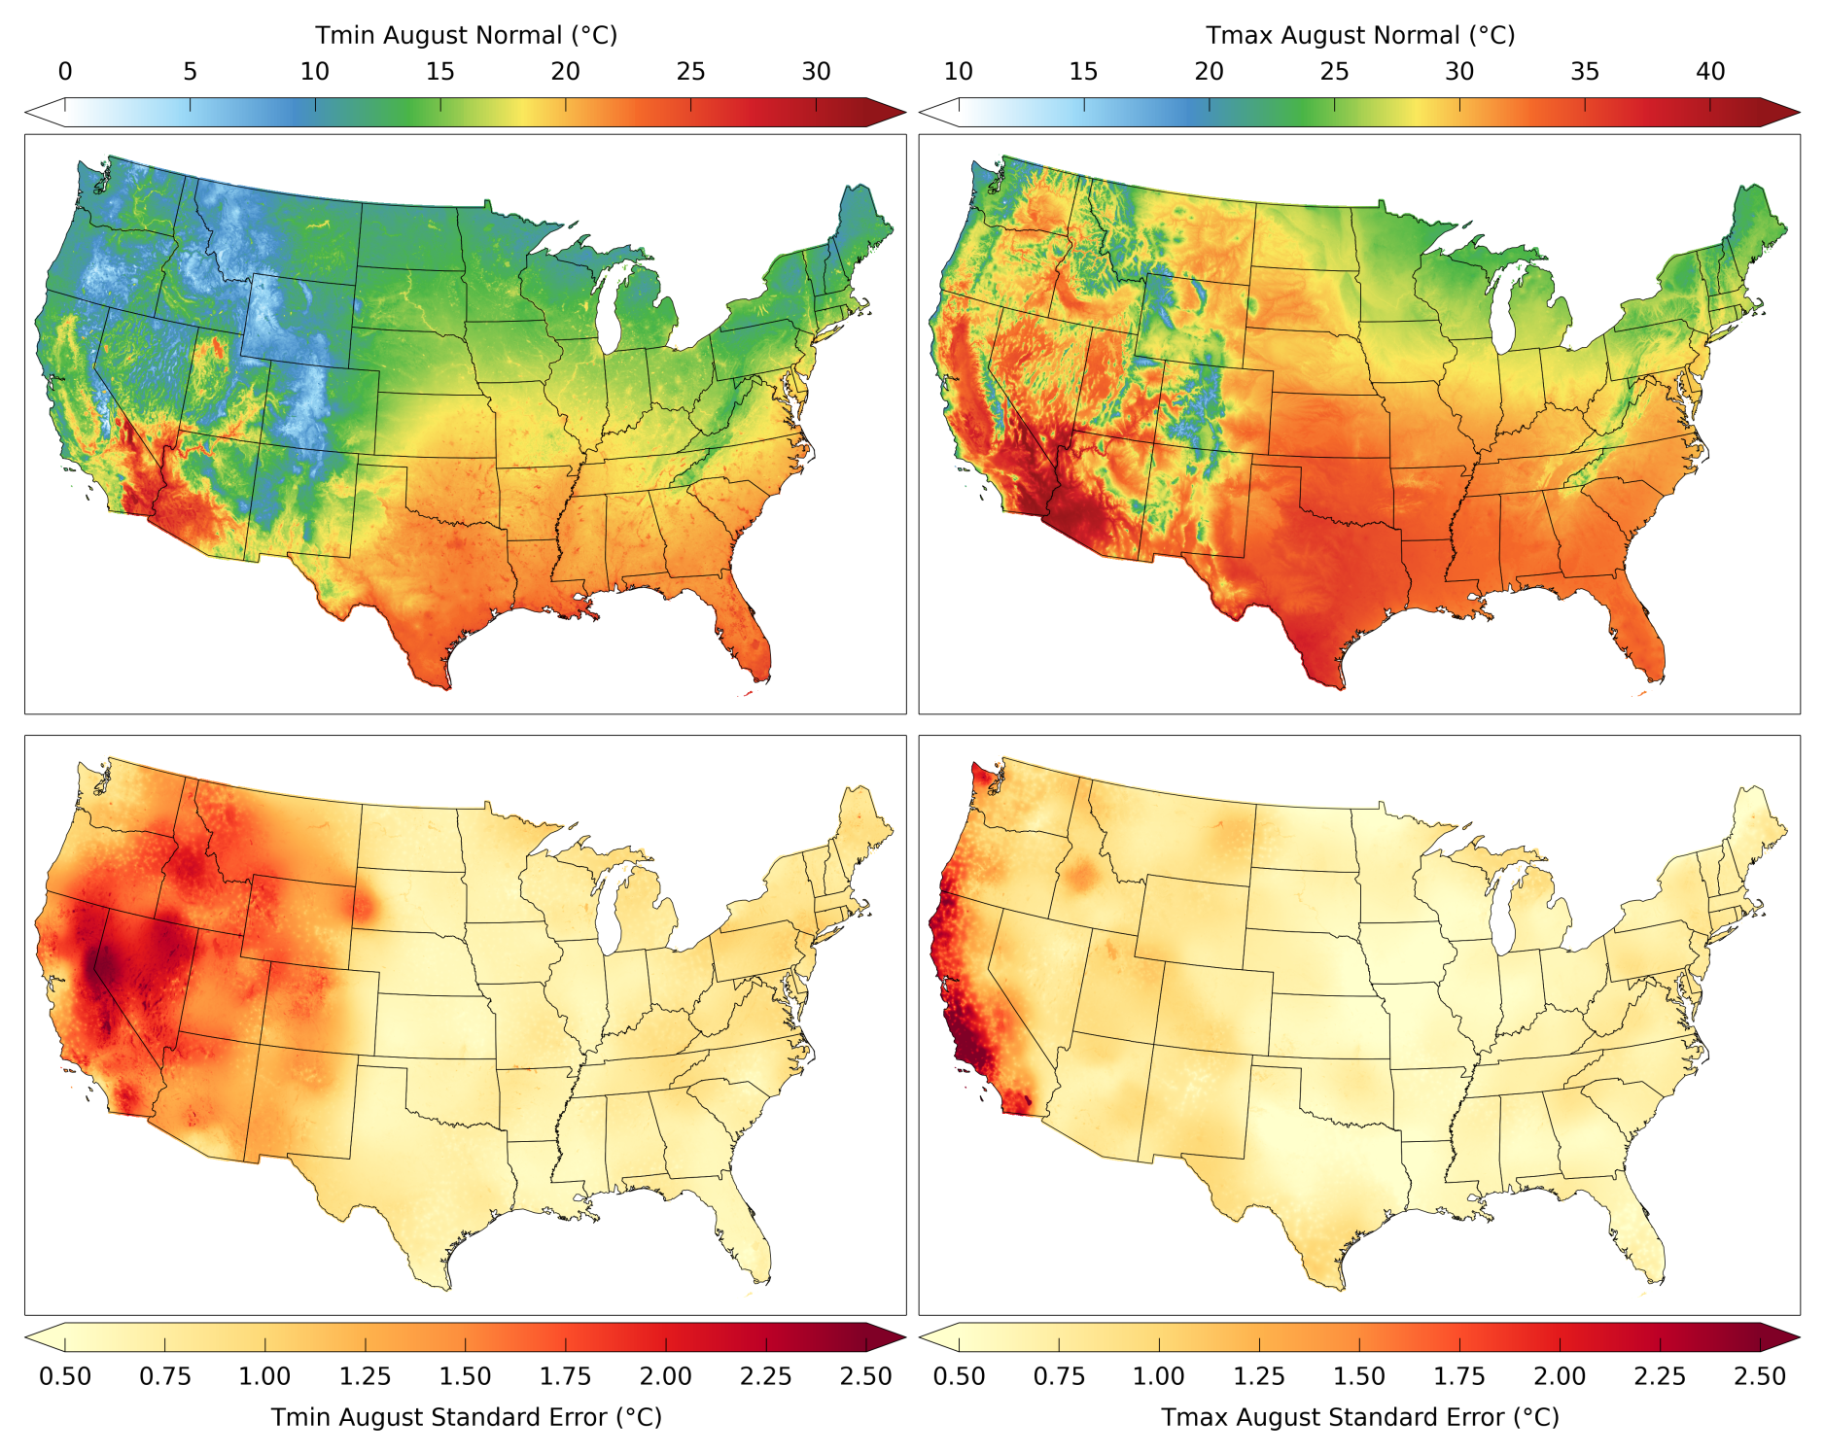
Results: Example CONUS Output

Slide 18
Results: Western U.S. Comparison
Notes:
Tmin: W. U.S. grid cells within 1 deg of Twx:
Daymet: 47%
PRISM: 57%
In general, Twx warmer in the mountains and cooler in the valleys
Tmax;
Daymet: 90%
PRISM: 90%

Slide 19
Results: Nevada northeastern
climate division
Notes:
On average, elevation only accounted for 6% of variance explained.
LST accounted for 77% of variance explained

Slide 20
Results: California
north coast drainage
climate division
Notes:
On average, elevation only accounted for 14% of variance explained.
LST accounted for 47% of variance explained

Slide 21
Conclusions
TopoWx contributes 3 main advancements to topoclimatic temperature interpolation:
An improved representation of interdecadal and long-term temperature trends
An improved representation of complex temperature spatial patterns, particularly for Tmin
A spatial representation of uncertainty that accounts for both model goodness of fit and the geographical arrangement of stations
These advancements were made through:
The use of previously developed homogenization procedures
Remotely sensed land skin temperature as an auxiliary predictor of topoclimatic air temperature
An unique implementation of moving window regression kriging

Slide 22
Technical Details and Data Availability
TopoWx open source code (Python, R) will be available on GitHub
License: GNU GPL
Built for HPC environments
NetCDF4 CONUS Dataset
1948-2012 30-arcsec daily Tmin/Tmax
1981-2010 30-arcsec monthly Tmin/Tmax normals with corresponding uncertainty
USGS THREDDS Data Server
http://cida.usgs.gov/thredds/catalog.html
ArcGIS-based web data services in development for Montana Climate Office
http://www.climate.umt.edu/
Corresponding publication in review
Oyler JW, Ballantyne A, Jencso K, Sweet M, Running S. Creating a topoclimatic daily air temperature dataset for the conterminous United States using homogenized station data and remotely sensed land skin temperature. International Journal of Climatology. In Review.

Slide 23
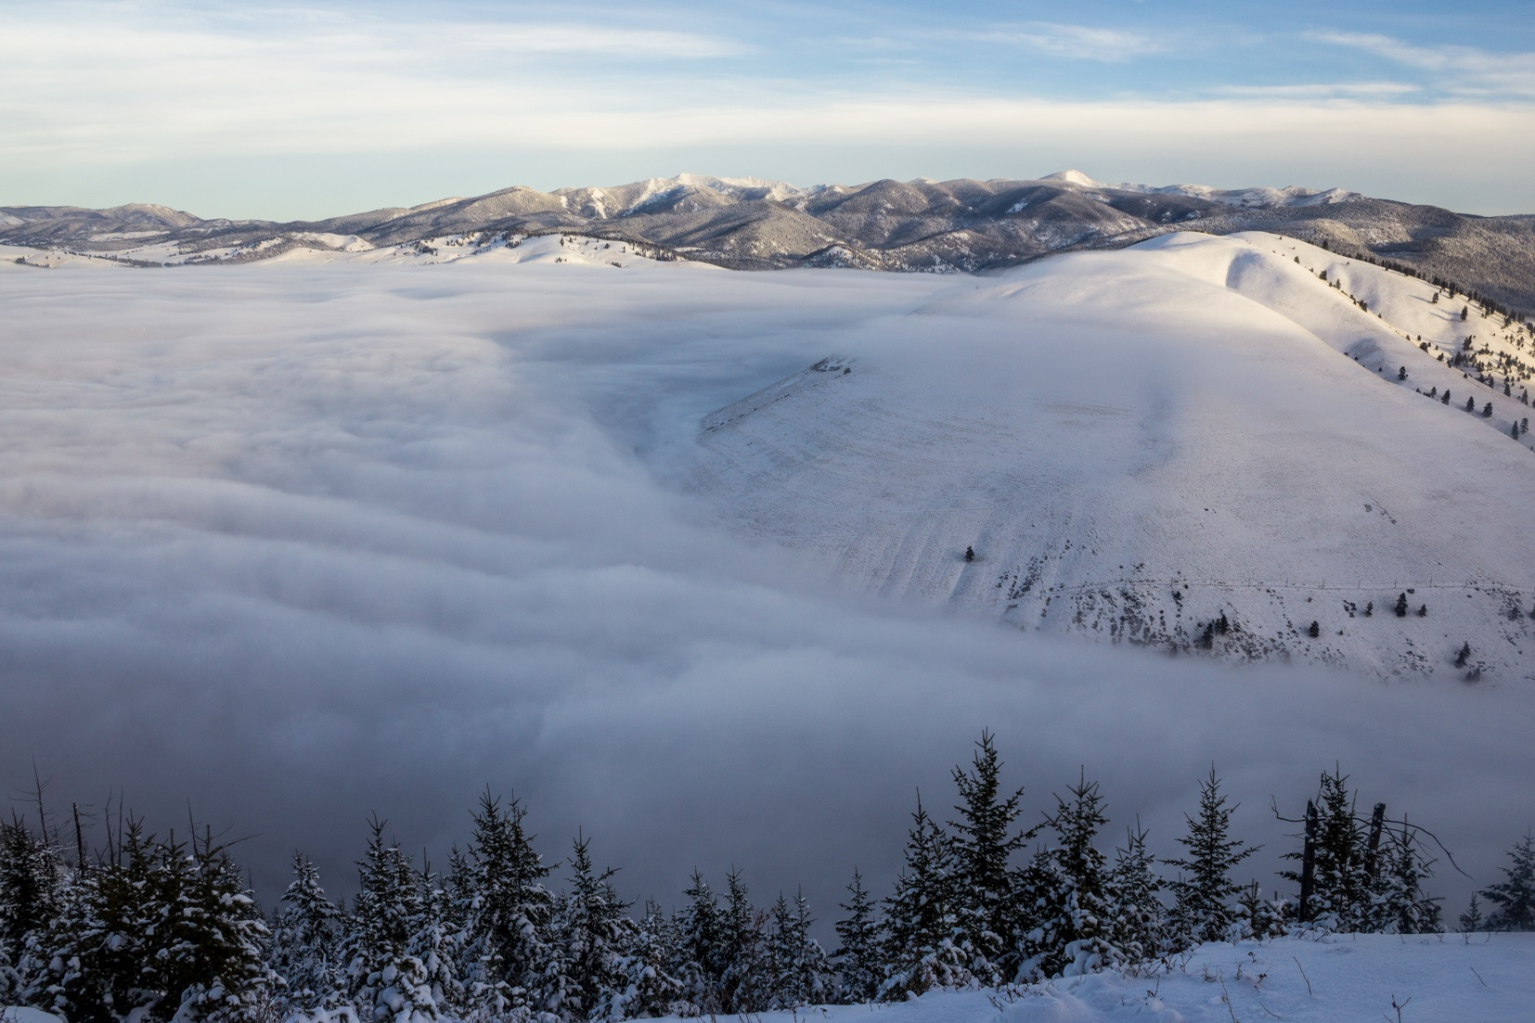
Thank You
Questions or
Comments?
Email: jared.oyler@ntsg.umt.edu

