Slide 1
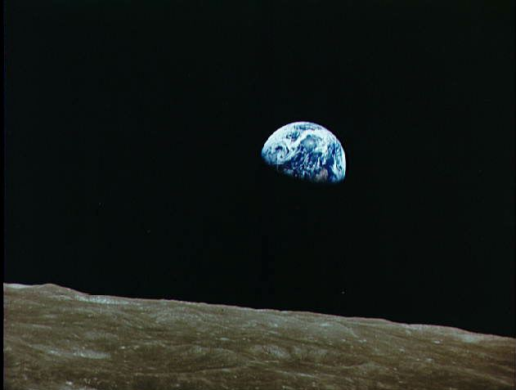
Is terrestrial net primary production a planetary boundary for the carbon cycle?
Steven W. Running
Numerical Terradynamic Simulation Group
College of Forestry and Conservation
University of Montana
Lund University
March 2, 2017

Slide 2
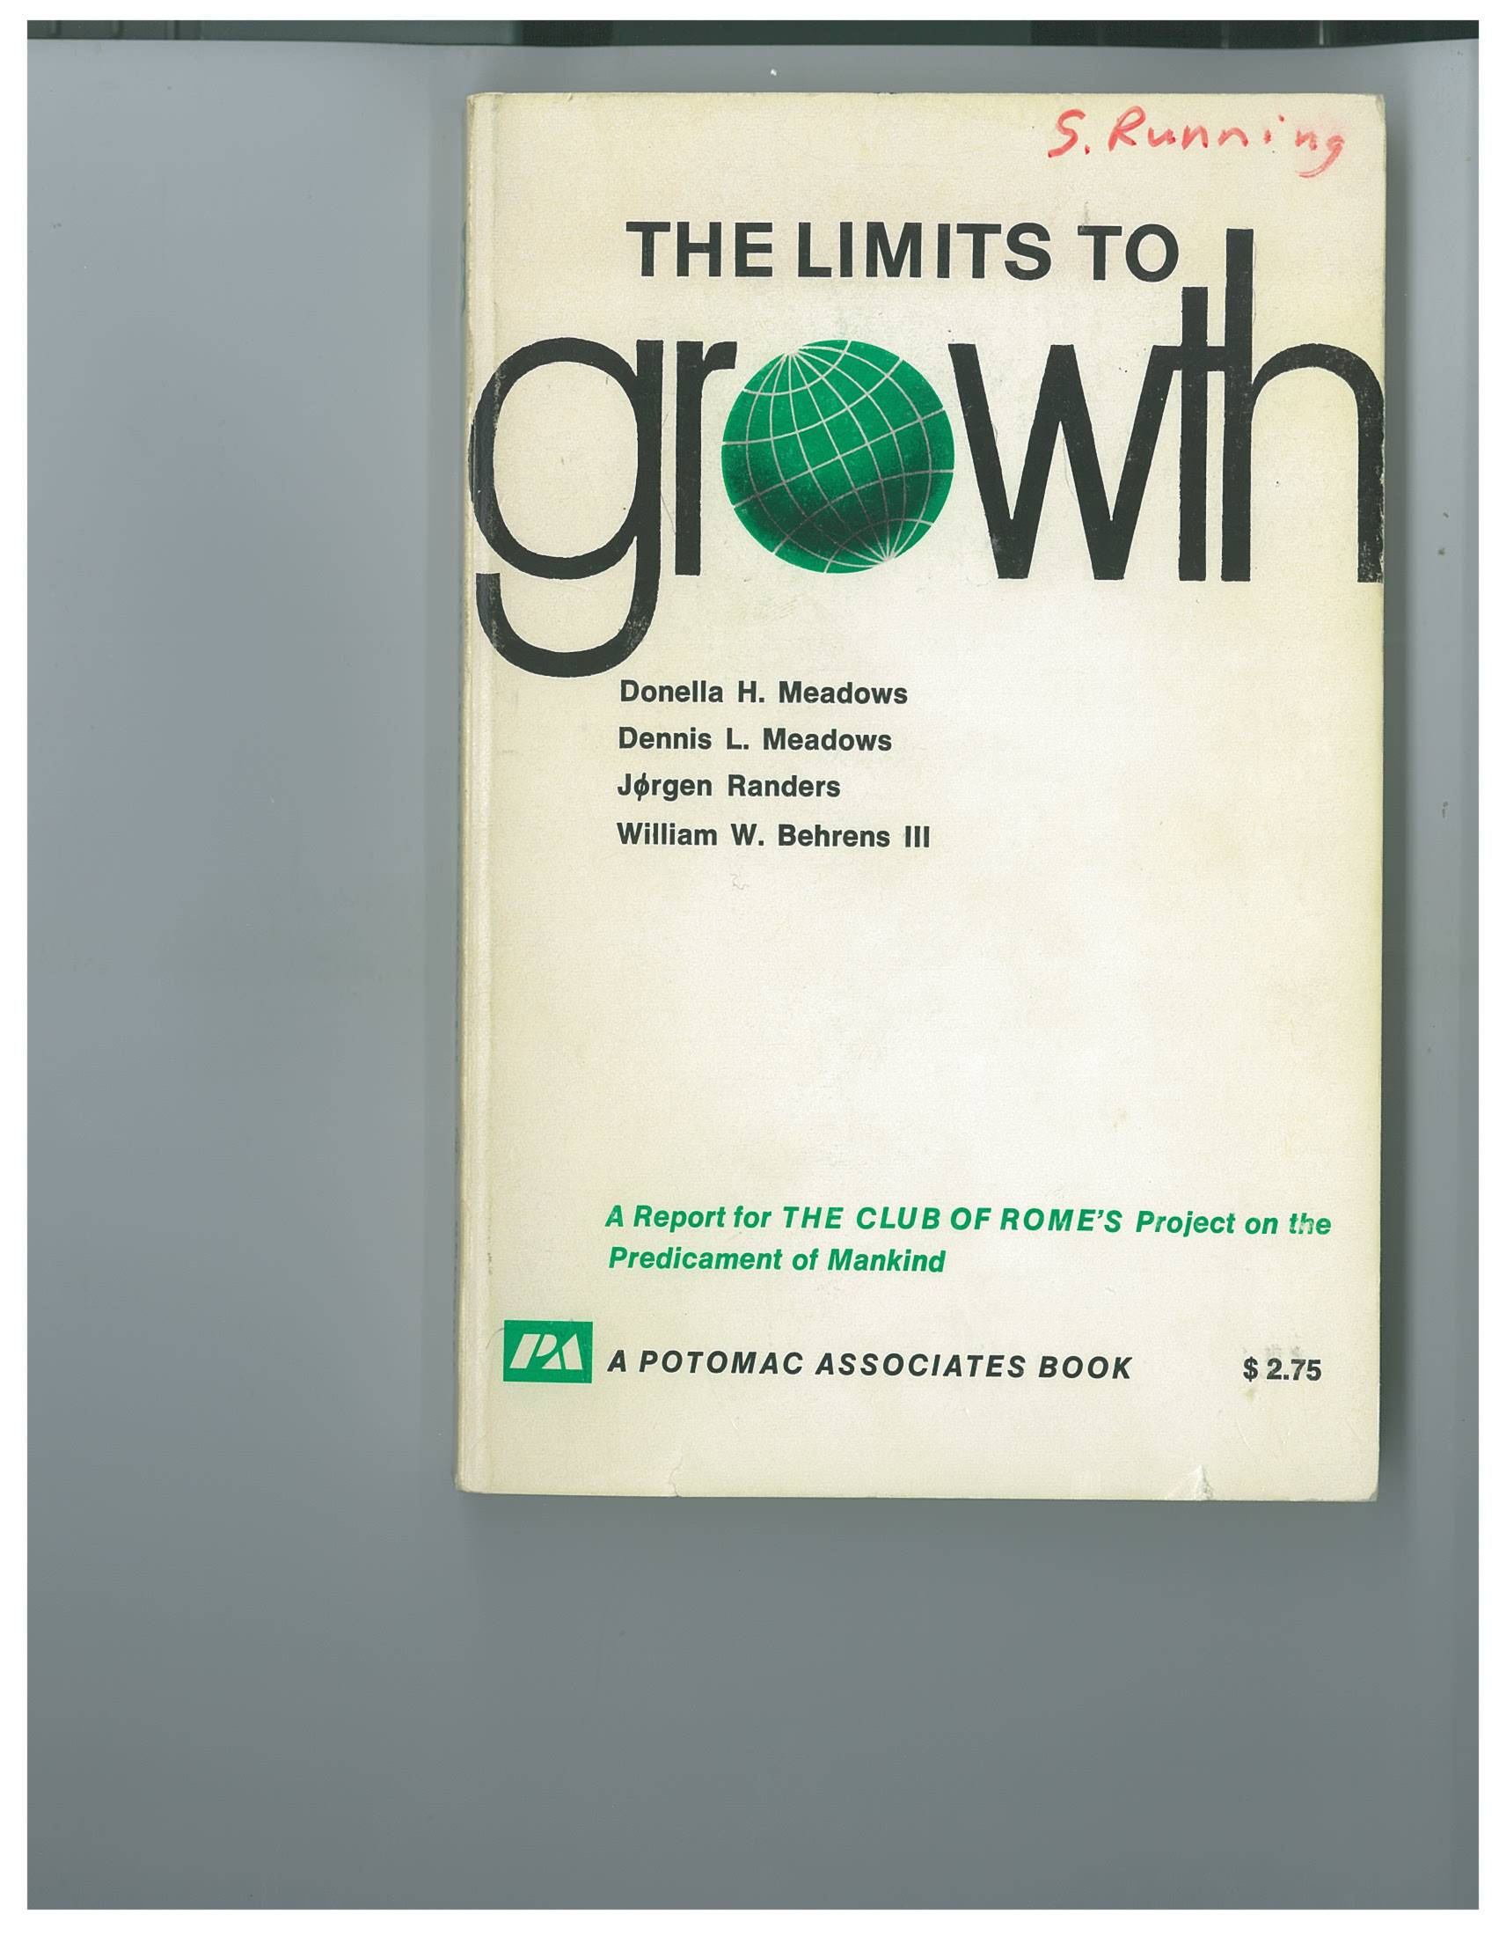
37 languages
12 million copies sold top-selling environmental title in history
1972

Slide 3
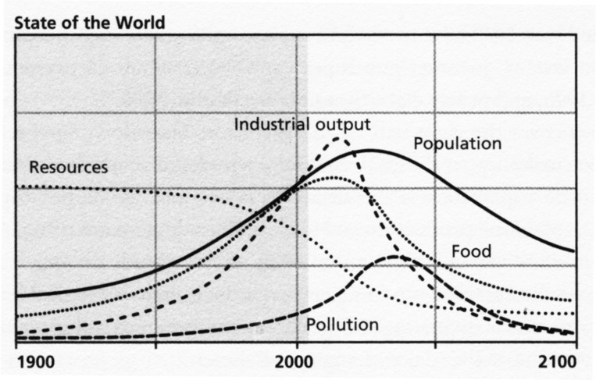
“Limits to Growth” Scenario in 1972 for 2016
From G. Turner, Global Env Change 18:397-411. 2008

Slide 5
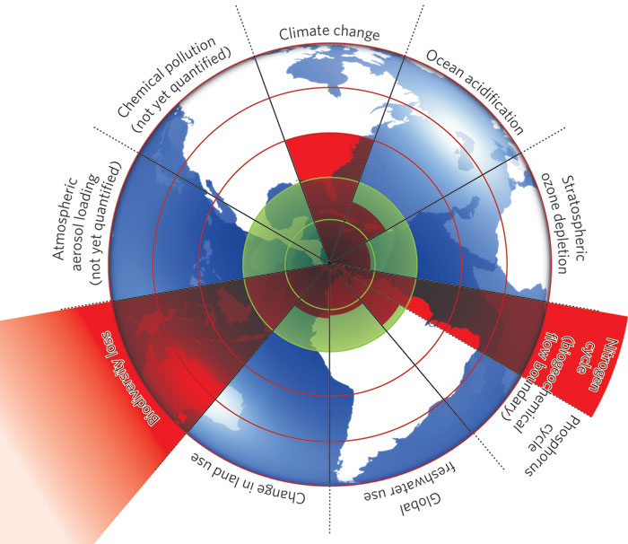
PLANETARY BOUNDARIES
Rockstrom et al. Nature 2009

Slide 6
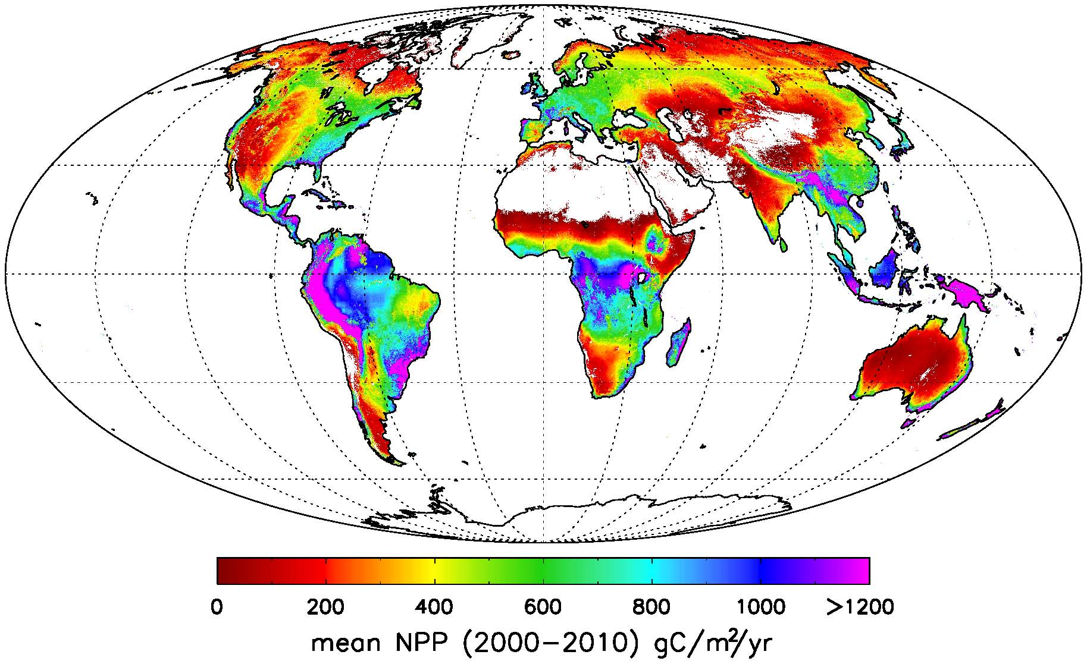
GLOBAL NET TERRESTRIAL PRIMARY PRODUCTION
Zhao and Running, Science (2010)

Slide 7
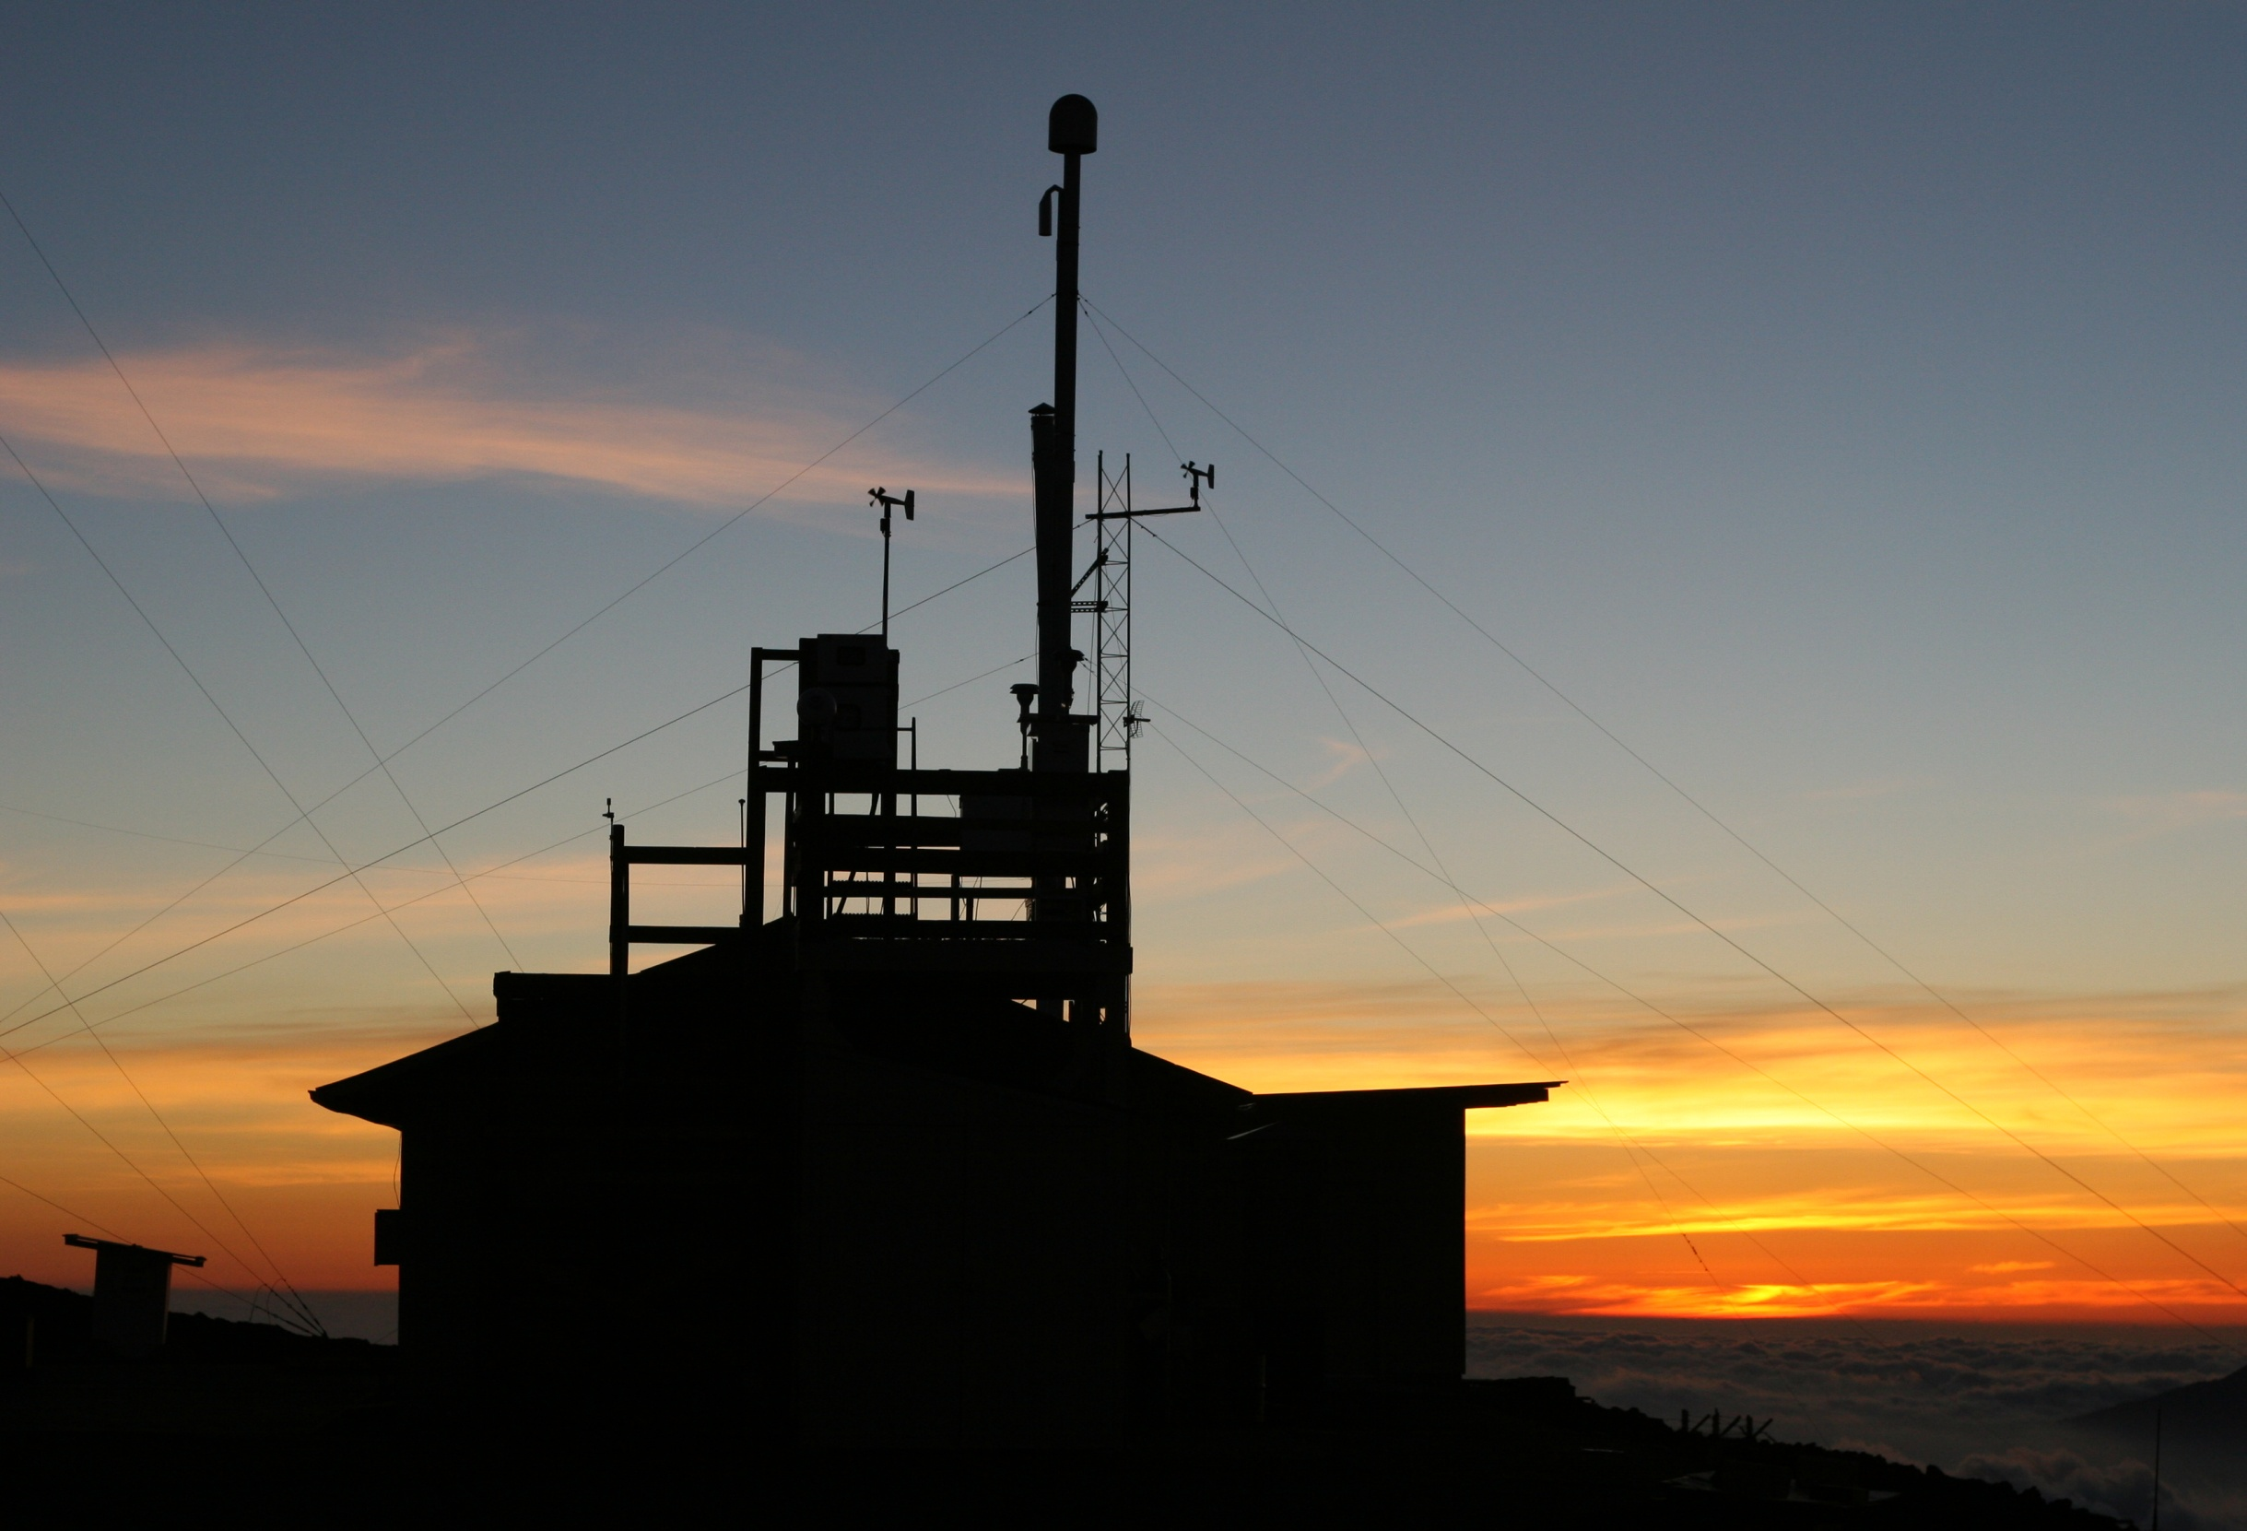
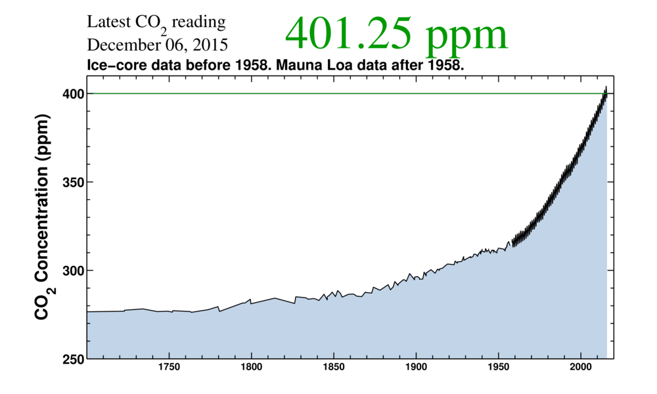

Carbon dioxide has risen by 40% since preindustrial
Mauna Loa Observatory on Hawai’i
Notes:
The photo in the background shows the Mauna Loa Observatory at dusk (courtesy Forrest Mims). This is where, in 1958, Charles David Keeling began his now-famous atmospheric carbon dioxide data set – sometimes called “the Keeling Curve.” The data trend shows carbon dioxide has risen from about 318 parts per million in 1958 to about 388 ppm in 2008. The gray “saw-toothed” line shows actual measurements and the red line shows the running mean value.
(Data courtesy NOAA Earth System Research Laboratory)

Slide 8
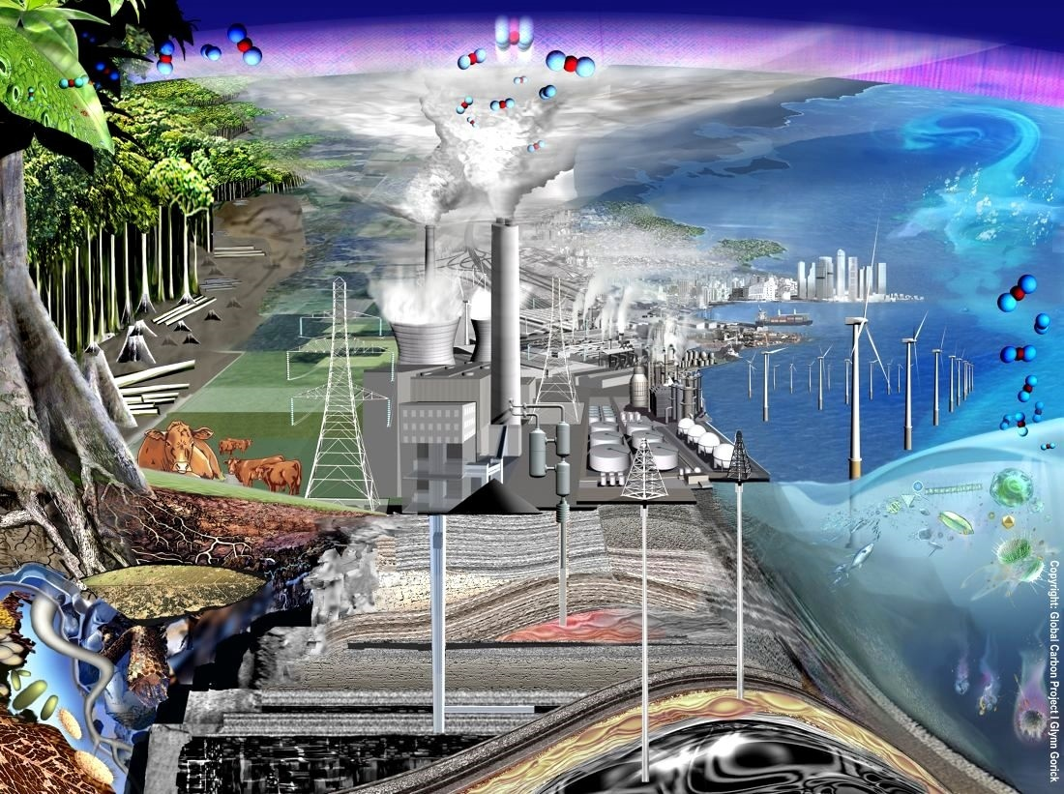
“The rise in CO₂ is proceeding so slowly that most of us today will, very likely, live out our lives without perceiving that a problem may exist”
Keeling CD, Harris TB, Wilkins EM, 1968. Concentration of atmospheric carbon dioxide at 500 and 700 millibars. J. Geophys. Res. 73:4511-28

Slide 9
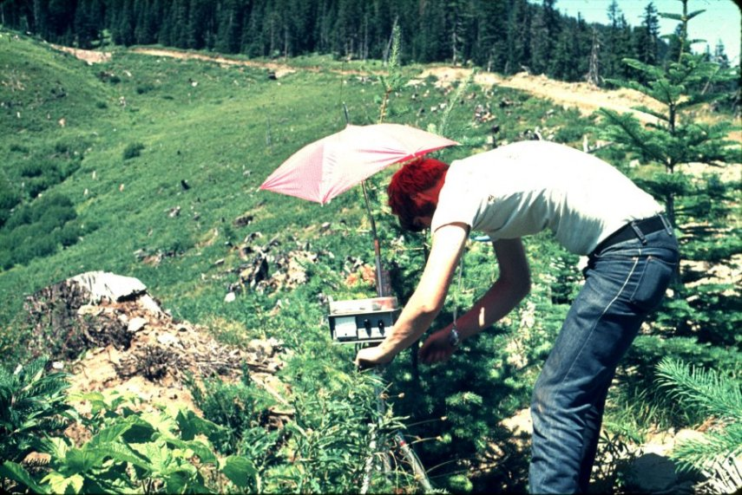
When I started, none of us worried about policy relevance, or explaining our science to journalists (or taxpayers)
Diurnal stomatal conductance and leaf water potential, MS thesis, Oregon 1973

Slide 10
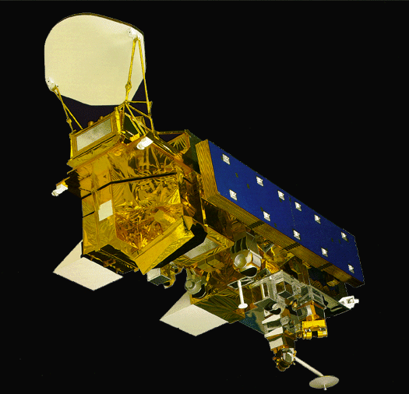
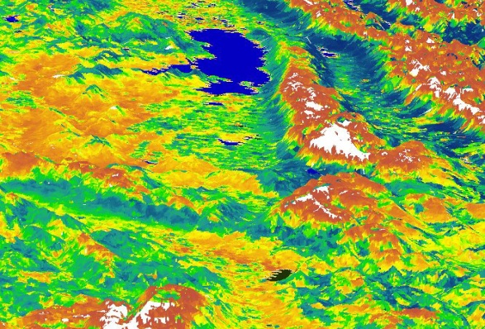
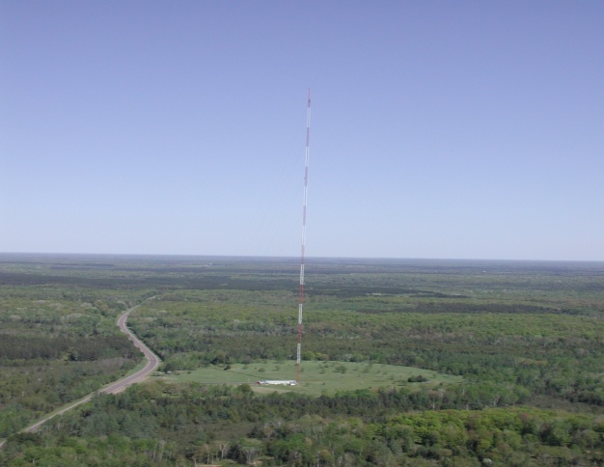
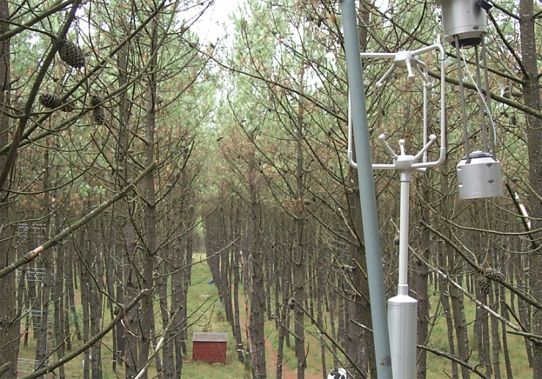
Integrated, Multiple Constraints on the Biosphere
1000 km
Upscaling
Prediction
10 km
1km
1ha
1m
Downscaling
Verification

Slide 11
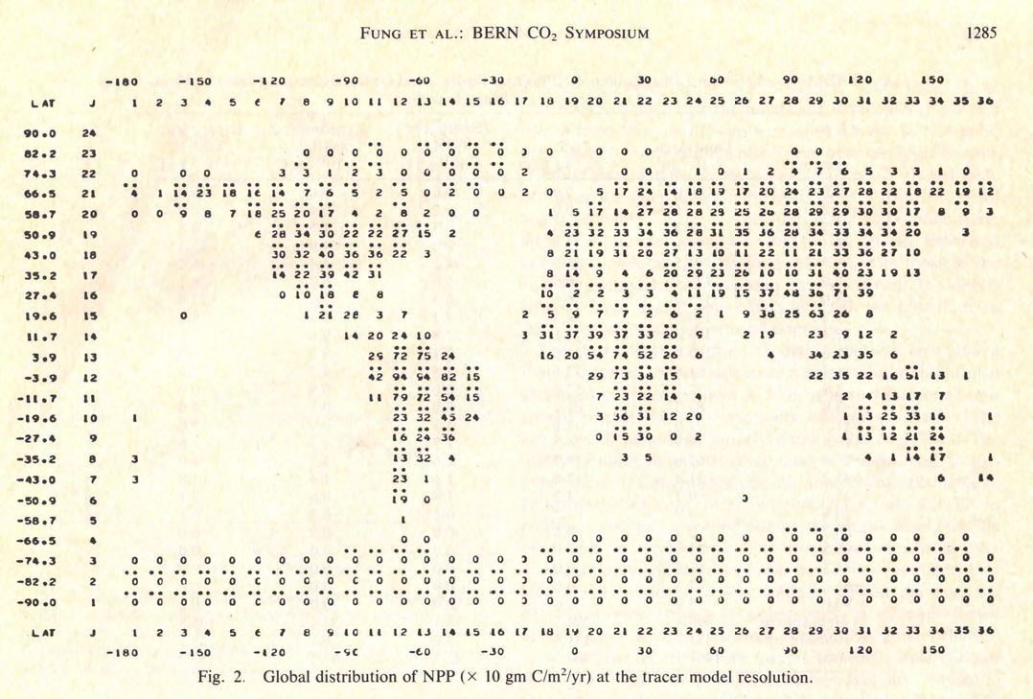
Global NPP 1983 version

Slide 12
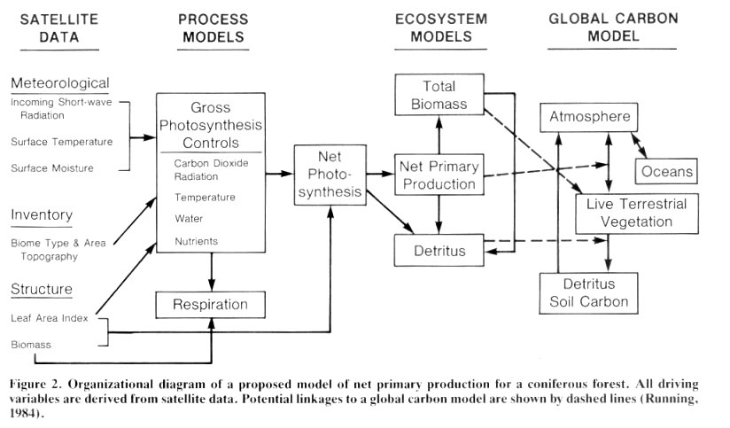
Driving ecosystem models with satellite data, concept for NASA Global Habitability, 1983

Slide 13
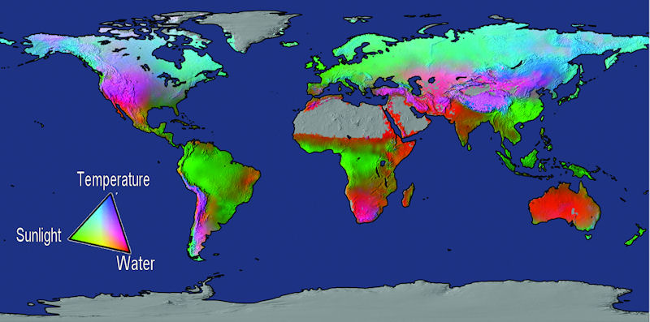
Water = 40%, Temperature = 33%, Radiation = 27%
Potential limits to vegetation net primary production based on fundamental physiological limits by solar radiation, water balance, and temperature (from Churkina & Running, 1998; Nemani et al., 2003; Running et al., 2004).

Slide 14
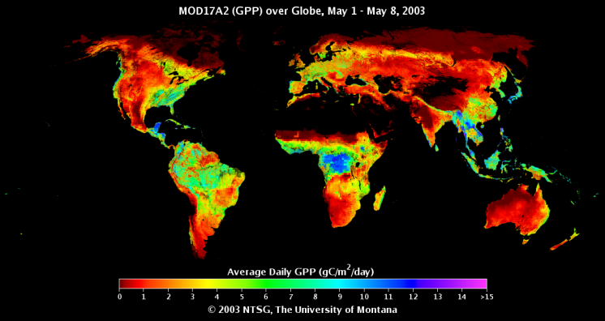
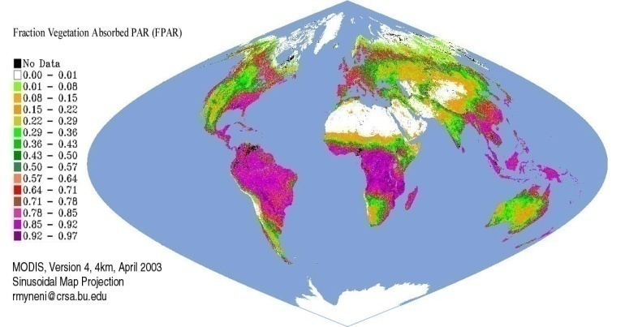
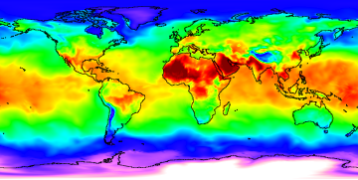
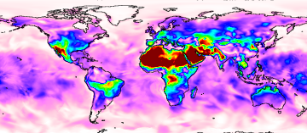
GPP = Light X Conversion Efficiency
GPP = f (PAR) x ε
Biome
Properties
Look-Up
Table (ε_{max} )
GPP
fPAR, PAR
Temperature
VPD

Slide 15
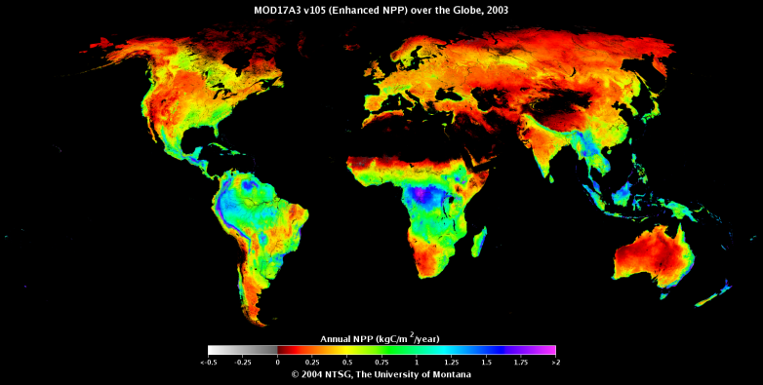
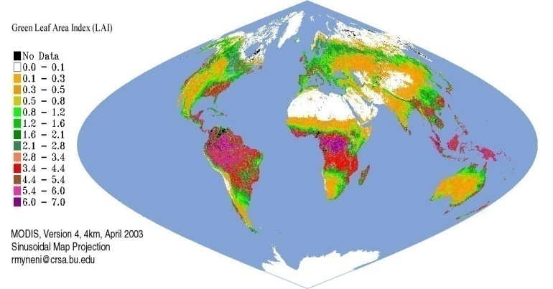
NPP = Annual GPP - Autotrophic Respiration
NPP =  GPP – (R_{m}+ R_{g})
Biome
Properties
Look-Up
Table
NPP
GPP
LAI
Temperature

Slide 16

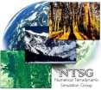
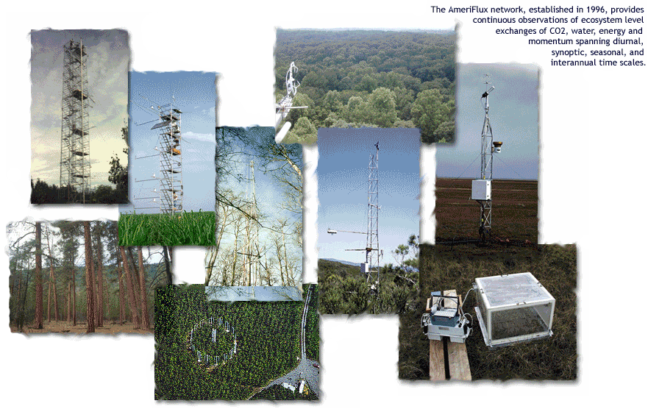
Comparison of GPP from Terra-MODIS and AmeriFlux Network Towers
Biome types used in comparison: forests (evergreen needleleaf, deciduous broadleaf, and mixed species), oak savanna, grassland, tundra, and chaparral.

Slide 17
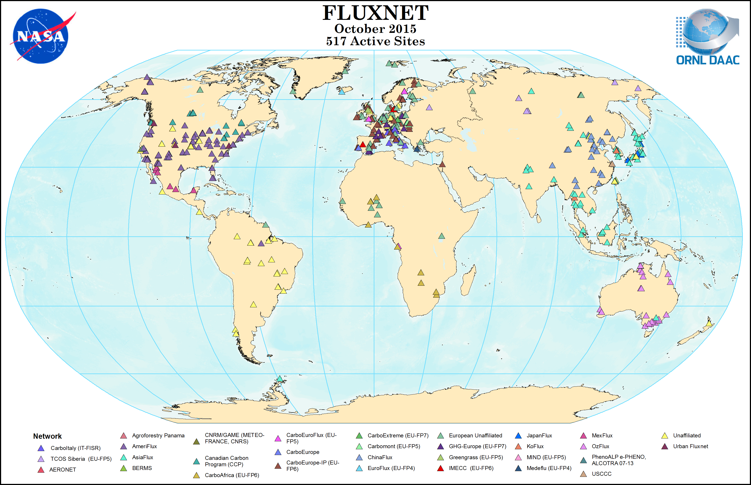
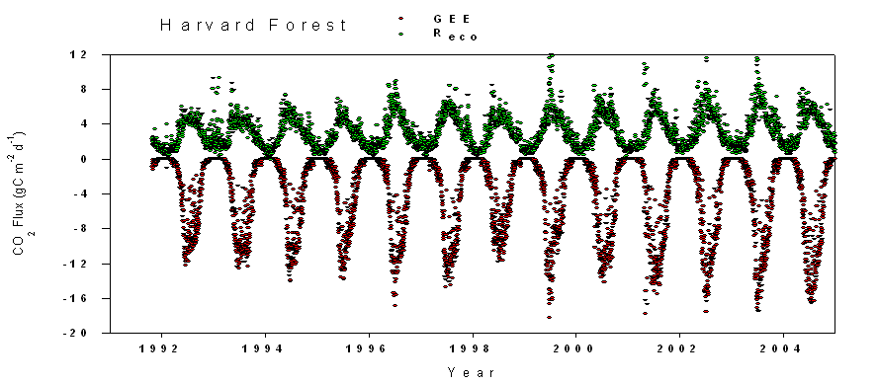

Slide 19
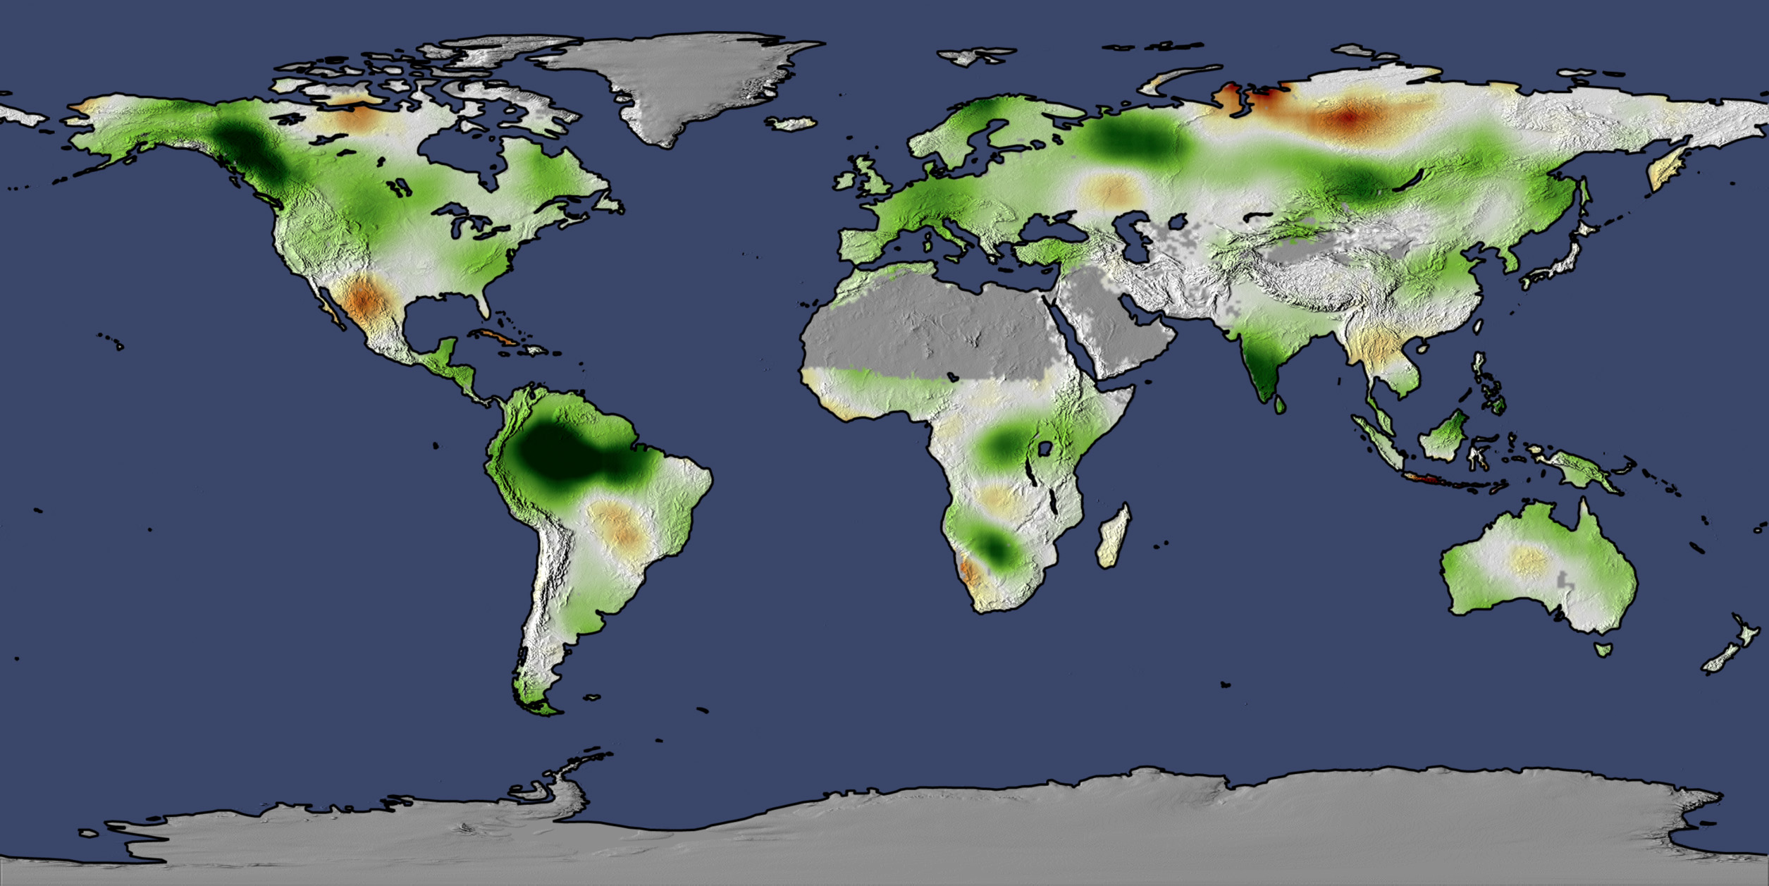
Change in Terrestrial NPP from 1982 to 1999
Nemani et al., Science June 6th 2003

Slide 20
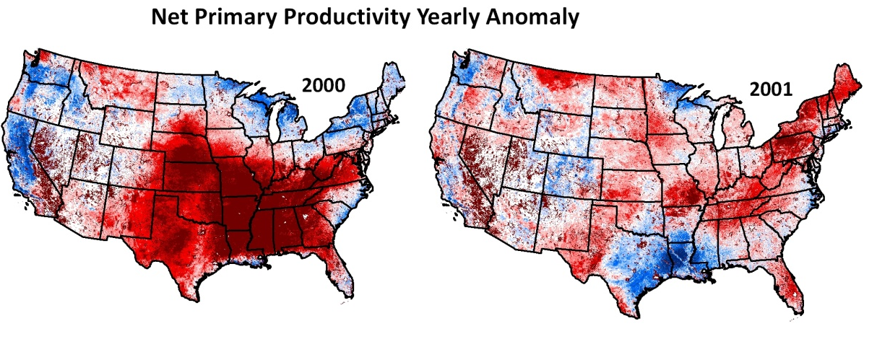
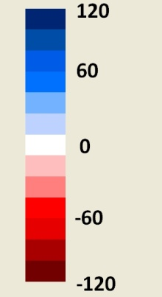
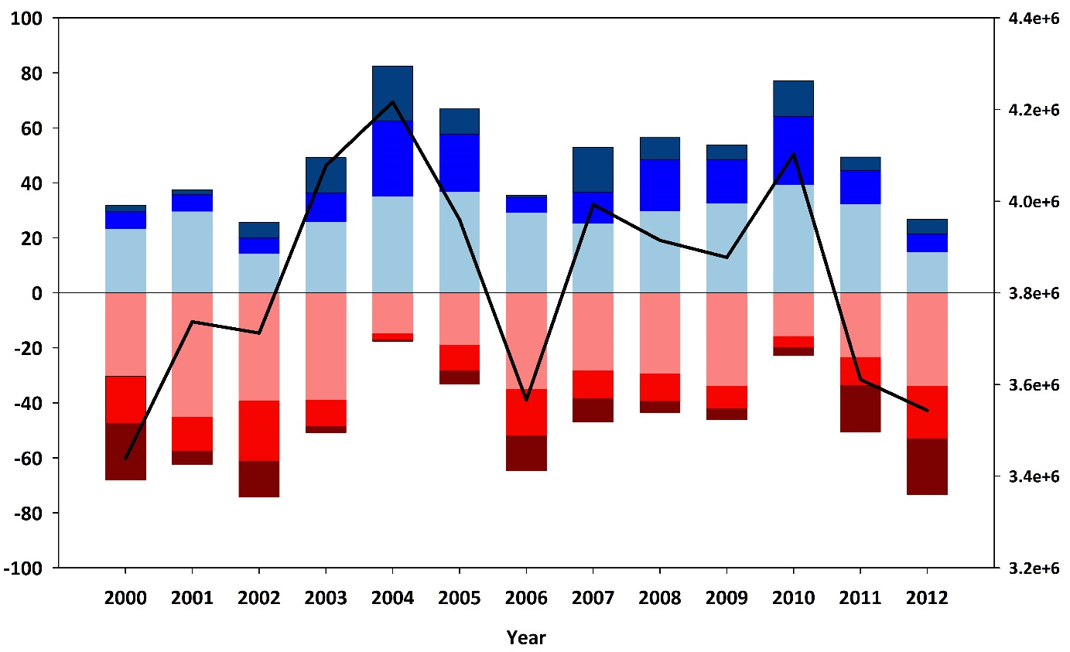

Net Primary Productivity Indicator
NPP (gC/m²)
Percentage of area above or below the 13-year NPP average
> 80 gC m² yr⁻¹
> 40 gC m² yr⁻¹
> 0 gC m² yr⁻¹
< 0 gC m² yr⁻¹
< -40 gC m² yr⁻¹
< -80 gC m² yr⁻¹

Slide 21
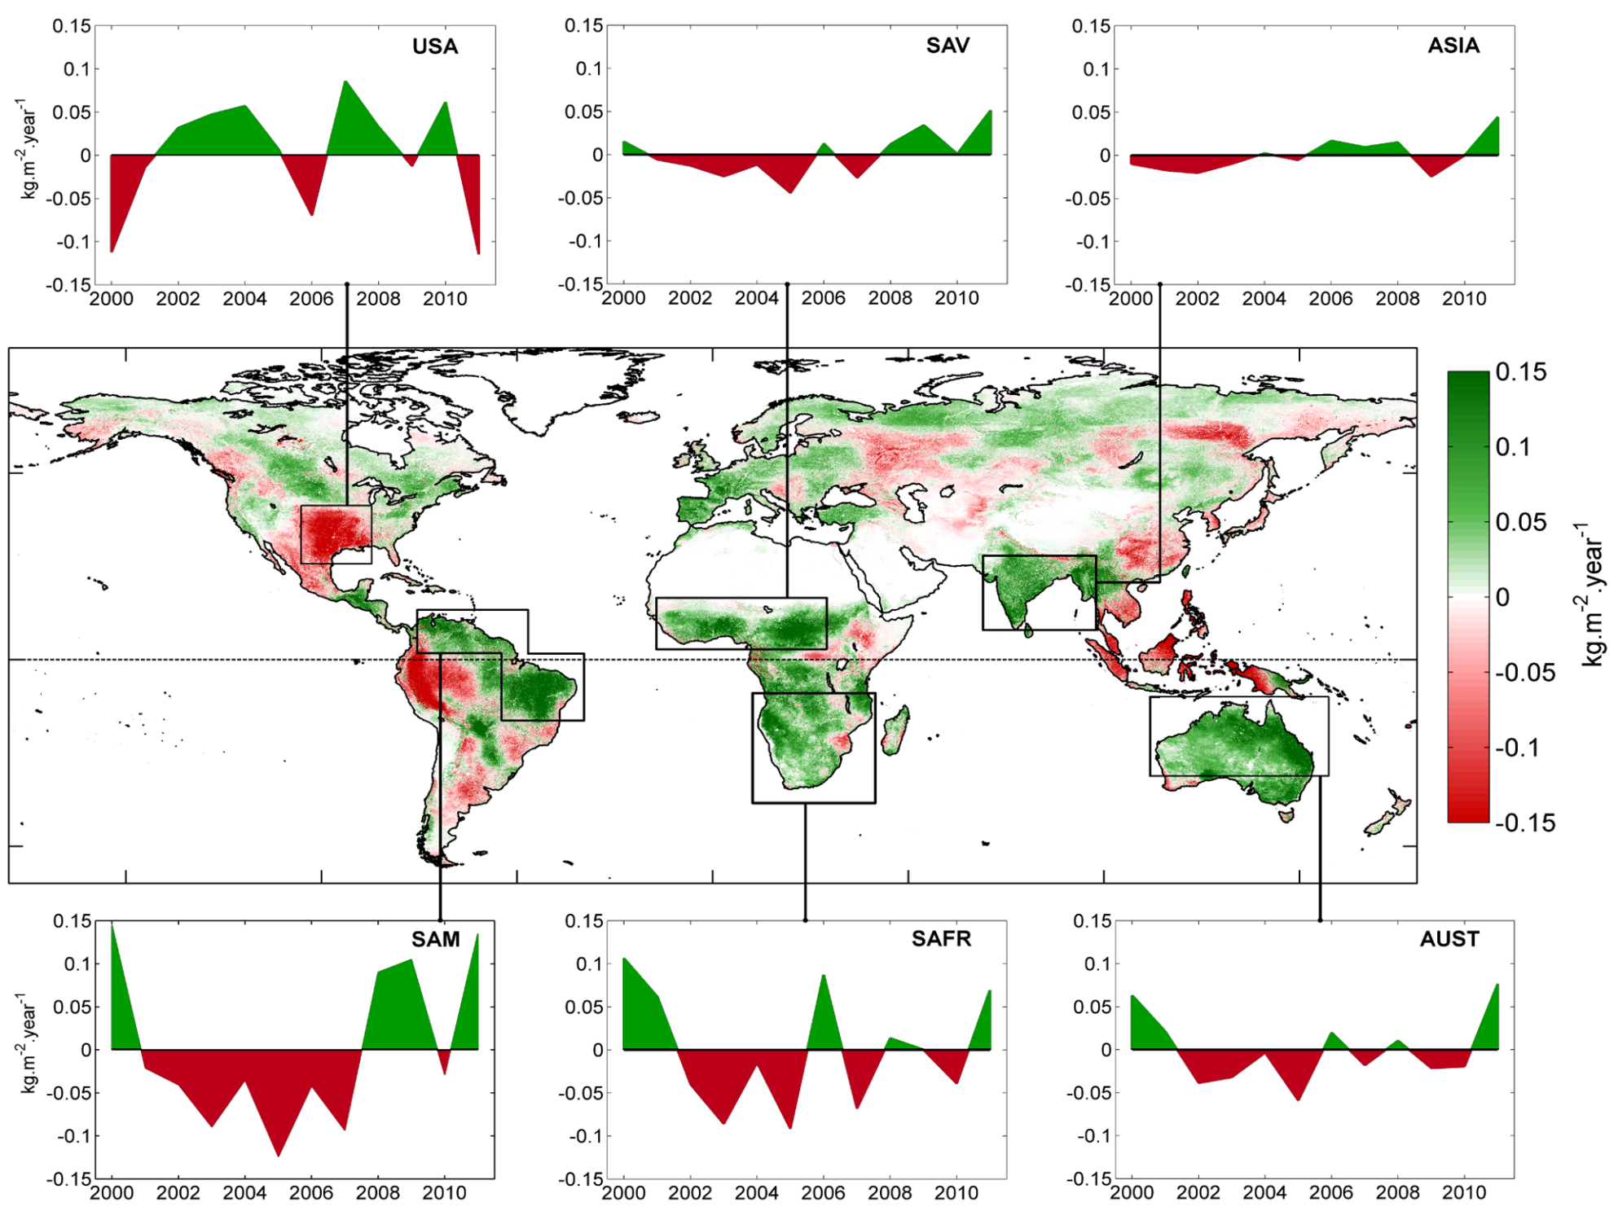
The global NPP dependence on ENSO: La Niña and the extraordinary year of 2011, highest terrestrial NPP recorded, largest increase in arid savannahs
Bastos et al 2013

Slide 22
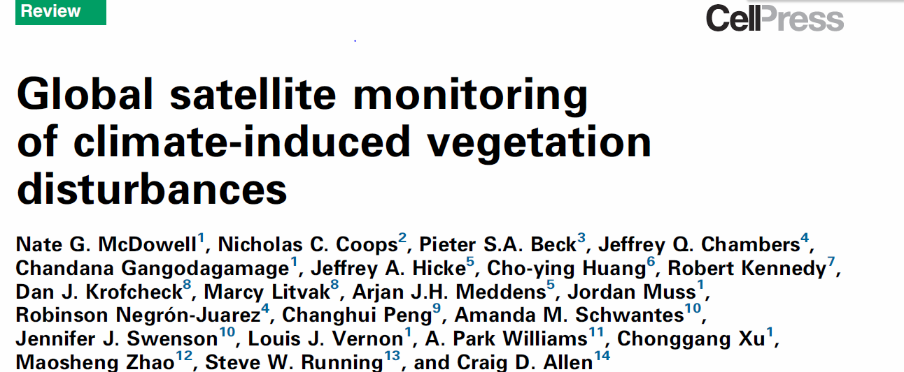

Slide 23
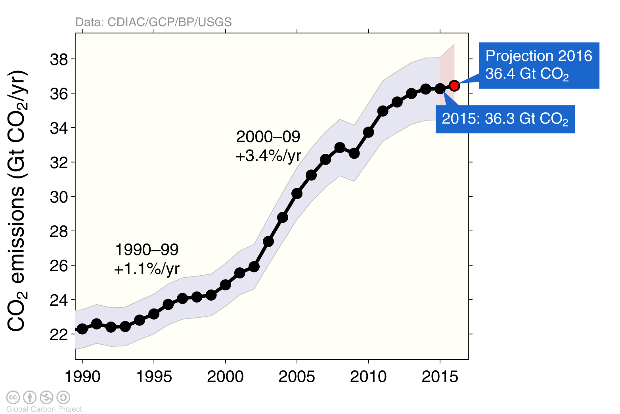
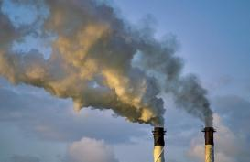
Emissions from fossil fuel use and industry
Global emissions from fossil fuel and industry: 36.3 ± 1.8 GtCO₂ in 2015, 63% over 1990
Projection for 2016: 36.4 ± 2.3 GtCO₂, 0.2% higher than 2015
Uncertainty is ±5% for one standard deviation (IPCC “likely” range)
Estimates for 2014 and 2015 are preliminary. Growth rate is adjusted for the leap year in 2016.
Source: CDIAC; Le Quéré et al 2016; Global Carbon Budget 2016

Slide 24

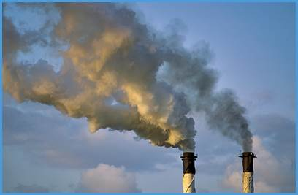
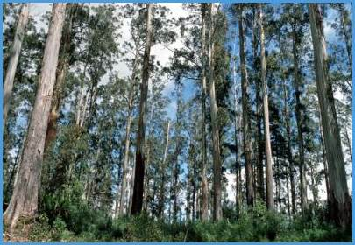
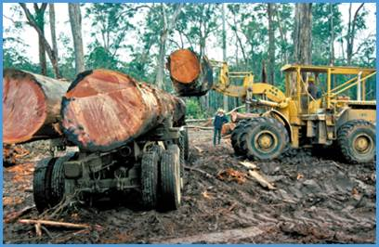

Fate of anthropogenic CO₂ emissions (2006-2015)
16.4 GtCO₂/yr
44%
34.1 GtCO₂/yr
91%
Sources = Sinks
31%
11.6 GtCO₂/yr
9%
3.5 GtCO₂/yr
26%
9.7 GtCO₂/yr
Source: CDIAC; NOAA-ESRL; Houghton et al 2012; Giglio et al 2013; Le Quéré et al 2016; Global Carbon Budget 2016

Slide 25
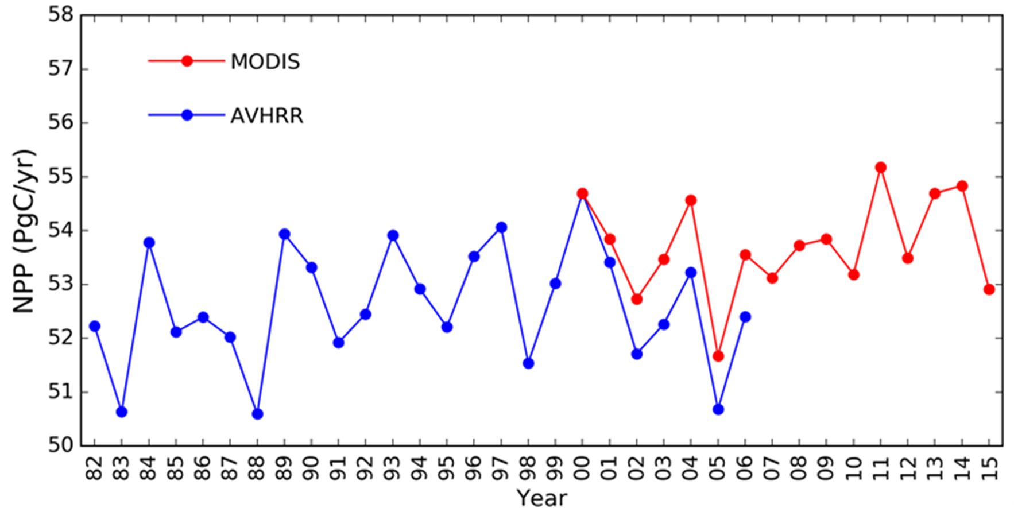
Global Terrestrial Net Primary Production (1982-2015)
+/- 1Pg or about 2%
Nemani et al 2003, Zhao and Running 2010

Slide 26
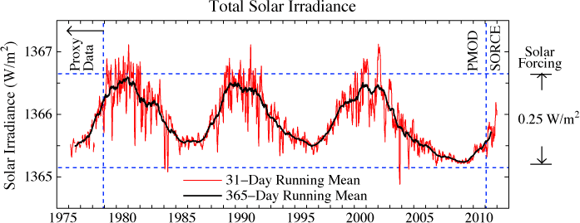
DRIVERS HAVE LITTLE INTERANNUAL VARIABILITY
Solar Energy Input = +/- 0.1%
Global average precip = 2.6 +/- .1mm/Day or 4%
EXCEPT CO2 UP….. 40%

Slide 27
1982- 2009

Slide 28
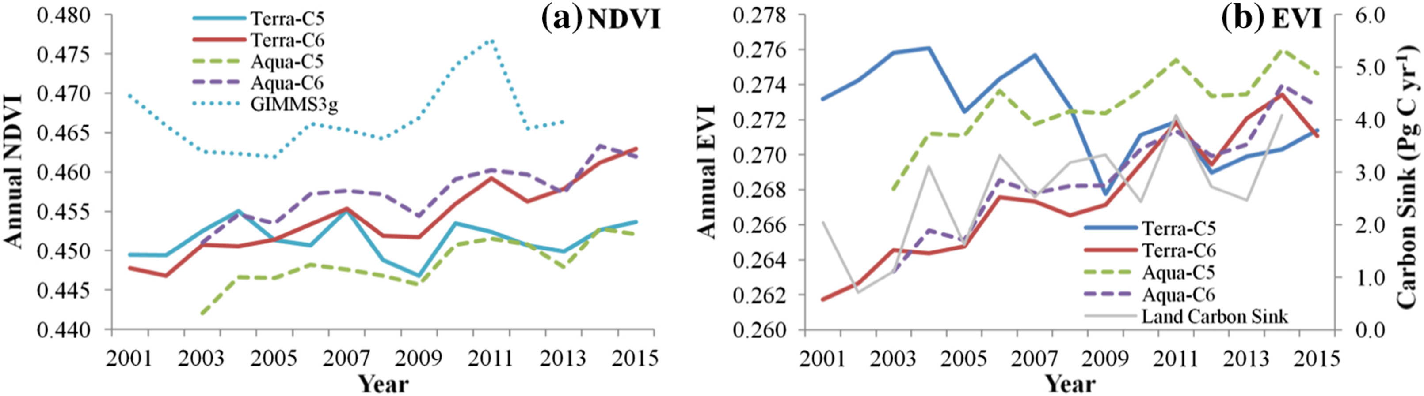
Fig. 2. Comparisons of annual changes of global average NDVI (a) and EVI (b) over vegetated area from 2001 to 2015 among MODIS products. Annual GIMMS3g NDVI and land carbon sink from global carbon budget were included in (a) and (b), respectively. (For interpr...
Yulong Zhang, Conghe Song, Lawrence E. Band, Ge Sun, Junxiang Li
Reanalysis of global terrestrial vegetation trends from MODIS products: Browning or greening?
Remote Sensing of Environment, Volume 191, 2017, 145–155
http://dx.doi.org/10.1016/j.rse.2016.12.018

Slide 29
Notes:
MODIS trend smaller than models

Slide 30
NEE and NPP not the same!!
Notes:
Note Northern hemisphere, not global

Slide 31
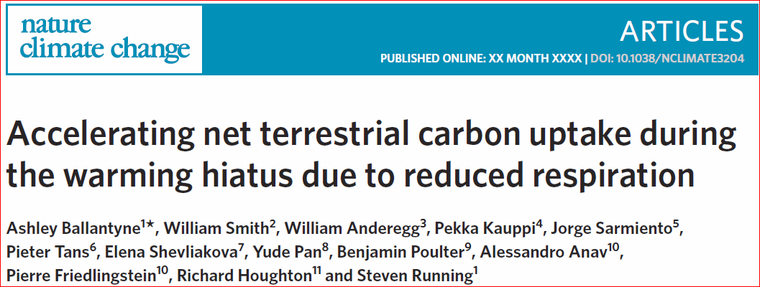
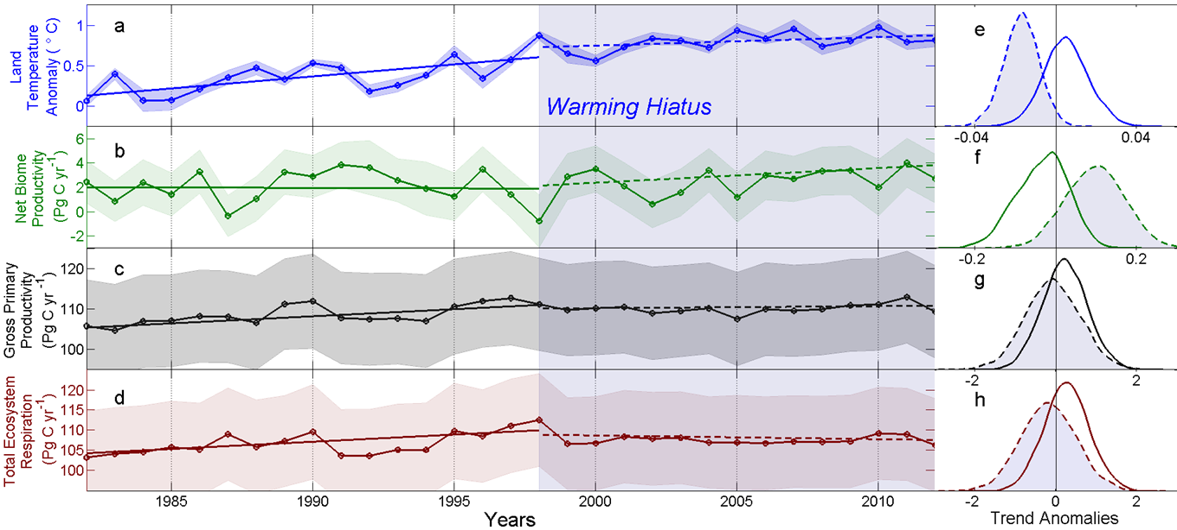

Slide 32
Smith et al 2016 Nature Climate Change, (6) p306-311
CMIP5 projections of NPP are too strong

Slide 33
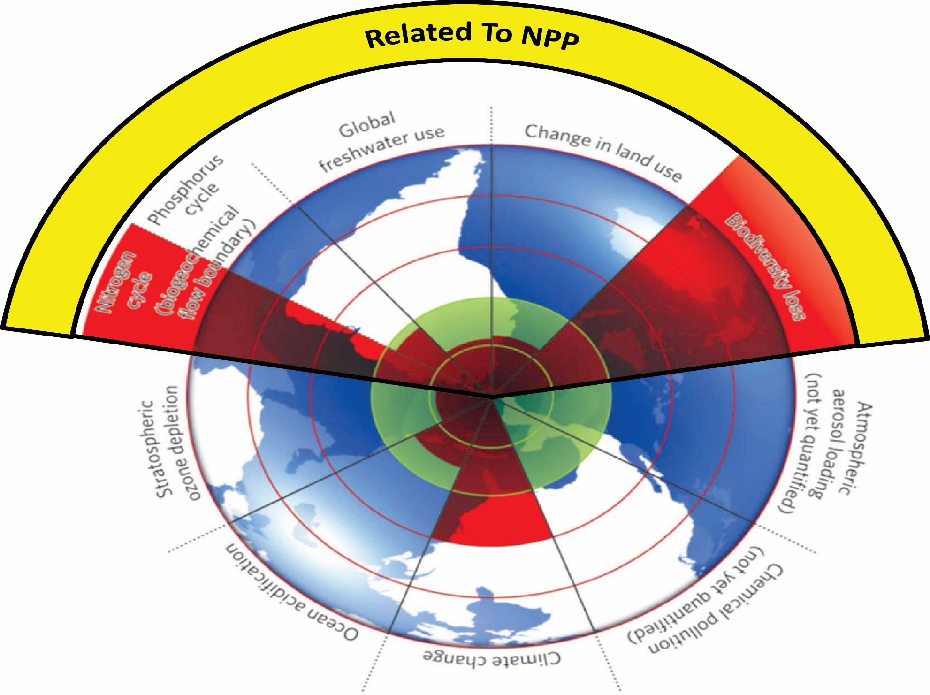
Planetary Boundaries, Rockstrom et al 2009, NATURE,
Steffen et al 2015 SCIENCE

Slide 34
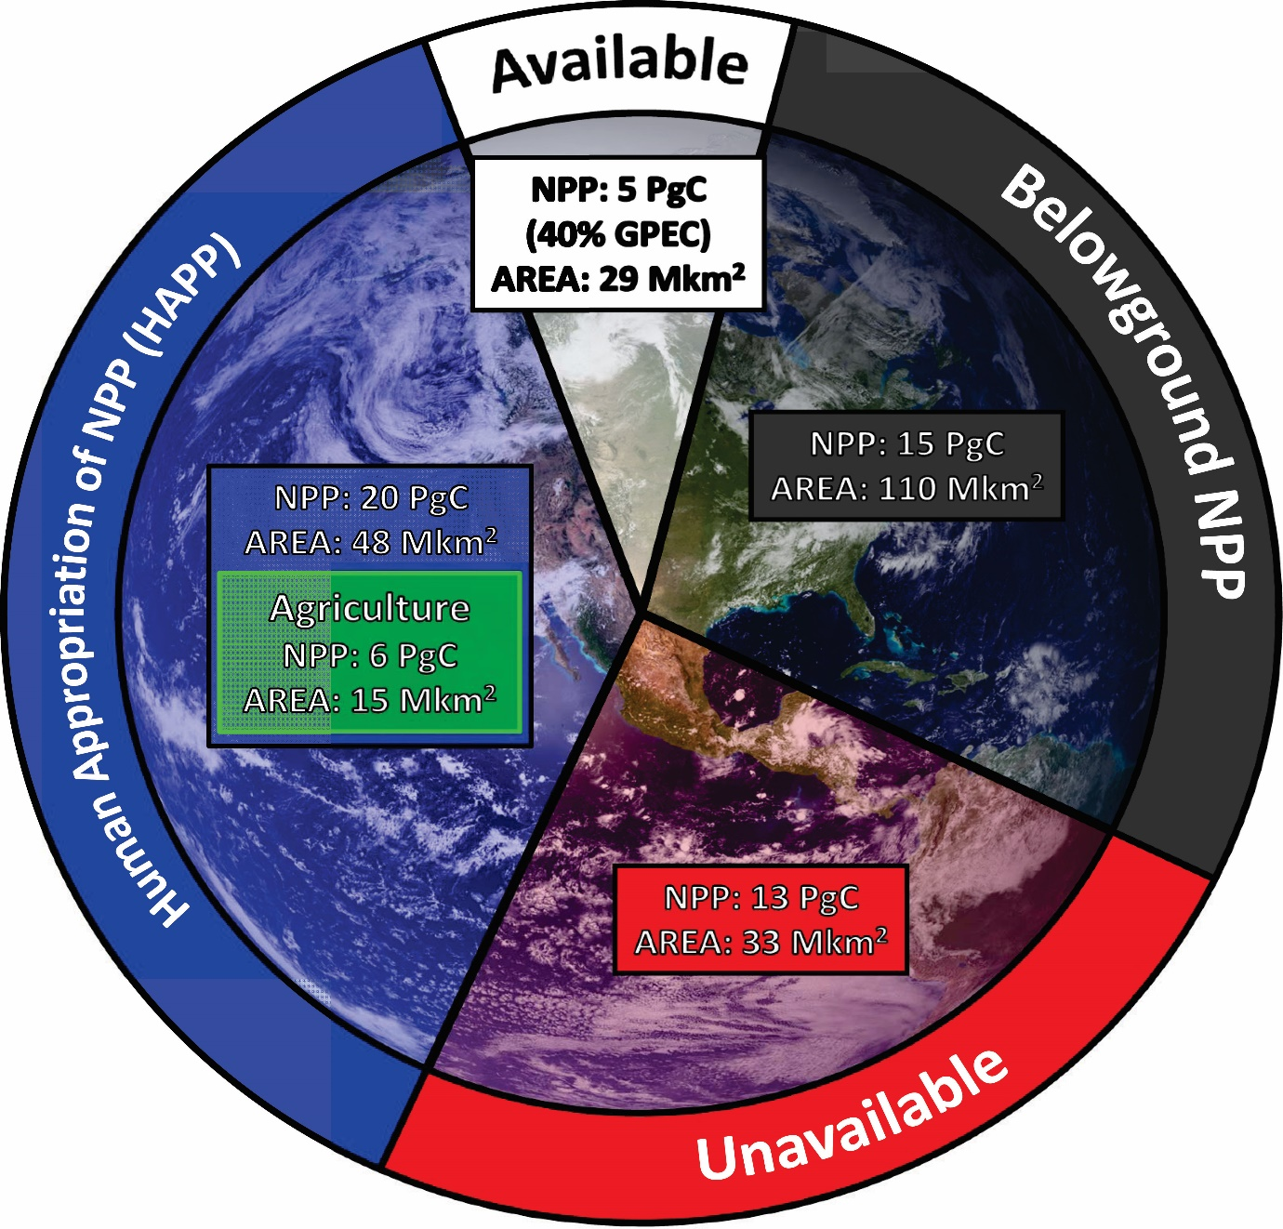
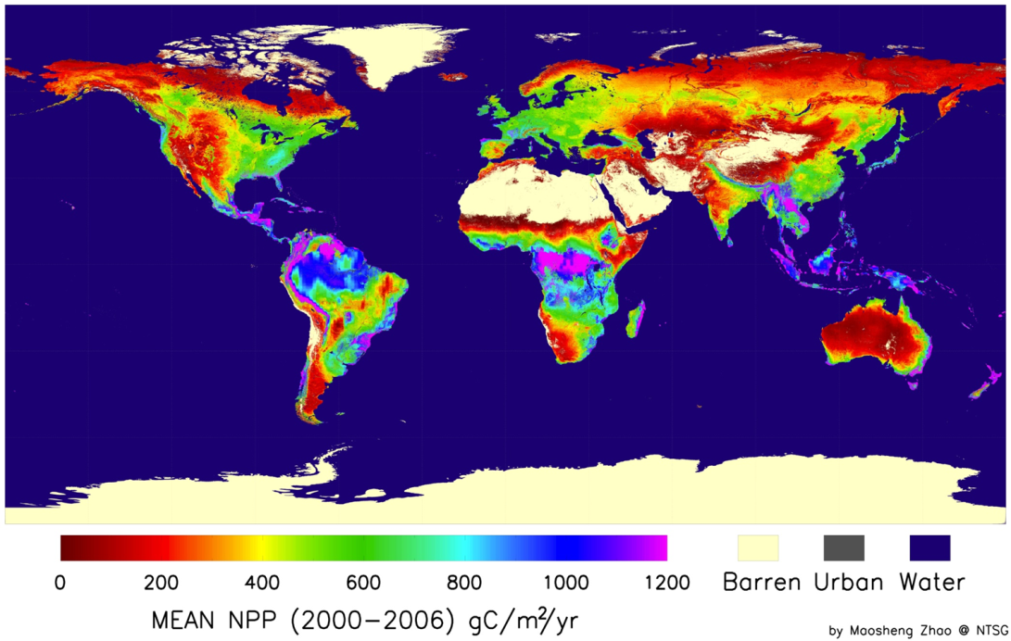
From Running, SW. Science 337 p1458-1459, 2012
Zhao and Running.
Science 329: 940-043 (2009)

Slide 35
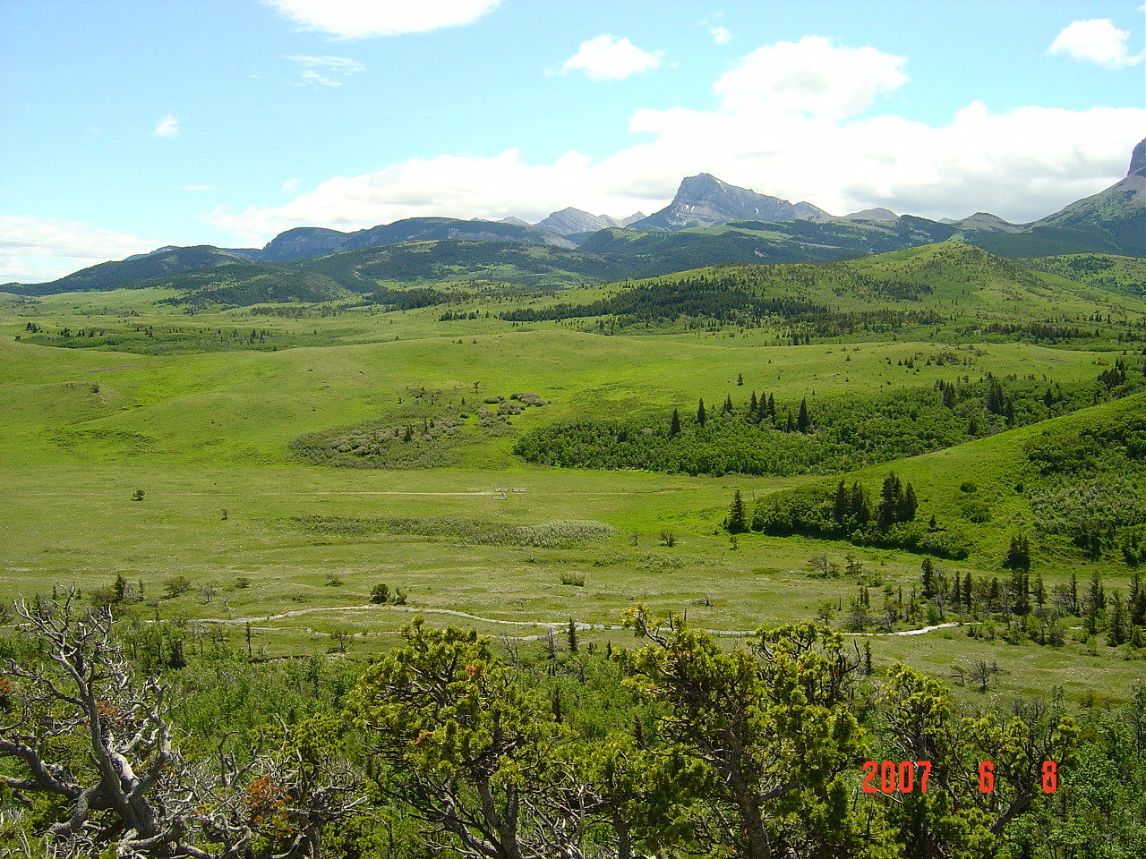
RELEVANCE OF NPP AS A BOUNDARY
Climate stabilization
Bioenergy policy
Food security policy
Terrestrial Carbon Source/Sink

Slide 36
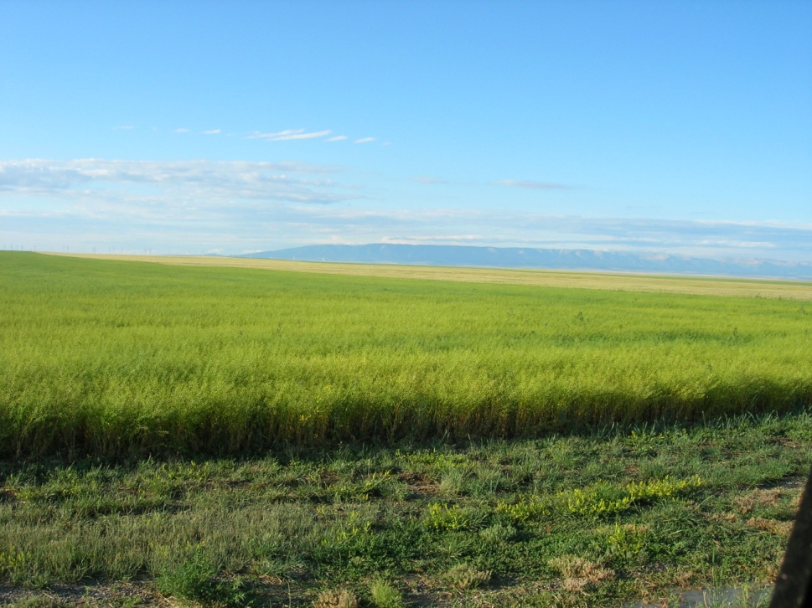
IS OUR CURRENT CONSUMPTION OF Biospheric NPP Sustainable*?
*Meeting needs and values of today’s generation, while preserving the planet’s life-support systems for the needs and values of future generations.

Slide 37
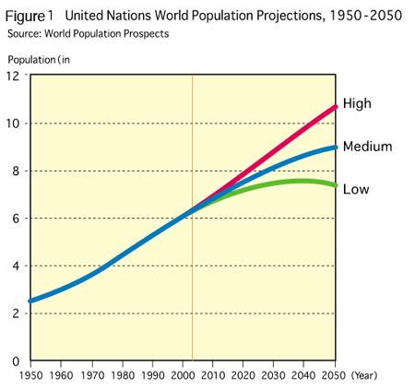
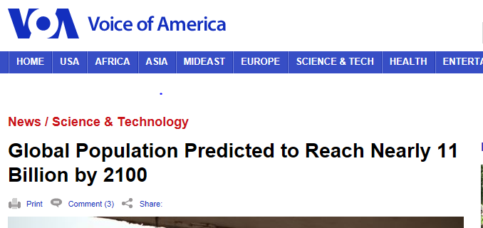

Slide 38
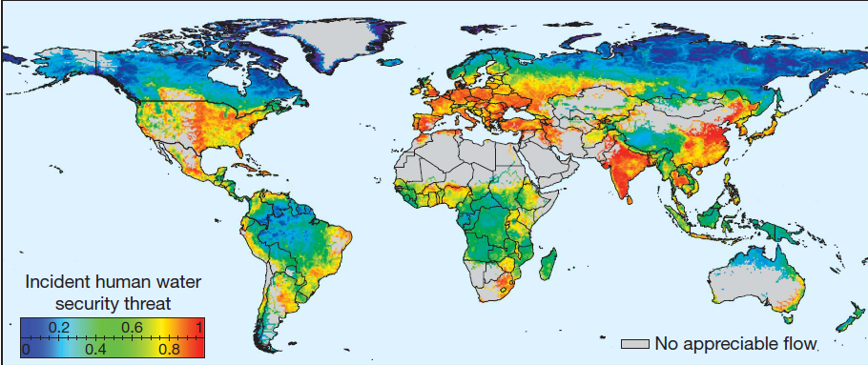
Global Water Supply Threat
Vorosmarty et al Nature 2010
The global percentage of dry areas has increased by about 1.74% (of global land area) per decade (11%) from 1950 to 2008. Aiguo Dai. J.Geophysical Res 2011

Slide 39

Nitrogen Loading is already damaging the biosphere
N Deposition rates ( 0 – 60kg/ha/yr )
Galloway et al. Science 2008

Slide 40

Per Capita Agricultural Production trends.
Global 14% Per capita reduction projected by 2030
Funk and Brown. Food Security (2009)

Slide 41
CROP YIELDS WILL NOT KEEP UP WITH POPULATION GROWTH to 2050
D.K. Ray et al PlosOne 2013

Slide 42

HUMAN APPROPRIATION OF NET PRIMARY PRODUCTION
NASA Visible Earth, Imhoff et al 2004

Slide 44


Food vs Fuel, a choice?
VERSUS

Slide 45

Future Bioenergy Potential
(estimated by economists)
Bioenergy Potential:
~ 425 EJ yr⁻¹
(Gritsevskyi & Schrattenholzer, 2003)
Notes:
Gritsevskyi, A., Schrattenholzer, L., 2003: Costs of reducing carbon emissions: An integrated modeling framework approach. Climatic Change 56(1): 167-184.
Link to the article:
http://www.springerlink.com/content/q0121u571t0w0t87/fulltext.pdf

Slide 46


Slide 47

The Anthropocene Era

Slide 48


THE GREAT ACCELERATION
From: Steffen et al. 2004
From Steffan et al 2004

Slide 49


Slide 50


Slide 51


Gross Domestic Product (GDP) measures everything….. “Except that which makes life worthwhile. “
Robert F. Kennedy, 1968
Constanza et al., Nature January 2014

Slide 52

Observed emissions and emissions scenarios
The emission pledges to the Paris Agreement avoid the worst effects of climate change (4-5°C) give a likely temperature increase of about 3°C in 2100
The IPCC Fifth Assessment Report assessed about 1200 scenarios with detailed climate modelling on four Representative Concentration Pathways (RCPs)
Source: Fuss et al 2014; CDIAC; IIASA AR5 Scenario Database; Global Carbon Budget 2016

Slide 53

EARTH FROM 1 BILLION KM AWAY
WE BETTER NOT SCREW THIS PLANET UP
And we cant all abandon ship to MARS either!!
Earth

