Slide 1
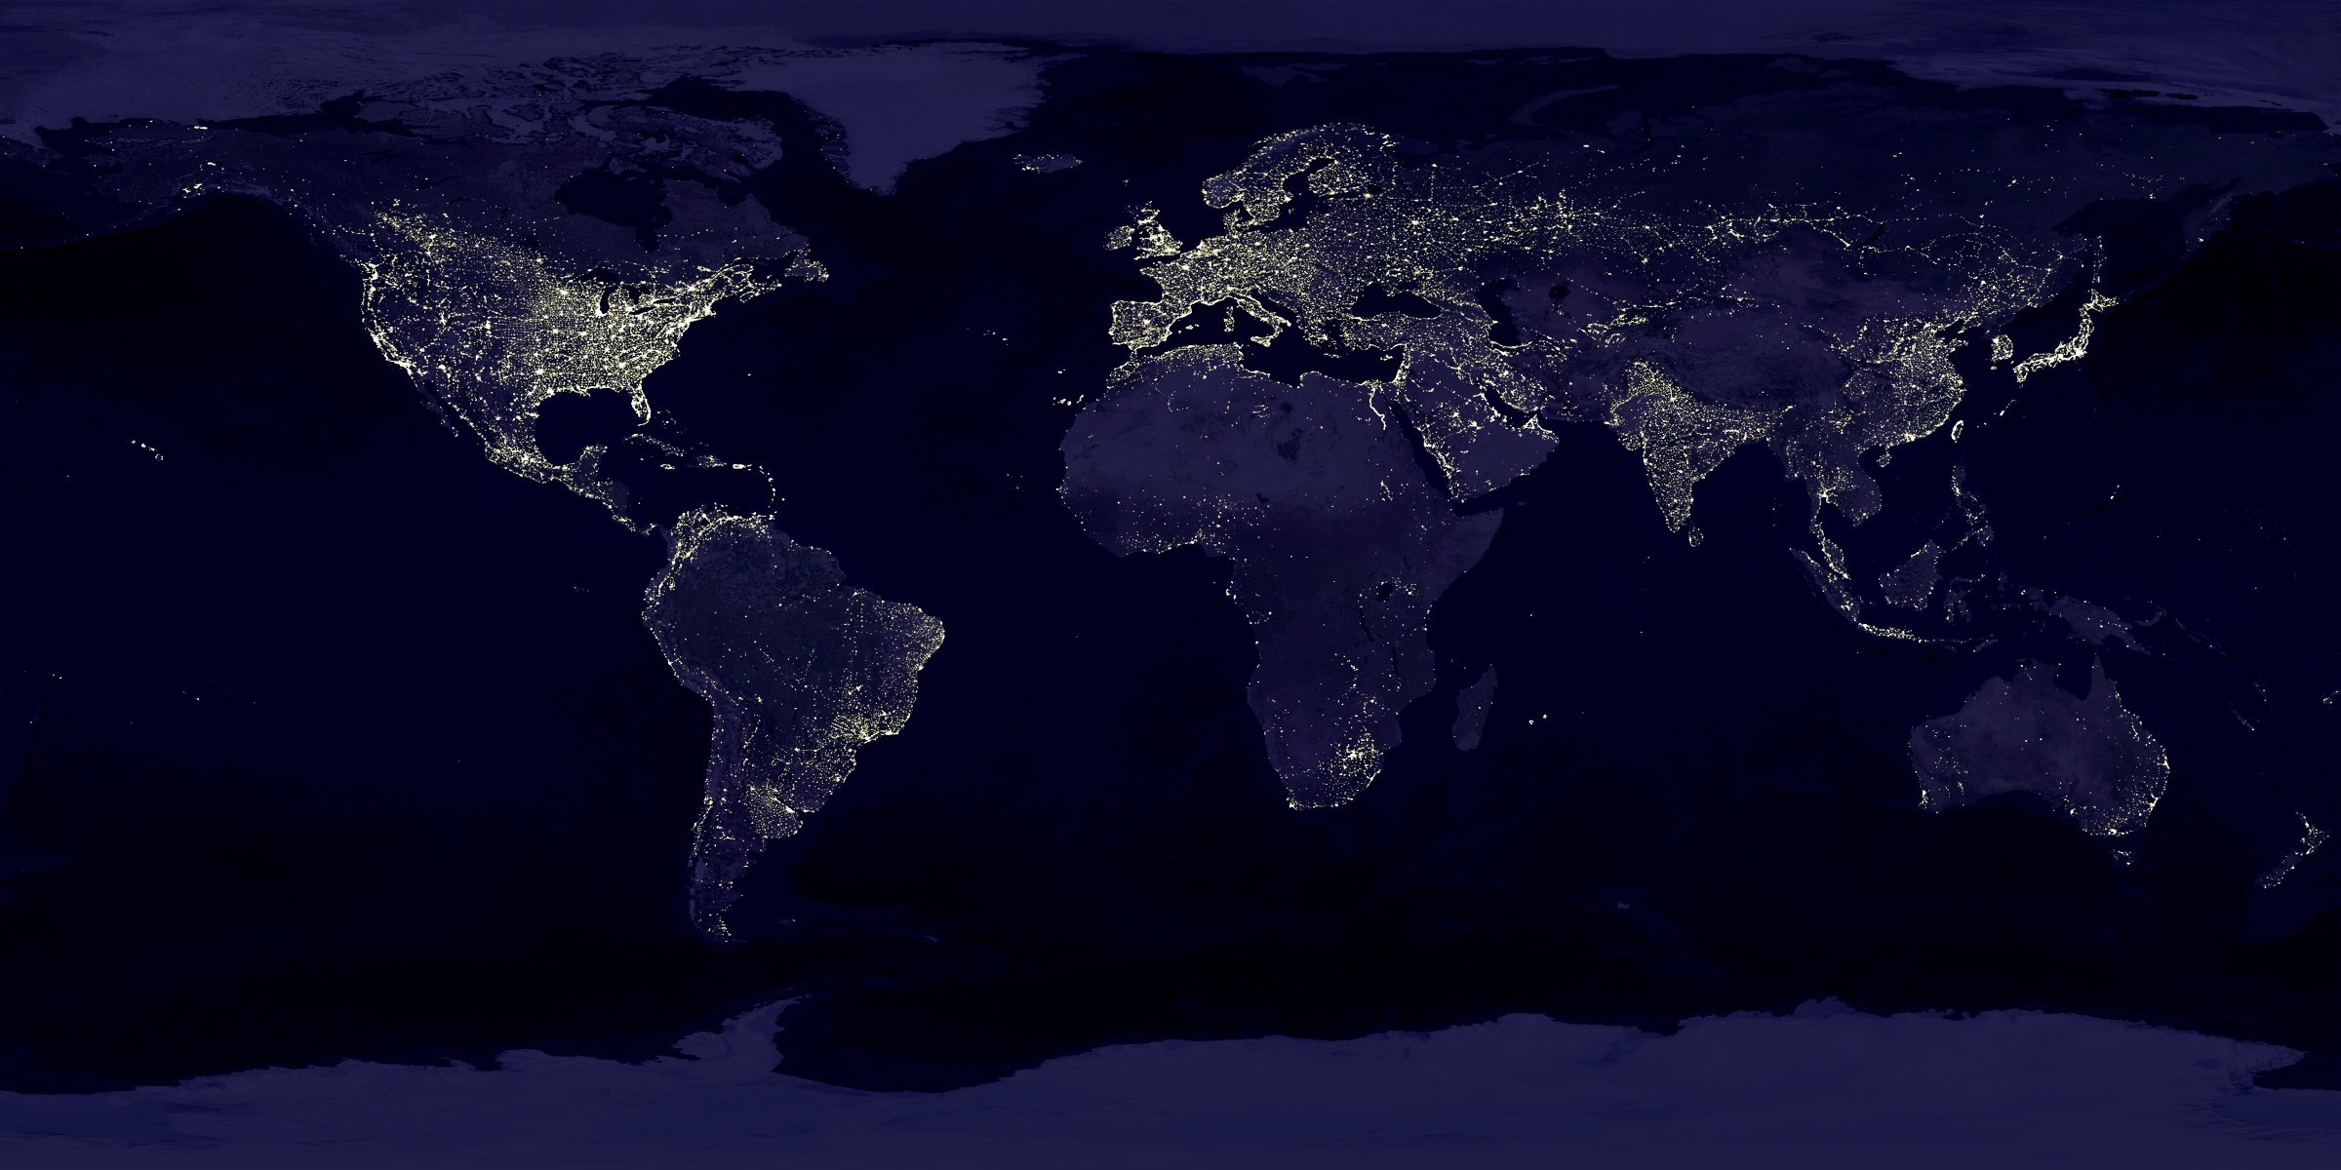
Global Change: Its about more than just climate
(Global limits to biological productivity and planetary resource boundaries)
22nd Annual Gregory Lecture
University of Southampton
February 12, 2014
Steven W. Running
NTSG, University of Montana

Slide 2
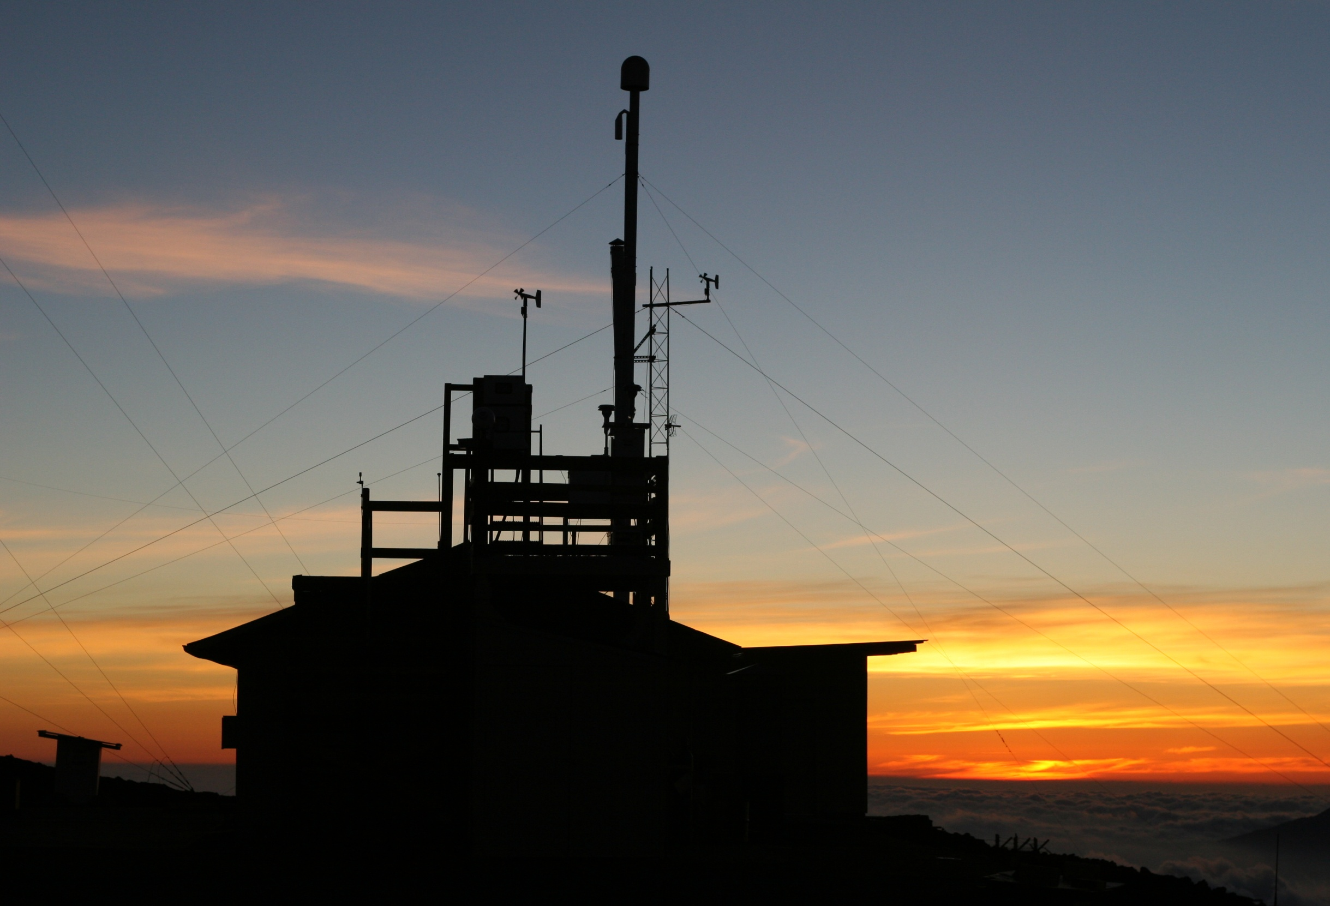

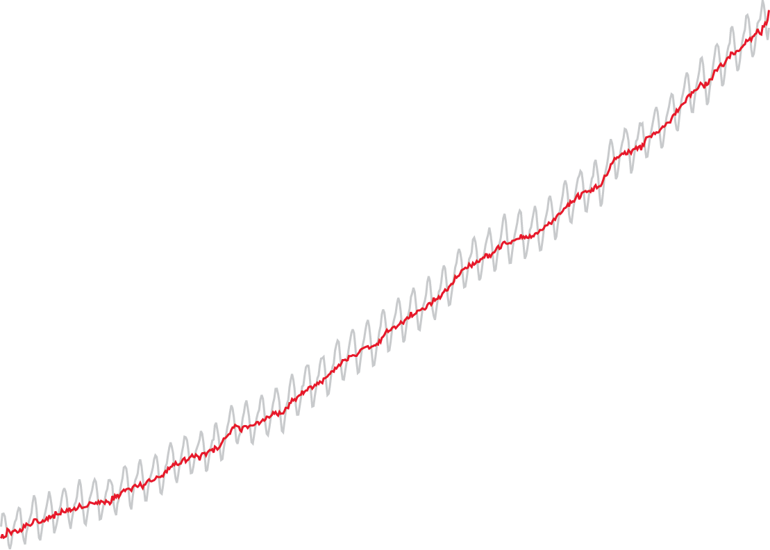
Carbon dioxide has risen by 36% since accurate measurements began in 1958
388 ppm (2008)
318 ppm (1958)
Mauna Loa Observatory on Hawai’i
Notes:
The photo in the background shows the Mauna Loa Observatory at dusk (courtesy Forrest Mims). This is where, in 1958, Charles David Keeling began his now-famous atmospheric carbon dioxide data set – sometimes called “the Keeling Curve.” The data trend shows carbon dioxide has risen from about 318 parts per million in 1958 to about 388 ppm in 2008. The gray “saw-toothed” line shows actual measurements and the red line shows the running mean value.
(Data courtesy NOAA Earth System Research Laboratory)

Slide 3
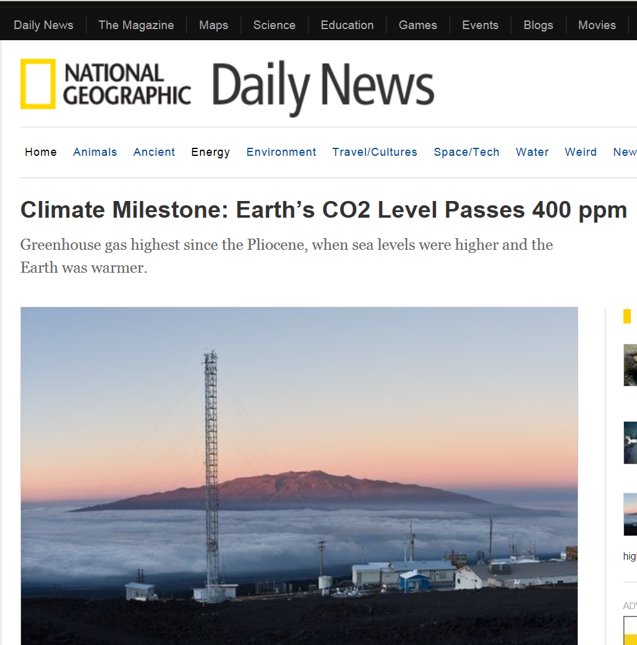

Slide 4
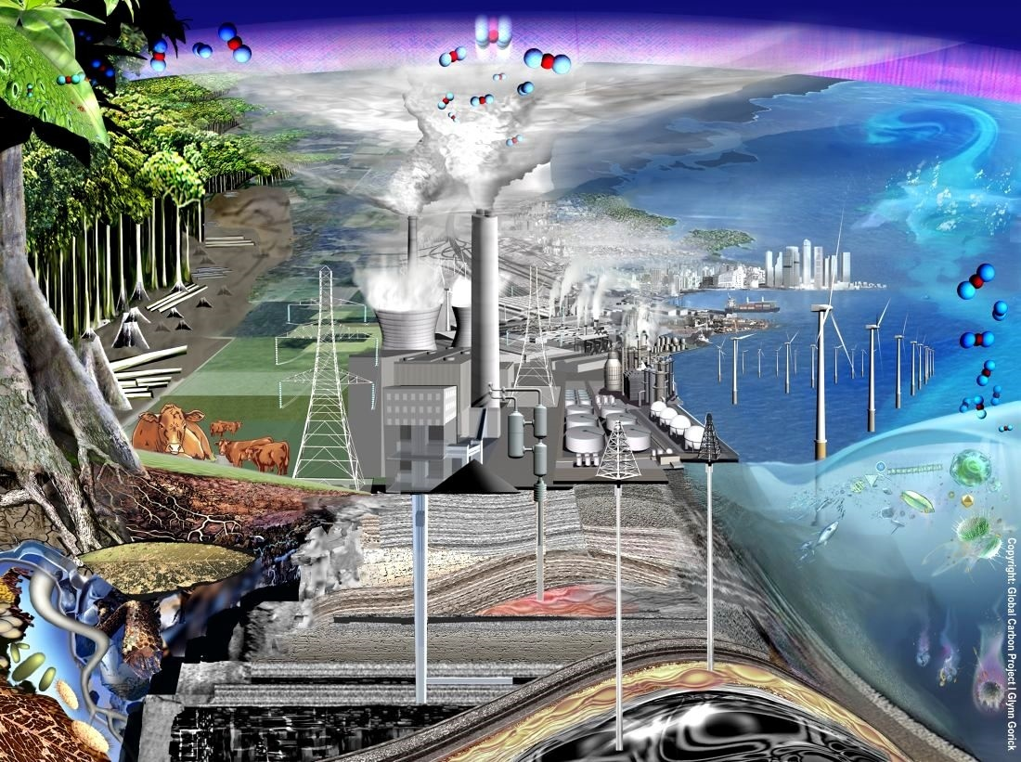
“The rise in CO₂ is proceeding so slowly that most of us today will, very likely, live out our lives without perceiving that a problem may exist”
Keeling CD, Harris TB, Wilkins EM, 1968. Concentration of atmospheric carbon dioxide at 500 and 700 millibars. J. Geophys. Res. 73:4511-28

Slide 6

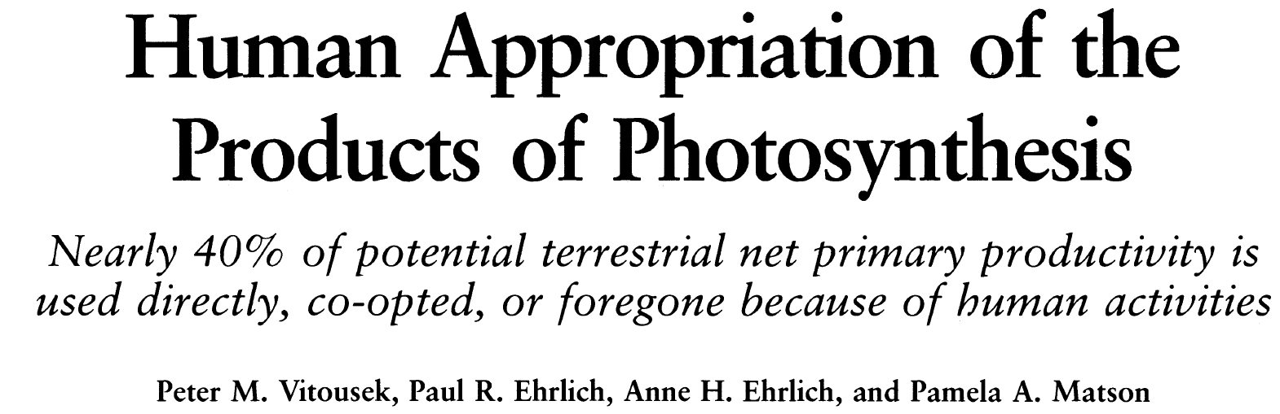

1972

Slide 7
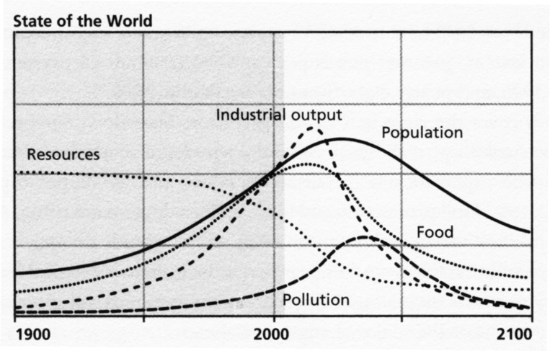
“Limits to Growth” Scenario in 1972 for 2012
From G. Turner, Global Env Change 18:397-411. 2008

Slide 8
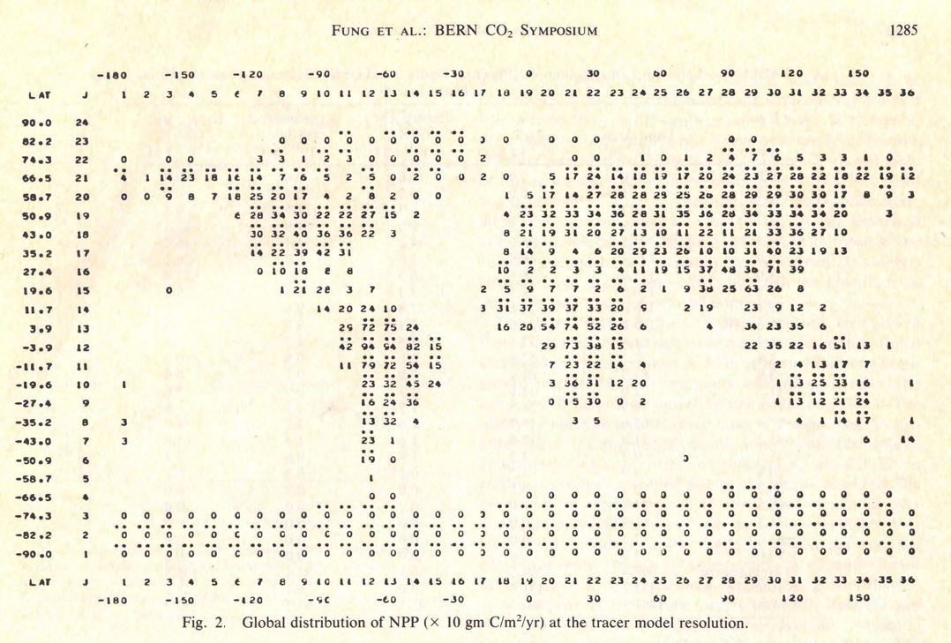
Global NPP 1983 version

Slide 9
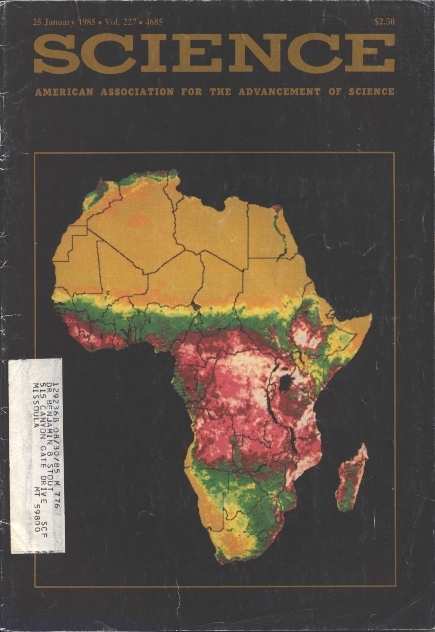
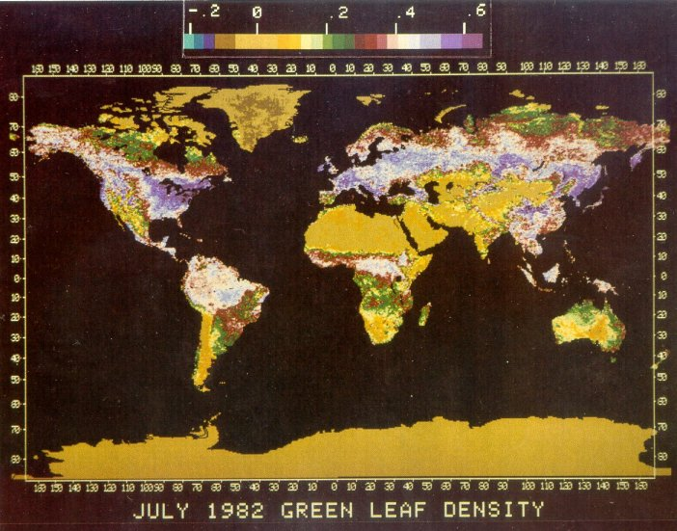
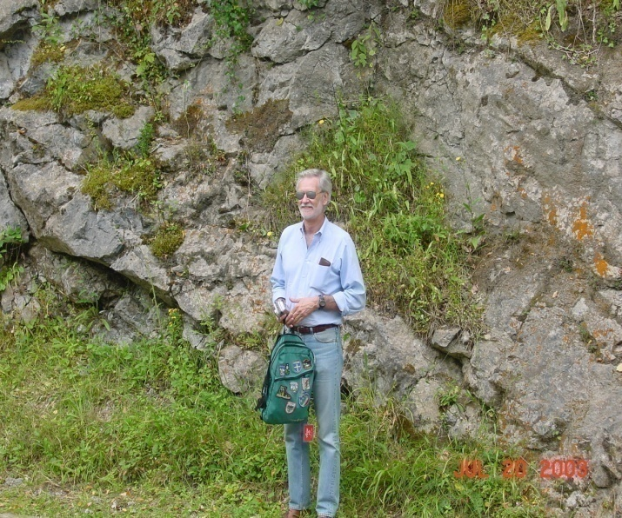

Slide 10
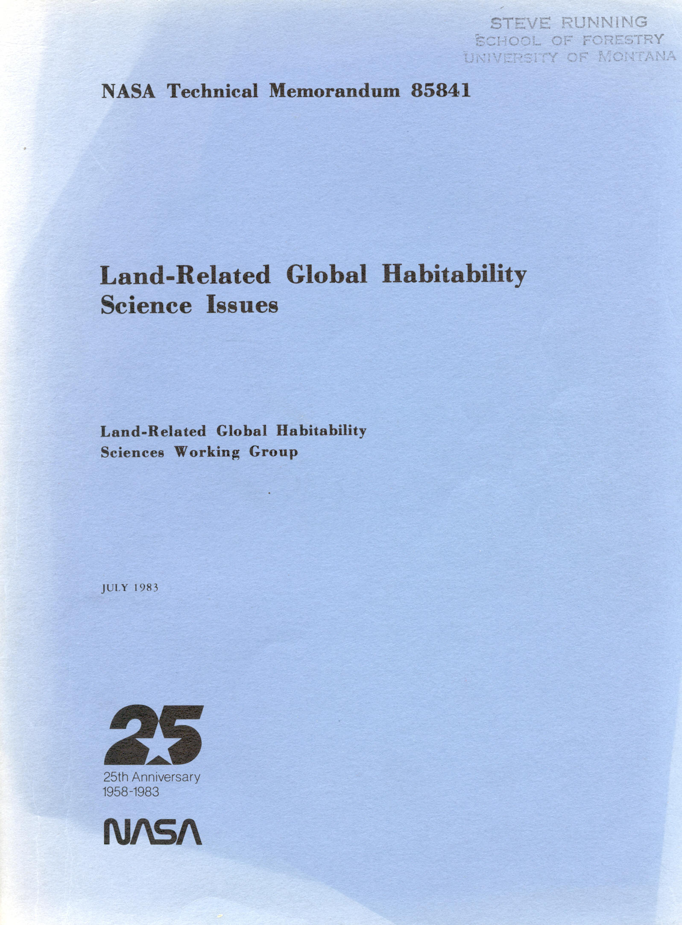

Slide 11
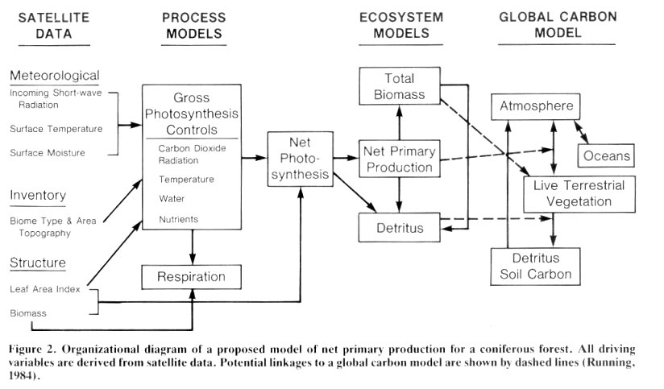
Driving ecosystem models with satellite data, concept for NASA Global Habitability, 1983

Slide 12
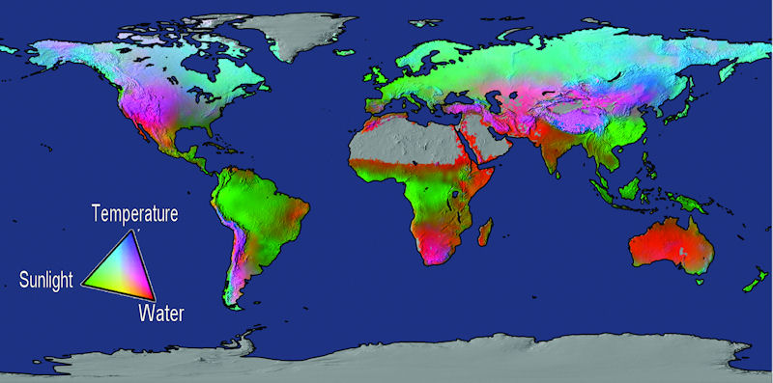
Water = 40%, Temperature = 33%, Radiation = 27%
Potential limits to vegetation net primary production based on fundamental physiological limits by solar radiation, water balance, and temperature (from Churkina & Running, 1998; Nemani et al., 2003; Running et al., 2004).

Slide 13
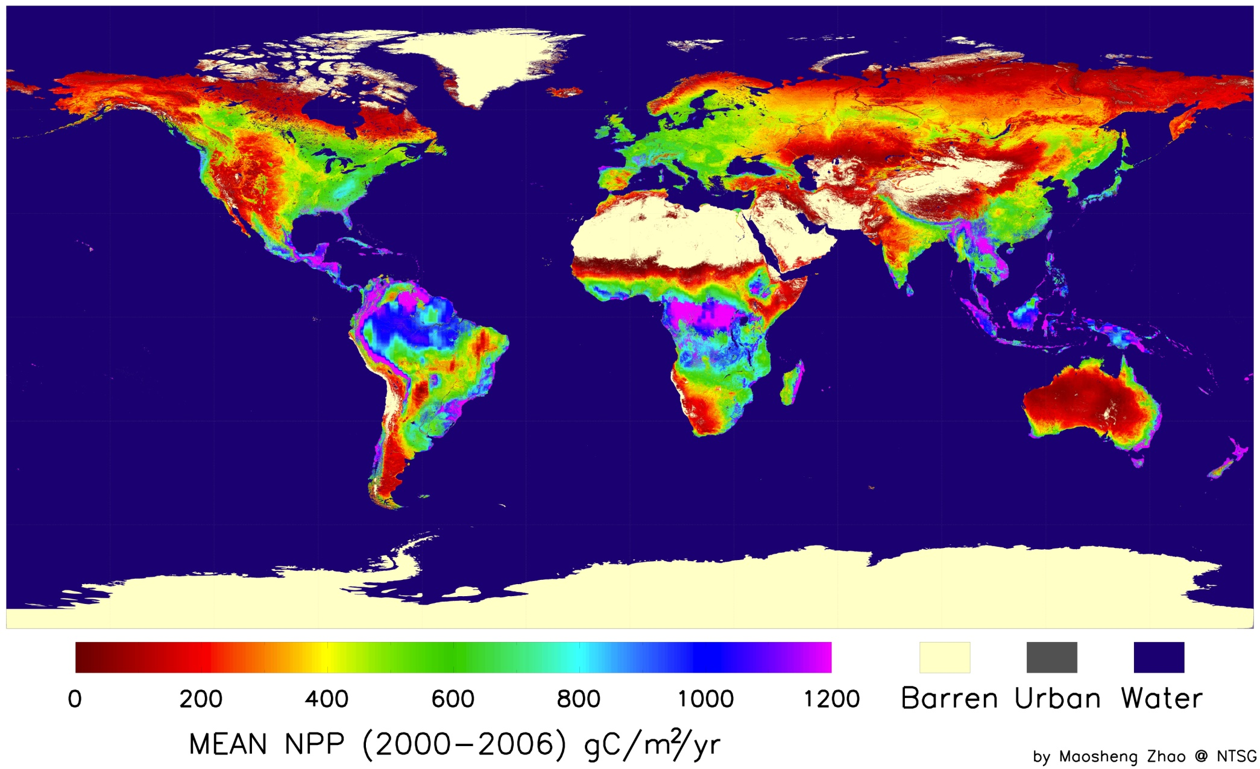
Terrestrial NPP = Planetary Boundary??
Zhao and Running. Science 329: 940-043 (2009)

Slide 14
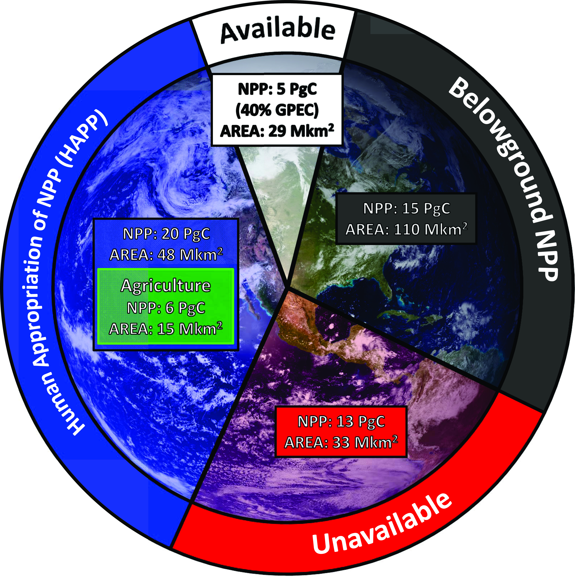
From Running, SW. Science 337 p1458-1459, 2012

Slide 15
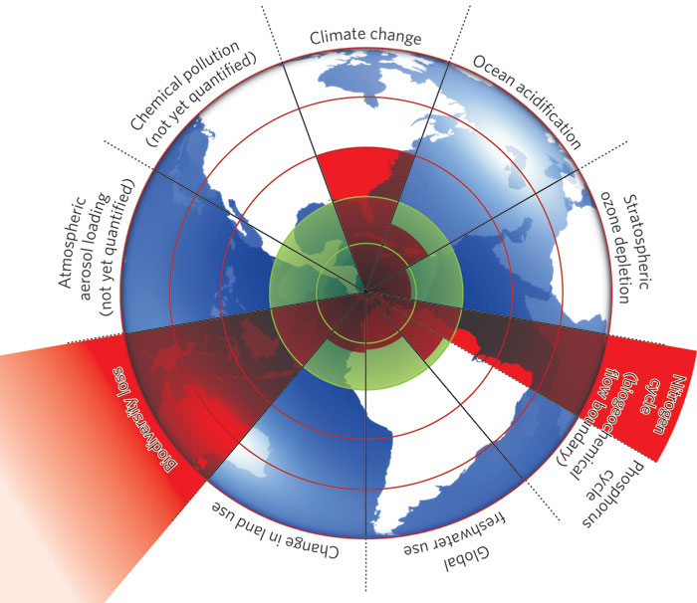
PLANETARY BOUNDARIES
Rockstrom et al. Nature 2009

Slide 16
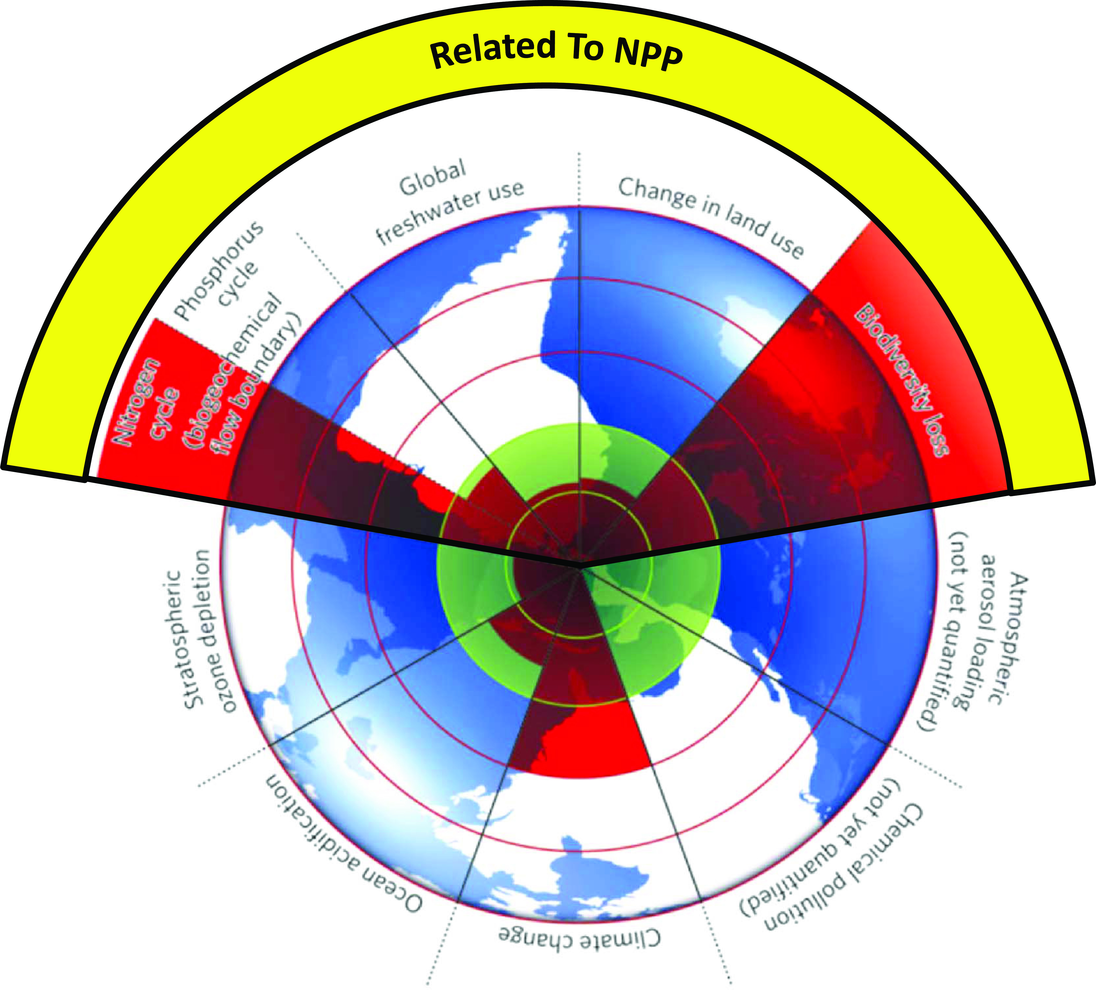

Slide 17
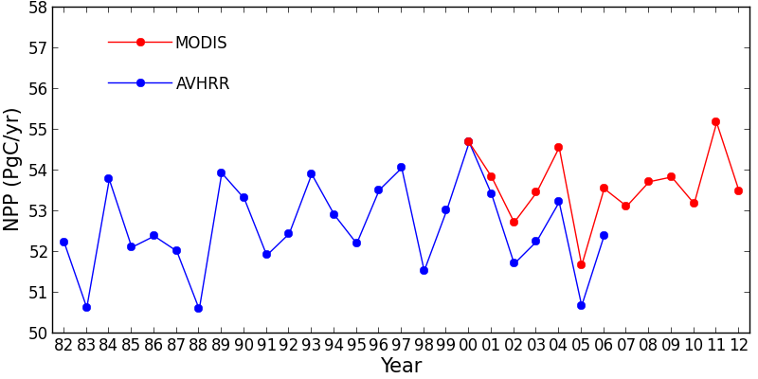
Global Terrestrial Net Primary Production (1982-2012)
+/- 1Pg or about 2%
Nemani et al 2003, Zhao and Running 2010

Slide 18
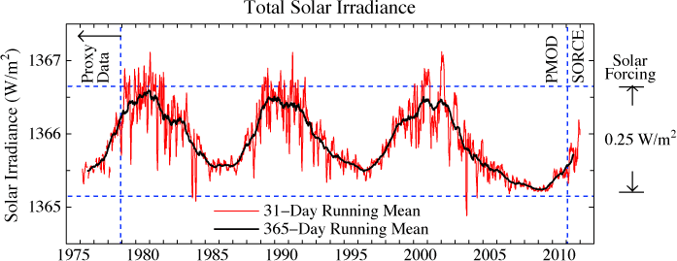
DRIVERS HAVE LITTLE INTERANNUAL VARIABILITY
Solar Energy Input = +/- 0.1%
Global average precip = 2.6 +/- .1mm/Day or 4%

Slide 19
CMIP5 Projections of Global NPP with RCP = 8.5, Really???

Slide 20
Global NPP has been reduced by 7% from agricultural conversion
Smith W.K. et al 2014 Geophys Res Letters.

Slide 21
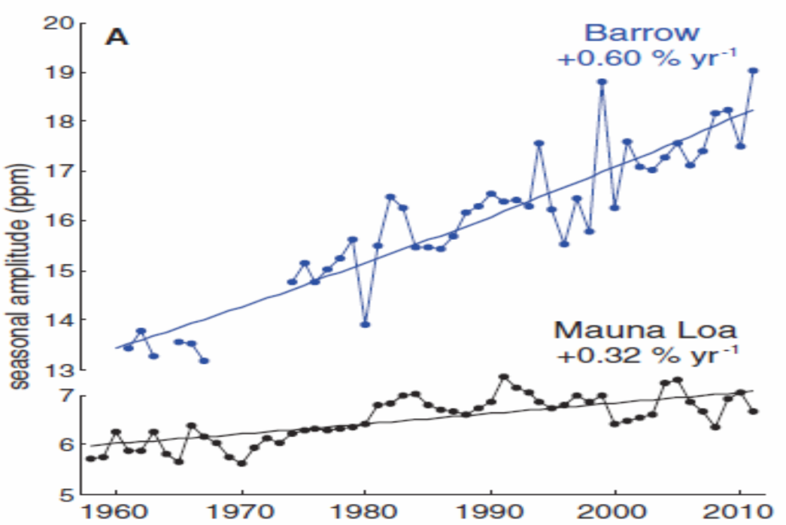
CO2 Fertilization
5 Flux towers
BUT,
Contradictory
Evidence???
CO2 Amplitude Increase
Keenan et al. Nature 2013
Graven et al Science 2013

Slide 23

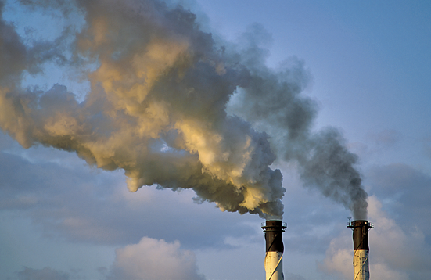
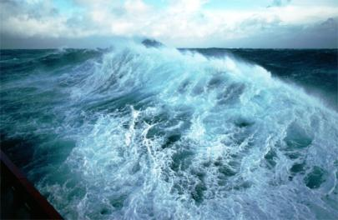
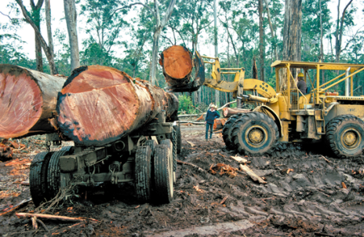
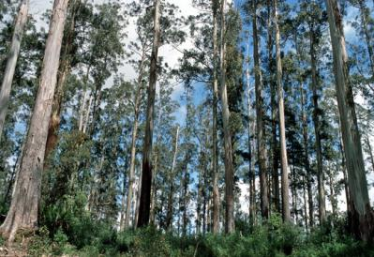
Fate of Anthropogenic CO₂ Emissions (2003-2012 average)
8.6 ± 0.4 GtC/yr 92%
4.3±0.1 GtC/yr
45%
+
2.6 ± 0.5 GtC/yr
27%
0.8 ± 0.5 GtC/yr 8%
2.6 ± 0.8 GtC/yr
27%
Calculated as the residual
of all other flux components
Source: Le Quéré et al 2013; CDIAC Data; Global Carbon Project 2013

Slide 24
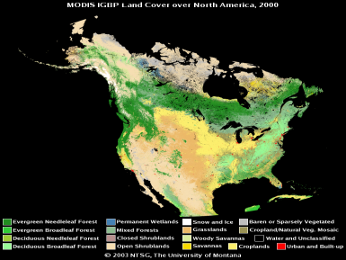
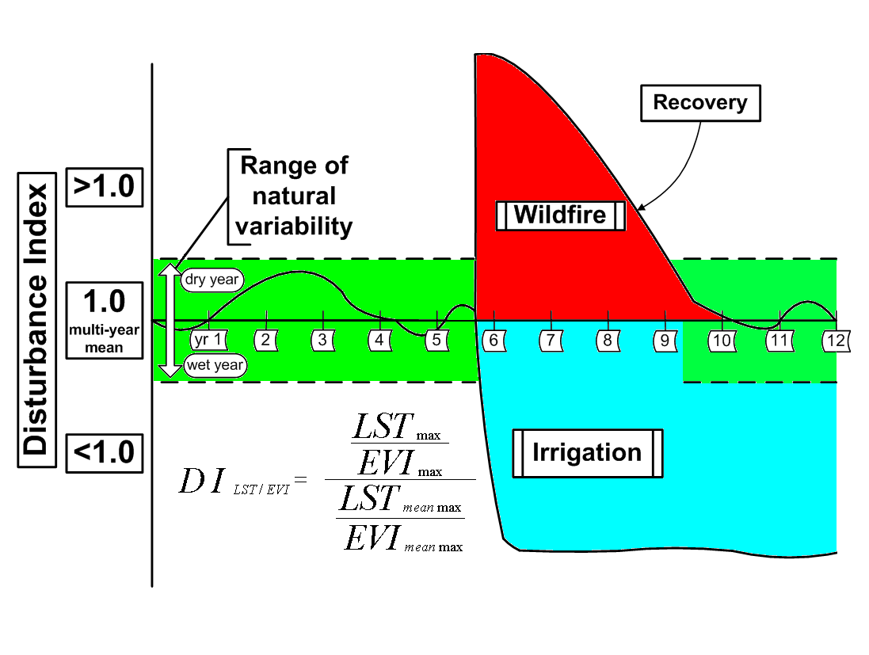
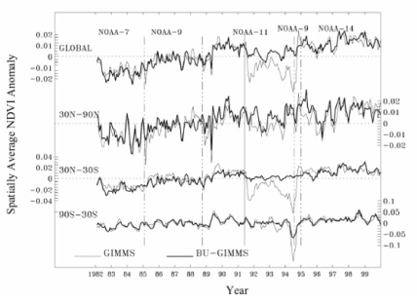
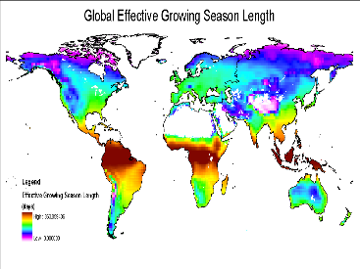
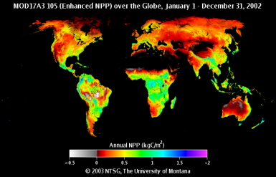
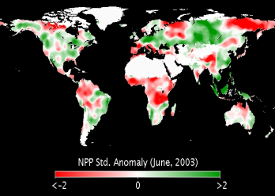
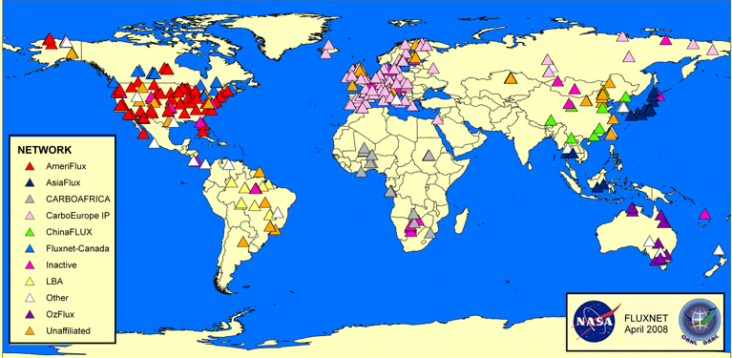
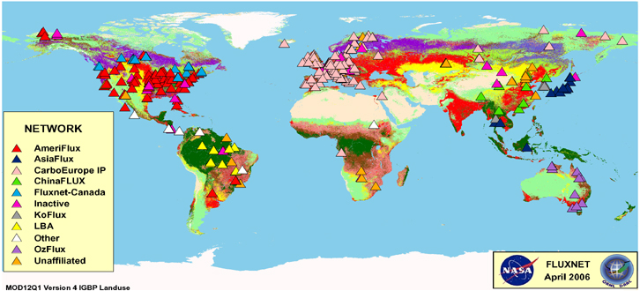
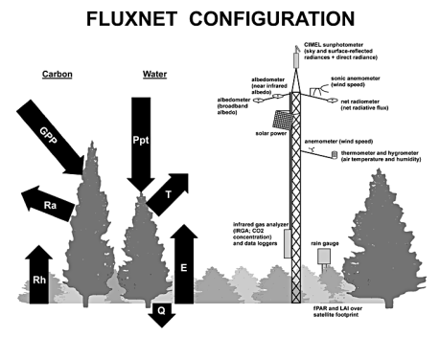
Terrestrial Carbon Monitor
State
Change
LANDCOVER
SATELLITE DATA
GROWING SEASON
PRIMARY PRODUCTION
GROUND DATA

Slide 25
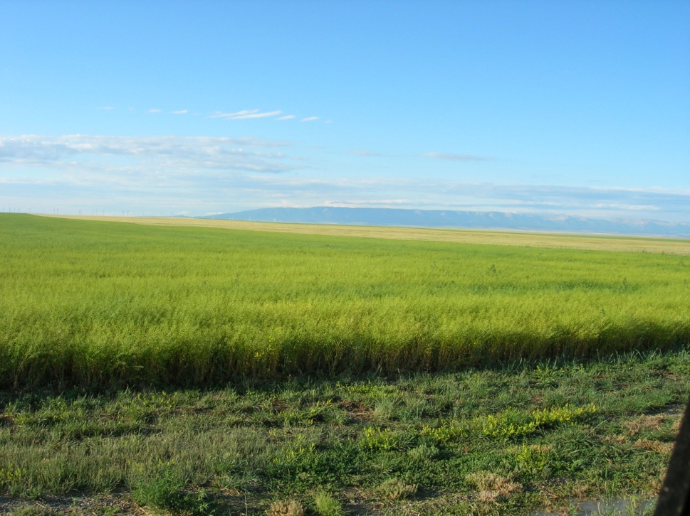
IS OUR CURRENT CONSUMPTION OF Biospheric NPP Sustainable*?
*Meeting needs and values of today’s generation, while preserving the planet’s life-support systems for the needs and values of future generations.

Slide 26
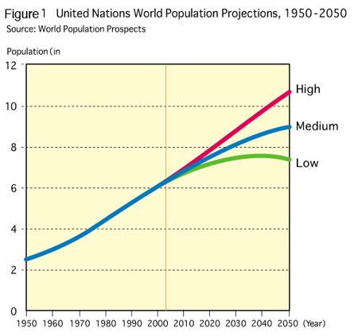

Slide 27
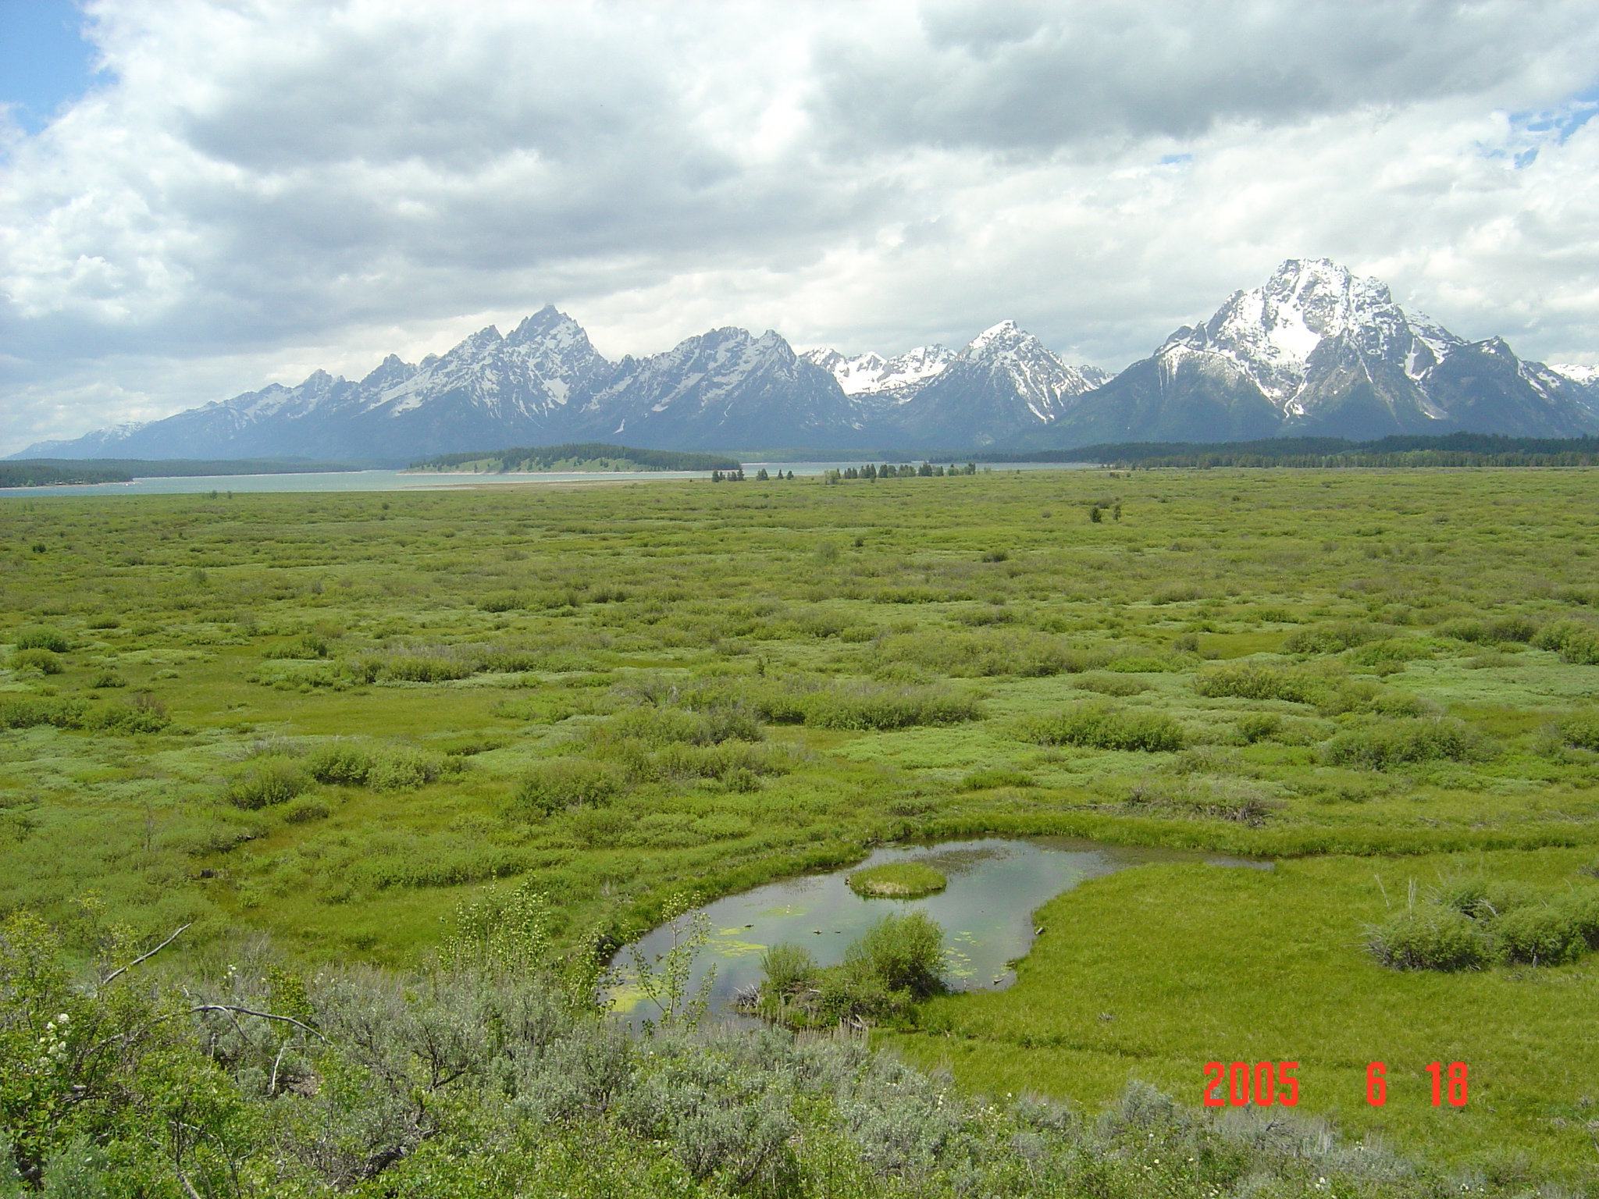
How will Biospheric Production meet a population increase of 40% and multiple new demands from
2011 - 2050?
Agricultural Production is normally increased by:
- Engaging more land
- Irrigation/fertilization
- Genetic improvements

Slide 28
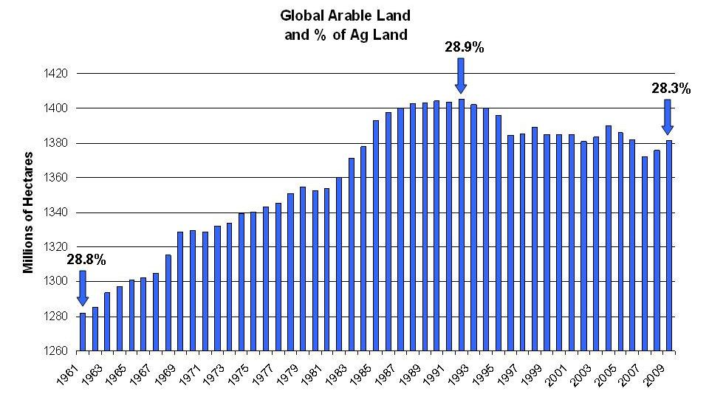
Land area is NOT increasing
UNEP Data

Slide 29
Food security: yield growth rate declining
World
FAO wheat yield data: Analysis
From Mark Howden, CSIRO (2009)

Slide 30
Yield Gap Fraction (Wheat)
Irrigation and Fertilizer use can be more efficient
Licker et al. (2010) Global Ecol. Biogeog. 19:769-782

Slide 31
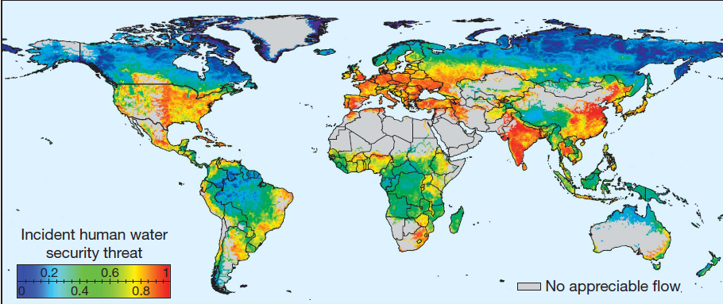
Global Water Supply Threat
Vorosmarty et al Nature 2010
The global percentage of dry areas has increased by about 1.74% (of global land area) per decade (11%) from 1950 to 2008. Aiguo Dai. J.Geophysical Res 2011

Slide 32
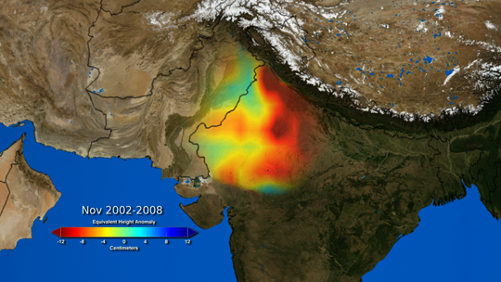
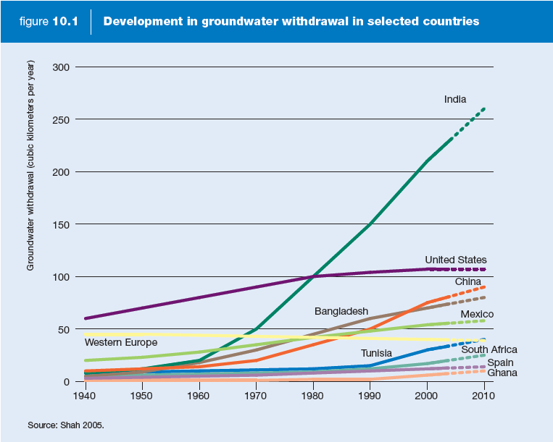
Unsustainable groundwater withdrawal
Depletion rate 4cm/yr
Groundwater withdrawals as % of recharge, 2002-2008.
Rodell et al Nature 2009
Notes:
The MA projected potential future water problems. Now the GRACE satellite confirms them

Slide 33
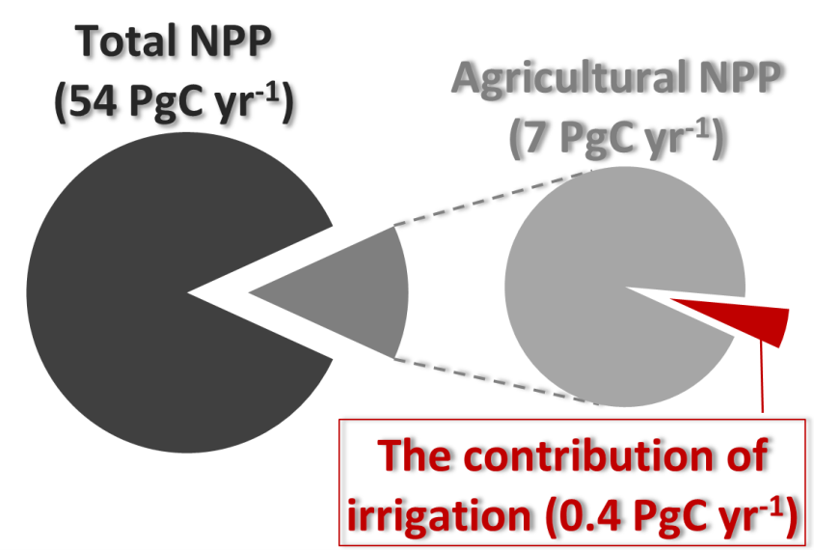
The contribution of irrigation to NPP
Ozdogan, GBC (2011)
The total contribution of irrigation was estimated to be
~6% of total agricultural productivity.

Slide 34
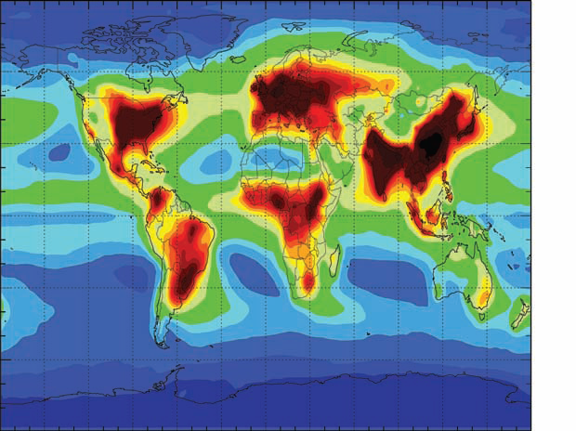
Nitrogen Loading is already damaging the biosphere
N Deposition rates ( 0 – 60kg/ha/yr )
Galloway et al. Science 2008

Slide 35
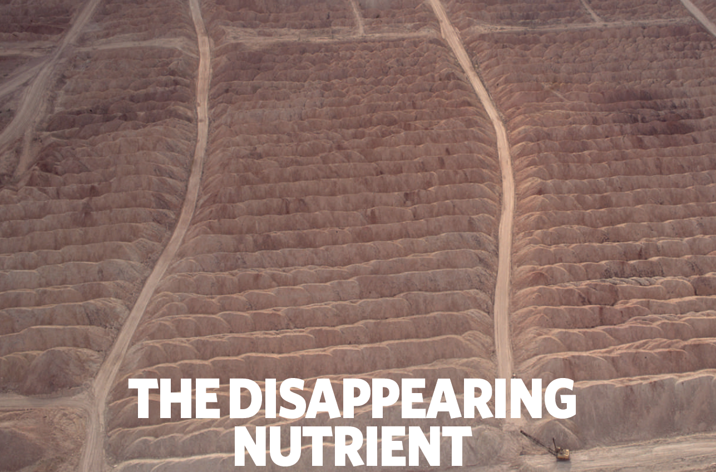
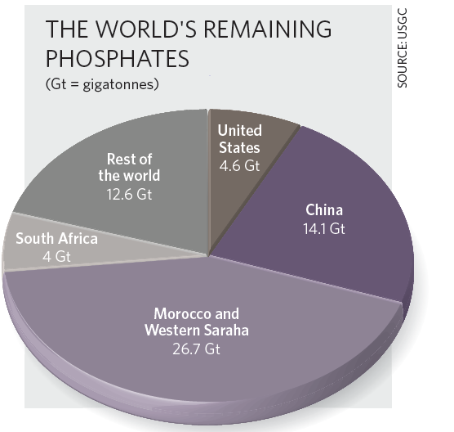
Gilbert (2009) Nature 461:716

Slide 36
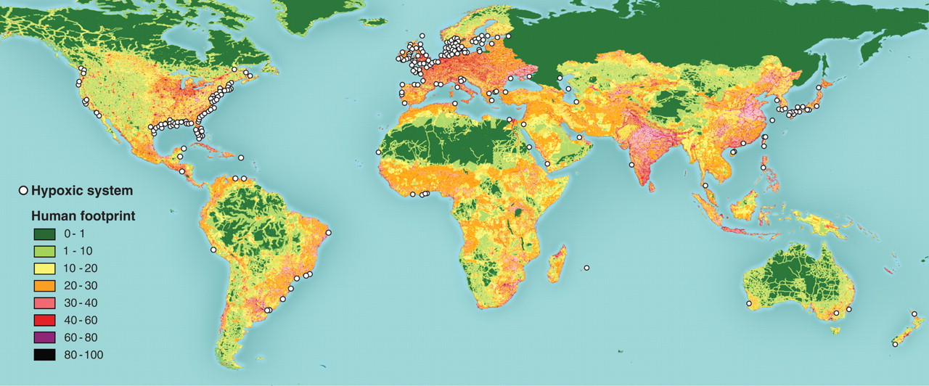
Global distribution of 400-plus systems with reported accounts of eutrophication-associated dead zones.
R J Diaz, R Rosenberg Science 2008;321:926-929

Slide 37
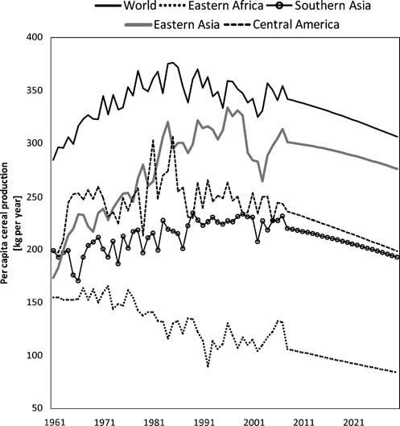
Per Capita Agricultural Production trends.
Global 14% Per capita reduction projected by 2030
Funk and Brown. Food Security (2009)

Slide 38
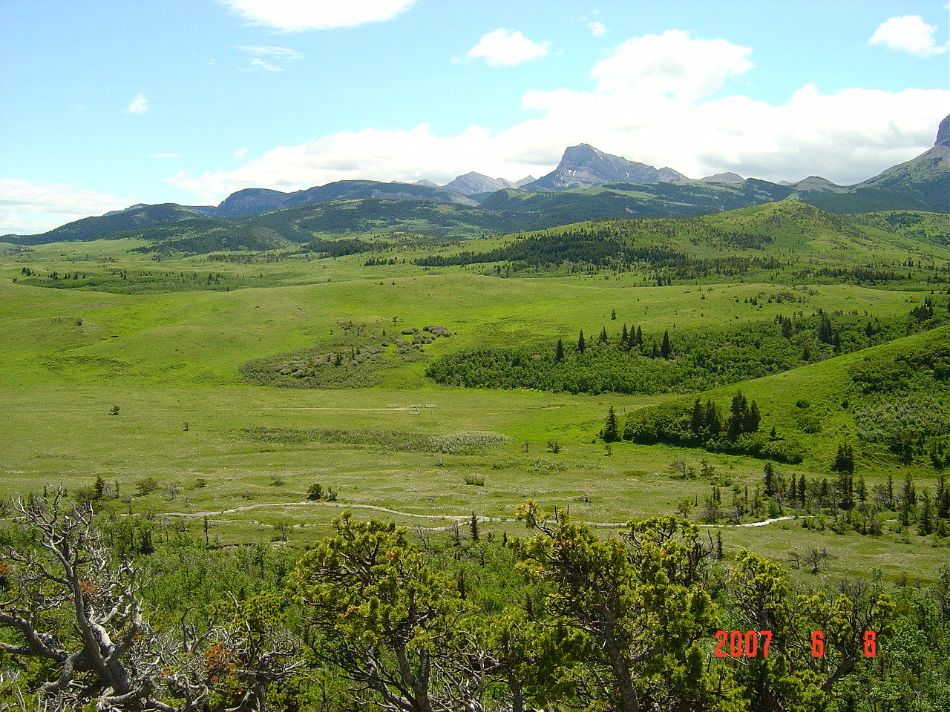
IF MORE LAND AREA IS NOT AVAILABLE,
MORE IRRIGATION WATER IS NOT AVAILABLE
MORE FERTILIZER USE POLLUTES THE BIOSPHERE
AMD
BIOENERGY CONSUMES ANY “EXCESS” NPP
THEN NPP MAY BE A PLANETARY BOUNDARY
THAT IS BEING APPROACHED

Slide 39
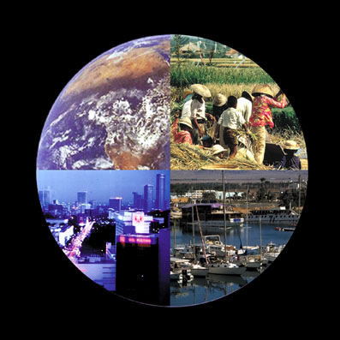
The Anthropocene Era

Slide 40
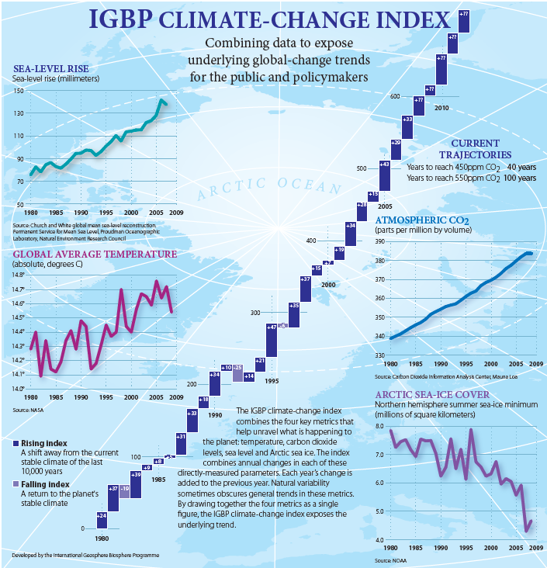

Slide 41


Fossil Fuel and Cement Emissions
Global fossil fuel and cement emissions: 9.7 ± 0.5 GtC in 2012, 58% over 1990
Projection for 2013 : 9.9 ± 0.5 GtC, 61% over 1990
Uncertainty is ±5% for one standard deviation (IPCC “likely” range)
With leap year adjustment: 2012 growth rate is 1.9% and 2013 is 2.4%
Source: Le Quéré et al 2013; CDIAC Data; Global Carbon Project 2013

Slide 42

Emissions from Coal, Oil, Gas, Cement
Share of global emissions in 2012:
coal (43%), oil (33%), gas (18%), cement (5%), flaring (1%, not shown)
With leap year adjustment in 2012 growth rates are: coal 2.5%, oil 0.9%, gas 2.2%, cement 2.2%.
Source: CDIAC Data; Le Quéré et al 2013; Global Carbon Project 2013

Slide 43

Alberta Tar Sands… Is This next?
But they wouldn’t dig it, if we didn’t buy it

Slide 45


Slide 47

Future Bioenergy Potential
(estimated by economists)
Bioenergy Potential:
~ 425 EJ yr⁻¹
(Gritsevskyi & Schrattenholzer, 2003)
Notes:
Gritsevskyi, A., Schrattenholzer, L., 2003: Costs of reducing carbon emissions: An integrated modeling framework approach. Climatic Change 56(1): 167-184.
Link to the article:
http://www.springerlink.com/content/q0121u571t0w0t87/fulltext.pdf

Slide 48

Capacity for Bioenergy Production
(estimated by ecologists)

Slide 49

COMPETITION FOR THE
GLOBAL CARBON PIE
From Haberl et al 2013

Slide 50

Observed Emissions and Emissions Scenarios
Our knowledge, modeling and monitoring is now
good enough for policy
Data: CDIAC/GCP/IPCC/Fuss et al 2014
Over 1000 scenarios from the IPCC Fifth Assessment Report are shown
Source: Fuss et al 2014; CDIAC; Global Carbon Budget 2014

Slide 51


Slide 52




WHY DO WE ALLOW THIS WASTE??

Slide 53

The new US - China Deal

Slide 54


Slide 55

IF SOCIETY IS NOT WILLING TO STOP BURNING COAL, THERE IS NO CHANCE THAT GLOBAL TEMP CHANGE CAN STAY <2.0 DEG

Slide 56

The “Climate Problem” cannot be
solved without a re-orientation
of society goals and priorities
When will global economic growth
hit a “Planetary Boundary”?

Slide 57


Slide 58

Human Ecological Footprint
http://www.footprintnetwork.org/en/index.php/GFN/

Slide 59


Gross Domestic Product (GDP) measures everything….. “Except that which makes life worthwhile. “
Robert F. Kennedy, 1968

Slide 60



The Center for the
Advancement of the
Steady State Economy
www.steadystate.org

Slide 61
Constanza et al., Nature January 2014

Slide 62


THERES HOPE WITH THE POPE
From Andrew Revkin, NY Times Dot Earth, April 10,2015

Slide 63

THE MOST DISTANT IMAGE OF EARTH EVER TAKEN, 1 BILLION KM
WE BETTER NOT SCREW THIS PLANET UP
Earth

