Slide 1
BlueSky Smoke Modeling Framework
Developed by the U.S. Forest Service Pacific Northwest Research Station – Airfire Team
https://www.airfire.org/bluesky/
Objective:
A user-friendly smoke modeling framework to enable simulations of smoke impacts from fires
Used across the U.S. in prediction systems by land managers, air-quality regulators, incident command teams and general public
Web-based platform (BlueSky Playground)
Key Assumptions:
Fuels:
Type, loading (volume), distribution, moisture, arrangement (density)
Wind
Temperature
Moisture
Humidity, Precipitation
Topography
Fuel consumption model (CONSUME)
Emissions model (FEPS
Sources: Larkin Narasimhan K., O’Neill Susan M., Solomon Robert, Raffuse Sean, Strand Tara, Sullivan Dana C., Krull Candace, Rorig Miriam, Peterson Janice, Ferguson Sue A. (2009) The BlueSky smoke modeling framework. International Journal of Wildland Fire 18, 906-920.
https://ww.airfire.org/bluesky/
Notes:
Wildfires, prescribed burns, agricultural burns
Some series of assumptions of how the fuel is burning – what proportion is being oxidized and what is creating particulates? This all depends on the specific model
Emissions model inside BlueSky is called FEPS – assumption is that this model works (same with CONSUME)
Can apply your own model and ”turn off” FEPS and CONSUME
outputs fuel consumed and emissions by consumption phase (CONSUME)
Fire Emissions Production Simulator model: model of fire consumption and emissions
(replaces EPM) http://www.fs.fed.us/pnw/fera/feps/
FOFEM First Order Fire Effects Model: modeling system containing fire consumption and emissions
components (BURNUP)

Slide 2
Inputs (minimum):
-Fire location
-Daily fire growth (size)
-Fuel loadings (default: FCCS)
-Consumption
-Total consumption
-Time-rate consumption
-Emissions by species
Outputs:
-Daily (or 12-hour) predictions of surface PM 2.5 for wildfires, prescribed burns and agricultural burns
-Plume height
-Plume collapse? Beta 3.0?
Notes:
Designed to answer a sequence of questions that end with smoke impacts:
1.) Where and how big are the fires?
2.) What is the fuel available to be burned?
3.) How much fuel is consumed?
4.) What emissions are produced?
5.) Where do the emissions go?
-Includes automatic connection to prescribed-burn reporting systems across PAC NW, and some agricultural burns; not all prescribed burns are lit, however
-

Slide 3
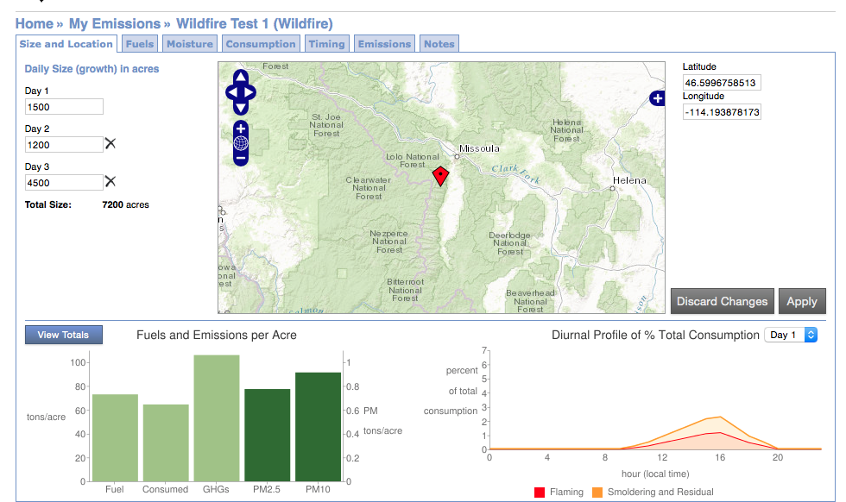
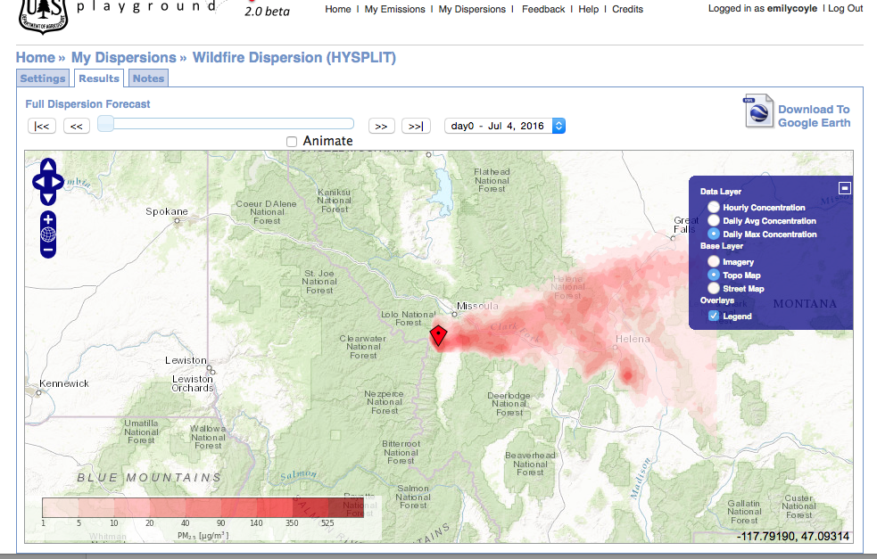

Slide 4
Potential Implications For Public Health
Enhance the ability of public health and planners to use publicly-available modeling systems for public health planning (e.g. built environment, parks and recreation)
Identify and predict potential economic impacts of exposure to particulate matter based on modeling framework
Effect on health care costs among vulnerable populations based on age, pre-existing conditions, etc. and tailor mitigation interventions
Policy: Inform health care workforce decisions based on predictable health impacts (e.g. cardiovascular, respiratory, etc.)
Others?

