Slide 1
Across Trophic Level System Simulation (ATLSS)
USGS and University of Tennessee at Knoxville Institute for Environmental Modeling
atlss.org
Objective
ATLSS projects the outcomes of future hydrologic scenarios on the biological components of south Florida terrestrial and wetland upper trophic systems. It is based on surface and groundwater hydrological models and biological submodels for plants and animals. It was designed to evaluate Everglades restoration strategies.
Key Assumptions of Hydrologic Model
Hydroperiod ranges estimated from published literature and expert opinion,
Temporal/Spatial Scale
5-day timestep/spatially defined at 500 x 500m

Slide 2
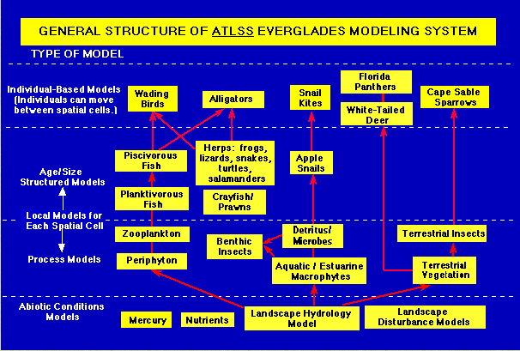
Input Drivers
MESH CELL IS THE UNIT OF THE LANDSCAPE HYDROLOGY MODEL
Evapotranspiration
Rainfall
Wind Sheltering
Effect of Vegetation and Microtopography on Overland Flow
Key Outputs
Spatial and temporal distribution of animals
Produces population relative mortality, reproduction, individual movement, territory size
Predict fish biomass to assess prey availability for wading birds

Slide 3
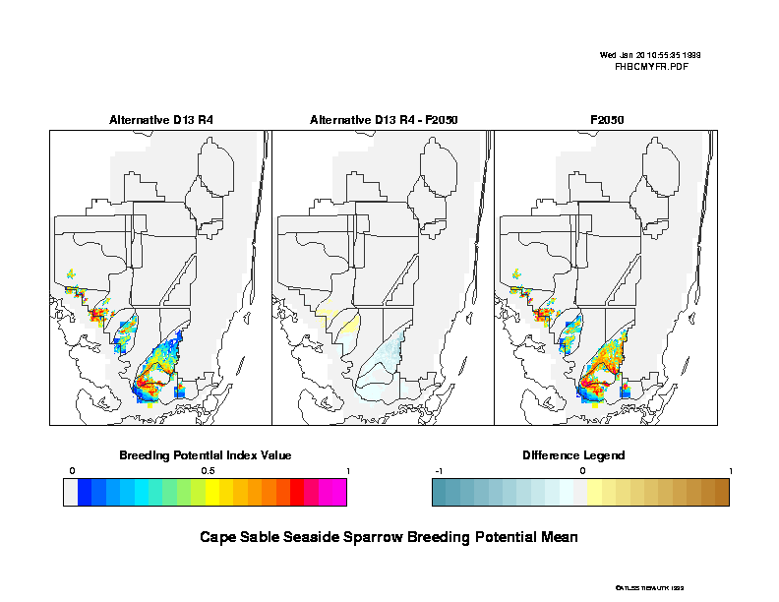
Cape Sable Seaside Sparrow Breeding Potential
Notes:
Hydrological output is verified from field inspections, independently computed values and function testing

