Slide 1
Model Evaluation: FOFEM
Lacey Hankin
First Order Fire Effects Model (FOFEM)
USDA Forest Service & Rocky Mountain Research Station
https://www.firelab.org/project/fofem
Domain/Objective
FOFEM is a model that predicts first-order fire effects including tree mortality, fuel consumption, emissions production, and soil heating caused by wildland fires at the stand to small watershed scale.
Key Assumptions
Point model: Extrapolating single points to a larger area can introduce significant bias
Require accurate fuel loading and fuel moisture inputs
Temporal/Spatial Scale
Forest stands to small watersheds
National scope: divides U.S. into four separate regions
Immediate effects
Notes:
First order fire effects: immediate consequences of a fire
Developed in the 1980s
Uses 4 metrics: tree mortality, fuel consumption, emissions or smoke production, soil heating
Model can be run in either prediction or planning mode – expected fire effects vs. range of conditions that may lead to a specified set of desired effects
Point model predicts fuel consumption and smoke emissions for a 1-5 sq m point on the landscape
- Can miss the variability in fuel and moisture conditions

Slide 2
Fuel consumption, emissions, and soil heating
Inputs | Outputs
Geographical region cover classification System and cover type, season of burn, general burning conditions Fuel type, fuel loading by size class, fuel moisture for some size classes, duff depth, type of duff moisture Percentage of crown burned Soil heating only: soil texture and soil moisture | Pre-burn loading, consumed loading, post-burn loading Percentage reduction, duff depth consumed, percentage of mineral soil exposure Emissions only: CO₂, CO, CH₄, SO₂, NO_{x}, PM_{2.5}, PM₁₀ from flaming and smoldering combustion, total consumption in combustion, duration of flaming and smoldering combustion Soil heating only: soil layer max temperatures and duration of heating at 0 to 13cm depth by 1cm increments, max depth reaching 60ºC, max depth reaching 275ºC
Tree mortality
Inputs | Outputs
Geographical region General burning conditions Density, DBH, tree height, crown ratio Flame length or scorch height for each species DBH class species | Percentage of tree mortality by species and size class Pre- and post-fire canopy cover
Notes:
Specific inputs vary according to which of the four outputs you are targeting
Default values are provided

Slide 3
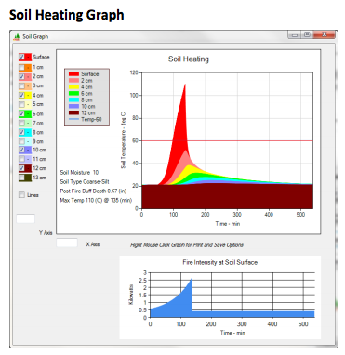
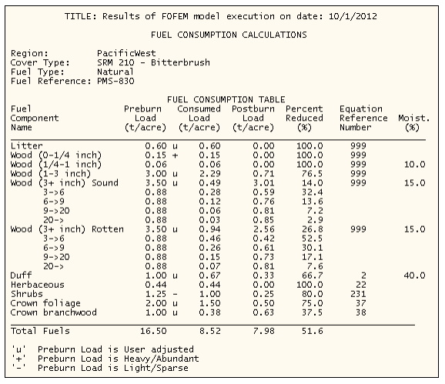
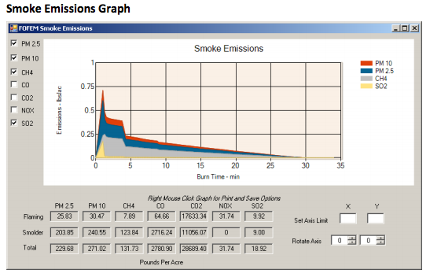
Notes:
Top left: inputs for the two target categories
See things like cover type, species, fuel load
Bottom left:
Summary of fuel consumption results: preburn load, consumed load, postburn load, percent reduced
Top right: soil heating graph
Bottom right: smoke emissions

