Slide 1
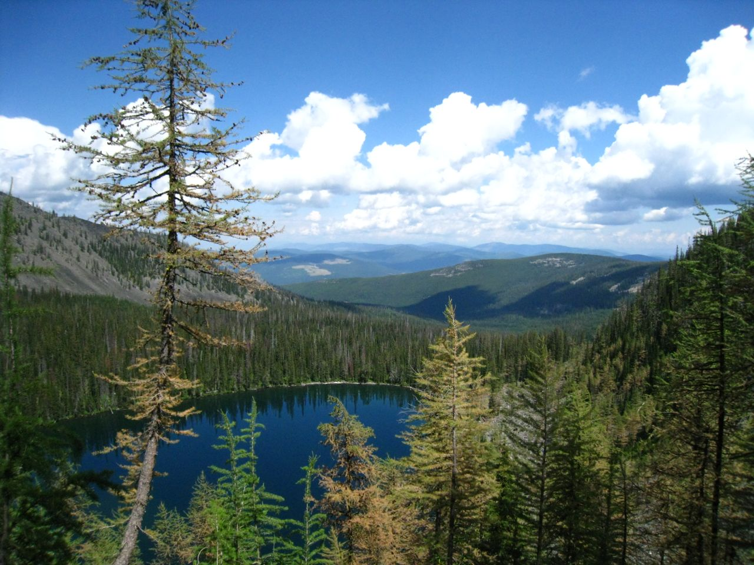
STANDCARB
Elissa Chott
February 22, 2017

Slide 2
STANDCARB, Department of Forest Science Oregon State University
http://andrewsforest.oregonstate.edu/pubs/webdocs/models/standcarb2/contents.htm
STANDCARB is a model to simulate the accumulation of carbon in mixed species, mixed aged forest stands
Key Assumptions
tree species may be defined while shrub and herb layers are not, lower trees only occur where upper trees are present
Temporal/Spatial Scale
modules based on annual data, functions within modules are monthly calculations
estimates degree of variation within a stand, not over landscape

Slide 3
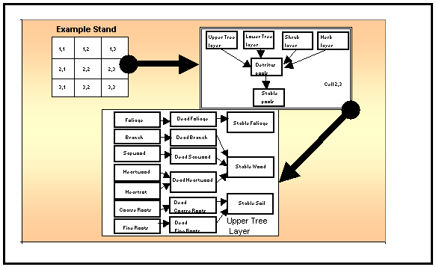
Input Drivers
Estab- sets rates that layers establish
EcoRegion- abundance of tree species
TreeReg- defines which tree species can establish
Growth- sets species attributes of growth
GrowLayer- sets layer attributes of growth
Mort- sets species attributes of litter formation and mortality
Decomp- sets species attributes of decomposition
DecayPool- sets detritus pool attributes of decomposition
BurnKill- sets levels of fire mortality for each plant layer
SitePrep- sets levels of fuel reduction for each detritus pool
Harvest- defines the level of removal given a harvest
Herbicide- sets ability of trees to recover from herbiciding
Soil- sets characteristics of soil texture classes
SiteIndex- sets level of productivity for a site index of tree species
Key Outputs
total organic matter or carbon values for live and dead pools
volume, age, and height of tree layers

Slide 4
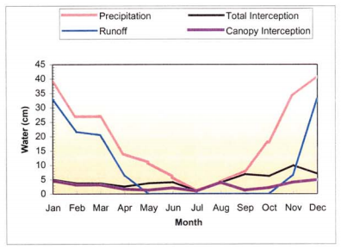
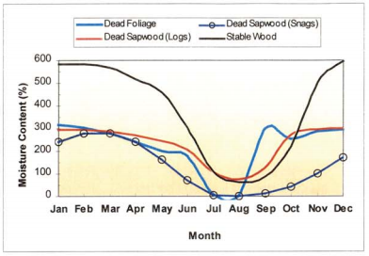
PET and Transpire
Detrital Water Store

