Slide 1
ECOSYSTEM MODEL EVALUATION
Gradient Nearest Neighbor (GNN) Model
LEMMA (Landscape Ecology, Modeling, Mapping, and Analysis) team
USDA Forest Service, Pacific Northwest Research Station, and the Department of Forest Ecosystems and Society, Oregon State University
https://lemma.forestry.oregonstate.edu/methods/home
Domain/Objective
The GNN model is a tool for creating detailed maps of vegetation structure and species composition across forested landscapes. It is a type of NN model that uses regional inventory plots and Landsat imagery, along with direct gradient analysis as its distance metric.
Key Assumptions
Each pixel should have attributes of its nearest neighbor plot (based on Euclidean distance)
Temporal/Spatial Scale
Intended for use at regional scale

Slide 2
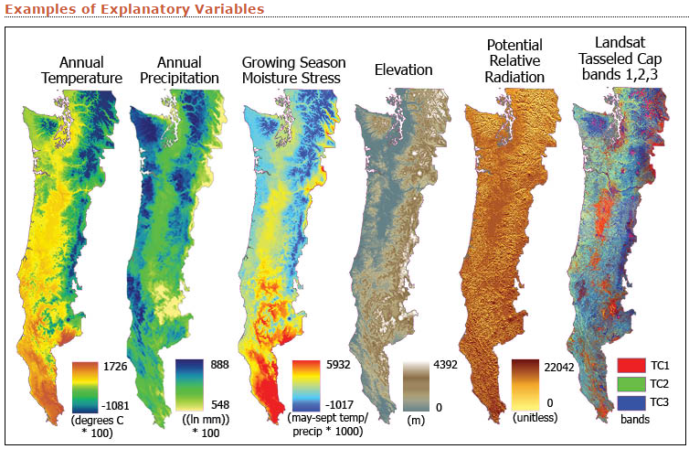
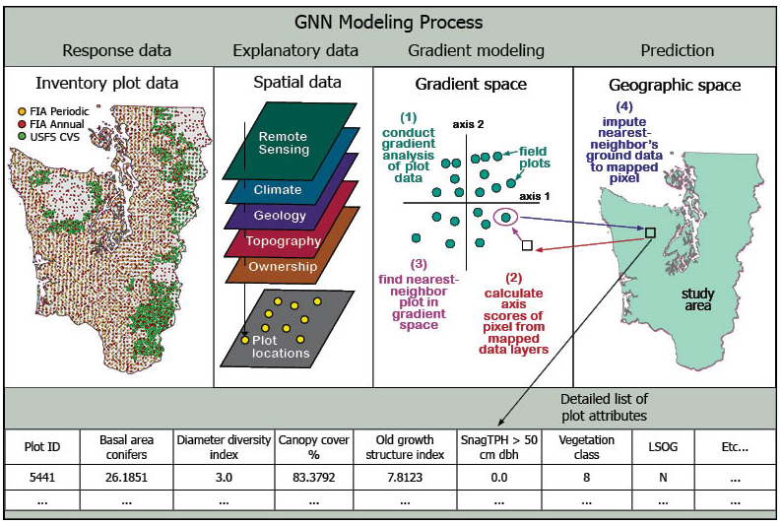
Input Drivers:
Inventory plot data
Explanatory data (examples):
-Annual Temperature
-Annual Precipitation
-Growing Season Moisture Stress
-Elevation
-Potential Relative Radiation
-Landsat Tasseled Cap bands 1,2,3
Key Outputs:
Pixel association with the inventory plot that has the most similar spectral and environmental characteristics
Species Maps
Structure Maps
GNN models can be used as input for several other types of models:
-habitat suitability
-fuels and fire risk
-biomass and carbon
-landscape scenario

Slide 3
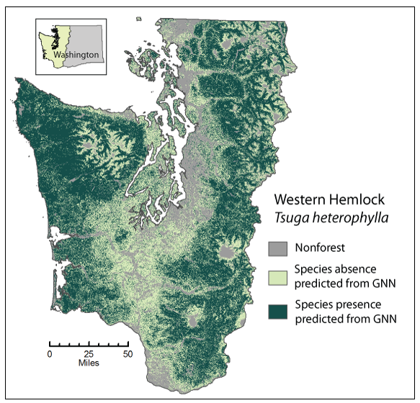
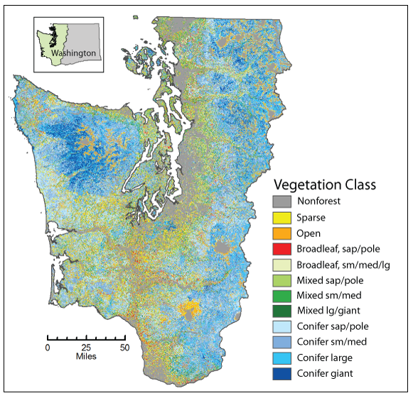
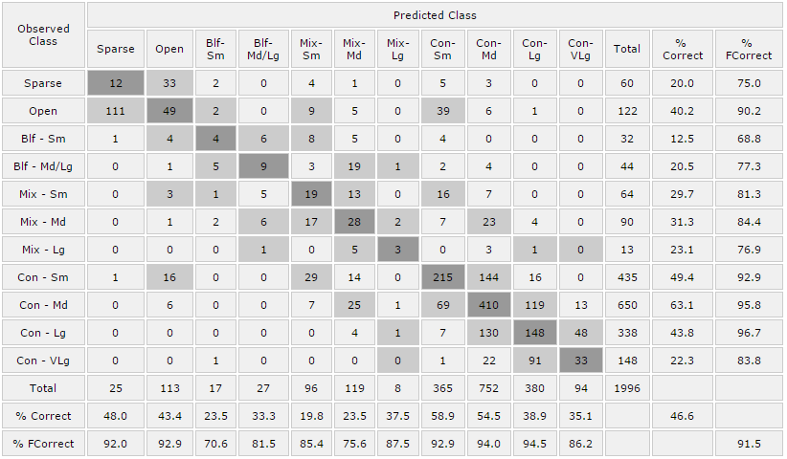
Testing/Validation, Examples of a result

