Slide 1
BehavePlus Fire Modeling System
An Introduction by Philip Williams
CONCEPT:
Model wildland fire 1) Behavior 2) Effects 3) Fire Environment, via mathematical models
First phases in 1970s; first offered in the field in 1984
USES:
Active Fires
Prescribed Burns
Fuel Hazards
Reference: BehavePlus Design & Features Manual, Dec 2010

Slide 2
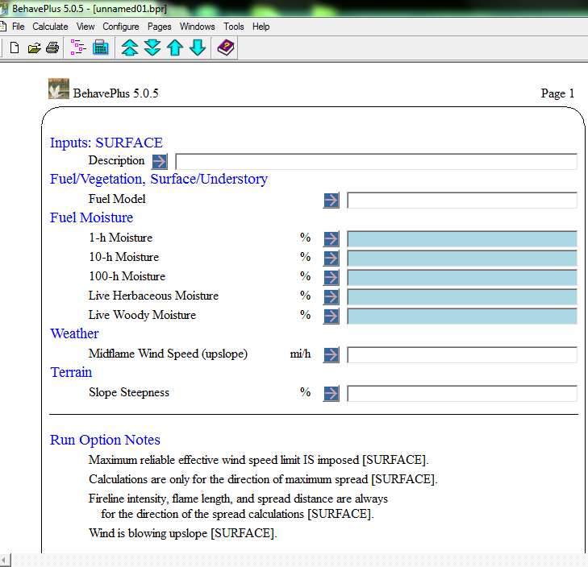
ASSUMPTIONS / INPUTS
User Input critical
Assumes some fire and ecology knowledge
IMPORTANT: Pick a relevant module

Slide 3
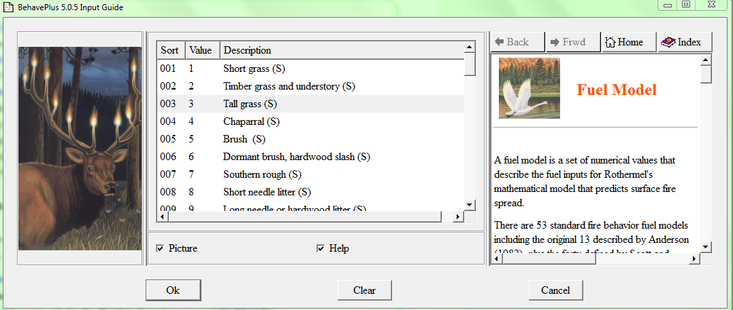
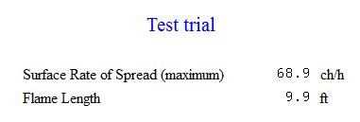
INPUTS
OUTPUTS: Example
SUMMARY
Module depends on research question
Works WITH field data; not a substitute for it

