Slide 1
Model Name: Hydrologic Engineering Center River Analysis System (HEC-RAS).
Host Institution: U.S. Army Corps of Engineers – Hydrologic Engineering Center.
URL: http://www.hec.usace.army.mil/software/hec-ras/
Domain/Objective:
The HEC-RAS model allows the user to perform steady and unsteady flow in one and two dimensions, sediment transport and water quality calculations. Options include the hydrologic engineering components of rainfall/runoff analysis, river hydraulics, reservoir simulation, and floodplain/flood damage analysis. The 5.0 version includes a User Manual, Hydraulic Reference Manual, and Applications Guide. The Applications Guide includes 24 examples of the features of HEC-RAS, with a step-by-step overview of its capabilities, and includes different scenarios such as bridges, ice-covered rivers, and groundwater inflow.
Key Assumptions:
Drivers are expected to be complete. All data, including flow, cross sections and accurate geometric data (i.e. rivers, elevation, bridges, culverts, irrigation) are necessary to run this model accurately.
Temporal/Spatial Scale:
This model can be used in a daily, monthly, yearly, decadal or longer term mode and can be used to take a snapshot or run comparisons in space and time. It is normally run on a watershed or sub-basin area.

Slide 2
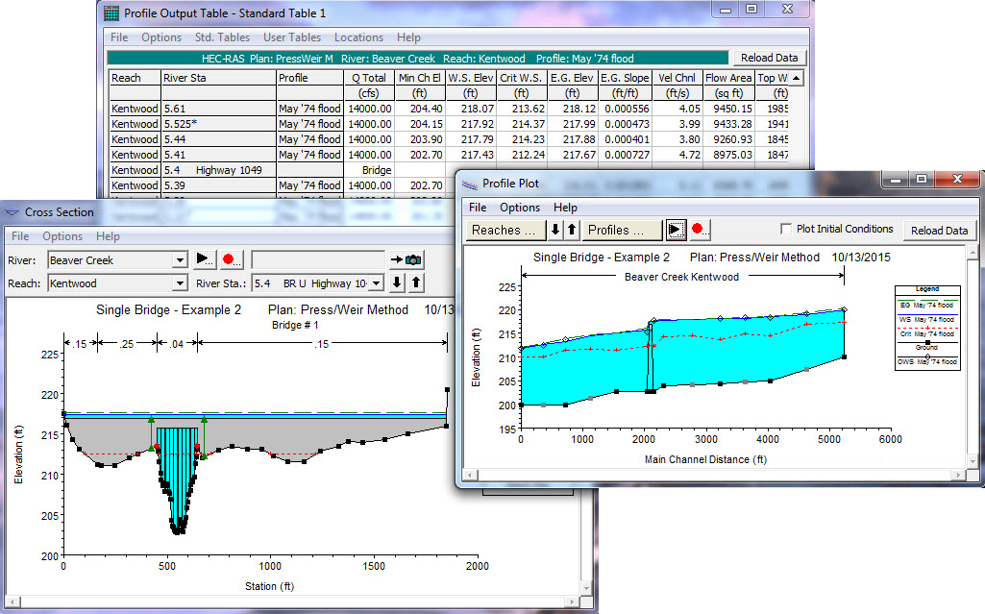
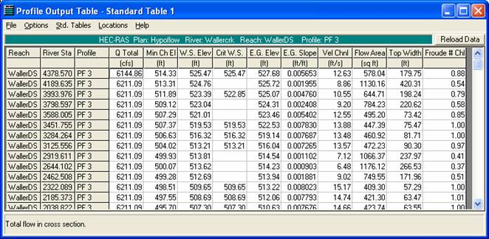
Input Drivers:
Flow Data and Geometric Data (river, reservoir, tributaries, elevation, bridges, cross sections, culverts, weirs, etc.) must be provided by the user.
Key Outputs:
Depends on exactly what you are running, as there are many different options. Could include flow calculations, sediment transport, water quality, floodplain assessment, etc.

Slide 3
