Slide 1
ECOSYSTEM MODEL EVALUATION Rachel Powers
TEM-Terrestrial Ecosystem Model of Biogeochemical Dynamics
Marine Biological Laboratory (MBL), Woods Hole, MA
University of New Hampshire (UNH)
http://ecosystems.mbl.edu/tem/
Domain/Objective
TEM is a process-based ecosystem model that describes carbon, nitrogen and water dynamics of plants and soils for terrestrial ecosystems of the globe.
Key Assumptions
Vegetation is not segregated into functional tissues
Detritus (soil) is not partitioned into age or quality classes
Vegetation and detritus are distributed evenly within grid cells
Temporal/Spatial Scale
The TEM normally operates on a monthly time step and at a 0.5 degrees latitude/longitude spatial resolution, but has been applied at finer spatial resolutions (down to 1 hectare).

Slide 2
http://ecosystems.mbl.edu/TEM/tem_graphic.jpg

Slide 3
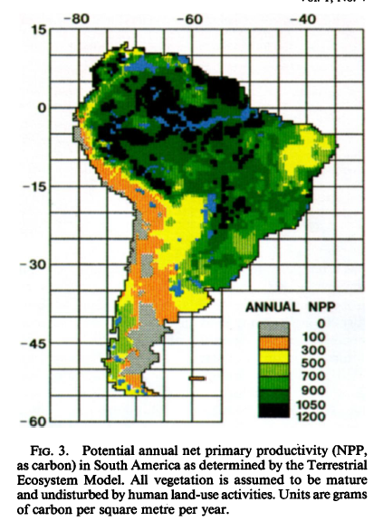
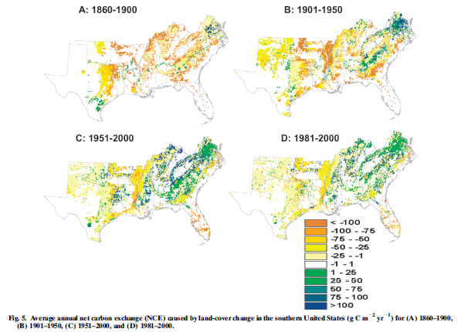
TEM 1.0 (1991) TEM 4.3 (2006)
Effect of Land-Cover Change on Terrestrial Carbon Dynamics in the Southern United States. Authors:Hua Chen, Hanqin Tian,* Mingliang Liu, Jerry Melillo, Shufen Pan, and Chi Zhang. Journal of Environmental Quality, Vol. 35 (July-August 2006) pp. 1533-1547.
Potential Net Primary Productivity in South America: Application of a Global Model,Author(s): J. W. Raich, E. B. Rastetter, J. M. Melillo, D. W. Kicklighter, P. A. Steudler, B. J.Peterson, A. L. Grace, B. Moore III and C. J. VörösmartySource: Ecological Applications, Vol. 1, No. 4 (Nov., 1991), pp. 399-429

