Slide 1
2052 A Global Forecast for the next 40 years
Model Name/Host Institution/URL
2052, Norwegian Business School
http://www.2052.info
Domain/Objective
2052 is a systems dynamic future predictive model for a number of different scenarios, all modeled in Excel with the ability for users to modify select key parameters. It is part of the efforts begun by Donella Meadows, Jorgen Randers and others in the Limits to Growth.
Key Assumptions
The model does not forecast impending disaster, rather it makes remarks on trends regarding growth of key sectors throughout the world. Each model assumes that growth which put pressures on constraints will peak and then decrease. Focused on individual decisions serving short term interests (temporal discount). There are few other details about model assumptions.
Temporal/Spatial Scale
The model provides forecasts in 5 year increments until the year 2050. There are predictions for specific countries and world entities (e.g. USA, China, OECD, BRISE,ROW) as well as an aggregate model that predicts on a global scale.

Slide 2
Input Drivers
Various inputs depending on desired predictions. Some examples are:
Birth rate, death rate
Percent voluntary and forced investments (GDP predictions)
Percent growth in energy sources including: oil, gas, renewables, nuclear and coal.
Cultivated land, gross yield from land (food production)
Total bio-capacity, rate of change of NEFPP (non-energy ecological footprint)
Key Outputs
Population, potential work force, labor productivity
GDP and consumption, energy use, CO2 emissions from energy use, climate change
An overall summary of important predictors/trends

Slide 3
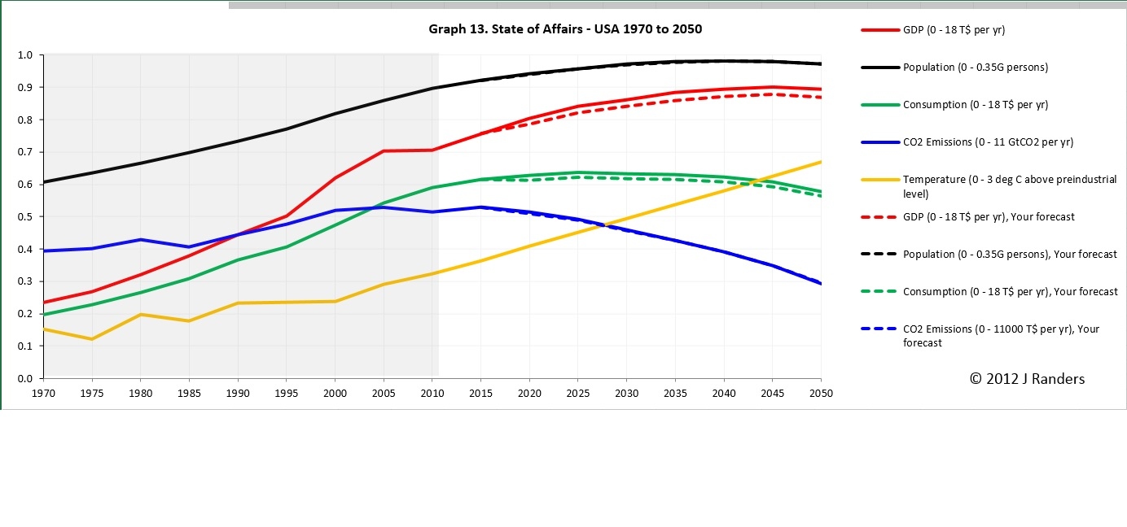
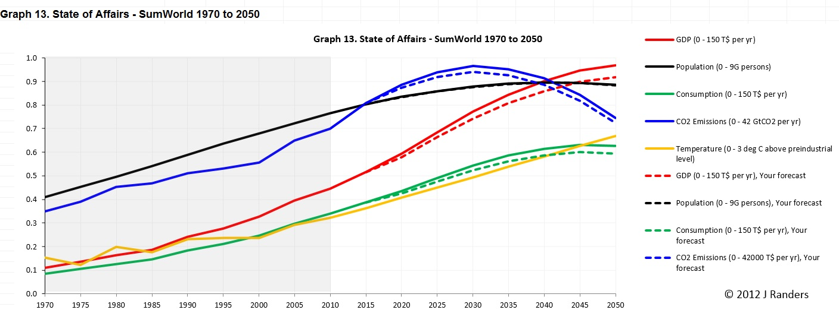
Testing/Validation, Examples of a result

