Slide 1
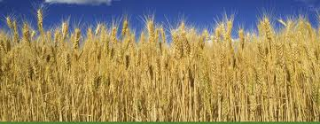
CERES-WHEAT MODEL
Model Name/Host Institution/ URL
CERES-Wheat
USDA Agricultural Research Service
http://nowlin.css.mus.edu/wheat_book
Domain/Objective
Simulate wheat development and yield depending on environmental/climatic variables, plant genetics, and crop management.
Assumptions
Excluded soil salinity and aeration, catastrophic weather events, interactions with pests and toxics, affect of Phosphorous, Potassium and other micronutrients.
Temporal/Spatial Scale
Daily timestep, designed for a farm or regional scale.
Notes:
Policy at regional scale-crop production and resource conservation

Slide 2
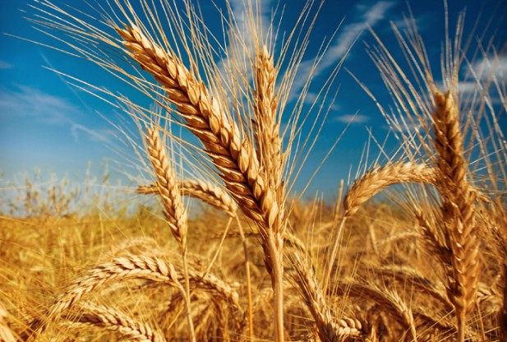
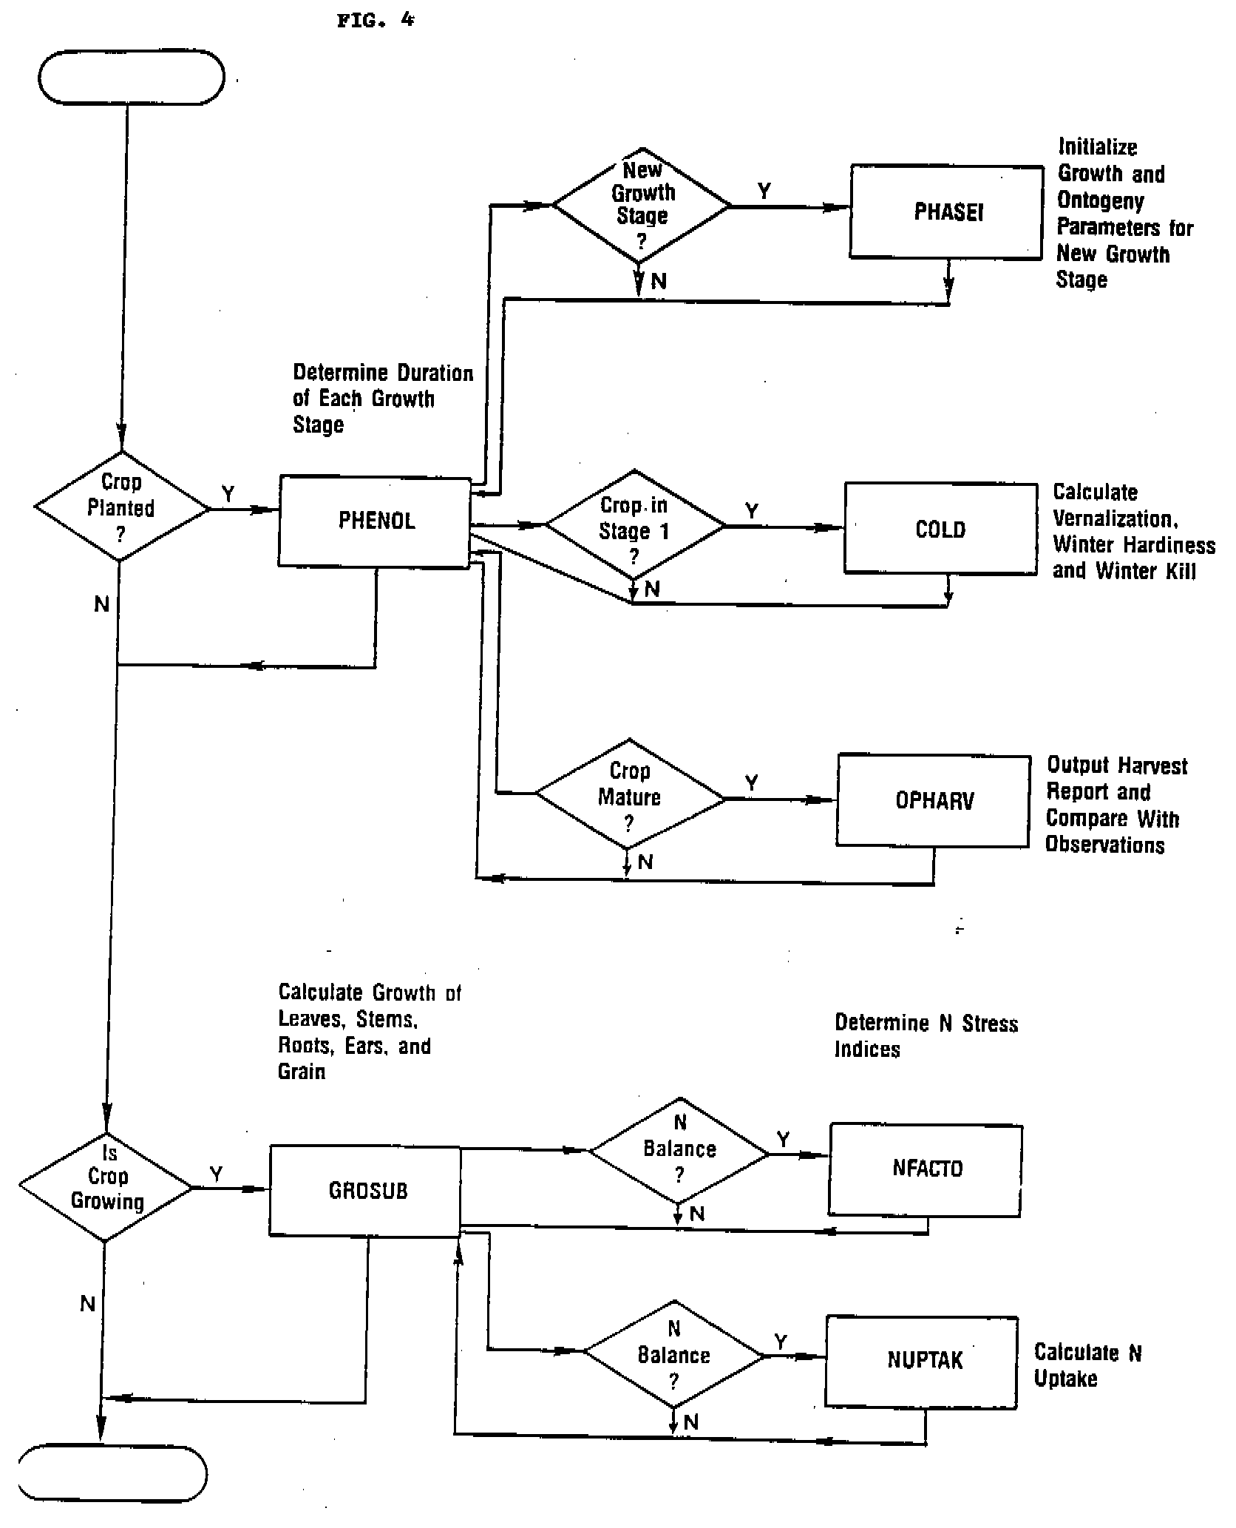
Input Drivers:
Cultivar
Planting Density
Weather
Soil H₂0
Nitrogen Availability
Management Data
Key Outputs:
Crop Growth
Crop Development
Crop Yield

Slide 3
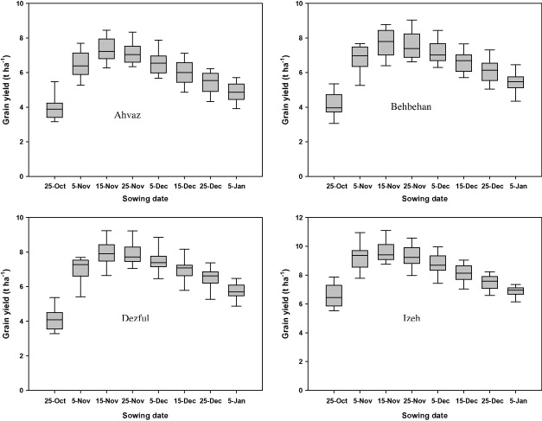
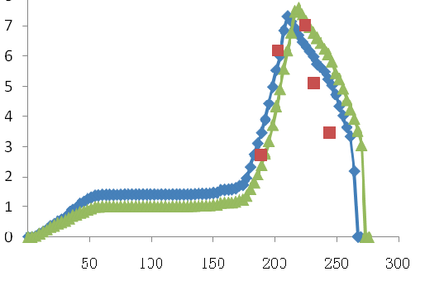
Simulated and measured LAI and above ground biomass of Chamran sown on Nov. 22, 2003 in Ahvaz, Iran.
Simulated yield for different sowing dates in 4 locations in Iran.
Comparison of simluated, observed, and predicted LAI in 2006 in Northern Beijing. Blue: Simluated, Red: Observed, Green: Predicted

Slide 4
http://nowlin.css.mus.edu/wheat_book
http://dl.ifip.org/db/conf/ifip12/ccta2008-1/WangZLLHW08.pdf (CHINA)
http://www.sciencedirect.com/science/article/pii/S1658077X14000307 (IRAN)

