Slide 1
ECOSYSTEM MODEL SUMMARY
Model Name/Host Institution/URL
Regional Hydro-Ecologic Simulation System (RHESSys)
University of California, Santa Barbara
http://fiesta.bren.ucsb.edu/~rhessys/index.html
Domain/Objective
RHESSys is a GIS-based, hydro-ecological modeling framework designed to simulate carbon, water, and nutrient fluxes. By combining a set of physically-based process models and a methodology for partitioning and parameterizing the landscape, RHESSys is capable of modeling the spatial distribution and spatio-temporal interactions between different process at the watershed scale.
Key Assumptions in design of model
Types of vegetation not defined;
Temporal/Spatial Scale
Daily/Monthly/Yearly; watershed scale

Slide 2
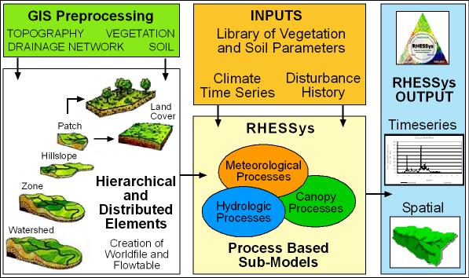
Input Drivers
Landscape representation
Basin partitioning
Hillslope partitioning
Zone partitioning
Patch partitioning
Stratum partitioning
Soils
Landuse
Vegetation
Stream networks
Leaf area index
Slope
Climate
Water Quality
Streamflow
Nitrogen Deposition
Key Outputs
Rain and snow throughfall
Groundwater output
Stream outflow
Net photosynthesis
Nitrate flux

Slide 3
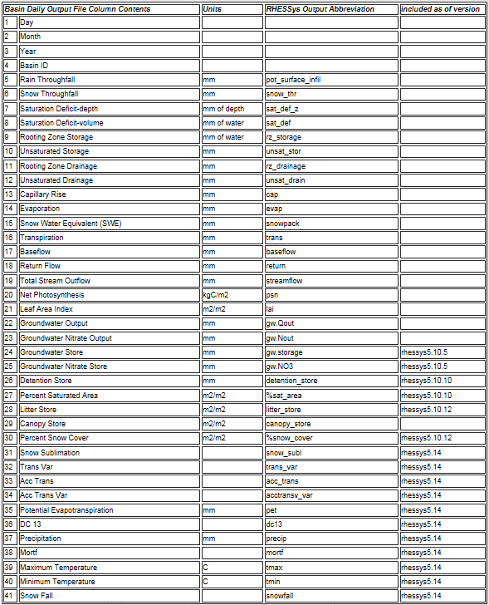
Notes:
Graphs from papers? Special apps: any graphs or statements

