Slide 1
InVEST (Integrated Valuation of Ecosystem Services and Trade-offs) Water Purification: Nutrient Retention
Host Institution/URL
http://www.naturalcapitalproject.org
Objective
Improve policies and planning by incorporating ecosystem nutrient retention capacity with land use
Model scenarios for spatial planning and/or environmental impact assessments
Key Assumptions and limitations
Hydrologic system not dominated by rainfall intensity events
- Nutrient Transport is continuous
i.e. Does not include diches that may speed up run-off into stream
Riparian Vegetation the only factor considered for water purification
i.e. does not represent biological/chemical processes for retention/degradation
Assumes marginal cost for pollution treatment
Temporal/Spatial Scale
Annual average, NOT an event based model
local to regional watershed scale

Slide 2
Water Retention Model
InVEST Inputs
Supply
DEM – Digital Elevation Model – data set with elevation for each cell
Water yield per cell- delineated by reservoir or interest pts.
Root restricting later (mm)
Precipitation (mm)
Plant available water fraction
Avg. Plant Evapotranspiration (mm)
Nutrient loading (kg/Ha/yr)
Nutrient filtration efficiency %
Threshold flow accumulation value-
# of cells nutrient is transported before waterway
Service
Time span (years of nutrient retention)
Value of pollution retention
Mean annual nutrient removal cost $/kg pollutant removed
Discount rate (%)
InVEST Outputs
Total exported nutrient (kg/ha/watershed):
Total nutrient retained (kg/watershed):
Nutrient Stream loading (kg/pixel)
2 Maps
Showing nutrient production, and
load retention downstream (kg/pixel)
Value of nutrient retained over time period (currency/time):

Slide 3
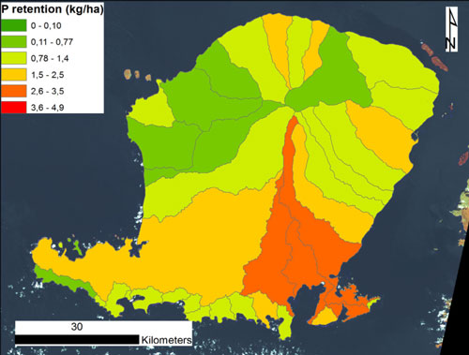
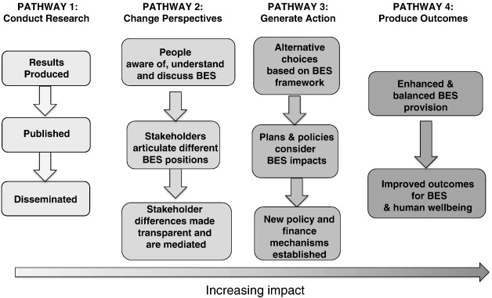
Research and Applications
Earth Observation for Ecosystem Valuation, EARSC
Lombok, Indonesia
http://www.hobgreeneconomy.org/en/invest
InVEST:
Lessons from the Field and
Measuring success

