Slide 1
MAGICC/SCENGEN
Model for Assessment of Greenhouse-gas Induced Climate Change/A Regional Climate SCENario GENerator.
http://www.cgd.ucar.edu/cas/wigley/magicc/about.html
(UCAR) University cooperation for atmospheric Research and (NCAR) National Center for Atmospheric Research, Boulder Colorado
http://www2.ucar.edu/, http://ncar.ucar.edu/
Shah Khan, Summary 1, BIOS 534
Objectives: “MAGICC consists of a set of “coupled gas-cycle”, “climate and ice-melt “models integrated into a single software package”. It is used to determine changes in greenhouse-gases concentrations, global-mean surface air temperature, and sea level resulting from anthropogenic emissions such as carbon dioxide (CO₂),methane (CH₄),nitrous oxide (N₂O), halocarbons and sulfur dioxide (SO₂).. SCENGEN constructs a variety of geographically distributed climate change projections for the earth using the results from MAGICC. These models are used by IPCC(intergovernmental Panel on climate change ) for the assessment reports since 1990.
Assumptions: To compare global mean temperature and sea level changes in different emission scenarios. To calculate the sensitivity of temperature to sea level as a result of any selected emission. Most of the these results are based on best estimates due to the uncertainties in the inputs such as emissions, climate sensitivity, aerosol forcing, carbon cycle and ocean mixing rate. MAGICC used global energy balance equation to calculate the change in mean global radiation.
Scale: The results are given as array files on a standard 2.5x2.5 degree latitude/longitude grid (0.5x0.5-5x5 degree) and displayed as maps with Monthly/yearly change.

Slide 2
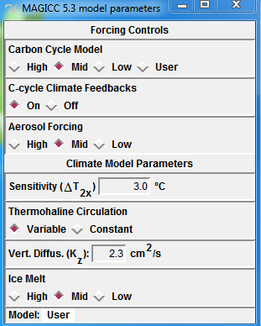
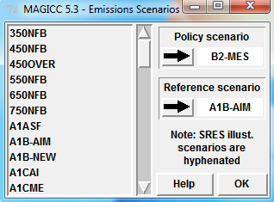
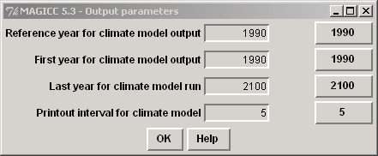
Input Drivers/Forcing changes
Tropospheric O3,
Biomass burning,
Fossil organic/and black carbon,
Nitrate,
Mineral dust,
Stratospheric H2O,
SO4 direct and indirect,
Land use
Primary Inputs (gases): Emissions Scenario
Carbon Dioxide (CO2),
Methane (CH4),
Nitrous Oxide (N2O),
Sulfur Dioxide (SO2),
Reactive gases (CO, NOx, VOCs)
Key Output
MAGICC Outputs:
Gas concentrations,
Radiative forcing breakdown,(change in radiation due to GHGs)
Global-mean temperature and sea level.
SCENGEN Outputs:
Baseline climate data,
Model validation results,
Changes in mean climate,
STRUCTURE OF THE MAGICC/SCENGEN SOFTWARE
Library of Emissions Scenarios
Gas Cycle Models
User Choices of Model Parameters
Feedback
Atmospheric Composition Changes
Global-mean Temperature and Sea Level Model
User Choices of Model Parameters
MAGICC
Global-mean Temperature and Sea Level Output
SCENGEN
Library of AOGCM data sets
Regionalization Algorithm
User Choices: Variable, AOGCMs, Future Date, Region, etc.
Library of Observed data sets
Regional Climate or Climate Change Output
Model parameters

Slide 3
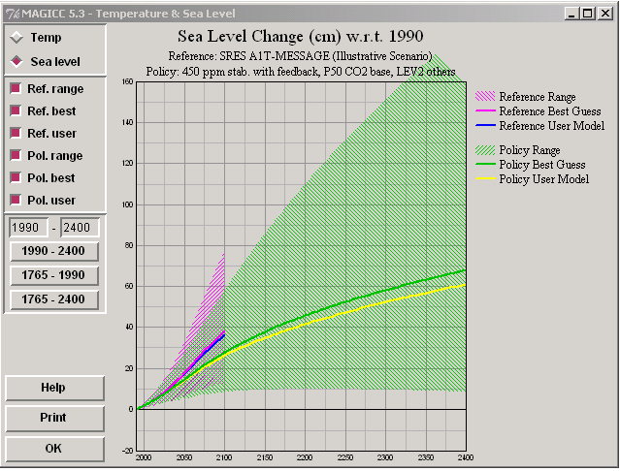
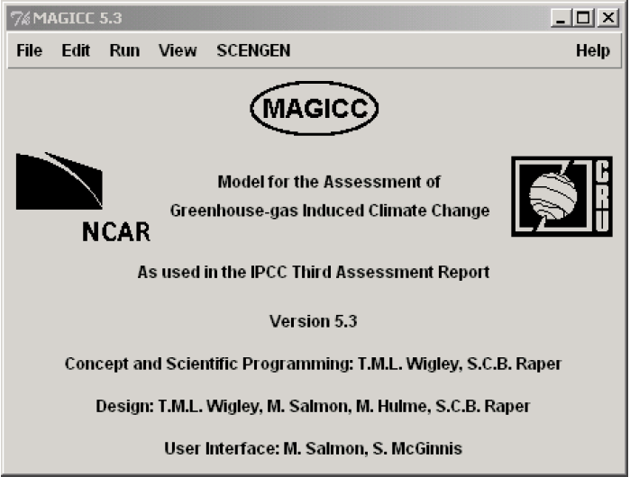
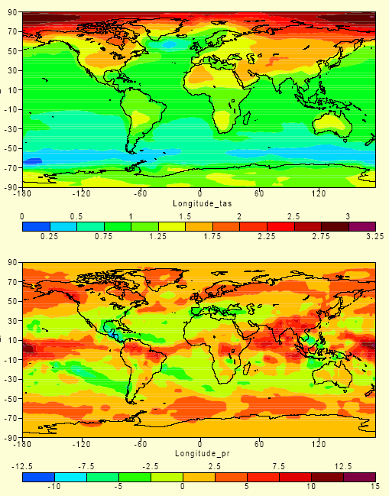
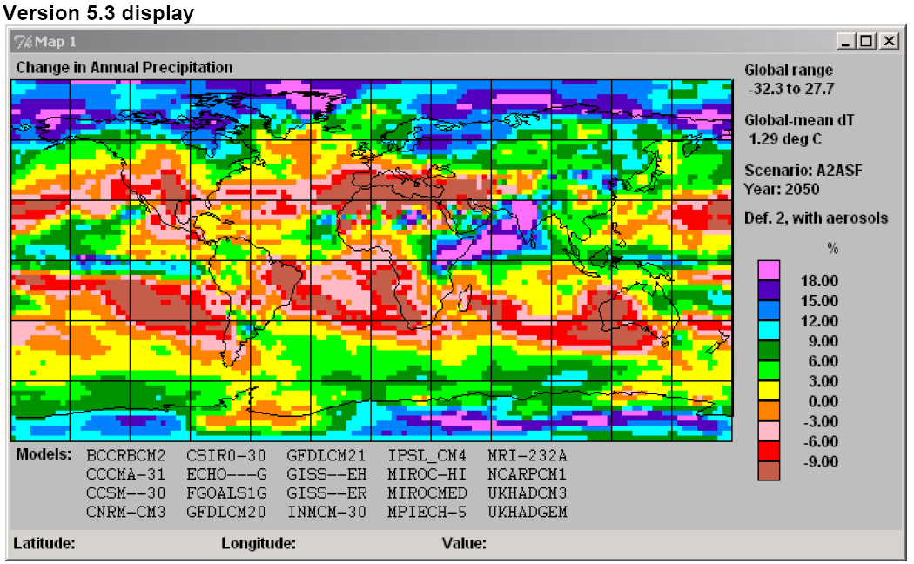
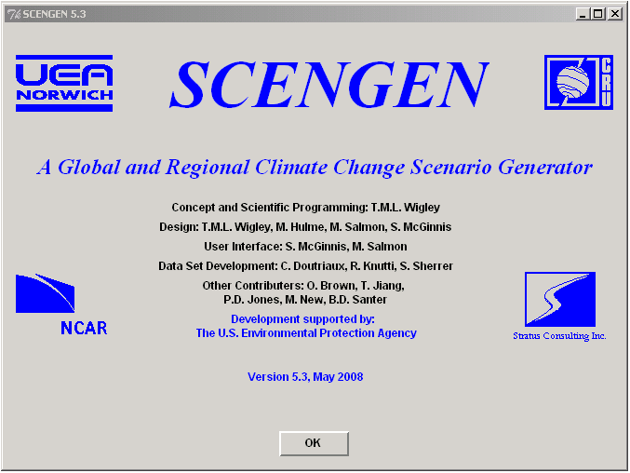
EXAMPLES OF RESULTS
Green House Warming Experiments, 1% per year Carbon dioxide increase
Normalized temperature change
Normalized precipitation change
Tom M.L. Wigley, National Center for Atmospheric Research,Boulder, CO 80307.
Wigley & Raper, Science 293, 451-454, 2001)

Slide 4
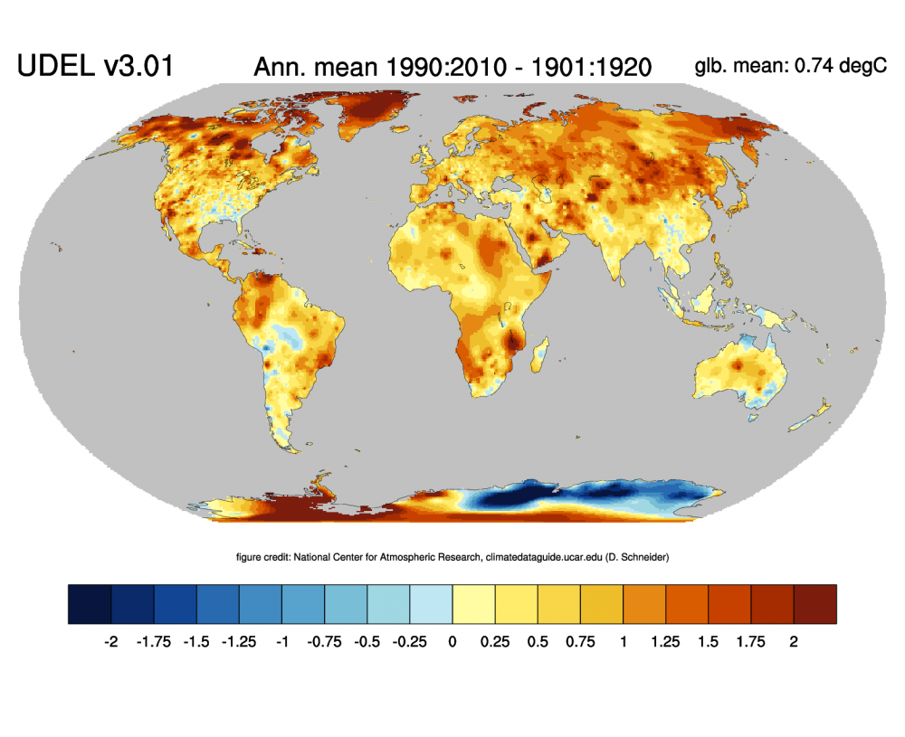
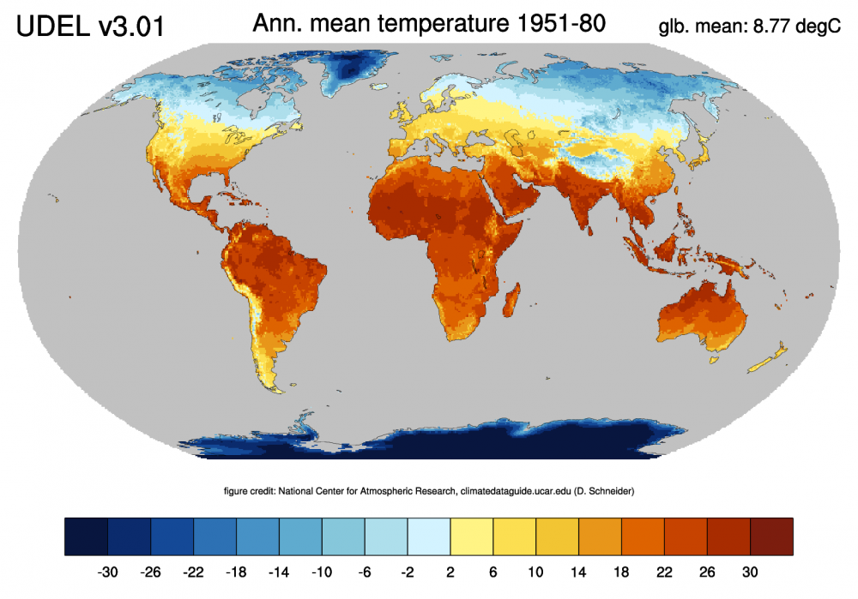
The Climate Data Guide: Global (land) precipitation and temperature: Willmott & Matsuura, University of Delaware.“ https://climatedataguide.ucar.edu/climate-data/global-land-precipitation-and-temperature-willmott-matsuura-university-delaware.
Change of annual mean land temperature between 1901:1920 and 1991:2010 based on the UDEL v3.0.1 dataset. Credit: ClimateDataGuide, NCAR
Mean annual surface air temperature over land according to UDEL v3.0.1, averaged for 1951-1980. (credit: D Schneider, ClimateDataGuide)
http://climate.geog.udel.edu/~climate/html_pages/download.html#T2011

