Slide 1
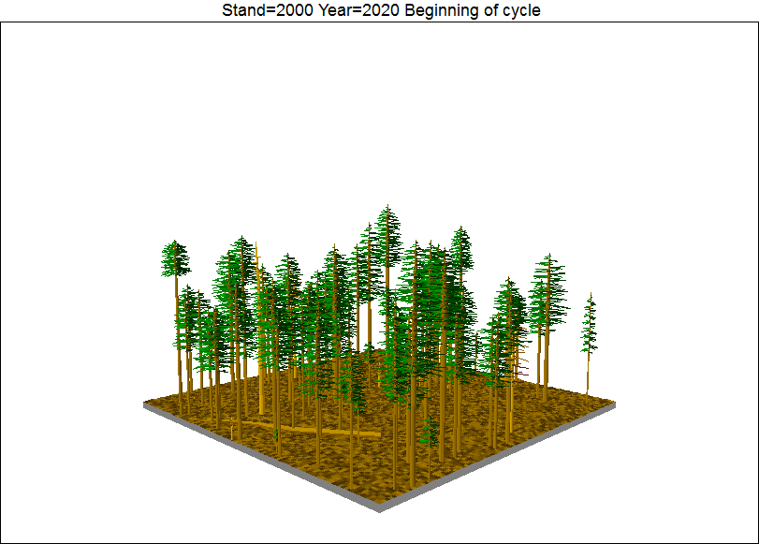
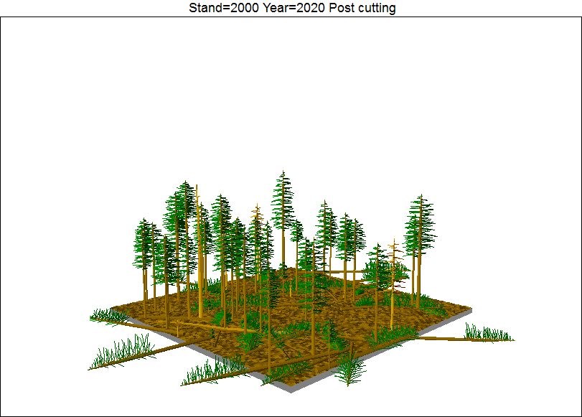
ECOSYSTEM MODEL EVALUATION
Forest Vegetation Simulator (FVS)
United States Forest Service (USFS)
http://www.fs.fed.us/fmsc/fvs/
Domain/Objective
FVS is an individual-tree, distance-independent, growth and yield model that can simulate a wide range of silviculture treatments for most major forest tree species, forest types, and stand conditions
Key Assumptions
Defined by regional variants (20), issues regarding regeneration and mortality are generalized by region
Temporal/Spatial Scale
Multi-year, spatially undefined but output is based upon (1-multiple) forest stands up to landscapes

Slide 2
Input Drivers (Forest Inventory Data)
Forest Stand Dynamics
Tree Species, DBH, Tree height, crown width
Site Quality
Latitude, Longitude, slope, aspect, elevation, habitat type
Key Outputs
Growth and yield calculations based upon site, conditions, and silvicultural treatments
TPA, BA, SDI, QMD, Bd.Ft./acre, MAI, Avg. Dominant Ht., CCF

Slide 3
Model Output and Validation
Model Extensions
Insect and Disease Extensions
Fire and Fuels Extension
Carbon Submodel
Climate-FVS
ECON

