Slide 1
Precipitation-Runoff Modeling System (PRMS)
United State Geological Survey
http://wwwbrr.cr.usgs.gov/projects/SW_MoWS/PRMS.html
Objective
To evaluate basin wide changes in water-balance relationships, flow regimes, flood peaks and volume, soil-water relationships, sediment yields, and groundwater recharge in response to precipitation, climate, and land use changes
Key Assumptions
Watershed has less than 50 habitat types, units are homogenous, measured streamflow data is available for calibration, extent of HRU’s is consistent across basins, there are no variations in solar activity or atmospheric effects, snowpack exists in a stable state
Temporal/Spatial Scale
Two temporal scales: Daily for mean data and storm for events between 1 minute and 24 hours
Spatial Scale: User determined based on the size of the watershed being investigated. Limited by the number of habitat types
Notes:
PRMS is a modular-design, deterministic, distributed-parameter modeling system used to….
It was developed in 1983.

Slide 2
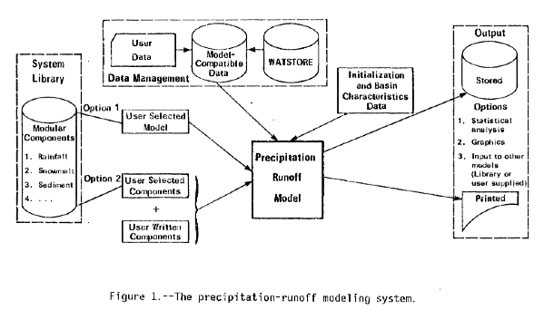
Inputs
• Daily Precipitation (mm)
• Daily Maximum Temperature (ºC or ºF)
• Daily Minimum Temperature (ºC or ºF)
• Daily Shortwave Radiation (snow)
• Daily Pan Evaporation (no snow)
• Descriptive Date: Topography, Soils, Vegetation
Outputs
• Streamflow (m³s)
• Evapotranspiration
• Groundwater Storage and Inflow (mm)
• Soil Moisture (mm)
• Snowpack Water Equivalent (mm)
• Sediment Yield
• Sediment Concentration
Notes:
The descriptive data are subunits called HRU’s – Hydrologic Response Units, based on descriptive statistics of the homogenous units.

Slide 3
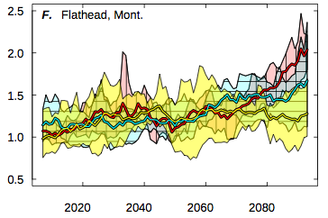
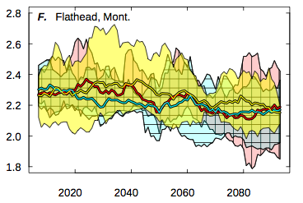
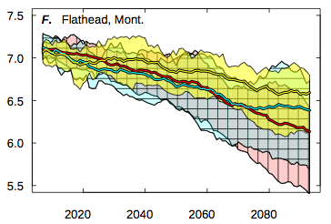
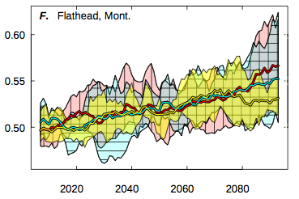
Surface Runoff (m³s)
Snowmelt (mm per day)
Soil Moisture (mm)
Recharge (mm per day)
Notes:
Intergrated Watershed-Scale Response to Climate Change for Select Basins Across the United States, USGS, Markstrom, et al. 2012.
- PRMS is combined with General Circulation Model Projections.
-South Fork Flathead River, MT. This study is necessary because of Hungry Horse Dam and the mandate from its license to provide minimum base flows for bull trout and to provide summer flow augmentation for Columbia River salmon and steelhead.
- The main take away is that streamflows are going to become highly variable, especially for for April, May, and June.
- Increased winter flows and decreased summer flows.
-None of this is that new of information but it allows a bunch of contributing variables to be looked at.
-This could also have application for looking at land use changes from pine beetle which was not done in this study.
Other studies: Growing season analysis, reservoir operation analysis, frozen soil impacts of runoff, basin sensitivity to climate change.

