Slide 1
ECOSYSTEM MODEL EVALUATION
David Fulton-Beale
The Terrestrial Ecosystem Model
The Marine Biological Laboratory
http://ecosystems.mbl.edu/TEM/
Domain/Objective
TEM is a model that describes the carbon, nitrogen and water fluxes for plants and soils in terrestrial ecosystems around the world.
Key Assumptions
Uses potential vegetation
individual species not defined
Temporal/Spatial Scale
Monthly timestep, .5° Latitude x .5° Longitude

Slide 2
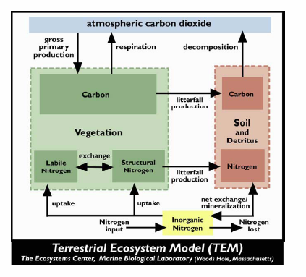
Input Drivers
Temperature
Precipitation
Solar radiation
Atmospheric CO₂ Concentration
Land Cover and Use
Nitrogen Deposition
Ozone
Elevation
Soil Type
Key Outputs
Plant growth
Ecosystem carbon storage or losses
Nitrogen losses to the atmosphere and rivers
Net methane fluxes
http://ecosystems.mbl.edu/TEM/tem.png

Slide 3
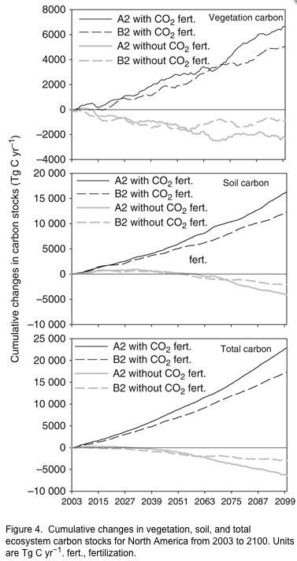
Example of a result
From Balshi et al. 2009

