Slide 1
3-PG The Use of Physiological Principles in Predicting Forest Growth
http://3pg.forestry.ubc.ca/
Landsberg and Waring 1997
Notes:
-The model is meant to be an easy-to-use tool for forest managers in simple forested ecosystems and can be run as an Excel spreadsheet with minimal training.

Slide 2
Objective
3-PG is a simple process-based model that simulates forest growth based on an understanding of physiological principles that predict tree growth
Key Assumptions
Uniform foliage distribution across stand
Constant ratio of NPP to GPP (a constant fraction of GPP is respired)
Precipitation is evenly distributed over a month
No major disturbance events
Temporal & Spatial Scale
Monthly or annual time step
Typically stand-level, but can be scaled up to model forest growth across landscapes (3-PG(S); Coops et al. 1998)
Notes:
-Very simply, the model calculates PAR absorbed by forest canopies and converts it to biomass production.
-needs to be parameterised for individual species.
-could potentially be used for mixed species stands (see 3-PGmix; Forrester and Tang 2016)

Slide 3
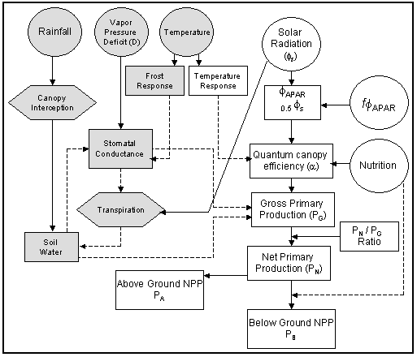
Input Drivers
Incoming shortwave radiation (Ф_{s})
Monthly precipitation (total)
Monthly mean daytime vapor pressure deficit (D)
Number of frost days per month
Initial stem, foliage, root biomass
Initial stand age, density
Soil type, depth, water holding capacity, initial available soil water
Site fertility rating (nutrition)
Latitude
Key Outputs
Net primary production (NPP)
Stem, foliage, root biomass
Available soil water
Stand transpiration
Figure 1. Simplified flow diagram of 3-PG model.
Ф_{APAR} = Utilized portion of absorbed PAR.
f = A modifier. The conversion of radiation to GPP is modified by the effects of nutrition, soil drought, VPD, sub-freezing temperatures and stand age
(figure from http://3pg.forestry.ubc.ca/model-description/)
Notes:
-Takes incoming solar radiation and converts this to “utilizable aPAR” which is basically saying that in the conversion of radiation to GPP, aPAR is modified by factors like high VPD, soil drought, sub-freezing temperatures, and stand age.
-3PG can be used to analyze the probable effects of varying growing conditions or management actions such as thinning or fertilization have on forest growth.

Slide 4
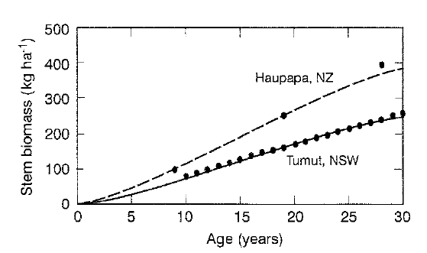
Model Validation
Figure 2. Modeled (lines) versus measured (points) stem biomass in two Pinus radiata stands. (From Landsberg and Waring 1997)

Slide 5
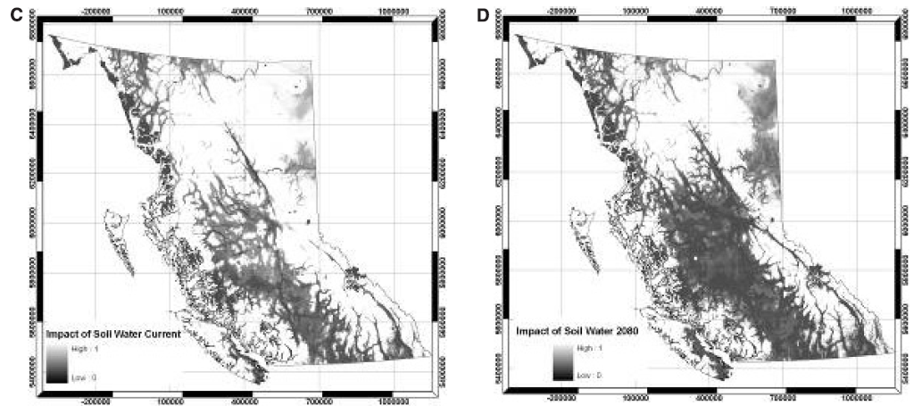
Example of Result
Figure 3. Current (C) and projected (2080; D) impact of soil water content on Douglas-fir growth across different climatic zones in British Columbia. (From Coops et al. 2010)

