Slide 1
ECOSYSTEM MODEL EVALUATION
Model Name/Host Institution/URL
ORCHIDEE (ORganizing Carbon and Hydrology In Dynamic Ecosystems Environment), Institut Pierre Simon Laplace
http://forge.ipsl.jussieu.fr/orchidee/wiki
Domain/Objective
Orchidee simulates Energy, Water and Carbon fluxes at the land surface/atmosphere interface.
To be used for being the ‘land surface’ component of a Earth system model
Key Assumptions
Surface is represented as a mosaic of vegetation, one set of soil properties per grid cell, parameters of C dynamic equations differ among PFT's, one water balance (2-layer bucket) per PFT
Temporal/Spatial Scale
ORCHIDEE does not enforce a spatial or temporal resolution, the model does use a spatial grid and equidistant time steps

Slide 2
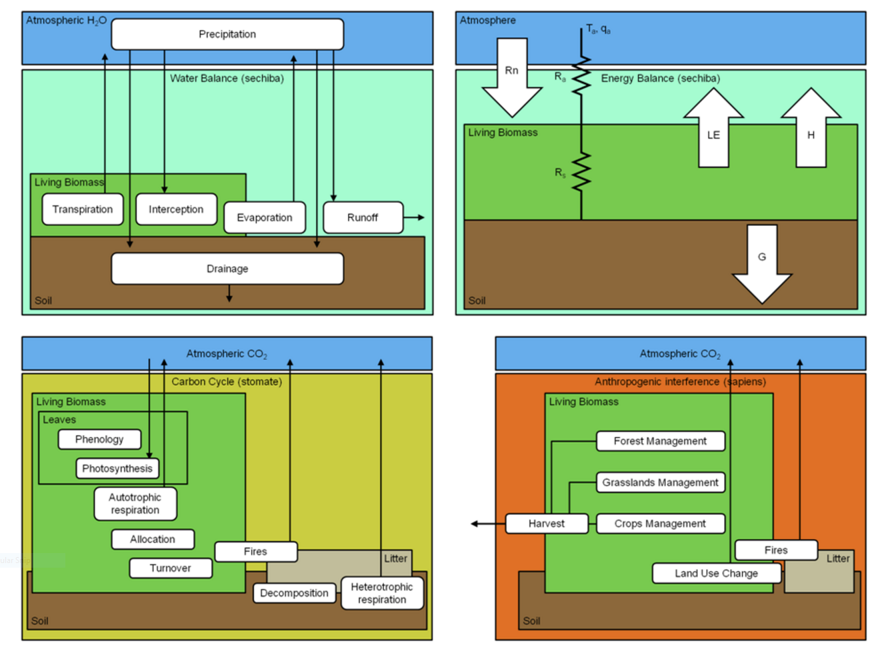
Energy Balance
Water Balance
Biogeochemical processes
Anthropogenic processes
Figure 1. ORCHIDEE is based on two different existing models (SVAT SECHIBA and DGVM LPJ) and one newly developed model (Stomate).
Input Drivers
Air temperature
Wind speed
Solar radiation
Air humidity
Precipitation
Atmospheric CO₂ concentration
Key Outputs
LAI
GPP
NPP
NEE
Heterotrophic Respiration
Total Living Biomass
Total Soil Carbon

Slide 3
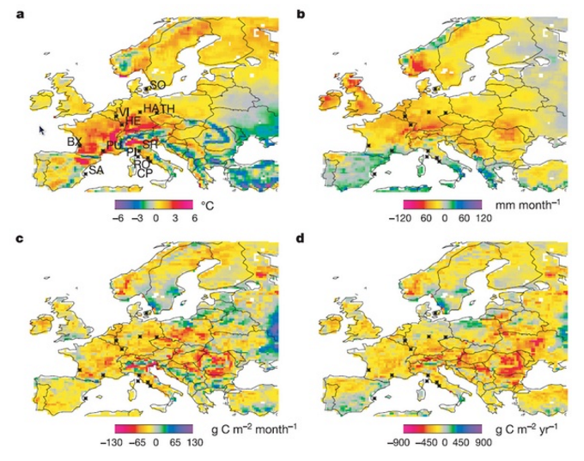
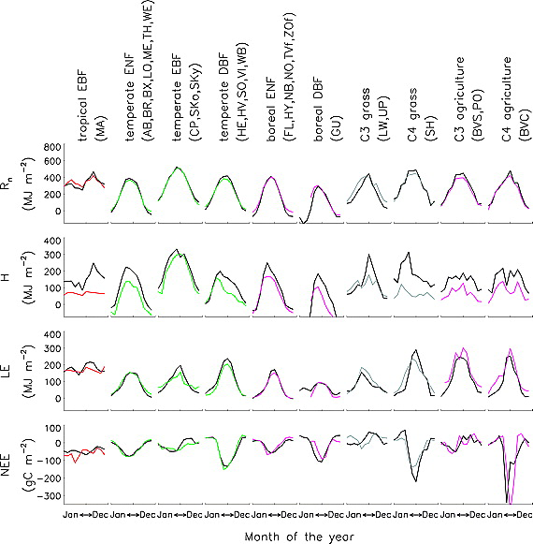
Testing/Validation, Examples of a result
Figure 2. European-wide anomalies of climate and net primary productivity (NPP) during 2003. All data compare 2003 and the average of 1998–2002. (a) Changes in July–September air temperature. (b) Changes in annual precipitation. (c) Simulated changes in July–September NPP. (d) Simulated changes in annual mean NPP.
Figure 3. Measured (colored) and modeled (black) seasonal cycle for each flux and each PFT (see text). From top to bottom: net radiation (R_{n}), sensible heat flux (H), latent heat flux (LE), and net CO₂ flux (NEE).

