Slide 1
ECOSYSTEM MODEL EVALUATION TEMPLATE
Model Name/Host Institution/URL
Fire Spread Probability Simulator (FSPro)
http://wfdss.usgs.gov/wfdss/WFDSS_Home.shtml
Domain/Objective
FSPro is a modeling system that outputs a spatial prediction of burn probability used to evaluate if a given fire ignition will result in fire spread that could impact a value(s) of concern. The modeling system includes fire spread, a time series generator of fire danger linked to wind and weather parameters, fuel models and fuel moistures as inputs in order to simulate thousands of ensemble fire simulations.
Key Assumptions
Fire spread is continuous for the length of the user defined burn period (hours) under daily constant wind and weather conditions. Suppression actions are not simulated except with a barrier file.
Temporal/Spatial Scale
Daily time step produces daily fire spread continuously for a user determined time period (usually 7 to 14 days) over a landscape (100 to 10,000 ha).
By Erin Noonan-Wright, 2.22.16

Slide 2
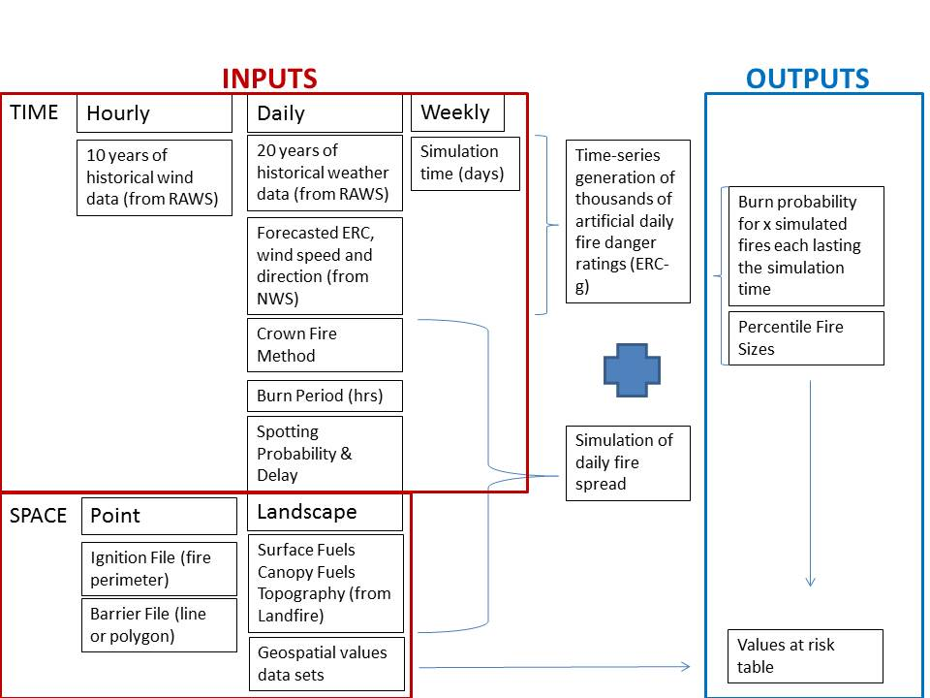
Input Drivers
Spatial landscape composed of geospatial grids (surface fuel model, aspect, elevation, slope, canopy cover, canopy base height, canopy bulk density, canopy height)
15 to 20 years of daily weather (downloadable files from a Remote Automated Weather Station – RAWS)
Hourly winds (also downloadable from a RAWS station)
Current fire location represented by a line or polygon (the fire perimeter either drawn or imported as a shapefile)
Estimates of the burning period (minutes) and duration of simulation (usually 7 – 14 days)
Percent fine dead and live fuel moistures (generated automatically from historical data)
Forecasted wind speed, direction, and fire danger (Energy Release Component – ERC for fuel model G).
Spatial data representing values (jurisdictions, building clusters, roads, wilderness areas, etc.)
Key Outputs
Percentile fire sizes (n = no. of simulations each lasting for 7-14 days)
Burn Probability
Values at risk for each burn probability bin, i.e. (<0.2%, 0.2-4.9%, 5-19%, 20-39%, 40-59%, 60-79%, 80-100%) (table)

Slide 3
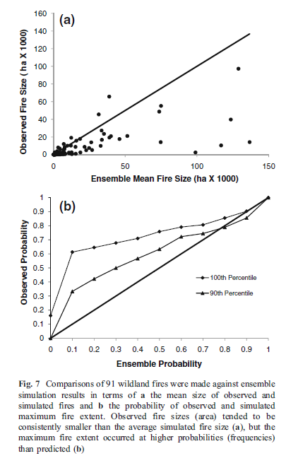
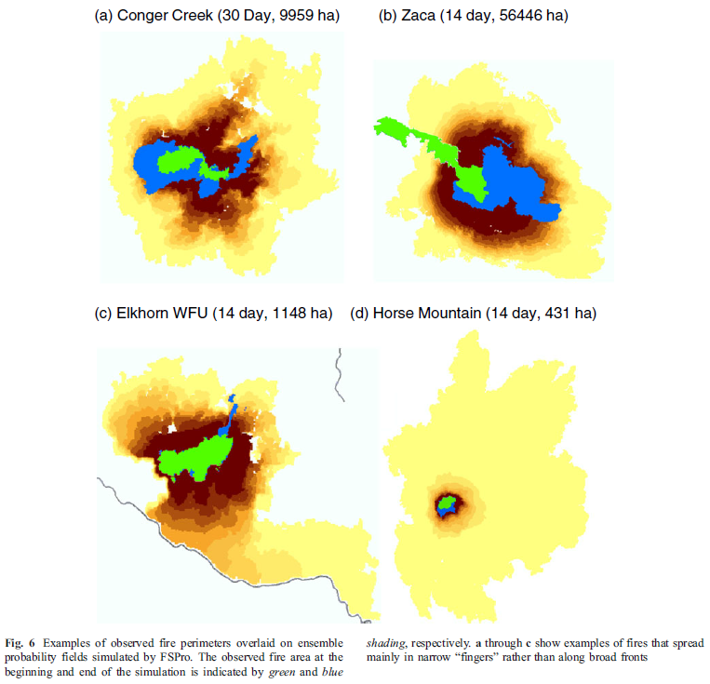
Testing/Validation, Examples of a result
From Finney, M.A., Grenfell, I.C., McHugh, C.W., Seli, R.C., Trethewey, D., Stratton, R., and S. Brittain. 2010. A Method for Ensemble Wildfire Simulation. Environ Model Assess. DOI 10.1007/s10666-010-9241-3

