Slide 1
Ecosystem Model Evaluation
MEaSUREs Wetlands ESDR – NTSG University of Montana
http://www.ntsg.umt.edu/project/measures_wetlands
Jen Harrington
Domain/Objective
“The NASA Earth science project's main objective is the construction of a global-scale Earth System Data Record (ESDR) of inundated wetlands to facilitate investigations on their role in climate, biogeochemistry, hydrology, and biodiversity.”
Key Assumptions
MeASURE data lacks continuity, and that is a serious obstacle
•Missions, specification, and objectives change
•Algorithms change
Temporal/Spatial scale
Monthly global mappings of inundation extent at ~25 km resolution, coupled with fine-resolution, 100m, maps
of wetland extent, vegetation type, and seasonal inundation dynamics.

Slide 2
SAR Data Classification: Decision tree
Assemble data layers
Mutually co-register data layers to common projection and 30 meter resolution.
Derive ancillary products such as slope, ndvi, fusion of radar and optical
Create training file based on ground truth data
Mask data layers to exclude open water
Set operating parameters and run Random Forest
Wetlands classification
Monitoring Landscape Inundation Dynamics For Supporting Characterization of carbon cycle of Northern Eurasia. McDonald et.al, 2012
NASA, JAXA, ASF

Slide 3
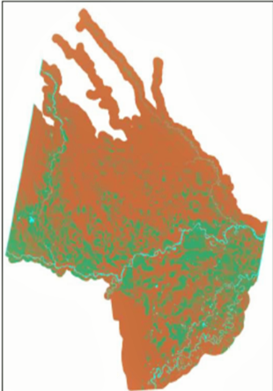
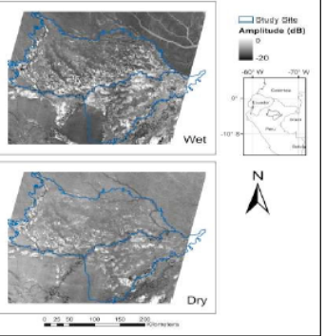
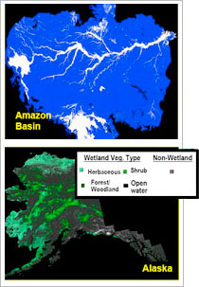
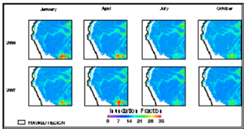
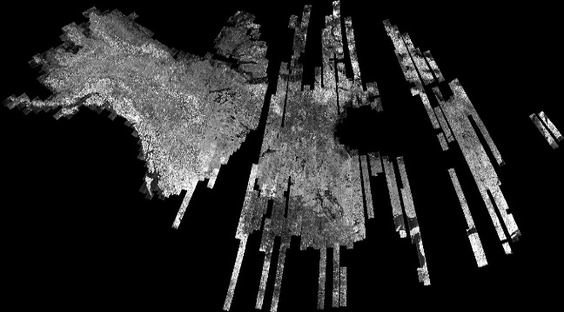
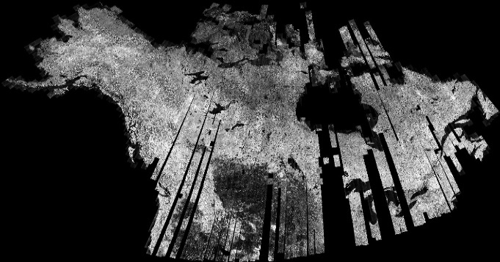
Wetlands exert major impacts on global biogeochemistry, hydrology, and biological diversity.
“The extent and seasonal variation of inundated wetland areas are very important in characterizing and predicting ecosystem dynamics. “
Remote sensing offers effective tools for characterizing wetlands.
Remote sensing is sensitive to surface water and to vegetation structure.
It allows monitoring large inaccessible areas on a temporal basis regardless of atmospheric conditions or solar illumination.
Fig.3 The Loreto study site, in the upper Amazon of Northern Peru, is delineated on the ALOS/PALSAR multi-temporal image mosaics of the area.
Fig. 4 Classification results of the Loreto floodplain. Green=palm swamps, blue=open water, brown=other classes. 20300km² are predicted to be covered by palm swamps.
Fig. 1 Courtesy of GRFM, (c) NASDA/MITI" .
North America JERS-1 Winter Mosaics
North America JERS-1 Summer Mosaics
Classification results show that improvements need to be performed in terms of excluding shadows and avoiding classification in areas of steep terrain and in obtaining better separability between dense and sparse palm swamp forest patches. Next is running a supervised decision classification approach based on the classes identified through the unsupervised approach. Podest et al., 2011
Fig. 5 Combined QuikSCAT and AMSR-E microwave data to generate landscape inundation fraction (shown as percent inundated of 25km grid cells) comparing the Upper Amazon Basin in Northern Peru for 4 months over2006 and 2007.
Fig. 2 North America JERS-1 mosaics. Images Copyright (c) 1992-1998 NASDA/MITI Courtesy of the Global Rain Forest Mapping (GRFM) project The JERS-1 SAR data, images and text are only intended for scientific and/or educational use. Any other use is prohibited under the terms of the NASDA/MITI copyright.
Courtesy of GRFM, (c) NASDA/MITI" .
Fig. 4,5,6 “Microwave Remote Sensing of Palm swamp distribution and flooding status over a sub-region in Upper Amazon Basin”, Podest, A. et al., 2011.

