Slide 1
Peter Davis
2.22.16
BIOS-534
Regional Hydro-Ecological Simulation System
UC Santa Barbara Department of Geography
http://fiesta.bren.ucsb.edu/~rhessys/index.html
Objective
RHESSYS is a carbon, water, and nutrient flux simulation model with a hydro-ecological framework using GIS technologies.
Key Assumptions
Small to medium (first-fifth order) streams, regional climate station-required precipitation and min/max daily temp, GRASS/ ARC inputs.
Temporal & Spatial Scale
Simulation is temporally undefined. Simulations must first go through a spinup period to generate Carbon and Nitrogen pools. Climate inputs are daily. Spatially undefined with expected variability.

Slide 2
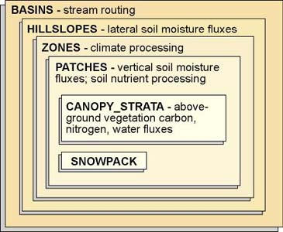
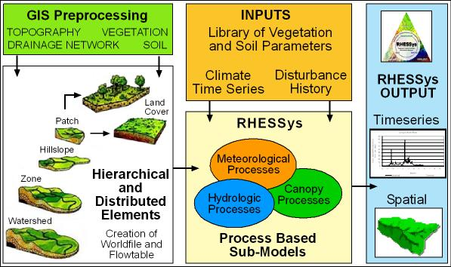
Inputs
Terrain partitioning
Stream network
Soil type K (hydraulic conductivity)
Land use
Wetness index
Vegetation cover
LAI (m²/m²)
Streamflow data (ft³/s)
Nitrogen deposition data
Water quality
Outputs
Groundwater N store/output (mg/L⁻¹)
Nitrification/ denitrification (g/m/day)
DOC loss (g/m²/day)
Net Photosynthesis (kg/m²)
LAI (m²/m²)
Precipitation (mm)
Evapotranspiration (mm/m2)
Percent snow cover (m²/m²)
PAR (KJ/m²)

Slide 3
Hydrologic controls on N cycling for a small
forested catchment (Band et al. 2001).
Overpredicted N concentrations, but captured temporal pattern.
(Band et al. 2001)

