Slide 1
ECOSYSTEM MODEL EVALUATION
Model Name/Host Institution/URL
MIMES (Multiscale Integrated Models of Ecosystem Services)
AFORDable Futures
http://www.afordablefutures.com/
Domain/Objective
MIMES is a multi-scale integrated set of models that assess the value of ecosystem services. The objective is to assist government decision-makers, NGO’s and any other natural resource managers in understanding ; 1) The Dynamics of ecosystem services, 2) How ecosystem services are linked to human welfare, and 3) How the value might changes under various management scenarios.
Key Assumptions
Ecosystems are structures and processes that generate functions, ecosystem services are ecosystem functions of value to humans, ES are fueled by solar energy, availability of ES depends on ecosystem functioning
Temporal/Spatial Scale
Spatially and temporally scalable – can be applied at multiple scales from watershed to global

Slide 2
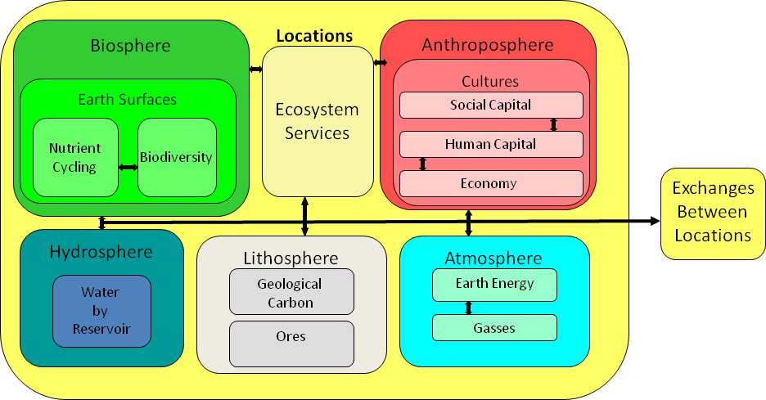
Input Drivers
MIMES uses a deductive matrix to build the model, including valuation of;
Marginal cost-pricing model, Ecosystem supplies and Ecosystem services, Economic uses, Economic impacts to Ecosystem Services
Includes stakeholder input and biophysical datasets
Key Outputs
Widely varied
Spatial and temporal scenarios on social equity, ecological integrity, economic efficiency, the contribution of ecosystem services to economic production, and the perceived scarcity of ecosystem services

Slide 3
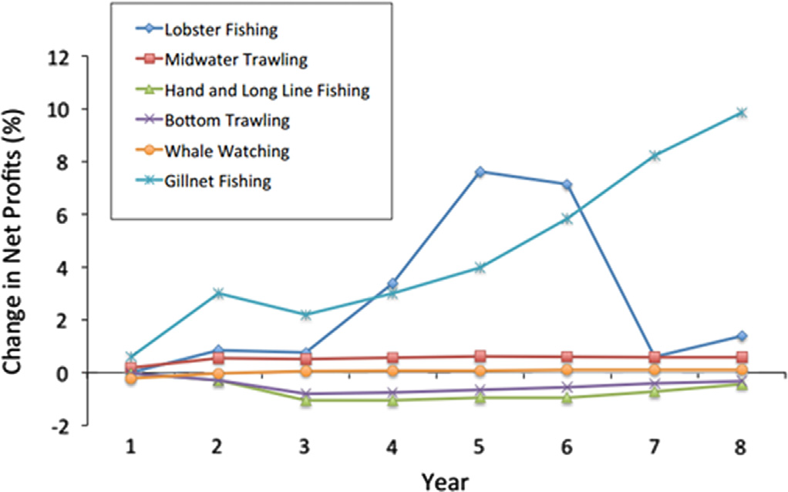
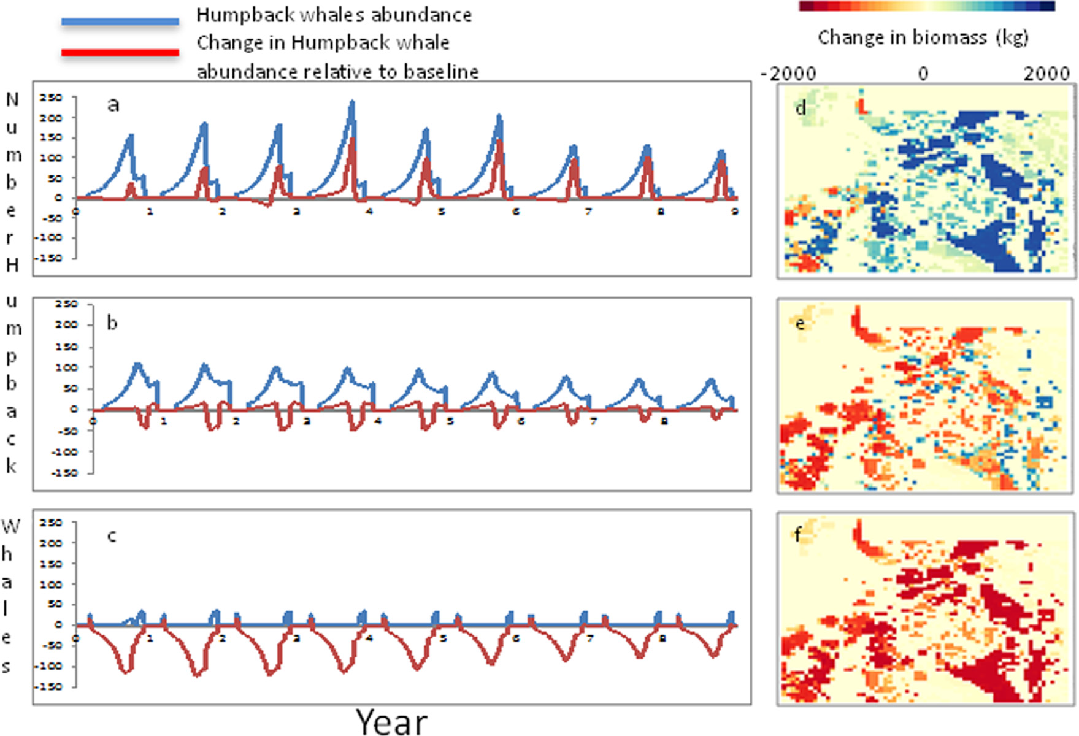
Testing/Validation, Examples of a result
Mimes – generated scenarios for the Massachussetttes Ocean case study. Model outputs showed the change in Humpback whale abundance based on different intensities of fishing for forage fish (N sand lance and Atlantic herring). Boumans et al, 2015
Mimes scenarios reveal the impacts of wind turbines on other human uses in Massachusetts Bay. The change in net profits from baseline conditions with no wind turbines in shown, across an eight-year model run within the largest area of wind development under full-use scenarios. For the human activities, each point is the average change in net profits from the baseline. Boumans, et al. 2015

