Slide 1
WindNinja
Model
WindNinja, Rocky Mountain Research Station, US Forest Service
http://http://www.firelab.org/project/windninja
Domain/Objective
WindNinja is a model that computes spatially varying wind fields for wildland fire and other applications requiring high resolution wind predictions in complex terrain.
Key Assumptions
Conservation of mass only (not momentum), steady state, deterministic, simple energy budget for thermally induced wind,
input wind values close to large scale flow
Temporal/Spatial Scale
Steady state within 1 hour scale, 3-D spatial dimensions,
horizontal domain (50-100km), vertical domain (1-5 km),
vertical cell size~ 5m, horizontal cell size ~ 100m

Slide 2
Site Data
Latitude
Longitude
Time of Day
Vegetation Type
Meteorological Data
Air Temperature
% Cloud Cover
Wind Speed
Wind Direction
Vegetation
DEM
Average Wind Flow
Point Initialization
RAWS
Solver
Stability
Model
2-D Weather Model
grid initialization
Diurnal
Model
3-D Gridded
Wind Speed
and Direction
2-D surface wind
20 foot
kml
ascii
shp
geo.pdf
Input Drivers
Wind Speed (m/s)
Wind Direction (degrees)
DEM (m)
Vegetation (grass, brush, trees)
Surface Heat Flux (W/m²)
Solar Irradiance (W/m²)
Key Outputs
3-D Gridded Wind Speed (m/s)
Wind Direction (degrees)
2-D surface wind (m/s)
Various file formats

Slide 3
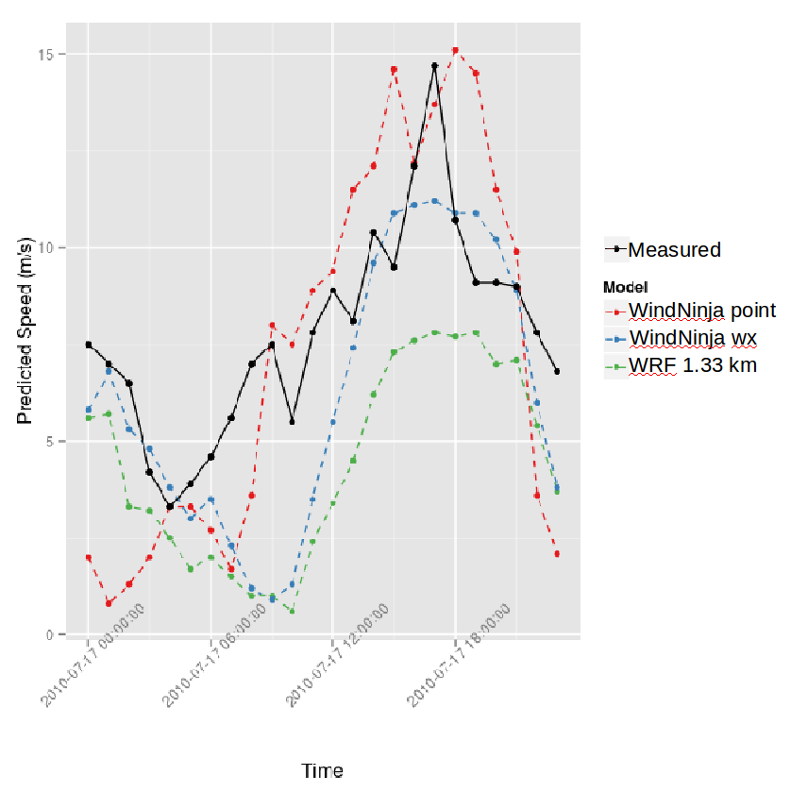
Testing/Validation, Examples of a result

