Slide 1
DayCent |Overview
Domain & Objective
Biogeochemical model that simulates exchanges of C and N among atmosphere, vegetation and soil
Name & Host Institution:
DayCent: Daily Century Model (SJ Del Grosso et al., 2011)
Hosted by the Natural Resource Ecology Laboratory (NREL) at Colorado State University http://www.nrel.colostate.edu/projects/daycent-home.html
Key Assumptions:
NPP based on vegetation type, phenology, and water/nutrient stress
Nutrient concentrations depending on vegetation type and nutrient availability
Decomposition and mineralization functions of substrate availability, substrate quality (lignin %, C/N ratio), and water/temperature stress.
N gas fluxes from de/nitrification driven by soil parameters
Spatiotemporal Scale:
Soil profile estimate for ‘pixel’ at daily timestep, can be spatially distributed

Slide 2
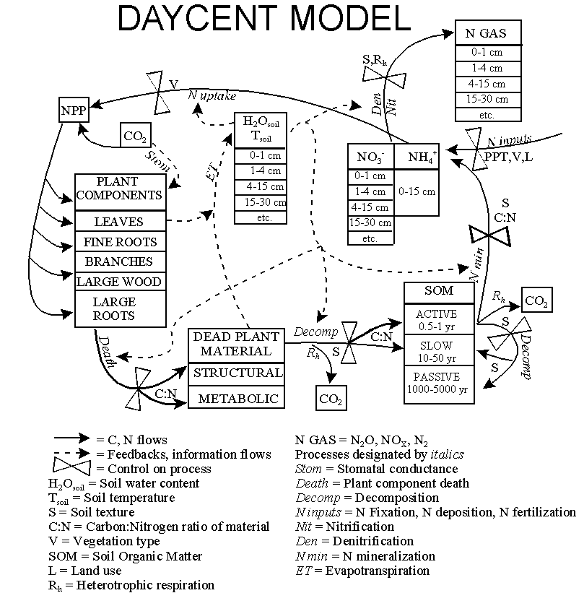
DayCent | Components
Inputs/Drivers:
Daily maximum/minimum air temperature and precipitation
Surface soil texture class
Land cover/use data
Outputs:
Daily N-gas flux (N₂O, NO_{x}, N₂)
CO₂ flux from heterotrophic soil respiration
Soil organic C and N, NPP, H₂O, NO₃ leaching,
Submodels:
Soil H₂0 and temperature by layer
NPP and allocation
Decomposition of litter and soil organic matter
Mineralization of nutrients
N gas emissions from nitrification and denitrification
CH₄ oxidation in non-saturated soils

Slide 3
DayCent | Applications
Estimates soil N₂O emissions for EPA inventory of GHGs
Alternative cropping comparison
Global soil C and N estimates
Wieder, Bonan, Allison, 2013 Nature Climate Change
Del Grosso et al., 2009 Global and Planetary Change

