Slide 1
Biome-BGC: Overview
Model Name/Host Institution/URL
Biome-BGC, NTSG University of Montana
http://www.ntsg.umt.edu/project/biome-bgc
Domain/Objective
Biome-BGC is a computer model that simulates the storage and fluxes of water, carbon, and nitrogen within the vegetation, litter, and soil components of a terrestrial ecosystem
Key Assumptions
Species and individual plants not defined
Ecosystem LAI is a key variable
Simple N budget
Spin-up to a steady state
Temporal/Spatial Scale
Daily timestep
Spatially undefined so can be computed for any area with a gridded computation
http://imgkid.com/forest-landscape-photos.shtml

Slide 2
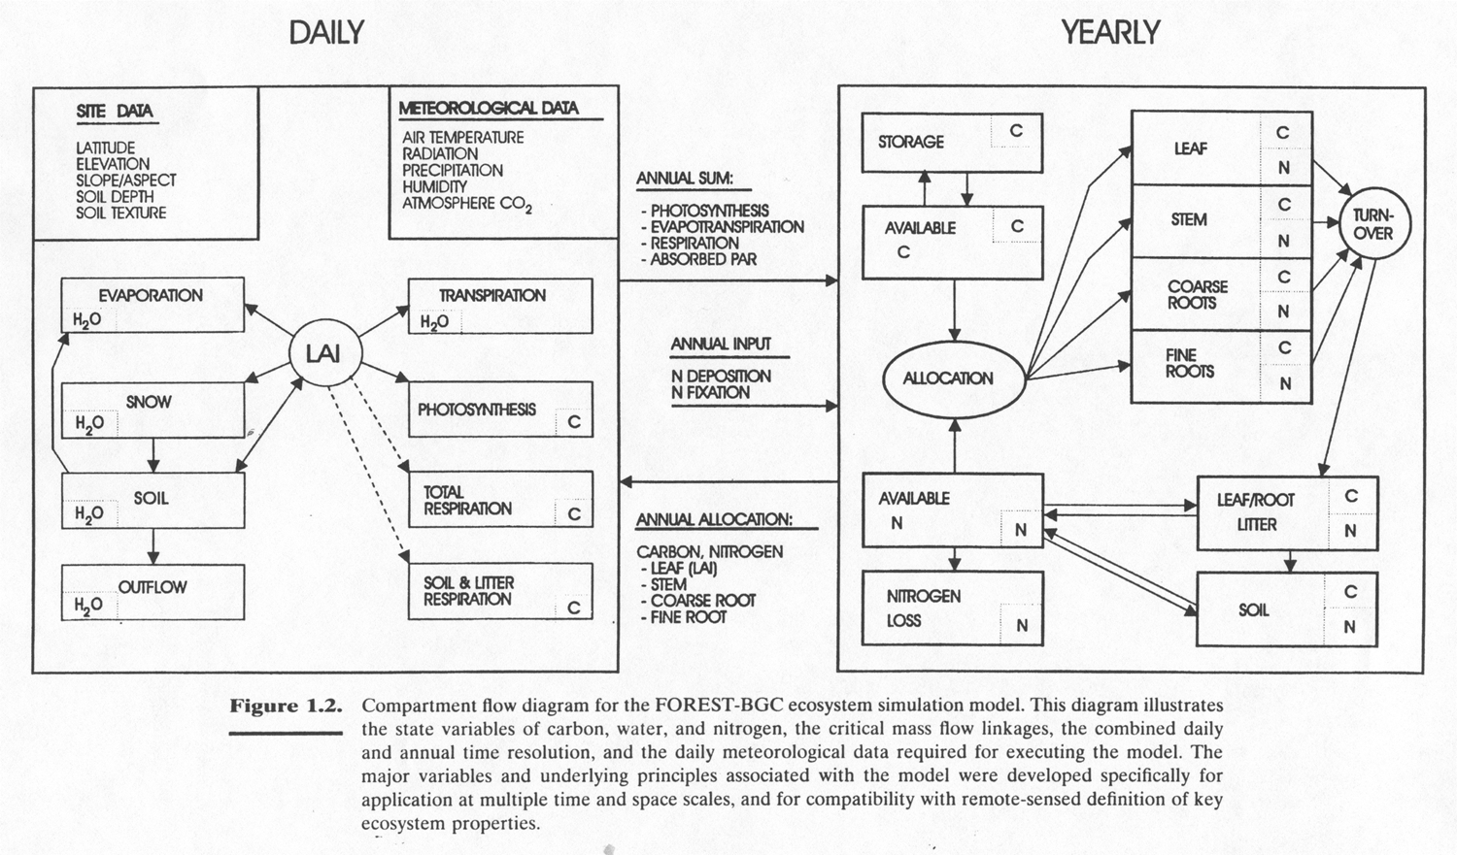
Biome-BGC: Inputs, Outputs, and Flowchart
Input Drivers (daily)
Climate
Temperature (min, max , mean daylight)
Total precipitation
Vapor pressure deficit
Incoming radiation
Average daylight shortwave radiant flux density
Daylength
Key Outputs
Daily water budget
Daily soil water
Snowmelt
Evaporation
Transpiration
Daily carbon budget
Photosynthesis
Maintenance respiration
Decomposition
Yearly carbon budget
Allocation
Plant growth
Litter turnover
Mortality

Slide 3
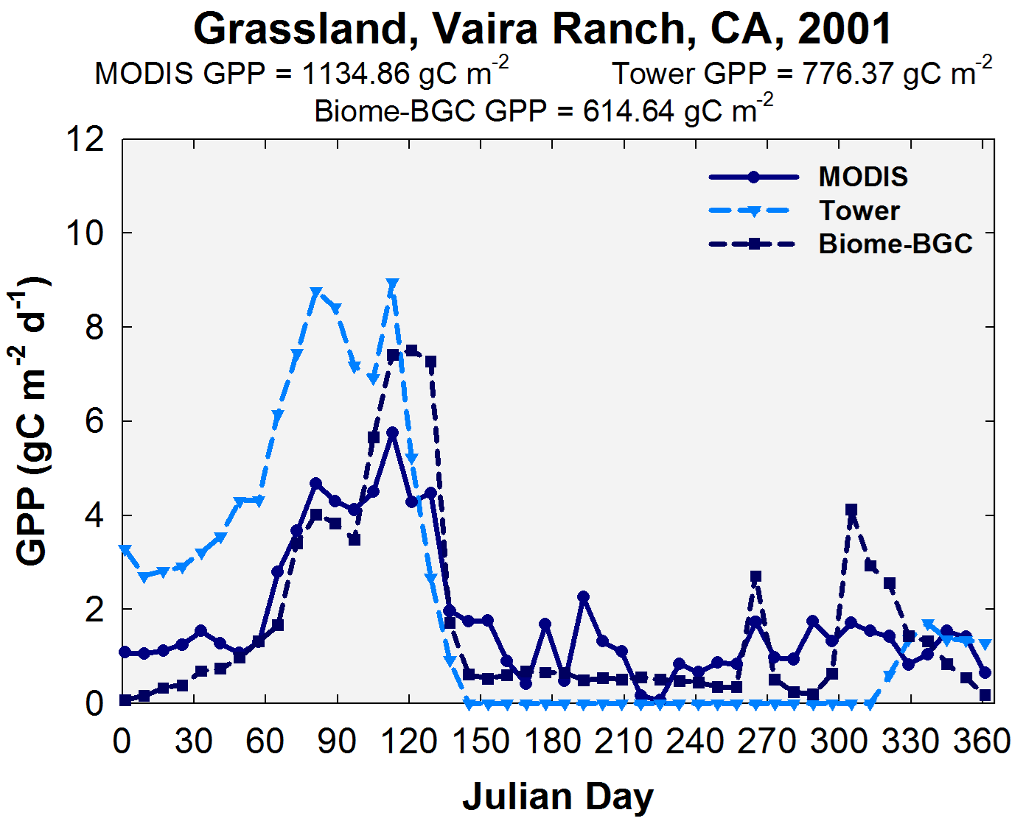
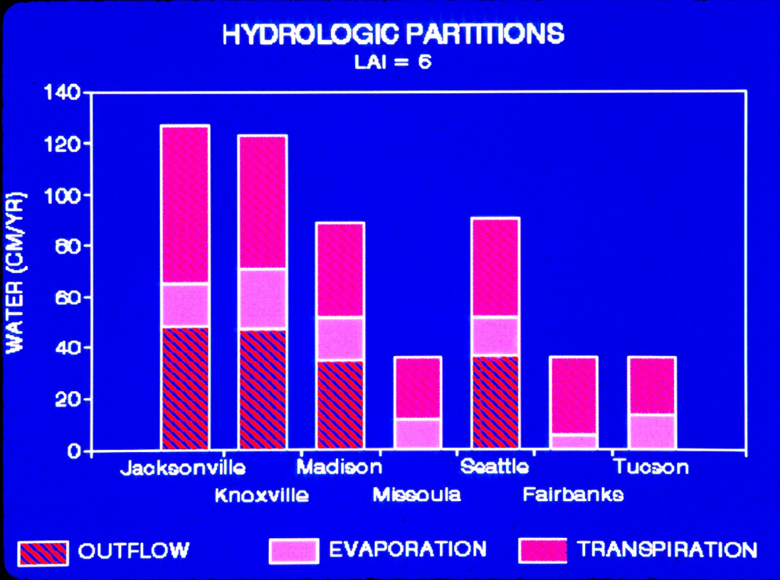
Biome-BGC: Testing and Applications
Petritsch et al. 2007, For Ecol Manag
Chirici et al. 2015, Eur J For Res

Slide 4
Biome-BGC: Running the Model
Hiccups for the newbie
Old, limited user guide
Command line interface
Ecosystem-level parameters
IDL, now ASCII
Spin-up
LAI??

Slide 5
Biome-BGC: Model Exercise

