Slide 1
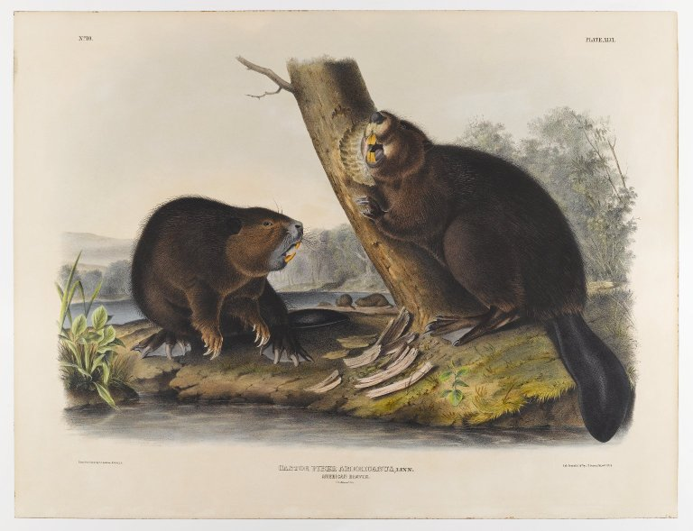
Modeling the Capacity of Riverscapes to support Beaver Dams
W. McFarlane, J. Wheaton, N. Bouwes, M.Jensen, J. Gilbert, N. Hough-Snee, J. Shivik
Utah State University, Salt Lake City, Utah
Macfarlane, W.W., et al., Modeling the capacity of riverscapes to support beaver dams, Geomorphology (2015),
http:// dx.doi.org/10.1016/j.geomorph.2015.11.019

Slide 2
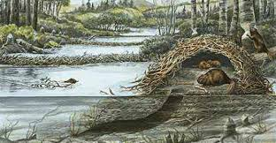
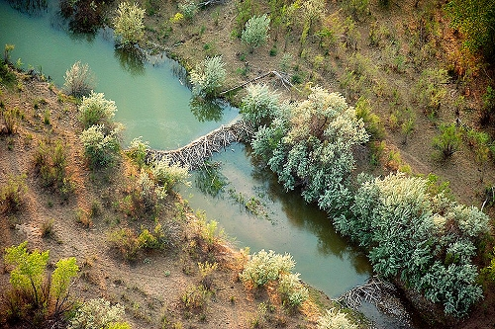
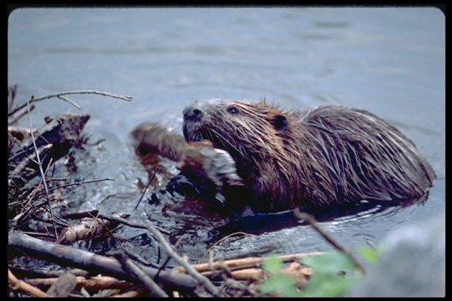
A Passive Restoration Tool
Castor canadensis, the North American Beaver
Resource managers have long recognized the ability of beaver activity to enhance floodplain connectivity through dam-building, and to reduce soil erosion, vegetation, and water loss (Scheffer, 1938).
“Beaver have relatively simple habitat requirements” (Naiman et al., 1988).
Traditional habitat suitability models do not work for beaver. With sufficient water and food beaver can survive almost anywhere. Correlations between suitability and beaver occurrence tend to be weak or non-existent.
“A better approach: A Dam-building capacity model.
Beaver dams, not beaver themselves, provide the restoration outcomes. Though beaver can survive in a wide range of conditions, where they build dams is more limited”
MacFarlane, W.W.et al, Modeling the capacity of riverscapes to support beaver dams, Geomorphology (2015)

Slide 3
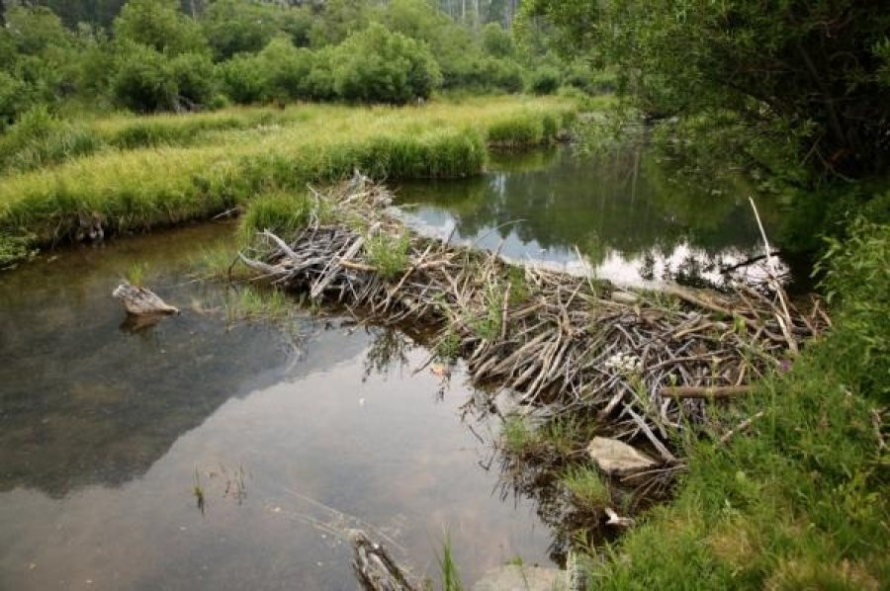
Estimates of beaver dam capacity come from seven lines of evidence:
1)Beaver need a reliable water source
2)Streambank vegetation conducive to foraging and dam building
3)Vegetation within 100m of edge of stream to support expansion of dam complexes and maintain large beaver colonies
4)Likelihood that dams could be built across the channel during low flows.
5)Likelihood that a beaver dam on a river or stream is likely to withstand typical floods
6)A suitable stream gradient that is neither too low to limit dam density nor too high to preclude the building of or persistence of building dams
7)A suitable river that is not too large to restrict the building or persistence of dams

Slide 4
MacFarlane, W., Wheaton,J., 2014 Utah State University, Ecogeomorphology and Topographic Analysis Laboratory

Slide 5

1)Evidence of a reliable water source
Streams Perennial water USGS National Hydrography Dataset http://nhd.usgs.gov/
To assess evidence that a stream within a network is a reliable water source for dam building beaver they used the National Hydrologic Dataset (NHD) cartographically derived 1:24,000 drainage network (USGS, 2014).
Study area extent covering 40,641km of stream in Utah. The white areas are the validation watersheds.
MacFarlane, W.W.et al, Modeling the capacity of riverscapes to support beaver dams, Geomorphology (2015)

Slide 6
2) Evidence of woody vegetation for building material
LANDFIRE 2011 (EVT and BPS) Riparian vegetation LANDFIRE land cover data http://www.landfire.gov/
MacFarlane, W.W.et al, Modeling the capacity of riverscapes to support beaver dams, Geomorphology (2015)

Slide 7
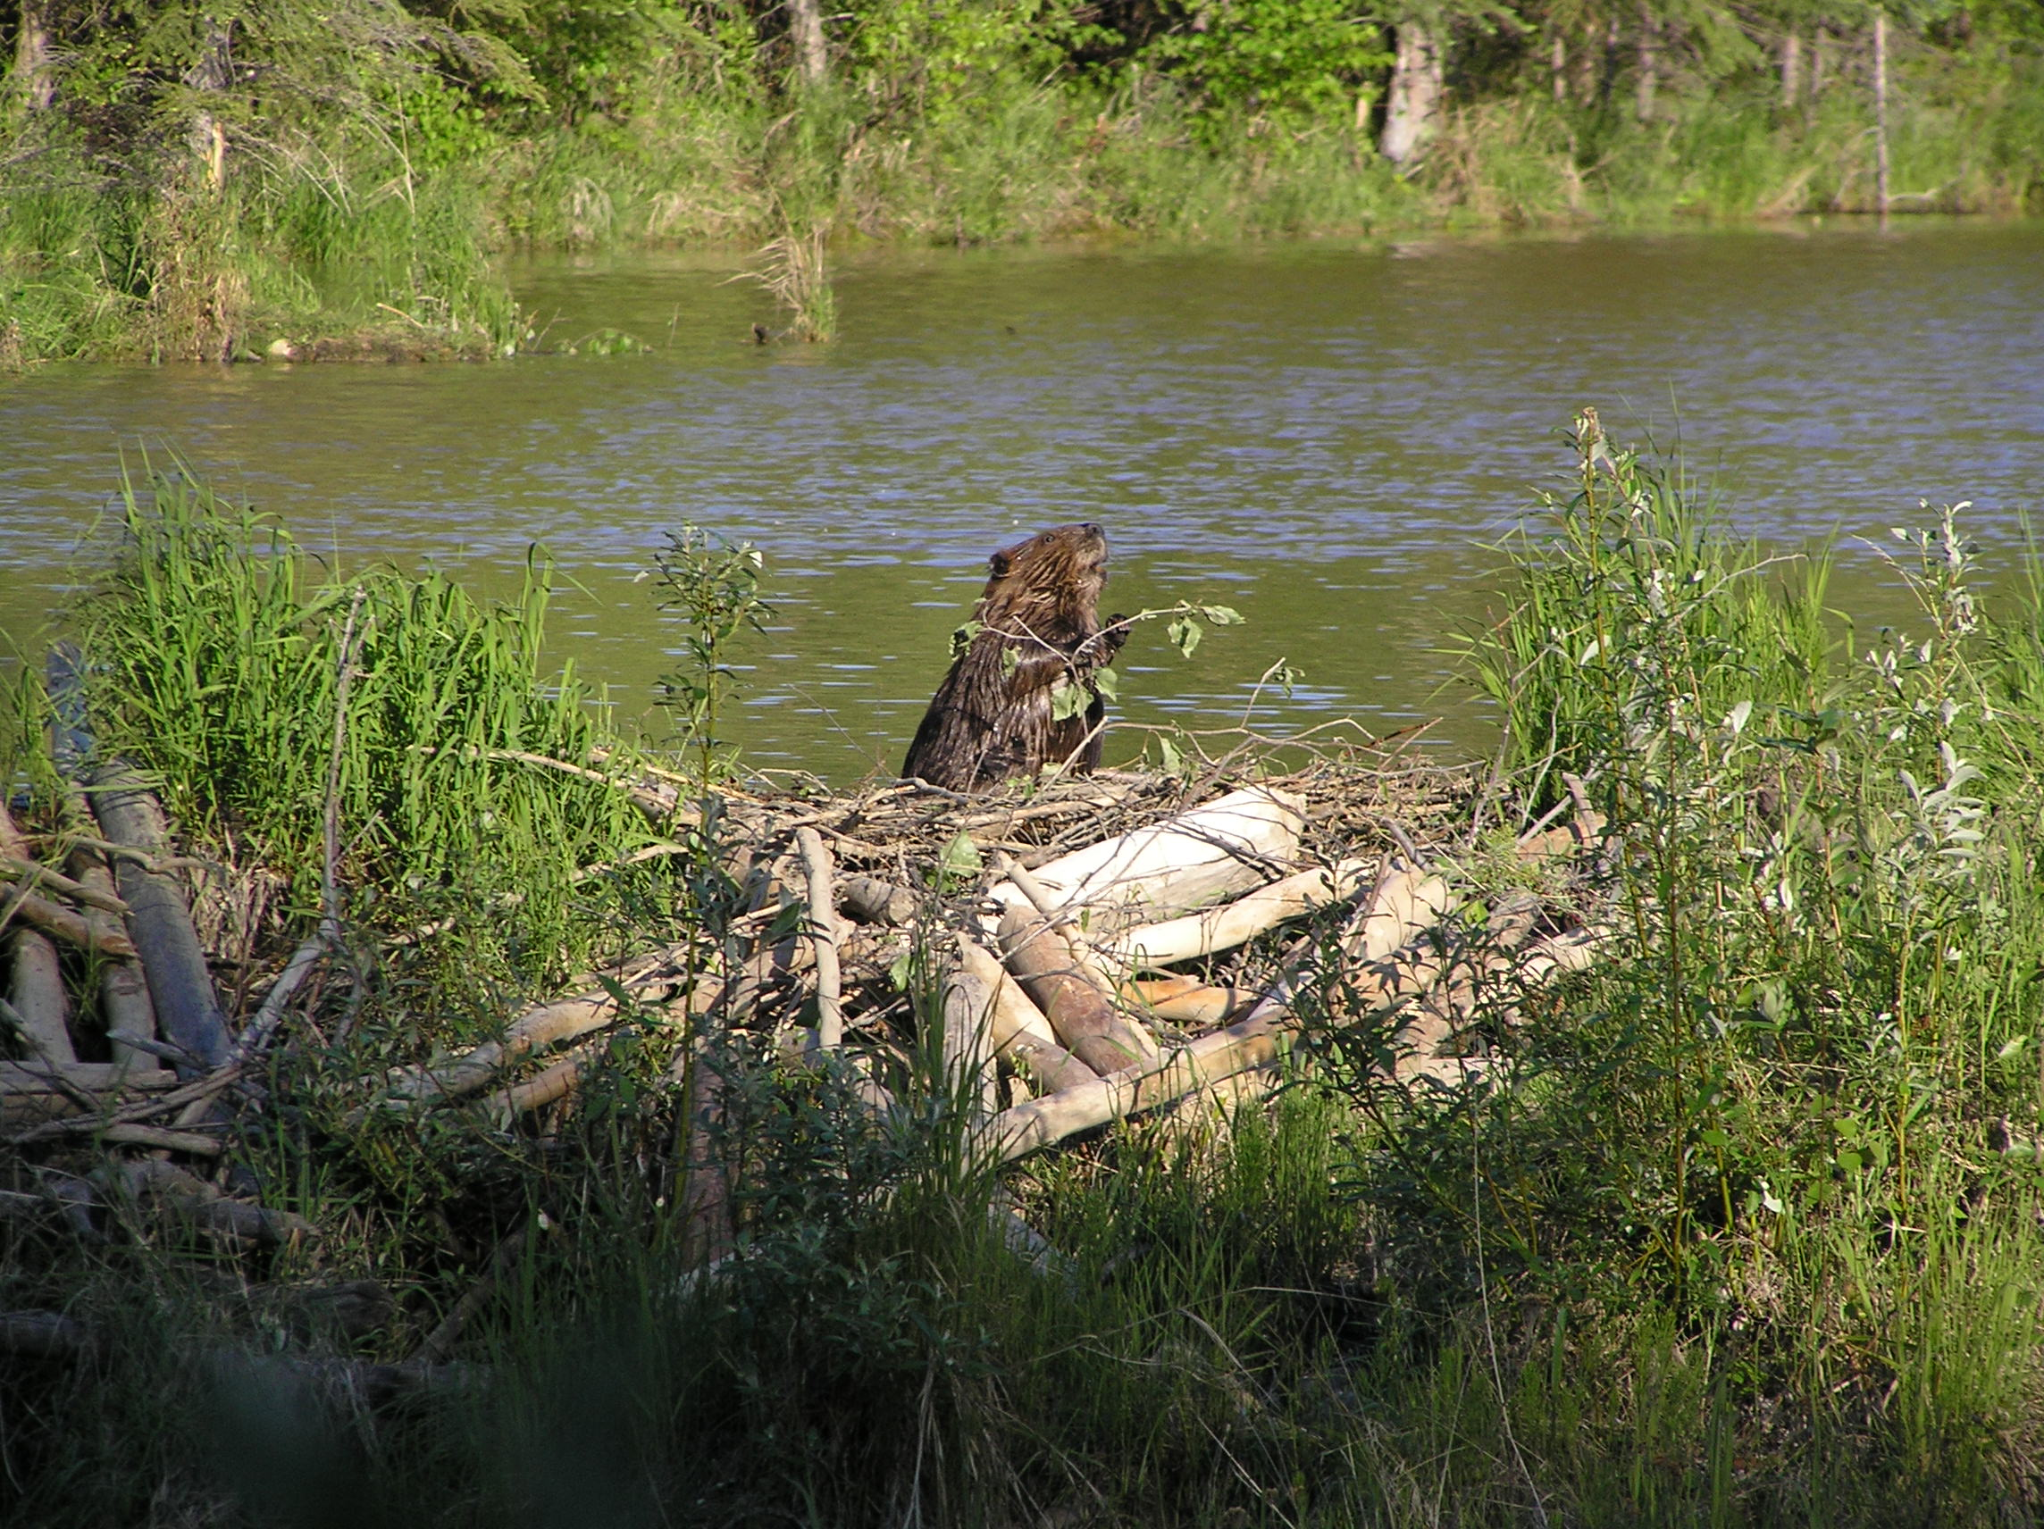
3)Evidence of vegetation within 100m of edge of stream to support expansion of dam complexes and maintain large beaver colonies.
Streamside vegetation buffers along drainage networks assessing beaver dam-building preference values:
A 30m buffer representing streamside vegetation
A 100m buffer representing maximum harvest distance

Slide 8
4)Likelihood that dams could be built across the channel during low flows.
5)Likelihood that a beaver dam on a river or stream is likely to withstand typical floods
floods
USGS baseflow equations Dam could be built Wilkowske et al. (2008) http://pubs.usgs.gov/sir/2008/5230/
USGS 2-year peak flow equations Dam could withstand floods Kenney et al.
(2008) http://pubs.usgs.gov/sir/2007/5158/ 10 m DEM
MacFarlane, W., Wheaton,J., 2014 Utah State University, Ecogeomorphology and Topographic Analysis Laboratory

Slide 9
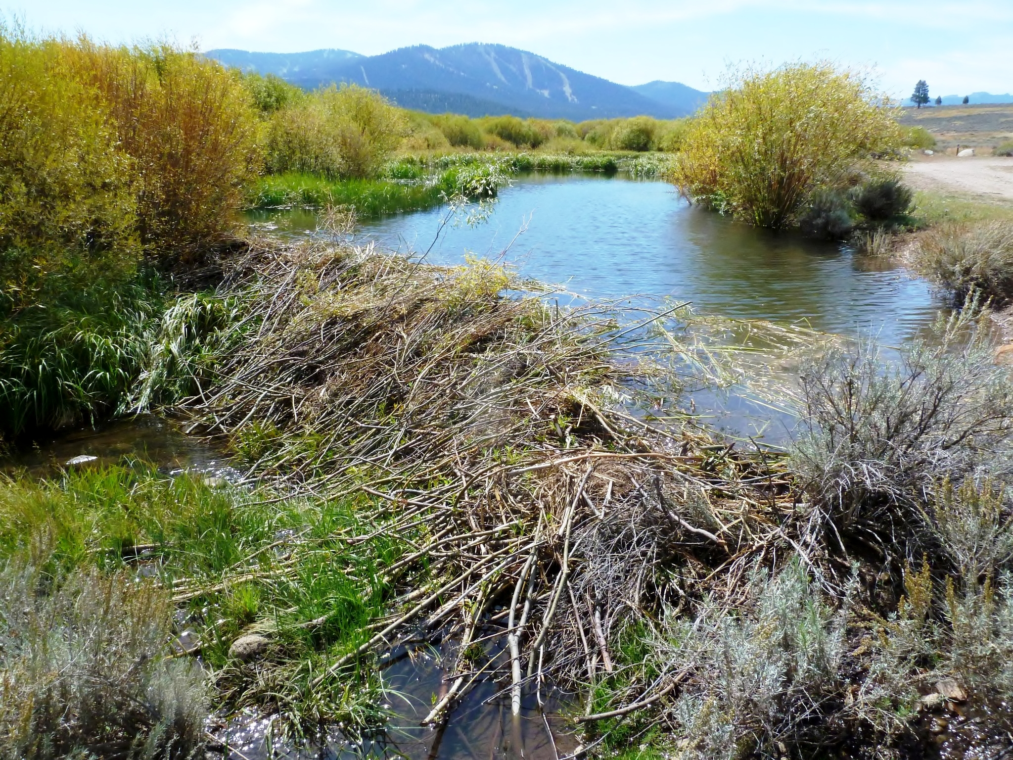
6)A suitable stream gradient that is neither too low to limit dam density nor too high to preclude the building of or persistence of building dams
7)A suitable river that is not too large to restrict the building or persistence of dams
Evidence of stream gradient USDA NRCS Geospatial Data Gateway http://datagateway.nrcs.usda.gov/

Slide 10
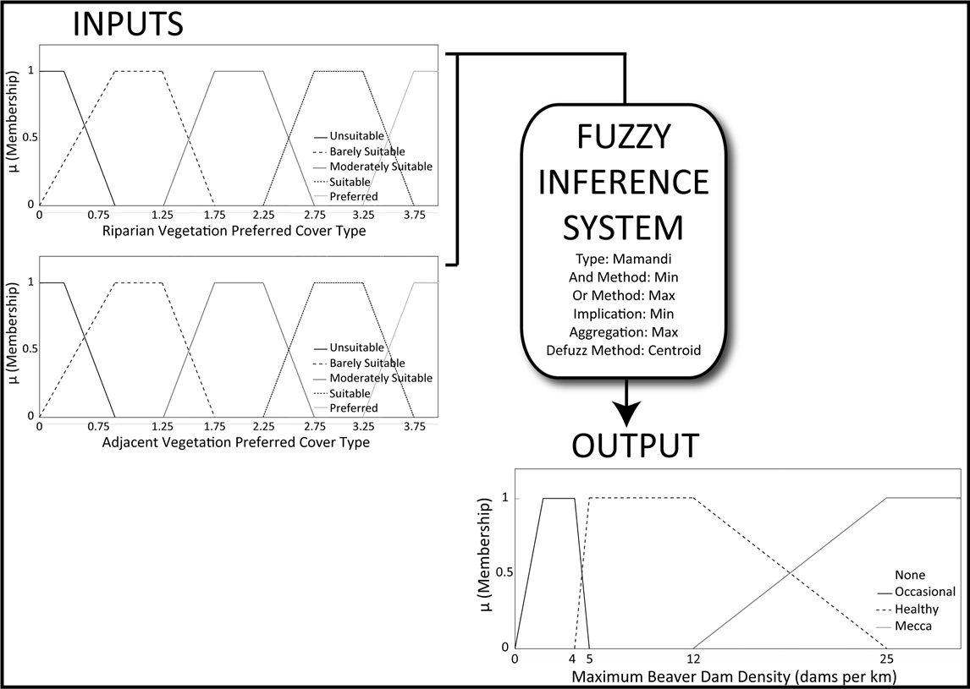
Fuzzy Inference System
The dam-building beaver capacity model consists of two FIS models, a vegetation_FIS and a combined_FIS. The vegetation_FIS is a two input FIS that uses the 30 m (stream bank vegetation) and 100 m (riparian and adjacent upland vegetation) buffer data to calculate a dam-building capacity based on land cover classification values (i.e., beaver preferences 0-4 values) . http://www.mathworks.com/help/pdf_doc/fuzzy/fuzzy.pdf.
Vegetation FIS, two inputs, based on the 30 m and 100 m LANDFIRE land cover beaver dam capacity classification data.
MacFarlane, W.W.et al, Modeling the capacity of riverscapes to support beaver dams, Geomorphology (2015)

Slide 11
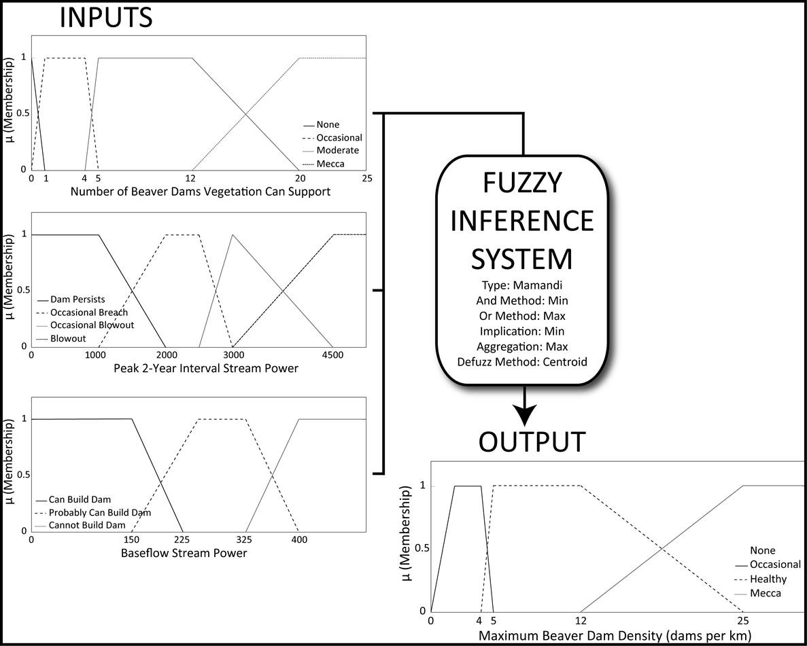
Combined dam-building beaver capacity FIS based on output from the vegetation FIS and stream power calculations baseflow and peak 2-year interval.
MacFarlane, W.W.et al, Modeling the capacity of riverscapes to support beaver dams, Geomorphology (2015)

Slide 12
Rule table for two-input fuzzy inference system that models the capacity of the riverscape to support dam-building activity (in dam density) using the suitability of streamside vegetation and suitability of riparian/upland vegetation as inputs.
MacFarlane, W.W.et al, Modeling the capacity of riverscapes to support beaver dams, Geomorphology (2015)

Slide 13
Workflow used to determine the riverscapes capacity to support beaver dam-building activity, based on suitable building material in close lateral connectivity to the channel.
MacFarlane, W.W.et al, Modeling the capacity of riverscapes to support beaver dams, Geomorphology (2015)

Slide 14
MacFarlane, W.W.et al, Modeling the capacity of riverscapes to support beaver dams, Geomorphology (2015)

Slide 15
Maximum Dam Density
MacFarlane, W.W.et al, Modeling the capacity of riverscapes to support beaver dams, Geomorphology (2015)

Slide 16
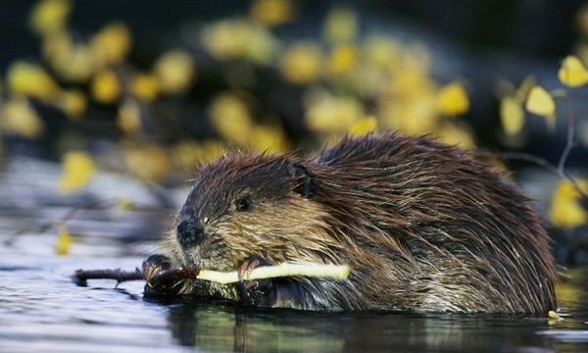
Validation
MacFarlane, W.W.et al, Modeling the capacity of riverscapes to support beaver dams, Geomorphology (2015)

Slide 17
Validation site: Logan Little Bear watershed with capacity estimates and actual dam counts.
MacFarlane, W.W.et al, Modeling the capacity of riverscapes to support beaver dams, Geomorphology (2015)

Slide 18
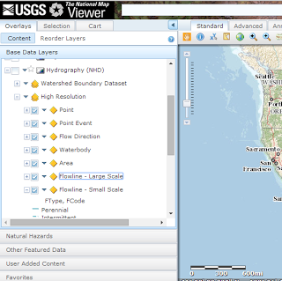
1. Input Data Capture
The dam-building beaver capacity model requires:
A drainage network layer
Hydrography data tied to that layer
Vegetation type raster data
Digital Elevation Model (DEM)
Baseflow information throughout drainage network
Highflow information throughout drainage network
Existing, readily and freely available GIS datasets from GIS data clearinghouses can be used as model inputs.
NHD for a drainage network layer & hydrography data
National Hydrography Dataset (NHD)
Download both stream, water body, area data.

Slide 19
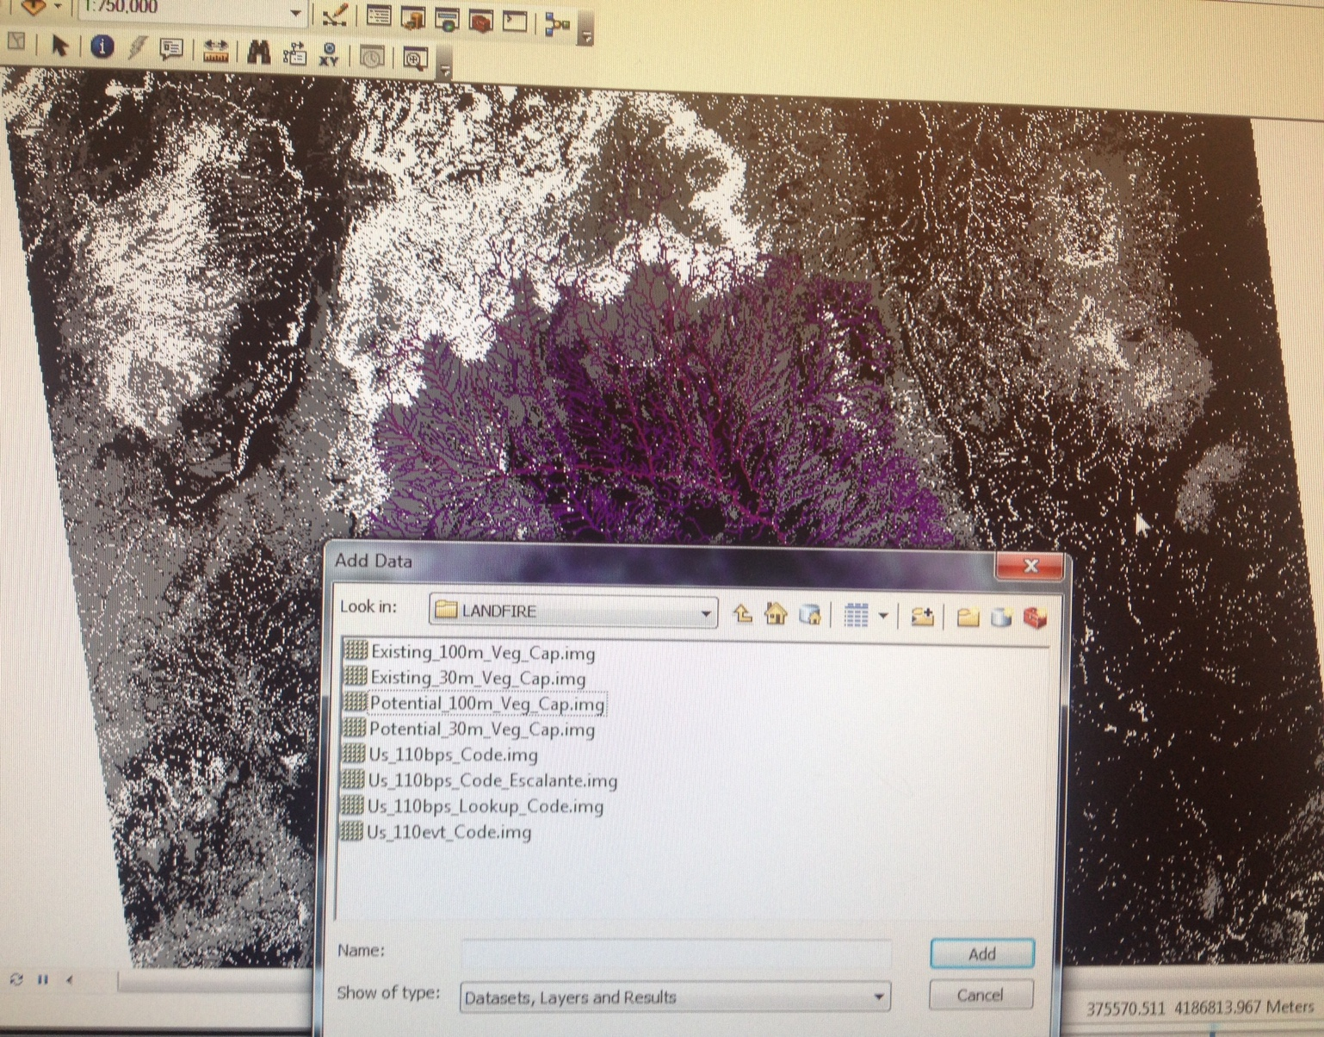
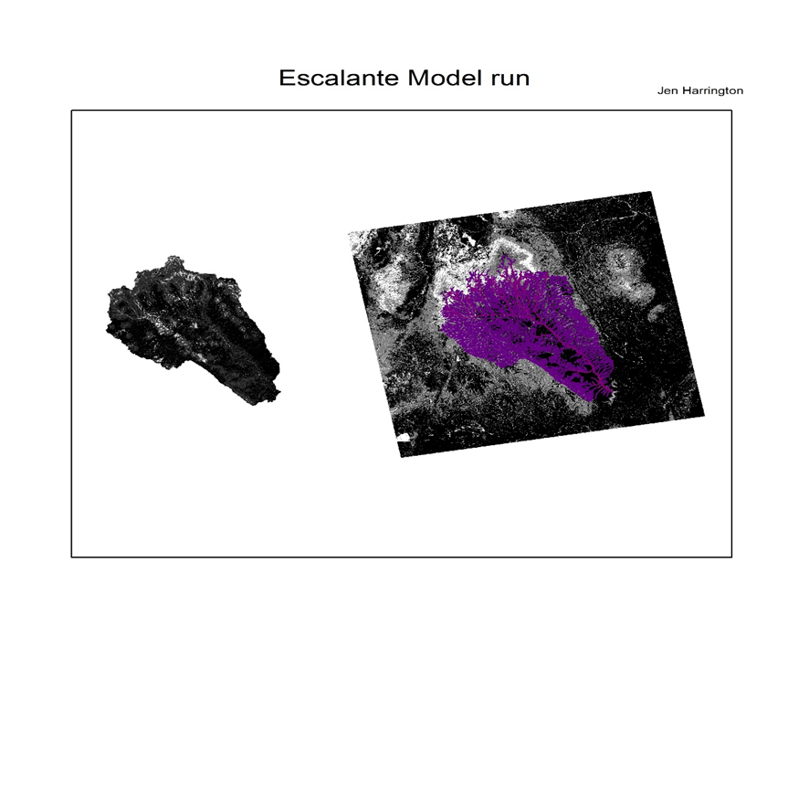
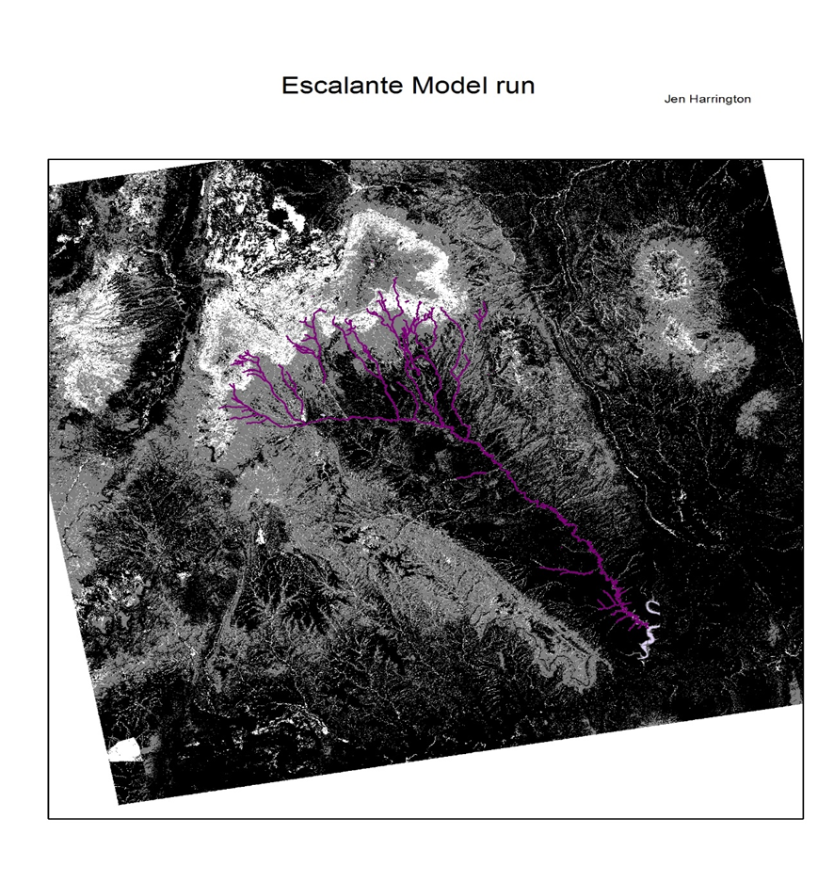

Slide 20
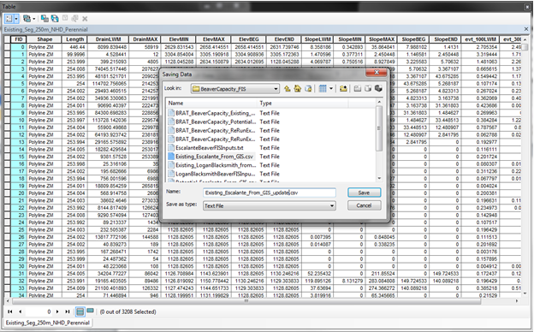
Export Final_NHD_Perennial_BRATInput.shp as a Text File

Slide 21
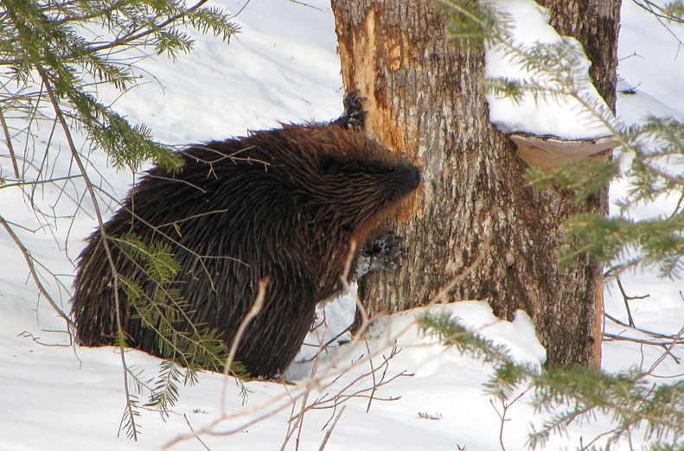
Source: MacFarlane WW and Wheaton, JM, Utah State University, 2013

Slide 22
