Slide 1
Modeling Invasive Plant Spread
David Fulton-Beale

Slide 2
Invasive Plants
Major problem for land managers
Negative ecological impacts
Reduce biodiversity
Alter ecosystem structure and function
Economic impacts
$137 billion in US (Runyon et al. 2012)

Slide 3
Management
Prevention is best
Once established, invasives are difficult to control
Invasion biology is not well understood
Which plants will become invasive?
No good rules or generalities
Prevent spread of known invasives

Slide 4
Models
CLIMEX
Works well
Expensive
Species distribution models
No biological characteristics
Requires extensive data
Habitat Suitability Models
No biological characteristics
Mathematical models
Complex, not easy to run

Slide 5
Objectives
Create a management-oriented model to predict spread of invasive plants
Assist management of known invasives by modeling whether a species will spread into an area
Prioritize management of infestations by modeling rate of spread

Slide 6
Domain
Calculate probabilities of invasive plant spread to adjacent areas
Assumptions
Species of interest is present in the region
Species biological characteristics well understood
Scale
Yearly time step
Spatial scale = user defined

Slide 7
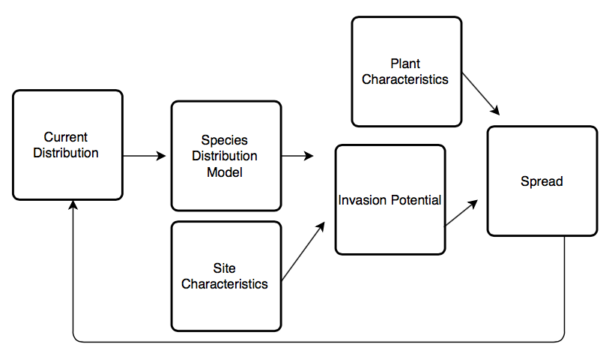

Slide 8
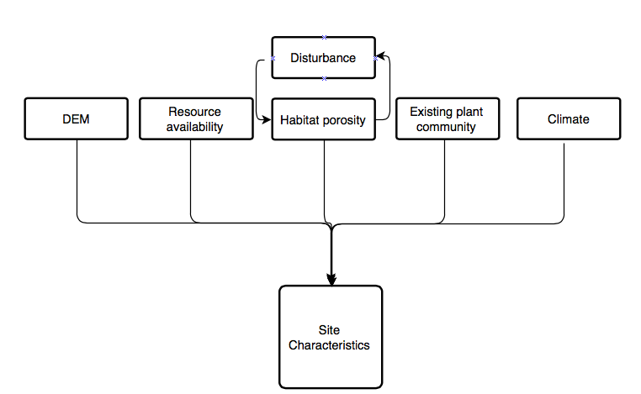

Slide 10
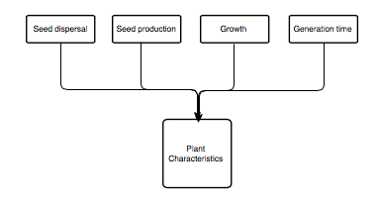

Slide 11
Outputs
Rate of spread
Probability of occurrence in a cell at the next time step
Map displaying probabilities

