Slide 1
Values, Trust, Attitudes and Funding Model VTAF
Frederick Lauer
Human dimensions laboratory, the University of Montana

Slide 2
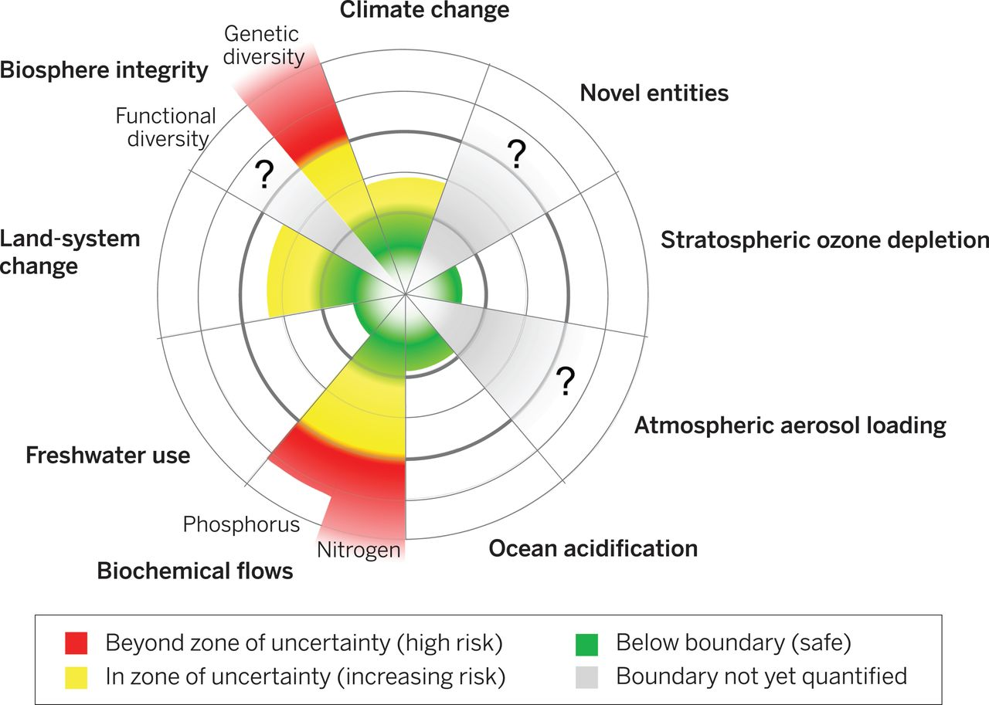
Current status of the control variables for seven of the planetary boundaries.
Will Steffen et al. Science 2015;347:1259855
Published by AAAS
Notes:
Current status of the control variables for seven of the planetary boundaries.The green zone is the safe operating space, the yellow represents the zone of uncertainty (increasing risk), and the red is a high-risk zone. The planetary boundary itself lies at the intersection of the green and yellow zones. The control variables have been normalized for the zone of uncertainty; the center of the figure therefore does not represent values of 0 for the control variables. The control variable shown for climate change is atmospheric CO₂ concentration. Processes for which global-level boundaries cannot yet be quantified are represented by gray wedges; these are atmospheric aerosol loading, novel entities, and the functional role of biosphere integrity.

Slide 3
Terminology
Social-Ecological System
“An integrated system of people and nature with reciprocal feedback and interdependence. The concept emphasizes the humans-in-nature perspective and that delineation between the social and ecological is artificial and arbitrary.” (Stockholm Resilience Center).
Resilience
The capacity of a system—be it a forest, city or economy—to deal with change and continue to develop; withstanding shocks and disturbances (such as climate change or financial crises) and using such events to catalyze renewal and innovation. (Stockholm Resilience Center).
Social Resilience
“the ability of groups or communities to cope with external stresses and disturbances as a result of social, political and environmental change” (Adger 2000:354).
Notes:
…it is difficult and even impossible to truly understand ecosystem dynamics and their ability to generate services without accounting for the human dimension” (Stockholm Resilience Center).
Resilience

Slide 4
30,000 Foot View
Social-ecological system resilience
Social
Adaptive Management
Biophysical

Slide 5
Adaptive Management Cycle
Assess a problem
Set Social-Ecological Outcomes
CoPrioritize
Codesign Project and Engagement Opportunities
Co-implement
CoMonitor
Communicate Success/Failure
Adjust
Governance approaches that are collaborative, flexible and learning-based and rely on networks of people and organizations at multiple levels. (Stockholm Resilience Center).
Uncertainty in social-ecological systems demands adaptive approaches such as managing for resilience (Walker et al. 2002)

Slide 6
Thinking Scale
Social-ecological systems connect actors and institutions to the biophysical environment.
What about scale?

Slide 7
Thinking Scale
Institutions - “Institutions are defined as the norms and rules governing human interactions. These can be formal, such as rules and laws, but also informal (unwritten), such as norms and conventions of society”. (Stockholm Resilience Center)
The world?
Montana?
Missoula County?
Condon?

Slide 8
Thinking Scale
Culture
Cultural differences exist at every level of scale from distinct to ambiguous at global scales.
IMAGE Level?
State level?
Community level?

Slide 9
Defining this model
Question
How do overlapping core values influence stakeholder attitudes regarding treatment preferences in landscape-scale natural resource management projects?
How does trust mediate the relationship between overlapping core values and stakeholder attitudes?
How can this information be used to inform adaptive governance structures?
What is the likelihood that there is enough support to provide funding to continue restoration efforts?

Slide 10
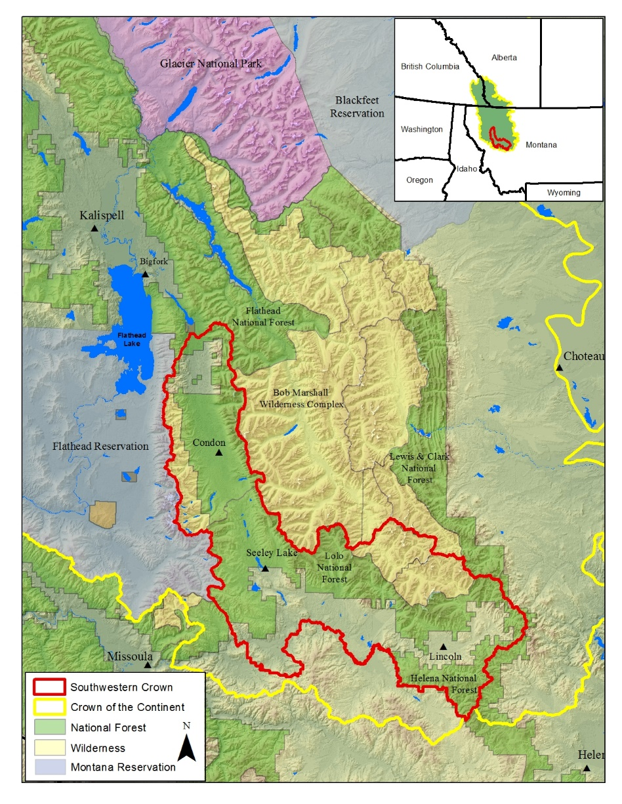
Defining this model
Scale
The Southwest Crown of the Continent (Regional Scale)
Timescale
Limited only by available data.
Model impacts include both social and biophysical implications
Social systems are the focus, but their contribution to adaptive governance, however indirectly, influences outcomes regarding restoration strategies.

Slide 11
Defining this model
Assumptions
The social system is nebulous and subject to change that is not as readily predictable as some natural systems.
Awareness of “efforts to change the social system” could actually cause apprehension towards needed change.
Adaptive management cycles are not temporally defined.
No time step, as there’s no true way to determine how long decisions –making cycles may take.
Coprioritized and codetermined ecological outcomes benefit future sustainability initiatives.

Slide 12
Communication
Stakeholder Engagement
Overlapping Core Values
Monitoring
Procedural Trust
Rational Trust
Affinitive Trust
Dispositional Trust
Stakeholder Preferences
Funding
Adjust

Slide 13
Adaptive Management Cycle
Assess a problem
Set Social-Ecological Outcomes
CoPrioritize
Codesign Project and Engagement Opportunities
Co-implement
CoMonitor
Communicate Success/Failure
Adjust
Governance approaches that are collaborative, flexible and learning-based and rely on networks of people and organizations at multiple levels. (Stockholm Resilience Center).
Uncertainty in social-ecological systems demands adaptive approaches such as managing for resilience (Walker et al. 2002)

Slide 14
State Variables
Overlapping Core Values
Dimensions of Trust
Stakeholder Attitudes
Environmental Values (continuum)
Utilitarian
Preservationist
Place-Based Values
Initially quantified through a survey instrument.
Affinitive
Rational
Procedural
Dispositional
Initially quantified through a survey instrument.
Regarding preferences of treatment alternatives.
Regarding feelings of engagement in NRM process.
Initially quantified through a survey instrument.

Slide 15
Putting the pieces together
Overlapping Core Values
Dimensions of Trust
Stakeholder Attitudes
Values form foundation of beliefs, which influence our attitudes, behavioral intentions, and ultimately our behavior (Vaske and Donnelly 1999).
Trust highly dependent on shared core values (Stern and Coleman 2014;Winter et al. 2004).
Influence stakeholder preferences (Vaske and Donnelly 1999;Steel et al 1994;Winter et al. 2004).
Reduces cognitive burdens of actors and institutions (Pretty and Ward 2001).
Is ephemeral (Pretty and Ward 2001).
Multidimensional (Stern and Coleman 2014).
Built through incorporating values and knowledge into management (Davenport et al. 2007)
Conflicting core values shown to be problematic in building trust (Stern and Coleman 2014;Davenport et al. 2007)
Engagement
Provides a way tor stakeholders to voice opinions (Lukensmeyer et al. 2011)..
Allows collaboration (Smith et al. 1999).
Important that stakeholders feel they’re being heard (Smith et al. 2001).
Preferences are directly related to ecological outcomes and ultimately to ecosystem sustainability and resilience.

Slide 16
Communication
Stakeholder Engagement
Overlapping Core Values
Monitoring
Procedural Trust
Rational Trust
Affinitive Trust
Dispositional Trust
Stakeholder Preferences
Funding
Adjust

Slide 17
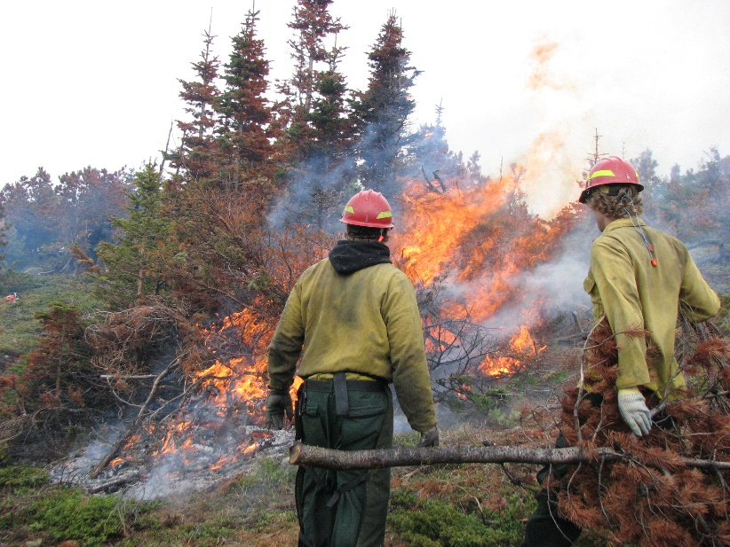
Feedback loops
Proper communication of management values to stakeholders increases the level of perceived overlap in core values. This increases stakeholders’ feelings of engagement. An increase in the perception of overlapping core-values increases trust, positive attitudes toward treatment alternatives, and likely funding for continued operations.
Overlapping Core Values
Communication
Stakeholder Engagement

Slide 18
Communication
Stakeholder Engagement
Overlapping Core Values
Monitoring
Procedural Trust
Rational Trust
Affinitive Trust
Dispositional Trust
Stakeholder Preferences
Funding
Adjust

Slide 19
Feedback loops
Positive attitudes toward treatment alternatives increases the chance they will get funded. Funding allows for adaptive governance adjustments whose perceived alignment with core values increases the opportunity for future funding due to increased trust and further increase positive attitudes towards treatments.
Stakeholder preferences
Funding
Adjust

Slide 20
Key Output
Why does funding matter?
Allows managers to proceed with and attempt to deliver project outcomes determined at start of the process.
Allows continued adjustment towards adaptive governance cycle.
Funding
Likelihood of continued project funding as a percent.

Slide 21
Conclusions
Information Gained
Social Learning
Achieve Adaptive Governance Outcomes more Effeciently
Ways to adjust adaptive governance.
Current system levels of trust/perceived overlapping core values.
Greater clarity regarding perceived engagement and treatment alternative preferences.
Help to reassess approaches to stakeholder involvement
Reveal new paths for communication
Understanding related to how values interact with trust
Give managers a means to align communication with values.
A smoother acting social system will help adaptive governance by:
Improving the rate at which decisions are made.
Increasing acceptance for necessary restoration strategies.
A smoother social system will help ecosystems
Allowing the proper treatments to be applied to landscapes.
Reduce uncertainty

