Slide 1
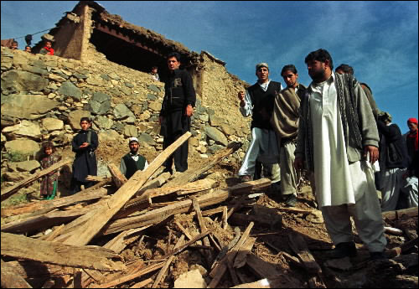
Landuse suitability Modeling of Balakot City, Pakistan, For Reconstruction and Inhabitation After October 8, 2005 Kashmir Earthquake
By
Shah F Khan
Graduate student
University of Montana

Slide 2
The project

Slide 3
Conceptual Model for Landuse Suitability
Environmental Systems Research Institute (ESRI) ArcGIS (www.esri.com)
Clarks Lab, Clarks University’s Idrisi (www.clarkslab.com)
LDR International, Inc.(LDR), Data Chromatics, Inc.(DCI) and Community Analysis and Planning Systems, Inc (www.dcigis.com ) What if? Planning support System
Domain/Objective
To develop a conceptual model for landuse suitability using ArcGIS.
Geospatial analysis of event controlling parameters for landuse suitability of Balakot.
To Analyze rebuilding of Balakot city and emphasis on the usefulness of Conceptual models and GIST as a Decision support system.
To provide support to the policy makers and government agencies in deciding the fate of Balakot.
To produce a detail GIST framework including citizen participation to spread awareness about earthquake and areas suitable for residential construction.
To produce final suitability map of Balakot using Multi Criteria Evaluation technique to test the model.

Slide 4
Research Question
Is the present location of Balakot City, Pakistan is suitable for Landuse reconstruction and Inhabitation after the October 8, 2005 Earthquake.
Assumptions
The analysis is based on user interpretation and constraints.
All controlling factors are equally important and satisfy suitability conditions.
Heavy rainfall are directly proportion to severe landsliding.
The area may likely to have another major earthquake.
Future construction will not be according to approved building code.
Geology and high slope prevent safe construction of houses and infrastructure.
New location will be earthquake proof and constructed with fool proof planning.

Slide 5
The Earthquake

Slide 6
The Earthquake by Numbers
Time | Saturday, October 8, 2005, 8:50:40 am
Moment magnitude | 7.6
Depth | 26 km
Epicenter | 10 km NE of Muzaffarabad
Aftershocks | 1,778 by end of 2005
Slip | Up to 8-9 m; mean 5.1-5.4 m
Recurrence interval | 475 to 2,000 years
Historically important quakes | 1555 (Mw 7.5); 1885 (Mw 6.3)
Usgs.gov, Bendick et al. (2006), erra.gov.pk

Slide 7
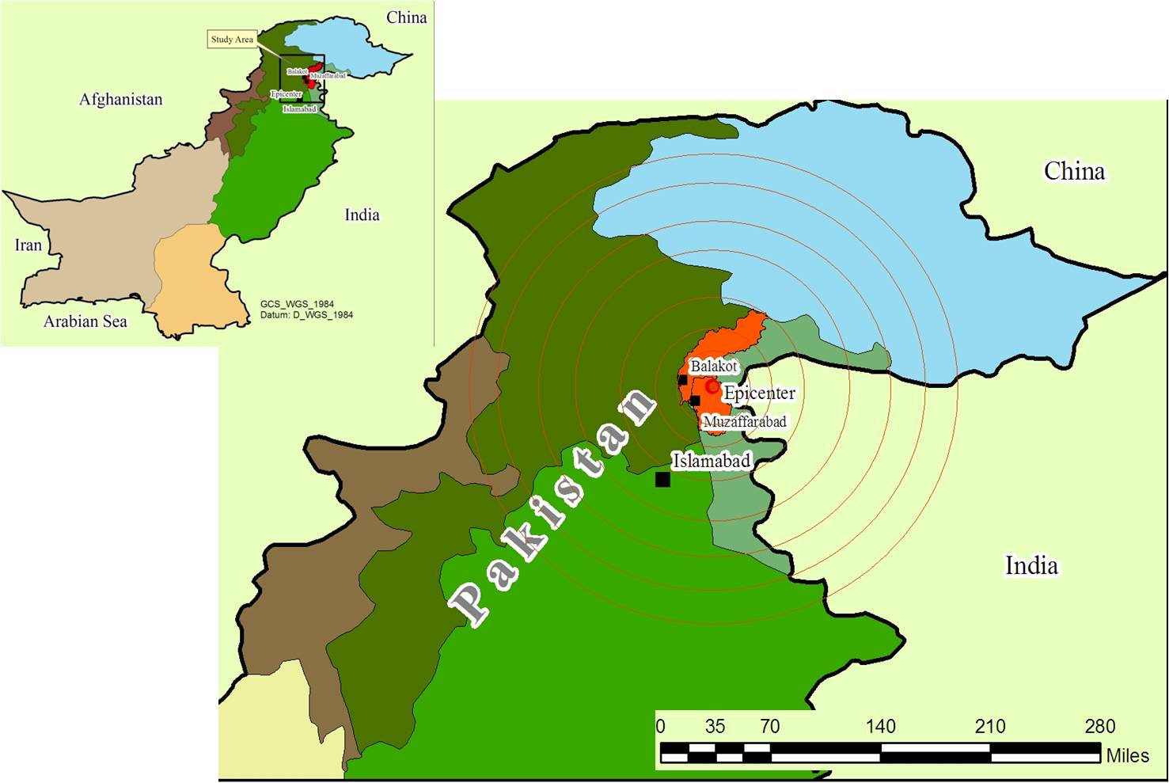
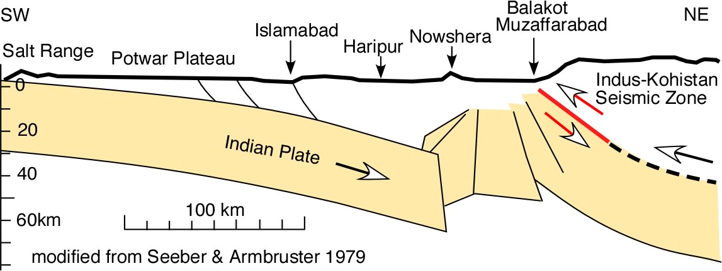
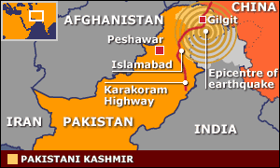
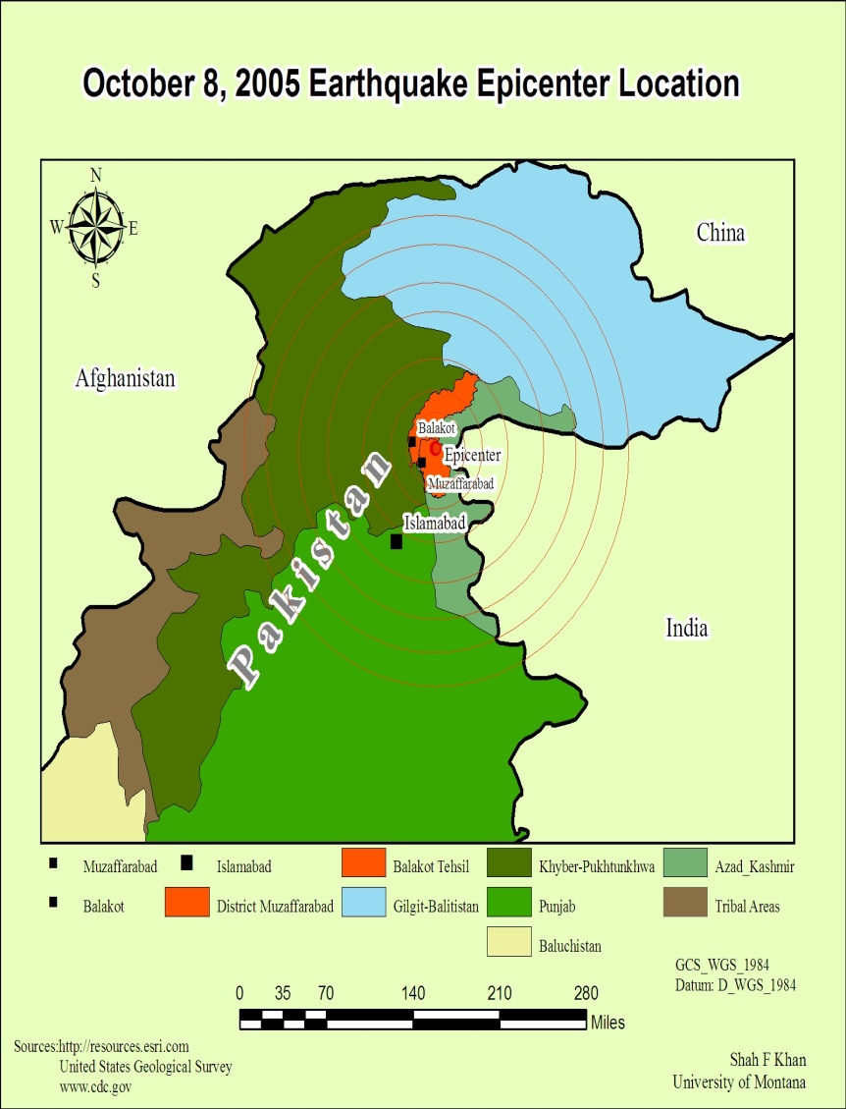
A
B
Kashmir Boundary Thrust and Murree Fault
C
(A) Map of Pakistan showing country and provinces boundaries,. (B) Map showing earthquake epicenter and major cities affected by the earthquake. (C) Map showing the 2005 earthquake location.

Slide 8
Balakot location :34° 32′ 24″ N, 73° 21′ 0″ E
38 kilometers north-east of Mansehra city, in Northwest Frontier Province (now Khyber Pakhtunkhwa).
Elevation is 971 meters (3188 feet). It is a historical town, a famous tourist destination of the region and the gateway to Kaghan Valley (Karakoram Mountains).
River Kunhar runs through the city which merges with Jhelum River near Muzaffarabad, Azad Kashmir.

Slide 9
Study Area

Slide 10
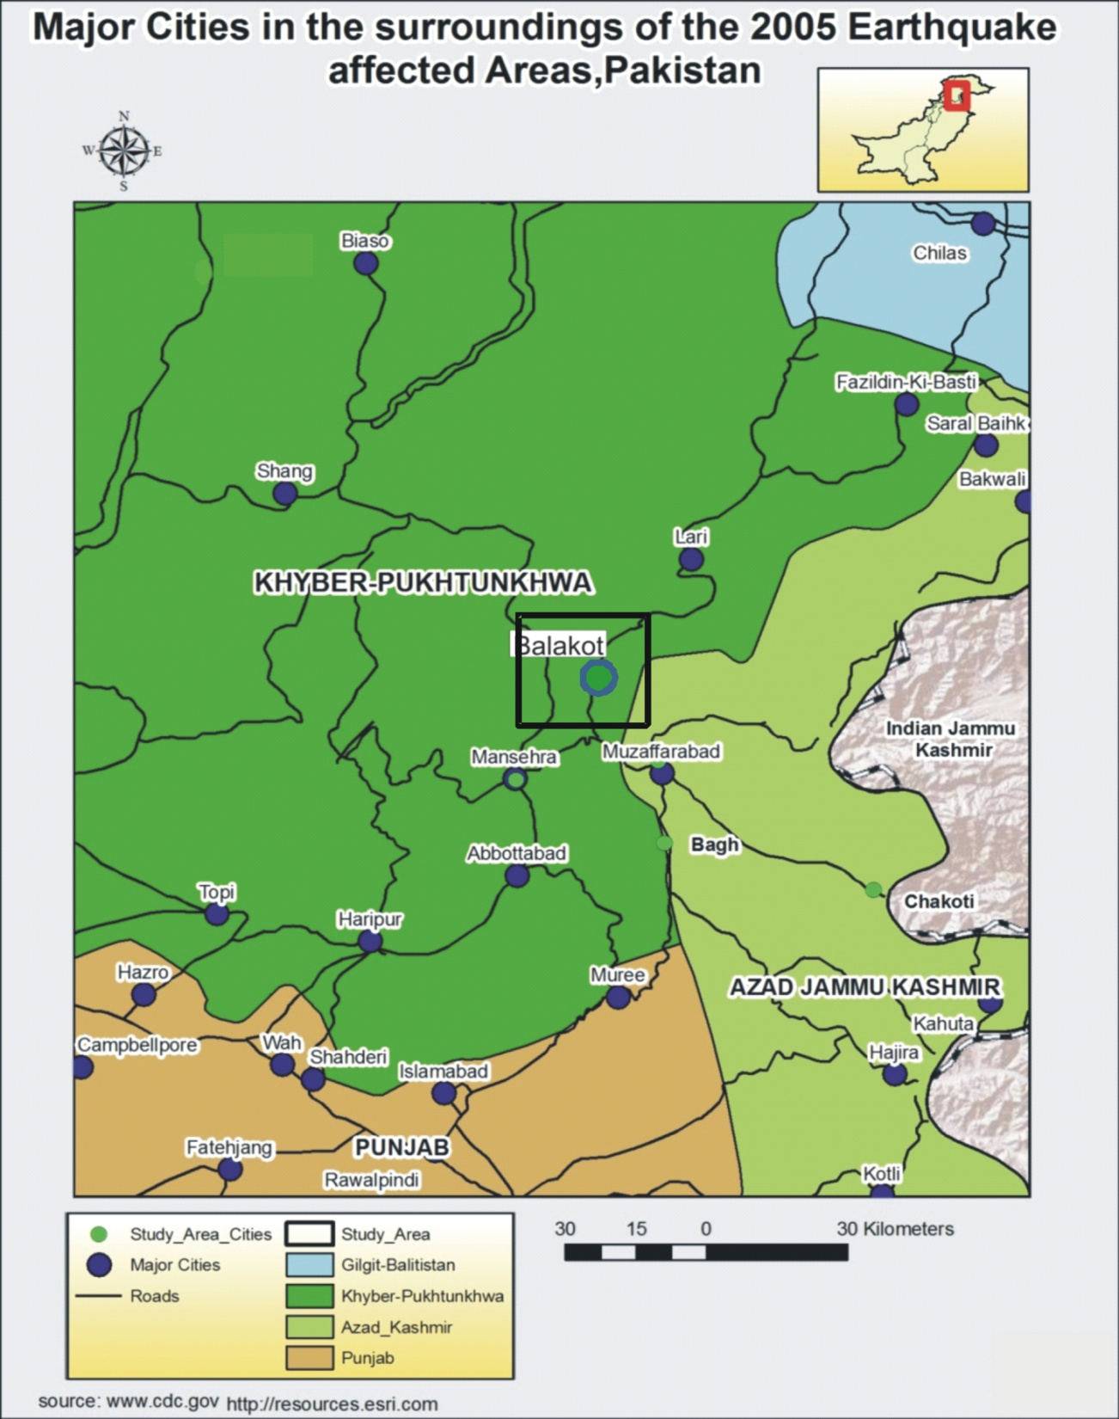
Balakot location :34° 32′ 24″ N, 73° 21′ 0″ E
Northwest Frontier Province (now Khyber Pakhtunkhwa
Elevation:
971 meters (3188 feet).
Earthquake epicenter

Slide 11
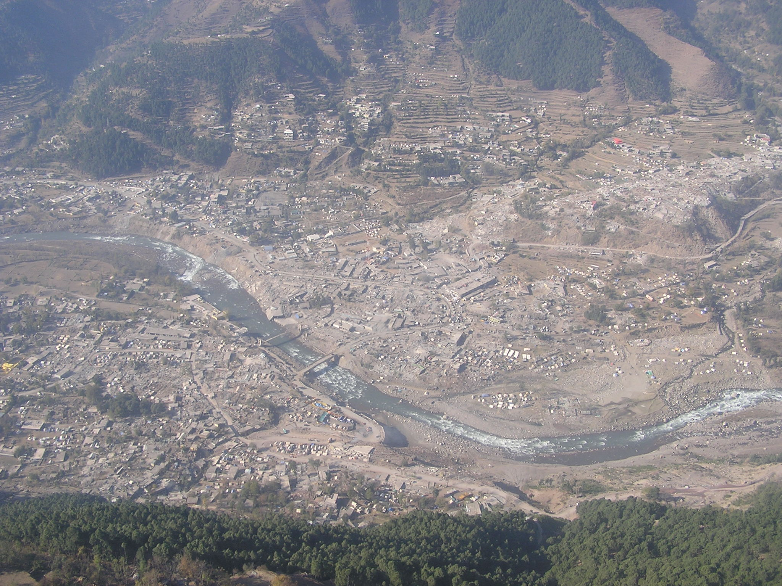
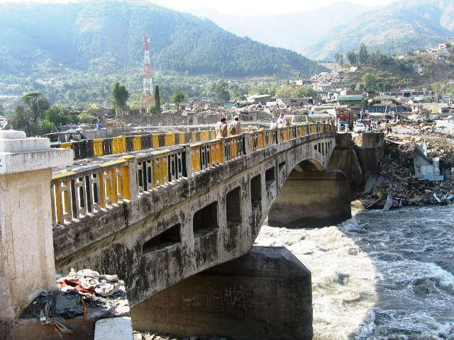
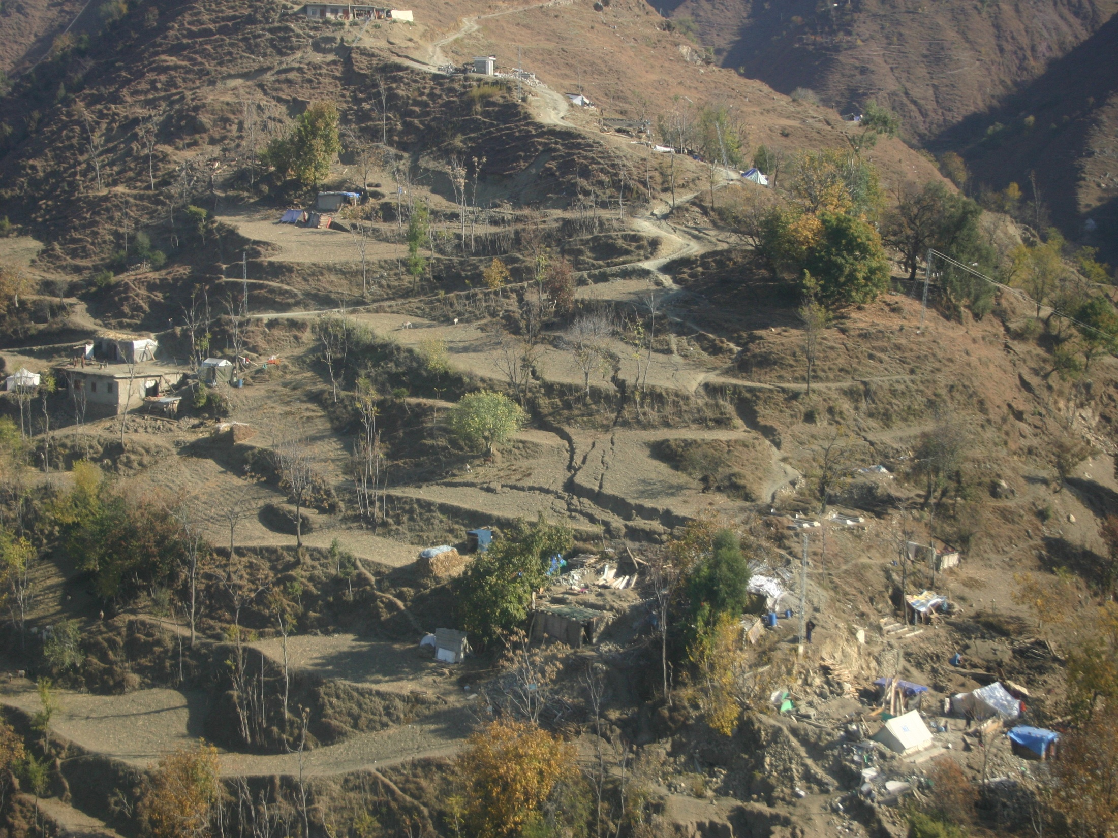
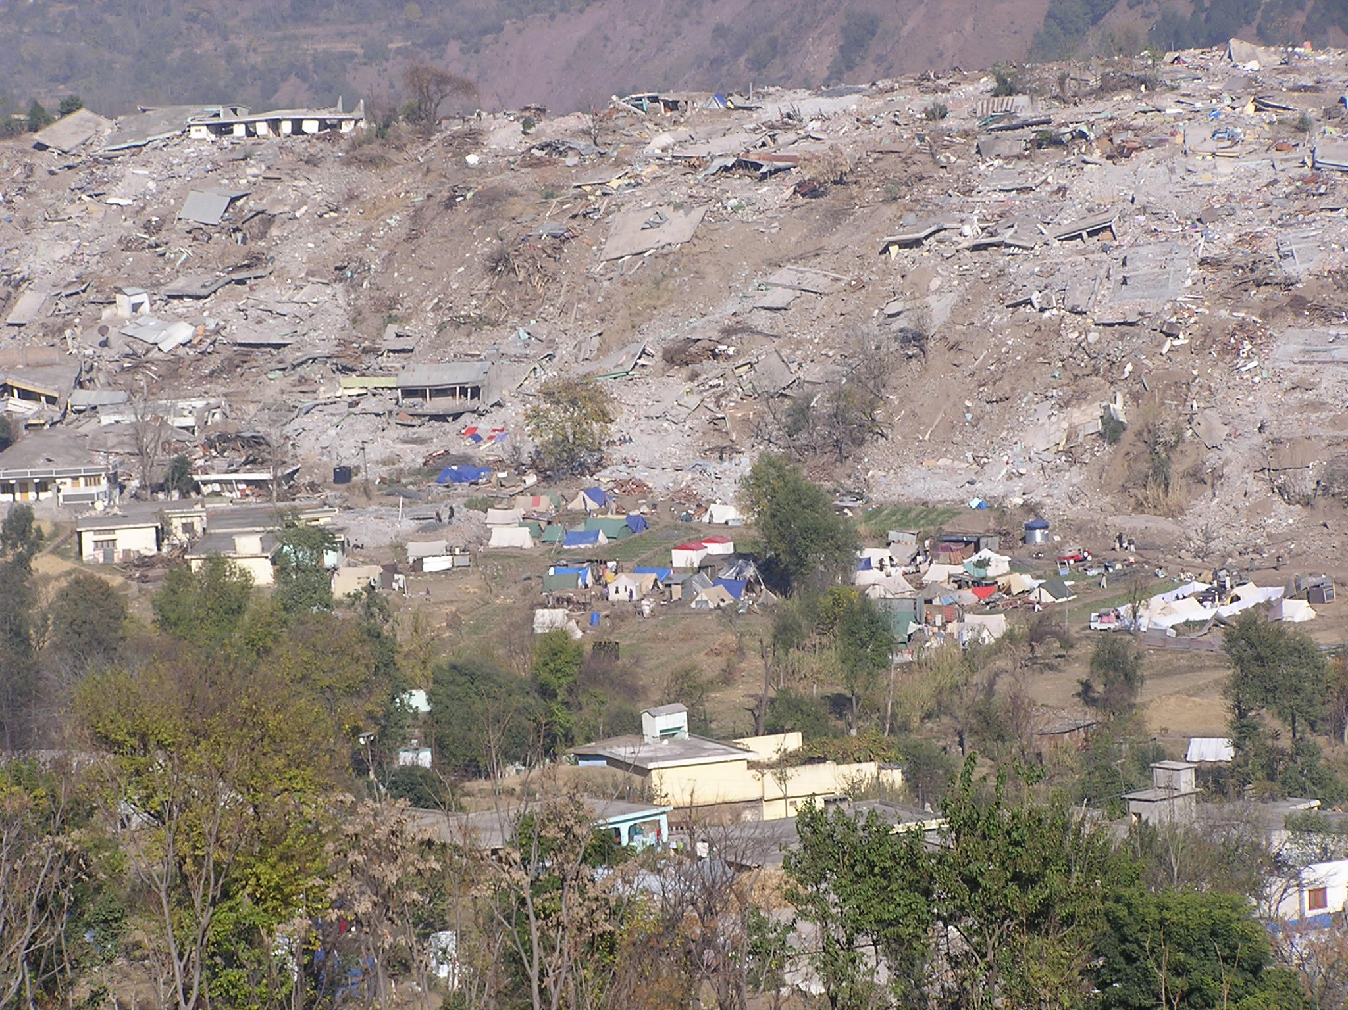
Aerial view of Balakot after the earthquake

Slide 12
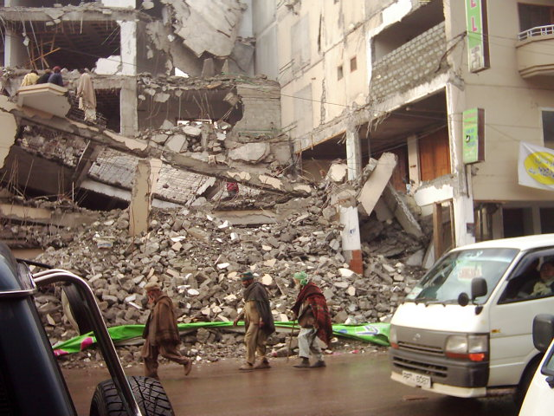
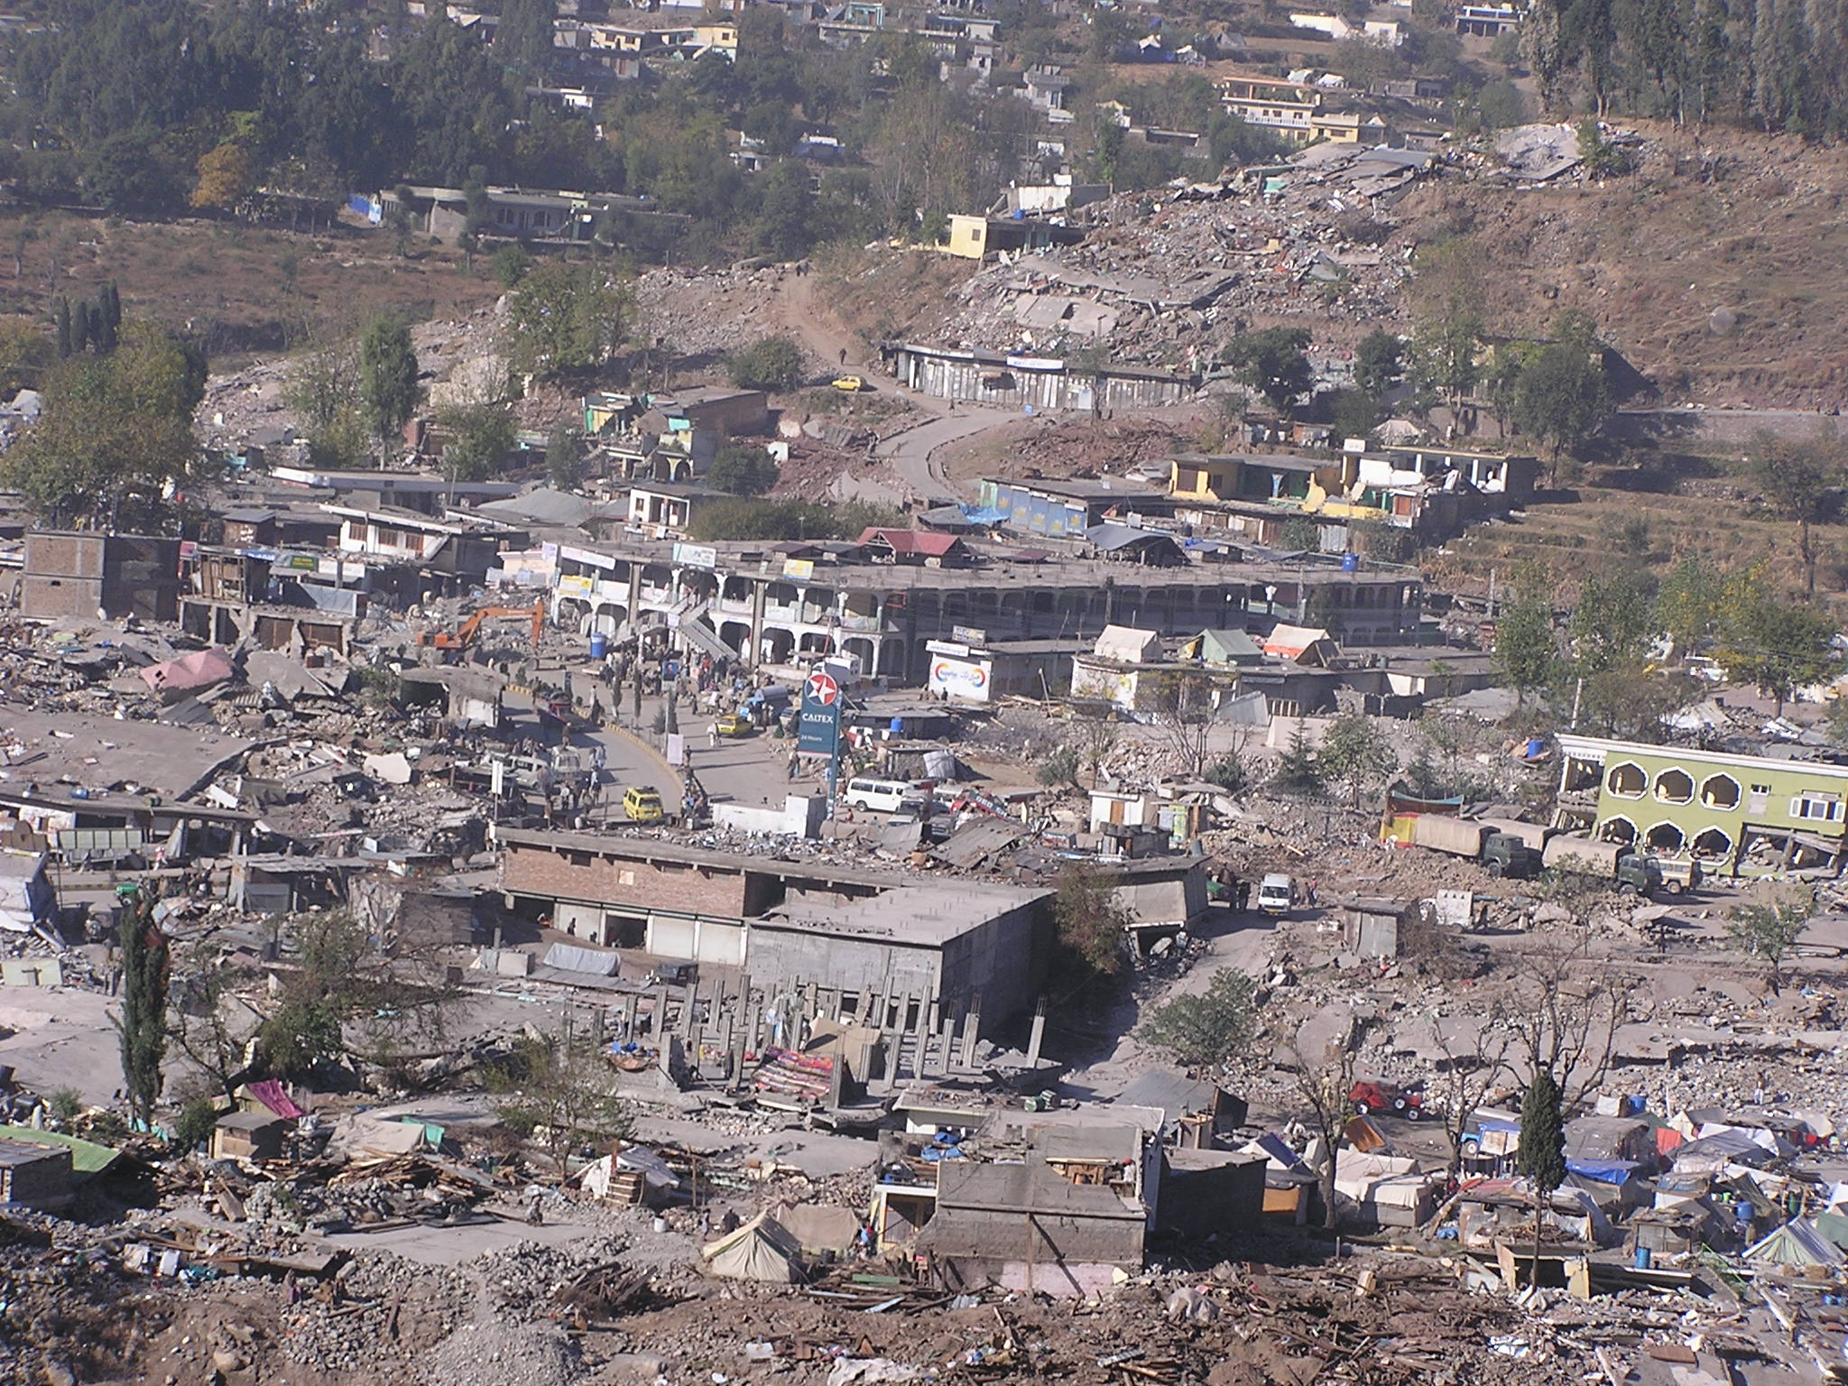

Slide 13
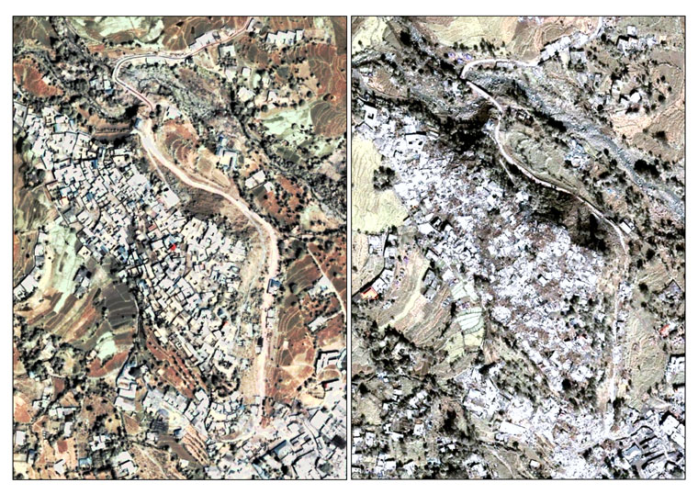
Left: Ikonos(60cm) image collected over the northern districts of the city of Balakot, 30 km east of the epicenter of the earthquake that struck Pakistan on 8/10/2005. Right: Shows the same area as seen from the same satellite on 12/05/2005 (ISFEREA 2005). Geo-Spatial information Analysis for Global Security Stability, http://isferea.jrc.ec.europa.eu

Slide 14
The Model

Slide 15
Landuse Suitability Model for Balakot using Multi-criteria Evaluation
Input data
Vector GIS
Raster GIS
Rainfall and Temperature
Volunteer Geographic Information
Literature review
Field Data
Topographic Map
Countour Map
Satellite Image
Pictures
surveys
Geology
Pre-disaster
Post-disaster
Landslides
Landuse classification
Land Cover classification
Slope Analysis
River/streams
Landslides
Conclusion: Suitable/Unsuitable

Slide 16
Inputs and Testing The Model

Slide 17
Steps in GIS Modeling
Preprocessing
Final Processing
Result & Conclusion
Model Execution

Slide 18
Tools used
ArcGIS
Is an integrated collection of GIS software products that provides a standards-based platform for spatial analysis, data management, Landuse suitability models and mapping by ESRI.
IDRISI Selva
A powerful, easy-to-use image processing and integrated mapping software product. It is used worldwide for resource management, urban planning, mineral/oil exploration, and many other applications. Use satellite and aerial imagery, radar, DEMs, raster maps, geophysical data, and other images.

Slide 19
COREL DRAW
A vector graphics editor developed and marketed by Corel Corporation of Ottawa, Canada.

Slide 20
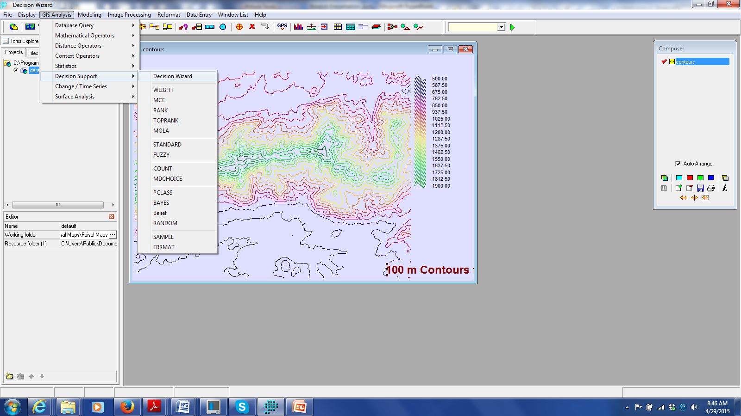
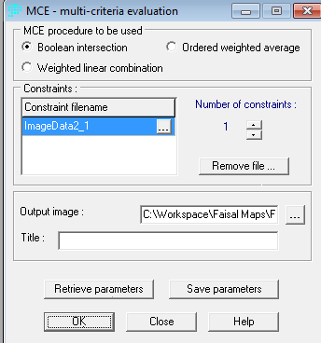

Slide 21
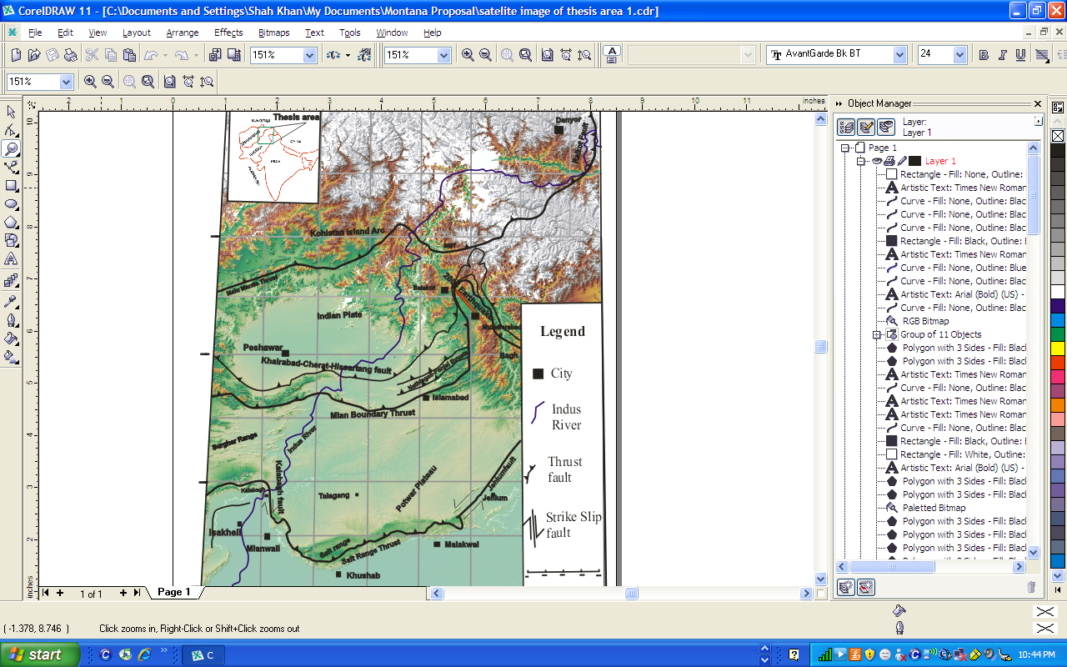

Slide 22
GIS Analysis
Geology
Landslides
Land Cover/Land use
Temperature and Rainfall
Slope
Channels
Literature review
Volunteer Geographic Information

Slide 23
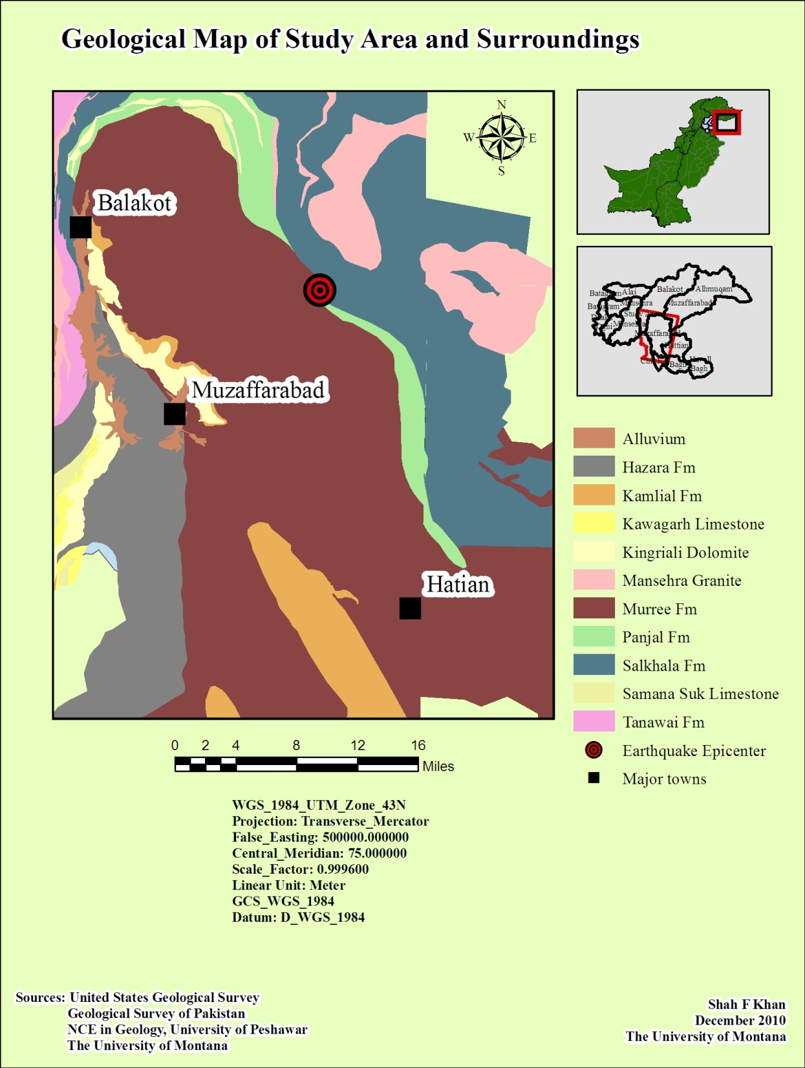
Geology
Geological map is prepared using field observations and previously available data

Slide 24
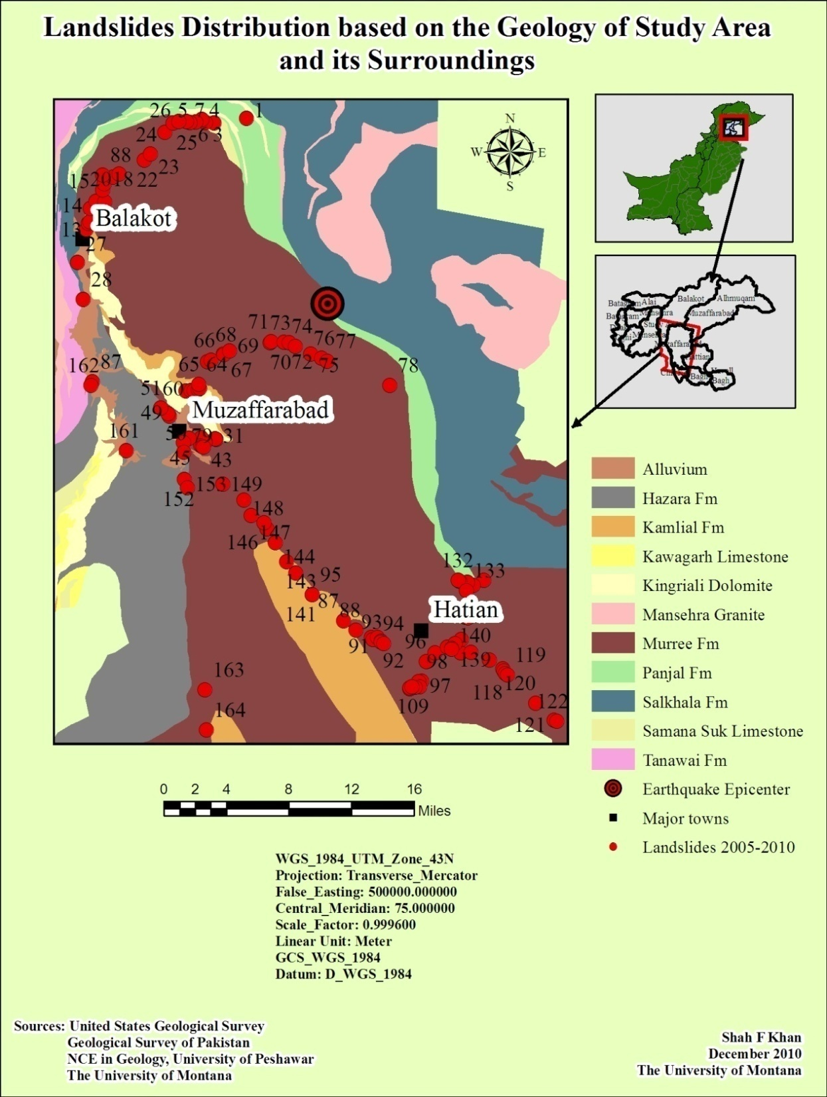
Landslide Analysis
Landslide data obtained after the earthquake is also plotted on the geological map
Majority of the Landslides are in the same formation comprising of sandstone, clay and mudstone.

Slide 25
Geological map of the region
(Kamp et al, 2008., Hussain et al. 1994, 2004)

Slide 26
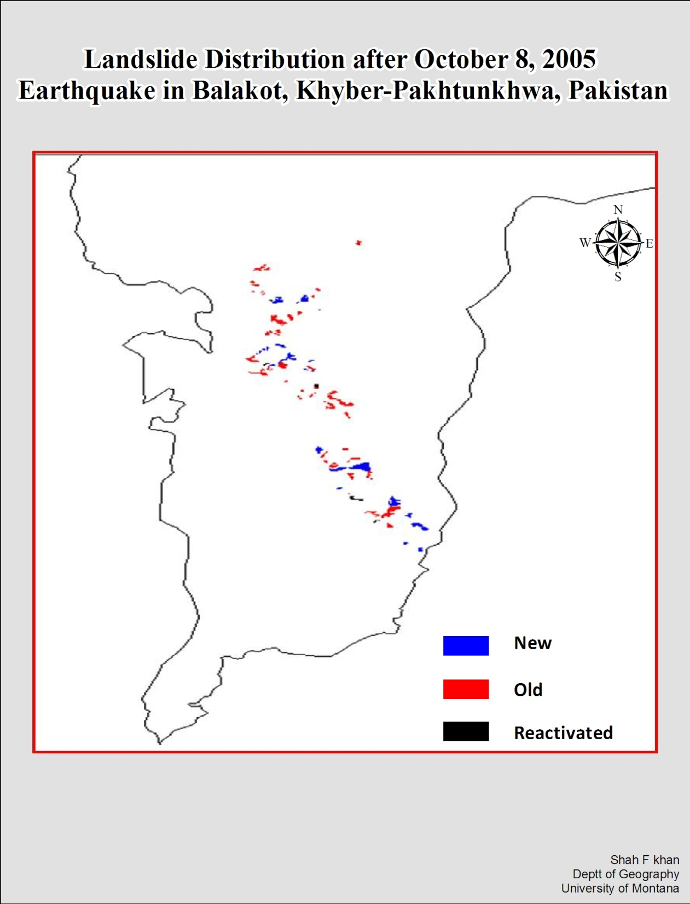
Landslide Analysis
All the observed Landslide after the earthquake within the Balakot Tehsil (2005-2010) are plotted on the Map of Balakot

Slide 27
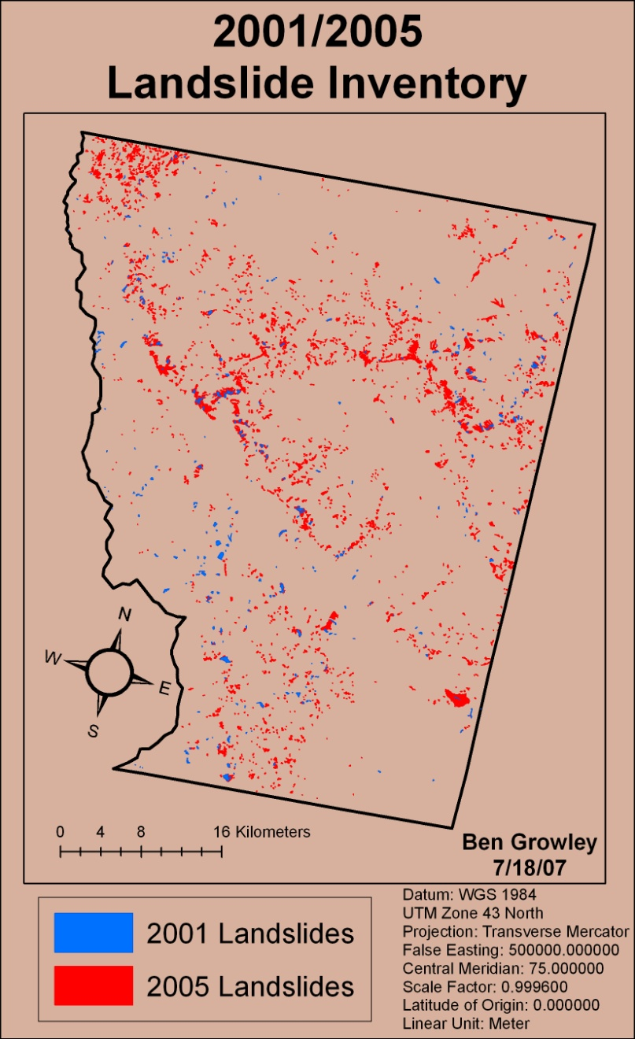
Landslide Inventories 2001 and 2005
Year | # of LS | LS Area (km²)
2001 | 371 | 8.3
2005 | 2252 | 60.8
~ 7-fold increase
→ 5-10 times above
“background” landsliding
Kamp et al, 2008

Slide 28
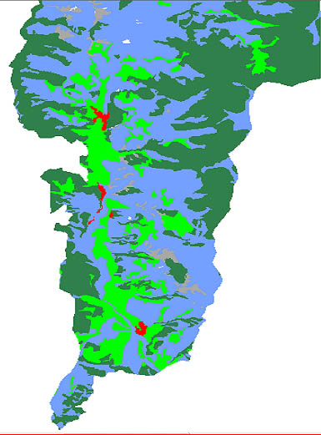
Land Cover Analysis
Land Cover distribution map of Balakot, Khyber Pakhtunkhwa, Pakistan(summer)
A land cover classification map was prepared for Balakot using the field observations and comparison with the identified classes in the Aster imagery for 2005.
Agriculture
Bare soil
forest
Grass land
settlement
Snow covered

Slide 29
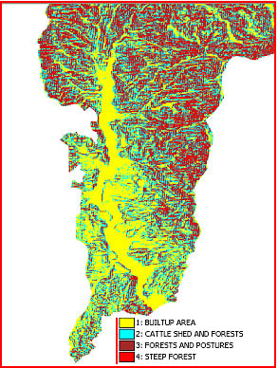
Land use Analysis
The Land Cover map is further analyzed and produced the Landuse map using supervised classification technique.
Land use map is mainly for showing man made structures and modified land
Landuse distribution map of Balakot, Khyber Pakhtunkhwa Pakistan

Slide 30
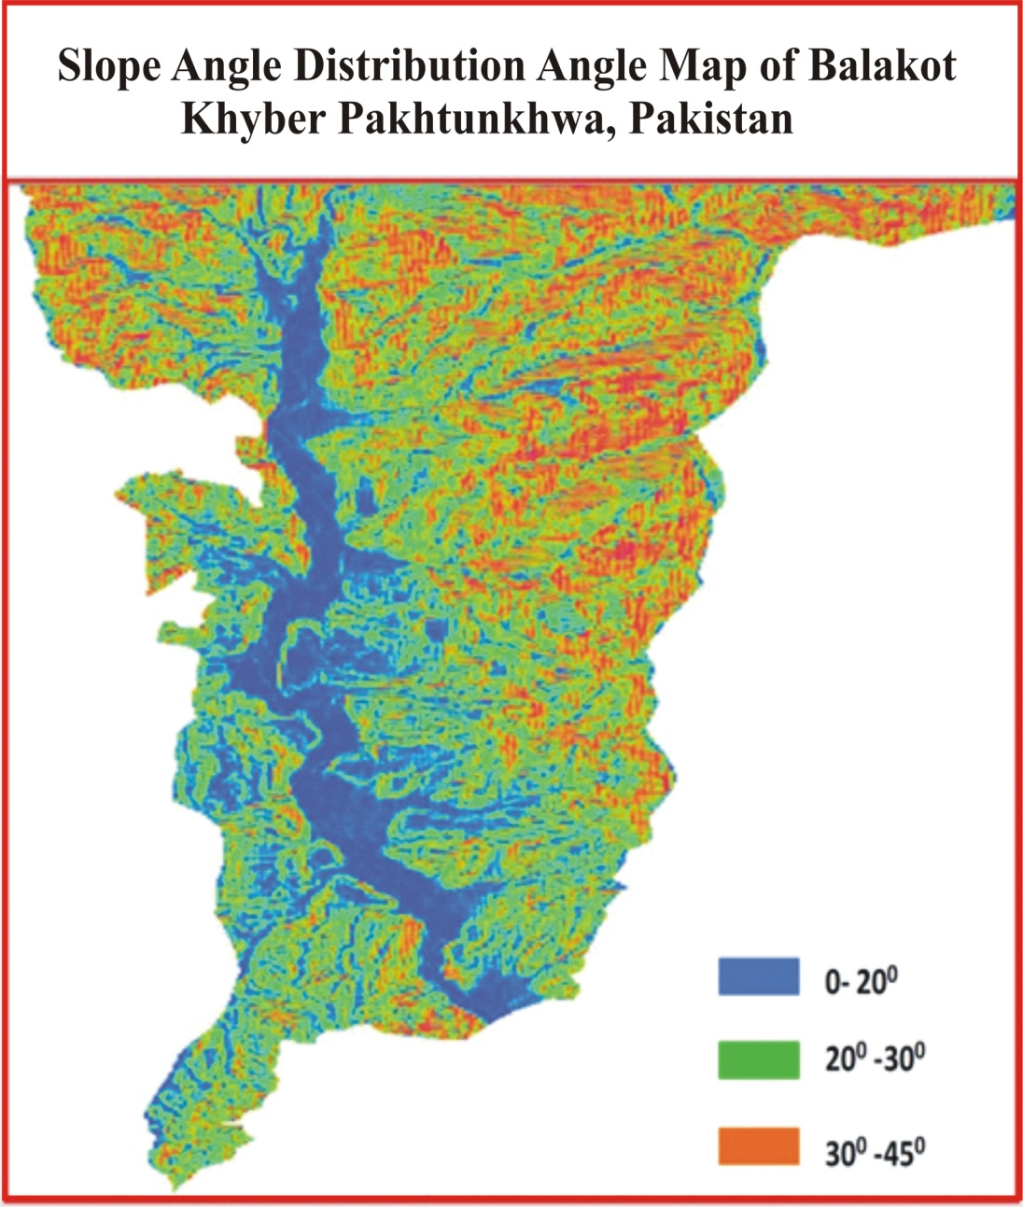
Slope angle Analysis
Slope Angle distribution map was prepared from the Digital elevation model of Balakot

Slide 31
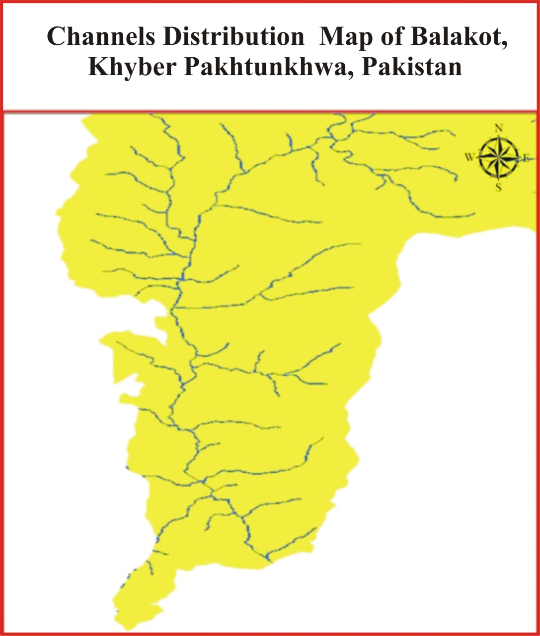
Channel Distribution
The Channels distribution map was prepared from the satellite data as well as using of topographic maps of the area

Slide 33
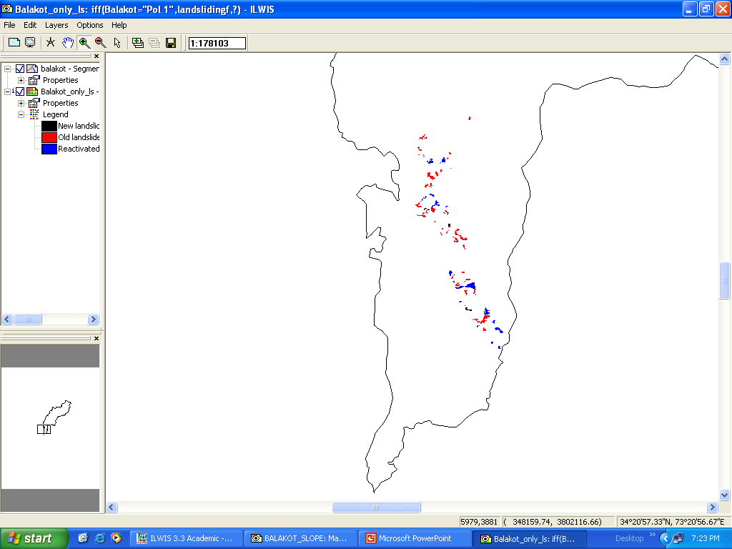
Landuse distribution map
Landslide distribution map
New
Old
Reactivated

Slide 34
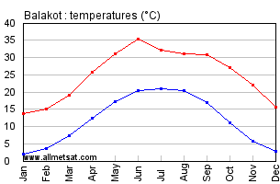
Temperature and Rainfall Analysis
Monthly Precipitation rate in Balakot for 2005-06-07 ( WMO, 2008)
Average Rainfall distribution during the years 2000-2007 at Balakot (WMO, 2008)
Average annual temperature for Balakot

Slide 35
Result
All the prepared layers are Combined using Multi-criteria Evaluation in Idrisi taiga.
Future earthquake data is also take in consideration.
Boolean methodology is used to prepare constraints images and aggregate them.
Finally all the layers are combined and produced two categories, suitable and unsuitable using classification technique. Decision wizard /MCE module/overlay multiplication" command

Slide 36
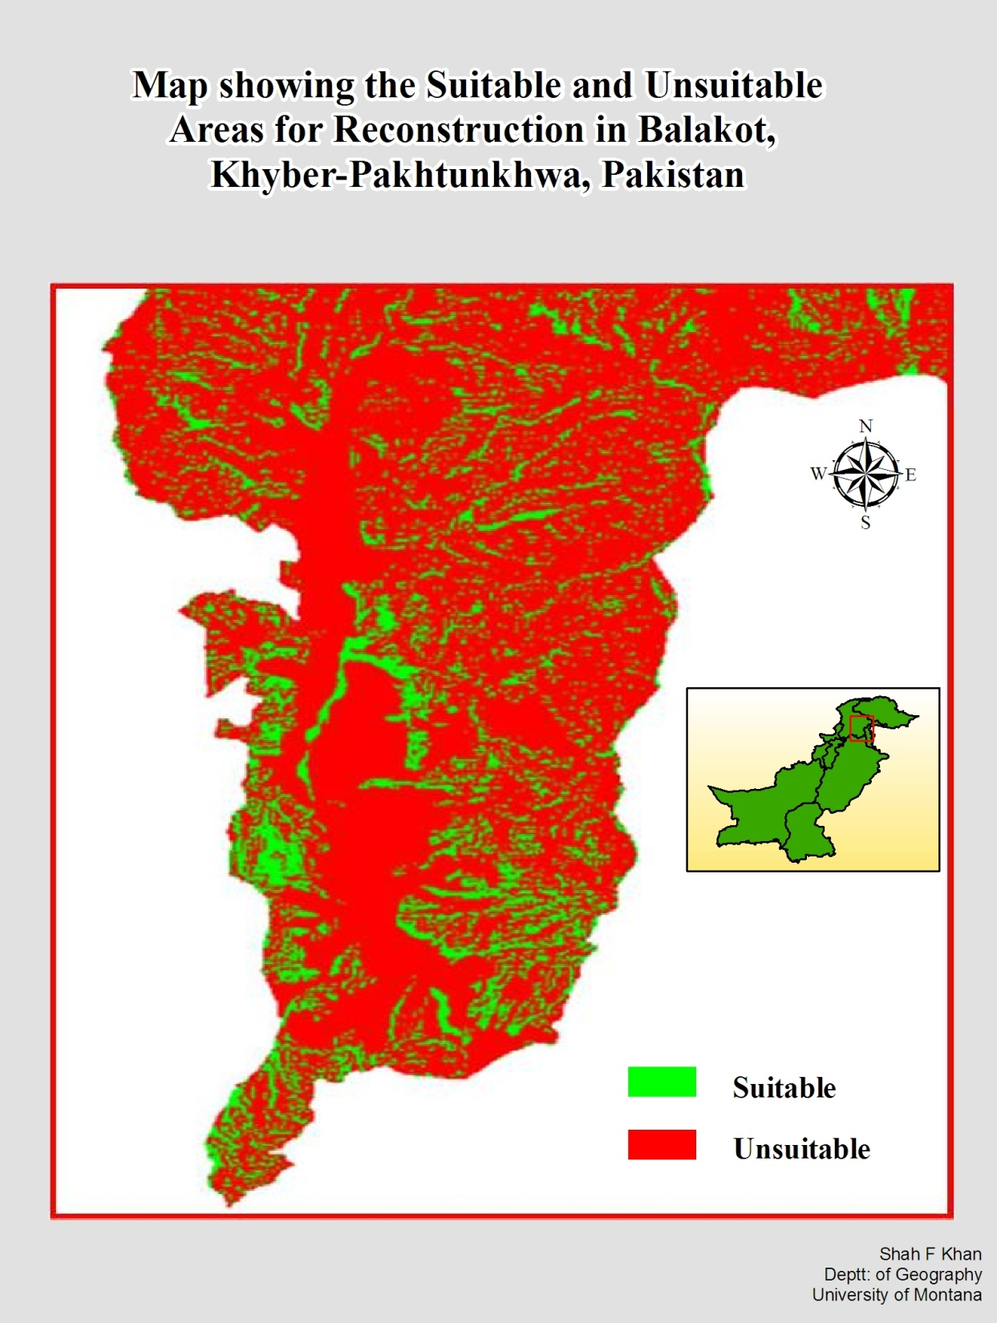
Final Result
Boolean Map showing suitable and unsuitable areas in Balakot after combining all the map layers produced previously using MCE technique in Idrisi.
Notes:
First Boolean images were created for all factors using buffers and reclass commands with 1 being suitable and 0 are unsuitable. Then all factors are combined and anything multiply by zero is become zero. If certain area is suitable base on one factor but unsuitable in regards to another factor then that area is considered unsuitable.

Slide 37
FUTURE EARTHQUAKE
Literature analysis

Slide 38
1600 (shortly after the 1501-1555-1570 Kashmir sequence)
Balakot/Muzaffarabad
Islamabad
Taxila
Pakistan
Kashmir
Tibet
India
1.7 meters/century

Slide 39
1700
Balakot/Muzafferabad
Islamabad
Taxila
Pakistan
Kashmir
Tibet
India
1.7m
1.7 meters/century

Slide 40
1800
Balakot/Muzafferabad
Islamabad
Taxila
Pakistan
Kashmir
Tibet
India
3.4 m
1.7 meters/century

Slide 41
1900
Muzafferabad
Islamabad
Taxila
Pakistan
Kashmir
Tibet
India
5.8m
1.7 meters/century

Slide 42
2005
Muzafferabad
Islamabad
Taxila
8 Oct. earthquake!
Pakistan
Kashmir
5m
Tibet
India
8.5m
1.7 meters/century
Plate convergence since 1600 ≈ 8.5 m
convergence 8 Oct ≈ 5 m
Interplate deficit ≈ 3.5 m

Slide 43
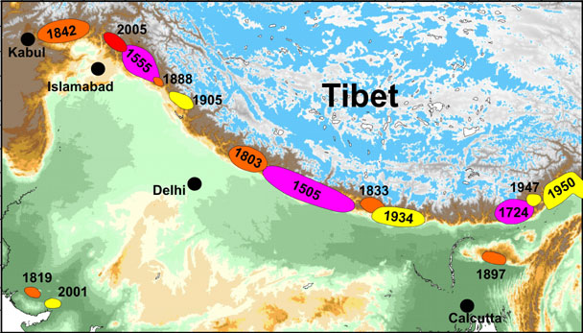
Past Earthquakes
AD 1555 (M_{w} 7.5) and AD 1885 (M_{w} 6.3)
Recurrence interval: 475 to ~2,000 years
Bilham et al. (2001, 2004, 2006), Bendick et al. (2006), Khan et al. (2008),

Slide 44
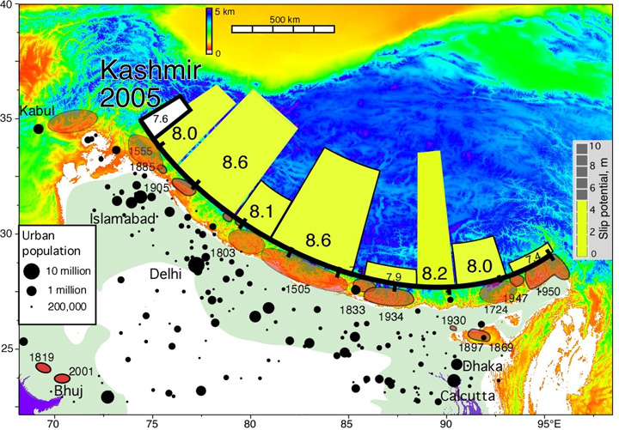
Potential Future Earthquakes
Bilham et al. (2001, 2004, 2006), Bendick et al. (2006), Khan et al. (2008),

Slide 45
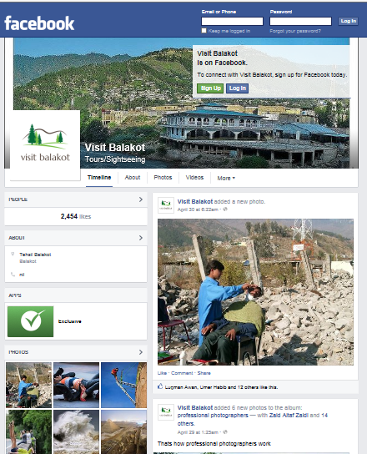
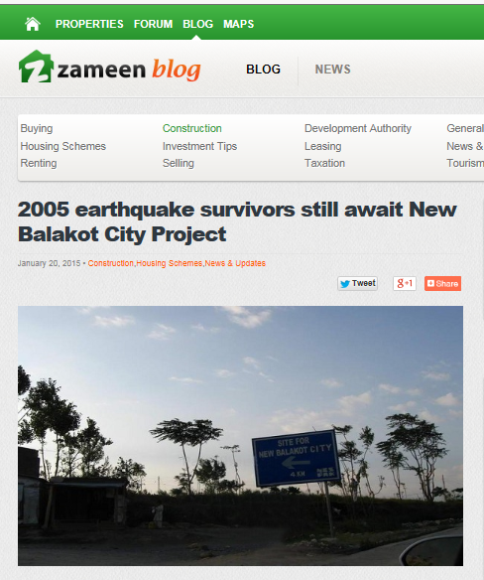
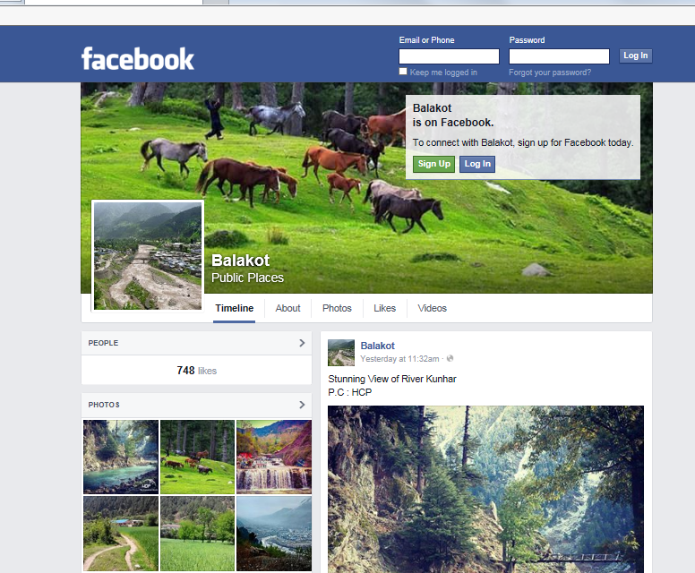
Volunteer Geographic Information
https://www.facebook.com/pages/Balakot/151129911621479?sk=timeline&ref=page_internal
https://www.facebook.com/pages/Visit-Balakot/198073540265088
http://www.zameen.com/blog/2005-earthquake-survivors-still-await-new-balakot-city-project.html

Slide 46
Conclusion
The present location of Balakot is not suitable for reconstruction and inhabitation.
The area is likely to experience another major earthquake and heavy landsliding.
Heavy landsliding may cause flooding in the area.
Recommendations
Building of Balakot at a different place based on GIS studies.
Development and implementation of building codes and spread it among general population using Volunteer geographic information
Construction of earthquake resistant buildings
Awareness of earthquake and related hazards among the masses
Integration of efforts and data at a singular plate form using GIST and Web GIS

Slide 47
Acknowledgment
The University of Montana, Missoula
NCE in Geology, University of Peshawar
Aga Khan Planning & Building Service, Karachi.
Earthquake Reconstruction & Rehabilitation Authority, Islamabad.
Aga Khan Cultural Service, Pakistan.
FOCUS Humanitarian Assistance, Pakistan.
United States geological survey.
Environmental Systems Research Institute (ESRI)
Clarks Lab, Clarks University’s Idrisi.
LDR International, Inc.(LDR), Data Chromatics, Inc.(DCI) and Community Analysis and Planning Systems, Inc.
The University of Montana (Student Research and Travel Grants)
Lt. General Nadeem Ahmed, Head Pakistan Relief Commission.
Mrs. Aisha Khan, Director, Mountain and Glacier Protection Agency.
United Nations, HIC.
Pakistani Army and U.S. Army.

Slide 48
Thank You

