Slide 1
The Duration of Treatment Effectiveness (DTE) model for stand management
Justin S. Crotteau
NRSM 532: Forest Ecosystem Analysis

Slide 2
Big picture
Dry forests and frequent low-severity fire regime
Fire hazard and treatment
Need: how long is a treatment effective for?
Growth models that have applicability to stands (management)

Slide 3
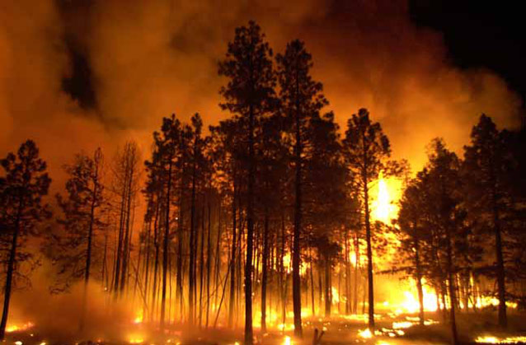
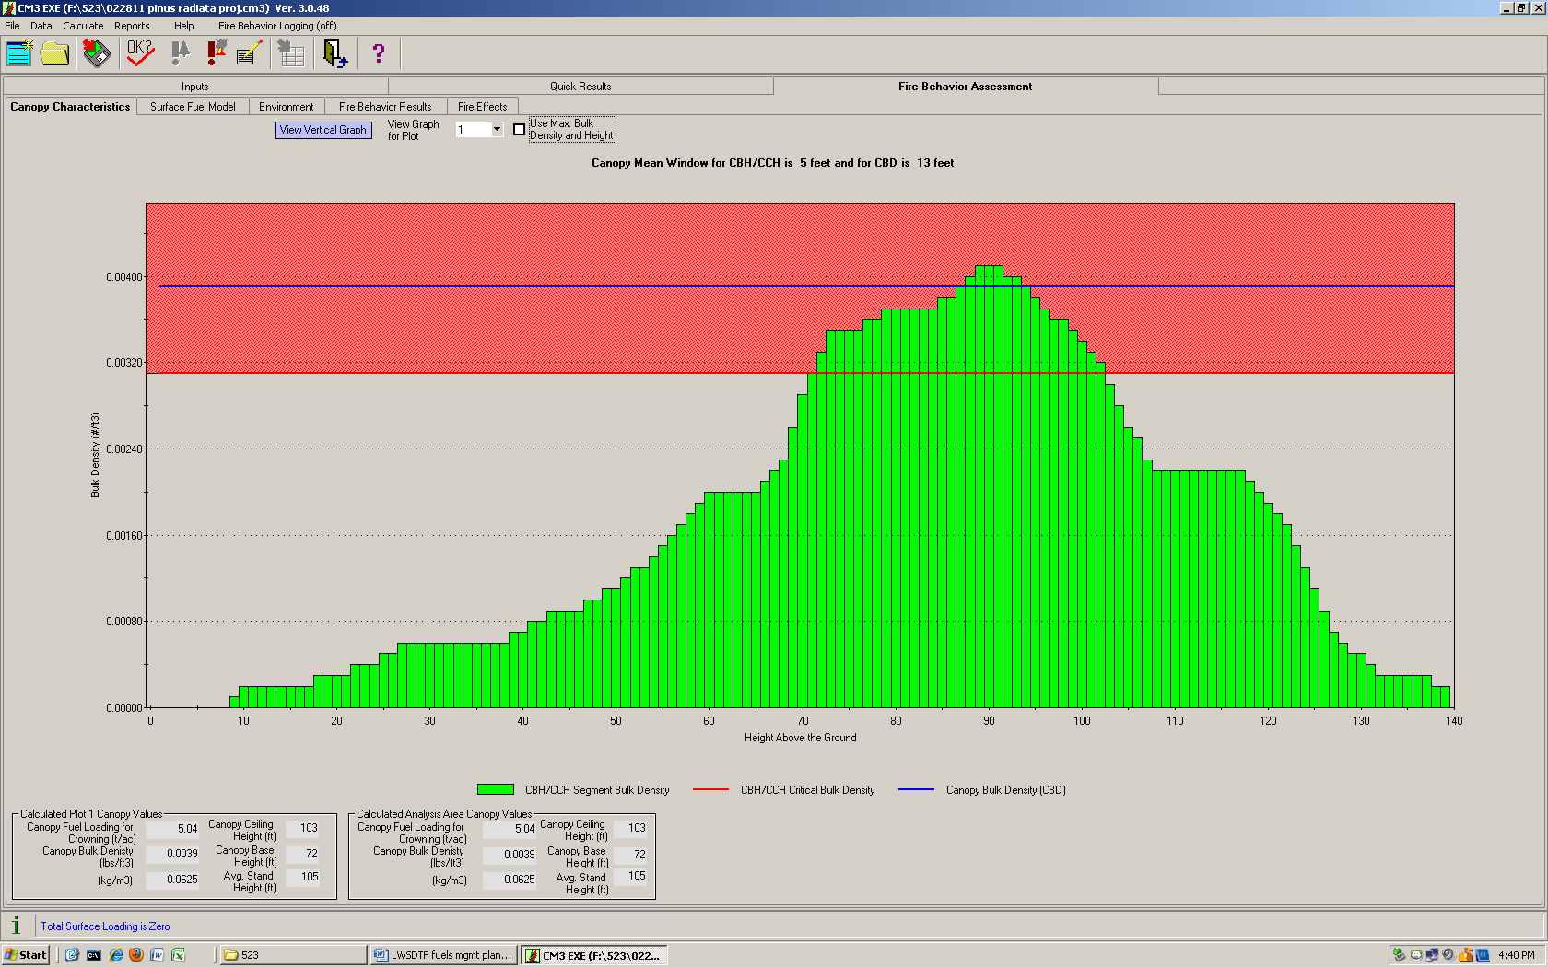
Big picture
www.nps.gov
Dry forests and frequent fire regime
Fire hazard and treatment
Need: how long is a treatment effective for?
Growth models that have applicability to stands (management)

Slide 4
Big picture
Dry forests and frequent fire regime
Fire hazard and treatment
Need: how long is a treatment effective for?
Growth models that have applicability to stands (management)

Slide 5
Big picture
Dry forests and frequent fire regime
Fire hazard and treatment
Need: how long is a treatment effective for?
Growth models that have applicability to stands (management)

Slide 6
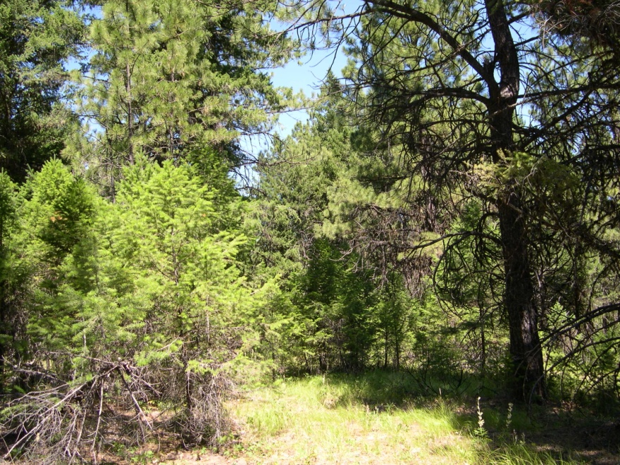
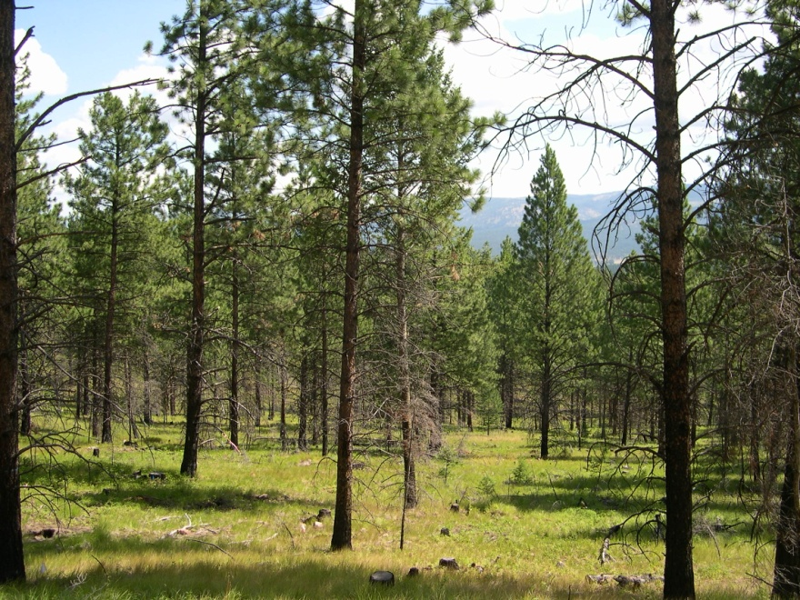
Growth after disturbance
T
Disturbances change growing conditions
Control
Thin and burn

Slide 7
Growth after disturbance
Canopy fuels (which fuel crown fire) develop at a different rate in perturbed stands

Slide 8
Growth after disturbance
Canopy fuels (which fuel crown fire) develop at a different rate in perturbed stands
Canopy C allocation
Canopy Bulk Density
“steady state” baseline
“steady state” baseline
Time 0
Time x
Time 0
Time x

Slide 9
Research questions
How does growth partitioning change in response to resource availability?
How many post-disturbance cycles until fire hazard is back to pre-disturbance levels?
“Decision support tool”

Slide 10
Objective and nested outline
The DTE (Duration of Treatment Effectiveness) model is a decision support framework for fire hazard that incorporates a process-driven computer model to simulate forest hydrologic and carbon balance given solar radiation, satellite-sensed canopy light interception/utilization, and climatic variation.
Decision support framework
Process growth model
Dynamic Growth Allocation and Partitioning sub-model

Slide 11
1. Decision support framework
IDENTIFY fire hazard
DEVELOP goals and treatment
SIMULATE stand and treatment
PREDICT growth using a process-based growth model
EVALUATE fire hazard on annual timestep
MODIFY treatment per duration of effectiveness
WEIGH implementation with external social components

Slide 12
2. Process growth model
Parent model: 3-PG or FireBGCv2
Disturbance
Tree density
Fire hazard

Slide 13
3. Growth partitioning sub-model
Disturbance
Crown fire hazard
Relative stand density
Tree leaf area
C stores
Available water
Available nutrients
Available incoming radiation
Growth partitioning
NPP
Roots
Stem
Foliage

Slide 14
Sub-model developmental needs
water
nutrients
light
% C allocation to resource acquisition tissues
“steady state” baseline
Resource availability, or time since disturbance

Slide 15
Inputs and outputs
Inputs
Site characteristics
Climatology
Ecophysiology
Treatment method, severity
Outputs
(valued outputs from parent model, incl. LAI, AET)
Canopy bulk density
Canopy cover
Duration of treatment effectiveness

Slide 16
Assumptions and limitations
Parent process model
E.g., dependence on LAI, climate time scale, …
Fire behavior model
E.g., canopy bulk density is a good measure of crown fire hazard
Spatial homogeneity
Ladder fuels and understory redevelopment

Slide 17
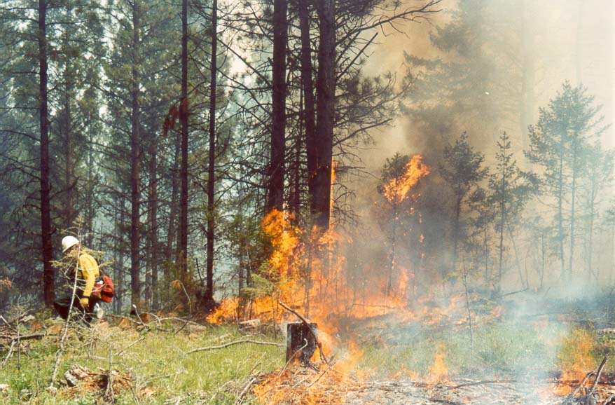
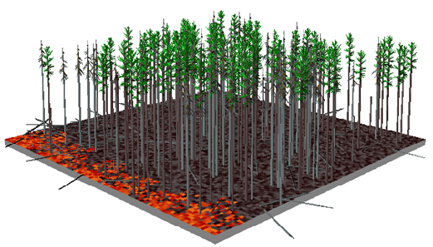
Anticipated uses
Fire hazard reduction treatment design
Alternative management evaluations
Ecosystem modeling after natural disturbance

Slide 19
Growth after disturbance
Canopy fuels (which fuel crown fire) develop at a different rate in perturbed stands

