Slide 1
Modeling Stream Temperature at a Management Level
Jacob Dyste
BIOS 534: Systems Ecology

Slide 2
Introduction
• Ninemile Creek in Western Montana
- Thermally impaired
- Temperatures regularly exceed 15 degrees Celsius for 3 months
- Critical location for bull trout and westslope cutthroat trout
• Impacted by historic placer mining
• Nearly 10 million dollars will be spent in management and restoration
actions in the next 5 years.
• Potential causes of thermal impairment
- Channel Complexity
- Riparian Vegetation
- Alluvium Ponds
- Flow Impacts
- Climate Change
Notes:
I’m thinking about the Ninemile as a case study for a larger overall problem.

Slide 3
Why is this an ecosystem level problem?
• Because were are spending 10 million dollars on an assumption!
- Restoration will bring back native trout
• New landscape level projections of stream temperature for western Montana
- Low elevation, snowpack driven watersheds are in trouble
• 18 to 92% decline in bull trout habitat across their range in the next 50 years
(Reiman et al, 2007)
• Temperature is a critical driver of stream ecosystem function
• There is a growing body of literature on problems with temperature modeling
for watershed management.
- Many managers lack a comprehensive understand of natural and anthropogenic
stream temperature drivers which often causes a model to be applied that is
inadequate for the system (Poole and Berman, 2001)
Notes:
I came across a growing body of literature over the last 15 years.

Slide 4
Stream Temperature
• A measure of the amount of heat energy per unit volume of water
• Heat load: a measure of heat energy added to a stream
- Five thermal processes control the increase or decrease (Burry-Trice, 2012)
1. Radiation
2. Evaporation
3. Convection
4. Conduction
5. Friction
• Insulating Process: Influence the rate of heat flux
• Buffering Process: Stores heat opposed to adding or removing

Slide 5
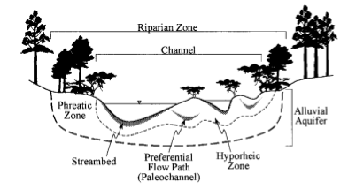
Stream Temperature
Internal Controls
• The channel (Buffering +
Insulating)
- Width
- Depth
- Sequence
- Substrate
• The riparian zone (Insulating)
- Height
- Density
- Proximity
• The alluvial aquifer (Buffering)
- Phreatic + Hyporheic
- Cold water fluxes
- Base temperatue

Slide 6
Stream Temperature
External Drivers – A trend towards atmospheric temperatures – Climate Drivers
(Poole and Berman, 2001)
• Topography
- Shade
- Upland influence
• Precipitation
- Drives all discharge
- Entry pathway
• Air temperature
- Air temperature vs direct solar radiation
• Wind speed
- Evaporation and convection
• Solar angle
- The amount of solar radiation reaching a stream
- Date, time, geographic location
- Shade
• Could cover
• Relative humidity
- Evaporation

Slide 7
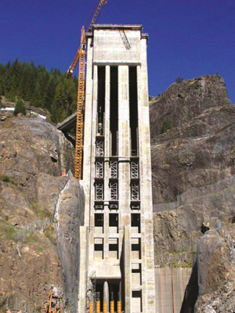
Stream Temperature
Human Influences
• Dams
- ,etc., etc.
• Forest Management
- Reduced infiltration
• Flow
- Concentration
• Channel Alteration
- Straightening
- Floodplain augmentation
- Diking
• Climate Change

Slide 8
Modeling Issues
• A lack of understanding of the complicated mix of problems
that affect stream temperature
- Not all processes are critical in every system
• Difficultly in determining spatial scale
- Different response in different parts of the stream
- Sweet spot for management actions
- Transition zone
• Reach vs Basin Scale
• How do you compare management simulations?
• There’s a lot of options and they’re all different.

Slide 9
Culling the Herd
Statistical Spatial Models
- Combines thermograph data with predictor variables such as climate data,
remotely sensed vegetation cover, and DEMs
- Require very little input data, cover a large spatial area
- Cannot determine causation
Process-based Models
- Can assess causes of impairment
- Requires field data
The Herd:
WET-Temp: Assumes shade as the primary driver and inflow of groundwater is linear
GENESYS: Combined approach, requires 1 meter LiDAR data
Heat Source: Requires thermal infrared stream temperature data
Hydrologic Simulation Program Fortran: Beyond my computer abilities
CE-QUAL-W2: Warrants a deeper look
SNTEMP: Warrants a deeper look

Slide 10
SNTEMP: Stream Network Temperature Modeling Software – USGS, 2010
• Mechanistic, one-dimensional heat transport model that predicts stream temperature
as a function of distance and heat flux
• To help predict the consequences of stream manipulation on water temperatures
Strengths
• Easy to use interface
• Can be used for any size stream
• Coarse incorporation of most of the main stream temperature drivers
Assumptions
• The channel is one-dimensional
• Groundwater temperature mirrors air temperature
• Upland vegetation is not considered

Slide 11
CE-QUAL-W2: USACE and Portland State University – 2015
• Mechanistic, two-dimensional water quality model that predicts temperature,
flow, and other water quality parameters
Strengths
• Two-dimensional
• Detailed channel information
• Proven track record of highly accurate results
Assumptions/Weaknesses
• Channel data requirements are significant
• Traditionally used for large, well mixed systems
• No upland vegetation component
• Lateral flow of ground water is not considered
• Groundwater influence is measured like a tributary

Slide 12
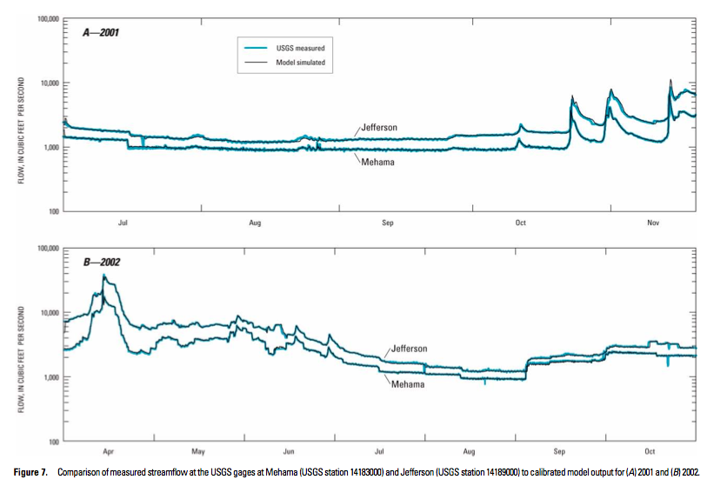

Slide 13
Conceptual Stream Temperature Management Model
Question
How does the ecologic restoration and management of a watershed impact
the thermal regime?
Bounds
• Alluvial Rivers
• Stream order is between 1 and 4.
• Does not include the influence of climate change or dams
- Ability to integrate watershed level thermal regime
predictions seems to be the next wave of stream
temperature modeling.
• Warm period of the year – native trout influence

Slide 14
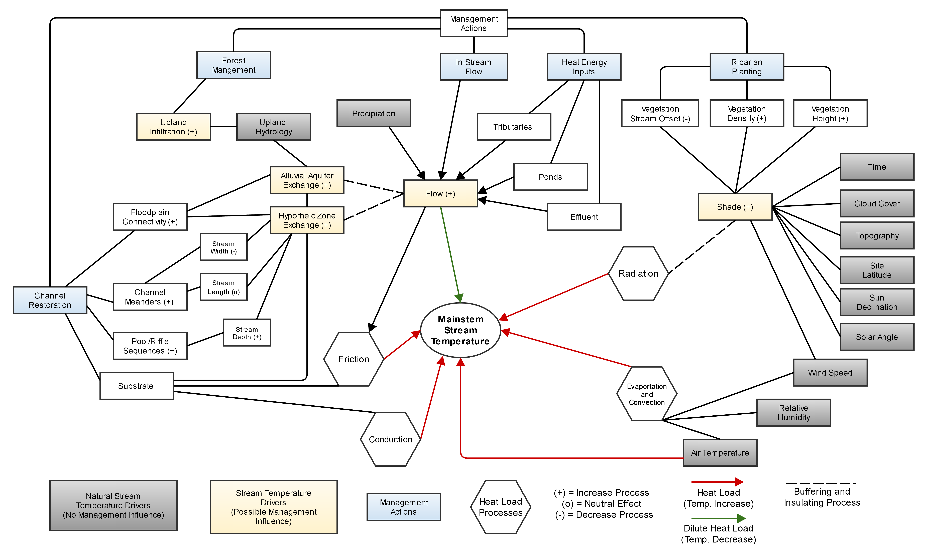
Conceptual Stream Temperature Management Model

Slide 15
Conclusions
• Ideas to create a better management model
- The ability to easily compartmentalize individual drivers
- Flexibility and availability within the model to allow managers
to set the bounds and assumptions
- Working across disciplines to think of stream temperatures as an ecosystem
level problem (Upland Issues)
- We need a more robust understand of how management impacts
stream temperature
• Determining the spatial scale is critical
- Ninemile Example
• Modeling the buffering impact of hyporheic flow is incredibly difficult
- Highly critical in many aquatic restoration projects.
- Could be considered a conservative measure to omit
• Stream temperature models need to be linked with watershed scale
climate change scenarios
• Stream temperature modeling is hard

